Slide 1
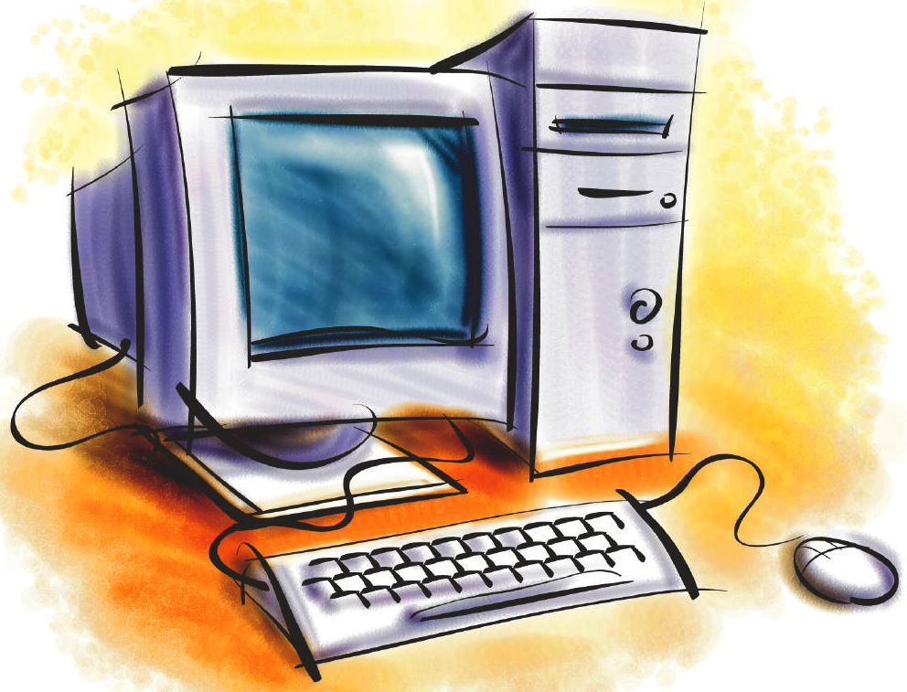
Creating a Home Network

Slide 2
Reasons for a Home Network
You have more than one computer at home.
You wish to access a document on the computer in the study and you are in the living room with your laptop.
You might add some Network Storage as a depositary for your data.
You might use a spare computer as a Web Server or media streamer (to listen to your CDs)
It’s a good practical subject to learn and try out.
It’s a cool thing to do!

Slide 3
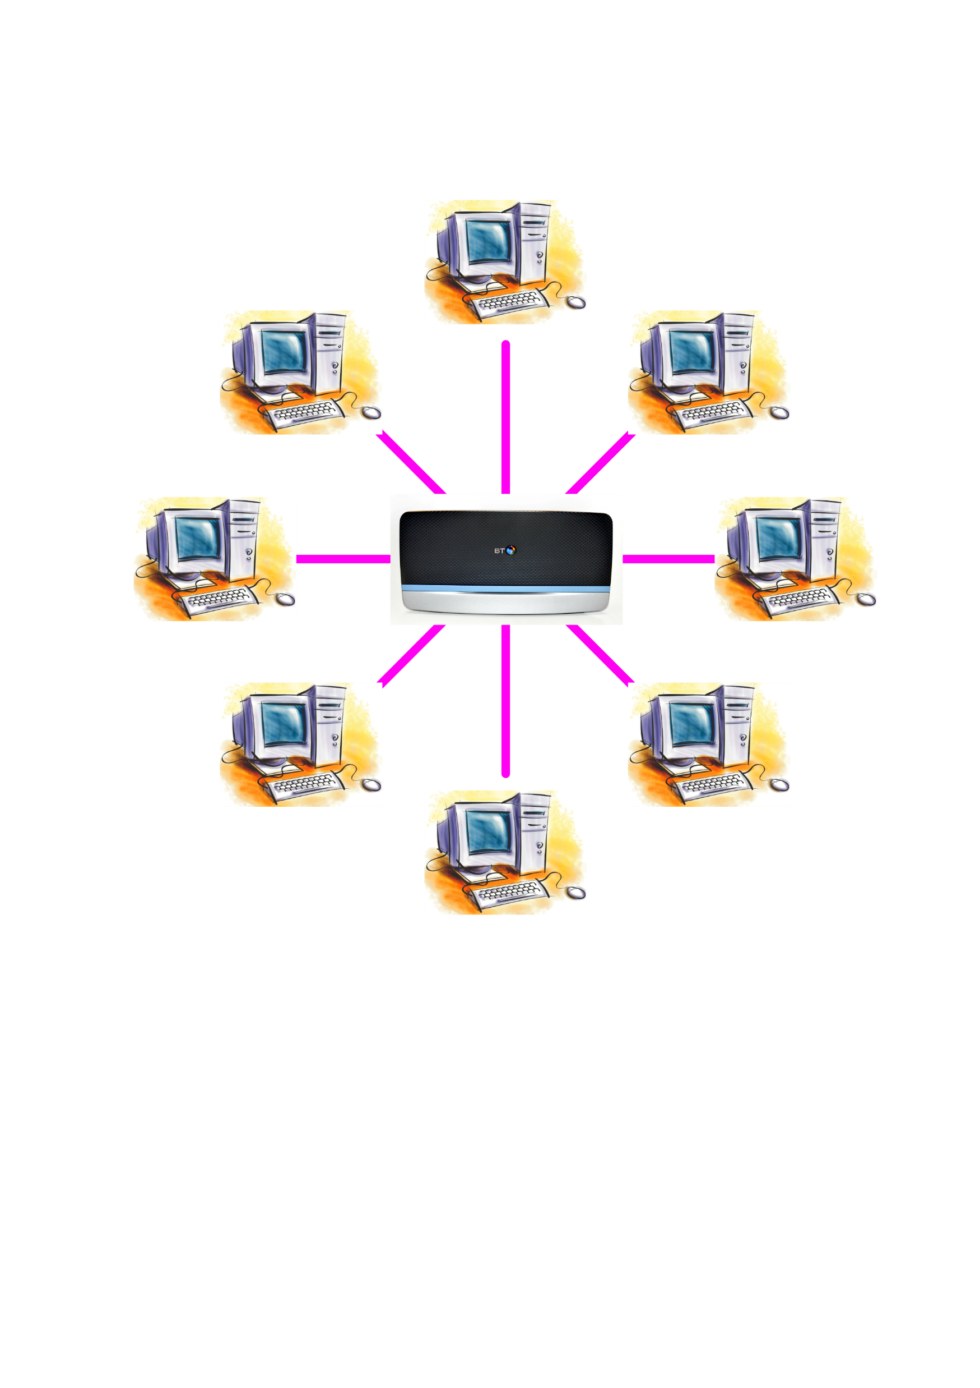
We are aiming for:
A state where every
computer can connect
with every other computer
on the network.

Slide 4
Our actions
We’ll create a new user (Administrator) and share his/her data rather than your personal files.
We need to ‘share’ elements of your C drive. Just the User’s Documents.
We need to set permissions on the Documents folder so that others can write.
We’ll map the other computers on our network so they are easy to see in File Explorer.
On each computer the main user will create a new text document. Type in your name and put a comment or two inside.
Navigate to the other computers and edit their newly created documents to add your name and a comment, close and save so that someone else can do the same.
At the end, we should have xx number of documents with comments from everyone.

Slide 5
Lets get started
Quick demo from me. At this point please don’t follow along.
User guide for you to follow.
Action!

