Slide 1

Personal Finance Software (PFS)

Slide 2
What is PFS?
PSF is software that helps you track your finances to make smarter financial choices.
Based on current and previous spending, it can forecast your expenditure for the future.
Outputs plenty of reports and graphs to see where your money goes.
Maybe online, downloaded to your computer or both. Perhaps an App on your smartphone.
You could use a spreadsheet!

Slide 3
Features
Set up Bank accounts, Credit cards, Premium bonds, PayPal & Investments
Standing order payments and Direct debits
Incomes
Frequency Annually, monthly, 4 weekly etc.
Linked to online App.
Budgeting
Expense and income categories
Grouping of accounts
Grouping of categories
Split transactions
Import statements from your bank
Transfer between accounts
Generate Reports & Graphs
Add “tags” for important projects

Slide 4
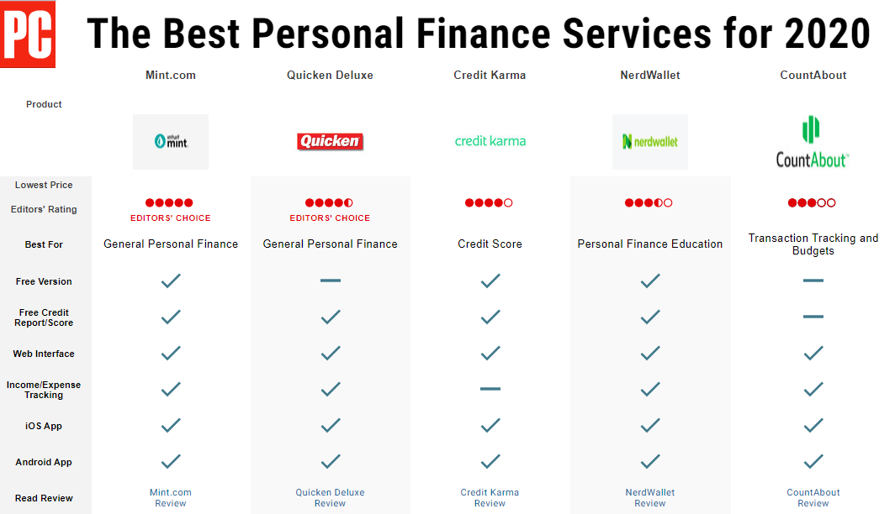

Slide 5


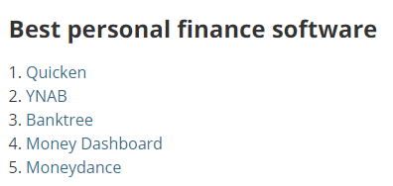
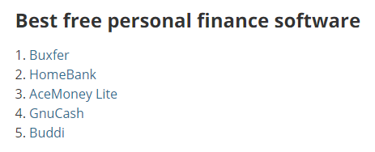

Slide 6
Costs
Some are free.
The free ones normally have a paid version with more features.
Costs might be for a one of purchase; ranging from about £25 to £50. (Many are priced in Dollars)
Some are priced per month or per year; try the free version first.

Slide 7
Lets see one in action

