Slide 1

Microsoft OneDrive

Slide 2
What is it, what can it do?
The OneDrive is a server (computer) located in a data centre. You connect to the server via the internet.
You can store files, folders, photographs etc in a secure and well managed environment.
Your files are SYNCHRONISED between devices ie you can create and save a file on your desktop computer then later on edit it on your laptop or your ipad.
You can keep your files private if you like or share some or all of your files – either permanently or for a limited duration
If you wish, you can set the OneDrive up so that it is always available on your local computer.

Slide 3

The Process
To use OneDrive you need a Microsoft Account. If you have a @outlook.com, @hotmail.com @live.com email address or a Skype account then you already have one. If not, it is free to create one.
OneDrive doesn’t start automatically when you start your computer. (Although you can make it so)
To set up your OneDrive, Open Start, search for OneDrive – open the App and click the sign in button. Enter the login credentials of your Microsoft Account.
Get used to looking for the cloud icon on the task bar by the clock.
No Cloud = no OneDrive running.

Slide 4
Syncing your files with OneDrive
Tutorial From Microsoft Support Pages
FILES ON DEMAND
Tutorial from Microsoft Support Pages
Notes:
With OneDrive, you can sync files between your computer and the cloud, so you can get to your files from anywhere - your computer, your mobile device, and even through the OneDrive website at OneDrive.com. If you add, change, or delete a file or folder in your OneDrive folder, the file or folder is added, changed, or deleted on the OneDrive website and vice versa. You can work with your synced files directly in File Explorer and access your files even when you’re offline. Whenever you’re online, any changes that you or others make will sync automatically.
OneDrive Files On-Demand helps you access all your files in OneDrive without having to download all of them and use storage space on your Windows device. This article is about Windows, but you can use Files On-Demand on Mac, too.
When you turn on Files On-Demand, you’ll see all your files in File Explorer and get new information about each file. New files created online or on another device appear as online-only files, which don’t take up space on your device. When you’re connected to the Internet, you’ll be able to use the files like every other file on your device.

Slide 5
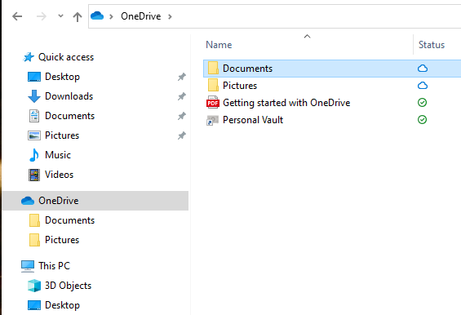

Some Examples
This is a new account freshly created.
Notice the status of the folders and files.

Slide 6
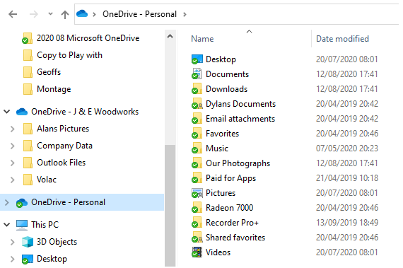
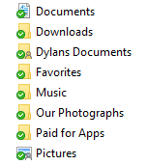
Some Examples
This is my account – Been in use for a while.
Notice the status of the folders and files.

Slide 7
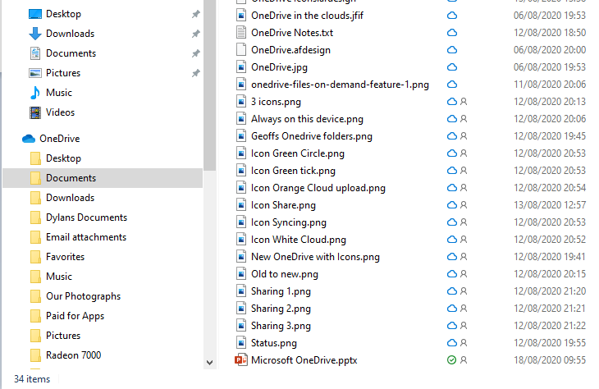
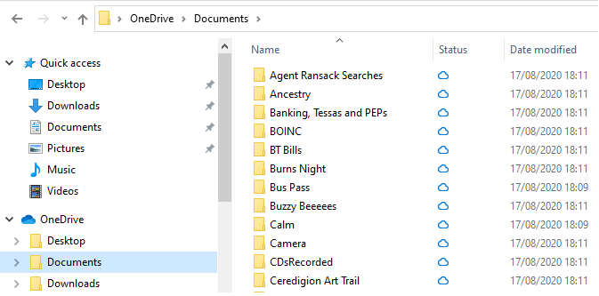
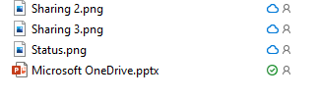
Some Examples

Slide 8







The Icons Explained
The file is only available online. It does not take up space on your computer
Synchronised successfully. The cloud copy and the file on your PC are the same
Your file/s and The OneDrive Are synchronising
The file or Folder is synchronized and always available on your Computer
The file or Folder has been shared by you or is shared to you
There is a problem, a file or folder cannot be synchronised right now

Slide 9
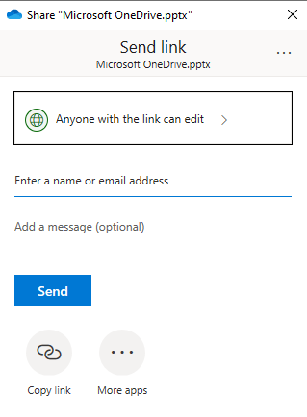
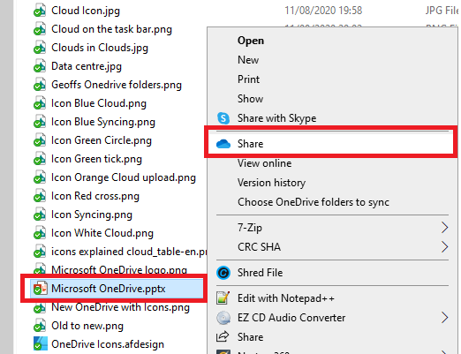
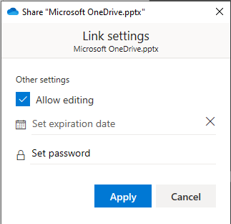
Sharing your files or folders

Slide 10
Access from the Web
You can of course view, share, edit, create and delete files from your OneDrive from the Internet.
Either:
Point your browser to http://onedrive.live.com or
Right click a file from File Explorer and select “View online” or
Right click the cloud on the taskbar (by the clock) and select “View online”

Slide 11

A Data centre
How many data centres
Does Microsoft have in
The UK do you think?

