Slide 1

Understanding Computer Memory

Slide 2
What is Memory
Memory is used to store data and instructions.
Memory is made up of a large number of Cells – each capable of storing a piece of information
The more Memory available, the more you can store.
End result, more Memory = more storage = faster computer.

Slide 3
Types of Memory
There are three primary types of Memory.
1. Cache Memory
2. Primary Memory / Main Memory.
3. Secondary Memory.

Slide 4
Cache Memory
Very high-speed memory.
Acts as a buffer between the CPU and main memory.
Holds data and programmes that are frequently used for quicker access by the CPU.
Stores data for temporary use. Has limited capacity. Is very expensive.

Slide 5
Primary Memory (Main Memory)
Volatile memory, loss of power means loss of memory.
The more Memory available, the more you can temporarily store.
Two categories: RAM and ROM. Random Access Memory & Read Only Memory.
Is the working memory of the computer. Faster than Secondary memory, slower than cache memory.
Notes:
Primary memory completes the calculations.
Secondary memory stores the results.
A few analogies
Imagine Primary Memory as your desktop (your real desktop) ie the working space. The more desktop space you have the more things you can be working on at a time.
Secondary memory is like the filing cabinet, when you’ve finished working on a project, it is ‘saved to disk’ ie saved to secondary memory - put back in the filing cabinet for access in the future.
Closing down your computer is like clearing your desk. Anything not saved and put away in the filing cabinet (secondary memory) will be lost when you switch off the power.
If you want to work on more things than you have desktop space available, you have to put some things back in the filing cabinet (Secondary Memory / Hard Drive) before you can make a bit of space to start on something new.

Slide 6
Secondary Memory
External memory or Non-volatile memory, stores data permanently. Think hard drive, floppy drive, CD, DVD, Flash Drive / Thumb drive, USB stick
The more Memory available, the more you can permanently store.
Not accessed directly by the CPU. Transferred through main memory.
Slower than the main memory, much slower than cache memory.

Slide 7
RAM. Random Access Memory
RAM is of two types: Static RAM (SRAM). Dynamic RAM (DRAM)
Dynamic: Short data life, needs to be refreshed. Compared to SRAM, is smaller, slower, cheaper and uses less power.
DRAM is the memory than people generally mean when they talk about computer memory.
Static: Long life, no need to refresh, fast, expensive, used as cache memory.
Notes:
Cache memory typically uses Static RAM (SRAM). SRAM retains its contents as long as power is connected. It is simple to interface with but does require using six transistors per bit (a lot of transistors)
Dynamic RAM (DRAM) on the other hand is more complicated for interfacing and needs constant updating to prevent losing its contents. The plus side is that it only uses one transistor and one capacitor per bit meaning it is much cheaper to produce.
SRAM is not worthwhile for desktop system memory, but is used for cache memory. DRAM memory dominates primary memory (or main memory)

Slide 8
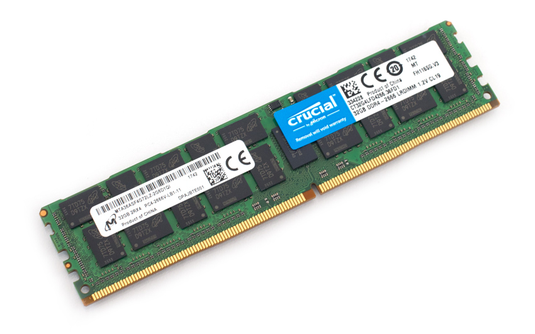
DDR4. Random Access Memory Module
Capacity: 32GB
Type: DDR4
Speed: 2666
Voltage: 1.2v
Latency: CL19
Made in China
Notes:
This Memory Module is a DIMM – Dual in-line Memory Module. DIMMS replaced SIMMS (Single in-line memory module)
SIMMS are only 32 bit architecture, DIMMS are 64.
DIMMS use contacts on both side of the module.
Using SIMMS in 64bit computers required them to be installed in matched pairs – so that a pair of them could populate a 64bit bus (2 x 32). DIMMS were introduced to eliminate this disadvantage (although it is still usual (but not necessary) to fit memory in pairs)
Memory used in laptops & notebooks etc has a Smaller Outline than regular modules and is thus known as SODIMMS.
All memory modules have a notch or keyway in amongst the contacts. The notches are in different places depending on the type of memory module ensuring that you can only replace (or install) the correct type of memory (Although you should still match speed, voltage and latency)

Slide 9
ROM. Read Only Memory
(Generally) read only, not write to. Non-volatile. Used in the boot up sequence
Easy to test and more reliable than RAM. Contents are always known.
Static, does not require refreshing.
Cannot be accidentally changed. Cheaper than RAM

Slide 10
Checking your Computer Memory
Check your current memory from Start | Settings | System | About | Device Specifications.
Current version is DDR4 (Double Data Rate ver 4) from 2014. (DDR2 from 2003 & DDR3 from 2007)
Different physical size for laptops. Different keyways for DDR3 and DDR4 etc.
Use a scanner to see what you could install. Download from https://uk.crucial.com/

Slide 11
Things to Consider
How much. 8GB minimum. 16GB is better. 128GB Flying. Be realistic.
Other considerations: Speed, Latency and voltage. Heat sinks and lights!
If adding a module (rather than replace), match the specifications.
Your version of Windows and your motherboard will dictate the maximum possible.

Slide 12
Further Reading
How-To Geek
https://www.howtogeek.com/346541/how-to-upgrade-or-replace-your-pcs-ram/
Ricks Daily tips
https://www.ricksdailytips.com/add-ram/
How Stuff Works
https://electronics.howstuffworks.com/how-to-tech/how-to-upgrade-ram.htm
wikiHow
https://www.wikihow.com/Add-RAM
Wikipedia
https://en.wikipedia.org/wiki/Computer_memory

