Slide 1
Understanding email

Slide 2
Helping understand how email works
The history. Email as we know it, first sent in 1971 when Ray Tomlinson sent a message to a user on another system identified by the “@” sign. The user name is in front of the @ sign and the domain name follows it.
A lot of changes since, probably the most important was the introduction of IMAP – The Internet Message Access Protocol which has virtually replaced the Post Office Protocol or POP email.
But first, a diagram might be helpful.

Slide 3
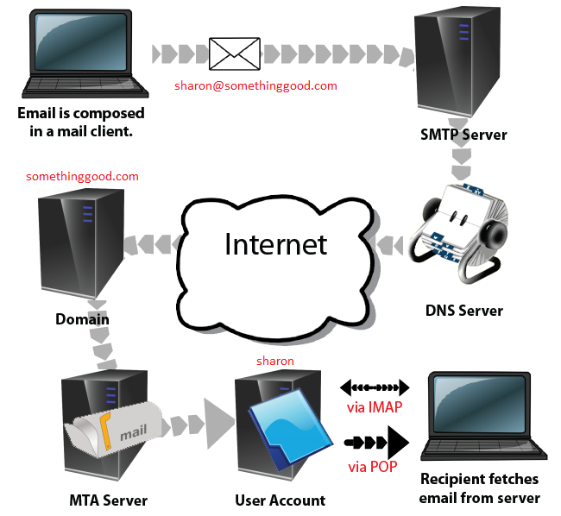

Slide 4
The SMTP Server
The SMTP server can be likened to a Post Office. It checks the postage and address and figures out where to send the email.
Unfortunately, it doesn’t understand domains. For this we need….

Slide 5
A Domain Name Server (DNS)
The DNS is a sort of cross reference or phone book of the internet.
It will translate the Domain Name ‘somethinggood.com’ into an IP address – something like 74.236.23.45
Using this IP address, the email does now know where to go. The DNS also checks if there are any mail servers (MX) at somethinggood.com.
This is like the Post Office consulting maps of where your mail is supposed to go, calling the local post office there and seeing if Sharon has a mailbox, a PO box or a letter box to receive her mail.

Slide 6
The MTA Server (Mail Transfer Agent)
From the Domain (somethinggood.com) the mail is sent to the MTA.
The MTA decides exactly where to put the mail (into Sharon’s account) much like the Post Office working out the best way to deliver to Sharon ie which Postie should take it.
Once the mail is in Sharon’s account, she can fetch her mail either via a web page, an app on her phone or an email client like Outlook.

Slide 7
POP vs IMAP
POP email is a unidirectional protocol. Information only travels one way.
Once you download it from the MTA server, YOU are in charge. If you delete it, it is lost.
POP was only ever envisaged to work with 1 email client, nowadays we want email on our computer, our tablet, our phone and the laptop. Enter IMAP.

Slide 8
IMAP
With IMAP, the protocol is two way. All messages are kept on the server (until you delete them)
Multiple devices can access your IMAP email. Once you have read an email on your phone, the changes (from unread to read) are synchronised back to the mail server and then to your other devices.
Similarly if you delete a mail on your laptop, it is marked for deletion on all your devices. So the next time you logon to your tablet, messages marked for deletion will soon disappear.

Slide 9
The Settings
There are a number of settings and options you should be aware of:
  Your email address
  Your password
  Your username – may or may not be the same as your email address
  The Outgoing mail server (SMTP)
  The Incoming mail server (IMAP)
  Whether any security is involved
  Whether the outgoing servers require any authentication

Slide 10
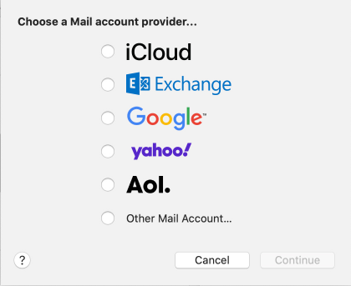
In setting up your email, many of the Big Players’
details will autocomplete for you, all you need
to know is your email address and password.
For others it’s not so easy, you need to enter
details manually as in “Other Mail Account….”

Slide 11
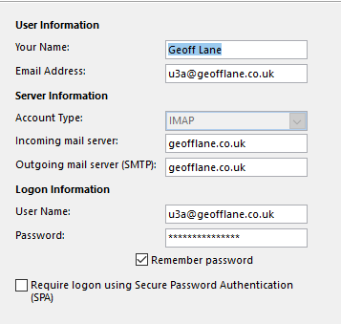
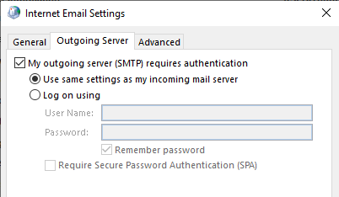
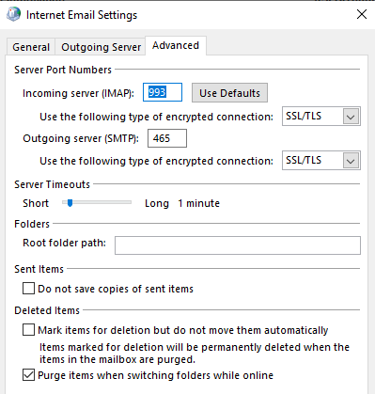
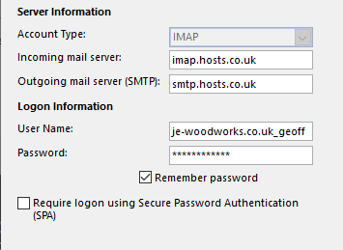
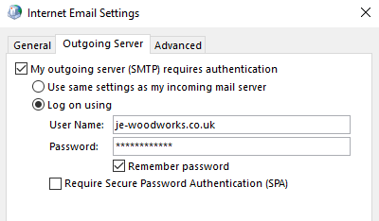

Slide 12
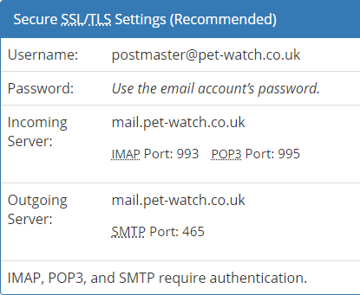
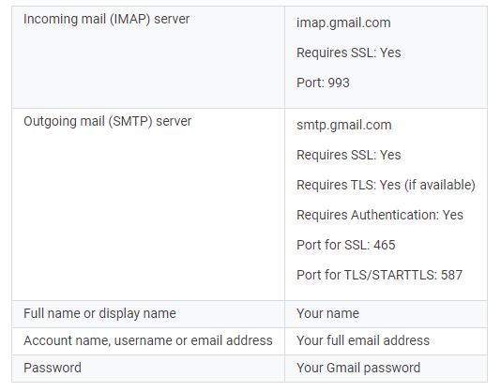
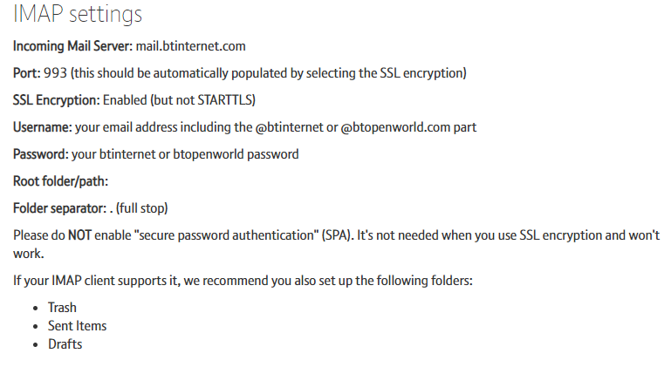
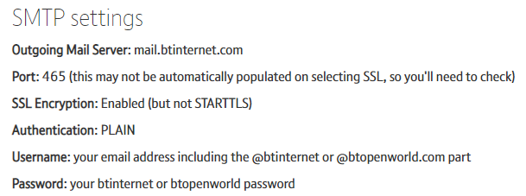

Slide 13
However…….
Sometimes you enter your password and it just isn’t recognised at all.
Google it and you learn about “App Specific Passwords”. These give a less secure device, access to your Google, Apple or Microsoft account by making you use a long, once only password.

Slide 14
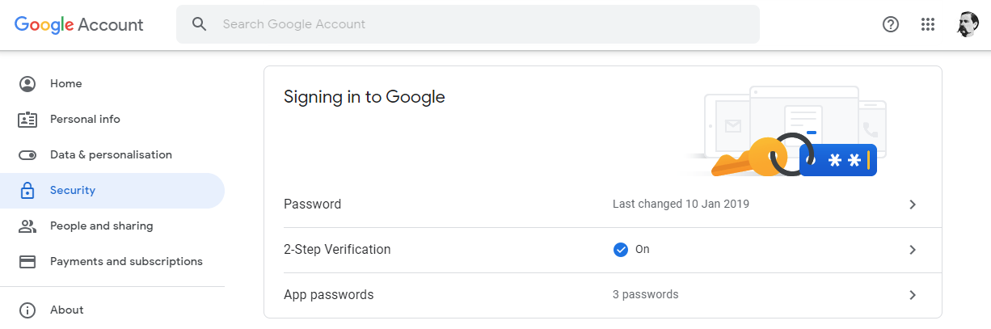

Slide 15
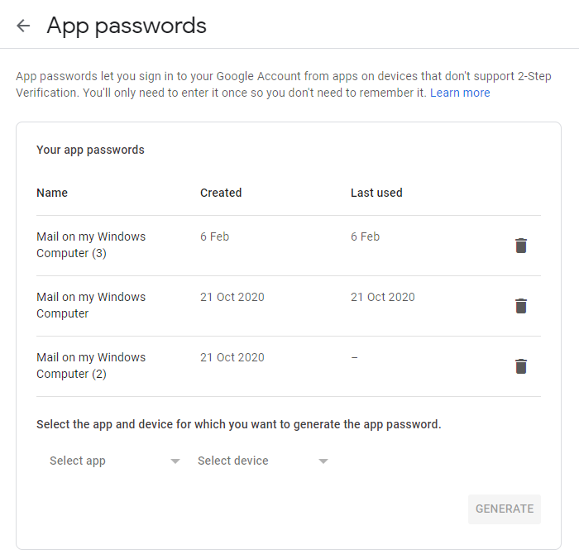

Slide 16
…. and some accounts require you to enter your password/s up to 3 times.
Once for the account,
Once for the Outgoing Mail Sever (SMTP)
And once for the Incoming Mail server (IMAP)

