Slide 1
Understanding File Explorer

Slide 2
What is it?
File Explorer is an essential file management application.
Provides a graphical interface for the user to navigate and access files stored on the computer or local network.
Use File Explorer to browse for files, rename, move or copy files, delete files and share files.
By “Files”, we mean documents, pictures, photographs, video’s, music files and so on.
Using File Explorer should be second nature to all members of the Computer Club!

Slide 3
There are at least a dozen ways to open FILE EXPLORER
Click the Task Bar icon
Use the keyboard shortcut: Windows + E
Via Windows Search
From the Start Menu. Under Windows System.
From the Power User Menu: Right Click Start icon.
Ask Cortana to open File Explorer
Use the Run Application. Win+R then Explorer
Run the Source Application. C:\Windows\Explorer.exe
Add a Desktop Shortcut
From Task Manager
From a Command Prompt
From PowerShell C:\Users\xxxx> explorer
Notes:
My favourite way is to use the windows shortcut key Win+E (E for Explorer)
You can use Win+E again to open a second or even third instance of File Explorer, this is great for dragging and dropping from one folder to another.

Slide 4
The Layout
And ‘top level’ navigation

Slide 5
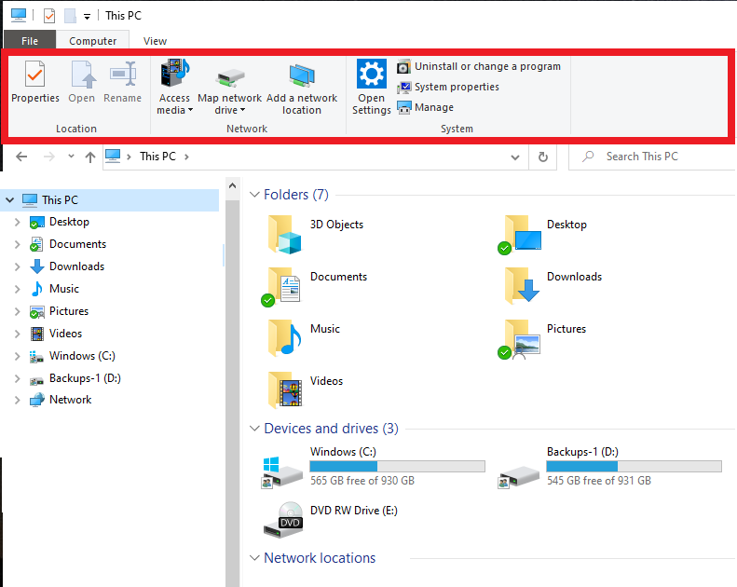
Notes:
Similar to most Microsoft Products File Explorer employs a Ribbon for quick access to various views, functions & actions.
If this takes up too much room on your screen you can minimize the ribbon from the little arrow in the top right of the window.

Slide 6
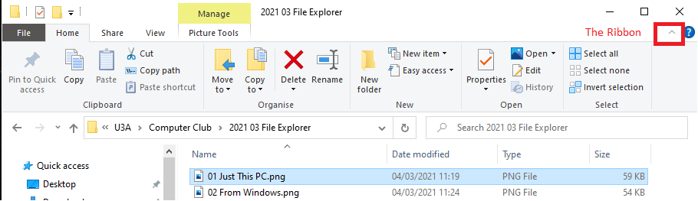
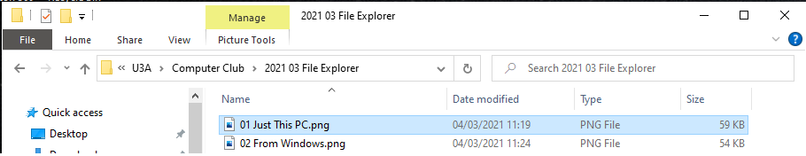
Notes:
With the arrow up the ribbon is maximised
*****
With the arrow pointing down the ribbon is minimised. It toggles one way then the other.

Slide 7
Notes:
The contents of the ribbon are ‘context sensitive’ so the functions and views available will change depending on what you have highlighted. Be it This PC, Windows, a single document or a networked computer.

Slide 8
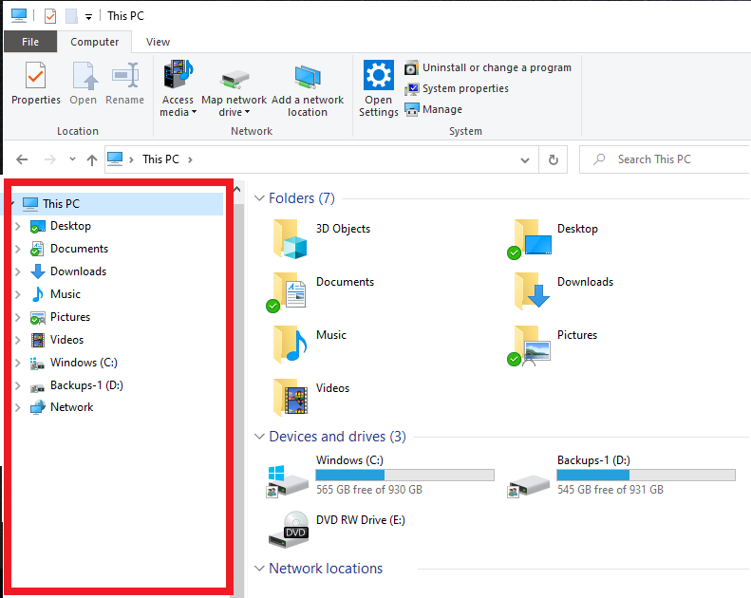
Notes:
The left hand pane is known as the navigation pane and contains a hierarchical tree that shows all the drives and folders on your computer. It doesn’t show individual files.
This is a simplified view – I’ve removed other items that we don’t want to see just yet.

Slide 9
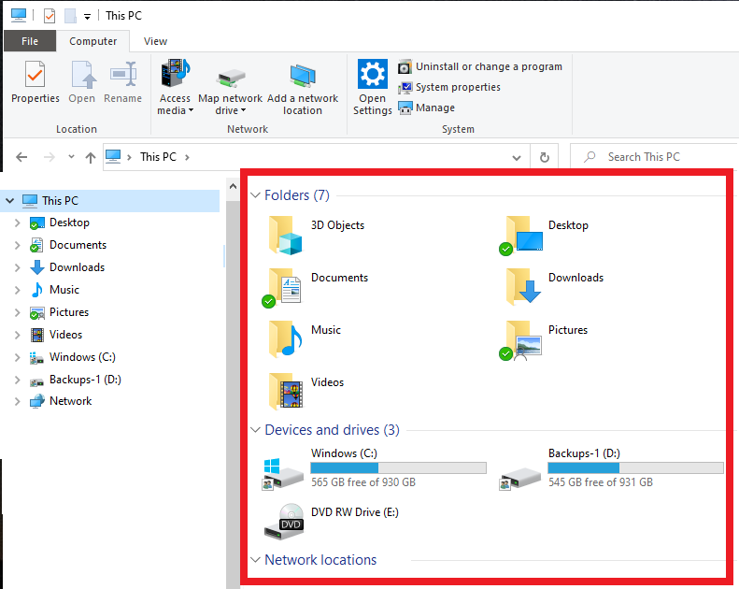
Notes:
The right hand pane shows folders, sub folders and individual files.
Generally we navigate using the left hand pane to the folder you are interested in and then use the right hand pane to carry out any actions on individual files.

Slide 10
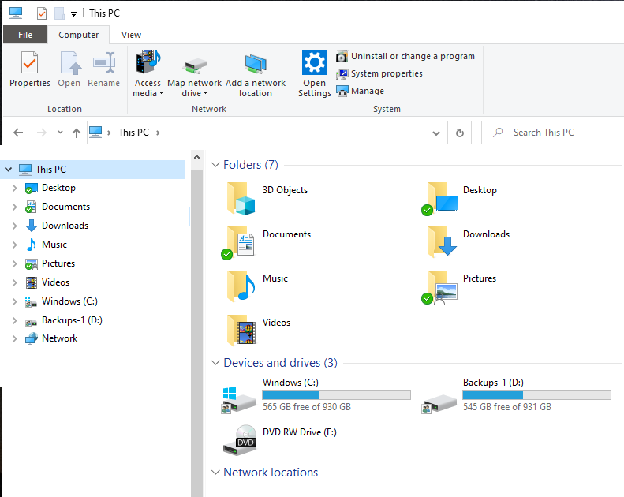
Notes:
Here is a simplified screenshot just showing “This PC”.
You can see the data folders from the user account, the C drive labelled Windows, a backups drive labelled Backups-1 and a DVD drive.
The C and D drive also show graphically how full they are and with a line of text showing how much is free and the drive size.

Slide 11
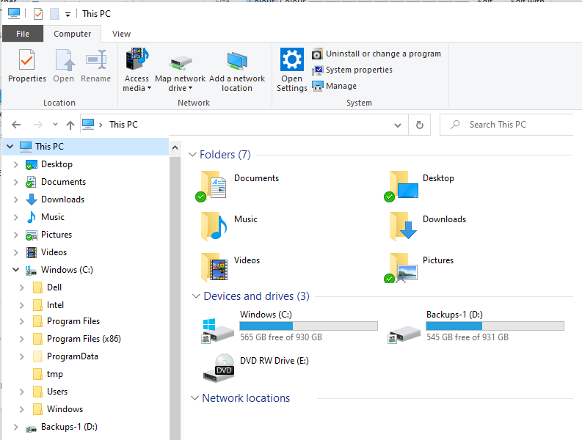
Notes:
Here I have expanded the windows folder in the (Left hand) navigation pane by clicking the little Right facing arrow to the left of “Windows (C:)”.
I could also have double clicked “Windows (C:)” in the right hand pane to show the same set of sub folders, but this time in the right hand pane.
As ever in Windows, there is normally more than one way to do something.

Slide 12
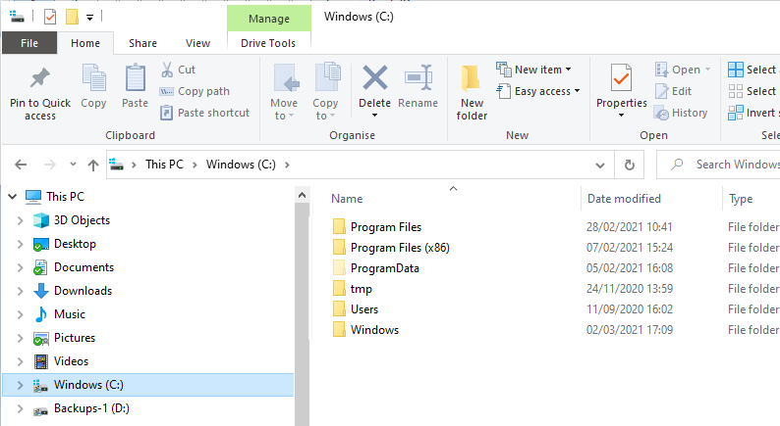
Notes:
Get used to reading the full file path in the address bar. Here it is showing
*****
This PC >
*****
Windows (C:) >
*****
I am getting ready to double click the “Users” folder.

Slide 13
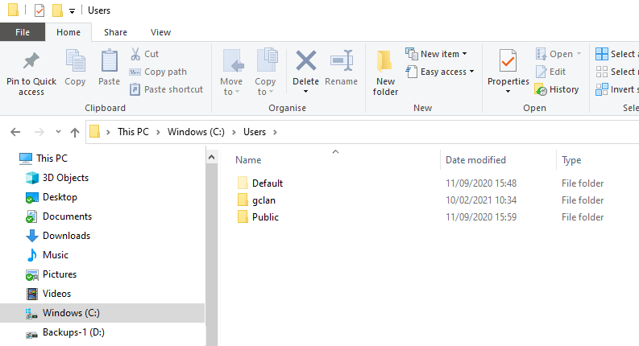
Notes:
The subfolders in the “Users” folder are shown: Default, gclan & Public.
You can see that one of the users is gclan which is taken from the first part of my outlook email address when I set up the user on the computer.
If your eyesight is good you will see that the yellow icon for the Default user is a slightly lighter yellow, this is because it is a hidden folder (and only expected to be used by Administrators*.)
In my case I like to see everything so on the view menu, I ticked the checkbox to show “”Hidden items”. Be default this setting keeps hidden items hidden.
* The Default folder is the template used for new user accounts. You could edit the default folder to include functions a, b & c and remove functions x, y & z so that when you create a new user, their profile would only show what you wanted it to show.

Slide 14
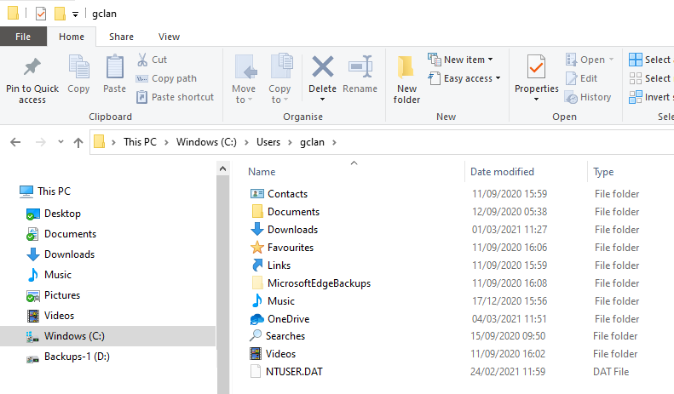
Notes:
Venturing further into the folder structure you can see the folders for an individual user.
Documents
Downloads
Music
Videos and so on.
Don’t forget the keep reminding yourself where you are in the structure from the address bar. We are at:
This PC > Windows (C:) > Users > gclan
*****
Note the arrows to the left of the address bar. The left and right arrows (right arrowed greyed out in this screenshot) will go backwards and then forwards through your changes. The Up arrow will go up a level.
The smaller down arrow provides a history of folders that you have recently been to.
Or you could click a folder section of the address bar and go straight to that level.

Slide 15
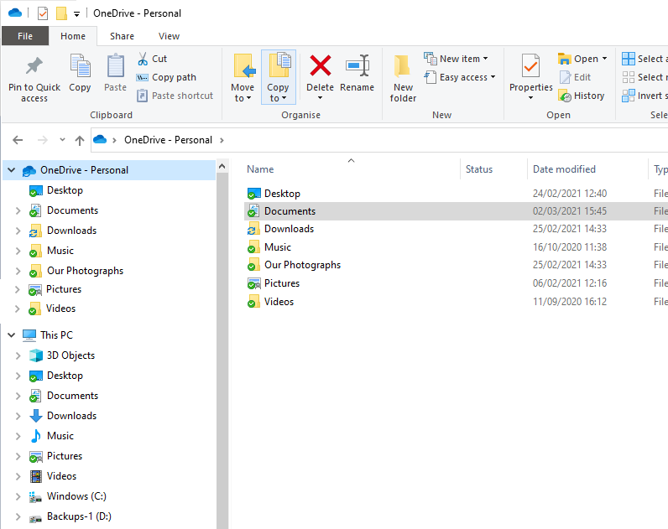
Notes:
So far, all the document structure we have discussed had been on the local computer. If you look in the left hand pane I have now included the OneDrive. (Microsoft’s storage in the cloud).
*****
You can have one Personal OneDrive per account. So I couldn’t show both my OneDrive and that of my Wife’s from her account.
You can though have as many business OneDrives as you like (If you have that many businesses that is…. ☺) Business Dries are not shown in this view.
The left hand pane / Right hand pane works just the same for the OneDrive as it does for the local structure discussed earlier.

Slide 16
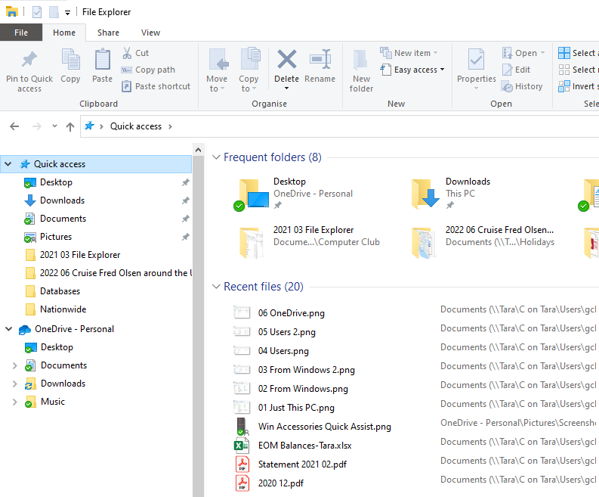
Notes:
… and then there is the Quick Access.
*****
I like this. By default File Explorer opens up to show the Quick Access structure in the Navigation pane. You can pin your favourite folders here if you like or just let Windows decide for you and let it include folders that you most commonly use.
This opening screen from File Explorer had another gem in the bottom half of the right hand pane;
*****
that of “Recent Files”. This is great and lists the last 20 files that you have been working on with the latest at the top. So to get back to the presentation or Word doc that I was working on earlier, just open File Explorer (Win+E) and double click the appropriate file from Recent Files to open it.
Also of use if you have a complicated folder/ sub folder structure, it shows the full path of the files as well – I have found this really useful on a number of occasions.

Slide 17
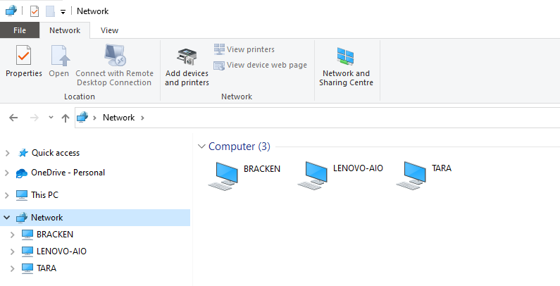
Notes:
To finish the overview of File Explorer we can see at the bottom half of the Navigation pane are the other computers on your network.
I have found this really frustrating over the years as sometimes you can see all your computers and sometimes not. Although my screenshot shows “Bracken” taken two days ago, “Bracken” is not visible today. And I’m actually on the “Bracken” computer! Nor are two other computers on my network showing. There seems to be no rhyme nor reason why this is so. Different computers on my network can show completely different combinations of which computers are visible and which are not.
There is an alternative to this unhappy situation and that is Mapped Drives.

Slide 18
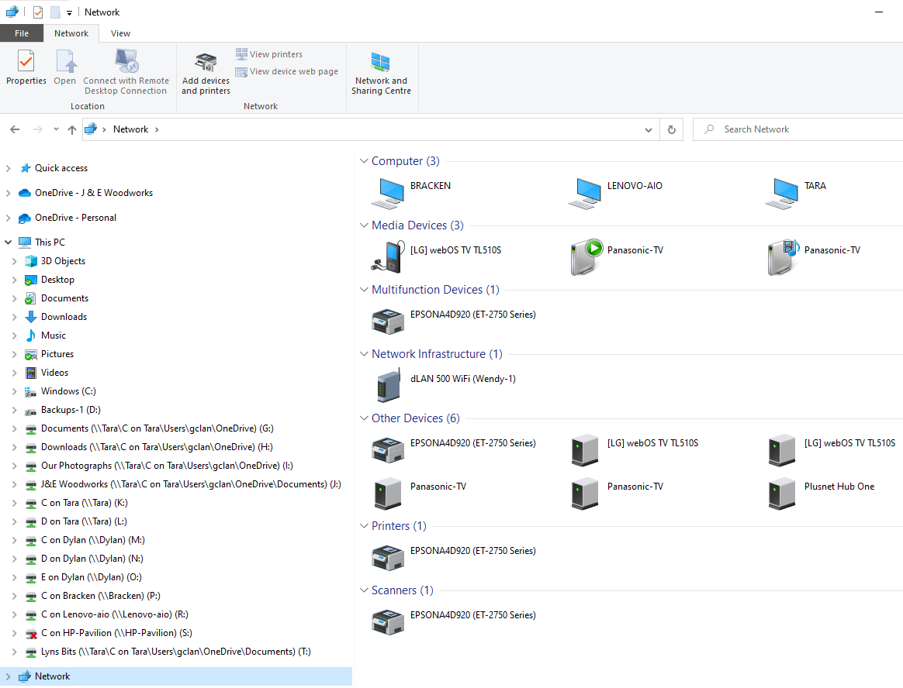
Notes:
Mapped drives allow you to ‘map’ a destination folder to a virtual drive. Whilst the screenshot may look complicated it is just the qty that I have that makes it look like this.
*****
My G drive takes me to the Documents folder of the OneDrive on the user account gclan on the Tara computer. I have set this to be the same on all my computers so if I go File, Save As and then navigate to the G drive, all my documents are saved in the same place.
The same goes for all my downloads, I save then to a subfolder of the H drive.

Slide 19
Top Tips

Slide 20
Top Tips
I recommend that a folder has either Folders and Sub Folders only or Files only. Do not mix the two.
Do not just click File, Save and hope the computer has saved your file somewhere useful (Unless you specifically know the default location for the App you are using). Use File, Save AS… This will always give you the option to navigate to a folder of your choice.
Think about a naming convention for your files and folders – and stick to it. I try and use
yyyy mm name.

Slide 21
Things to Consider
Think about downloading a file from the internet. By default it goes into your “Downloads” folder.
Do you really want your bank statements mixed up with newsletters and applications?
Far better to put each type in their own folders or subfolders.
Once downloaded, open a second instance of File Explorer and arrange the two windows side by side.
In one screen show the downloads folder. In the other, show your destination folder.
Click and drag from one screen to the other. Or use Cut and Paste. Either shortcuts or from the ribbon bar.
Notes:
To open a second (or more) instance/s of File Explorer use the shortcut keys Win+E again.
Alternatively, Shift click the icon on the taskbar for as many windows as you want opened.

Slide 22
Better still……
Download to the correct folder in the first place.

Slide 23
Browser Options

Slide 24
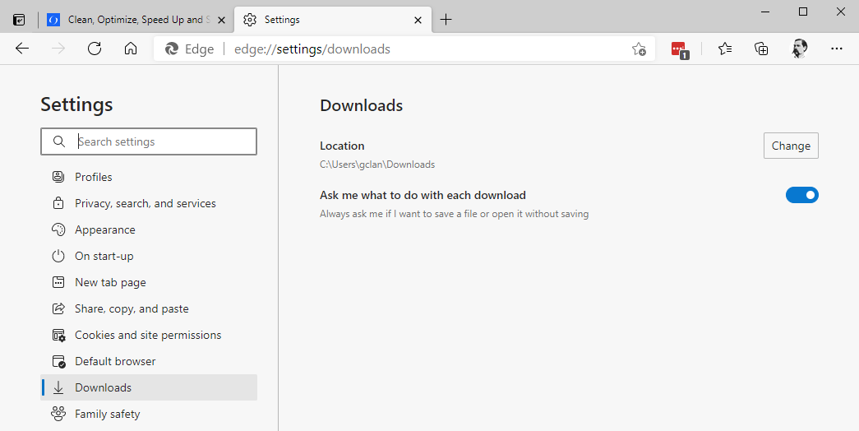


Microsoft Edge
Notes:
All the common web-browsers will allow you to do this in the browser settings.
For Microsoft Edge, go Settings | Downloads and turn on “Ask me what to do with each download”
(Two animations)

Slide 25
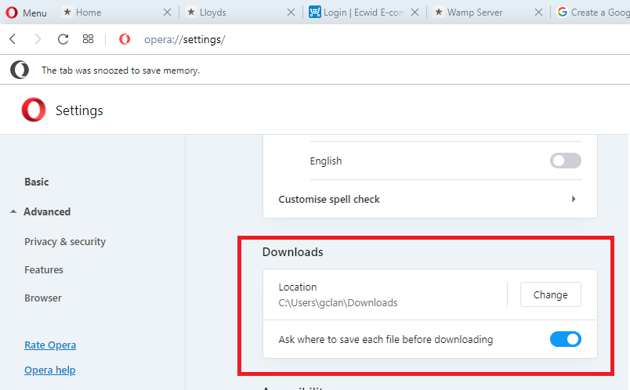
Notes:
For Opera, go Settings | Advanced | Downloads

Slide 26
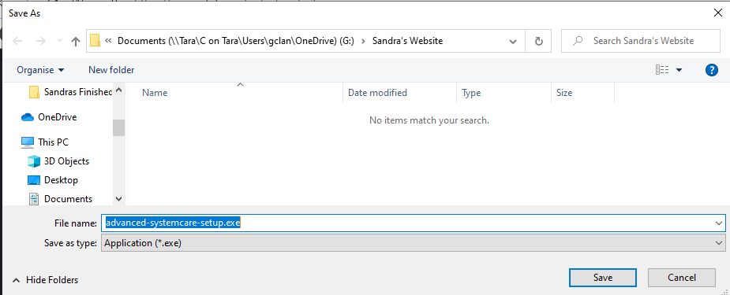
Notes:
Note that some applications will always start you off at the same place ie username | downloads
*****
And some will start you off where you were the last time.
*****
In this case I am in the Documents folder and then a subfolder called Sandra’s Website.

Slide 27
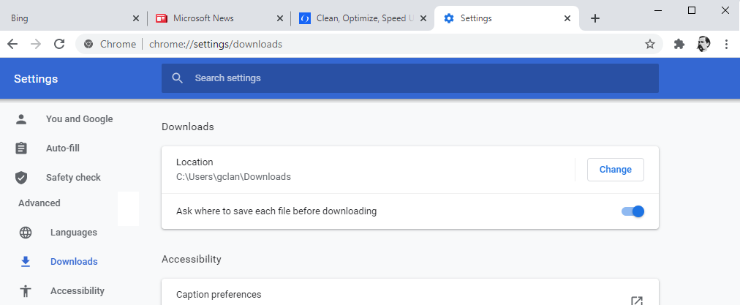
Notes:
For Chrome. Go settings | Advanced | Downloads

Slide 28
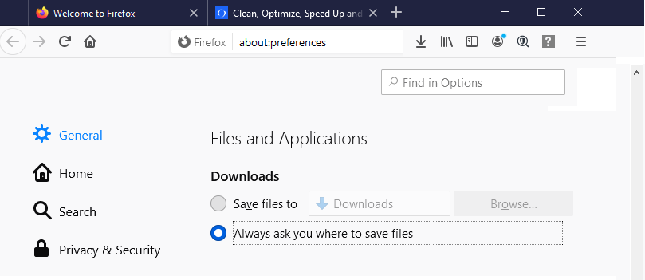
Notes:
And for Firefox go Options* | General | Downloads
* Go Options from the menu but Firefox have not been consistent here, the address bar in my screenshot says “about:preferences”.

Slide 29
Detailed navigation
a closer look in the Right Hand Pane

Slide 30
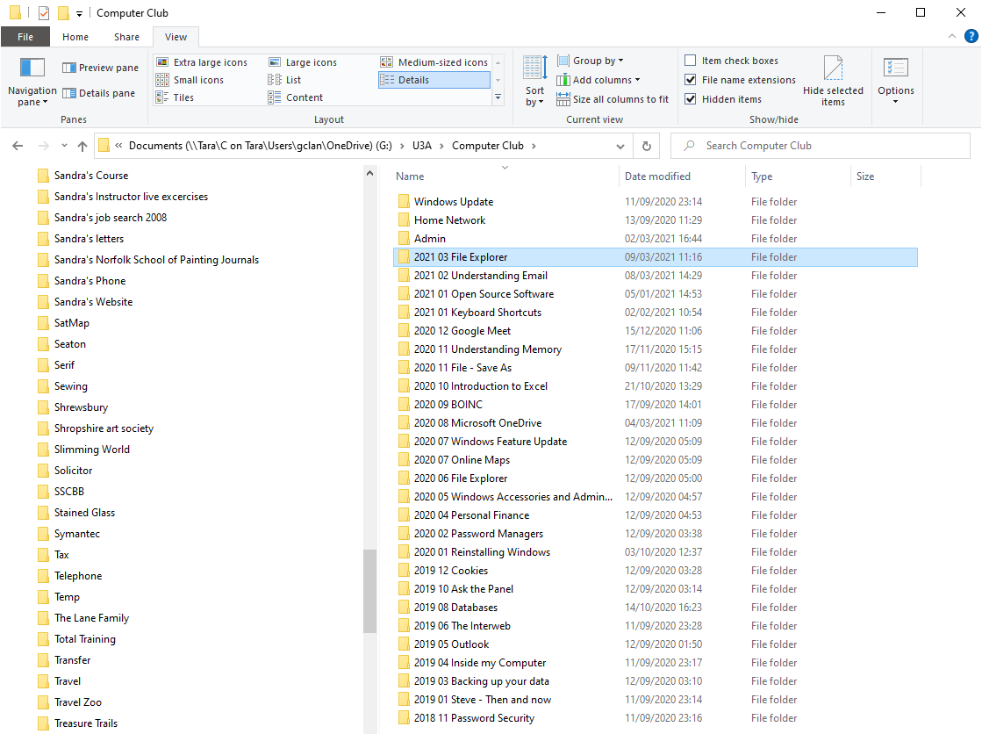
Notes:
From the Address bar you can see that I am in my G drive. The U3A Folder and then the Computer Club
Following my recommendations I only have sub folders here.

Slide 31
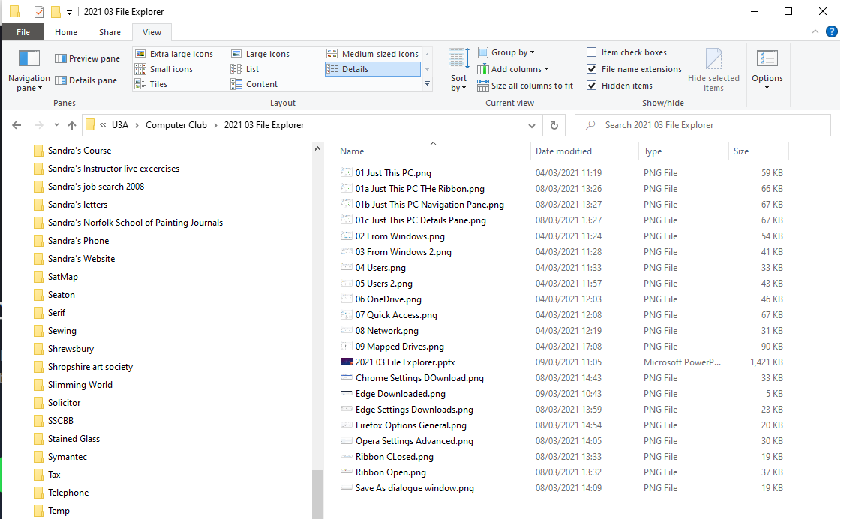
Notes:
And here in the
*****
2021 03 File Explorer folder I just have files.
*****
Note the column headers at the top of each column, we can use these.

Slide 32
Notes:
See the little arrow centred over the name column. This tells me that the files are sorted by this column – and you can see that; figures first 0 – 9 followed by letters A – Z.
If I clicked the little upward pointing arrow it would sort the column in reverse order.

Slide 33
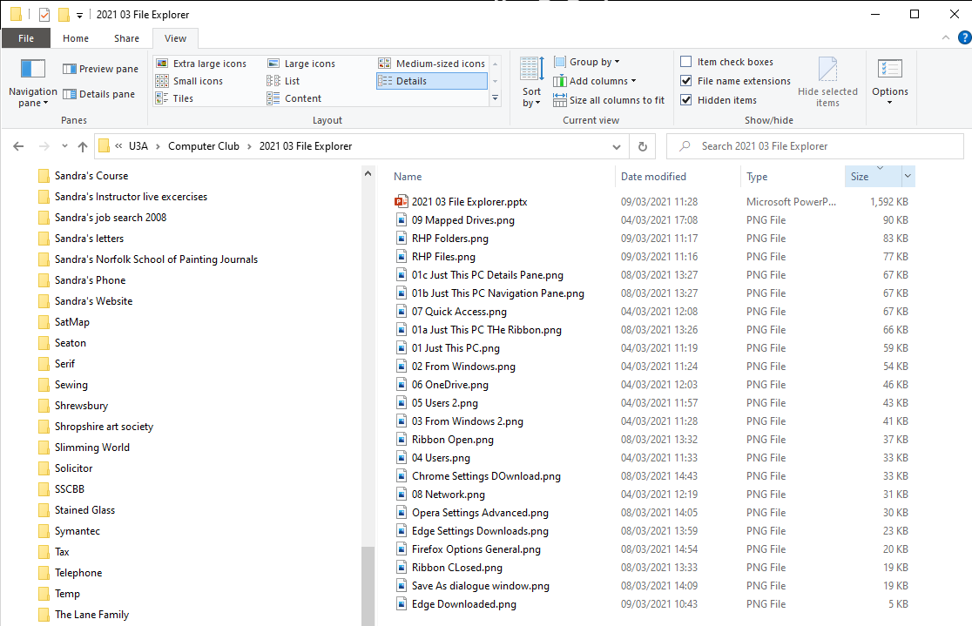
Notes:
And here I’ve sorted by the Size column. (This can be really useful if you are tight on space, you can quicky see where the largest files are.)
Mostly though I tend to sort on the Date Modified column. The first single click will sort with the newest files/folders at the top.

Slide 34
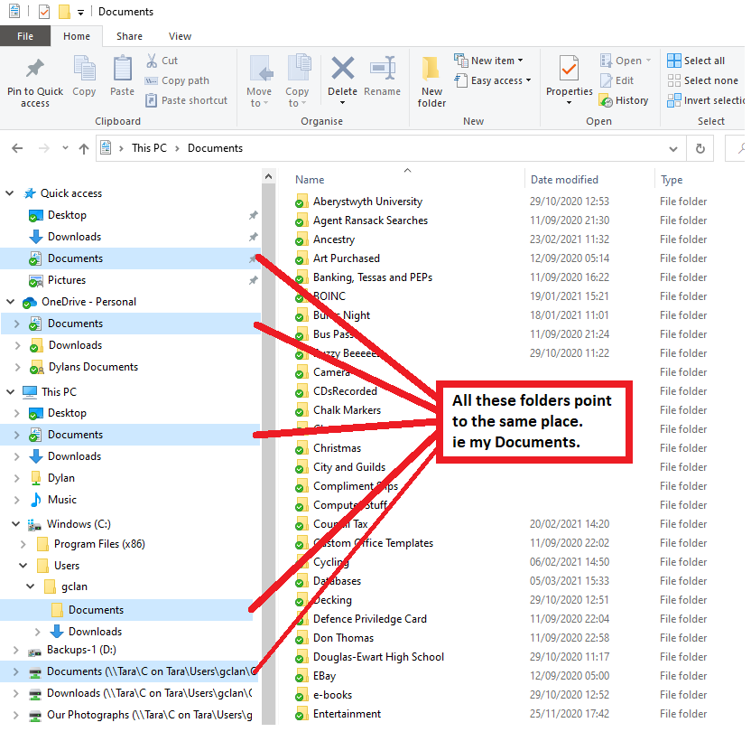
This slide is made up with a bit of trickery
However, it shows that there is more than one
Way to view your files.
Quick Access
OneDrive
This PC
The Users folder from Windows
A Mapped Drive
Advanced stuff.
One of these folders is an error,
can you tell me which one?

Slide 35
File or Folder Selection

Slide 36
Selecting a number of files
There are many occasions where you will want to select a selection of you files – moving the better quality photographs to their own folder for example.
We are going to use Shift Click and Ctrl Click.
Shift Click selects a group of files from the first to the last. You click the first file and then Shift click the one at the end of your wanted selection
Ctrl Click selects individual files. Click the first one, then Ctrl Click any additional others. Ctrl Click again to deselect any you don’t want.

Slide 37
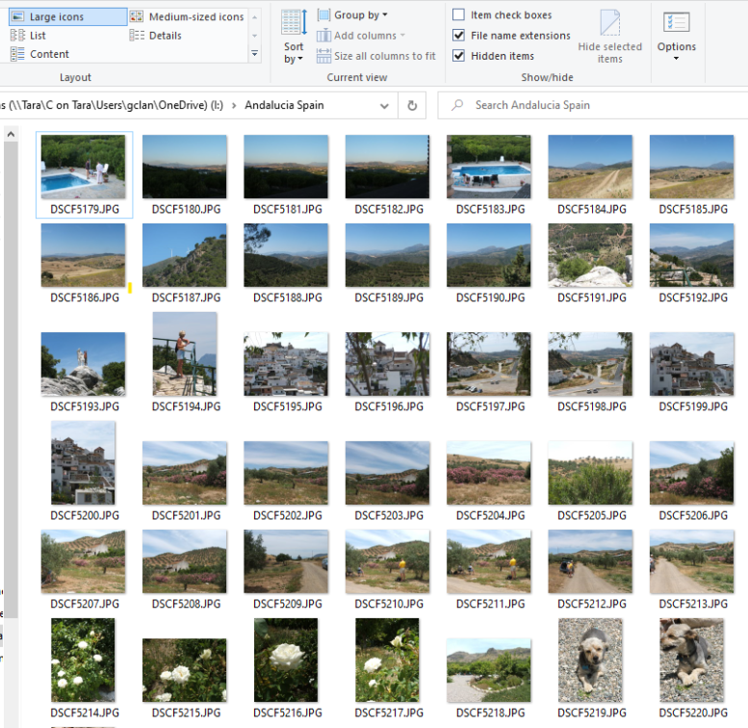
Say I wanted to select the photographs from here
To here
Notes:
Notice I’ve changed the view here to Large icons

Slide 38
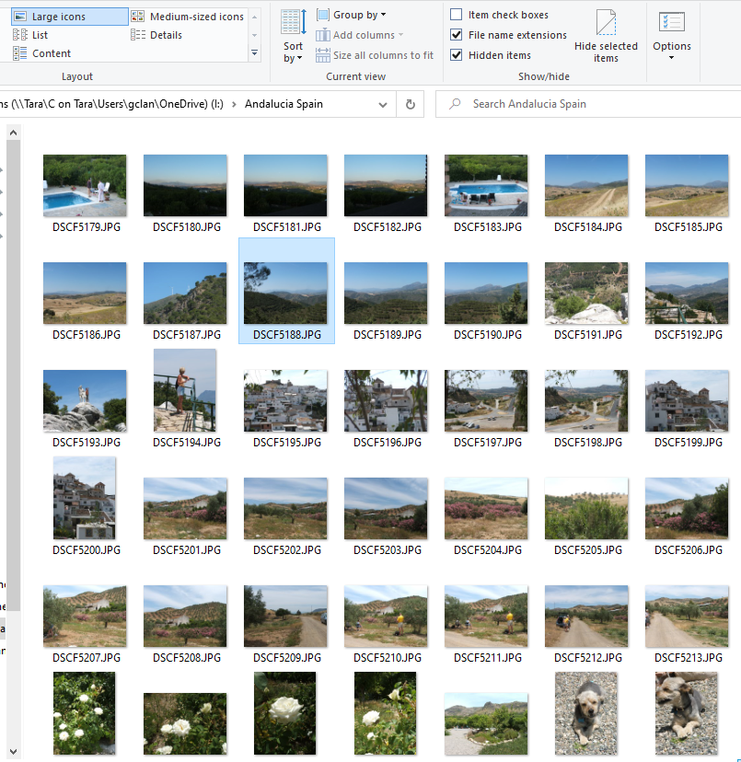
Say I wanted to select the photographs from here
Click the first file (Single click)
To here

Slide 39
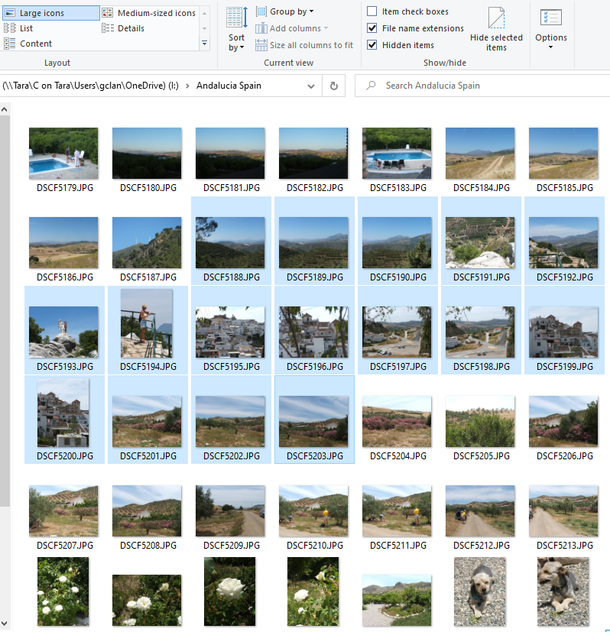
Say I wanted to select the photographs from here
Click the first file (Single click)
And then Shift Click the last file. Notice the selection
in blue
You can now either cut and paste this selection to a
different location or click and drag to do the same.
To here
Notes:
To use click and drag, then having made your selection, position your mouse cursor over one of the selected photos (it doesn’t matter which one) and then drag the mouse to it’s new location. All of the selected files will go with it.

Slide 40
This time I want to select every other photograph
from here
To here

Slide 41
This time I want to select every other photograph
from here
As before, click the first file (Single click)
To here

Slide 42
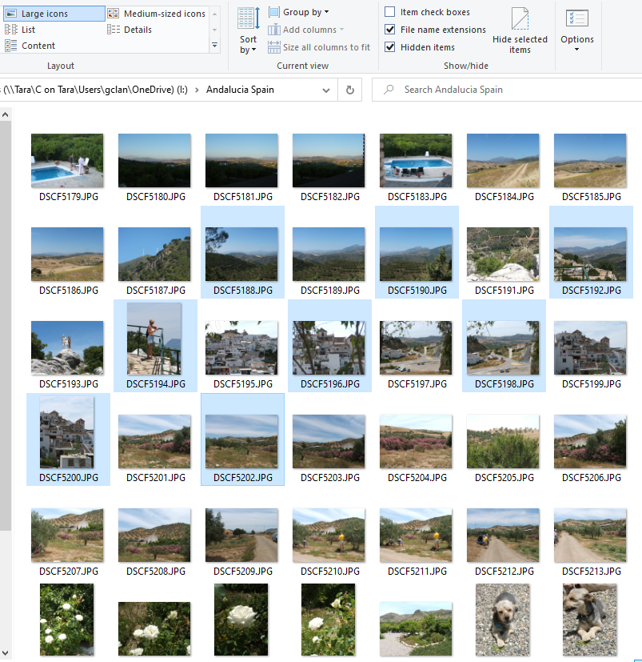
This time I want to select every other photograph
from here
As before, click the first file (Single click)
Now Ctrl Click each single file you want in turn.
Notice the selection in blue.
As before you can cut and paste this selection to a
different location or click and drag to do the same.
To here

Slide 43
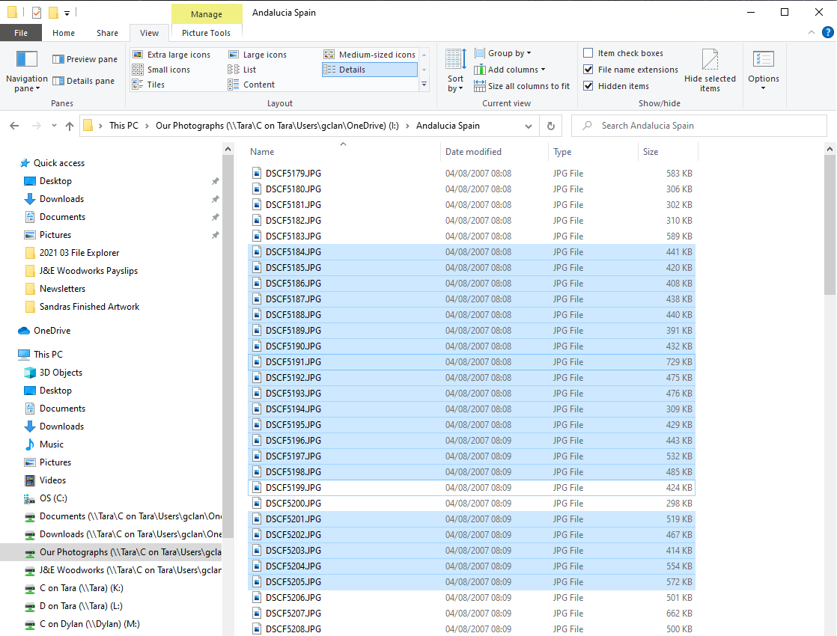
You can also use a combination
of the two
I Clicked and then Shift Clicked
the first and the last files
Then used Ctrl Click to
remove (deselect) two
files from the middle
Notes:
I’ve changed my view back to details.

Slide 44
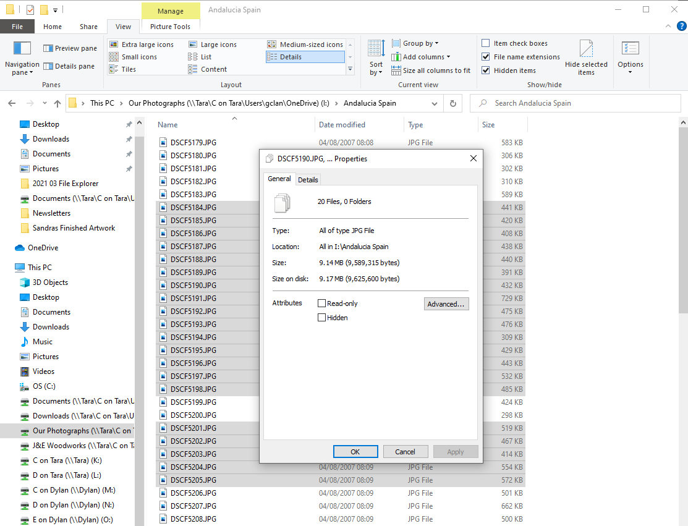
Final two things on ‘Selection’.
The right Mouse click and
‘Properties’ gives you totals for
the qty of files and folders in
your selection and total file
size as well.
When you click and drag, if you hold the Ctrl key at the same time you will copy the file/s or folder/s. If you just click and drag you will move them.
If you right click and drag you will get the option of move or copy when you release the mouse.

Slide 45
Using the Search Facility

Slide 46
Searching
File Explorer has a search function – I’ve had mixed results, sometime it works very well and sometimes it doesn’t find files you know are there.
As well as finding documents that match a file name (or part of). You can also search for a string of text that might be within a document.
The search is at the top right of the screen, underneath the ribbon.

Slide 47
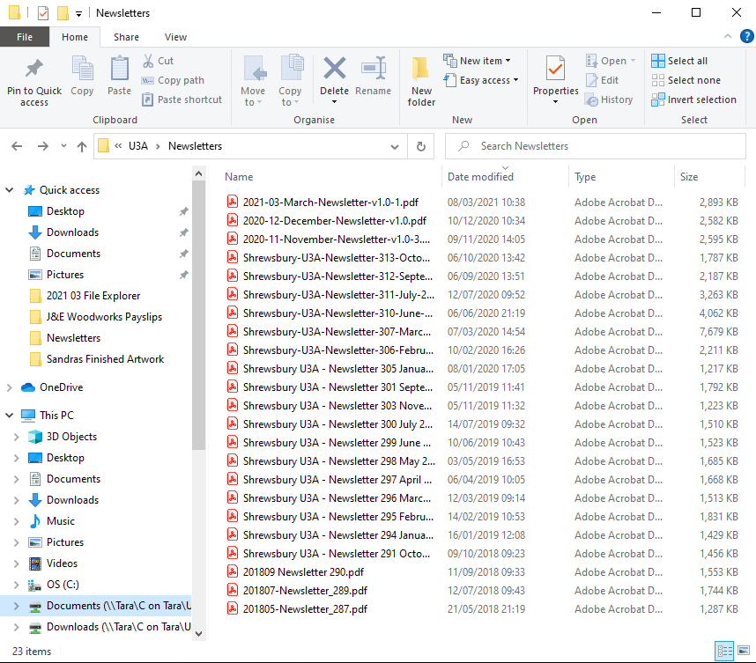
In my Newsletter folder, there are
23 items

Slide 48
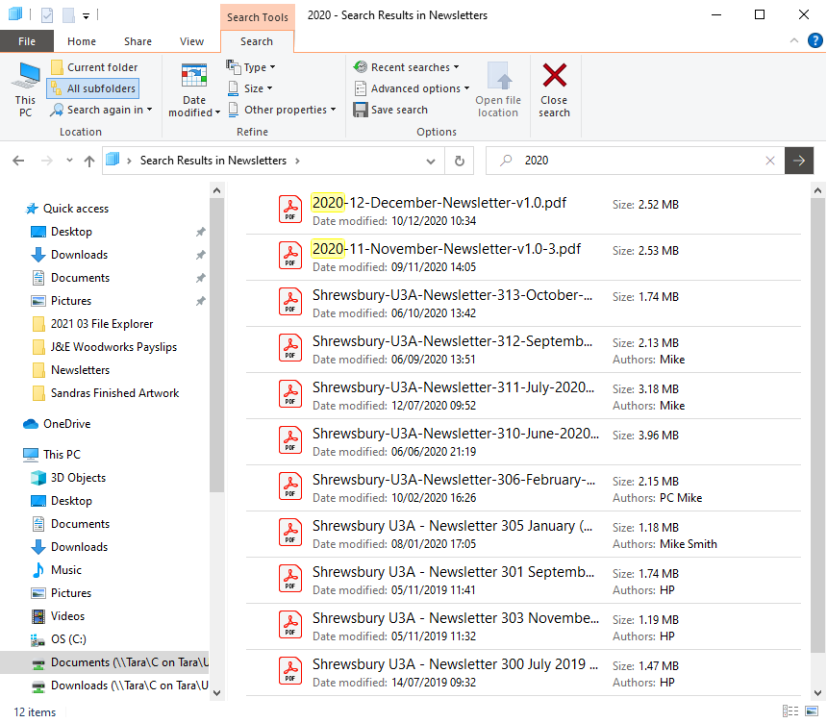
I’ve searched for 2020 – and found
12 items
The status bar at the bottom of the
screen gives you some useful
Information.
Also, remember that right clicking
most things will give you a sub menu
and generally a “properties” tab.
useful info here too.
Notes:
The Status bar at the bottom of the screen gives you some useful information

Slide 49
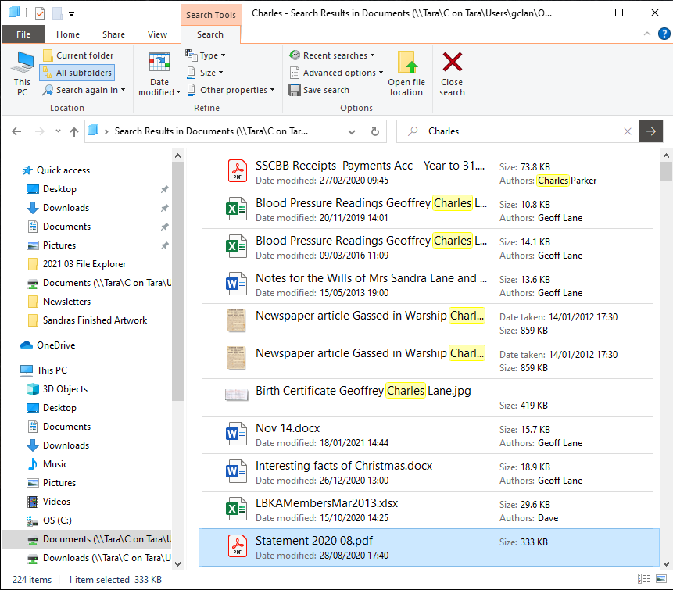
This time I’ve searched for “Charles”
at the top level of my Documents
Folder. I’ve found 224 matches.
The yellow highlights are with “Charles”
In the file name or as an author.
The others have “Charles” in the text
of the document
Right click the file name and select
“Open File Location” Or use the icon
from the Search Ribbon to see where it
lives in your document structure.
Note other options from the Search
Ribbon
Notes:
Once you have initiated your search, the search Ribbon opens.
From here you have lots of options to either expand or filter your results as required:
Search in this PC - everywhere
Current Folder. - just the active folder that your are looking at
All subfolders. - the current folder and any subfolders
Date Modified: Today, this week, last week, this month, last month, this year, last year and so on.
By file type, size or by other properties.
You can save the search so that you can use it again if you want to.
If you are searching in multiple subfolders or this PC. The “Open File location” icon can be useful.
The search function accepts wildcards – an asterisk (*) for a string of letters/numbers. Eg *.jpg for any file that has an extension of jpg.

Slide 50
Other Elements
The Preview Pane and the Details Pane

Slide 51
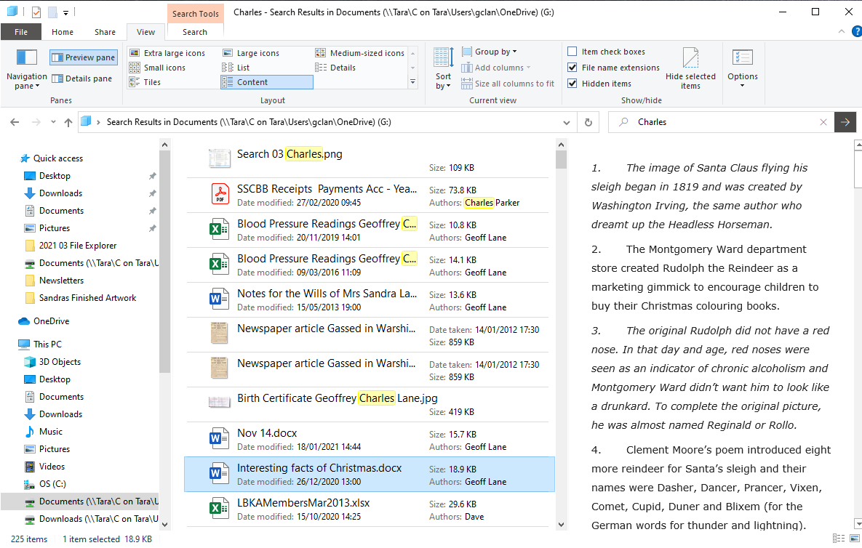

Slide 52
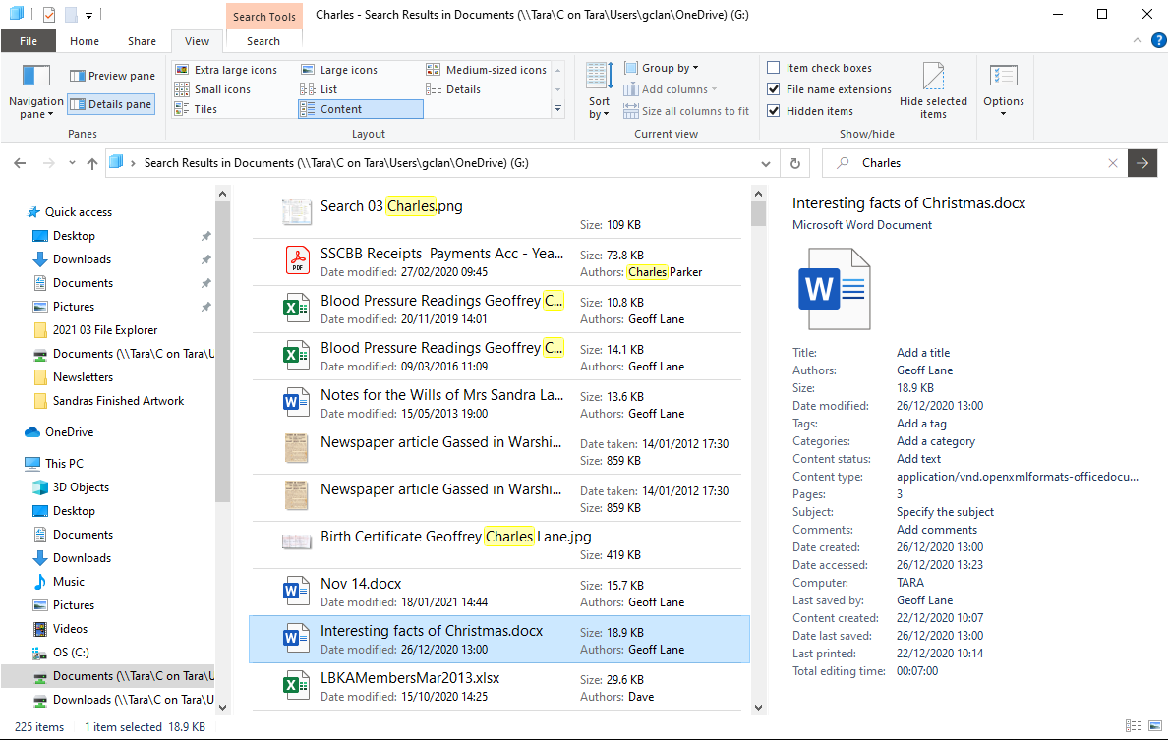
Notes:
I’ve never used the Preview and Details panes before, but in checking them out for this presentation I quite like them, particularly the Details Pane. So much so that I have left it turned on. If you have a wide screen or ultra wide screen then it works perfectly.

Slide 53
We’ve covered quite a lot – but there is still more
On the Share menu for instance – when you share pictures (photos) you have an option to resize them before you send then
Also on the share menu you could zip up a collection of files into one zip file
Or burn your pictures to a CD or DVD
On the View menu, as well as different layout options you can group them by a number of different attributes; size, date, author and so on
Don’t be shy, explore and see what you can find that we haven’t covered.
We covered File Explorer last summer, From our documents on the website, see 2020 06 File Explorer for an 8-page factsheet.
Notes:
We’ve covered quite a lot today some 53 slides. Unlike other presentations I’ve done with you, this one does contain notes, so it would be a lot of paper to print it all out. The 2020 06 File Explorer document in our website is a 8-page factsheet that covers about 90% of what we have done her. That would be a better option to print.

