Slide 1

Top Tips for fault-finding and maintenance
Notes:
I’ve been dabbling in computers for many years now, and over time have fixed quite a few for friends and family. This presentation is aimed at giving you some top tips to enable you to keep your computers running in top condition.
Mostly there is no “best method” to find a fault. But we can make some generalisations.

Slide 2
Things to consider
Every computer is slightly different. No two are exactly the same.
Is it a hardware fault or a software fault?
Does it apply to every account on the computer or just yours?
Is it just the one website that is ‘faulty’ or every website you visit?
Is it the same in different web browsers?
Does it happen all the time or is it intermittent?
Can you reproduce the fault?
Notes:
Every computer is slightly different from the next. Even two computers that come off the assembly line side by side and are then ‘enabled’ by two different people – Account created and No additional software added, will be different from one another. Plus of course there is the type of fault, is it a hardware fault or a software fault. Does it apply to just your account or every account on the computer. Is it just one website or every website that you visit. Does it happen all the time or is it intermittent. Can you reproduce the fault?

Slide 3
The basics: Restart the Computer
The first line on every support line help script.
Rather than ‘Restart’, Turn the computer off, check all plugs and sockets for security and then turn on again.
Restarting the computer clears out the 1’s and 0’s, clears the memory, closes programmes running in the background (although they might start again) and is generally a good thing to do.
Listen for – and get to know, any beeps as the computer boots up. These are as result of the POST (Power on Self Test)
Notes:
POST. Power On Self Test. Google the POST for the manufacturer of your computer and see what the beeps mean. Start here https://www.computerhope.com/beep.htm
My Dell computers use the following:
1 beep BIOS ROM corruption or failure.
2 beeps Memory (RAM) not detected.
3 beeps Motherboard failure.
4 beeps Memory (RAM) failure.
5 beeps CMOS battery failure.
6 beeps Video card failure.
7 beeps Bad processor (CPU).

Slide 4
Run a deep Anti-Virus Scan
Your automatic scans might not be a ‘full’ or ‘deep’ scan. They compromise to minimise downtime (or resources).
Run a ‘Full’ scan. (And set it to run weekly / daily or whatever)
Notes:
Search amongst the settings and run a ‘full’ scan. Start it, leave it alone to do it’s thing and come back to it.

Slide 5

Hardware
Check for hardware problems with Reliability Monitor and Device Manager (Both built into Windows).
Or use a hardware scanner.
Notes:
Mechanical parts can fail. Fans & Hard disk drives are mechanical. Do the fans sound smooth and sweet or is it a graunching noise?
CPUs and Memory can fail too. There are lots of warning signs when your RAM is close to failing. They include worsening performance, frequent crashes, video cards failing to load on boot, corrupted data files, and incorrect RAM information in the Windows System app.
Device Manager is a utility from previous versions of Windows. It’s still available in Windows 10 in the Control Panel.
Right Click the start icon and select Device Manager, or search Device Manager from the Task Bar search.
Problem items are identified with a Yellow exclamation mark.
Or use a hardware scanner
Some, like “Speccy” monitor real-time temperatures of critical component, so you could, potentially, spot problems before they occur.

Slide 6
Reliability Monitor
Control Panel | Security & Maintenance | Reliability Monitor
or you might see it as
Control Panel | Security & Maintenance | Maintenance | View reliability history
Provides a graph of Application failures, Windows Failures, Miscellaneous failures, Warnings and Information.
Notes:
I like this, a good place to start.

Slide 7
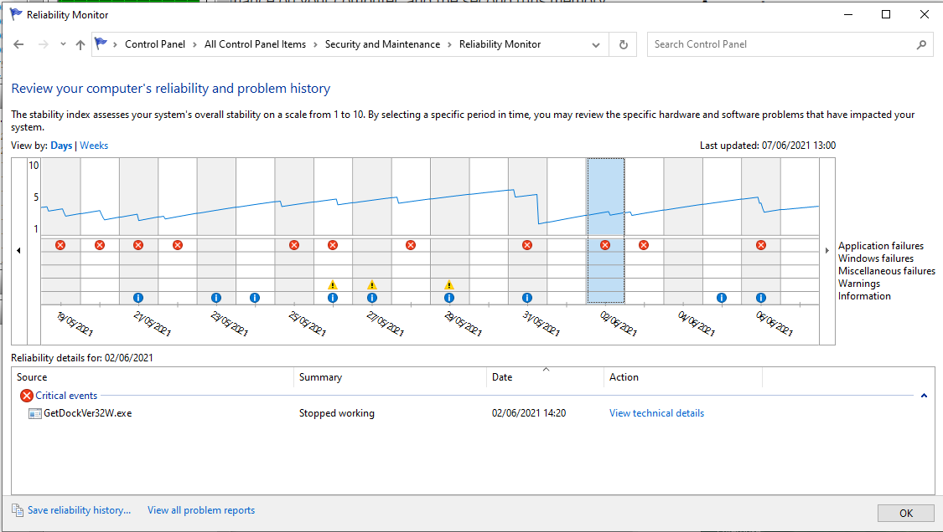
Notes:
Click on the red cross, the exclamation triangle or the blue Information circle for details.
In my screenshot I’ve clicked on the red cross for the 2 Jun. In the bottom part of the screen you can see the event it refers to. In this case there is a problem with GetDockVer32W.exe – it stopped working.
I googled GetDockVer32W and found it to be a Dell Firmware update file (It’s a Dell Computer). Tying two things together, I use (amongst others) Dell Support Assist to keep my computers running in top condition. Recently, Support Assist has recognised a BIOS update available, but when I tried to install it, it failed. So far I’ve done nothing further with this failure, but I could uninstall Dell Support Assist, reinstall it and try again and see what happens there.

Slide 8
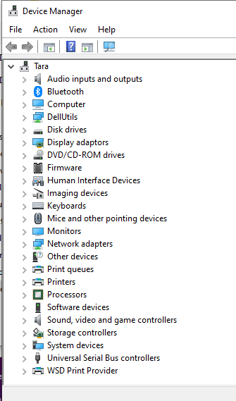
Device Manager
Control Panel | Device Manager
No problems here, no yellow triangle with black exclamation marks.

Slide 9
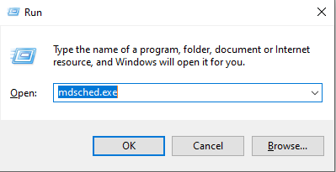
Memory Scanner
Open the ‘Run’ window
(Press Windows + R)
Type mdsched.exe.
Press OK and follow the prompts

Slide 10
3rd Party Applications
Plenty available, I use two: “Advanced System care” and “Speccy”. Gives real time results and lists everything you need to know about what is in your computer.
Also reads temperature sensors so that you can see what is running hot.
Notes:
Make sure all software is up to date.
For Windows: Start | Settings | Update & Security | Check for Updates.
For Applications it is normally on the ‘Help’ or ‘Support’ menu item | Check for updates. Or visit the website and go to their Support/Download pages to see the latest version.

Slide 11
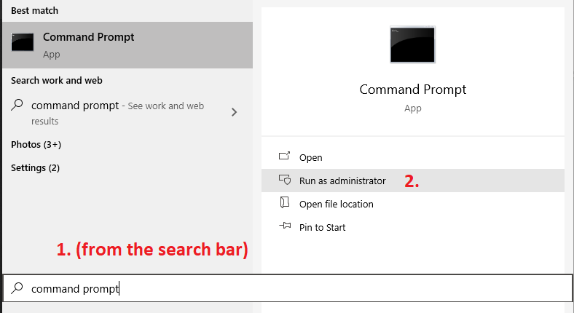
Software
Is it the operating system – or just
a single application/programme.
For OS problems, try the System
File Checker
System File Checker (Built in with Windows) is a very useful tool to check your Windows OS for integrity and corrupt files. First however, you should run the “Deployment Image Servicing and Management” (DISM) tool.
Open a Command Prompt with elevated privileges ie run as an Administrator.

Slide 12
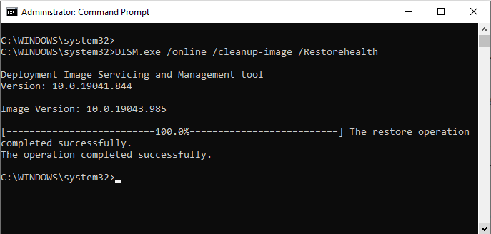
DISM
Read the results
To close the Command Prompt window, type exit at the prompt
(Flashing cursor) It’s a cleaner exit than just closing the window
from the Top Right X
At the prompt, type in
DISM.exe /online /cleanup-image /Restorehealth and press enter.
1.
2.

Slide 13
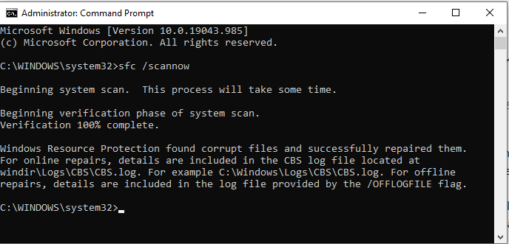
System File Checker
At the prompt, type in
sfc /scannow
Read the results
To close the Command Prompt window, type exit at the prompt (Flashing cursor) It’s a cleaner exit than just closing the window from the Top Right X
1.
2.

Slide 14
E-Mail Problems
If you use an email client on your computer, Outlook or Thunderbird etc, try logging into the webserver direct on a webpage – and eliminate your client as a problem.
If you use a Webmail service – Hotmail, Google mail etc. Try from a different device, your tablet or phone and see if it works there.
What is the problem, You cannot send mail, receive mail or both? Perhaps it is just one individual email address that refuses to accept mail (BTInternet mail address are well known for this).
Use more that one account – it makes checking easier.
Or use a second Profile if you only have the one email account
Notes:
To create a second profile go: Control Panel | Mail (Microsoft Outlook) | Show Profiles… and then add a new profile. As you do so it will prompt you for your email address credentials, so make sure you know these before hand.

Slide 15
E-Mail Problems
Windows include a useful facility to scan and repair pst files.
Location of “scanpst.exe” varies, check here
In my case, Program Files\Microsoft Office\root\Office16
Double click (open) the scanpst.exe. file and follow the prompts. You will need to know the location of your pst data file. Sometimes Outlook Files are a subfolder of My Documents or it may be in:
C:\Users\username\Appdata\Local\Microsoft\Outlook (Note that AppData is a hidden folder, so set file explorer settings to view hidden folders)
Notes:
Most likely you are using imap structure rather than pst files. If however you are still using pst files, then this is for you.

Slide 16
The Internet
The internet: Web pages. Trouble using a specific web page? Try using a different browser – Chrome, Edge, Opera, Firefox etc.
Still a problem? Visit Down for everyone or just me, enter the web address and see what they say.
Try restarting your Router, very often this is left forgotten. Learn what the lights indicate.
Is there a difference when you use your phone or tablet rather than the computer?

Slide 17
Miscellaneous
Cursor behaving erratically? Check the batteries in your wireless mouse
Take a screenshot (or a photo) of any error messages – then google them for more information.
On anything more than a simple fault, write down what you do or change to try and fix the fault.
Use the Task manager to check if any software is hogging all the memory.
If you can replicate the fault, Use the Steps Recorder (from Windows Accessories) to show how you got there – then send the file to your local helpful guru.

Slide 18
Make life easier for the future
Make sure all software is up to date.
Run utility software: Advanced System care and Carpet Cleaner etc
Uninstall apps you don’t need or use any longer.
Connect to the internet with a cable rather than WiFi
Disconnect from the mains, Open the case and brush and blow any dust out.
While you have the case open, make sure memory and expansion card slots are firmly seated in their slots.
A useful idea is to load a USB stick with your favourite ‘Portable Apps’
Notes:
Make sure all software is up to date.
For Windows: Start | Settings | Update & Security | Check for Updates.
For Applications it is normally on the ‘Help’ or ‘Support’ menu item | Check for updates. Or visit the website and go to their Support/Download pages to see the latest version.
PortableApps.com is a website offering many free, commonly used Windows applications that have been specially packaged for portability. These portable applications can be used from removable media such as USB flash drives. User data is stored in a subfolder, allowing the user to upgrade or move the software without affecting the data. Use Apps for either productivity or faultfinding / maintenance.

Slide 19
If all else fails…..
Reinstall Windows – loads easier than it used to be.
Go: Settings | Update & Security | Recovery | Reset this PC
As a matter of course, I recommend you reinstall Windows every 12-18 months or so, it gives your computer that “fresh out of the box” feeling.

