Slide 1
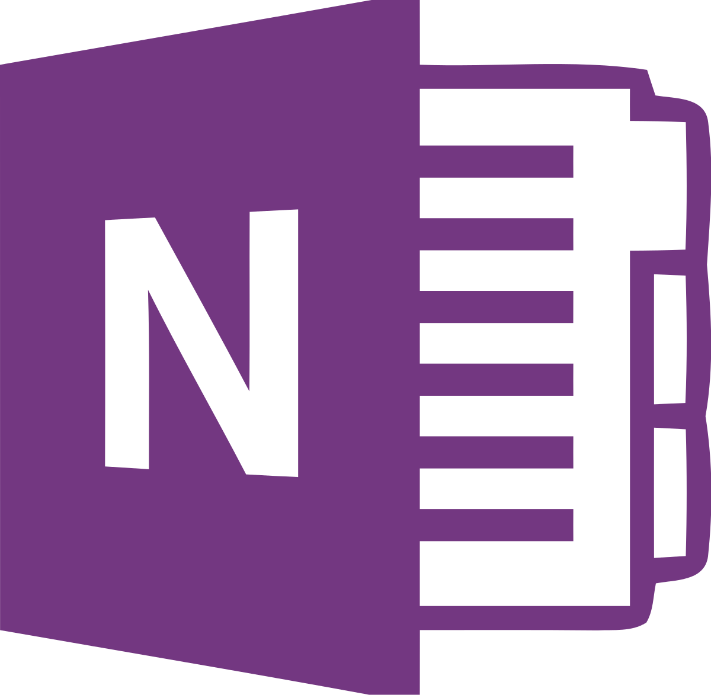

Microsoft onenote

Slide 2
What does it do?
It’s a cross-functional digital notebook for all your notetaking needs!
Great for taking notes. Create different sections, create pages for those sections.
Making lists. Write anywhere on the page.
Capture ideas or record audio. Add pictures from your Phone.
A to-do list. An OCR system. Tag items to find them easily.
Synchronised to your desktop, smartphone (iPhone & Android), tablet and OneDrive
Share with other people. Let others share to you.
Create additional Notebooks if needed.
Notes:
OneNote is your very own digital notebook. And a very clever one it is too
Whether you have a million ideas, a million things to do, Or a million things to remember, OneNote is the perfect app for capturing pretty much everything.
So what does it do? What is it? (from the slide)

Slide 3
Various versions available
Two Desktop versions, a version for your Mobile and a Web Application. All are free to download and use.
For the Desktop: Either “OneNote for Win 10” comes preinstalled with all versions of Win 10. OR “OneNote” (formerly OneNote 2016) part of the Microsoft 365 suite.
Mobile: iPhone iOS 12.0 or later. Android 5.0 or later
WebApp: Any modern browser – https://www.onenote.com
Notes:
To use any version of OneNote you will need a Microsoft account. Most of you will already have one, if not it is free to create one. www.account.Microsoft.com
For the Desktop: ‘OneNote for Windows 10’ comes preinstalled with all versions of Windows 10/11. It’s light and easy to use. When you sign in with a 365 subscription, you’ll enjoy premium features. Ie Ink replay, Researcher and Maths Assistant!
‘OneNote’ (Formerly OneNote 2016 (and before that OneNote 2013)) is part of the Microsoft 365 suite of software – although you can download and use it independently. However, to gain access to it’s full features, you need to be signed into the 365 subscription model. This app features a full Office Ribbon that you will be used to in Word Excel etc and is the only version that supports local notebook storage on your local PC (in addition to cloud storage). As this is the ‘Paid’ version, it also has the most customisation options.
Mobile download the app for Android and iPhone. Needs Android 5.0 or later & iOS 12.00 or later.
Or you can use it from a web page Onenote.com

Slide 4
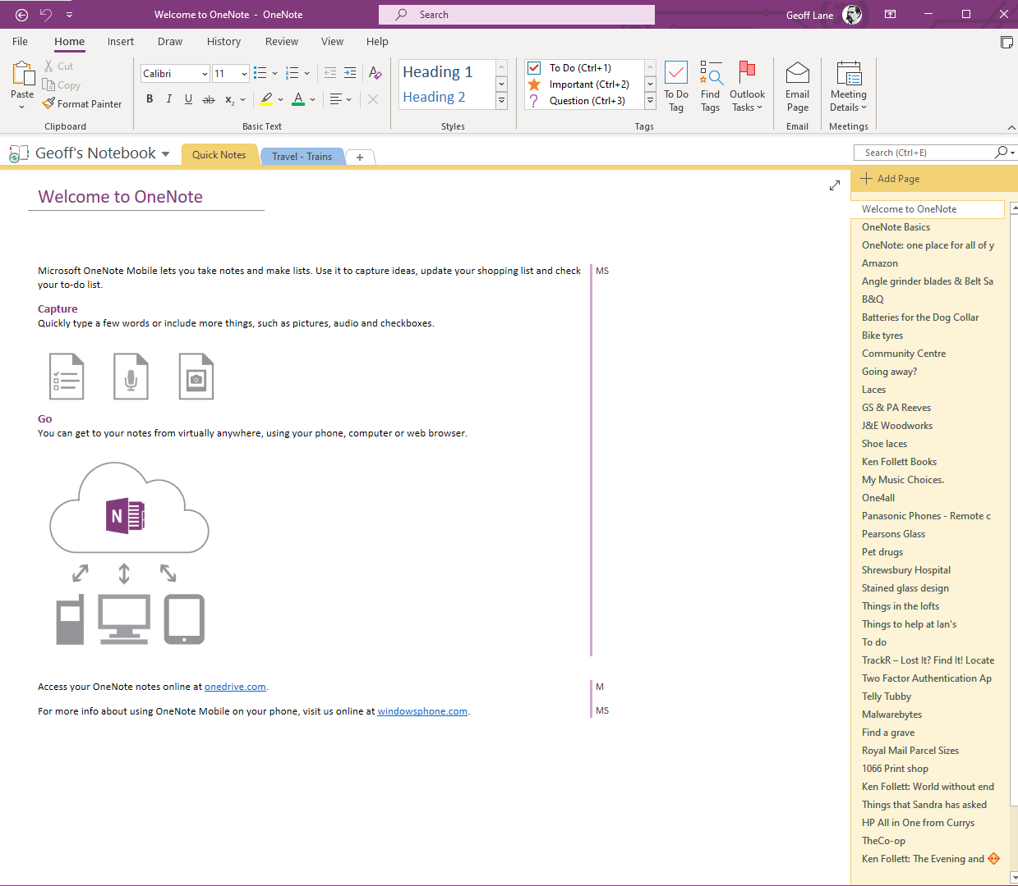
Notes:
This is the Desktop Version “OneNote”. There are differences in the layout of the various versions, but nothing that shouldn’t be too difficult to navigate. This version – along with a MS 365 subscription also has the most functionality.
When OneNote is installed and first used, a default Notebook is created for you. You can create additional Notebooks as required. One for Work and one for Home perhaps.
****************
Within each Notebook you can have as many ‘Sections’ as you like – click the small + sign at the end of your current sections to add a new one.
****************
And for each Section you can have as many pages as you like. So the hierarchy goes: Notebook | Section | Page.
You can type text anywhere on the page. Just click with your mouse wherever you like and start typing. This is unlike a word document where you can only insert text from the beginning of the document up to the end cursor position.
And if you have a smart screen and or a pen and stylus, you can draw on the screen – even with your finger.

Slide 5
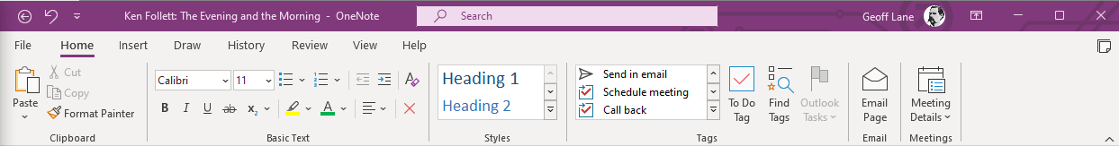
The Office full Ribbon bar:
On the Home tab, Clipboard, Basic Text and Styles are similar to any other Office Suite programme.
The Email section does exactly what the icons says, it will open a new email with the body of the text an exact copy
of your OneNote page.
Tags and Meetings are interesting.
Notes:
Lets have a look at the tools on the Home tab of the Ribbon.
****************
The Clipboard, Basic Text & Styles should all be familiar to you – they appear across the MS Office suite of software.
****************
And the Email Page does exactly what it says on the tin, It open up a new email message with the body of the email an exact copy of the OneNote page you are looking at.
****************
With tags, you can tag an item to that you can easily find it again. You might tag something as important or as a project or as a book to read.

Slide 6
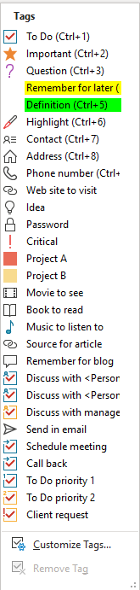
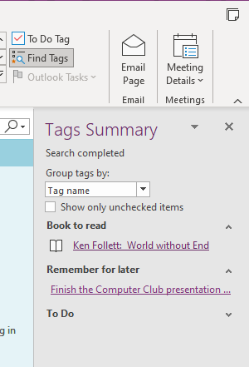
Available tags
Finding tags
Notes:
There are loads of different tags to choose from, you can even customize your own or modify those that are already there.
The beauty of tags is that you can then find them easily.
****************
****************
Click the “Find Tags” button and they are listed in their own side panel. Here I have three examples:
‘Books to read’, ‘Remember for later’ and a ‘To Do’ List. Note the results are hyperlinked, so clicking on the link will take you to that page.
****************
The ‘To Do’ list needs to be expanded as there are lots of them and I didn’t want to clutter the screen. There are other ways to use the ‘To Do’ tag……

Slide 7
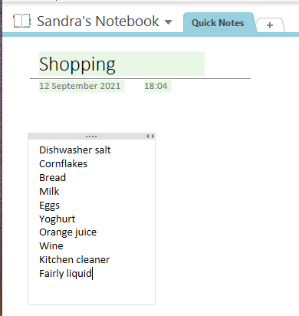
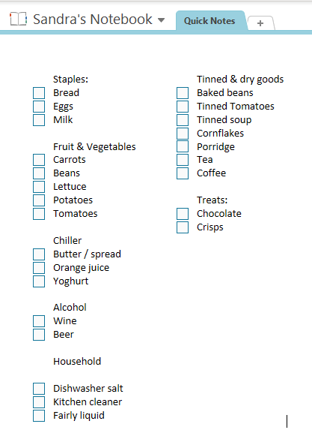
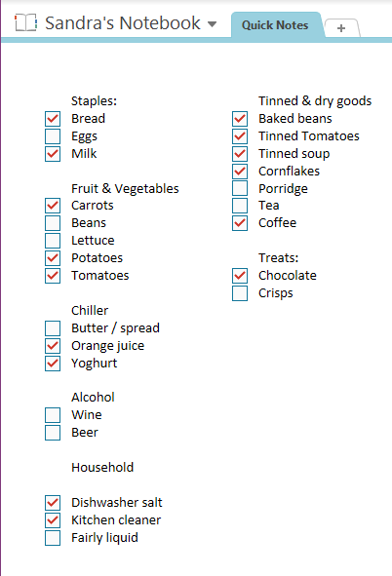
Notes:
Use of the “ToDo” Tag.
Consider this list, first of all notice that it is from Sandra’s Notebook – so we share, and I can add to the shopping list as I come across things that need to be replenished.
Items are written down as we think of them, so they can be in a fairly random order.
As we go around the Coop or Tesco’s sandra then deletes the item from the list so we know where we are. After we have our shopping, we have to write the items again for the next time. Any items unavailable in the store stays on the list until next time.
****************
Consider this list, items have been sorted into sections and given a tick box; in reality a ‘To Do’ checkmark. (You can write the list first, select the text and then tick them all in one go if you like rather than line by line)
****************
This time as we need to add something to the list, we just tick it’s box – and then untick it when the item is actually in the shopping trolley. This way, you only need to write the actual commodity once.
You might consider arranging the sections and items within those sections as they are in your favourite supermarket so that it all flows easier.

Slide 8
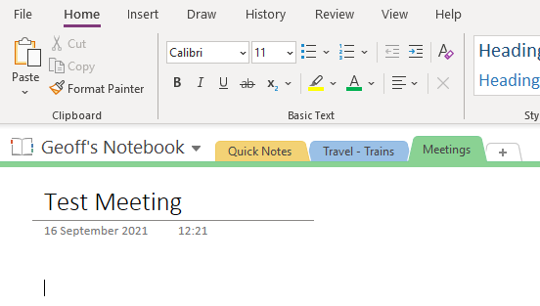
Notes:
Here I have created a new Section
**************** called Meetings: When you create a new section, by default it creates a new page within it too. Here I’ve called it ‘Test Meeting’

Slide 9
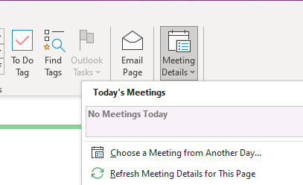
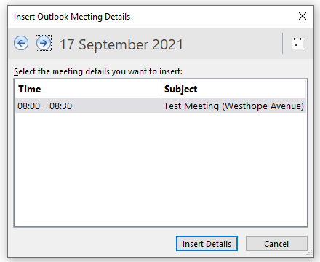
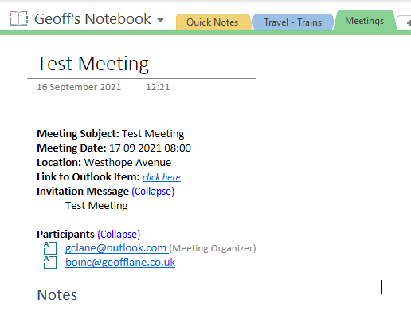
Notes:
I’ll leave that Test Meeting as the ‘active’ page, Now let’s look at the last item on the Tool bar its ‘Meeting Details’.
****************
In my screen shot here, there are no meetings for today,
****************
but I can select one for tomorrow (17th Sep).
****************
Once selected,
****************
it populates my ‘Test Meeting’ page with all the details from the Meeting that has previously been set up in Outlook.
Now you are ready to go and make any notes you wish.

Slide 10
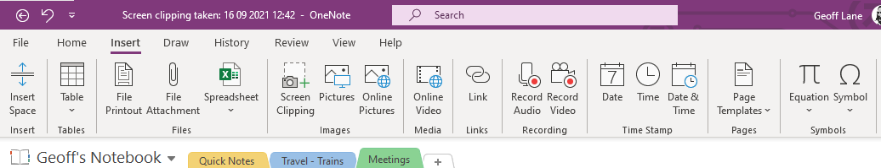
The Insert Menu: Most are straight forward
Screen Clipping and Recording are worth taking a look at.
And if you like colourful pages, then have a look at the templates.
Notes:
The Insert Tab of the Ribbon
Most are straight forward
****************
Screen Clipping
****************
& Recording are worth taking a look at.
****************
And if you like colour, pictures and patterns take a look at the templates.
One way to add a screenshot to your page is to use ‘Snip and Sketch’ a Windows utility that is preinstalled on all versions of Win 10 (and Win 11). To do this I would use the shortcut keys Win + Shift + S. At that point the screen goes grey and you can then click and drag to select the portion of the screen that you want.
As you release the mouse, a popup appears in the bottom right of your screen, I then click this popup and either copy the image, or more likely for me to save it, I then navigate to the correct folder to save it in, and then go back to the original programme, then from the insert menu, navigate to the file I have just saved. It’s not hard, it’s just a lot of clicks to get there.
If you click the Screen Clipping Icon here, the screen goes gray and OneNote minimises (to get it out of the way) so that you can click and drag for your selection. This time though, as you release the mouse, your image is placed directly onto the open page you have in OneNote leaving you the only thing to do and that is to drag and drop it where you like. Nice.

Slide 11
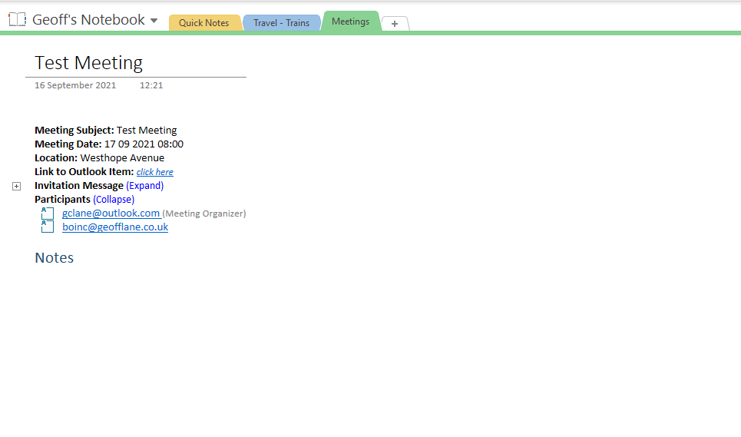

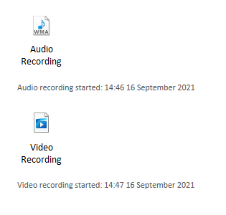
Screen clipping taken: 17 09 2021 11:07
Notes:
So here’s a screenshot of an
****************
image inserted and an
****************
audio recording and video recording. (I was still on the ‘Test Meeting’ page, so that’s where they have been pasted!)

Slide 12
Plenty of choice of Templates to jazz up your pages.
If you can’t find one you like, you can create your own
And/or set any template as the default for any new pages to that particular section.
Notes:
Plenty of choice of
****************
Templates to jazz up your pages
If you cant find you like, you can create your own
And / Or set any template for the default to a particular section

Slide 13
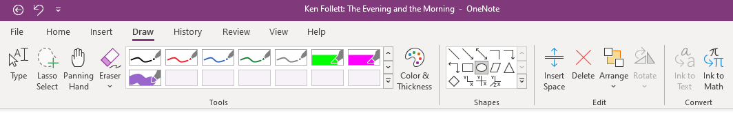

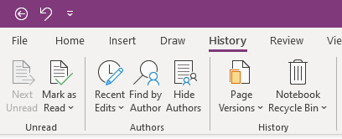
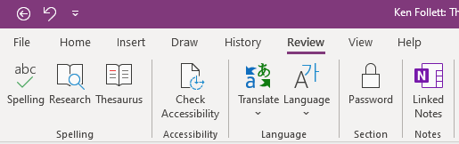
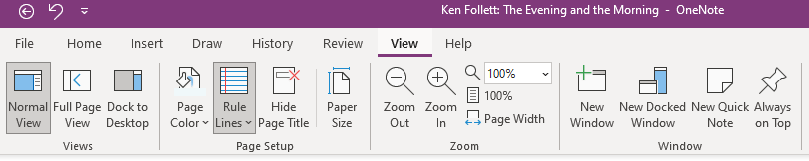
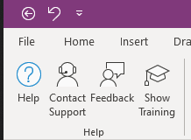
Notes:
The other Tool bars from the Ribbon:
Draw – all pretty standard
****************
History: OneNote keeps a note of your changes – so you could go back to an earlier version of an edit if you wished. You can also clear your previous versions (apart from the last one) if you want to.
****************
The Review,
****************
& View menus are pretty straight forward
****************
as is the help menu.

Slide 14
Final thing: OCR
Optical Character Recognition. Turns scanned text in an image to editable text in a document, the reverse of a pdf file if you like.
Normally OCR is carried out from your scanner.
In this case, import the image/pdf into OneNote or open an image or pdf and print it – but select OneNote as the printer.
Then Right click the resulting import, and select ‘Copy Text from this page (or all pages) of the printout’
Position the cursor in a blank area, right click and then paste
Notes:
Final thing: OCR
Optical Character Recognition. Turns scanned text in an image to editable text in a document, the reverse of a pdf file if you like.
Normally OCR is carried out from your scanner.
In this case, import the image/pdf into OneNote or open an image or pdf and print it – but select OneNote as the printer.
Then Right click the resulting import, and select ‘Copy Text from this page (or all pages) of the printout’
Position the cursor in a blank area, right click and then paste

Slide 15
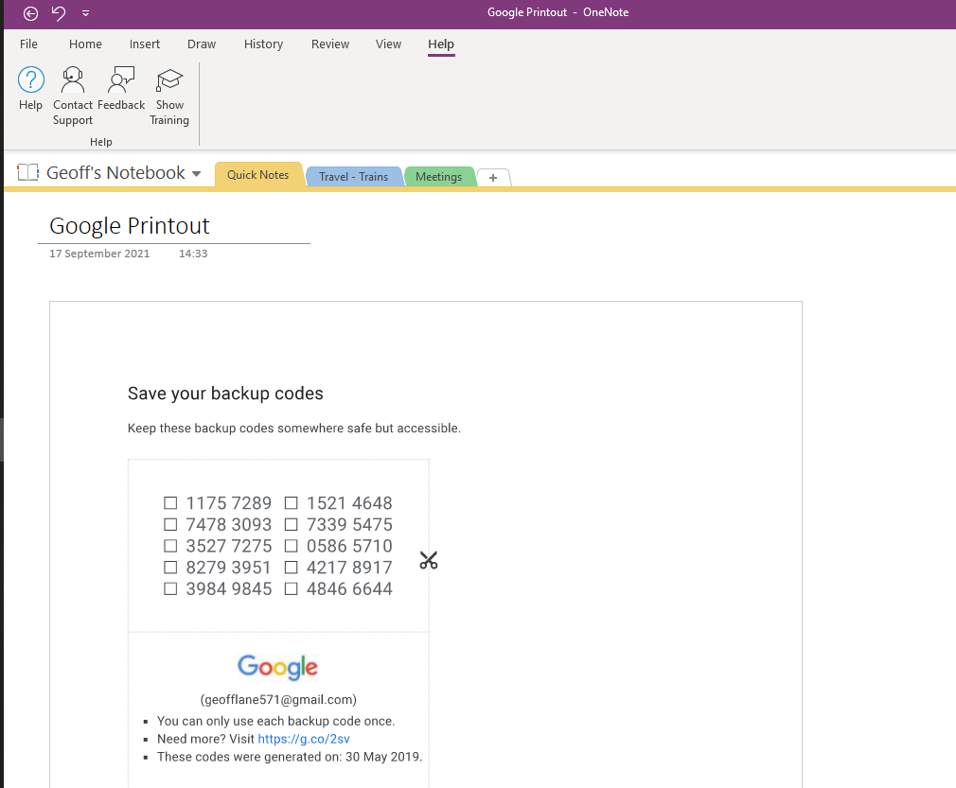
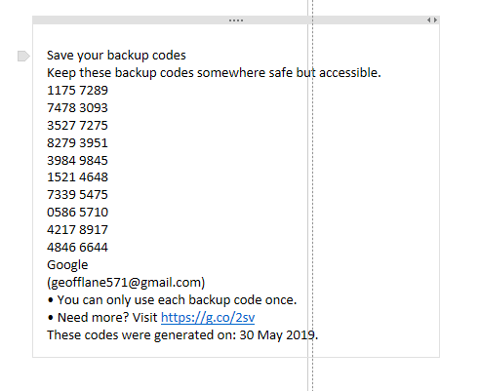
Notes:
Example 1.
Here I’ve pasted in a pdf file – that you can’t edit.
****************
And extracted the text from the image so that I can.

Slide 16

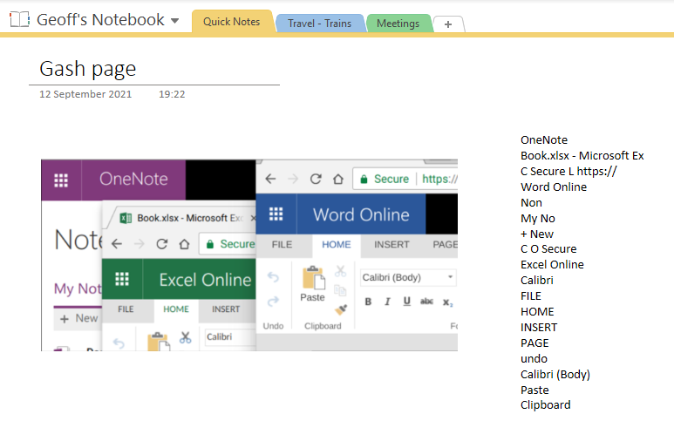
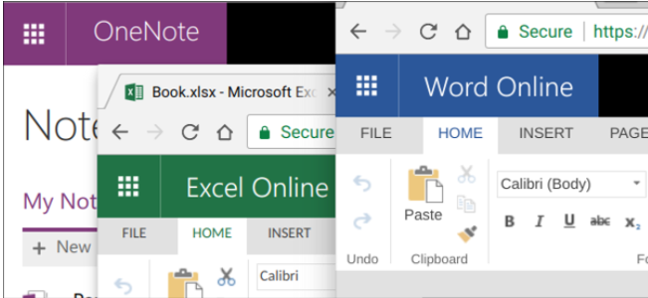
Notes:
Example 2

