Slide 1
The Stage Coach Era in Shrewsbury

Slide 2
Introduction
Early 16th century – the first coaches were covered wagons drawn by 4 horses. Travelled at 5 mph over rutted tracks.
Stage coaches were so called because they travelled in “stages” of 10-15 miles before stopping, usually at a coaching inn, to change the horses.
There were many regular routes around the country by the early 1700s.

Slide 3
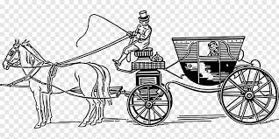
Berlin Stagecoach, 1660

Slide 4
17th Century
1659 Public coach service twice a week from London to Birmingham, Wolverhampton, Shrewsbury, Newport, Whitchurch and Holywell.
1681 Daily service between Shrewsbury and London (the Shrewsbury Coach) which took 3 days.
This was the beginning of public transport for the wealthy.

Slide 5
Early 18th Century
Stage-coaches were pulled by 4-6 horses and travelled at 8 mph.
They could carry up to 8 passengers inside, with second-class seats available in a large open basket attached to the back. The cheapest seats were sitting on the roof.
Travel was neither comfortable nor safe.

Slide 6
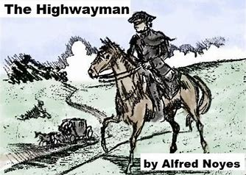
Danger on the Road

Slide 7
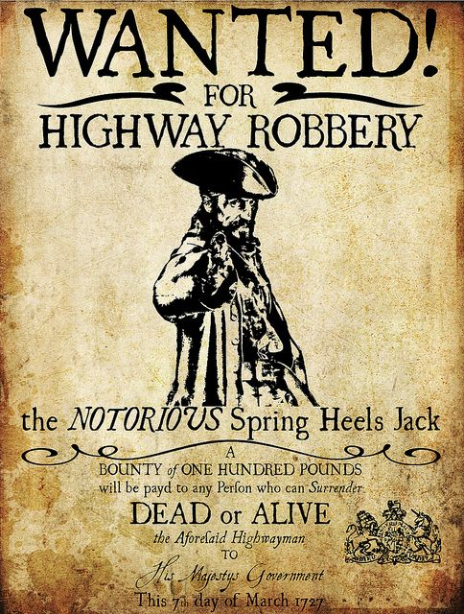

Slide 8
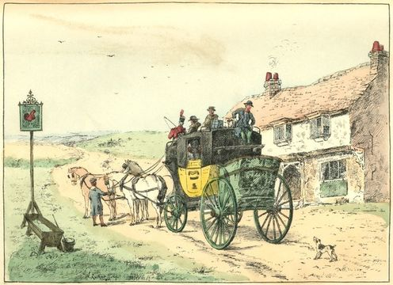
A Stage Coach outside a Coaching Inn

Slide 9
1750-1800
Turnpikes improved the state of the roads.
1750 the People Carrier ran each week between Shrewsbury and Chester.
1753 First regular weekly direct public transport service from Shrewsbury to London.
1773 Could get to London in 2 days.
1780s Services from Shrewsbury to Bath and Bristol set up.

Slide 10
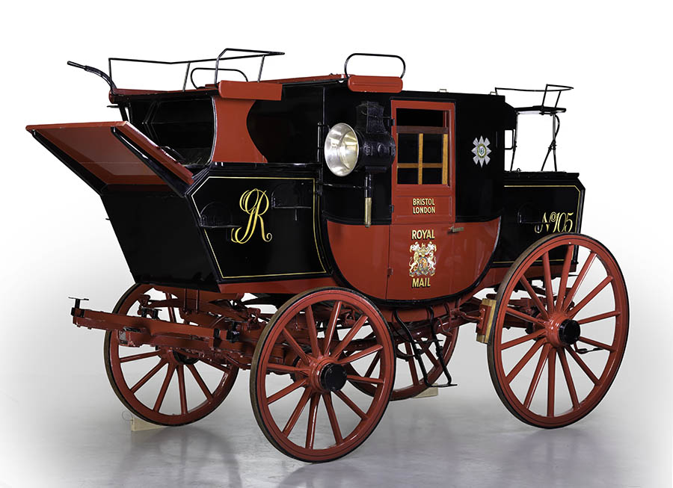

Slide 11
Mail Coaches
From 1784 mail was delivered by coach.
Mail coaches had 4 horses with seating for 4 passengers inside and one outside with the driver.
The mail was carried in a box at the back, protected by a Royal Mail guard.
This system was used until 1850 when the railways took over mail delivery.

Slide 12
To Operate a Coach Service to London
An inn with stabling facilities
4 stage coaches (one travelling north; one south plus two spares at each end)
152 horses (one horse per mile of route)
6 coachmen (each driving 50 miles a day)
4 guards (24 hours on duty, 24 hours off)
+ you had to pay stage coach tax and road tolls.

Slide 13
Robert Lawrence
Robert Lawrence owned the Lion Hotel from 1780 until his death in 1806.
The Lion became one of the most famous coaching inns in the country.
He introduced the London-Shrewsbury-Dublin mail coach, a huge economic boost for Shrewsbury.
He was responsible for Shrewsbury, rather than Chester, becoming the local centre for travel and trade.

Slide 14
Other Coaching Inns in Shrewsbury
The Raven Hotel, Castle Street (now demolished). Owned by Robert Lawrence until he moved to the Lion in 1780.
The Talbot Hotel, Market Street (formerly Loch Fyne restaurant).
The Unicorn, Wyle Cop (now Tanners Wine Merchants). Had 40 stalls and standing room for 200 horses.

Slide 15
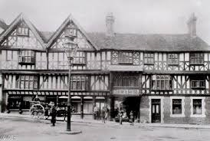
The Unicorn Hotel, Shrewsbury

Slide 16
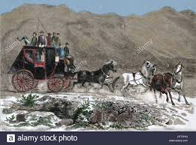
19th century stage coach

Slide 17
The Golden Age of Coach Travel
From the late 18th century until the end of the 1830s has been described as the golden age of coach travel.
In 1835, 23 coaches ran from Shrewsbury each day, 15 from the Lion and 8 from the Talbot.
200 horses were stabled in Shrewsbury each night and grooms could be seen washing them in the River Severn.

Slide 18
Isaac Taylor and Sam Hayward, of the Lion Hotel
Isaac Taylor ran the coaching business at the Lion and he was as influential in the 19th century as Robert Lawrence had been in the 18th.
Sam Hayward was the most famous coach driver at this time. He drove his coach, the Wonder, up Wyle Cop, turning full circle at the top to enter the Lion’s yard without stopping and only having inches to spare each side.
The Wonder went from the Lion to London in just 16 hours, with an average speed of 11 mph.

Slide 19
The Wonder
The Wonder was the most famous stage coach, but there were many others.
They all had distinctive names, such as the Defiance, the Retaliator, the Hero, the Salopian and the Nimrod.
The Wonder (from the Lion) and the Nimrod (from the Talbot) used to race each other, with bets being placed on who would win.

Slide 20
The Wonder Departs
“Before the hour all passengers were required to be in their places, all luggage had to be safely packed and as the chime of the first of the four quarters rung out from St Julian’s church tower, Richard Ash, the guard clambered to his place behind, the coachman took his seat on the box, and with this first stroke of the hour, the four well-groomed steeds dashed forward under the archway of the inn-yard, the horse cloths were removed with a flourish, the skid was put on as the corner was turned, and sharply went the heavy vehicle down the Wyle Cop” (Evason, Victorian Shrewsbury).

Slide 21
King’s Birthday Celebrations
On 28 May 1833, the official birthday of King William IV, eleven coaches belonging to the Lion paraded through the streets of Shrewsbury.
In 1836 there was a magnificent parade of 15 coaches with two bands of musicians.
There were no more parades after this, though, as the King died the next year and coaches were facing their greatest threat – railways.

Slide 22
Decline of Stage Coaches
The Grand Junction railway, from Manchester and Liverpool to Birmingham, which began in 1833, had a profound effect on Shrewsbury.
By 1841 the Wonder only went as far as Birmingham, with a reduced number of horses.
In the 1840s the railways and the stage coach companies worked together.

Slide 23
Final Days of Stage Coaches
Isaac Taylor kept the coaching business going at the Lion for 25 years after the coming of the railways.
The Talbot, however, could not cope with the railway competition. At an auction in March 1844, the sale included 10 black and grey post horses, with four sets of harnesses and a coach. This marked the end of the Talbot as a coaching inn, although it continued as a hotel until 1854.

Slide 24
Shrewsbury Chronicle, 27th July 1861
“Sale at the Lion, property of Mr George Curtis, 30 first-class coach or post horses, now engaged in working the Shrewsbury and Aberystwyth Mail and Coaches and well-known on the road for their fast pace and powers of endurance. Will be sold without reserve in consequence of the opening of a portion of the Welsh railway, and the retirement of Mr Curtis from working the Aberystwyth coaches.”

Slide 25
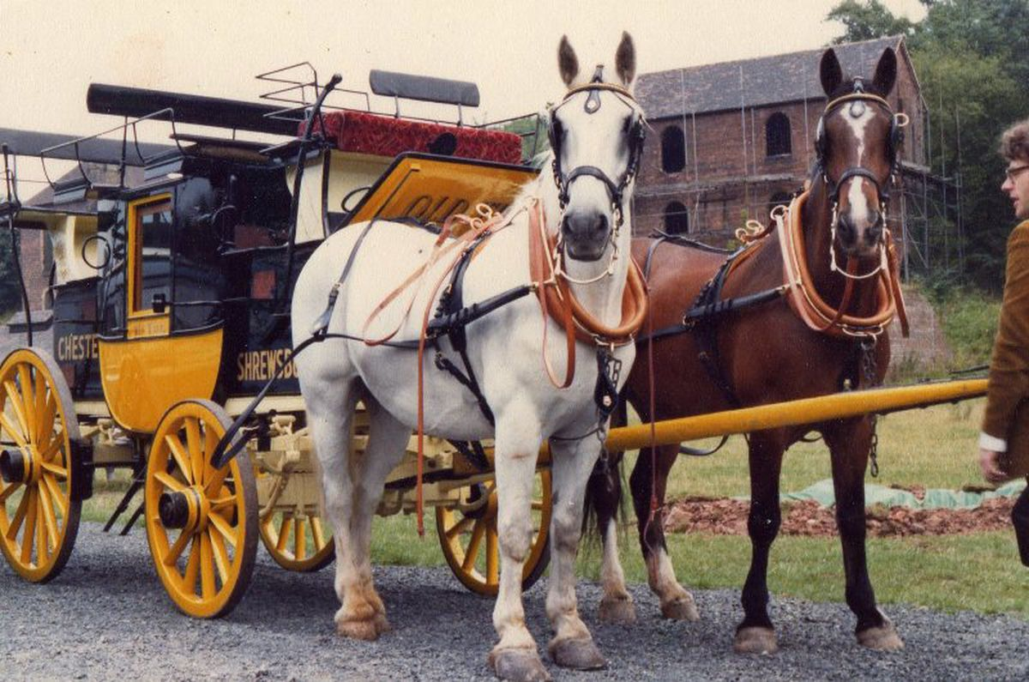
The “Old Times” Stagecoach

