Slide 1

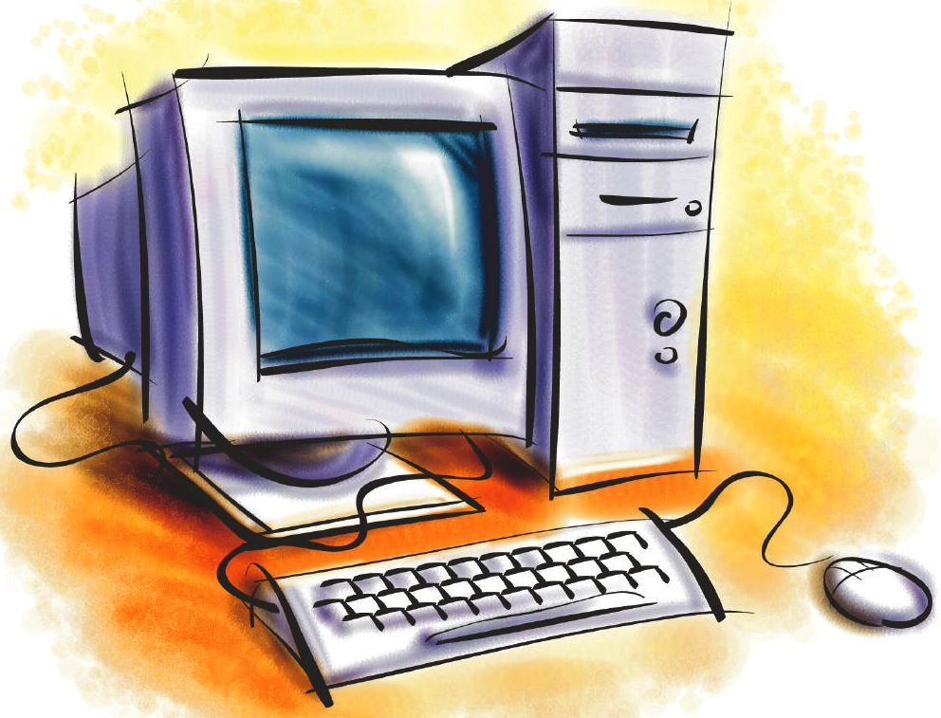
Understanding and Using
Google Calendars

Slide 2
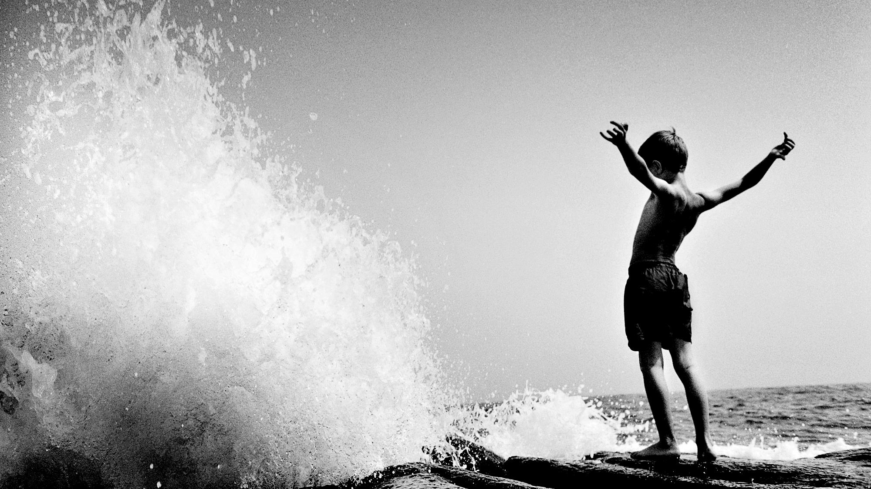
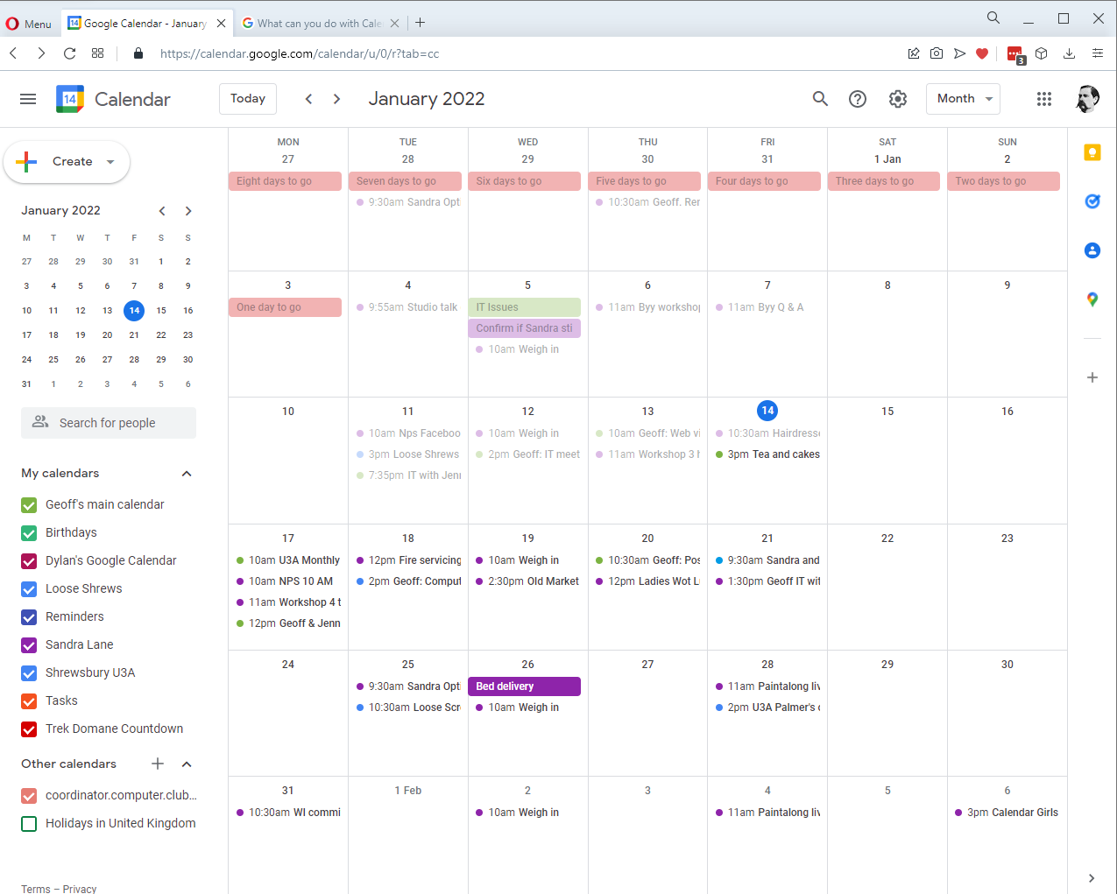
Reasons for a Google Calendar
Quick and easy to schedule meetings and events.
Get reminders about upcoming activities.
View on your phone, tablet or even TV.
Share with others.
View calendars that others have shared with you.
Create different calendars for different areas of your life. (Family, u3a, golf club etc)
View different views.
Works with PC, Android & IOS.

Slide 3
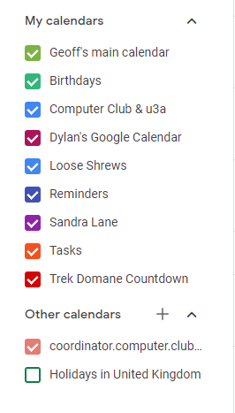
Create a Google Calendar
If you have a Google account, you will already have a default calendar
It is easy to create additional calendars – use different colours, view or not view & share.
Additional Calendars can only be created from a web browser, not the actual calendar App.
In the left hand pane, next to “Other Calendars” click the
“Add Other Calendars” + sign and then Create New Calendar.
Give it a name and Description – Job done!
First though, start here https://calendar.google.com/

Slide 4
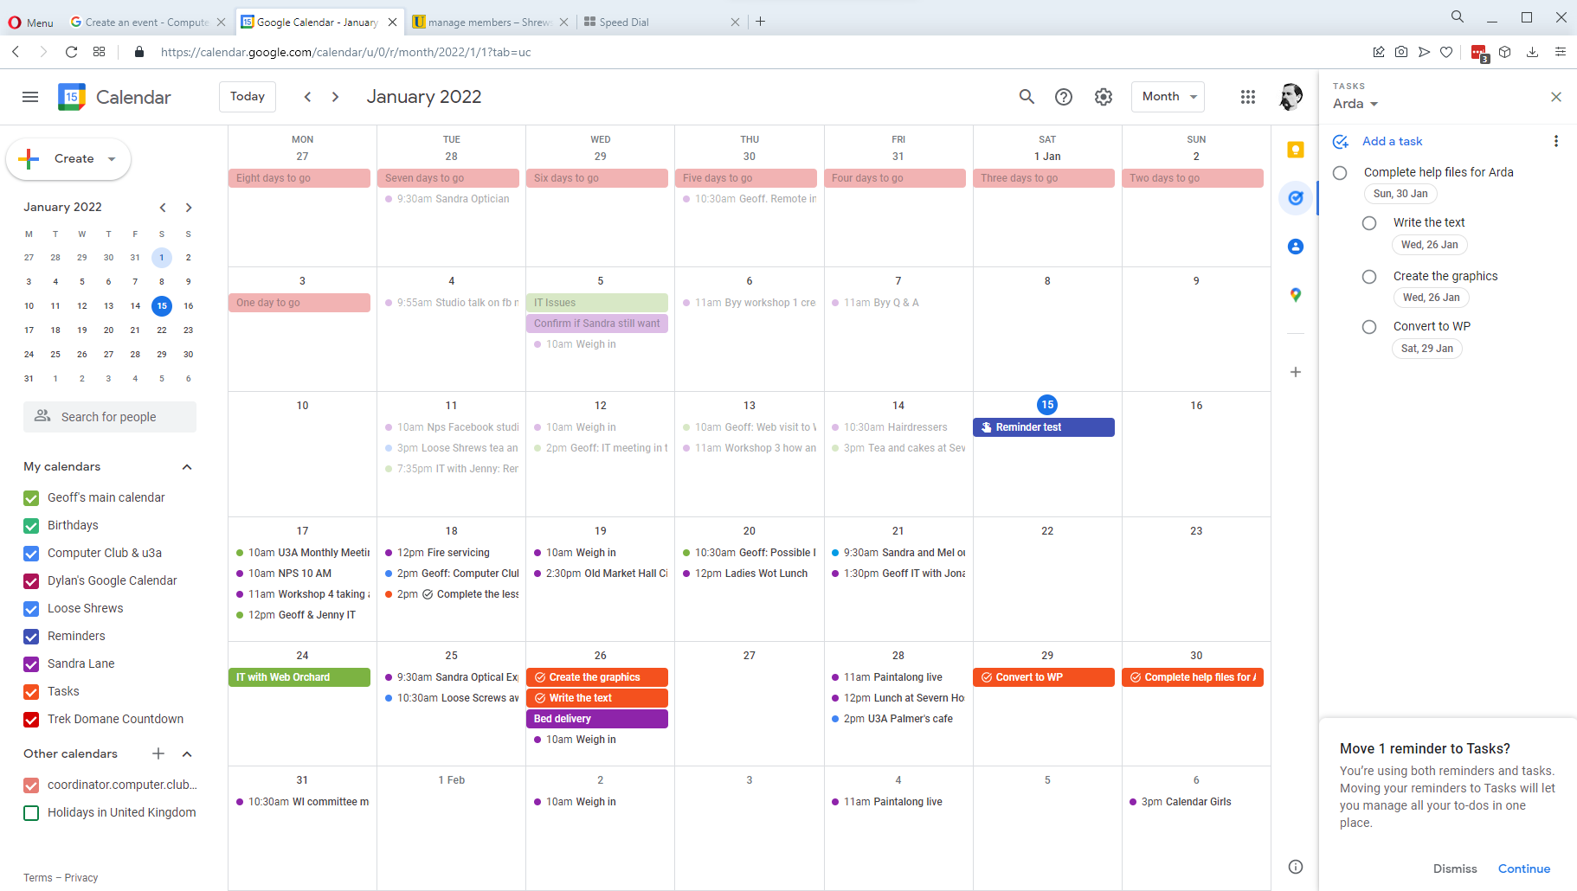
Different Views
The Default view for the PC version is Monthly view. Other views are available.

Slide 5
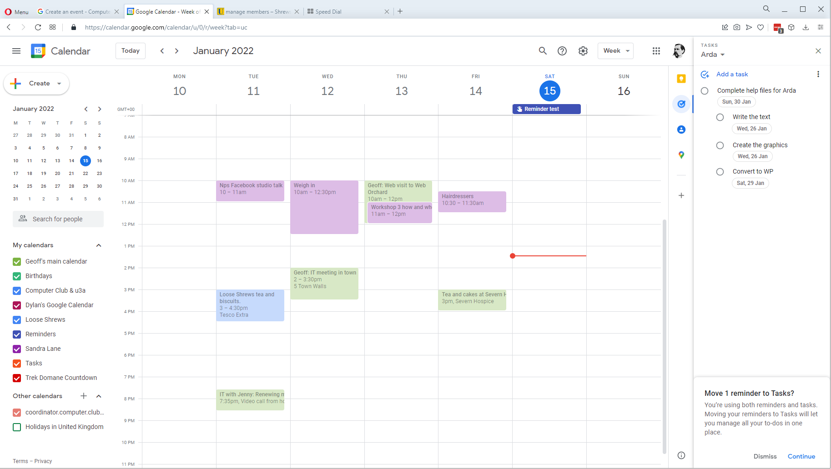
Different Views
Weekly view.

Slide 6
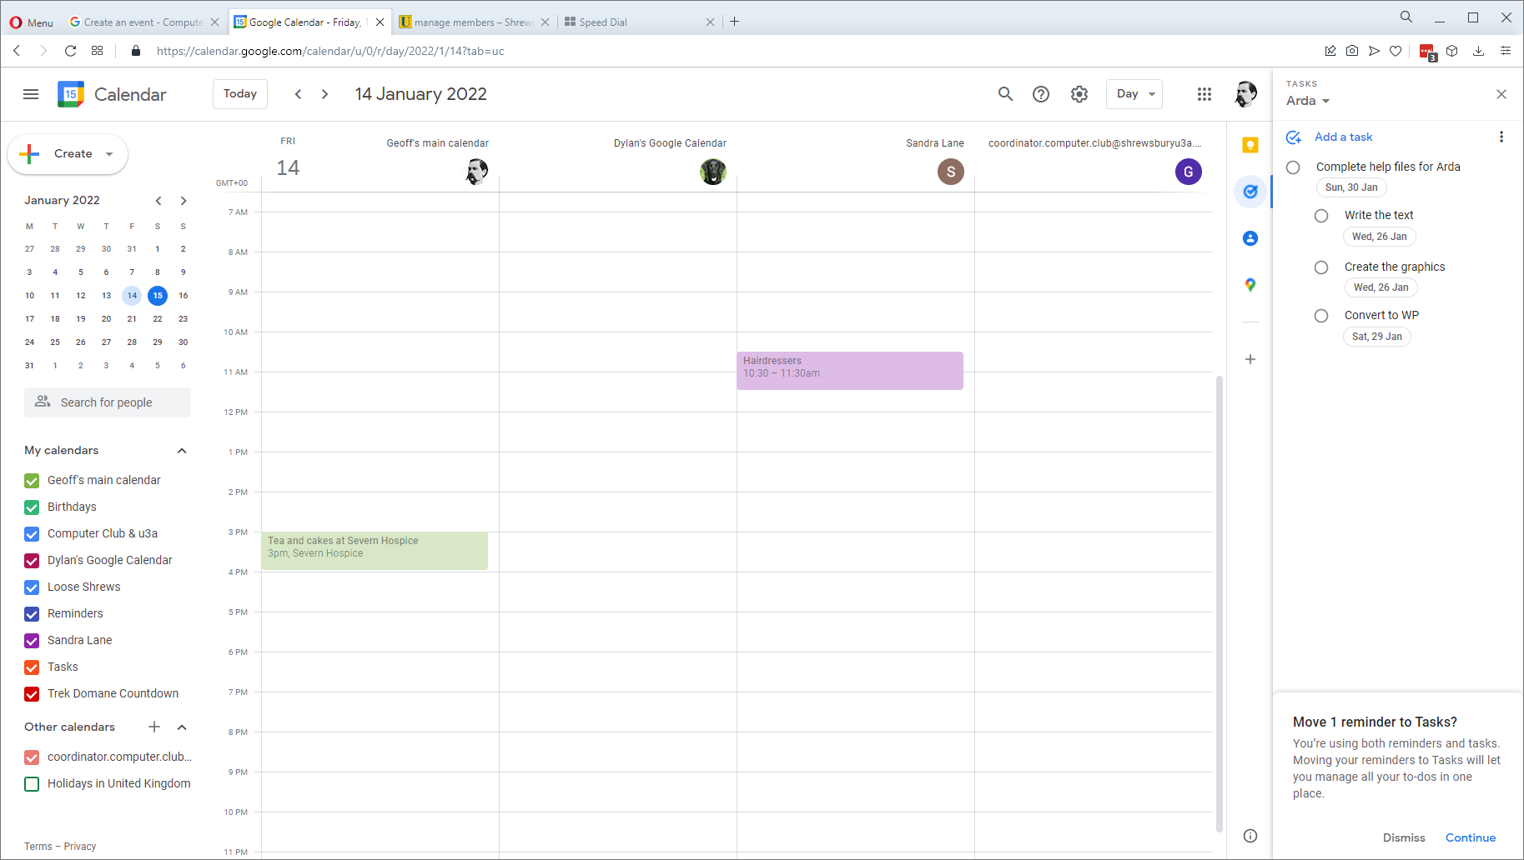
Different Views
Daily view.

Slide 7
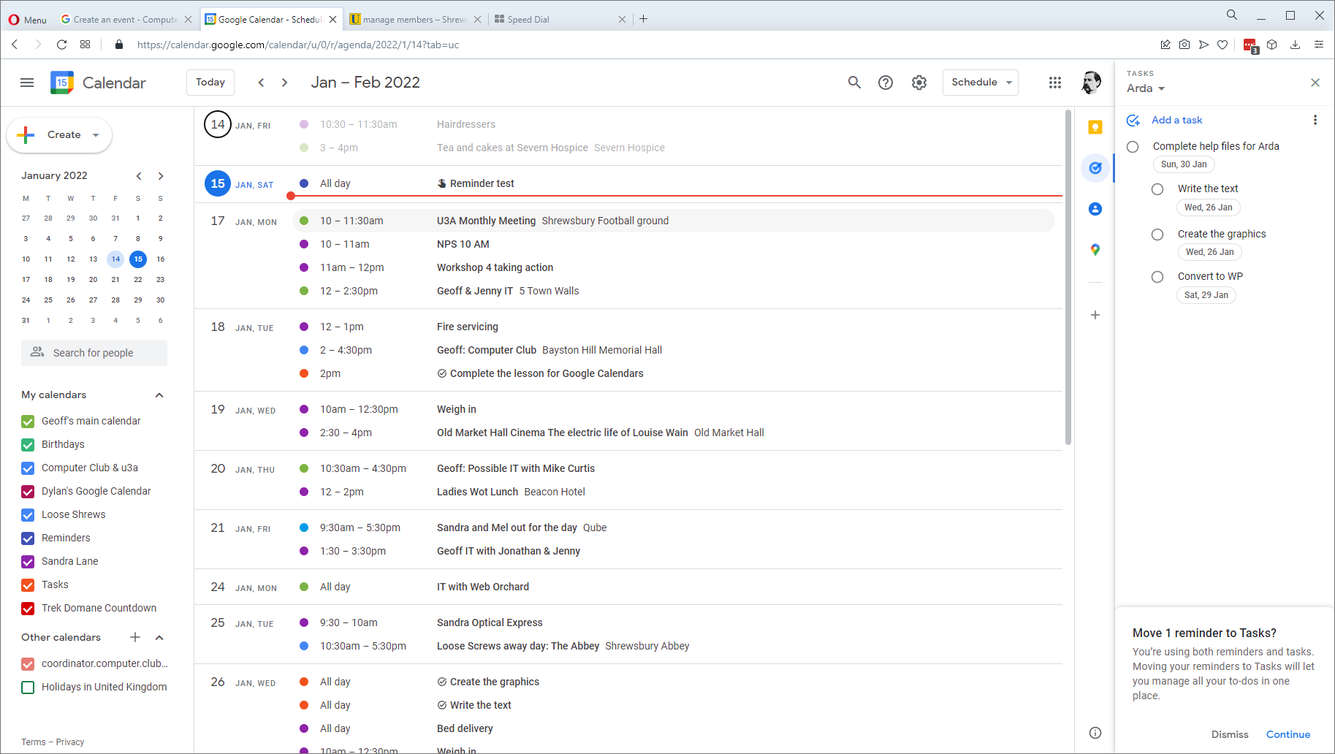
Different Views
Schedule view. Works well for your phone

Slide 8
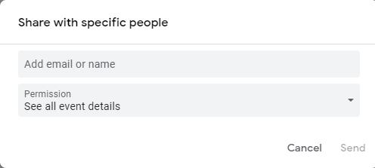
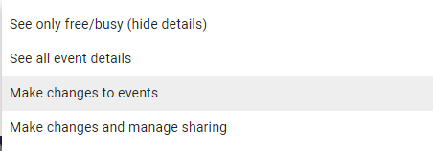
SHARE a Google Calendar
Sharing Calendars is a great way to keep your life organized. One thing my wife has embraced….. 🙂
Select the calendar in the left pane then the 3 dots & “Settings and Sharing”.
Make available to the Public(!) or “Share with Specific People”.
Add their email address.
Select their access levels.
Click send.

Slide 9
Create an Event
There are plenty of ways to create an event:
Click an empty time in your calendar.
Click the Create Button.
Click an empty date in your calendar.
From a Gmail message: Select the message, 3 dots, create event.
In a different Calendar: Start to create the event, near the bottom, select the
Calendar you want to use.

Slide 10
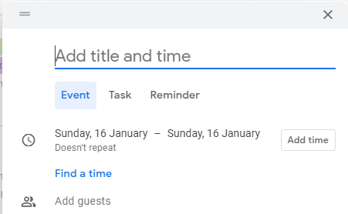
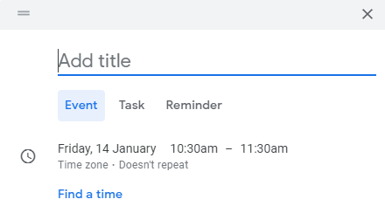
Create an “All Day” Event
Depending on your view: Monthly view “All Day” is
the default. (Click Add Time If you don’t want an
“all day” event.
Click the date and then select “All Day”.
Daily view, “All Day” is not the default. In which case start to create the event, and then click the time fields to edit the times.

Slide 11
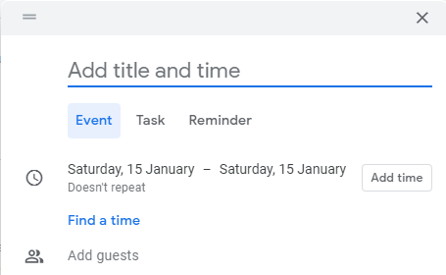
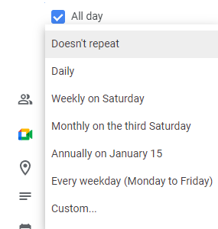
Create a REPEATING Event
By default, events are one only ie they do not repeat, it is possible to make them recurring events.
Click the “Doesn’t Repeat” link to select, either from predetermined dates or a custom repeat sequence.

Slide 12
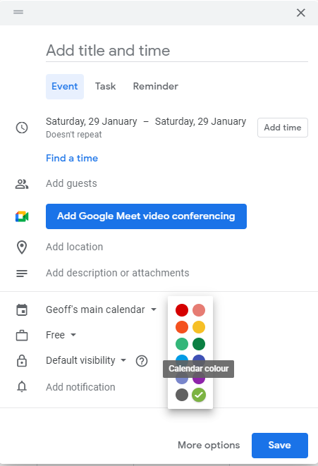
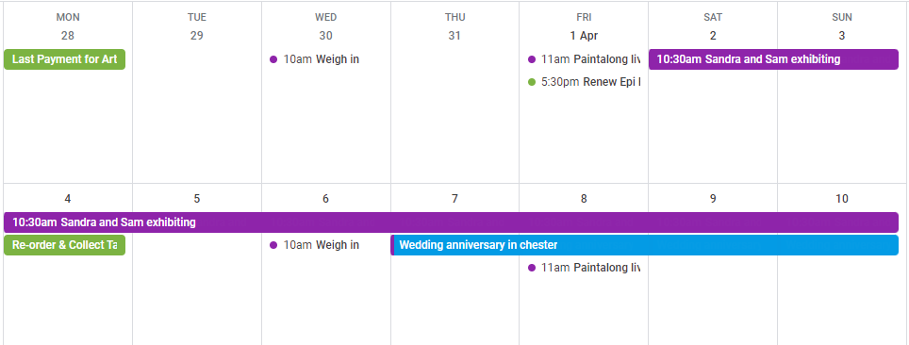
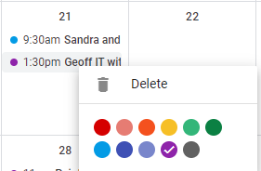
Give it some Colour
By default, events take on the colour of the calendar you are using, either in a coloured block for an all day event or a small dot for a timed event.
You can change the colour as you create an event, or right click to select a new colour for an event you’ve saved already.

Slide 13
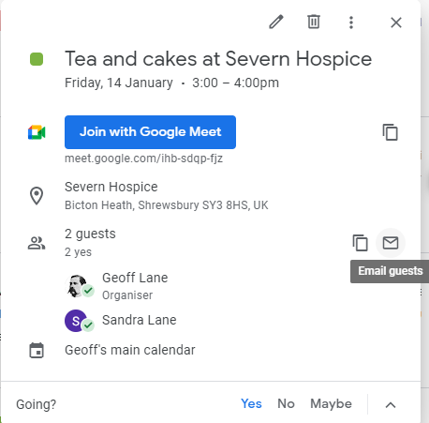
INVITING OTHERS, Notifications and Updates
When you create an event, you can invite others. The system will automatically send them an invite when you save the event. (Next Slide) You can if you wish, email them as well.
If you change any details of the event, any changes you make will be reflected on their calendars. As before, you could email them as well if you wish to make it a bit more personal.
Google Calendar all always send notification emails to guests who don’t use Google calendar.
In my screenshot here, both myself (the organizer) and the guest – the lovely Sandra Lane have accepted and agreed to go – Little green tick.

Slide 14
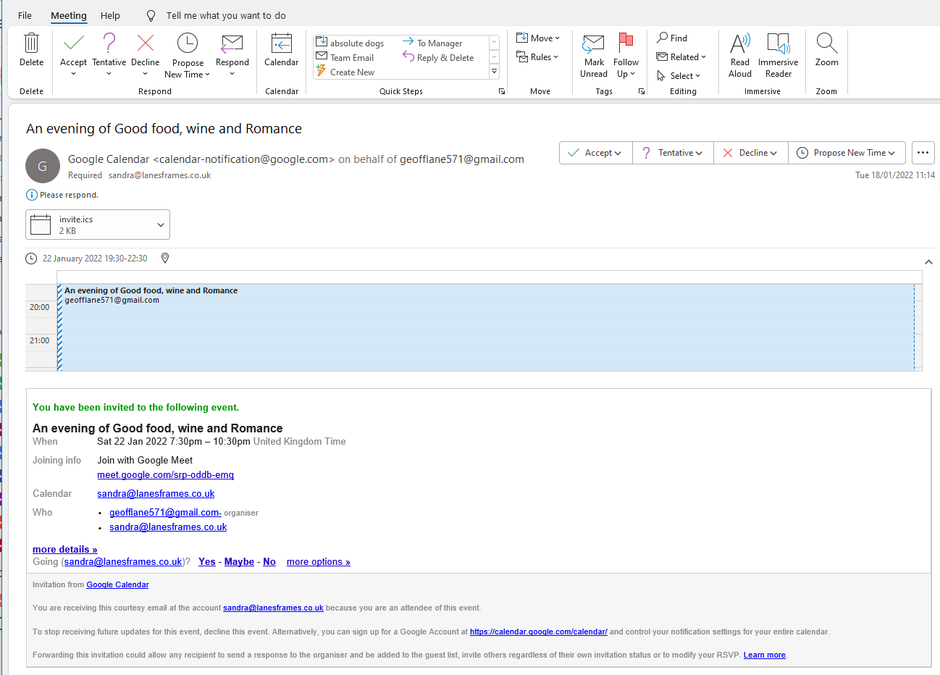

Slide 15
Events, Tasks or Reminders
By default, when you create a new entry on your calendar it is an “Event” ie is scheduled for a certain day or day and time. A regular calendar entry.
Tasks allow you to have multiple items to be done with subtasks. These show up in the right -hand panel and the calendar. You can have different sections.
Reminders are initially set for a date/time. At the scheduled time they appear as a pop-up in your Browser window. Right click the reminder in your calendar to mark it as done.
If it is not marked as done, it will Remind you again tomorrow!
Google suggests moving Reminders to Tasks if you are using both.

Slide 16
Your Actions:
I have a calendar “Shrewsbury U3A.” Give me your email address and I will share it with you – so that you don’t need to worry about putting it in your calendar.
Create an event and invite others from our group. (Add the words “Test” in there somewhere, so they don’t actually turn up)!
Create a Reminder to actually do something. Renew Insurance, clean the guttering etc.
Change the colour of your whole calendar
Change the colour of an event
*******************
WiFi: Memorial Hall_guests. PW: 7F&3CB4P8C

