Slide 1
Robert Clive
1725 - 1774

Slide 2
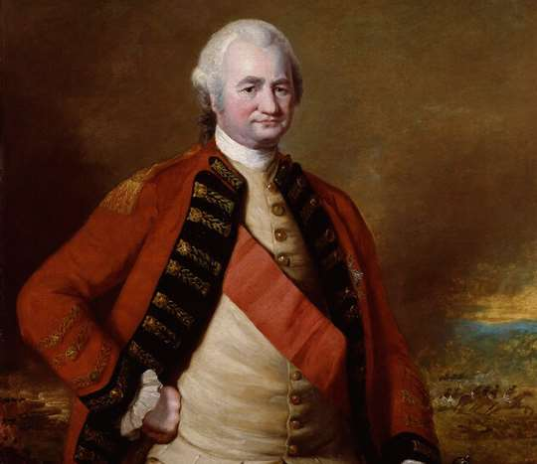

Slide 3
Born 1725 at Styche near Market Drayton
Small estate had belonged to Clive family for 500 years
Father in debt
Robert eldest of 13 children
At age 3, sent to aunt in Manchester
Became ill, and had problems with his health during rest of his life

Slide 4
Not a good pupil, teachers despaired of him
Always getting into fights
Returned to parents at age 10
Climbed church steeple
Led a gang of boys in protection racket
Early traits: energetic, risk-taking, impulsive, stubborn, leadership

Slide 5
At age 18, joined East India Company
Sent to Madras – Fort St. George
Clerk, poorly paid, quarrelsome, in debt and depressed
French East India Company based at Pondicherry
French led by Dupleix – Clive’s arch-rival
Dupleix ambitious to expand French control in India

Slide 6
Moghul empire disintegrating and Indian rulers fighting amongst themselves
Dupleix took Madras from British
Clive became a soldier of East India Co.
Suffered from depression and gallstones, took opium
1751 at age 26 Clive took Arcot to draw Nawab and Dupleix away from Trichonopoly and then defended it against seige

Slide 7
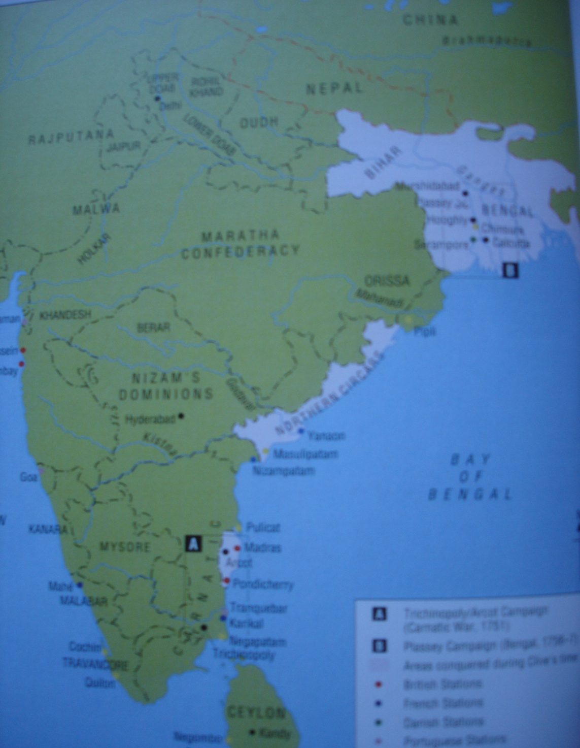

Slide 8
Clive became famous, had large personal fortune, married Margaret, sister of his friend Edmund Maskelyne, and returned to England
He paid off his father’s debts and bought a house in London
He maintained a lavish lifestyle
Clive failed to become MP and had spent all his money
1754 - He returned with Margaret to India as Governor of Fort St. David and left his two sons behind

Slide 9
1756 Nawab of Bengal, Siraj-ud-dowla, took Calcutta from British
Black Hole of Calcutta
Clive recaptured Calcutta 1757
Clive defeated Siraj-ud-dowla at Plassey
He became rich as Governor of Bengal
1760 returned to England, rich and famous

Slide 10
1761 Clive elected MP for Shrewsbury
He faced opposition from East India Co. and dealt with it
1764 He returned to India as Governor of Bengal
During the next year, he took over Bengal, made treaties with the Indian rulers and put down an army rebellion
He increased land tax
But the strain affected his health badly and in 1767 he returned to England

Slide 11
He faced opposition and envy – a Nabob
His houses: Berkeley Square, Walcot in Shropshire, Claremont in Surrey (he never lived there), Oakly Park near Ludlow
Conditions in Bengal deteriorated. 1770 famine, one third of population died
Clive had to face attacks from a Select Committee of MPs
He was made Lord Lieutenant of Shropshire in 1772

Slide 12
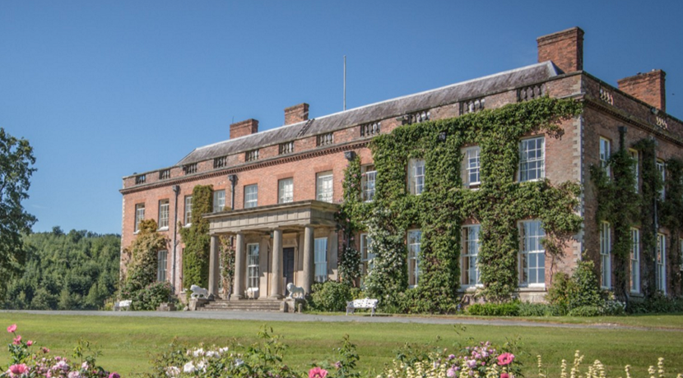
WALCOT HALL

Slide 13
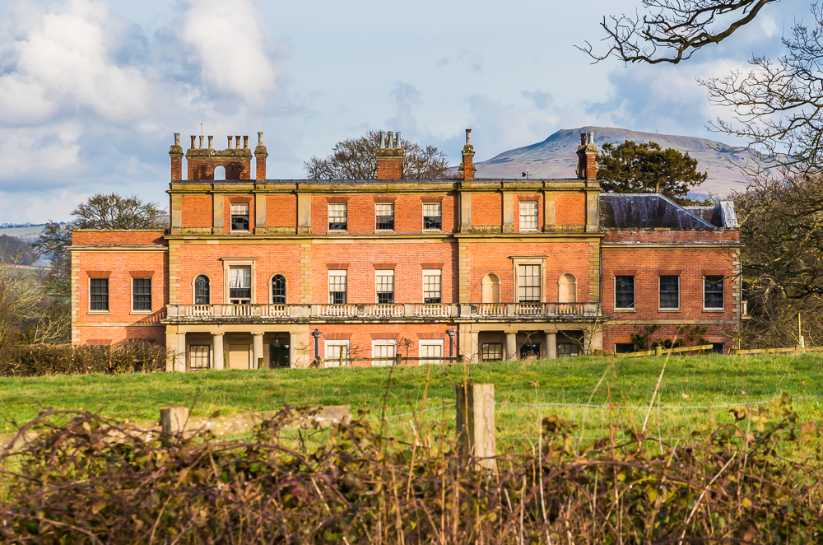
OAKLY PARK

Slide 14
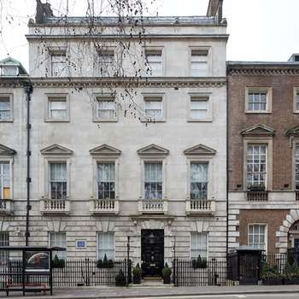
45 Berkeley Square

Slide 15
Clive’s health deteriorated and he took increasing amounts of drugs
He died November 1774 probably of an overdose of laudanum, although rumours of suicide
He was buried in secret at Moreton Say church
His eldest son Edward, then 20, later became Earl of Powis by marriage to Lady Henrietta Herbert, and lived at Powis Castle

Slide 16
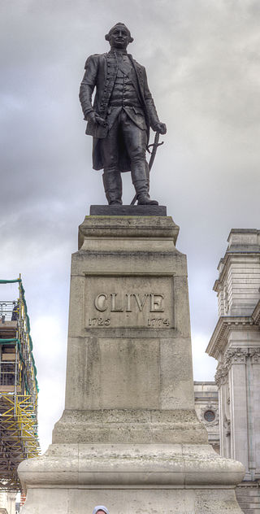
Statue of Clive in Westminster

Slide 17
QUESTION
How do we view Robert Clive now ?
Was he a hero ?
Or was he, in the words of Simon Schama, “a sociopathic, corrupt thug” ?

