Slide 1
Keeping Organised

Slide 2
A Problem experienced recently
Couldn’t log into a Microsoft account – not sure of the password
Clicked the reset password link
Asked for confirmation of mobile number, phone number not the same as they had because the mobile had been changed, new sim card plus new number.
The Microsoft site did allow us to change the mobile number
But not for …… how long do you think before it became effective?

Slide 3
Working with online accounts
They have a duty to keep your data safe.
You have a duty to safeguard your details.
The more ‘other’ means of contact you can provide, the better.
Mobile Telephone, Landline, Partners Mobile No, different email address/es.
The average user has 150 online accounts (2017) expected to rise to 300 by 2022. Not all accounts are as important as others.

Slide 4
The important ones
Any banking institution
Microsoft
Apple
Google
Social Media

Slide 5
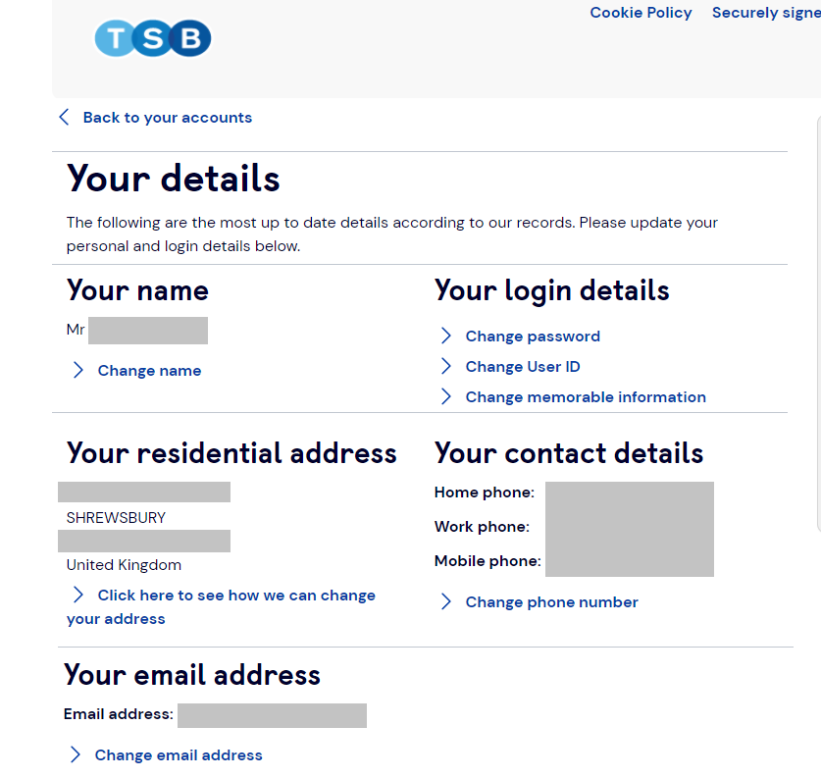
A Bank

Slide 6
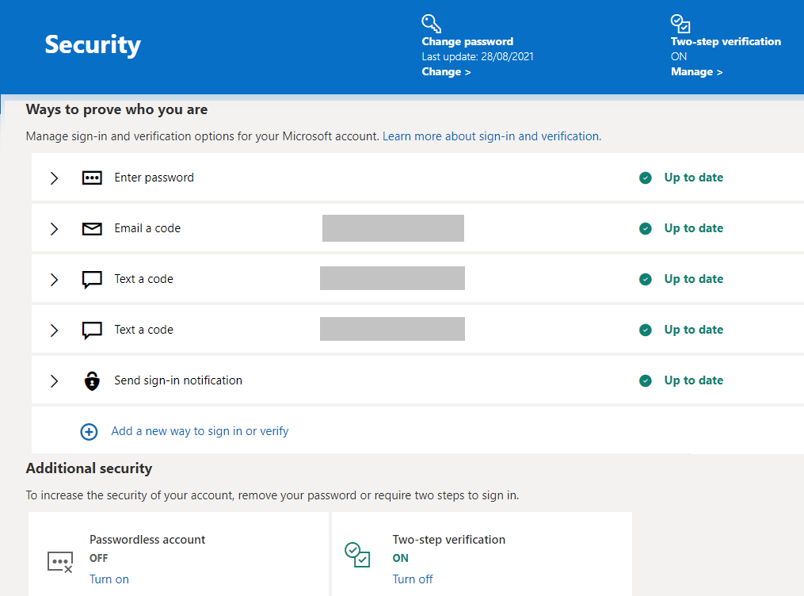
Microsoft

Slide 7
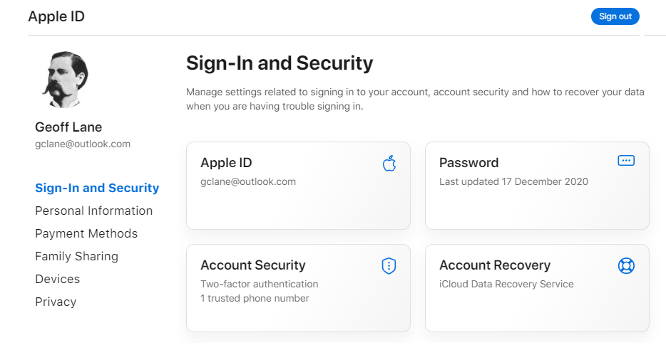
Apple

