Slide 1
WiFi Network: Memorial hall_guests
Password: 7F&3CB4P8C
https://www.security.org/how-secure-is-my-password/
Notes:
Log on to the wifi network
*****
Visit the website address and enter in a selection of your passwords. Make a note of the longest time and the shortest time that you see.

Slide 2


Password Security
This Photo by Unknown Author is licensed under CC BY-SA
Notes:
Today we are going to look at Password Security.
What makes a good password
What makes a terrible password
How secure are my passwords
And Password Managers

Slide 3
Logins or usernames

Slide 4
A password is only half of the story, you also need a login or username.
A username might be your name or email address – both of these are easy to obtain….. and with that
A hacker will have half of your security information.
Notes:
A password is only half of the story, you also need a login or username.
***** A username might be your name or email address – both of these are easy to obtain and with that
***** they have half of your security information.

Slide 5
Wherever possible, change your login name to something different, something that only you will know.
This way, you immediately, massively, enhance your security effectiveness.
Notes:
Where-ever possible, change your login name to something different, something that only you will know.
***** This way, you immediately and massively enhance your security effectiveness.

Slide 6
Security Questions
Please answer the following security questions

Slide 7
Many Security Questions are of the
Mother’s maiden name,
your 1st school,
your first car,
place of birth etc.
Before social media these type of questions were adequate.
Notes:
Many Security Questions are of the Mother’s maiden name,
your 1st school, your first car, place of birth etc.
***** Before social media these type of questions were adequate.

Slide 8
Nowadays you might belong to a facebook group for “St Johns Primary School”
or you might have your family tree on Ancestry.com made public and so on.
It is much easier to discover this kind of information than it was previously.
Notes:
Nowadays you might belong to a facebook group for “St Johns Primary School” or you might have made public, your family tree on Ancestry.com and so on.
***** It is much easier to discover this kind of information than it was previously.

Slide 9
The answer? Make them up! As long as the string of characters match it doesn’t matter what you put.
Your first school? Eton college.
Place of birth? Buckingham Palace.
Mount Everest!
No one will know if you don’t tell them.
Notes:
The answer? Make them up! As long as the characters match it doesn’t matter.
***** Your first school? Eton college.
***** Place of birth? Buckingham Palace. Mount Everest!
***** No one will know if you don’t tell them.

Slide 10
How secure is my Password?
Notes:
So how secure is your password. It’s open to a number of different types of attack.

Slide 11
Types of HaCK or ATTACK
Local or Personal attack
Dictionary attack
Full blown Brute Force (FBI or MI5/MI6) attack
Notes:
There are 3 main types of attack:
***** Local or Personal attack: Loved by detective and whodunnit films. Someone sitting at your desk looks around and sees the picture of the dog Spotty, they put Spotty in the PW box and job done, they have hacked it!
***** Dictionary attack: Lists of dictionary words and login names, they check (loop) each login name for all the dictionary words and then go onto the next login name until a match is found.
***** Full blown attack: every character and every combination of characters on the keyboard is checked against each other.

Slide 12
How secure is my password
Numbers 0-9
2 – 100. 3 - 1000. 4 - 10000 combinations.
26 letters of the alphabet
2 - 675. 3 – 17,500. 4 – 450,000. roughly
94 Keyboard characters
2 – 9000, 3 – 830,000. 4 – 80,000,000 roughly
The longer the better – it goes up exponentially.
Notes:
On my keyboard there are 10 digits, 26 lowercase letters, 26 uppercase letters and 33 special characters. Total 95. Do not use the ‘space’, therefore you have effective 94 characters to choose from.
***** Numbers 0-9 2 – 100. 3 - 1000. 4 - 10000 combinations.
***** 26 letters of the alphabet 2 - 675. 3 – 17,500. 4 – 450,000. roughly
***** 94 Keyboard characters 2 – 9000, 3 – 830,000. 4 – 80,000,000 roughly
***** Goes up exponentially as you add another character – the longer the better

Slide 13
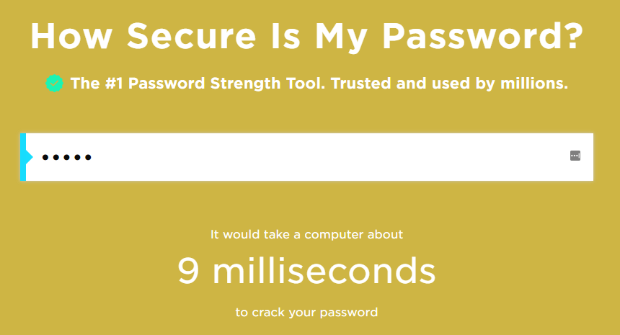
Notes:
The background changes colour as the security increases

Slide 14
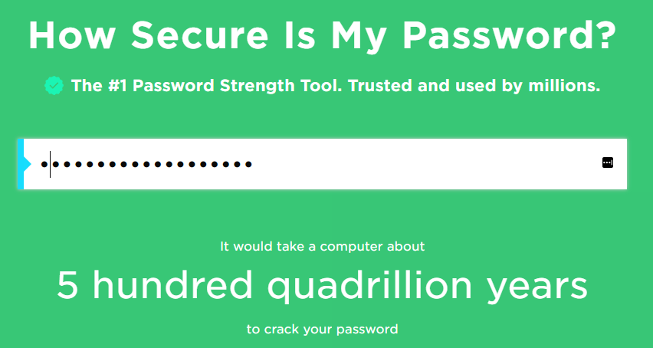
Notes:
19 characters

Slide 15
How to create a secure Password

Slide 16
A couple of facts
Nearly 50% of all passwords currently being used today can be cracked in seconds due to them be very weak.
Another 45% can be cracked within a few hours.
Only around 5% of passwords offer any real challenge, and given that computers today can make millions of guesses per second, it would not take long to crack many of these also.
Notes:
In fact, around half of all passwords currently being used today can be cracked in seconds due to them be very weak,
***** and another 45% can be cracked within a few hours.
***** Only around 5% of passwords offer any real challenge, and given that computers today can make millions of guesses per second, it would not take long to crack many of these also.

Slide 17
It is better to have a longer simple password than a shorter complex password.
Microsoft officially recommend 14 characters as its minimum.
Doesn’t Rely on Obvious Substitutions: For example, “H0use” isn’t strong just because you’ve replaced an o with a 0. That’s just obvious.
PassPhrases are generally better than passwords because they are much longer.
A PassPhrase is a combination of about three to five completely unrelated words.
Notes:
It is better to have a longer simple password than a shorter complex password.
***** Microsoft officially recommend 14 characters as its minimum and Wikipedia recommend 12 to 14 characters.
***** Doesn’t Rely on Obvious Substitutions: Don’t use common substitutions, either — for example, “H0use” isn’t strong just because you’ve replaced an o with a 0. That’s just obvious.
***** PassPhrases are generally better than passwords because they are longer.
***** A PassPhrase is a combination of about five unrelated words.

Slide 18
One way to create a password is to take the initial letters of a simple phrase
Jack and Jill went up the hill to fetch a pail of water
becomes JaJwuthtfapow
To add in symbols and numbers, take the a in ‘and’ and substitute it for an & (special character) and the ‘o’ for a 0 (number) – this substitution doesn’t necessarily make it stronger, but is on the way to conform to formatting requirements.
You now have J&Jwuthtfap0w – adequate for most needs.
Notes:
One way to create a password is to take the initial letters of a simple phrase
***** Jack and Jill went down the hill to fetch a pail of water
***** JaJwdthtfapow take the a in ‘and’ and substitute it for an & (special character) and the ‘o’ for a 0 (number – this substitution doesn’t necessarily make it stronger, but does add required number/s)
***** You now have J&Jwsthtfap0w – adequate for most needs.

Slide 19
How about from a Hymn
I vow to thee my country all earthly things above. Ivttmcaeta.
Split it in the middle to add some numbers, say 4 perhaps – year of birth maybe YYYY or a DDMM or MMYY for something that you can easily remember.
Ivttm1954caeta
Add in some special characters #Ivttm1954caeta+ Eh voila
Notes:
How about from a Hymn
I vow to thee my country all earthly things above. Ivttmcaeta.
***** Split it in the middle to add some numbers, say 4 perhaps – year of birth maybe YYYY or a DDMM or MMYY for something that you can easily remember.
Ivttm1954caeta
***** Add in some special characters .Ivttm1954caeta+ Eh voila

Slide 20
Pass Phrases
A PassPhrase – a combination of about 3-5 completely unrelated words - is not necessarily more complicated than a regular strong password, but it is easier to remember and stronger by virtue of it’s length >than 20-25 characters.
There are PassPhrase lists to help you generate a suitable PassPhrase, easier is to open a dictionary and stab your finger somewhere on the page!
You might end up with clink, photo, sweep, group & chain.
Notes:
A PassPhrase is not necessarily more complicated than a regular strong password, but it is easier to remember and stronger by virtue of it’s length >than 20-25 characters.
***** There are PassPhrase lists to help you generate a suitable PassPhrase, but the easiest way is to open the dictionary at a random page and stab your finger somewhere on the page!
***** You might end up with clink, photo, sweep, group & chain.

Slide 21
Pass Phrases
Your passphrase becomes clinkphotosweepgroupchain
Add in some capitals, say the 2nd letter of each word cLinkpHotosWeepgRoupcHain
Separate the words with a special character or set of characters
cLink-pHoto-sWeep-gRoup-cHain
Add in some numbers cLink-1pHoto-9sWeep-5gRoup-4cHain and you have a really secure password! This might be too far!!
Notes:
Your passphrase becomes clinkphotosweepgroupchain
***** Add in some capitals, say the 2nd letter of each word cLinkpHotosWeepgRoupcHain
***** Separate the words with a special character cLink-pHoto-sWeep-gRoup-cHain
***** Add in some numbers cLink-1pHoto-9sWeep-5gRoup-4cHain and you have a really secure password!

Slide 22
Changing Passwords
Take “Adequate Precautions”.
For online Banking passwords, I recommend you change it every six months.
You might keep your ‘regular’ password but add some sort of date code to it. I added 4 digits to mine in the format MMYY. “xxxxxxxxxxMMYY”
Notes:
I have learnt that some Banks have refused to compensate some customers when hacked because there weren’t taking ‘adequate’ precautions for their online banking security. The reason? They created a password when they setup their online banking and have never changed it since.
***** For online Banking passwords, I recommend you change it every six months.
***** You might keep your ‘regular’ password but add some sort of date code to it. I added 4 digits to mine in the format MMYY. xxxxxxxxxxMMYY

Slide 23
Changing Passwords
If you make the MMYY the 6 month point in the future, then you will know when to change it when the time arrives. So, if we changed it today, the 6 month point would be xxxxxxxxxx0922
(Sep – the 09th month and 22 for 2022).
If you change it in Apr May or Jun & Oct, Nov or Dec then you will always get at least two numbers to change.
Notes:
If you make the MMYY the 6 month point in the future, then you will know when to change it when the time arrives. So, if we changed it today, the 6 month point would be xxxxxxxxxx09 (Sep – the 9th month and 22 for 2022).
***** If you change it in Apr May or Jun & Oct, Nov or Dec then you will always get at least two numbers to change.

Slide 24
Make everything unique

Slide 25
Make them different, make them unique
Many people use the same password for every occasion, this is a mistake. Ideally, everyone should be different.
One way is a take your regular or base password and add a few extra characters – 3 is a good number, to make it unique. Make the extra characters specific to the website or service you are using so that you can easily remember it.
This works for logins and usernames too.
Never use/tick ‘Remember me’.
Notes:
***** Many people use the same password for every occasion, this is a mistake. Ideally, everyone should be different.
***** One way is a take your regular or base password and add a number of characters – 3 is a good number to make it unique. Make the extra characters specific to the website or service you are using so that you can easily remember it.
***** This works for logins and usernames too.
***** Never use the “Remember Me” option.

Slide 26
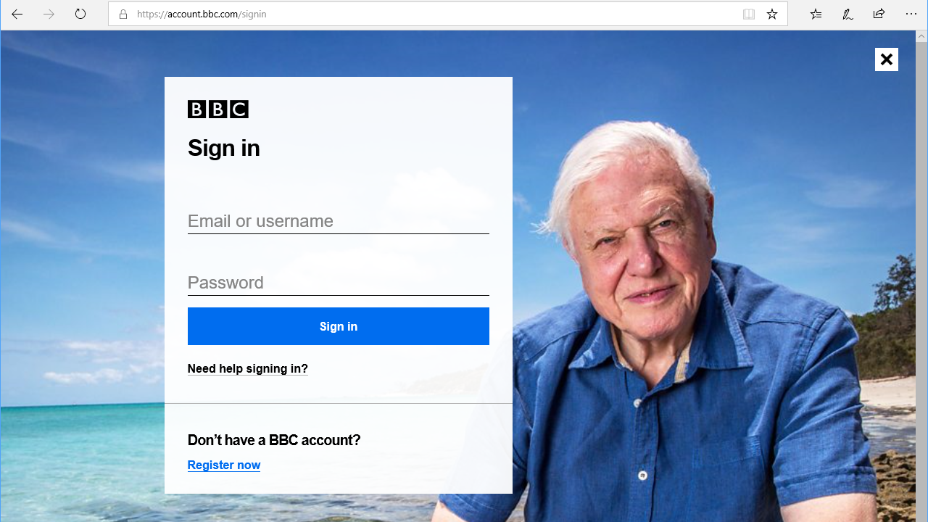
Notes:
BBC

Slide 27
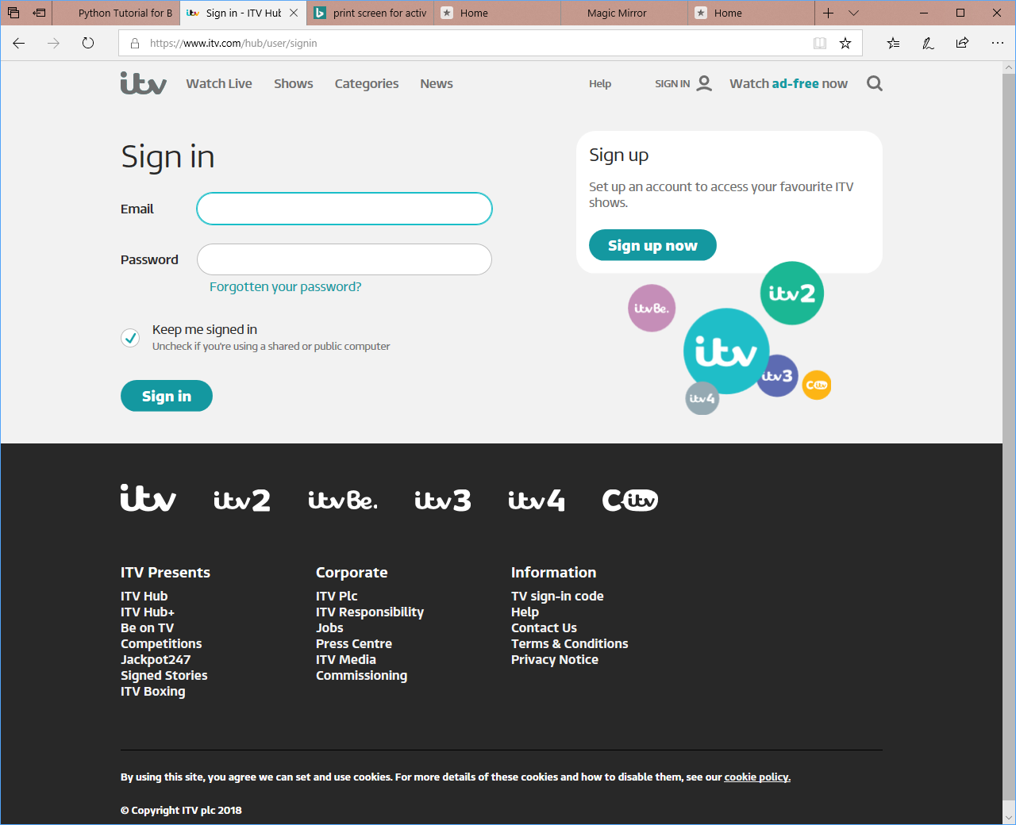
Notes:
ITV

Slide 28
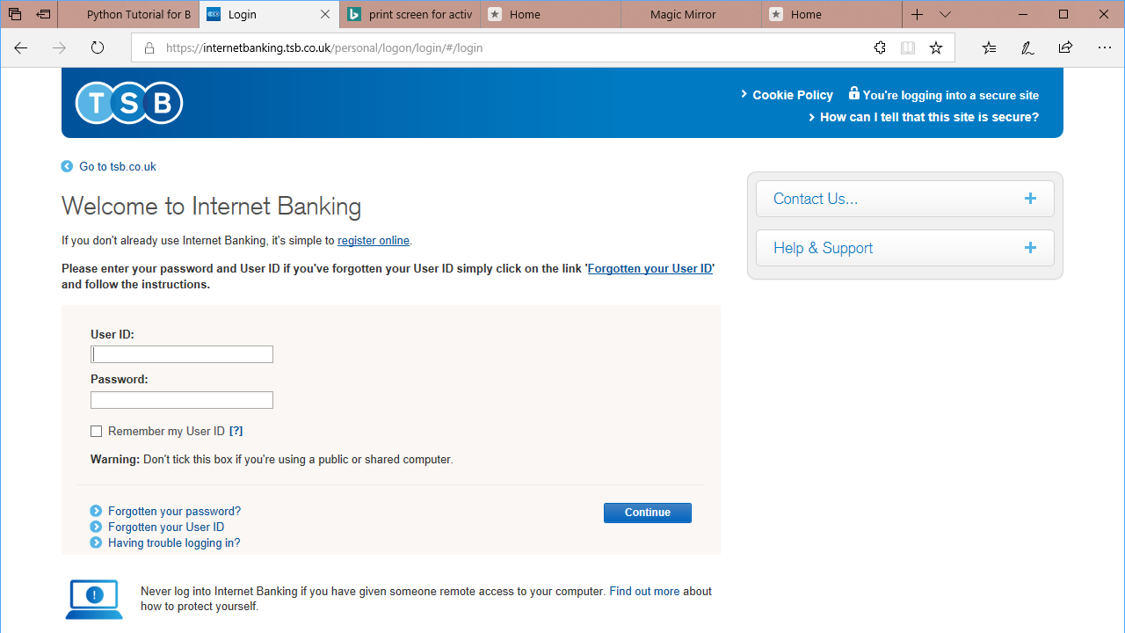
Notes:
TSB

Slide 29
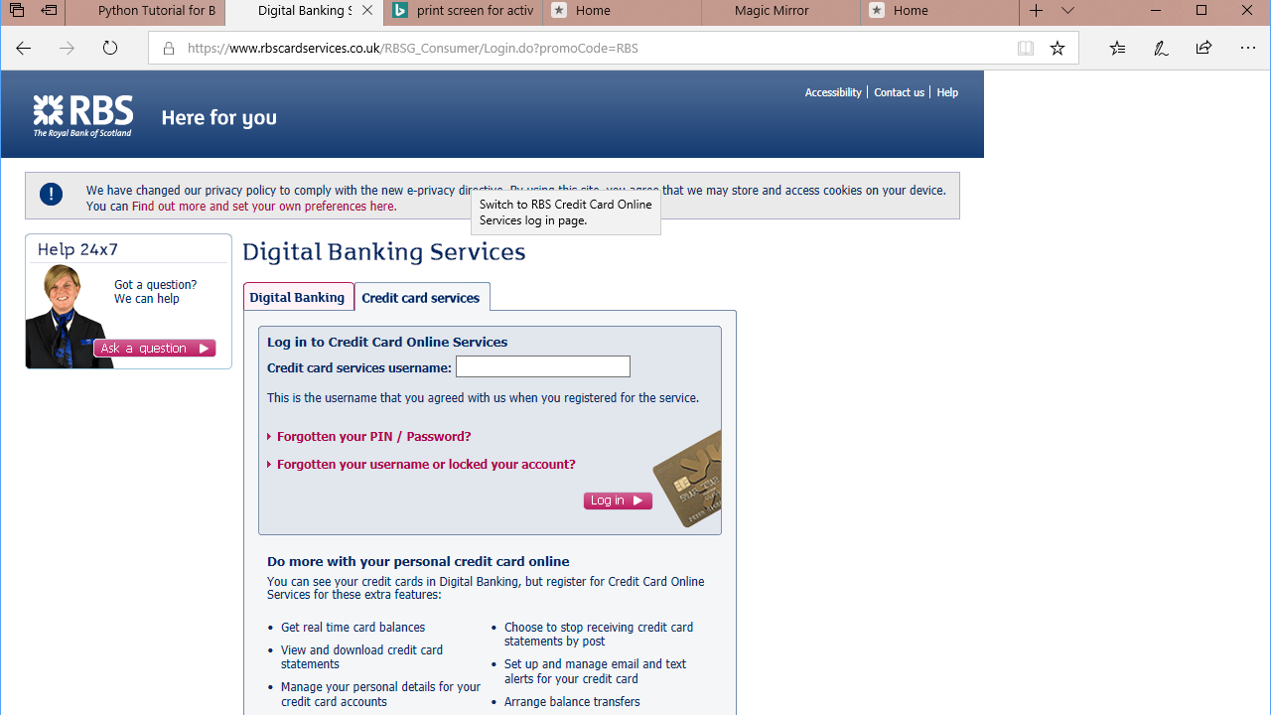
Notes:
RBS

Slide 30
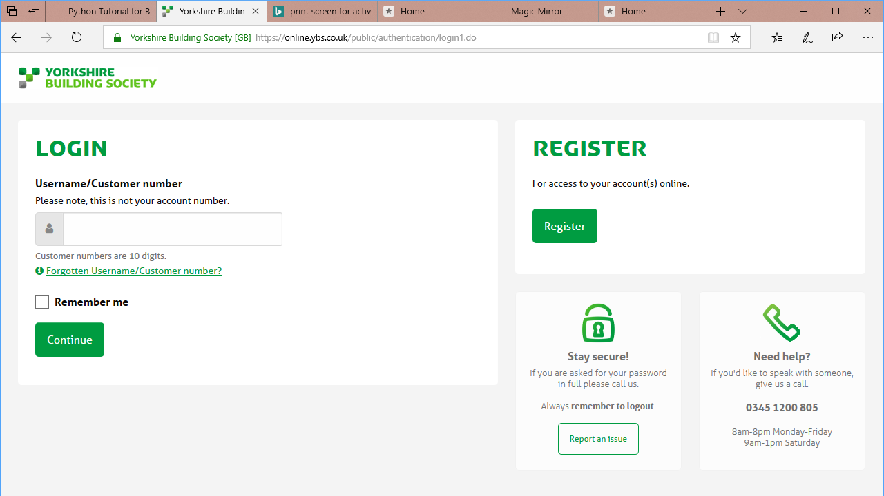
Notes:
YBS

Slide 31
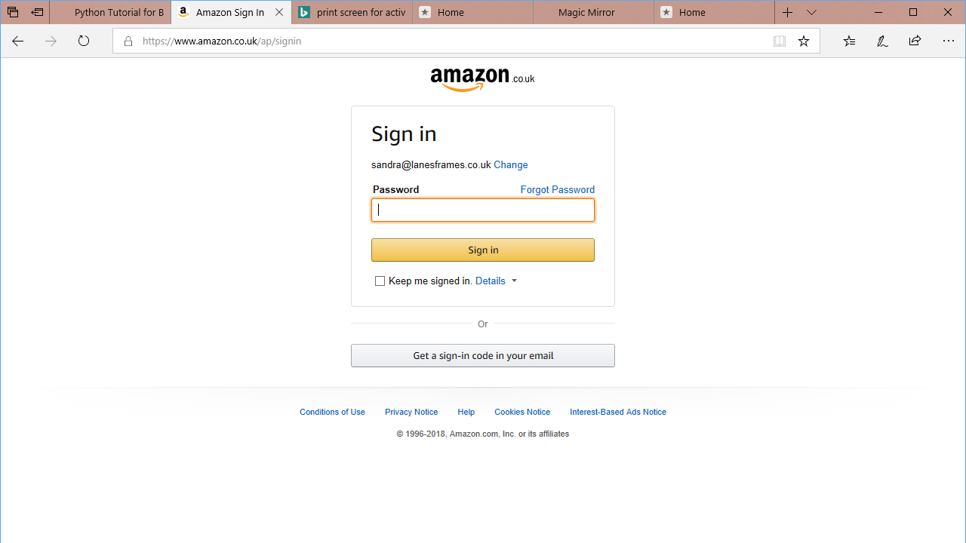
Notes:
Amazon

Slide 32
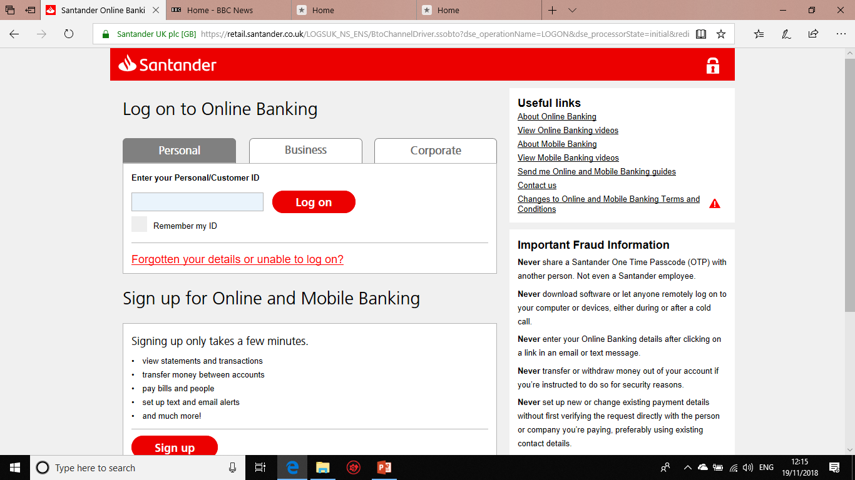
Notes:
Santander

Slide 33
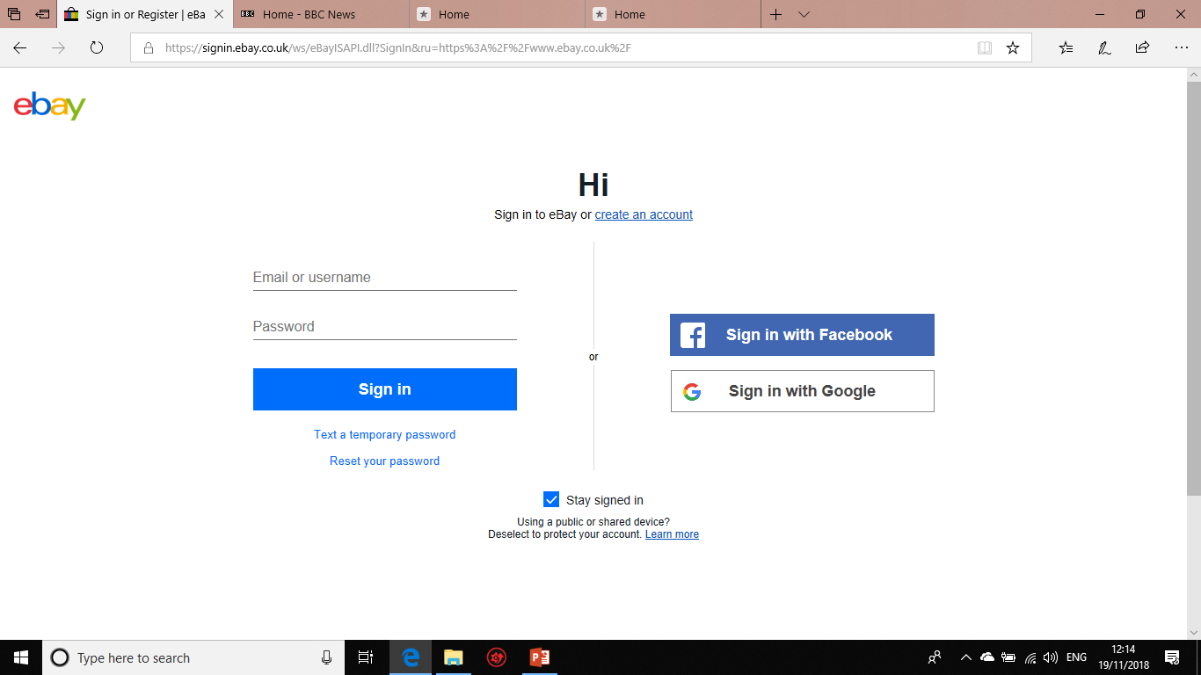
Notes:
ebay

Slide 34
Have we done enough?
We’ve learnt how to make a secure password.
We know that longer is better.
We know that passwords should be unique.
Better still, use a Password Manager.
Notes:
We’ve learnt how to make a secure Password
We know that longer is better
We know that passwords should be unique
Better still, use a Password Manager

Slide 35
Password managers

Slide 36
Advantages
Passwords are kept in one safe place; an encrypted vault.
You only need to remember one really strong password.
Your passwords are synchronised across all your devices.
The Password Manager will remember your usernames and passcodes etc.
The Password Manager will generate really robust passwords – unique for each site.
You can also store other sensitive information such as credit card details, Passport number etc.
They do what they say they will.
You can add passwords for desktop applications too
Notes:
Passwords are kept in one safe place; an encrypted vault
***** You only need to remembers one really good password
***** Your passwords are synchronised across all your devices
***** The Password Manager will remember your usernames and passcodes etc
***** You can also store other sensitiveinformation such as credit card details, Passport numbers etc.
***** They do what they say they will
***** You can add passwords for desktop applications too.

Slide 37
Disadvantages
Forgetting the master password could be disastrous……
☹️
Notes:
Forgetting the master password could be disastrous

Slide 38
What about Browser-based Password managers?
Web browsers – Chrome, Firefox, Internet Explorer and others all have integrated Password Managers. But none of them can compete with a dedicated programme written specifically for the job.
Notes:
If you use these, then you have to continually use that same browser – I use a number of browers plus other peoples computers, they might use a different browser again.

Slide 39
The Main Players
Dashlane
LastPass
NordPass
Sticky Password
Avira
RoboForm
1Password
Kaspersky
IoloEverkey
Zoho Vault
Keeper PM & DV
Agile Bits
Notes:
Search for Top 10 Password Managers – there’s even a website top10-passwordmanagers.com to help you.

Slide 40
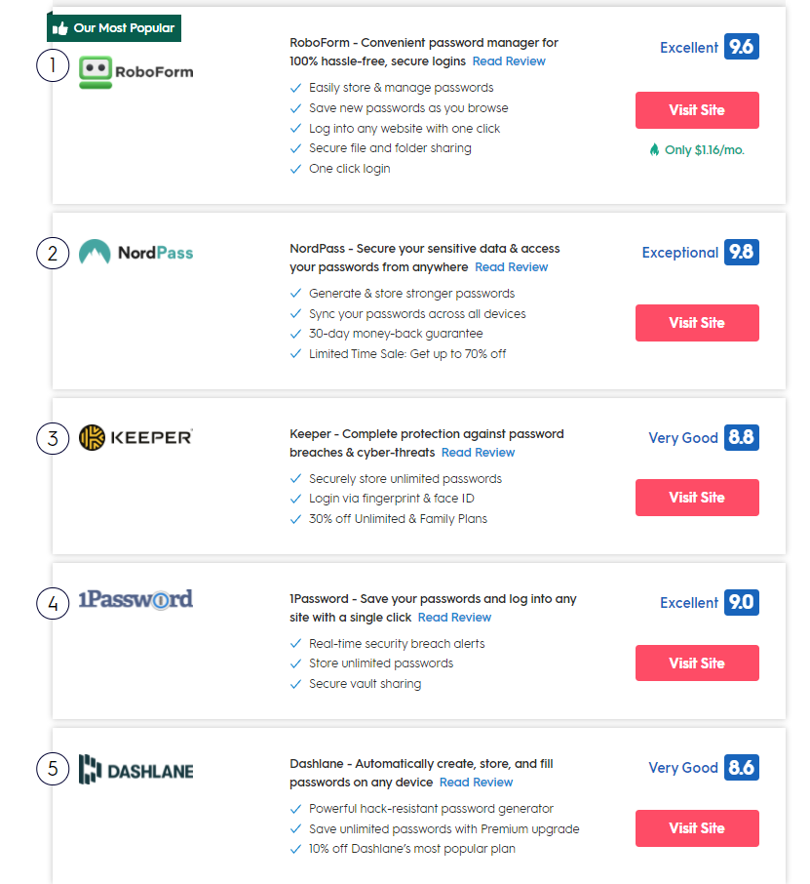

Slide 41
Principles of Operation
After installation, the application works with your Browsers.
Create a Master really strong password to access your ‘Vault’.
Visit your regular websites that require login and password. Do so.
The PWM prompts you to save the site in the Vault. Say Yes.
Update the PW with one from the PWM. Update your Vault.
Explore Settings and adjust to suit
Notes:
***** After installation, the application works with your Browsers.
***** Create a Master really strong password to access your ‘Vault’.
***** Visit your regular websites that require login and password. Do so.
***** The PWM prompts you to save the site in the Vault. Say Yes.
***** Update the PW with one from the PWM. Update your Vault.
***** Explore Settings and adjust to suit

Slide 42
Lets see it in action……

Slide 43
COnclusion

Slide 44
Create your own username or logon if possible
Make up answers to common security questions
Pass Phrases are more secure than Pass Words
The longer, the better
Change regularly for high security applications
Make logins and passwords unique
Don’t use ‘Remember Me’
Use a Dedicated Password manager, not your Browser’s.
Notes:
Conclusion
Create your own username or logon if possible
***** Make up answers to common security questions
***** Pass Phrases are more secure than Pass Words
***** The longer, the better
***** Change regularly for high security applications
***** Make logins and passwords unique
***** Do not use “Remember Me”
***** Use a Dedicated Password Manager, not the one provided by your browser.

