Slide 1
SALOP INFIRMARY
1747-1797

Slide 2
INTRODUCTION
Most people lived in small, insanitary dwellings with no land.
1 in 7 new-born babies died.
Life expectancy was approx. 50 years.
Fevers and illnesses killed many, e.g. in 1763 60 people died of smallpox in one parish in Shrewsbury.

Slide 3
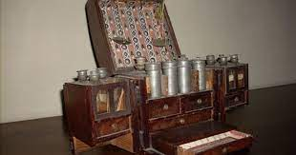
MEDICINE CHEST

Slide 4
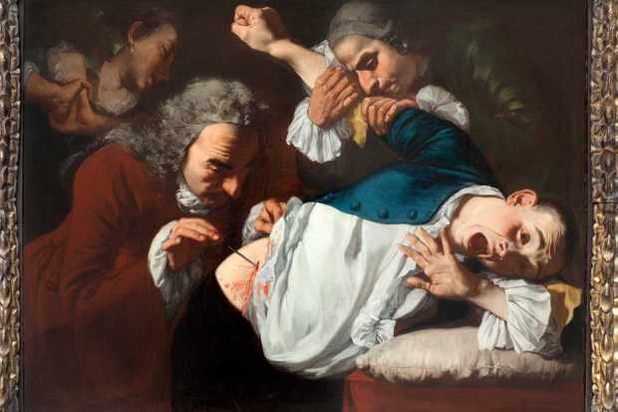
A SURGEON AT WORK

Slide 5
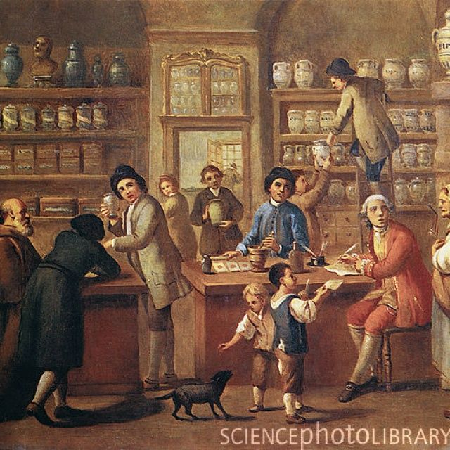
THE APOTHECARY’S SHOP

Slide 6
18TH CENTURY DISEASE
ELEMENT | CORRESPONDING HUMOUR | CORRESPONDING MOOD | REMEDY
Air | Blood | Sanguine | Blood-letting/blistering
Earth | Black Bile | Melancholy | Diet
Fire | Yellow Bile | Choler | Purging/vomiting
Water | Phlegm | Phlegmatic

Slide 7
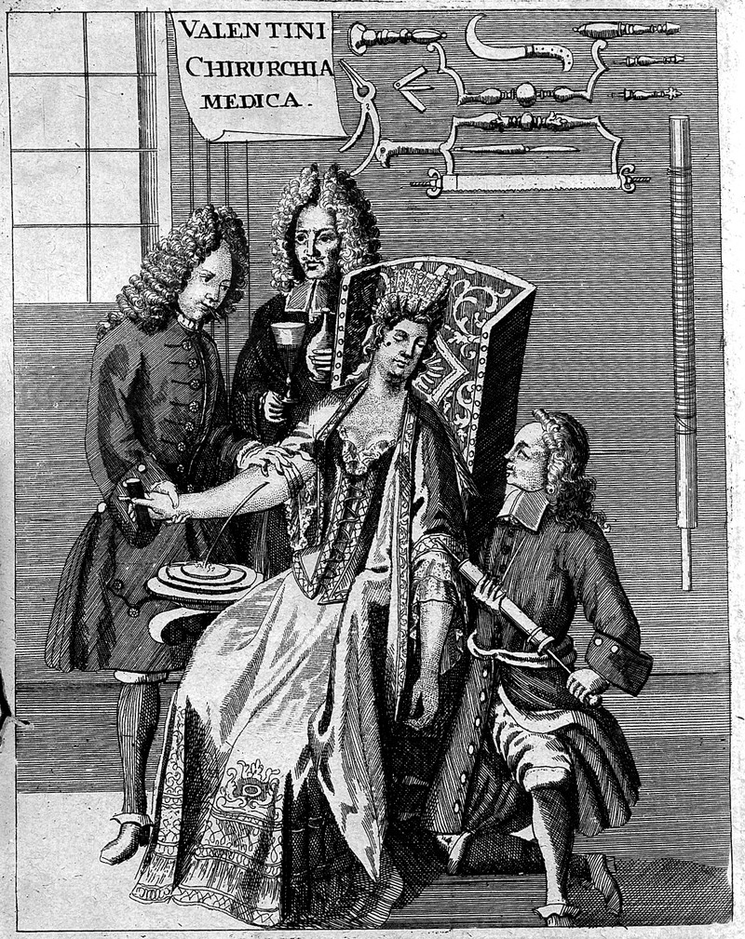
BLOOD-LETTING

Slide 8
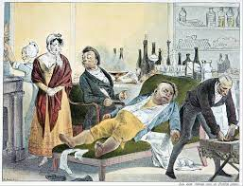
18th CENTURY PATIENT

Slide 9
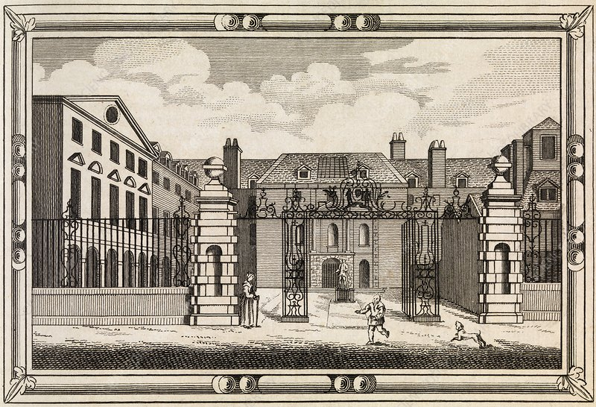
GUY’S HOSPITAL, LONDON

Slide 10
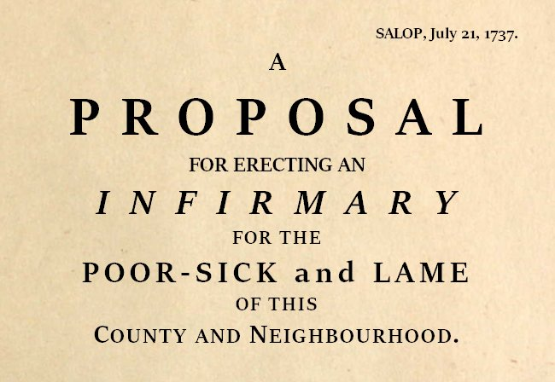

Slide 11
TRUSTEES OF SALOP INFIRMARY
Sir Richard Corbett MP (Chair)
Edward Corbet
John Mytton
Dr Davies
Rev Mr Wingfield
John Wood
Sir Henry Edwards
Rev Mr Cotton
Mr Whitfield
Sir Rowland Hill
Thomas Beale
James Downes
Rev Mr Adams
Mr Pryce
Thomas Hill
Dr Wingfield
Dr Berrington
Mr Blakeway

Slide 12
FINDING A SITE
Broom Hall – large, unfinished house in Shrewsbury, near to St Mary’s Church. The owner had died and the trustees felt the house could be adapted to become an infirmary.
No agreement between the executors and the trustees and the idea was abandoned.

Slide 13
A NEW BUILDING
The trustees decided instead to erect a new building in the Quarry, a large area of pasture outside the town.
Terms were quickly agreed with the town corporation.
By early September 1745 a plot had been chosen and a plan drawn up.

Slide 14
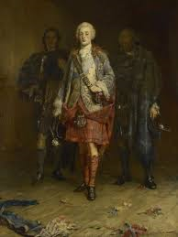
BONNIE PRINCE CHARLIE

Slide 15
BROOM HALL (AGAIN!)
The Committee next met in March 1746. The Broom Hall executors had changed their minds and were willing to offer a lease.
July 1746 – the Committee decided to suspend work on the new building in the Quarry and to accept the offer of Broom Hall.
Shropshire was the 6th provincial county in England to have an infirmary.

Slide 16
INFIRMARY STAFF
Physicians: John Wingfield, Richard Davies and William Berrington.
Surgeons: Peter Blakeway, John Wingfield and Richard Price.
Apothecary: William Harland.
Matron: Margaret Sandford.
Nurses: Eleanor Colston and Sarah Reynolds.

Slide 17
WHO WERE THE PATIENTS?
The purpose of the infirmary was quite specific. It was for workers who were sick or injured, i.e. the “deserving poor”.
All patients had to be recommended by one of the subscribers.
There was a long list of people who were barred from coming to the infirmary, e.g. the chronically sick; the disabled; the dying; expectant mothers; children under 7 years.

Slide 18
THE FIRST PATIENTS
The first patients were admitted on 25 April 1747.
The first four were: Ann Simcox; Widow Roberts; Hannah Morgan and John Cottrell.
Hannah Morgan and John Cottrell were discharged “cured” after a few weeks.
Ann Simcox and Widow Roberts were “relieved” some time after.

Slide 19
OUT-PATIENTS
From the beginning, there was an out-patient department for those cases not requiring admission in the infirmary.
Mary Barber was the first out-patient and there were soon 500 per year.
The idea of out-patients being funded by subscription was quite new, and made Salop Infirmary almost unique.

Slide 20
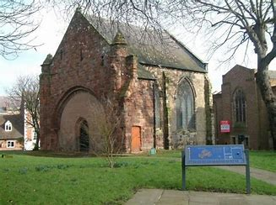
OCTOBER 1747 – A CELEBRATION AT OLD ST CHAD’S

Slide 21


Slide 22
GROWING DEMAND
1748 Infirmary enlarged to 46 patients.
This caused a debt of £340 in the first year of operation.
1749 Infirmary enlarged to 72 patients.
1747-1752 Infirmary admitted 1,479 patients.
In 1753-54 350 patients were admitted.
136 cured.
22 relieved.
19 died.
16 decided to leave.
9 discharged incurable.
9 discharged for irregularity (bad behaviour)

Slide 23
WHAT WAS IT LIKE FOR PATIENTS?
Patients could be suffering from rheumatism, jaundice, dropsy, colic, or palsy. Or they might have had a wound, sprain or fracture.
Treatment was mostly rest and good food.
The Infirmary was an institution with rules to be obeyed.
All patients were expected to attend church after discharge to give thanks to God for their good fortune.

Slide 24
WHAT IF YOU DISOBEYED THE RULES?
William – alleged his bread allowance was insufficient. Reprimanded for ingratitude. A week later, accused of theft and discharged for impropriety.
John and James – reprimanded for failing to do cleaning duties.
Thomas – reprimanded for failing to help another patient, even though his hands were too tender to do so.

Slide 25
WHAT IF YOU DISOBEYED THE RULES?
Mary – reprimanded for being insolent to Matron.
Patients were expected to go to St Mary’s church if they were well enough, but Thomas went to the ale-house instead.
Charles Smith and Eliza Jones “quitted the House without Leave” after first “secreting some Bottles with a Design to carry them away”. They were dismissed and told they could never be admitted as objects of charity again.

Slide 26
TROUBLED TIMES
By the end of the 18th century, Salop Infirmary was facing numerous problems.
Accommodation was inadequate.
Ward cleanliness was an issue.
Matron had been dismissed after discrepancies were found in the wine and coal accounts.
National economy in decline.

Slide 27
TROUBLED TIMES
Subscribers were often late making their subscriptions or even withheld them.
As old subscribers died or moved away, it was difficult to find new subscribers.
In the 1790s, £1,100 annual income required, but from 1797-1800 only £690 received.
Patient numbers had to be reduced from 500 to 300 patients per year, in spite of demand.

