Slide 1
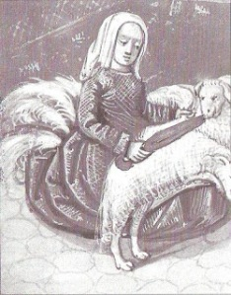
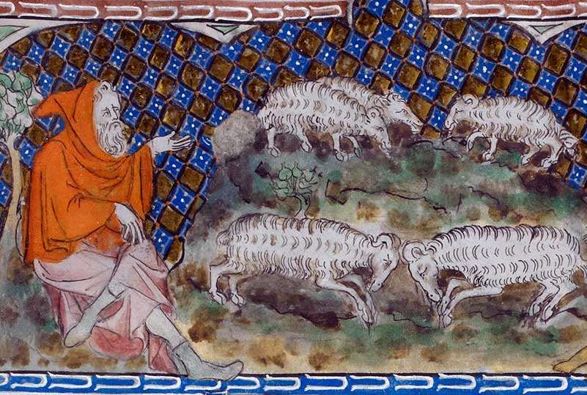
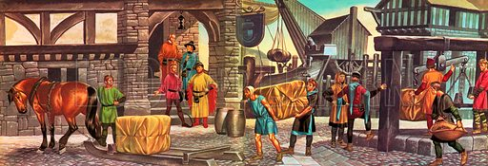
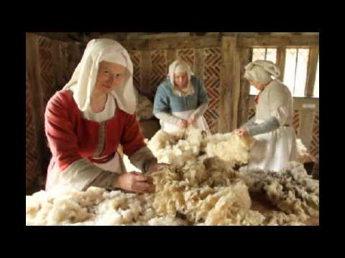
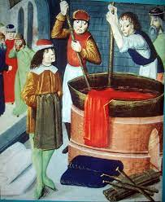
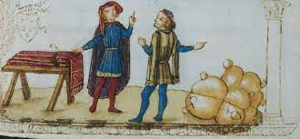
The Shrewsbury
Wool Trade

Slide 2
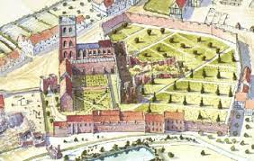
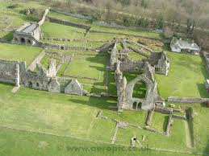
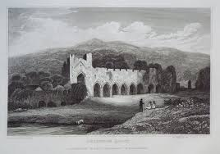
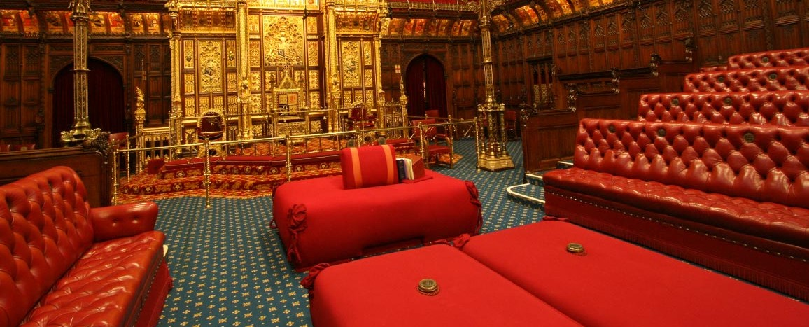
Originally local Monasteries sold wool in bulk to Wool Merchants
Shrewsbury Monastery
Haughmond Monastery
Buildwas
Monastery
Wool sack in House of Lords
Notes:
Slide 2 Beginning of Wool Trade
The wool trade in Shrewsbury began centuries ago. Even as far back the 1100’s.
Even a man with other interests, would own sheep and the more he had, the better his trading position. A peasant tilling his open field system might have owned 20 or 30 sheep, supplementing his meagre income with the profits. At the other end of the social scale, a landed gentleman might have thousands of sheep.
The Lords Abbots and Bishops began using their land to raise sheep and produce wool. The largest producers were land owning aristocrats and the Church.
The local monasteries such as Shrewsbury, Haughmond &Buildwas (supplied wool in bulk to the Merchants. They benefitted from very low labour costs because much of the work was done by unwaged lay brothers. They would deliver their wool-sacks to a convenient venue for the buyer using some of their many privileges such as toll exemptions , they also had fleets of carts & waggons. This saved the Merchants from travelling many miles around the county. The monasteries in turn gained various advantages by working with the Merchants, in particular they were able to negotiate long term contracts.
Many of the records of religious houses were lost during the Reformation by Henry V111 in the 16th century but there is evidence that in 1334, 847 sheep were sheared in Shrewsbury, supplying a huge amount of fleece.
An artefact of this era is a seat in the House of Lords for the Lord High Chancellor There is a square bag of wool which is a wool sack the principal source of English wealth in the Medieval era. And Shrewsbury played a major part in this industry.

Slide 3
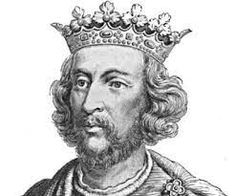
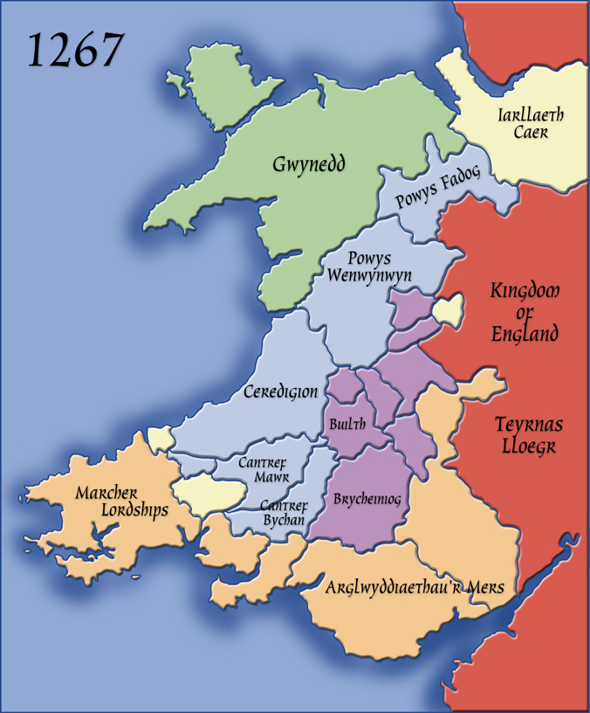
In the 12th & 13th Centuries Shrewsbury was the Foremost market town in the Marches
Henry 111
(1154-1189).
Shrewsbury
Henry forbids wool merchants to buy any wool or cloth in the County apart from in Market towns
Notes:
Slide 3
In the 12th & 13th Centuries Shrewsbury was the foremost market town in the Marches.
In 1267 Henry 111 had moved his court and army to Shrewsbury in his campaign against Prince Llewelyn of Wales. As a reward for the town supporting him in .
Henry rewarded the town by proclaiming that the Burgesses of Shrewsbury were to be free of all tolls in all English towns and no wool merchants, whether from outside Shropshire or within it were permitted to buy wool other than in the market towns. This gave Shrewsbury’s wool based economy a tremendous boost and advantage because of the towns position in the Marches.
Shrewsbury becomes a part of the national wool market that was developing during the middle Ages to meet the needs of a growing population.
The trade in Welsh cloth became increasingly important to the profits of the Shrewsbury Merchants. Cloth was also being brought into Shrewsbury from Yorkshire and East Anglia.

Slide 4
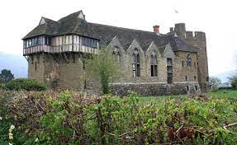
Nicholas De Ludlowe the
“King’s Merchant”
1261 …155 sacks of wool
1262……38 sacks of wool
TOTAL…..193 sacks
Which includes 260 fleeces in each sack
This represents over
50,000 fleeces
He was paid £2,000 by dealers in Flanders.
Shepherd and his flock from an early manuscript
Laurence De Ludlowe
Stokesay Castle
Notes:
Slide 4
From this base, the town’s merchants were able to build up trade and distribution links that could deliver wool and later cloth to markets around the country as well as to the principal market in London and later even to Flanders, France and the Iberian Peninsula.
One example of a Shrewsbury Merchant who achieved international stature was called Nicholas De Ludlowe( his surname coming from extensive commercial interests in the town of Ludlow.
Nicholas De Ludlowe (spelt with an e on the end) was a wool merchant to Prince Edward, who later became Edward 1.
The Shrewsbury Bailiff's accounts for 1261 show that he exported 123 sacks of wool from the town in June and 2 months later there was a further 32 sacks. On August 1st 1262 he sent 26 sacks through the town gates and the following week he shipped a further 12 sacks that makes a total of 193 sacks at 260 fleeces per sack which represents over 50,000 fleeces, that’s a lot of sheep! It is recorded that he was paid £2,000 by dealers in Flanders. And that was an extremely huge amount of money then.
He built the stone Hall, later known as Bennet’s Hall part of it can still be seen (I think) at the back of Pret a Mange in Pride Street.
When he died in 1279 he was equivalent to a multi-millionaire today and was known as the ‘King’s Merchant”
After his death his son Laurence continued the business and acquired Stokesay castle in 1281. The castle was strategically placed on the roads to Gloucester and Hereford between and also with access to the River Severn. It became his base from where he managed his international business.
In 1334 Shrewsbury was the 7th wealthiest town in England outside London.
During the 14th Century from 1540 to 1584 Shrewsbury’s population rose from 385 to 756
By 1634 it had risen to 1072 excluding Abbey Foregate because it was outside the town walls.

Slide 5
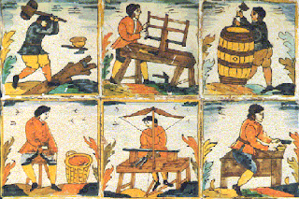
The Rise of the Drapers
& Guilds

Slide 6
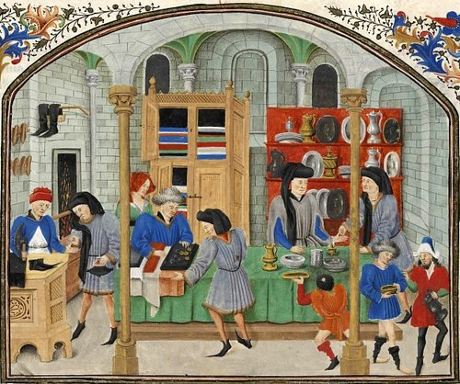
The start of the Draper’s Guild
Draper’s first mentioned in 1204
By the end of the 14th Century Guilds were very important.
The introduction of the Craft & Merchant Guilds in a town lead to its own hierarchy and involvement in civic duty.
Notes:
Slide 6
Draper’s Guild
In a town like Shrewsbury during the Middle ages or Medieval times there could be as many as 100 different guilds. Examples include weavers, dyers, armorers, bookbinders, painters, masons, bakers, leatherworkers, embroiderers, cobblers (shoemakers), and candle makers.
They were a very important part of medieval life.
There were 2 main kinds of Guilds:-
• The Craft Guilds
• The Merchant Guilds
A higher social status could be achieved through membership of the Merchants Guild.
During the Middle Ages and Medieval Times there was a system of Feudalism which allowed the Lords & owners of land to tax the people and their trades. As trades increased during the medieval times the taxes were excessive and individuals had no chance in objecting to the high taxes.The Merchant Guild were able to negotiate with the Lord and the trade levy became regulated.
However the Draper’s Guild also controlled the way in which trade was conducted in town, they applied rules which were included in their charters.
The leaders of the Draper’s guild became very important members of the town leading to its own hierarchy and involvement in civic duties eg: they became Mayor, alderman and burghers of the town.
As a result the power of the Draper’s guild increased to such an extent that the livelihood of individual trades & crafts suffered. Therefore the individual trades and crafts followed the example of the Draper’s and set up their own guilds. The functions of the different guilds sometimes overlapped.
The Merchant and craft workers guilds were able to give their members support and aid, they could ensure that production standards could be maintained and that completion time was reduced. In addition members acting collectively could achieve certain political influence.

Slide 7
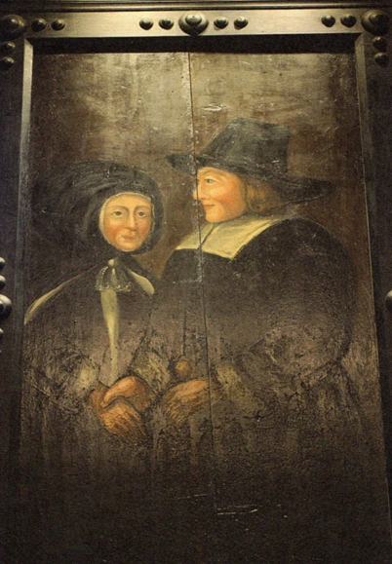
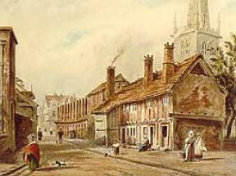
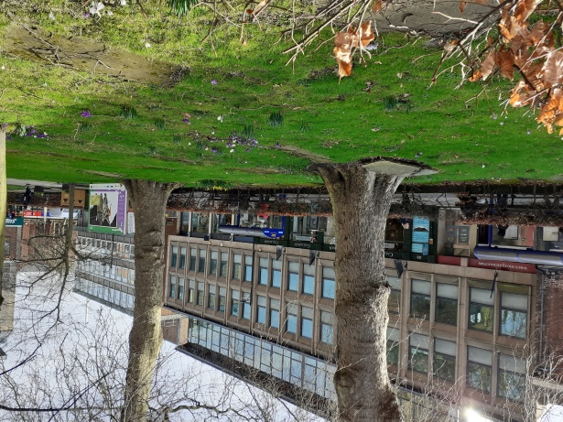
The Almshouses & Degory Watur
This is where the first almshouses
would have stood
Single cell almshouses with open hearth were built along the West side of St Mary’s churchyard.
Degory Watur and his wife. This can be seen in the Draper’s Hall today
Notes:
Slide 7 – Edward 1V & Degory Watur Draper’s Charter
Degory Watur was one of the successful, astute & pious Drapers in Shrewsbury.
He became the benefactor of the alms houses that were built in 1444. Degory was granted a licence by the Dean of St Mary’s to build an almshouse for poor people on the West side of St Mary’s church yard it was then known as Ox Lane.
Thirteen timber framed cottages, a common hall and a warden’s house were built, each cottage was a single cell with open hearths. The common hall was built complete with fireplace & chimney. The fireplaces with tall chimneys were built much later.
During the Wars of the Roses (1455-1487) Degory supported the House of York thereby gaining the protection of the King. When Edward 1V became King , Degory decided to make his move to consolidate his position.
He travelled to London to apply to Edward for a Charter that linked the existing Draper’s Guild and the Guild of the Holy Trinity of St Mary’s.

Slide 8
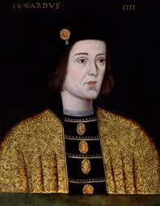
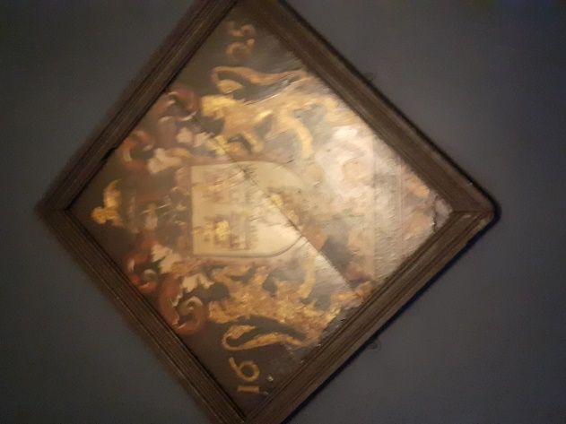
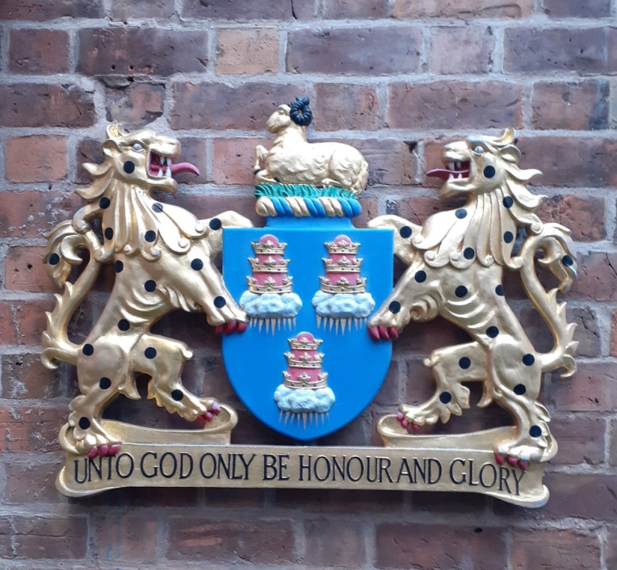
1462 –Shrewsbury Draper’s Company received Royal Charter
Edward 1V – Yorkist during Wars of the Roses
Painted hatchment 1625 as seen in Draper’s Hall
The Draper’s crest outside the Draper’s Hall today.
Notes:
Slide 8
Degory’s strategy succeeded and on 12th January 1462 the Shrewsbury Draper’s Company Charter was signed by Edward 1V.
The Shrewsbury Draper’s Coat of Arms is the same as that of the London Draper’s. And you can see the coat of arms on the wall outside the entrance to the Draper’s Hall today.
The arms are depicted in a painted hatchment dated 1625 which can also be seen inside the Draper’s Hall today.
The the Drapers fulfilled welfare and charitable functions providing accommodation in almshouses for their sick , elderly and widowed members.

Slide 9
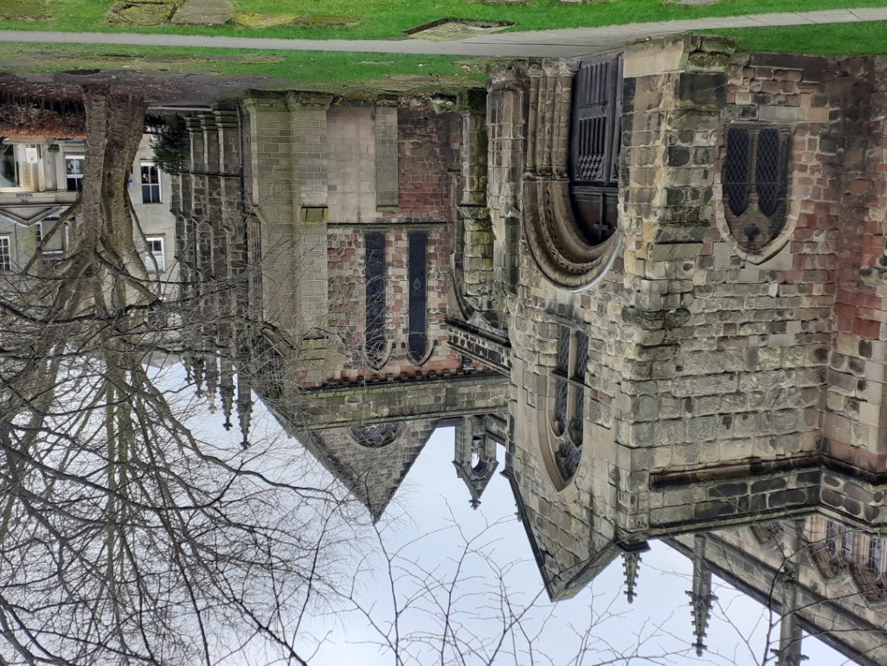
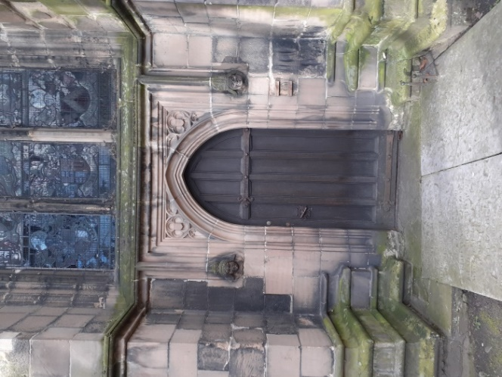
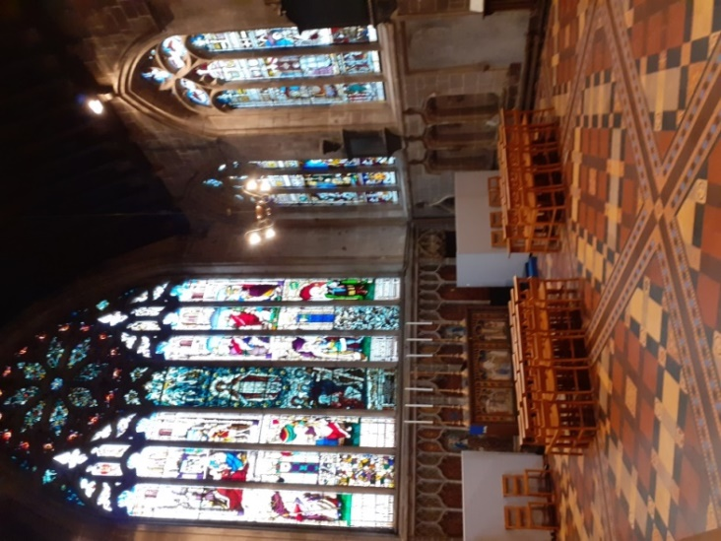
“A Fraternity or Gild of the Holy Trinity of the Men of the Mystery of Drapers in the town of Salop”
This is the door at the side of the Chantry Chapel through which the Drapers process during their religious ceremonies today.
Chantry Chapel (outside & inside) built by the Shrewsbury Drapers in 1501
Notes:
Slide 9 St Mary’s Church
As you can see the original spelling of Guild is without the U.
In the Charter the Shrewsbury Drapers were given the title ‘A Fraternity or Gild of the Holy Trinity of the Men of the Mystery of Drapers in the town of Salop’ and this title had religious connotations.
The Charter required the Guild to appoint a chantry priest to say Mass for the Guild and to pray for the souls of Richard, Duke of York, and his son Edward, Duke of Rutland, both of whom were killed in the Wars of the Roses.
Both the Guild and the Chantry Chapel which was built by the Draper’s in 1501 in St Mary’s Church were dedicated to the Holy Trinity. Today within the Chantry Chapel you will see part of an altar which is decorated with the symbols of the Trinity.
The symbols of the Trinity also appear in the Company’s Common Seal which was authorised in 1462
The religious obligations of the Guild, along with the chantry priest, were swept away in 1547 during the Reformation.
However the Shrewsbury Draper’s still hold religious services within St Mary’s.

Slide 10
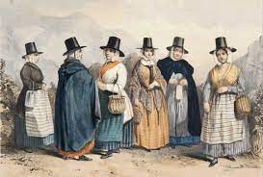
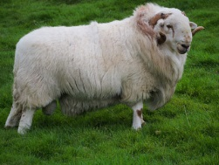
The Trade in
Welsh Cloth

Slide 11
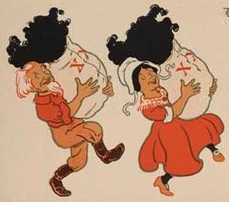
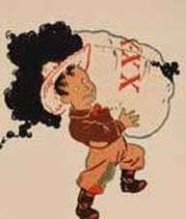
Three bags full of meaning
The Wool Merchants acted as Middlemen to the Crown
Baa Baa Black sheep have you any wool?
Yes Sir, yes Sir, three bags full
One for the Master, one for the Dame and one for the little boy who lives down the lane
The wool trade was extremely lucrative and successive Monarchs from Edward I taxed it quite heavily
Notes:
Slide 11
Baa baa Black Sheep
The history of the nursery rhyme “Baa Baa Black Sheep” goes back from the 13th to 15th Centuries when Monarchs from Edward 1 started taxing wool. Black wool had a high resale value than white wool due to the fact it would not take costly time and material to dye the wool.
One bag for the Master ……meaning The King
One bag for the Dame……..meaning the Church
These were in essence references to the taxes paid to the Church & State.
The remaining bag is the one for the little boy meaning…..the wool merchant or shepherd .
A very heavy tax indeed.
The wool merchants acted as the middlemen to the Crown.

Slide 12
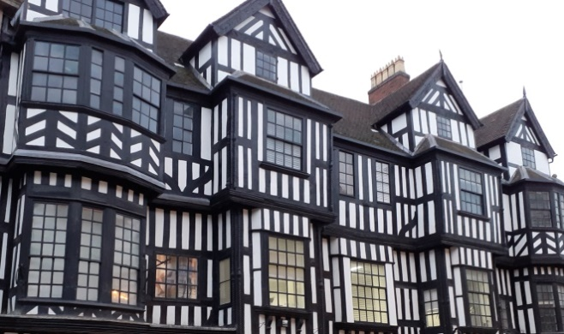
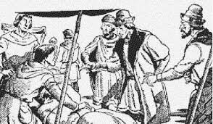
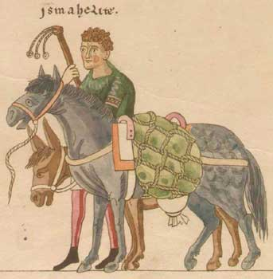

The Merchants
16th Century
A. Stable Merchants
Wealthy
Dealing with export market
Large houses
B. Merchant’s Middlemen
Travelling to collect wool from growers
C. Commodity Dealers
eg: glove makers etc
Notes:
Slide 12
Middleman handled the large quantities of wool for the merchants, and organised it into classifications of good, or middle quality wool. Inferior wool included wool that came from sheep who were already found dead, or locks, that were left after the main fleece had gone – eg:- from the legs. It was still worth trading, though, as it could be used to make rougher cloth.
Weights were used during packing the wool, and a load was 28 pounds. Wool merchants used the same kind of methods for weighing wool into the 20th century as they did in the medieval period, balancing out 14 pound stones on a scale with the sacks of wool on the other side. The merchants would mark their wool showing the name of the merchant, and the quantity and quality of the wool. Large sums of money were involved – often the balance was paid off in three instalments. One at the weighing, and then two more payments within four months.
The wool left in convoys by sea where they were less likely to be hit by pirates, and it let merchants spread their cargo across ships. Sailings happened in Spring, Summer, and Autumn, but generally not winter.
By the middle of the 16th century the middlemen, the dealers in wool, emerged as three separate classes. There were the Staple Merchants at the top, dealing in large quantities and with the export market. They were generally wealthy and owned a large country house in an area where wool was produced, as well as a town house where they carried on their business. The Merchant’s middleman, who travelled his area collecting the great bundles of wools, collecting from the growers. Next came the commodity dealers such as glove makers, who bought for their own leather products. They purchased wool fells (sheepskins) and removed the fleece before processing the skin, selling the wool to dealers and other manufactures .

Slide 13
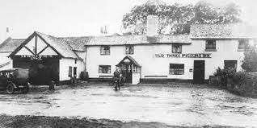
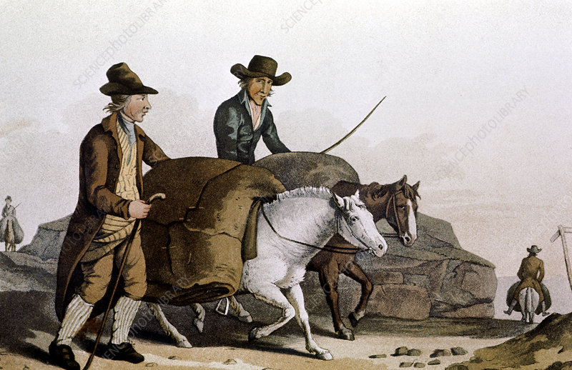
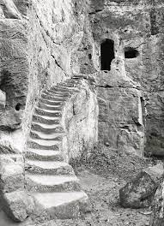
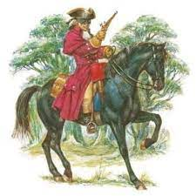
Merchant’s Middlemen travelled to Oswestry in groups to buy Welsh cloth
The Old Three Pigeons
Nesscliffe
Highway man
A coarse kind of cloth called Welsh Webb was brought by pack horse from Wales.
Kynaston cave
Notes:
Slide 13
Welsh Wool
In the early 16th Century Shrewsbury Merchants turned their attention towards the Welsh woven cloth trade in the North Marches. They started to compete with Welsh Drapers.
The wool merchants acted as the middlemen to the Crown. The crown needed middlemen to handle the taxation of the wool and
The Crown also required all wool for export to be traded at a designated market, called ‘The Staple’. This allowed the Crown to monitor the trade and levy tax on exports.
In Shropshire the border town of Oswestry was licensed as a Staple or market to trade woollen cloth. The cloth traded came from all over North Wales and also from different parts of England. The cloth could be various grades of woollen cloth, flannels and cottons.
The merchants from Shrewsbury would travel to Oswestry on horse back and they carried a large amount of money on them. For safety reasons they would all meet at the Old Three Pigeons in Nesscliffe to travel in groups as there was a great risk of being robbed by highway men such as Humphrey Kynaston who lived in a cave in the hills above Nesscliffe.

Slide 14
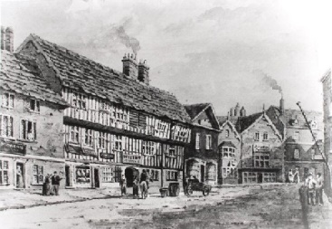
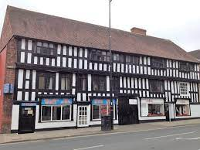
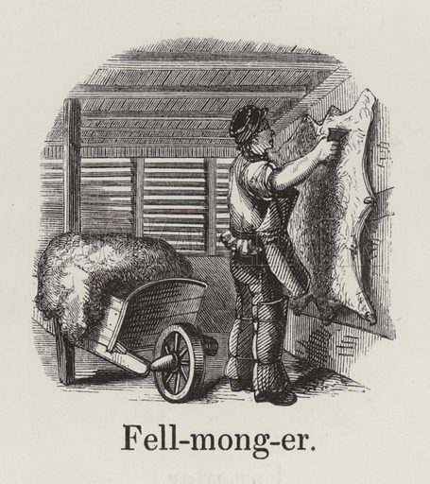
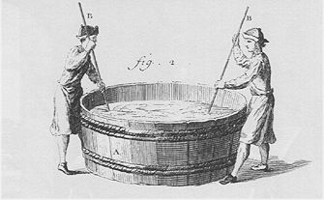
Fellmonger’s Hall Frankwell
Fellmonger Hall in Shrewsbury today
Fellmonger Hall in Frankwell c 1570
Fullers
Notes:
Slide 14
Strictly speaking the Welsh cloth were so named after the origin of the wools used in their manufacture and in this sense cloths of this kind were finished off and made by weavers in Shrewsbury.
The word “Fells” comes from “dressed skins”. The job of the fuller was extremely unpleasant and smelly. The cloth was put in barrels of urine collected from the people of Shrewsbury. Then fullers would stamp on the wool for hours, as a result the cloth (and the fullers feet) became very soft. Afterwards it was washed in the river.
The fellmonger’s Hall in Frankwell was built around 1570 s and was around 70 feet (21m) long The upper floors were used for dealing with the skins, processing and storing the wool. The ground floors would have been shops and there would have been workshops on the first and second floors.
Wool processing and tanning were still in operation there as recently as the 1970s.

Slide 15
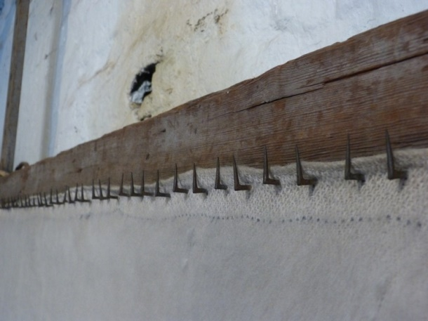
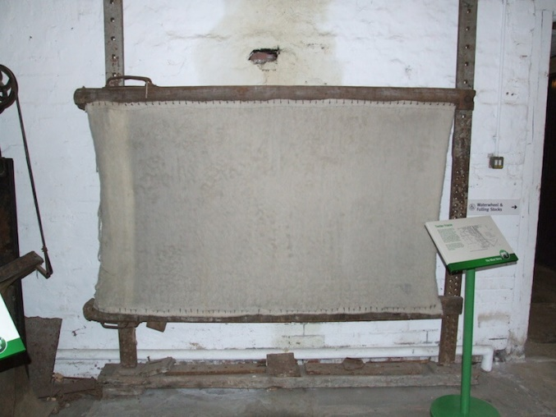
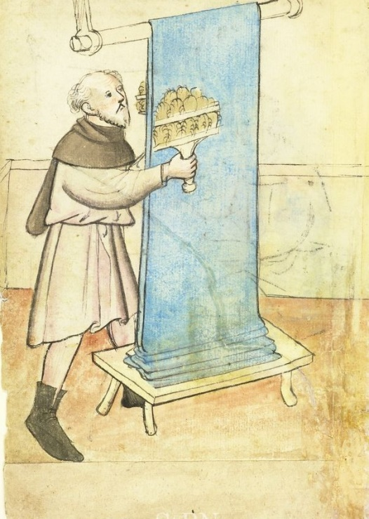
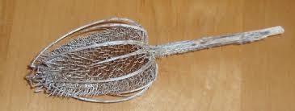
Washed cloth was hung on tenter hooks
The next process is napping the cloth
teasel
Notes:
Slide 15
The next part of the process was to hang the washed cloth on tenter hooks
Where the phrase “ I’m on tenter hooks” comes from..
The following part of the process is called napping.
The cloth would be worked with teasels that were attached to small paddles. They would then raise the nap which makes it much softer to touch and it would then sell for a better price.
Teasels were brought up the river Severn from the Somerset Levels.

Slide 16
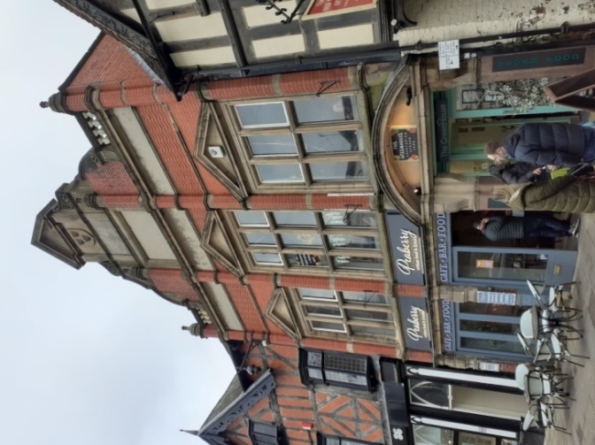
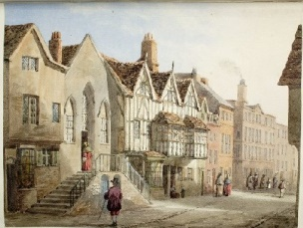
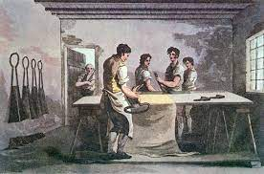
Shearmen’s Hall
Shearman’s Hall today is Peaberry’s cafe
The number of Shearmen working in Shrewsbury rose dramatically over the years
1398……. .12
1525 …….70
1553……..81
1569…….118
1587…….200
Shearman’s Guild Hall ( on the left) in Milk Street.
Black & White building on right is Proude’s mansion
Notes:
Slide 16
Once the woollen cloth had had its nap raised it was ready for the shearman. It was his job to trim the nap to ensure a smooth and even finish. A shearman had to combine a steady hand with strength and concentration. They worked with a coarse kind of cloth called Welsh webb.
This cloth went mainly to America to cloth the slaves and to Flanders where it was worn by the peasants.
Although the Draper’s relied on the Shearmen to finish the cloth before sale, there was great rivalry between the Guilds and the Draper’s refused to allow the Shearmen share the trade in cloth.
The Guild of Shearmen were probably the largest but poorest of all the guilds in Shrewsbury., even though they provided an essential service to the Drapers. As you can see the number of Shearmen that moved into Shrewsbury increased in huge numbers in the late 14th century.
The stone building in this view is the Shearman's Hall. Only the cellar of the Hall remains today. The fine timber building beyond it is Proude's Mansion.

Slide 17
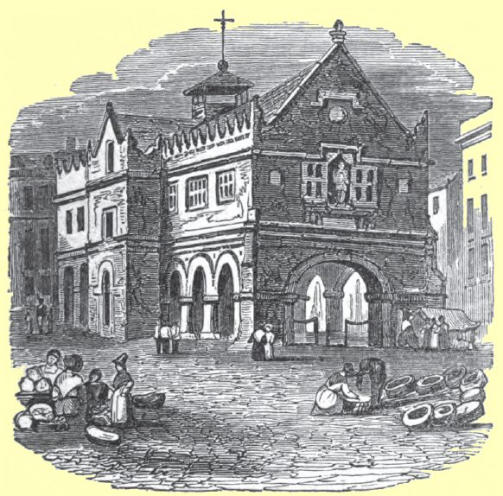
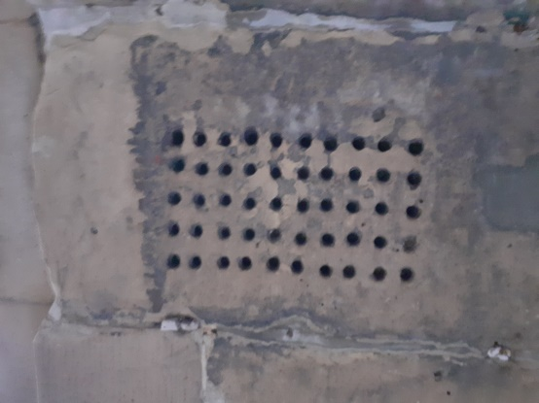
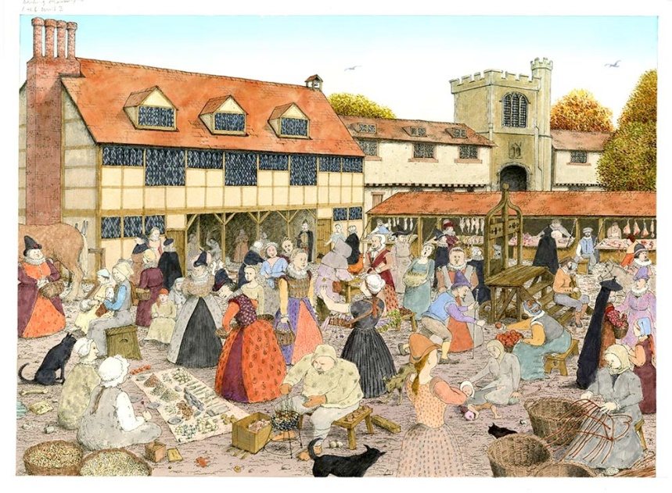
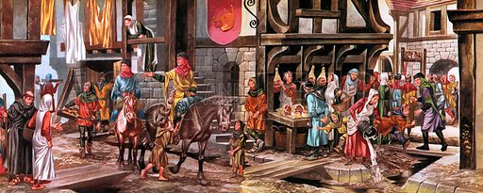
Market Day in Shrewsbury
was a Thursday
Corn was stored underneath the market hall in the square
Welsh cloth dealers & town Drapers conducted their business in the first floor room
A tally stone used to record or document quantities or prices can still be seen
today.
Giving you a flavour of busy street markets in 15th & 16th Centuries
Notes:
Slide 17
The Market Hall in the square was built in 1596 by the Guild of Drapers. It was built of stone which is unusual most market halls at this time were timber framed. The Welsh cloth dealers & town Drapers would meet and negotiate prices in the first floor room the covered area beneath was for the sale of corn.
This is a passage from the Draper’s in the 18th century describing Shrewsbury markets .
Every Thursday the central parts of the town were all life and bustle. Troops of hardy ponies, each with a halter of twisted straw and laden with two bales of cloth poured into the market -place in the morning driven by stout Welshmen in their country coats of blue cloth and striped linsey waistcoats. After dinner at 2pm the drapers with their clerks and shearmen, assembled under the market-hall and proceeded up the stairs in seniority . The market being over, drays were seen in all directions conveying cloths to the several warehouses and more than 6oo pieces of web have been sold in a day. As Welshmen left much of their cash behind them in exchange for malt, groceries and other shop goods

Slide 18



Transporting Wool
Pack horses
Severn Trow
Mardol Quay
Notes:
Slide 18
The poor quality of the road system during the Tudor period required the woollen cloth to be taken from Shrewsbury to London, the principal market, by pack horse. It was then sold onto the London Draper’s where it was exported.
Later when markets opened in places like Bristol the cloth would be transported on the river Severn by boats called Severn Trows. The Severn was not always navigable before weirs were built there were problems of low water in the summer and too much water in the winter.. Sometimes the boats had to be dragged over mud by men called “bow hauliers” using ropes & pulleys. So the journeys were not easy.
On the return journey the trows brought back, teasels from Somerset levels and wine and spirits from Europe.
Many of the trows were based near the Welsh bridge. At Mardol Quay

Slide 19






How
The
Other
Half
Live!

Slide 20

Map of Tudor Shrewsbury
Key
Fellmonger’s Hall
Mardol Quay
Rowley’s House & Mansion
Bennet’s Hall
Ireland’s Mansion
Market Hall
Lloyd’s Mansion
St Chad’s Almshouses
Henry Tudor House
The Red Lion
Shearmen’s Hall & Proude’s Mansion
The Abbots House
Jones Mansion
Draper’s Hall
St Mary’s church
Perche’s Mansion
Grammar School
WG = Welsh Gate,
SG = Stone Gate,
CG = Castle Gates,
M = St Mary’s Church,
A = St Alkmund’s church,
J= St Julian’s church,
C = St Chad’s church,
P1 –P12 = Poster n Gates within Town walls
m = mills ( stone bridge & Abbey mills)

Slide 21




Vaughan’s Mansion
As it appeared in 18th century
Today in the courtyard of Stop Café - Museum
One of the original beams .
The top room today used for weddings etc
Notes:
Slide 21
Vaughan’s Mansion
William Vaughan was a successful wool trader originally from Haughmond. In 1268 he paid 10s (about £365) to join as a foreigner (an outsider) member of the Draper’s guild . If his father had been a member of the Guild, he would only have to pay 4d (about £12).
Vaughan’s Mansion is typical of stone buildings from the time and consisted of a first floor communal living space, the hall, an undercroft (cellar or storage room) and other domestic buildings attached to it’s side. Originally the building was built in a U or half H shape around a court yard.
The Mansion is now incorporated into the buildings of the Museum in the Square. What was the communal hall has now been dressed and set up as a function room for weddings and parties. But you can still see some of the original beams in that room.

Slide 22






Lloyd’s Mansion
1898
1903
Early 19th Century
Today!! What can I say!?
Gable end
Notes:
Slide 22
Lloyd’s Mansion
Lloyd’s Mansion used to be on the corner of the Square and Candle Lane (which is now Princess Street….named after the visit of Princess Victoria) David Lloyd appears to have had his roots in the Welsh gentry in the Welshpool area. He was admitted to the Draper’s company in 1556 , his imposing house was built in 1570 when he was a warden of the company
David Lloyd served as one of two baliff’s, the town’s highest office in 1575, 1586, & 1594. A plague with his name on was placed on the new wing of Shrewsbury school (now the Library).
After his death the building passed to the Draper’s Company and they received rental from the income for almost 400 years until the 1960s.
The Mansion was demolished in 1937 all that remains is the gable (that you can see in the photo) this is on display at the Shrewsbury Museum, it’s on loan from Avoncroft Museum.

Slide 23




Mytton Mansions Wyle Cop
Many changes have been made to the original building
This is a photograph of a painting by Louise Rayner that was sold at Sotheby’s in 1986
Painting by Alfred J Hulme
Henry Tudor House
Notes:
Slide 23
Mytton Mansions
Part of the building is now Grade 2 listed. It was built by the Mytton family several years after the great fire of 1393. A palatial timber-framed building. Generations of the Mytton family were wool merchants and their wealth increased by various marriages.
The evening before Henry Tudor was due to enter the gates of Shrewsbury Thomas Mytton who was baliff found himself in an embarrassing situation due to previous events.
He swore that Henry would only enter the gates of Shrewsbury “over my dead body”! By the following morning he had been persuaded to change his mind but to save face he duly lay down, belly upward (so it is said!) .Henry stepped over him before passing through the Town Gates. He lodged for one night on his way to Bosworth Field . That house is now known as Henry Tudor House.
The bottom left picture is a copy of a painting showing Thomas Mytton lying belly up allowing Henry to step over him.

Slide 24



Jones’ Mansion High Street, built by Thomas’s father, William
Thomas Jones & his wife Sarah
Jones’ Mansion Dogpole
Notes:
Slide 24
Jones Mansion 16 High Street is a Grade 2 listed building
The present building can be dated back to about 1575. It was built by William Jones from Holt in Clwyd, who became a very successful Draper in Shrewsbury.
His 2 sons Richard and Thomas (see above) both became very wealthy Drapers. Thomas became an Alderman and bailiff 6 times between 1601 & 1635 and he was also High Sheriff of Shropshire in 1624. In 1638 Charles 1 appointed him the first Mayor of Shrewsbury.
The portrait of Thomas and Sarah his wife was painted in 1615. Both portraits can be seen at the Shrewsbury Museum. Thomas is wearing the robes of probably a bailiff.
Thomas and Sarah moved into what became known as Jones’ Mansion when he bought the property in 1617. It stood at the bottom of Wyle Cop , it was a large timbered framed house at the North end of the “stone” or English bridge . It was pulled down in 1829.

Slide 25





The Decline of the woollen trade
Edward 1
1272-1307
Edward 1V 1461-1483
Henry V111
1509- 1547
Henry Tudor 1485-1509
Elizabeth 1 1558- 1603
Successive Monarchs from Edward 1 to Elizabeth 1 taxed the wool trade very heavily.
On Sunday’s “a cap of wool knit and dressed in England” should be worn
Notes:
Slide 25
In the 1550s the cloth trade – England’s main trade for centuries – collapsed. Merchants needed new markets for their goods and new goods to sell. They wanted a sea route to India or China so they didn’t have to rely on overland merchants.
Woollen export was England’s main export. There was decline in demand and this led to unemployment. Taxes were increased to compensate for the price of waging war. Harvests were particularly bad in the 1590s leading to even higher demand and more rising prices.
Elizabeth 1 was so concerned about the decline of the wool trade she got Parliament to pass a law that said on a Sunday everyone over the age of 6, (not the wealthy) should wear a quote “cap of wool knit and dressed in England”.
Under Charles 11 Parliament passed a law requiring coffins to be lined in fleece and shrouds to be made from wool.

Slide 26
Phrases, sayings and nursery rhymes
Little Bo Peep
Has lost her sheep,
And doesn’t know where to find them;
Leave them alone and they’ll come home bringing their tails behind them
As gentle as a lamb
Dyed in wool
I might as well be hanged for a sheep as a lamb
Making sheep eyes
Mary had a little lamb, it’s fleece as white as snow;
And every where that Mary went the lamb was sure to go.
Counting sheep to go to sleep
The black sheep of the family
Two shakes of a lambs tail
Lamb to the slaughter
Separate the sheep from the goats
Pull the wool over her eyes
March comes in like a lion and goes out like a lamb
Bless his cotton socks
CAN YOU THINK OF ANY MORE?
A wolf in sheep’s clothing

