Slide 1
NOTABLE OLD SALOPIANS
Ex-pupils are called Old Salopians, whether or not born in Shropshire
All male – girls only admitted fully in 2015
However, Issy Wong (2015-2020) toured with England Women’s Cricket team in 2021
High achievers in many areas – politics, sport, TV, journalism, church, military and academic
Most famous - Charles Darwin

Slide 2
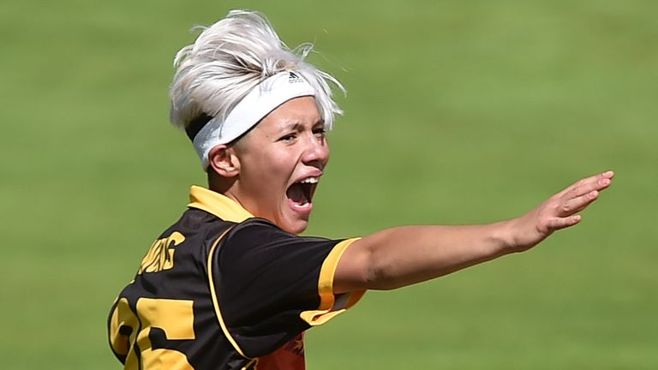
Issy Wong

Slide 3
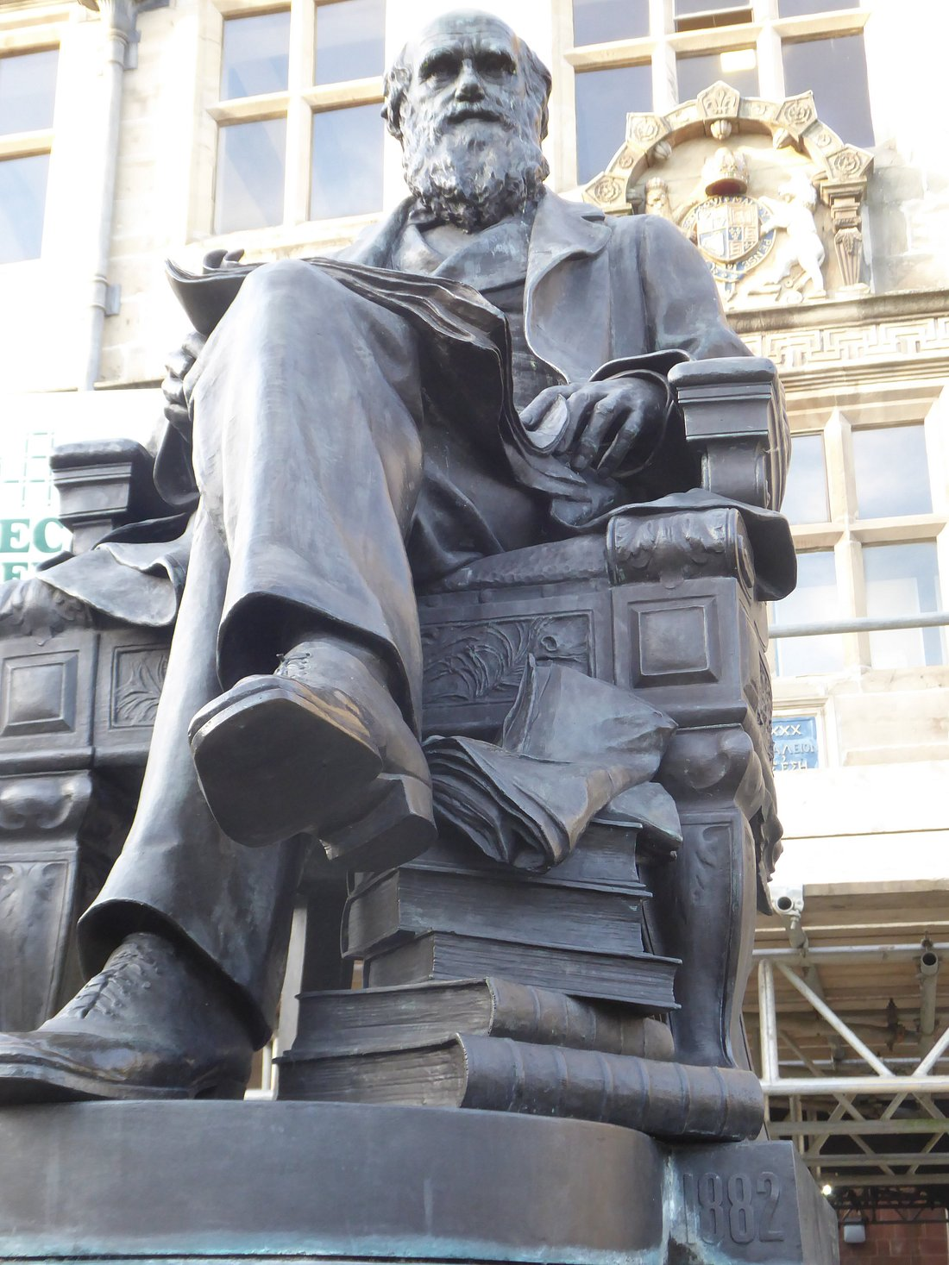
Charles Darwin

Slide 4
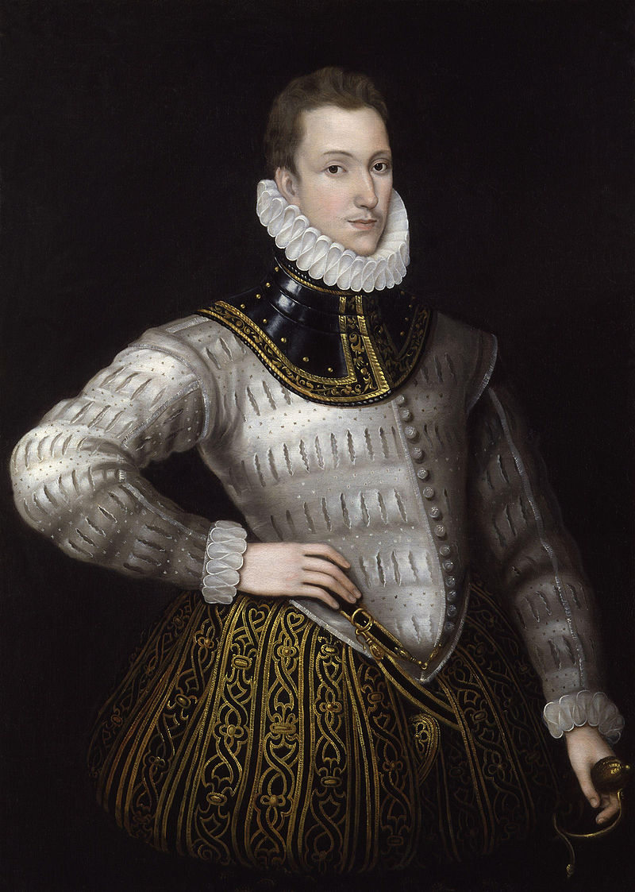
Sir Robert Philip Sidney

Slide 5
1554 – 1586 : poet, courtier and soldier
Nephew of Robert Dudley, Earl of Leicester
Married to Frances, daughter of Sir Francis Walsingham
Ambassador to the German Emperor and the Prince of Orange
The “flower of chivalry”, wrote the pastoral romance “Arcadia” and several sonnets
Died aged 32 from wounds received fighting against the Spanish at the Battle of Zutphen
Memorial statue at the school

Slide 6
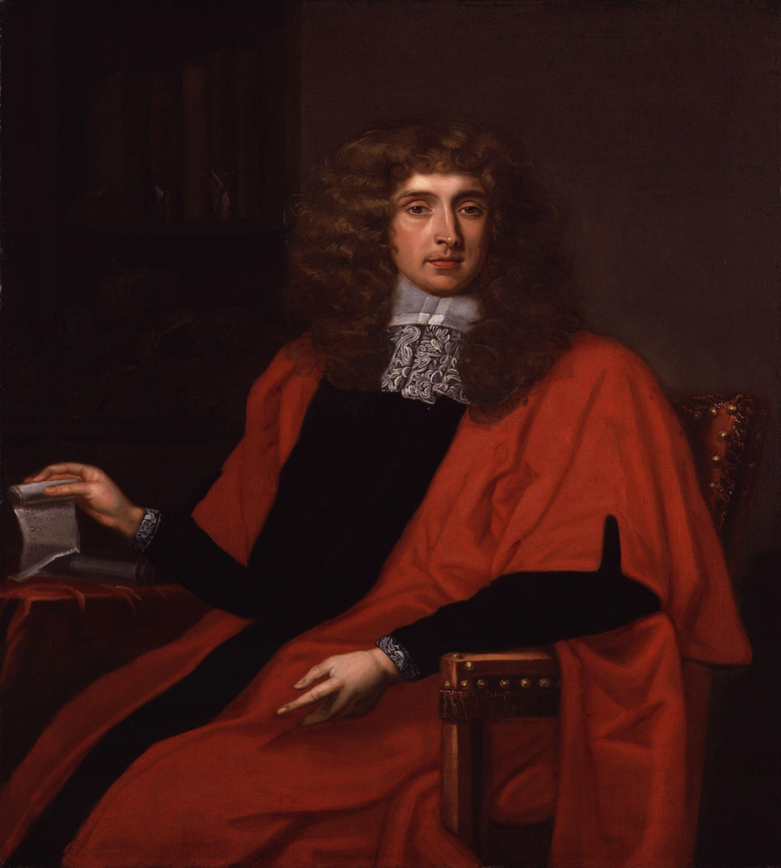
Sir Judge George Jeffries 1645 - 1689

Slide 7
Known as the Hanging Judge
James II appointed him Lord Chancellor, Baron of Wem, and Lord Lieutenant of Shropshire
After the Monmouth Rebellion, he tried and sentenced to hang many West Country rebels at the Bloody Assizes in 1685
After the Glorious Revolution in 1688, he tried to flee disguised as a sailor but was captured and died in the Tower in 1689

Slide 8
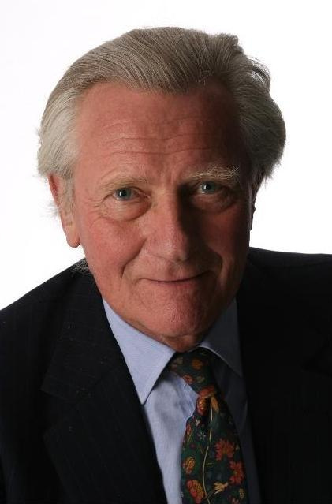
Lord Michael Heseltine (1933 - )

Slide 9
MP 1961 – 2001
Promoted Right to Buy campaign
Served in Margaret Thatcher’s cabinet as Defence Minister, resigned 1986 over Westland affair
Deputy Prime Minister under John Major
Currently in the House of Lords
A lifelong supporter of the EU and announced he would vote for the Liberal Democrats in the 2019 election
The school runs a Heseltine Society

Slide 10
Nevil Shute (1899 – 1960)
Novelist and aeronautical engineer
Wrote 24 novels, including A Town like Alice and On the Beach
Took part in the Normandy landings and later as a war correspondent in Burma
Spent his later years in Australia

Slide 11
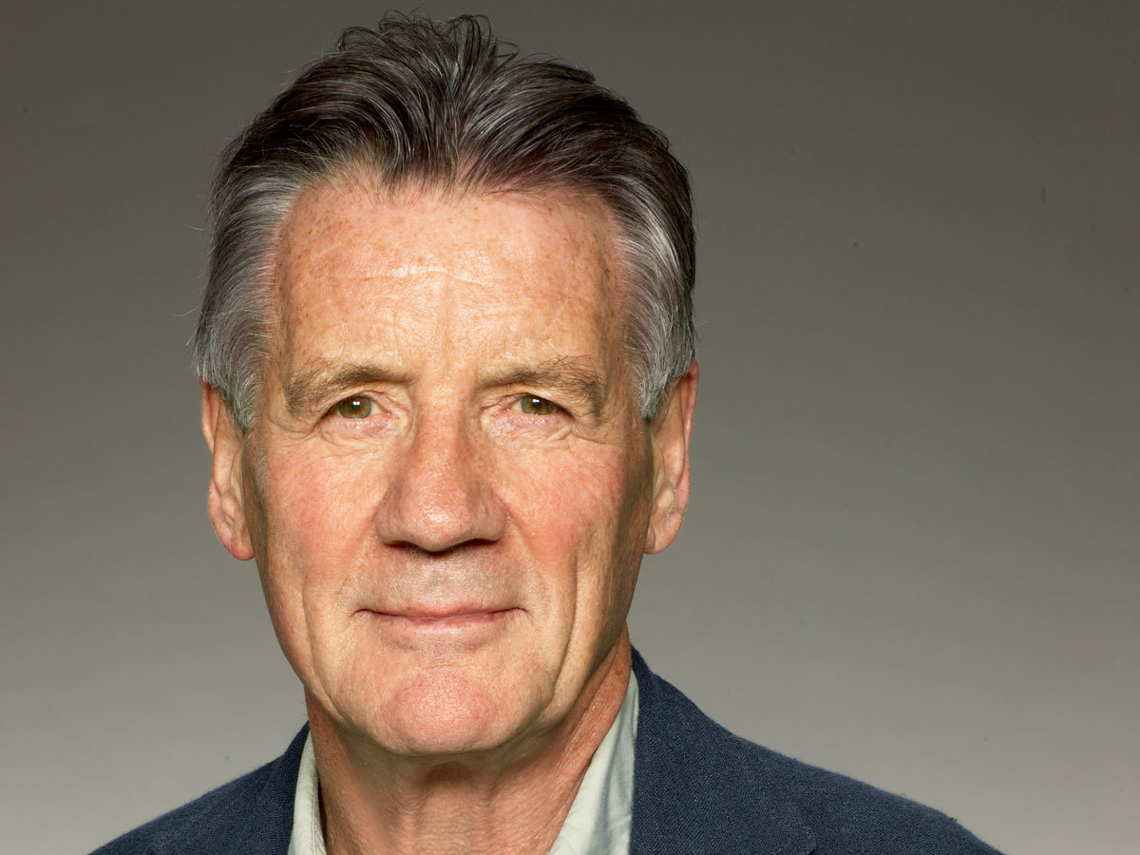
Sir Michael Palin

Slide 12
Comedian, actor, TV presenter and world traveller
Initially a script writer for other comedians and the Frost Report, where he met other Monty Python members
Wrote and took part in many Monty Python sketches and films
A Fish called Wanda
Appointed CBE in 2000 and is only Python member to receive a knighthood
Has presented many travel programmes and documentaries
In 2017 the school launched Palin scholarships

Slide 13
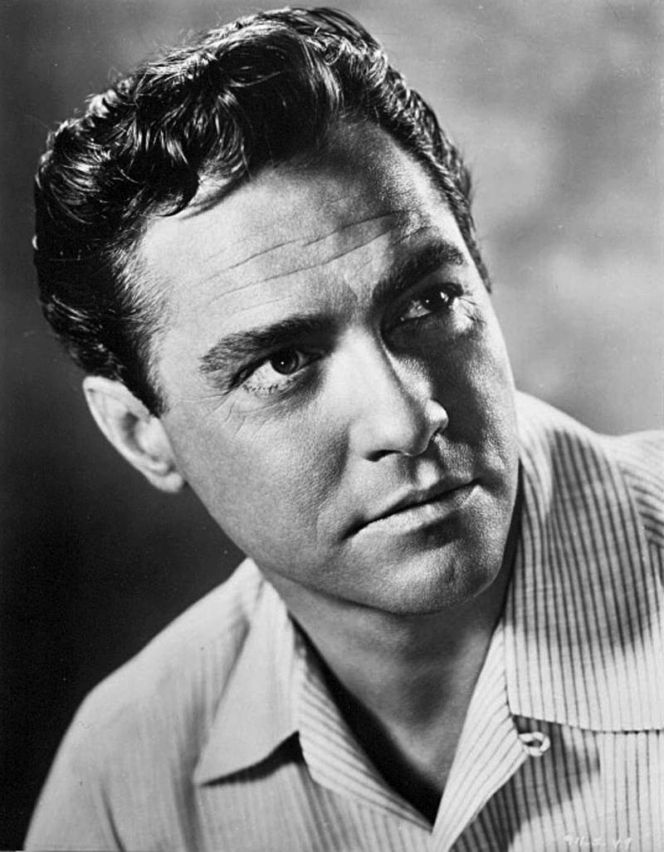

Slide 14
Richard Todd OBE (1919 – 2009)
Spent childhood in India
Served with the Army in World War II
Began acting in repertory after the war
Notable film roles, as Guy Gibson in The Dambusters, and Walter Raleigh in The Virgin Queen
Awarded the Golden Globe

Slide 15
The Founders of Private Eye magazine
Richard Ingrams, Willie Rushton, Paul Foot, and Christopher Booker – all Old Salopians
A forerunner to Private Eye was The Salopian, a school magazine published in the mid 1950’s
Ingrams edited Private Eye until 1986 when Ian Hislop took over
Willie Rushton (1937 – 1996) actor, writer and cartoonist; lifelong member of Labour Party
Paul Foot (1937 – 2004) editor and investigative journalist. Michael Foot was his nephew.

Slide 16
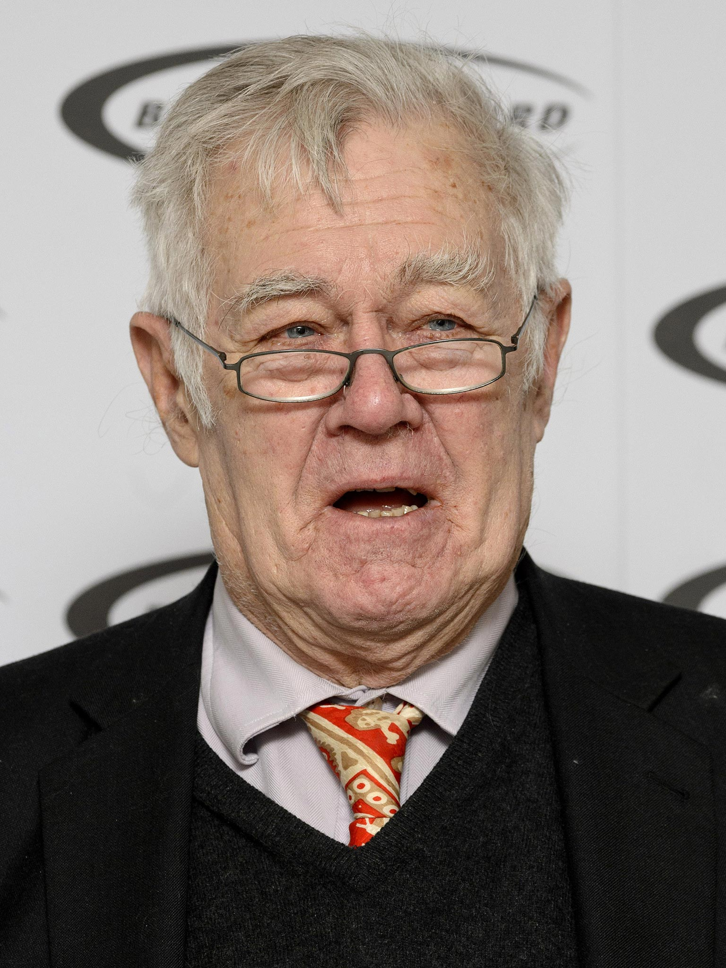
Richard Ingrams

Slide 17
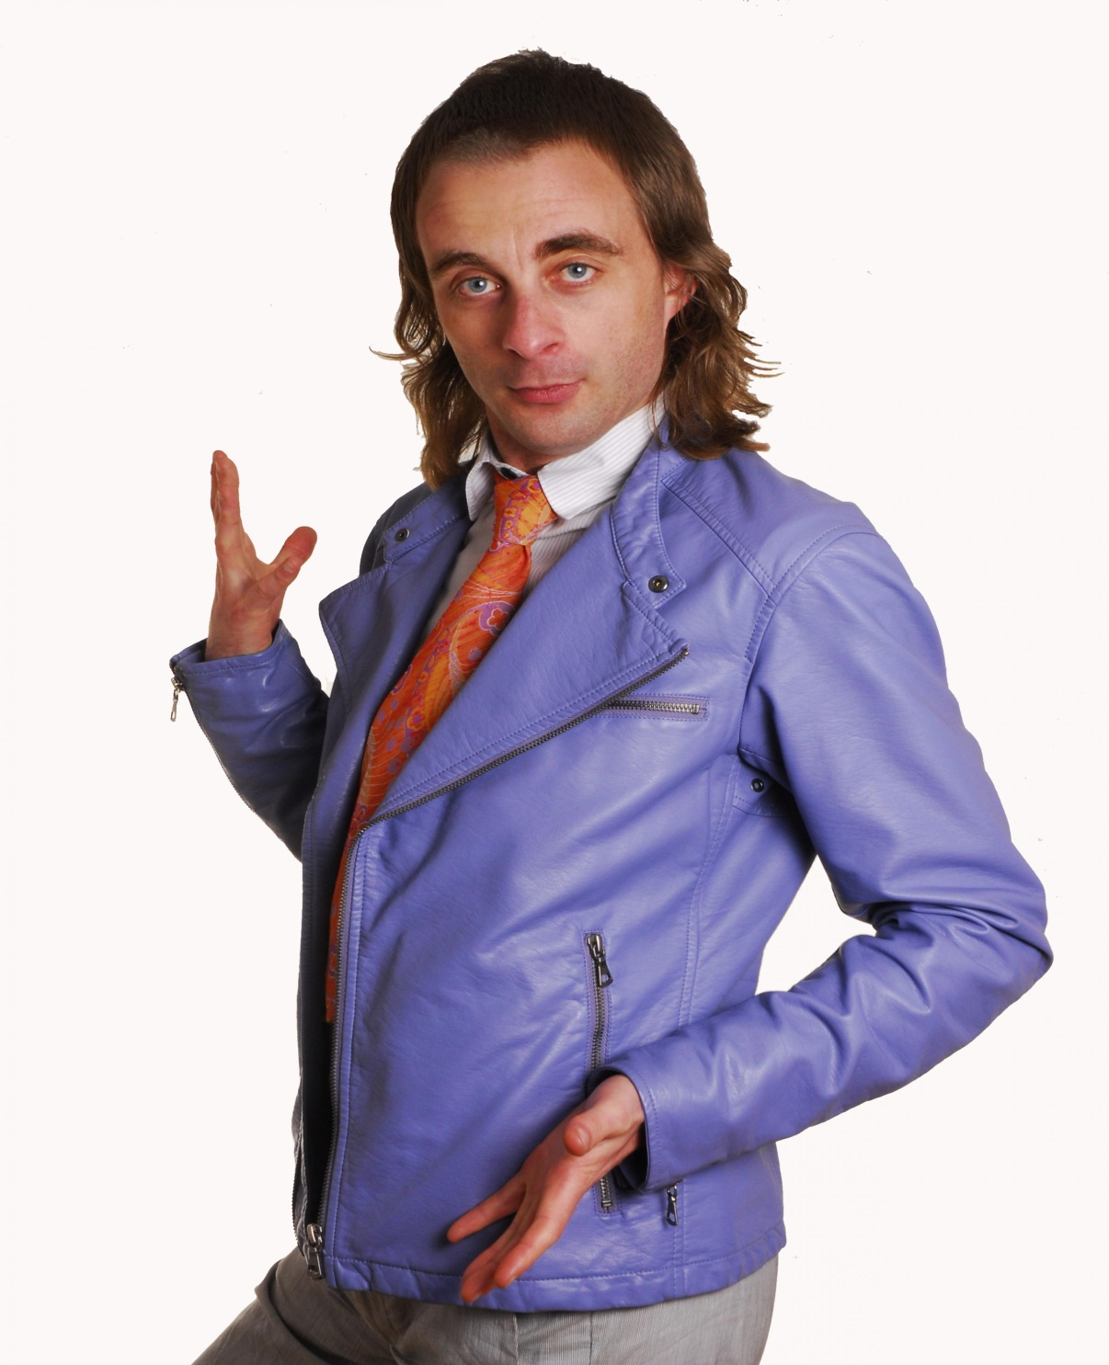
Paul Foot

Slide 18
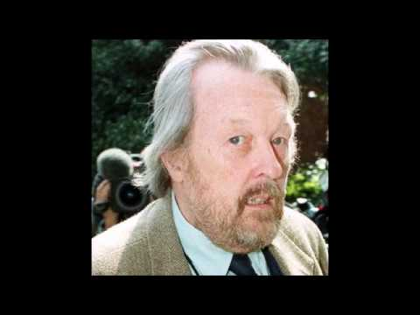
Willie Rushton

Slide 19
David Blakely (1929 – 1955)
Victim of Ruth Ellis, last woman to be hanged for murder in the UK
He was a racing driver and in an abusive relationship with Ellis, who managed a night club

Slide 20
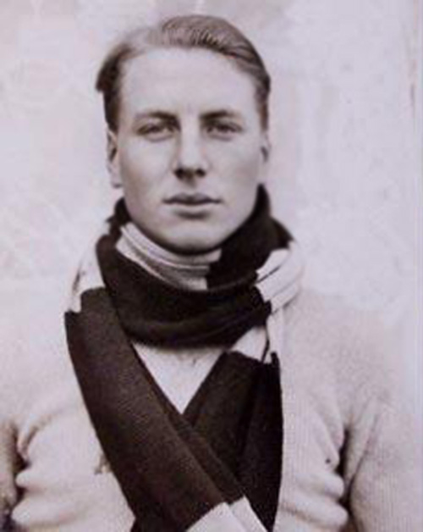
Andrew Irvine (1902 – 1924)

Slide 21
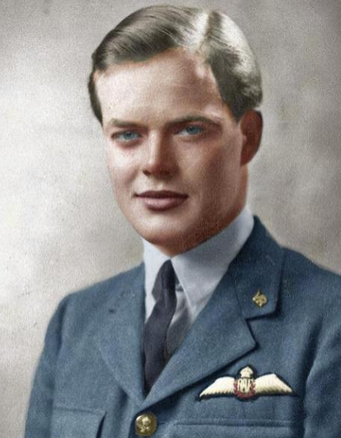
Richard Hillary (1919 – 1943)

