Slide 1
THE SALOP INFIRMARY IN THE 19TH CENTURY

Slide 2
INTRODUCTION
In 1800, the Salop Infirmary had several problems.
Accommodation was inadequate.
Expenses exceeded income.
Shropshire economy in decline.
BUT demand for the Infirmary was increasing.
In 1805, Nelson’s victory at Trafalgar changed economic prospects.

Slide 3

BATTLE OF TRAFALGAR, 1805
Picture by Nicholas Pocock.

Slide 4
1800-1826
By 1808, there was an increased number of subscribers and finances were more settled.
After 1815, and the victory at Waterloo, there was greater prosperity in the country.
By the 1820s there were more than 650 in-patients each year at the Infirmary and approx 2,000 out-patients. By 1826, there was a waiting-list.

Slide 5
NEW ACCOMMODATION
It was clear that the Infirmary needed new premises and a committee was formed to investigate the options.
At the AGM in November 1826, the committee recommended that a new infirmary should be built.
After much debate, it was agreed and a fund-raising campaign was launched.

Slide 6

NEW ACCOMMODATION

Slide 7
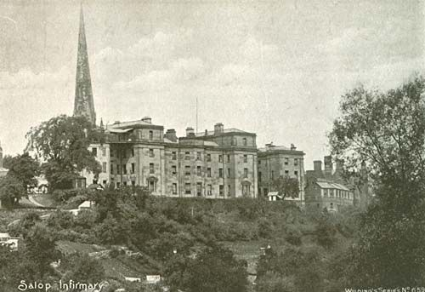
BACK VIEW OF THE HOSPITAL

Slide 8
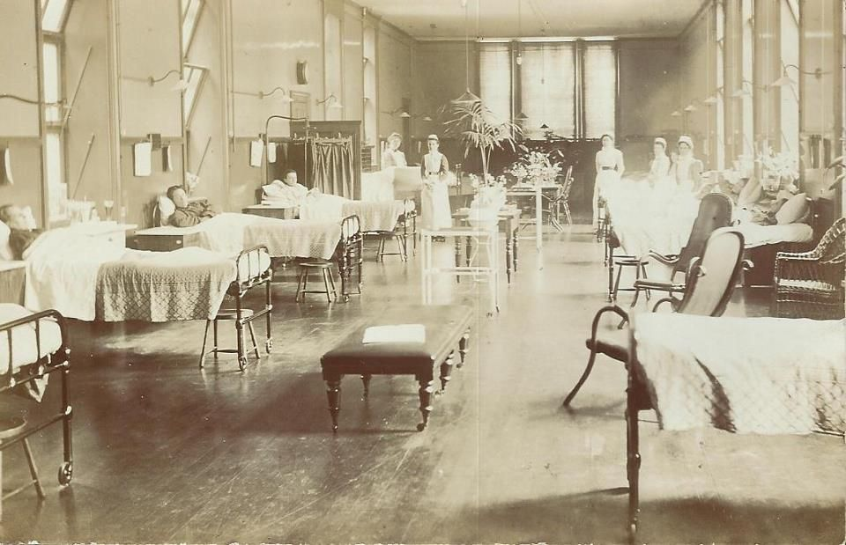
A HOSPITAL WARD

Slide 9
THE PATIENTS
Patient records for 1846/47 show that approx 1,000 patients were admitted that year, most aged from 10-40 years.
Admission was based on the recommendation of the subscribers, not by referral from a doctor.
It was said the voluntary hospitals were really a “sick club” for the gentry, because most patients were agricultural labourers or domestic servants, i.e. employees and tenants of subscribers.

Slide 10
ILLNESSES
Common reasons for hospital admission were:
Dyspepsia
Leg ulcers
Bronchitis
Scrofula
Fractures and diseases of bones and joints
Surprisingly, perhaps, the single most common reason for admittance was syphilis.

Slide 11
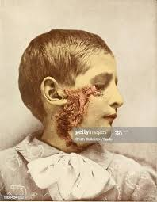
SCROFULA
Scrofula is the most common form of tuberculosis infection that occurs outside the lungs.

Slide 12
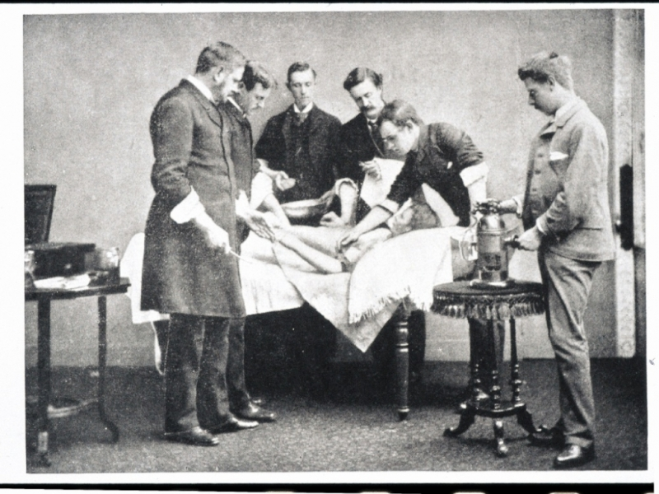
ANAESTHESIA

Slide 13
FINANCIAL COMPARISONS
Salop Infirmary
Salisbury Infirmary
Catchment area: 230,000
Admission rate of 5.2 per 1,000 population
Cost of each admission (1855): £2.39
Average length of stay: 26 days
Treated patients for one-third less than other hospitals.
Catchment area: 246,000.
Admission rate of 2.8 per 1,000 population
Cost of each admission (1855): £3.39
Average length of stay: 43 days
Control of length of stay still critical for hospitals today.

Slide 14
SOME HOSPITAL SCANDALS
In 1831 Dr John Webster succeeded Dr Robert Darwin at the Salop Infirmary.
A friendship developed between the doctor and Mrs Eliza Wilton, wife of a prominent draper in the town.
On her death-bed, she confessed to her husband that she had been unfaithful.
Mr Wilton sued the doctor and the court case led to the doctor’s dismissal from the hospital.

Slide 15
DR J PROUD JOHNSON
This physician caused several conflicts.
Dispute over purchase of drugs upset two prominent local chemists, who were also trustees of the charity.
Opposed a proposal to elect Mr Sutton as “Surgeon Extraordinary”, an honour normally given to distinguished surgeons on retirement.
Then……

Slide 16
THOMAS TOMLINS
The whole institution was brought into public disrepute over the case of Thomas Tomlins.
He was an inmate at Atcham workhouse who was admitted to the hospital with a gangrenous leg. The surgeons couldn’t agree on his treatment. One wanted to amputate and the other two wanted to try an operation.
All medical staff consulted and weeks of dispute followed. Dr Johnson and one of the surgeons favoured amputation; the others disagreed.

Slide 17
THOMAS TOMLINS
Finally, Tomlins was smuggled out of the infirmary and taken to see William Clement, a well-known Shrewsbury surgeon. Clement amputated the leg and Tomlins was taken back to the workhouse.
The whole incident was reported in “The Lancet” and an investigation was carried out.
Dr Johnson and one of the surgeons, Mr Keate, were found to be “highly blamable” and were both dismissed.

Slide 18
MISS PIM
In 1856, Miss Pim was appointed matron, amid controversy. The directors preferred another candidate, but the subscribers elected Miss Pim.
Miss Pim was accused of slighting Lady Leighton, wife of the chairman and was dismissed.
Her supporters raised 88 sovereigns (more than a year’s salary) for her and one of the surgeons resigned in protest and went off to Lancashire.

Slide 19
CONCLUSION
Overall, the story of the Salop Infirmary in the 19th century was a huge success.
It survived difficult financial times at the start of the century and was able to achieve a brand-new, state-of-the-art building in 1830.
It offered its patients advanced medical treatment and yet managed to keep its costs relatively low.

Slide 20
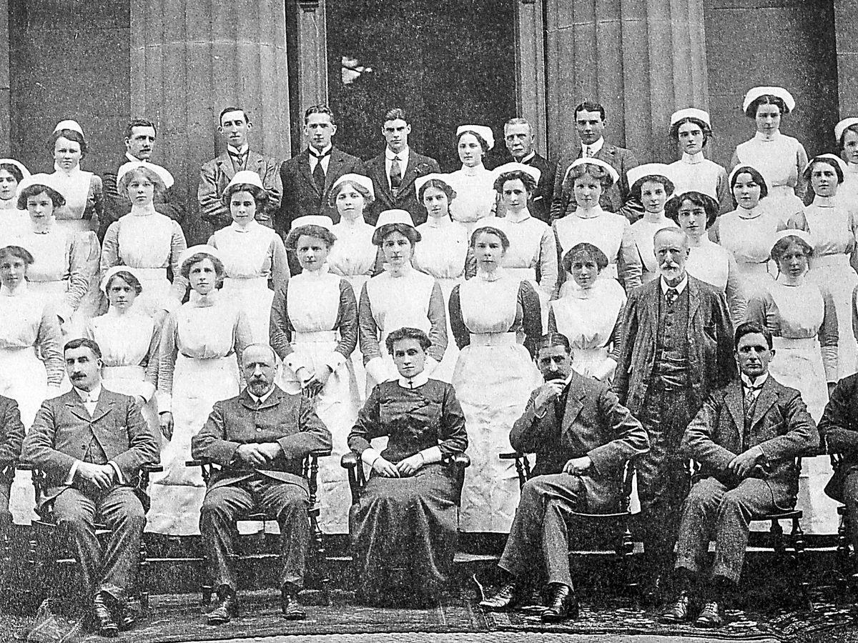
HOSPITAL STAFF, 1914

Slide 21
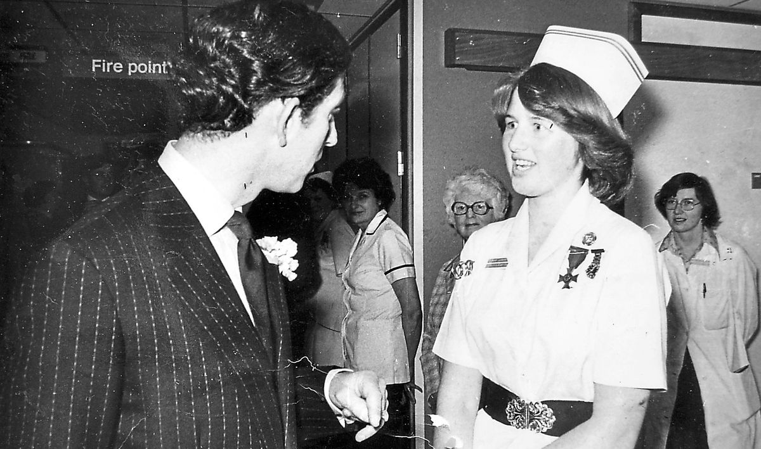
VISIT OF PRINCE CHARLES, 1978
HRH with nurse Lynne Breakell

