Slide 1
The Windows Photos App
Shrewsbury u3a
Computer Club

Slide 2

Introduction
Looking at basic editing of images.
Lots of programmes that will do this for you.
Photos
Paint
Affinitity Designer
Adobe Photoshop (Elements)
GIMP
We are just looking at the Photos app
Notes:
Adobe Photoshop Elements 2023. £86.56
Affinity Designer 2. £89.99 (Currently 40% off £144.99) or just £35.99 forjust one of the three apps. Designer 2, Photo 2 or Publisher 2.
GIMP GUI Image Manipulation Programme £.00.00 free
Photos Help https://support.microsoft.com/en-gb/windows/photos-help-702104c6-7541-6757-d624-c0846b3bdbd3?ocid=cmme032lwht

Slide 3
Use as a viewer
Updated version Oct 2022
  Amongst a general update, now includes integration of iCloud photos.
Add in addition folders as you wish.
Mark some pictures as Favourites.
Display as SML, Square or River (my choice)
Sort by Date Taken, Created, Modified or Name. Asc or Des.
Import from a connected device.
Share.
Edit.

Slide 4
The edit Screen
Double click a photo to edit it.
Edit, Rotate, Delete, Make Favourite, File info, Share, More.
Full Screen, Actual Size, Zoom,

Slide 5

Edit Functions
Crop: and/or shape to specific aspect ratios.
Adjustment: Brightness, Exposure, Contrast, Highlights, Shadows Vignette.
Colour: Saturations, Warmth & Tint.
Filter: B&W, B&W Cool, B&W Warm, Golden, Radiate, Cool etc
Mark Up: Draw with Highlighter or pen tool.

Slide 6
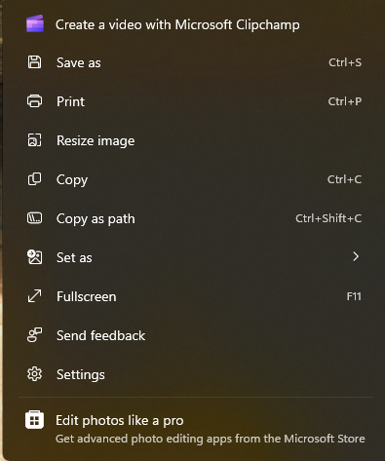
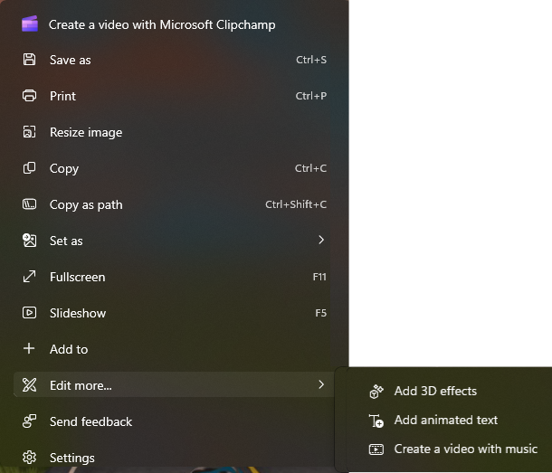
Photos &
Photos Legacy

Slide 7
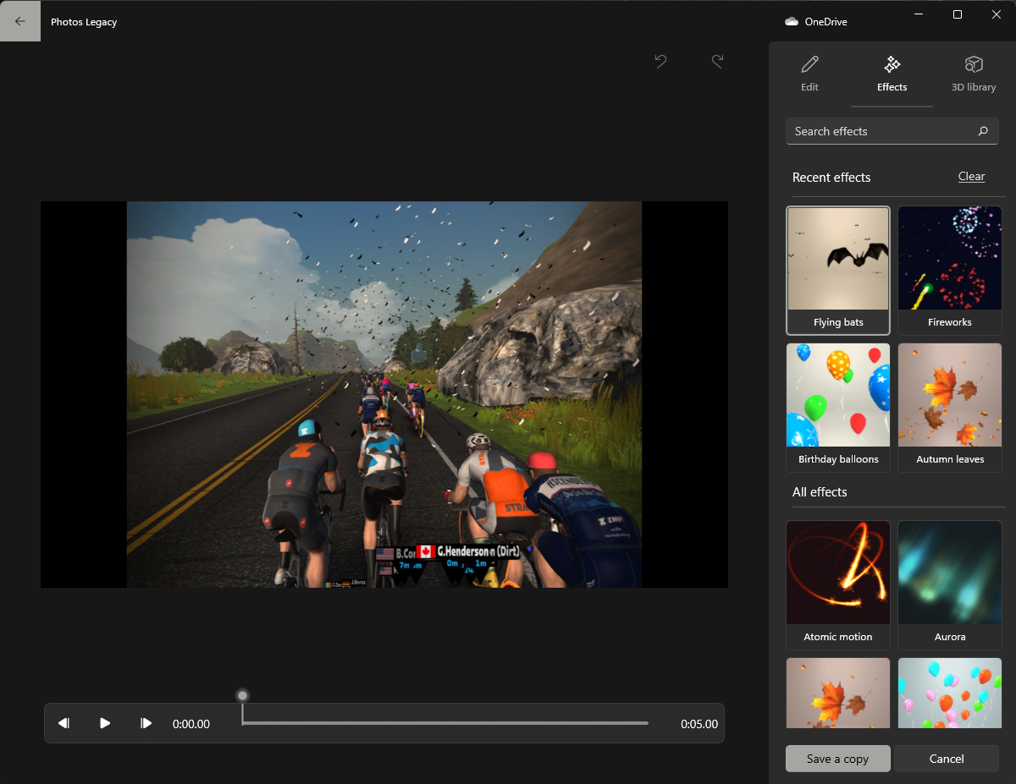
3D
Effects

Slide 8



Summary
There are many apps to edit and enhance your photos, the Windows Photos app comes preinstalled with Windows.
It’s a good viewer and present a good range of photo enhancement functions
Try the photos Legacy app for some interesting 3D effects

Slide 9




Thank you

