Slide 1
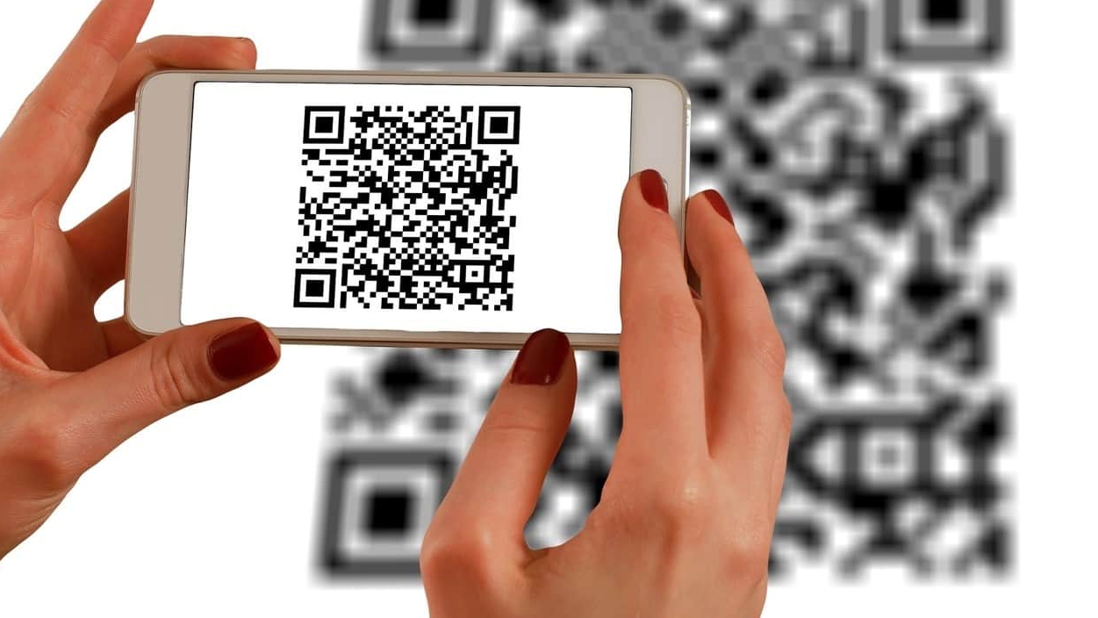
QR Codes
Geoff Lane

Slide 2
What is a QR Code
QR Stands for Quick Response.
It is a type of Barcode.
Can be read by a digital reader – like the camera on your phone
Handles four modes of data:
  Alphanumric, numeric, binary and Kanj.
Holds a lot more data than a barcode.
Most popular use is to take you to a website.
There are different versions
Notes:
Created in the Mid 1990’s vy a subsidiary of Toyota as a way to track automobiles throughout the manufacturing process. Normal barcodes require a light source to read them and are one dimensional. They also are limited in their scope in that they only provide the numeric value of a product (about 12 characters), QR codes are two dimensional and can be read by a digital QR reader – similar to the camera on your phone or an app that you can download and install and can hold much more data up to 4,000 characters
Quick response (QR) codes are square-shaped matrices of dark or light pixels used to encode and quickly retrieve data using computer devices.
An enhancement on traditional barcodes, QR codes can store vastly more information and are used in a variety of applications from supply chain management to cryptocurrency wallet addresses.
Several versions and variations of QR codes now exist that are customized to different purposes, or which can store greater amounts of data.
Primarily handle four modes of data: alphanumeric, numeric, binary, and Kanji. (Kanki holds Japanese characters (it was invented in Japan)
Numeric mode - This is for decimal digits 0 through 9. Numeric mode is the most effective storage mode, with up to 7,089 characters available.
Alphanumeric mode - This is for decimal digitals 0 through 9, plus uppercase letters A through Z, and symbols $, %, *, +, –, ., /, and : as well as a space. It allows up to 4,296 characters to be stored.
Byte mode- This is for characters from the ISO–8859–1 character set. It allows 2,953 characters to be stored.
Kanji mode - This is for double–byte characters from the Shift JIS character set and used to encode characters in Japanese. This is the original mode, first developed by Denso Wave. However, it has since become the least effective, with only 1,817 characters available for storage.

Slide 3
Uses of a QR Code
Log in to a website
A mobile ticket
Restaurant ordering
Download an App
Send and Receive payment information
Bus stops, train stations & tube. Real time info
Social Media apps (all of them!)
Product packaging
E Learning
As a gift
In museums and art exhibitions
Wine and spirit bottles
Business cards
On a wedding invitation
Treasure Hunts
Tracking vehicles through manufacturing
Just displaying some text
Advertising – to a web page
Digital Payments
Your BitCoin address
Add a vCard contact to your contacts list
Connect to a wireless network
Compose an email or text message
Been printed on coins and banknotes
Displays multimedia – a video, audio, image etc
Combat Counterfeiting
House purchases
Add one to your CV
Notes:
Combat Counterfeiting. Fashion retail brands add a unique digital identity and product authenticity
Login to a website. Scan the QR code with a verified phone and you are good to go.
Restaurant ordering: The menu on your table has a unique QR code. So that it knows who you are.
Bus stops, train stations & tube – updated information on cancellations etc
Launch all your social media apps in one go.
E Learning – include a QR code in a book or magazine that takes you to a website for extra information or an audio or video course
Add a QR code to a gift tag for your dearly beloved to see the online surprise (Cruise for 2?)
Wine and Spirit bottles – The story behind their favourite tipple, how it is manufactured etc
Details of the big day, local hotels for accommodation etc, pictures of the wedding and honeymoon (afterwards)

Slide 4
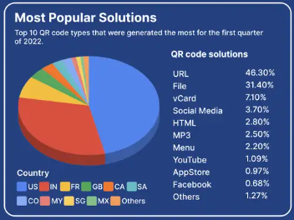

Slide 5
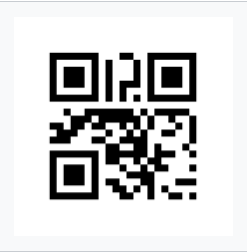
The versions:
Version 1 (21×21). Content: "Ver1"

Slide 6
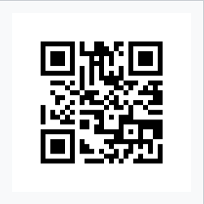
The versions:
Version 2 (25×25). Content: "Version 2"

Slide 7
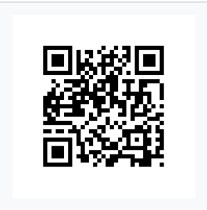
The versions:
Version 3 (29×29). Content: "Version 3QR Code"

Slide 8
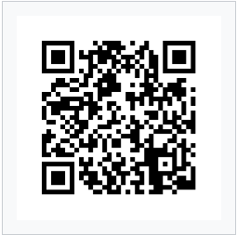
The versions:
Version 4 (33×33). Content: "Version 4 QR Code up to 50 characters"

Slide 9
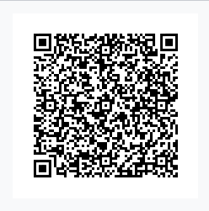
The versions:
Version 10 (57×57). Content: ""VERSION 10 QR CODE, UP TO 174 CHAR AT H LEVEL, WITH 57X57 MODULES AND PLENTY OF ERROR CORRECTION TO GO AROUND. NOTE THAT THERE ARE ADDITIONAL TRACKING BOXES"

Slide 10
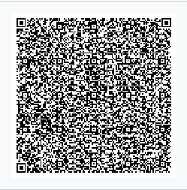
The versions:
Version 25 (117×117). Content: "1,269 characters of ASCII text describing QR Codes"

Slide 11
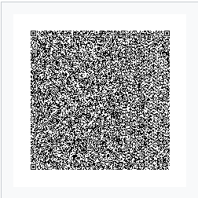
The versions:
Version 40 (177×177). Content: "Version 40 QR Code can contain up to 1852 chars..." (and followed by four paragraphs of ASCII text describing QR Codes)”

Slide 12
What are all the dots for?

Slide 13

Position Detection Markers
Notes:
01 Positioning detection markers
Located at three corners of each code, it allows a scanner to accurately recognize the Code and read it at high speed, while indicating the direction in which the Code is printed.
They essentially help quickly identify the presence of a QR Code in an image and it's orientation.

Slide 14

Alignment Markers
Notes:
02 Alignment markings
Smaller than the position detection markers, they help straighten out QR Codes drawn on a curved surface.
And, the more information a Code stores, the larger it is and the more alignment patterns it requires.

Slide 15

Timing Pattern
Notes:
03 Timing pattern
Alternating black/white modules on the QR Code with the idea of accurately helping configure the data grid.
Using these lines, the scanner determines how large the data matrix is.

Slide 16

Version Information
Notes:
04 Version information
With currently 40 different QR Code versions, these markers specify the one that is being used.
The most common ones are versions 1 to 7.

Slide 17

Format Information
Notes:
05 Format information
The format patterns contain information about the error tolerance and the data mask pattern and make it easier to scan the Code.

Slide 18

Data and Error Correction
Notes:
06 Data and error correction keys
The error correction mechanism inherent in the QR Code structure is where all your data is contained,
also sharing the space with the error correction blocks that allow up to 30% of the Code to be damaged.

Slide 19

The Quiet Zone
Notes:
07 Quiet zone
This is similar to the importance of white space in design, that is it offers structure and improves comprehension.
For whom or what you may ask? For the scanning program. In order to distinguish the QR Code from its surroundings, the quiet zone is vital.

Slide 20
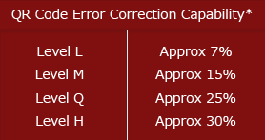







Error Correction
Notes:
4 levels of error correction. Low Medium, Q (Quarter) and High.
Obviously the more you have then the less spots you have for actual data. However, don’t forget there are 40 versions to choose from, So you can have a High Level of error correction but with a larger QR code ie more pixels, not area.
https://en.wikipedia.org/wiki/Reed–Solomon_error_correction

Slide 21
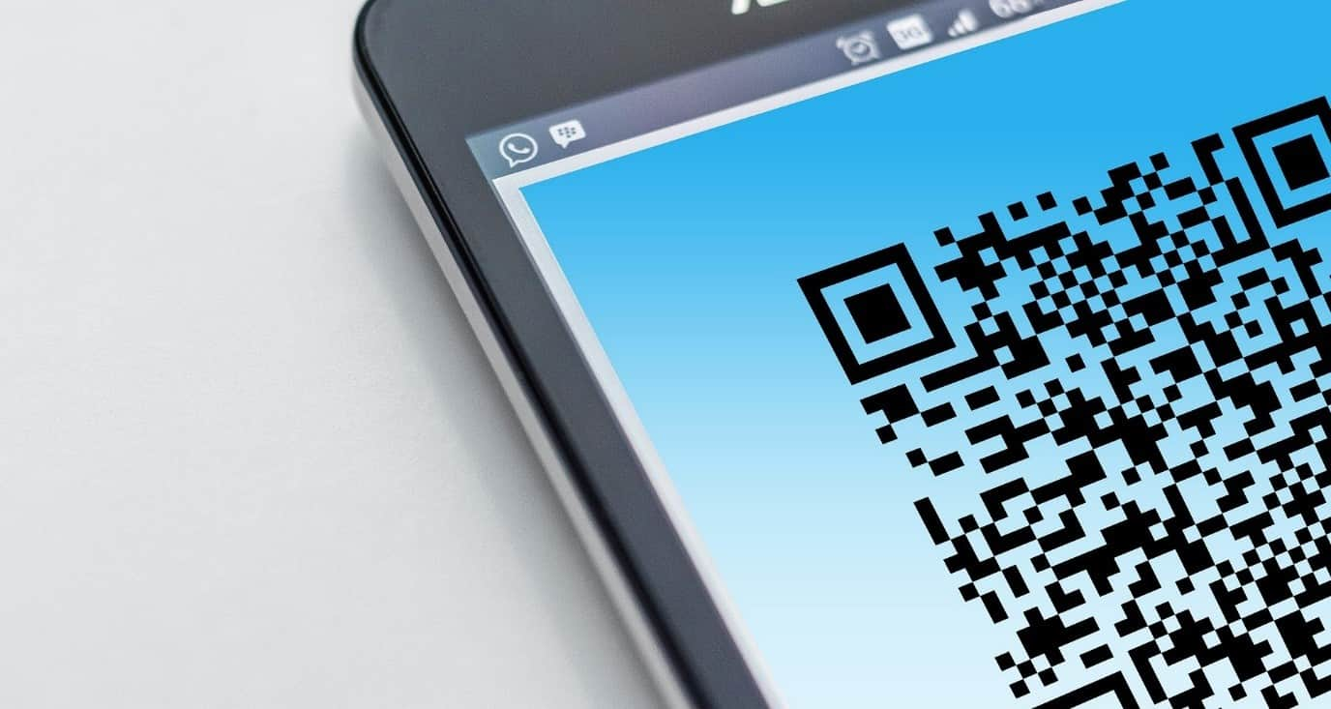
Are they safe?
“
”
Sandra Lane

Slide 22

The Risks
Notes:
QR Codes themselves are not faulty or risky. It is the end result that is (or might be).

Slide 23
The Risks
You could be sent to a fake website
Stickers over a legitimate QR Code – Parking Meters
Malicious websites – “drive by”
Russian phones sent premium rate texts.
QR Codes do not collect personal information.
Dynamic codes do collect data – but not personal
Use a scanner that checks codes first. ie Kaspersky QR Scanner
Notes:
QR Codes themselves are not faulty or risky. It is the end result that is (or might be).
Attackers can embed malicious URLs containing custom malware into a QR code which could then exfiltrate data from a mobile device when scanned. It is also possible to embed a malicious URL into a QR code that directs to a phishing site, where unsuspecting users could disclose personal or financial information.
Do QR codes collect my personal information and data? QR code-generating software does not collect personally identifiable information.
Dynamic QR Codes do collect data. The data it does collect – and which is visible to the code’s creators – includes location, the number of times the code has been scanned and at what times, plus the operating system of the device which scanned the code (i.e., iPhone or Android).
Because humans cannot read QR codes, it is easy for attackers to alter a QR code to point to an alternative resource without being detected. While many people are aware that QR codes can open a URL, they can be less aware of the other actions that QR codes can initiate on a user’s device. Aside from opening a website, these actions can include adding contacts or composing emails. This element of surprise can make QR code security threats especially problematic.
A typical attack involves placing malicious QR codes in public, sometimes covering up legitimate QR codes. Unsuspecting users who scan the code are taken to a malicious web page which could host an exploit kit, leading to device compromise or a spoofed login page to steal user credentials. Some websites do drive-by downloads, so simply visiting the site can initiate a malicious software download.
In Russia, a malicious QR code caused phones that scanned it to send premium texts at a fee of $6 each.
QR codes have also been linked to scams in which stickers are placed on parking meters, posing as quick payment options, as seen in Austin, San Antonio and Boston, among other cities across the United States and Australia.
If your phone doesn’t have a built in QR Scanner, there are lots you can download from the Google Play Store or Apple equivalent.
See if there are settings in your scanner to view the destination first before launching the website
The Kaspersky QR Scanner provides everything you need from a QR Scanner, such as adding contacts to your phone. It also creates a log of past scans so that, if necessary, you can trace back to see when and where you may have been compromised.. Better than all that though, it checks the validity of any web address for you before it opens that page. Neat.

Slide 24




Any questions?

Slide 25

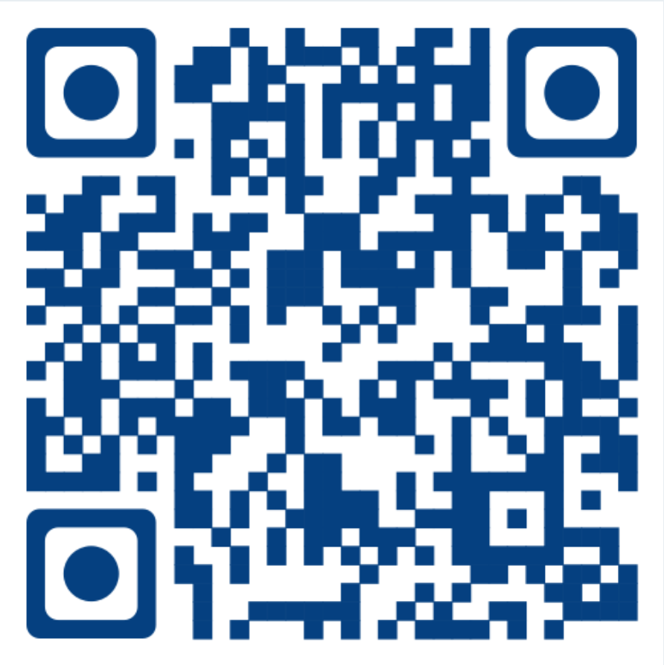
Try it
Scan me!

