Slide 1

Send me a txt, send me an email.
Geoff Lane​​
17 Jan 2023
Notes:
Today we are going to be looking at security of sending emails and texts via messaging apps. Which are the most popular, most secure and so on. Later we are going to look at QR Codes
Emails first of all

Slide 2
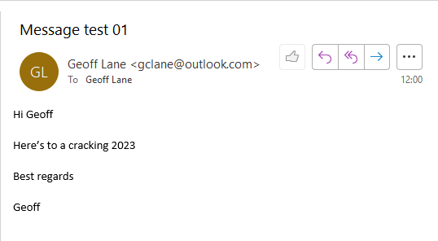
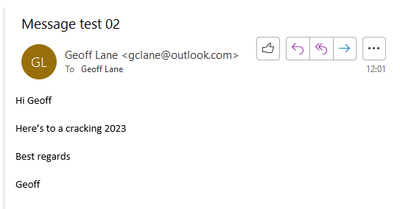

What is the difference
Notes:
What is the difference between these 3 emails
****** test 02
****** test 03

Slide 3
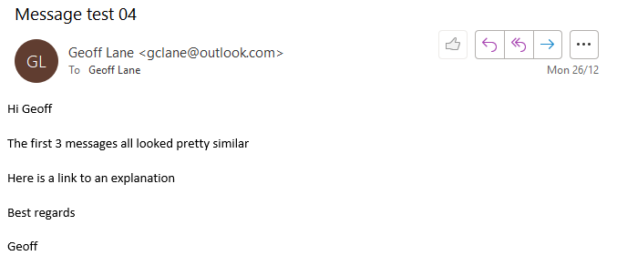
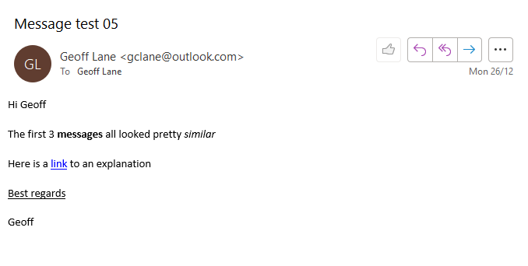
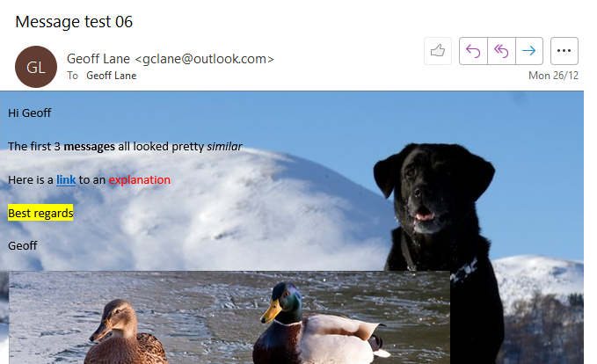
What is the difference
Notes:
Maybe clearer with thee three messages
****** test 05 – Character formatting and hyperlinks
****** test 06 – Character formatting, hyperlinks and pictures + code

Slide 4

The Formats
HTML
Rich Text Format
and Plain Text
Notes:
The three different formats to send an email – plus their pros and cons
***** HTML
***** Rich Text Format
***** Plain Text

Slide 5


HTLM
The bells and whistles of today’s email – it’s the norm.
Allows text formatting: Bold, italics, underline Size etc,
Insertion of hyperlinks and pictures.
Crucially, allows code; legit and non-legit to be executed.
Notes:
HTML

Slide 6


Plain Text
Plain text is as it says.
No extras, just the standard character set.
No hyperlinks, character formatting or pictures.
Very safe
Notes:
Plain Text
To ensure you are really safe you can have all your email delivered as Plain text – so you can’t click a link in the email to execute any malicious code.

Slide 7


Rich Text Format
Halfway between HTML and Plain Text.
Allows character formatting. Bold, underline and size.
Shouldn’t allow pictures or hyperlinks
Notes:
Rich Text format
More than Plain Text, not so much as HTML – although in my Outlook it seems to be the same as HTML! That’s because it was converted to HTML. RTF is a Microsoft format that is only supported by Microsoft Exchange and all version of Outlook.

Slide 8

So , if you want to be really safe, set your mail to receive in Plain Text only – However, it’s a pain in the a**e.
Better to train yourself to think about an email first before you click a link
Notes:
In Outlook you would need to go File | Options | Trust Centre | Trust Centre Settings | Email Security |
and enable the checkbox for “Read all standard mail in Plain Text”

Slide 9
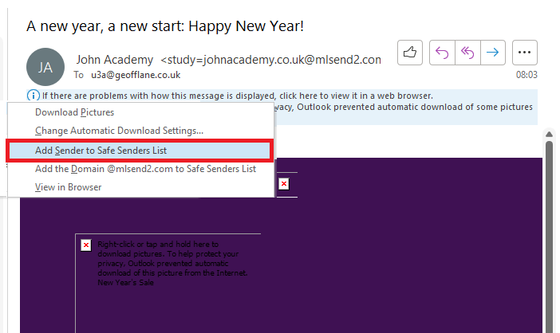
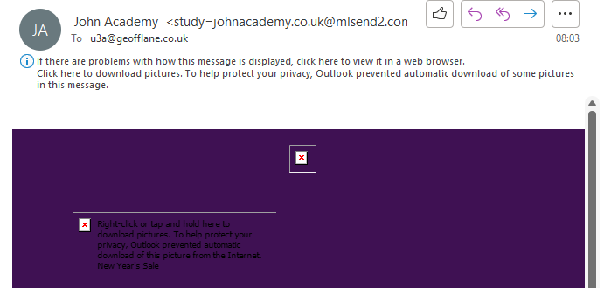
Click to download pictures
You’ll be familiar with the prompt. Click to download the pictures.
Then click again on the next email you receive – and again on the next. ​
​
Notes:
While we are looking at emails, I’m sure you’ve all see the “Click here to download pictures” prompt.
If you do that Outlook will download the pictures for THAT Message only.
***** If you right click and “Add sender to Safe Senders List” you will always get the pictures.
TIP. If you reinstall Windows or otherwise refresh your OS installation, remember to export and then import your Safe Senders List – otherwise you’ll have to save them all again.

Slide 10
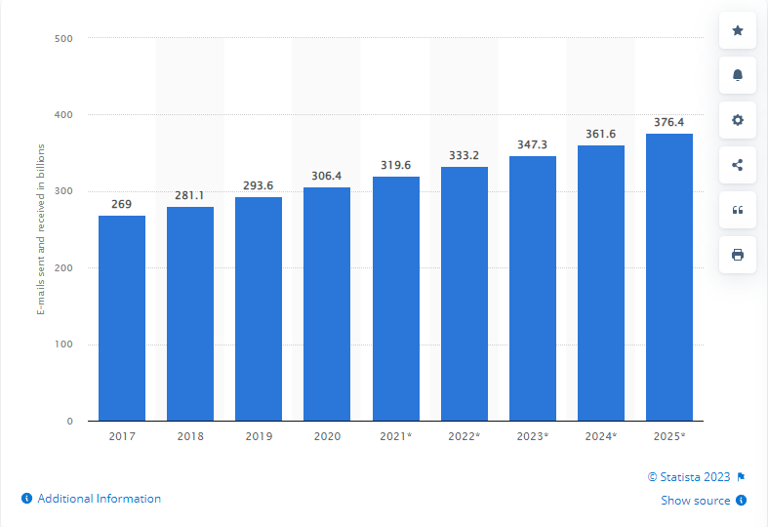
Emails sent & received per year
2017 - 2025
Are emails getting less popular?
Notes:
Emails aren’t going away. Even though messaging apps have become popular, use of email is still increasing –and forecast to increase.
******* Emails sent and received

Slide 11

How secure is my email?
Email by default is not and was never intended to be a secure mechanism for sending sensitive data.
Notes:
However, it’s not very secure.
****** By default is not secure……
Things you shouldn’t include in an email.
Any personal information.
Logins
Passwords
Passport numbers
NI Insurance numbers
Date of birth

Slide 12

Encrypting e-mail
Today, there are two main protocols used for encrypting emails:
Encrypting an email while it’s in transit (TLS)
End-to-end email encryption
Notes:
You can encrypt email.
There are two main protocols:
TLS Transport Layer Security
And End to End Encryption (E2EE)

Slide 13
Transport Layer Security
Transport Layer Security (TLS) Encryption is used by email providers, like Microsoft and Google, to secure emails as they move from sender to recipient From your mail server to theirs. It stops emails from being read after they are sent, but before they are delivered.
It stops “Man in the Middle” attacks.
Notes:
Only works between the mail servers. Not from you to your server and from their server down to them.
It does stop “Man in the Middle” attacks.

Slide 14
End-to-end Encryption
End-to-end encryption (E2EE) ensures that email messages are encrypted by the sender and can only be decrypted by the intended recipient on their device. End-to-end encrypted emails are secured at every stage of delivery and cannot be read even by email servers.
Put simply, end-to-end encryption uses public keys to secure email. The sender encrypts messages using the recipient’s public key. The recipient decrypts the message using a private key.
Can be hard to set up

Slide 15


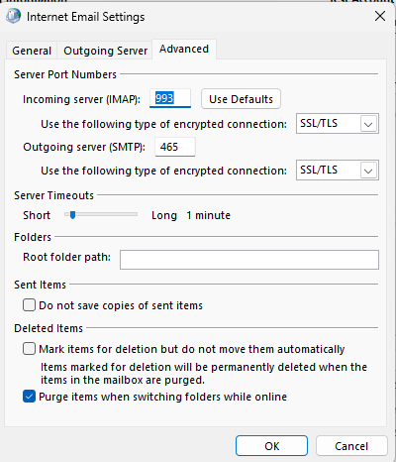
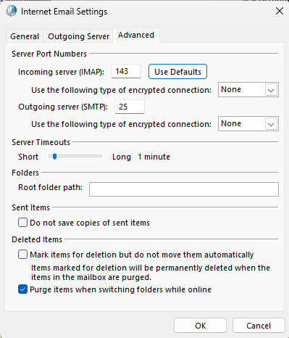
Advanced Mail settings
Notes:
My Mail server settings.
***** With
***** and Without TLS

Slide 16

Is there a better way to send secure communications?
Messaging Apps
Notes:
The best encrypted instant messaging apps for Android make it simple and easy to keep your chats, calls, and videos private and secure.
Messaging apps have been common in Android smartphones since their release, but while there are an increasing number of privacy apps available, there are also a growing number of encrypted chat apps.
These aim to better protect users in an internet world where marketing(opens in new tab) companies are increasingly trying to not just track users but also read their messages. Additionally, private messaging traditionally involves copies of your chat sessions to be saved on the company servers(opens in new tab), which could be exposed and published online by a successful hack attack.
Encrypted instant messaging ensures privacy(opens in new tab) and security by making sure that only the person you are sending your messages to can actually read them. Powerful encryption software(opens in new tab) built into the messaging apps means that any third-party intercepting those messages will not be able to read them.
With the ever-increasingly popularity of Android phones, encrypted apps have become increasingly popular. Here we feature the best encrypted instant messaging apps currently available.
***** Messaging Apps

Slide 17


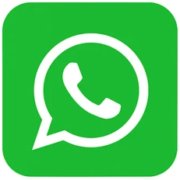



Most Popular Messenger Apps
WhatsApp
WeChat
Facebook Messenger
QQ
Snapchat
Telegram
Notes:
***** WhatsApp
***** WeChat
***** Facebook messenger
***** QQ
***** Snapchat
***** Telegram

Slide 18
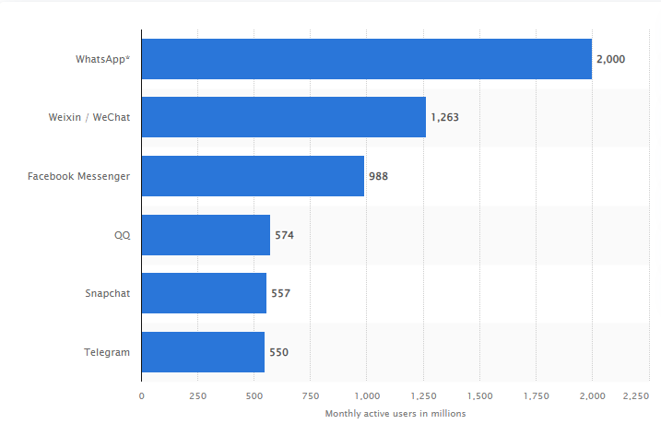
Most popular global messenger apps
Notes:
WhatsApp. Default is E2EE. Owned by Facebook. Messages are not stored on their servers. Nor can they decrypt them themselves. Works across many OS. Video calling, voice messaging and file sharing. Has the golden standard for encryption, but owned by Facebook.
WeChat. Chinese, release in 2011. in 2018 became the worlds largest standalone mobile app with over 1 billion monthly active users. An “App for everything” because of it’s wide range of functions.
Facebook Messenger. Originally Facebook Chat in 2008. Optional E2EE, not the default. Tracks your behaviour, multiple security breaches.
Launched 1999. Chinese.
Snapchat. American, Pictures and messages only available for a short period of time – after which they become inaccessible. Popular among the younger generation <16. Also available Snapchat Plus a paid subscription model
Telegram; 2013. E2EE is only used in “Secret Chats”, it is not the default. Founded by a Russian. Has an open competition open to Hackers win up to $100,000 to crack their encryption. Works on many OS
There are others:
Signal. E2EE is the default. Been around since 2013. Self destruct after xxx time. Open Source. Multiple platforms . Allows you to set a password. Doesn’t store user data or metadata. Good Choice. Smaller user base than the top 6. Gold standard of messaging apps
Wire. Default is E2EE. Also Open source. From 2014 Based in Switzerland – considered one of the best jurisdictions in the world for any kind of secure online service or secure chat app.
Threema
Wickr Me. E2EE by default. Doesn’t store data. Open source. Self destruct messages.
Viber. E2EE by default. Self destructing secret chats
Dust
I Message
Line

Slide 19
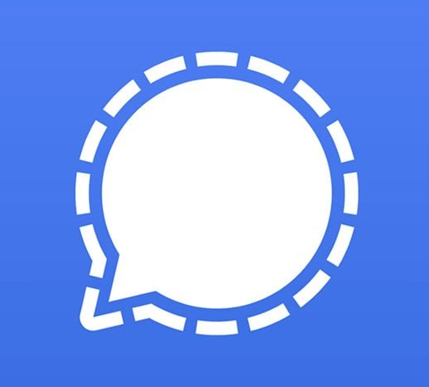
Signal
E2EE is the default
Self destruct after xxx time
Open source
Multiple Platforms
Password if you want
Doesn’t store user data
Gold standard of messaging apps
Notes:
Signal. E2EE is the default. Been around since 2013. Self destruct after xxx time. Open Source. Multiple platforms . Allows you to set a password. Doesn’t store user data or metadata. Good Choice. Smaller user base than the top 6. Gold standard of messaging apps

Slide 20
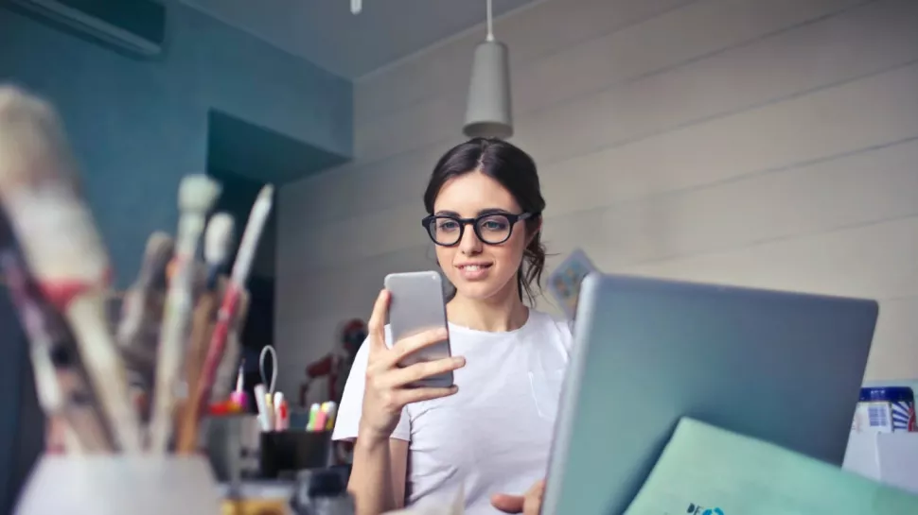
Txt me
Notes:
Email and texts are everyday actions for millions and millions of people. Billions of emails and texts pass though their systems.
Some are more secure than others.
In emails, think before you click a link. Does the email look right? Is it addressed to you or just “Dear Member”. Does the email express a sense of urgency to take action? Are there any typos? Mouse over (not click) any links and view them in the status bar, Does it look a good URL or nonsense.
In Messaging Apps – does the app you use, use “E2EE” by default. If not have you turned it on. Do you delete old messages; consider an app that has self-destruct after xxxx period of time.
Don’t despair, the vast majority of texts and emails are just fine.

