Slide 1
REGENCY SHREWSBURY
FOOD AND DRINK

Slide 2
INTRODUCTION
The Regency was the period between 5 February 1811 and 29 January 1820 when the Prince Regent, eldest son of George III, reigned on behalf of his ill father.
The term “Regency” is often used to describe a wider period of the late 18th and early 19th centuries, from about 1795 to 1837.

Slide 3
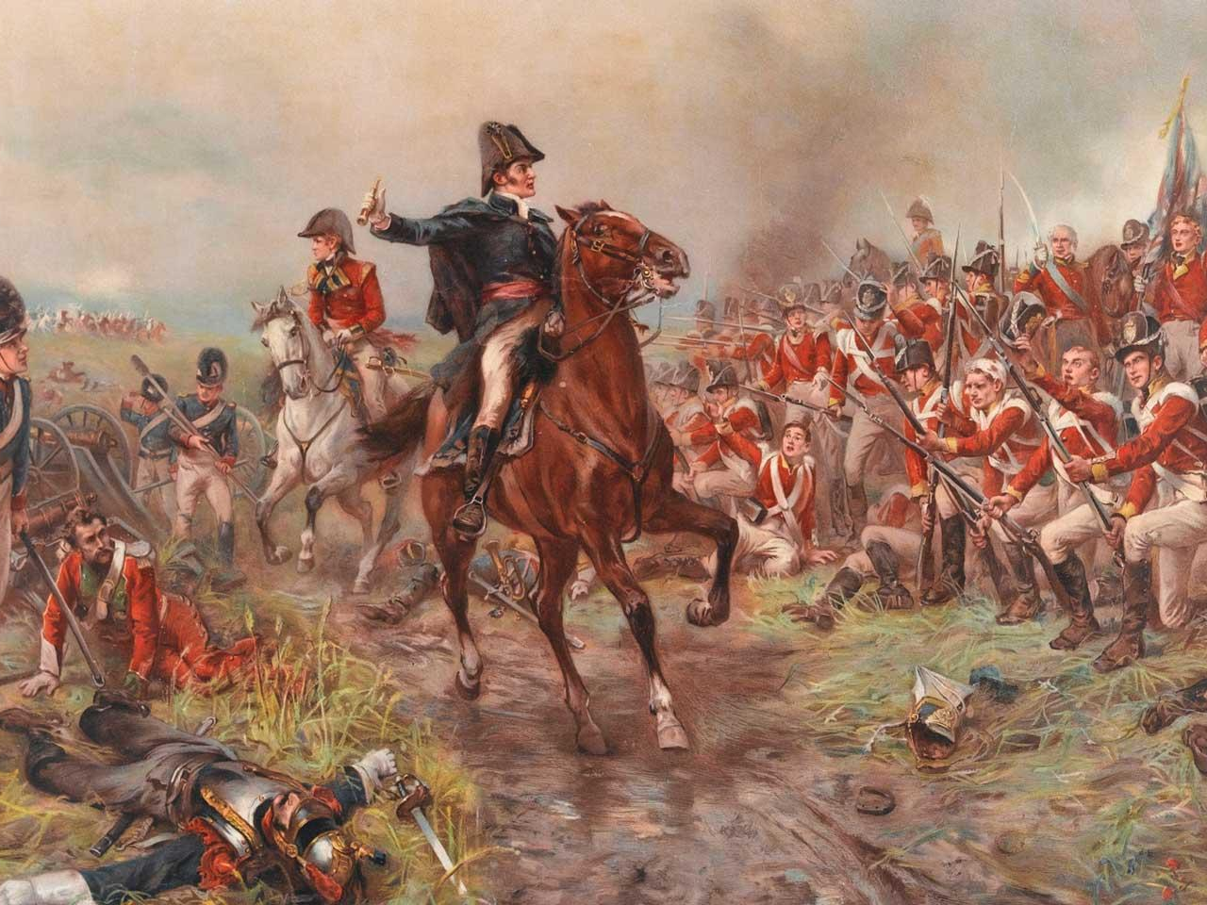
The Battle of Waterloo

Slide 4
NATIONAL EVENTS
Industrial Revolution
Napoleonic Wars
Poor conditions for the mass of the population
Monarchy under strain, because the King was ill and the Prince Regent was on the throne

Slide 5
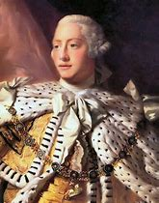
George III

Slide 6
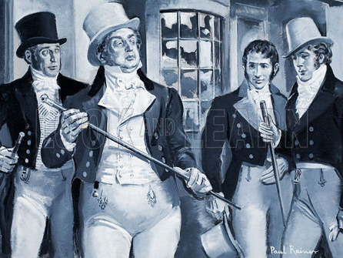
The Prince Regent

Slide 7
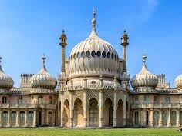
Brighton Pavilion

Slide 8
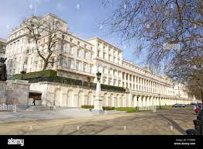
Carlton House, London

Slide 9
CELEBRATION PARTY, JUNE 1811
This is a description of the main table decoration:
“In front of the Regent’s seat was a large circular basin feeding a stream, filled with goldfish, that meandered between banks of moss and flowers, past three picturesque bridges all the way to the end of the table.”

Slide 10
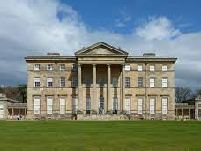
Attingham Park, Shropshire.

Slide 11
TABLE SETTINGS
Dining “a la Francaise”
All dishes on table before diners entered.
Guests helped themselves to food, using footmen if dishes were out of reach.
Plates from first course retained by diners for following courses.
Dining “a la Russe”
Dishes handed round in turn to each guest.
Required more servants, silver, glass and cutlery.
In both styles, footmen served the wine to guests, with glasses kept on a sideboard.

Slide 12
ORDER OF PRECEDENCE
Duke
Marquess
Earl
Viscount
Baron
Knight
NB: If 2 guests held the same rank, the oldest title took precedence.
Duchess
Marchioness
Countess
Viscoutess
Baroness
NB: Lady Anne Cousins was a title from birth; Anne, Lady Cousins, was a title gained through marriage.

Slide 13
CELEBRATION DINNER MENU
FIRST COURSE
Leek and ham soup
Salmon baked in pastry
Fricassee of chicken
Cabbage and spinach cake
Roast saddle of mutton
Asparagus with butter
A boiled neat’s (beef) tongue
Potato pudding
SECOND COURSE
Salmagundi (chopped meat, anchovies, eggs, onions, with oil and condiments)
Raspberry cake
Boiled turkey with crayfish
Braised beefsteaks
A raised game pie
Syllabub
Wine and butter sauce

Slide 14
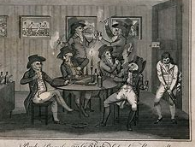
“Drunk as a lord” – the Regency bottle men.

Slide 15
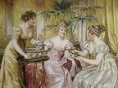
Regency ladies drinking tea.

Slide 16
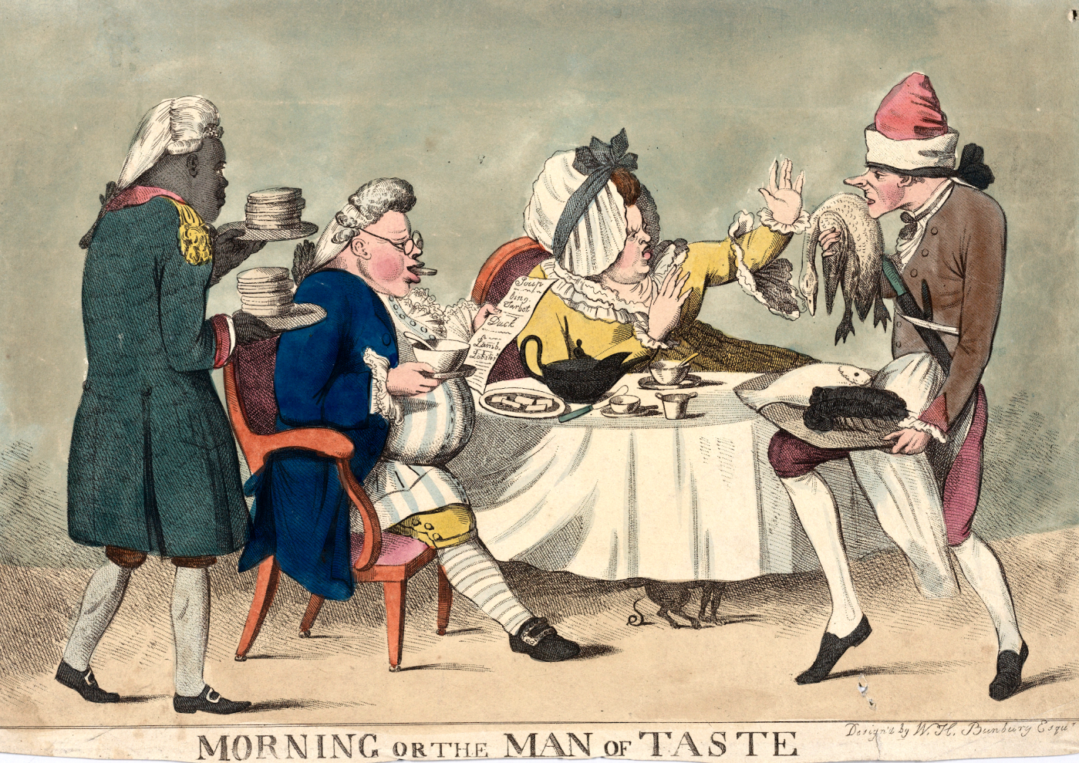
A Regency breakfast

Slide 17
SUPPLIES FOR A COMPLETE REGENCY PICNIC
Serving trays and bowls
Salad and dessert plates
Forks and butter knives
Spoons and a serving spoon for syllabub
Knives for slicing meat
Stemmed glasses
Napkins or cloth if possible
Blankets or a rug, plus pillows
Patio umbrella
Baskets to put it all in
Supplies for tea:
Teapot(s)
Tea cups
Saucers
Teaspoons
Insulated jug
Sugar bowl
Sugar spoon
Cream pitcher

Slide 18
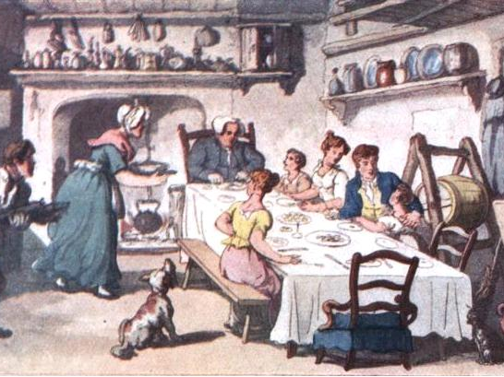
A meal in the farmhouse kitchen.

Slide 19
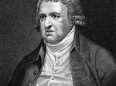
Erasmus Darwin

