Slide 1


our smartphoNe SURVEY

Slide 2

Q1. Do you regularly use a smartphone?
All but one of us use a smartphone. 13/14
We know Phil Booth doesn’t!

Slide 3
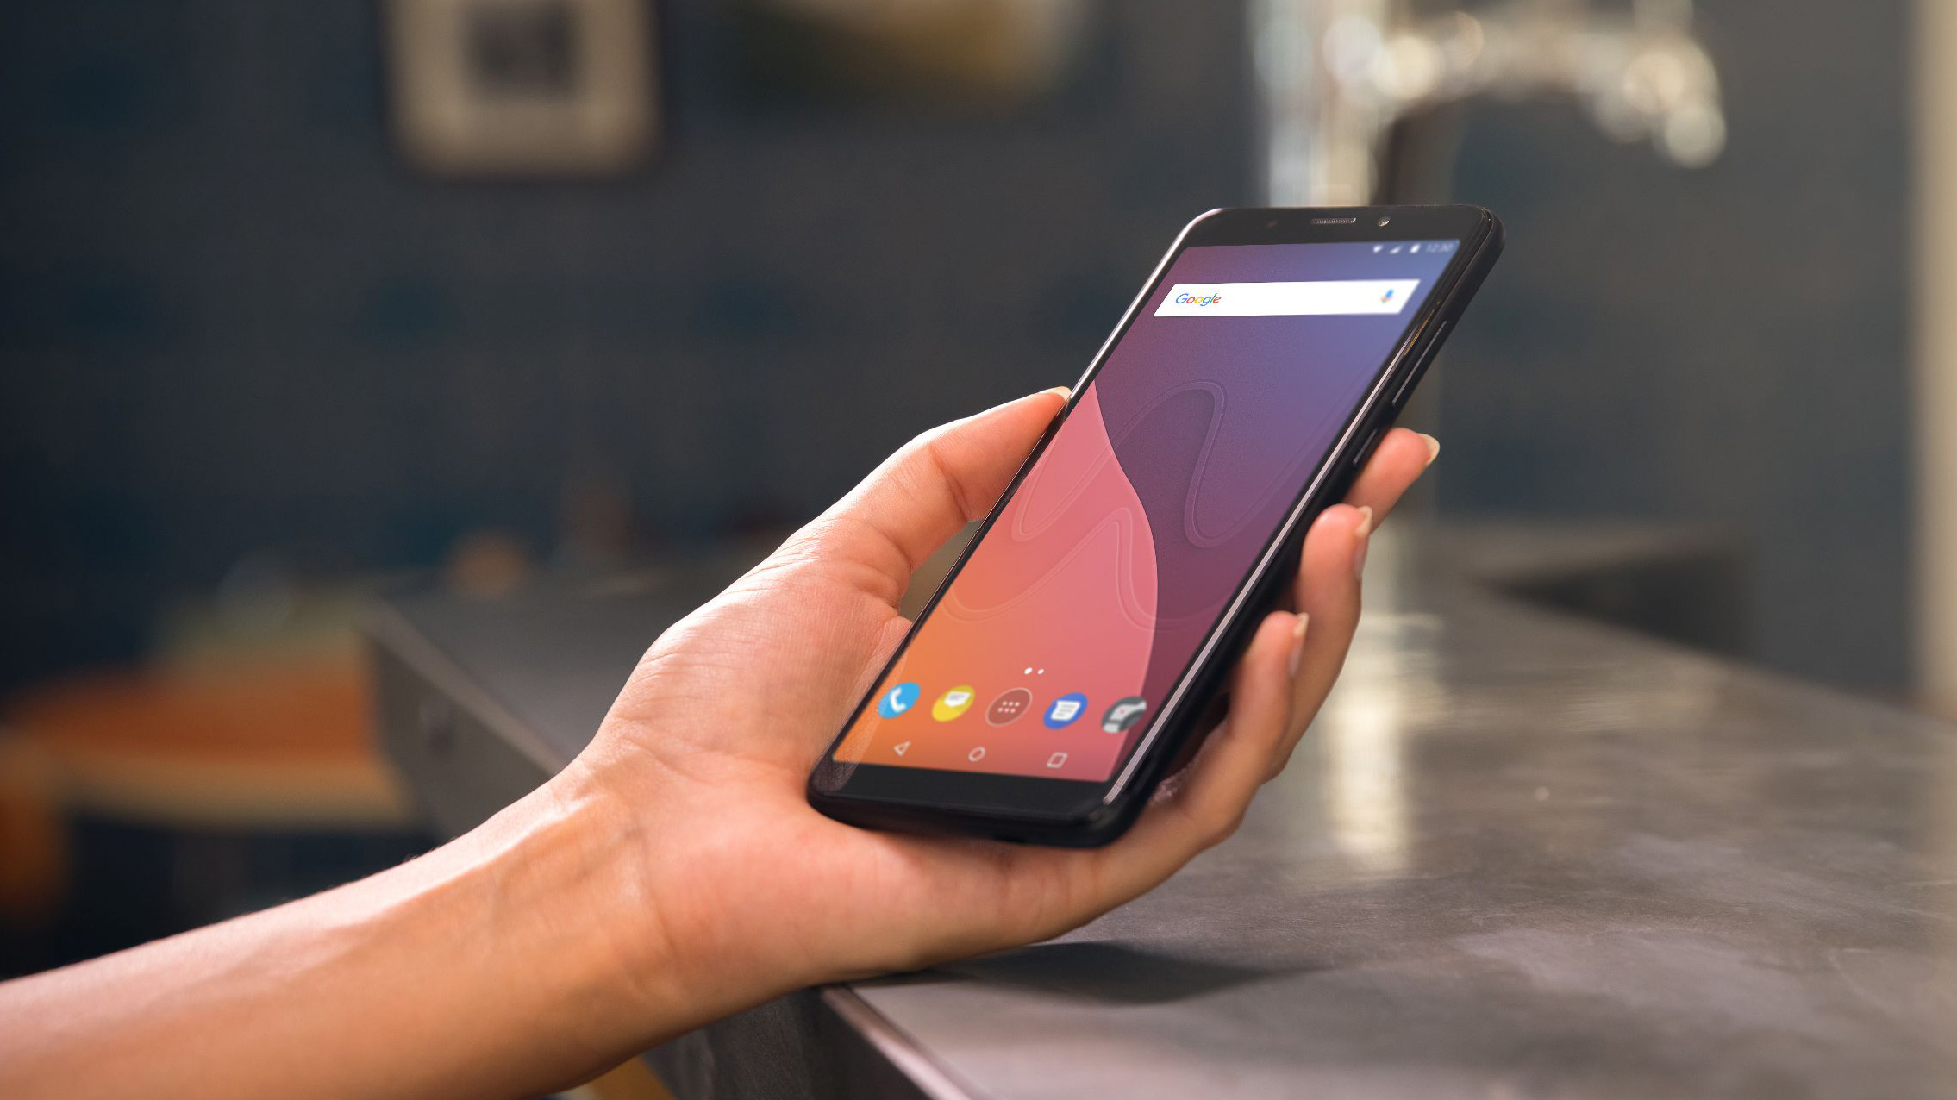
Q2. Android or Apple
10 out of 13 use an Android phone (77%)
Notes:
******* 10 out of 13 used an Android Phone (77%)

Slide 4
Q3. Apps we use the most
Plus 30+ other single response answers
Notes:
Watch the scale between left and right hand graphs

Slide 5
Q4. Our Favourite Apps
Notes:
Watch the scale between the graphs

Slide 6



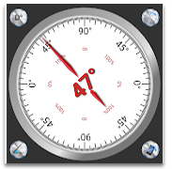
Q5 The Quirky Apps
Mastodon
Stocard
Story Cache
Clinometer
Notes:
Mastodon is free and open-source software for running self-hosted social networking services. It has microblogging features similar to Twitter, which are offered by a large number of independently run nodes, known as instances, each with its own code of conduct, terms of service, privacy policy, privacy options, and content moderation policies.[6][7][8]
Each user is a member of a specific Mastodon instance (also called a server), which can interoperate as a federated social network, allowing users on different instances to interact with each other. This is intended to give users the flexibility to select a node whose policies they prefer, but keep access to a larger social network. Mastodon is also part of the Fediverse ensemble of computer servers, which use shared protocols allowing users to interact with other users on computers running compatible software packages[9][unreliable source?] such as PeerTube and Friendica. Mastodon is crowdfunded and does not contain ads.
Stocard appAll your loyalty cards in one app
From the biggest supermarket to your local flower shop - you can add the card to Stocard. Organizing your cards has never been this easy.
Discover hidden stories across the Stiperstones Hills. Using GPS, this app will help you to explore the
landscape, get you off the beaten track and maybe find some paths you never knew existed.
Myths and legends from around the world are retold in our stunning landscape by local professional storyteller Sally Tonge in her own inimitable style.
Hear tales of local wildlife, ladders to the sky, Wild Edric and of course the Devil and his mysterious chair, on the Stiperstones, along with many more to enhance your visit.
Clinometer
Clinometer is an instrument that measures vertical slopes, usually the angle between ground or the observer and a tall object.
The motion range is 90 degrees, so it is possible to use any side of your device.The precision is adjustable up to 3 decimal places

Slide 7

New apps
Like twitter, not involving Elon Musk
Bus time-table that works
Simplified version of Hugo
Language Translator
Photo Image Identifier

Slide 8
























The Busiest person – all their favourite apps
Notes:
WhatsApp Mail Safari The Times Google Maps Contacts PGA Tour Cricinfo
Camera Photos ATP Live Bird Guide Volvo Cars Instavolt easyJet Wallet
Monzo XE Trainsplit BBC News NGS National Trust Citymapper Explore

Slide 9


Thank you

