Slide 1

Wi Fi
SSID:
Memorial hall_guests
PW:
7F&3CB4P8C

Slide 2
Microsoft
PowerToys
For Windows 10 & 11

Slide 3




Introduction
Microsoft PowerToys is a set of utilities for power users to tune and streamline their Windows 10 and 11 experience for greater productivity.
https://learn.microsoft.com/en-gb/windows/powertoys/

Slide 4



The Utilities
Always on top
Awake
Colour Picker
Fancy Zones
File Locksmith
File Explorer AO’s
Hosts file editor
Image Resizer
Keyboard Manager
Mouse Utilities
Paste as Plain Text
Power Rename
PowerToys Run
Quick Accent
Screen Ruler
Shortcut Guide
Text Extractor
Video Conf’ Mute
Notes:
Not all the utilities of course will be useful to everyone. You may find that only about 3 or 4 are useful to you.
We’ll go through them one by one
Always on Top: A quick and easy way to pin Windows on top.
Awake: A convenient way to keep your PC awake on demand
Colour Picker Quick and Simple system wide colour picker
Fancy Zones Create windows layouts to help make multi-tasking easy
File Locksmith An extension to find out which processes are using the selected files and directories
File Explorer Add-ons Allows you to manage your Win File Explorer custom preview handlers
Hosts File Editor Utility for managing your hosts file
Image Resizer Right click and image or images to resize to selected presets
Keyboard Manager Remap unwanted keys on your keyboard to something useful
Mouse Utilities A collection of utilities to help you find your mouse, track it, highlight it etc
Paste as Plain Text Paste the contents of your clipboard without any additional formatting
Power Rename An extension to bulk rename files/directories
PowerToys Run A quick launcher for all sorts of things.
Quick Accent An alternative way to type accented characters
Screen Ruler A quick and Easy way to measure pixels on your screen
ShortCut Guide Displays a help overlay with Windows Shortcuts
Text Extractor A convenient way to copy text from anywhere – including from pictures.
Video Conference Mute Mute your Mic and close video from your webcam all in one go.

Slide 5
Some of the more useful ones

Slide 6

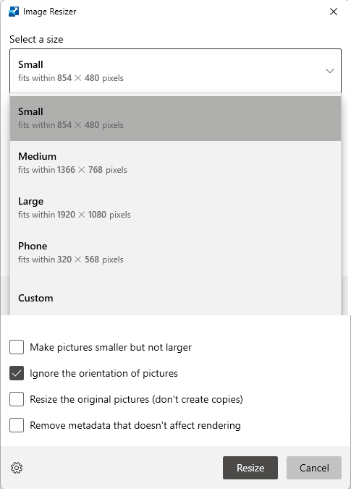
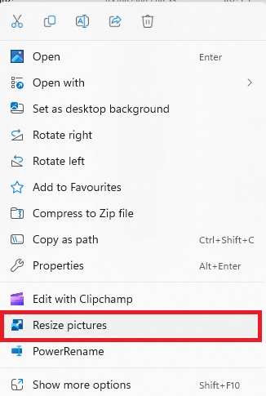
Image Resizer
Right click a file in file explorer
Select, from near the bottom of the list,
“Resize Pictures”
Select a suitable size
Notes:
****** Right Click
****** Select file size
Experiment with different sizes to see how large or small the file size is. You won’t be able to send 10 photographs of 5MB (5,000KB) in one email. (It’ll be too large, but you could send 10 photos of 500KB each.
Unlike most of the other utilities, Image Resizer doesn’t have a keyboard shortcut.

Slide 7

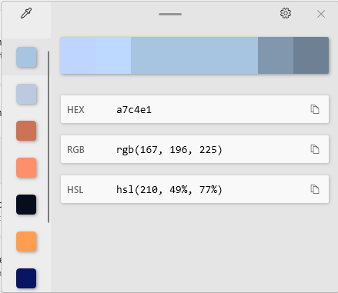




Colour Picker
Great for creative types
Notes:
****** Default brings up the editor as well as selecting the colour and copying it to your clipboard.
Suggests two colours lighter and two colours darker - your selected colour is in the middle of the band.
Click that band of colours to fine tune

Slide 8



Always on Top
Keeps a nominated window on top of all the others you have open,
Options: Show a border, enable rounded corners if you like and play a sound when pinning

Slide 9

Keyboard Manager
Remap keyboard keys to something more useful.
The ‘Alt Gr’ key to the Back button for your browser perhaps.
Notes:
Don’t forget there are loads of keyboard Shortcuts. We created a very comprehensive list that is available in the Computer Club Documents folder: “2021-01 Keyboard Shortcuts” and an earlier version “2018 04 Keyboard Shortcuts”
Mapping one key doesn’t have too much scope – there aren’t that many keys that you don’t use,

Slide 10


Keyboard Manager
Shortcuts give plenty of options – combinations of:
Notes:
Mapping one key doesn’t have too much scope – there aren’t that many keys that you don’t use,
but mapping a shortcut gives you plenty of options. Combinations of the Windows key, Ctrl, Shift, Alt and a regular key

Slide 11

Mouse Utilities
Find my Mouse Highlighter
Mouse Jump Mouse Crosshairs
Notes:
******

Slide 12



Find my Mouse: Left twice. Highlighter
Mouse Jump Crosshairs
Notes:
Find: Left Ctrl Key twice. Nice and simple, works well
Highlighter Win Shift H. Highlights when you click with your mouse, a coloured circle around the click
Jump Win Shift D. Moves to a different window – good if you have lots of them open.
Crosshairs Win Alt P. This is really in your face.

Slide 13
Power Rename
Useful for renaming multiple files in one go.
Ideal to rename photographs that are just in a date time format.
Select the files in File Explorer.
Right Click & select “Power Rename”
Complete as required.

Slide 14
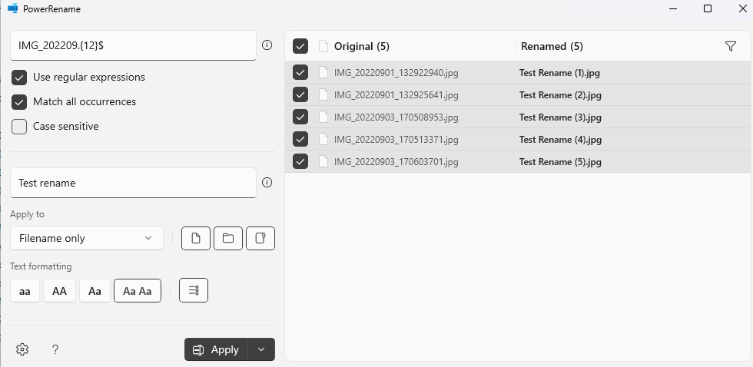
Power Rename
Notes:
I thought this was going to be good, but not quite so straight forward. You can already rename a selection of files in one go from File Explorer, Select a group, right click and then rename them (shortcut is F2) they will rename to the text you enter with Brackets 1, Brackets 2, Brackets 3 etc.
In the power rename it’s similar to a search and replace, so to enable the replace in my example here, I had to ignore the last xxx characters, so the match was just on the month of the date. To do that I used a “Regular Expression” or regex.

Slide 15

PowerToys Run
Use to launch, find or run programmes. I like this 😊
Notes:
Try typing anything …….

Slide 16

Screen Ruler
Measure an area of your screen in Pixels
Activate:
Select how/what to measure:
A box
Spacing
Horizontal Spacing
Vertical Spacing
Good for Web designers and creative types!

Slide 17

Installing PowerToys
Search PowerToys from the Microsoft Store
…. and install.
Launch from the start menu.
By default it updates automatically and runs at startup.

Slide 18
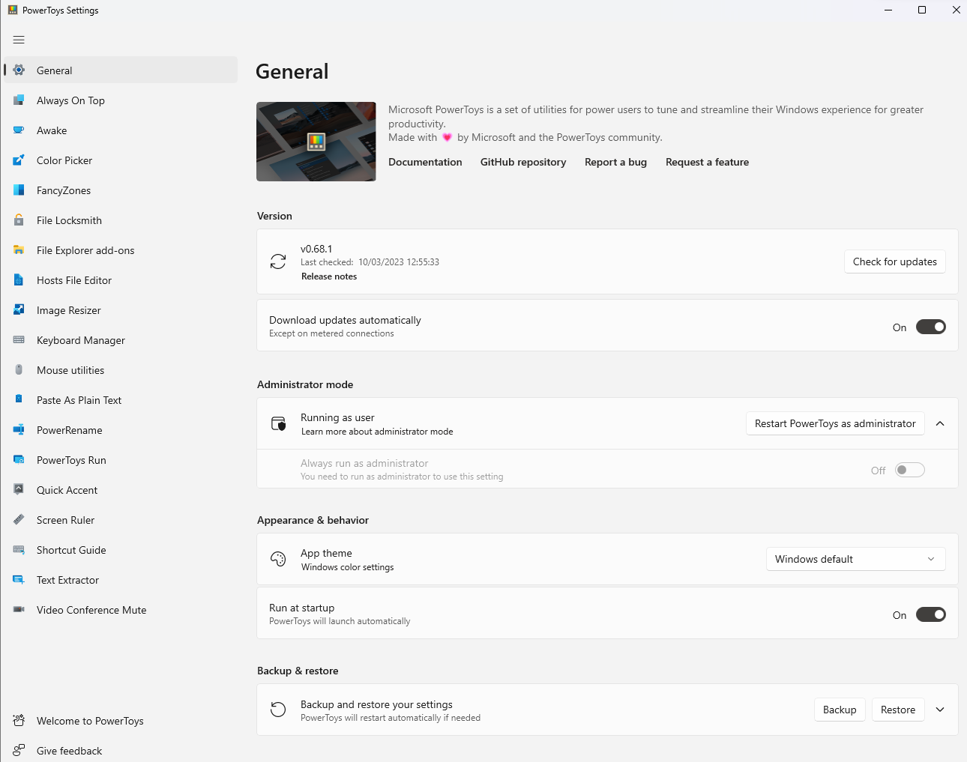
Notes:
You can see in the left hand pane the list of utilities. Click on any one of them for information about it and any settings you can change.

Slide 19
Thank You
Demo time……
Remind me to show you an alternate way to rename files
Notes:
***** Demo time

Slide 20
Chart

Slide 21
Table
 | Category 1 | Category 2 | Category 3 | Category 4
Item 1 | 4.5 | 2.3 | 1.7 | 5
Item 2 | 3.2 | 5.1 | 4.4 | 3
Item 3 | 2.1 | 1.7 | 2.5 | 2.8
Item 4 | 4.5 | 2.2 | 1.7 | 7

Slide 22
The way to get started is to quit talking and begin doing.
Walt Disney

Slide 23




Team
Name
Name
Name
Name
Title
Title
Title
Title

Slide 24
Timeline
Title
To start a presentation, go to the Slide Show tab, and select From Beginning.
Title
To display Presenter view, in Slide Show view, on the control bar at the bottom left select the three dots, and then Show Presenter View.
Title
During your presentation, the speaker notes are visible on your monitor, but aren't visible to the audience.
Title
Title
If you can’t see the Notes pane or it is completely minimised, click Notes on the task bar across the bottom of the PowerPoint window.
The Notes pane is a box that appears below each slide. Tap it to add notes.

Slide 25
Content
Subtitle
Subtitle
Add text, images, art, and videos.
Add transitions, animations, and motion.
Save to OneDrive, to get to your presentations from your computer, tablet, or phone.
Open the Design Ideas pane for instant slide makeovers.
When we have design ideas, we’ll show them to you right there.

Slide 26
Content 2
Subtitle
subtitle
subtitle
Add text, images, art, and videos.
Add transitions, animations, and motion.
Save to OneDrive, to get to your presentations from your computer, tablet, or phone.
Open the Design Ideas pane for instant slide makeovers.
When we have design ideas, we’ll show them to you right there.
Add text, images, art, and videos.
Add transitions, animations, and motion.
Save to OneDrive, to get to your presentations from your computer, tablet, or phone.
Open the Design Ideas pane for instant slide makeovers.
When we have design ideas, we’ll show them to you right there.
Add text, images, art, and videos.
Add transitions, animations, and motion.
Save to OneDrive, to get to your presentations from your computer, tablet, or phone.
Open the Design Ideas pane for instant slide makeovers.
When we have design ideas, we’ll show them to you right there.

Slide 27
Summary
With PowerPoint, you can create presentations and share your work with others, wherever they are. Type the text you want here to get started. You can also add images, art, and videos on this template. Save to OneDrive and access your presentations from your computer, tablet, or phone.

