Slide 1
The
Battle of Shrewsbury
21st July 1403

Slide 2
King Henry IV
Henry Percy k/a Hotspur
Prince Henry (later Henry V)
Principal participants

Slide 3
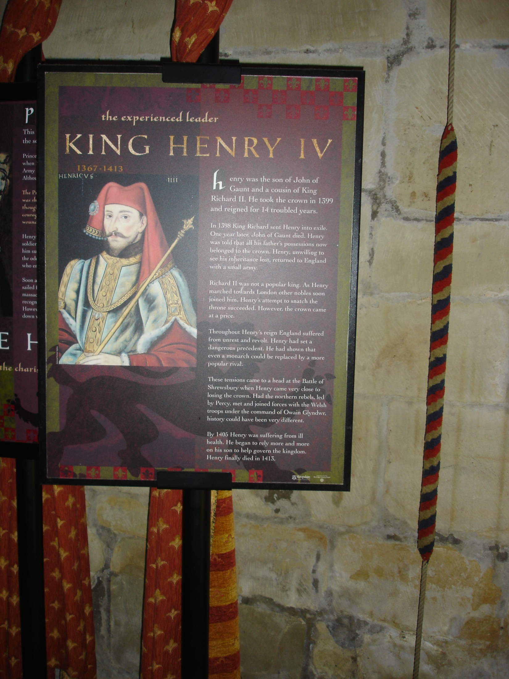
Henry IV

Slide 4
Why Henry IV usurped the throne
Henry Bolingbroke was grandson of Edward III and cousin of Richard II
Richard II banished Henry Bolingbroke and appropriated Lancastrian property
Richard was an unpopular king
Richard was in Ireland in1399 when Henry returned
Henry had the support of the Percys

Slide 5
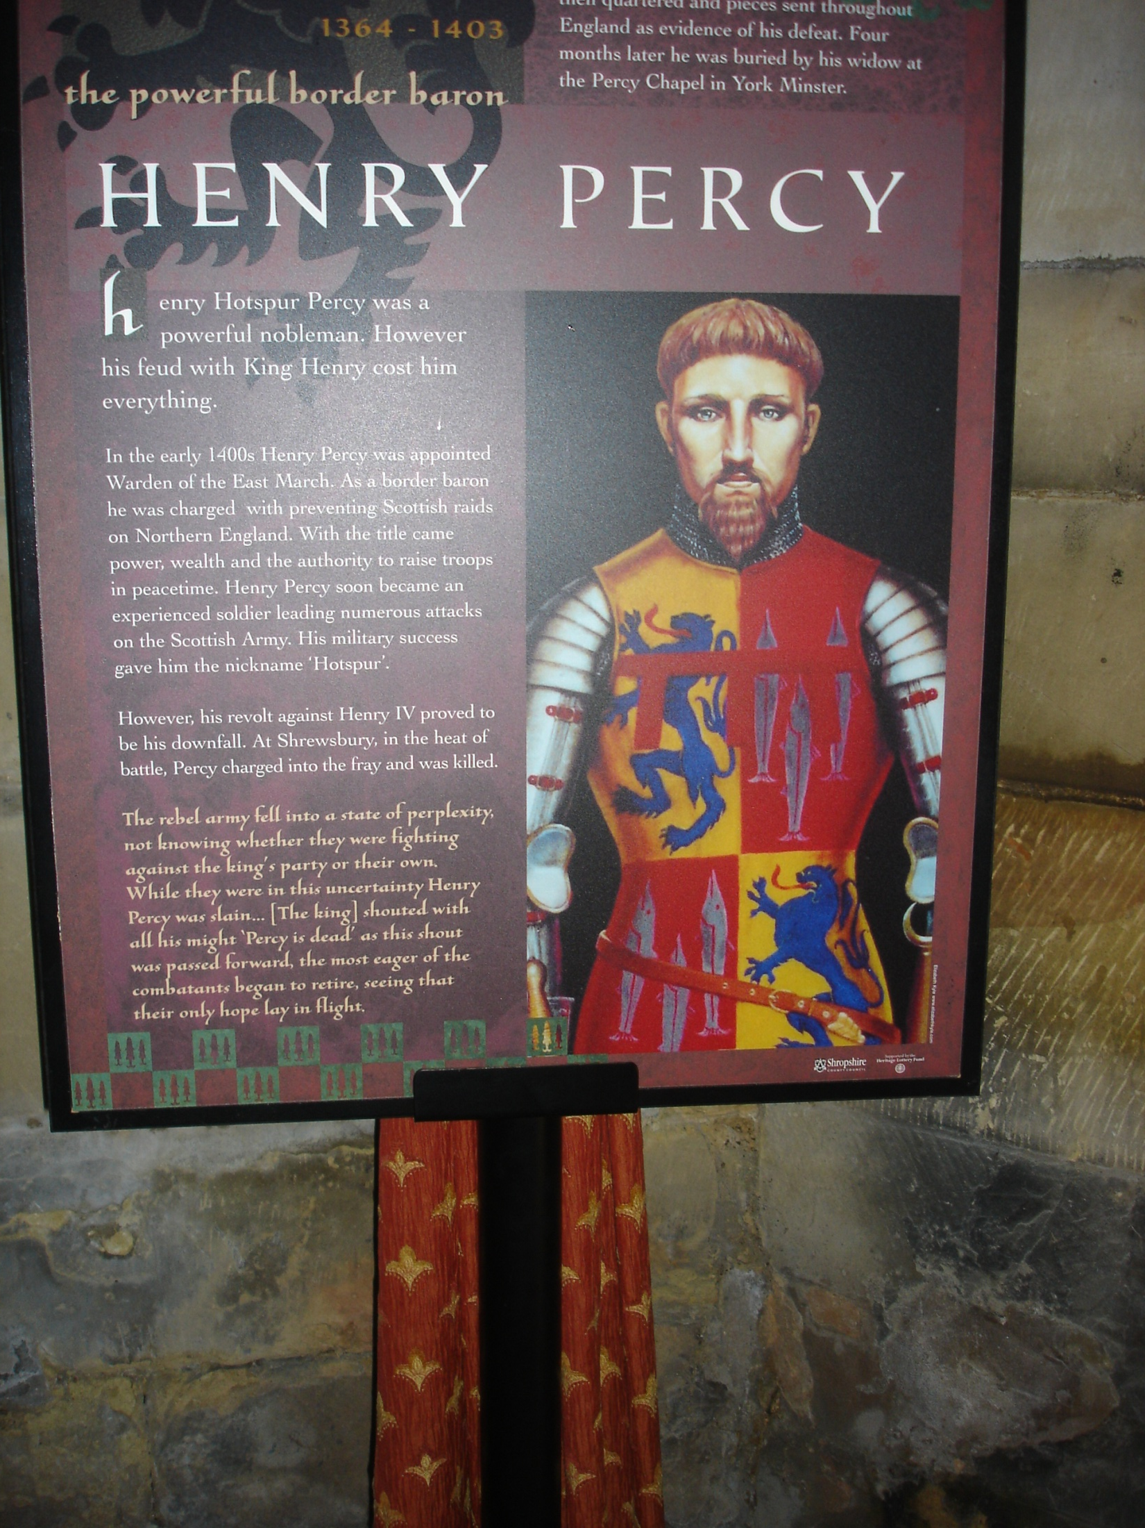
HOTSPUR

Slide 6
Reasons for Hotspur’s rebellion
The King failed to repay the Percys – the Earl of Northumberland and his son Hotspur – for their campaigns against the Scots and Welsh
The King had broken his oath not to take the throne
The King refused to ransom Edmund Mortimer
The King rewarded the Earl of Westmoreland and made him Keeper of Roxburgh
The King made Hotspur hand over the Scottish knights whom he had captured at Homildon Hill

Slide 7
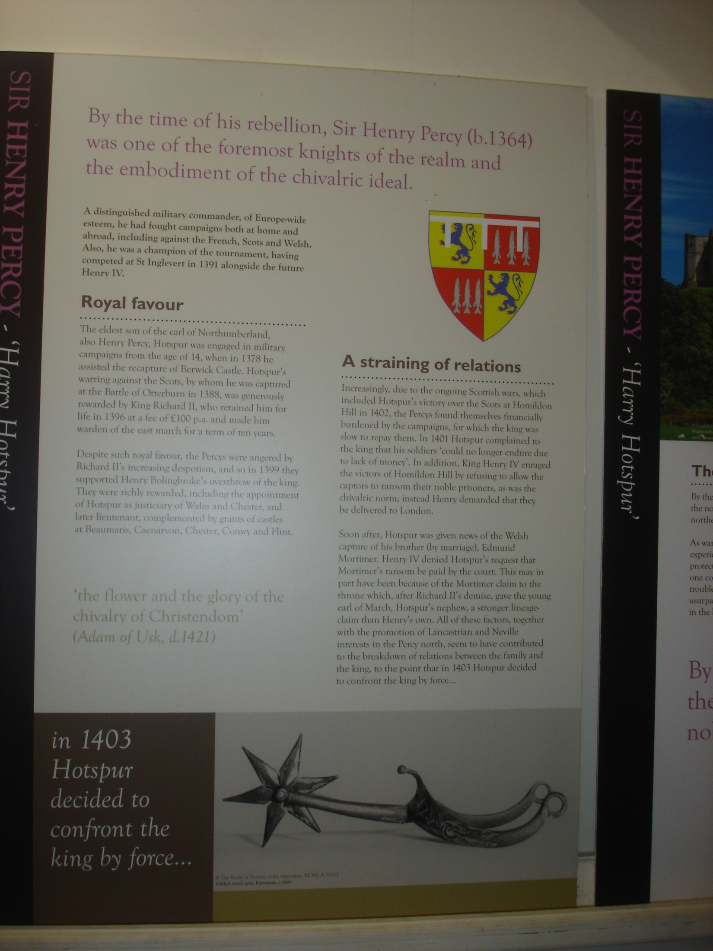

Slide 8
The battle - why Shrewsbury ?
Hotspur recruited forces in Cheshire
He hoped to have support of Owen Glyn Dwr
He planned to attack Henry, Prince of Wales, at Shrewsbury
The King was marching north but as soon as he learned of the rebellion, he diverted his army to defend Shrewsbury and to confront Hotspur

Slide 9
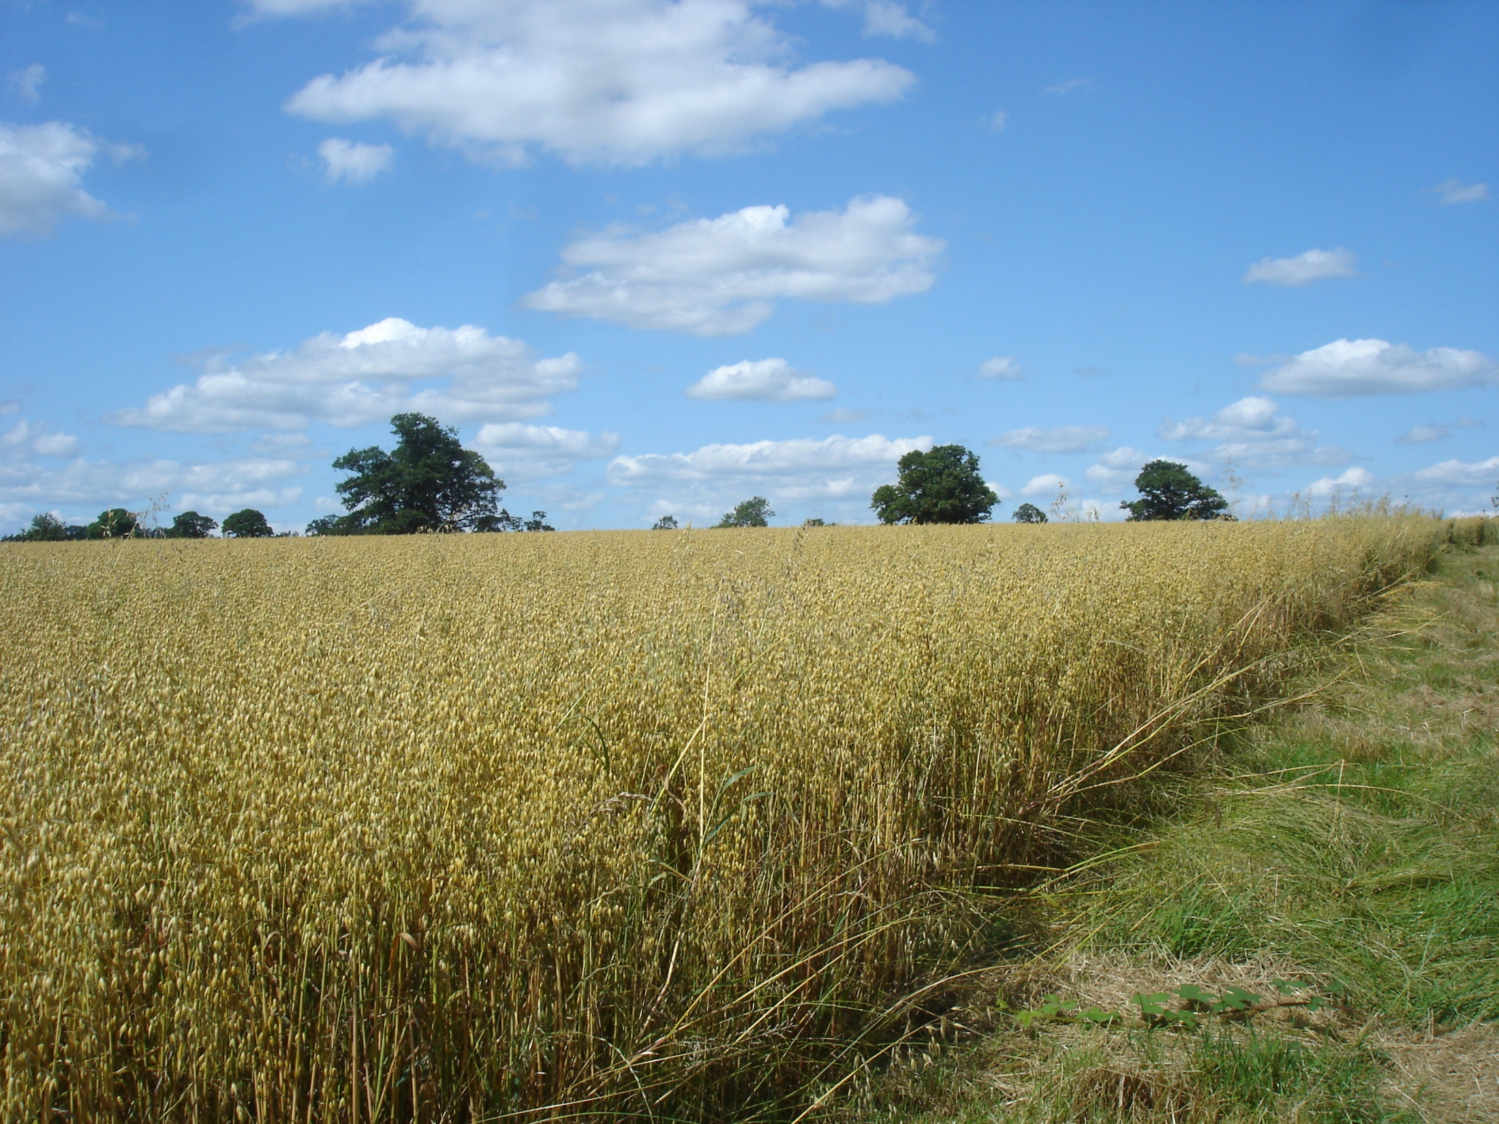
The battlefield

Slide 10
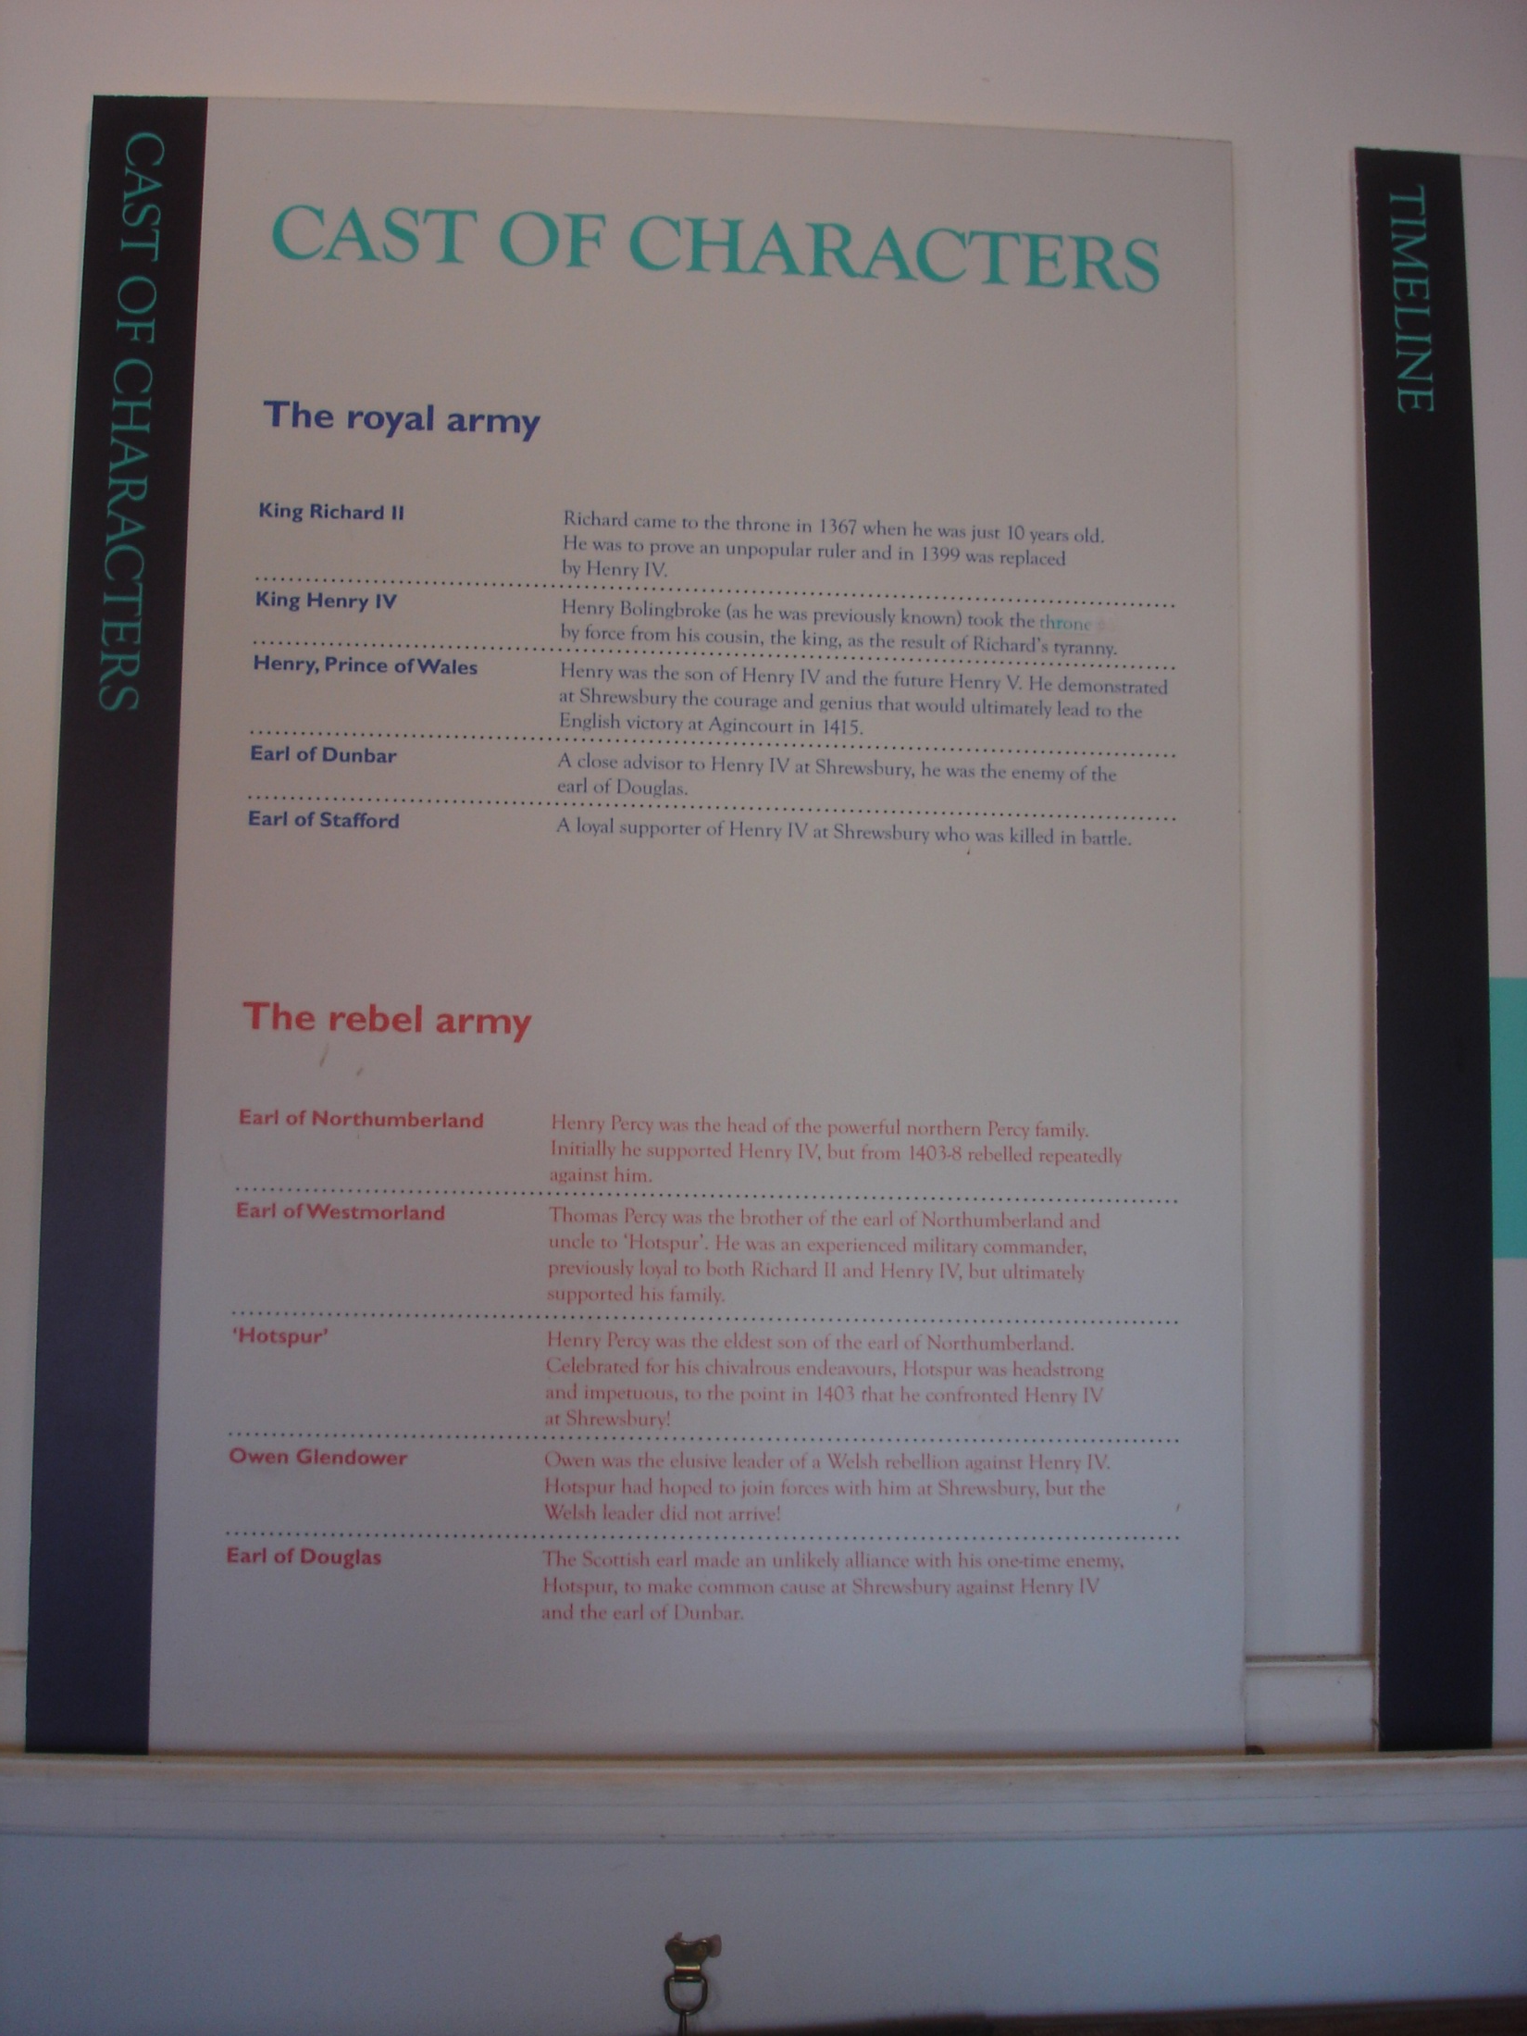

Slide 11
Deployment of Hotspur’s army
Possibly 5,000 but as many as 12,000
Hotspur took the higher ground on a ridge near Albright Hussey
Each army in three units, with archers in between men-at-arms
Hotspur and the Earl of Douglas led the centre, and Thomas, Earl of Worcester led the vanguard
Worcester had defected from Prince Henry

Slide 12
The King’s army
Perhaps 10,000 men or as many as 14,000
The King led the main force with the Earl of Dunbar
The Earl of Stafford led the vanguard on the right
Prince Henry led the rearguard on the left
The King sent the Abbots of Shrewsbury and Haughmond to parley; Hotspur sent his uncle, the Earl of Worcester

Slide 13
The battle
It took place on Saturday 21st July 1403
It began late in the afternoon
At first, Hotspur’s archers were dominant
It was the first battle on English soil in which both sides used the longbow against each other
Hotspur led an onslaught directed at the King
Hotspur was killed
Prince Henry led a counter-attack in spite of his wound
The rebel army was routed

Slide 14
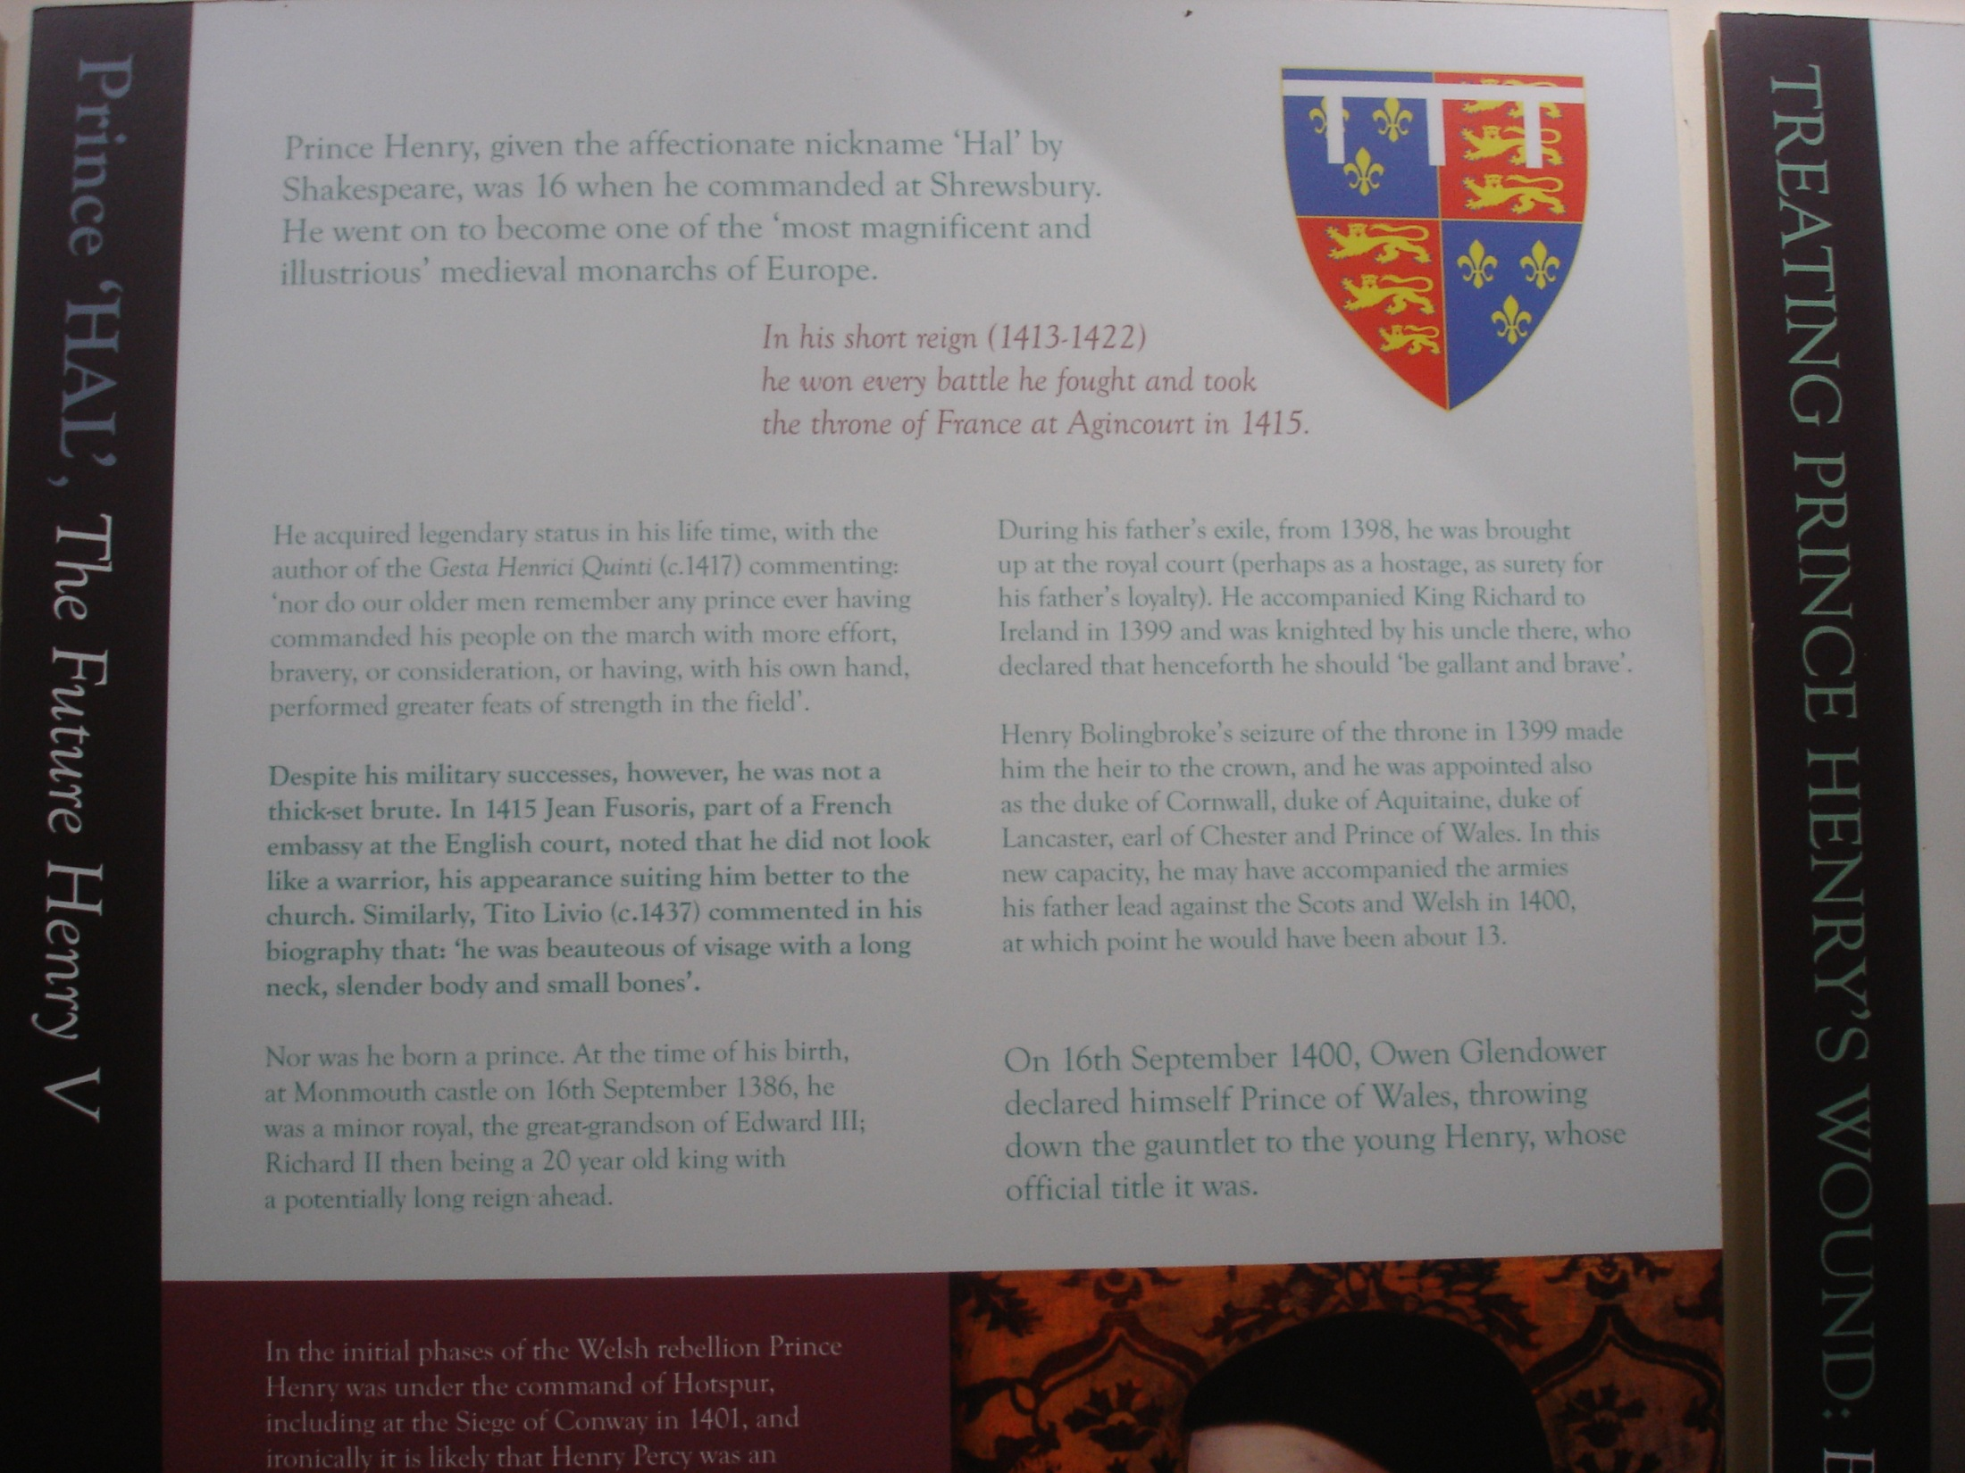
Prince Henry

Slide 15
The aftermath
The Earl of Douglas fled but was captured (Douglas’ leap)
The Earl of Worcester, Sir Richard Venables and Sir Richard Vernon were captured, and executed on 23rd July
Hotspur’s body was buried at Whitchurch, but disinterred on the order of the King, and then beheaded and quartered
The Earl of Northumberland claimed not to have been party to the rebellion, but rebelled in 1408 and was killed
Owen Glyn Dwr’s rebellion – highpoint in 1404

Slide 16
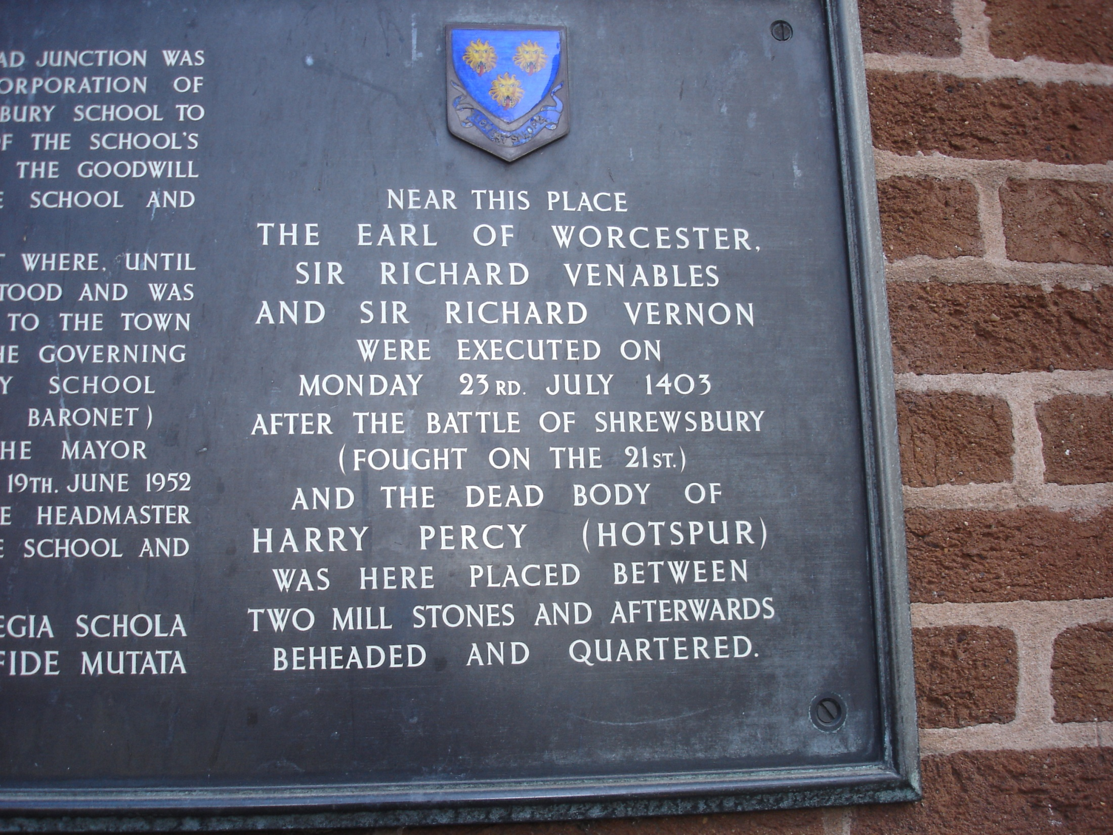

Slide 17
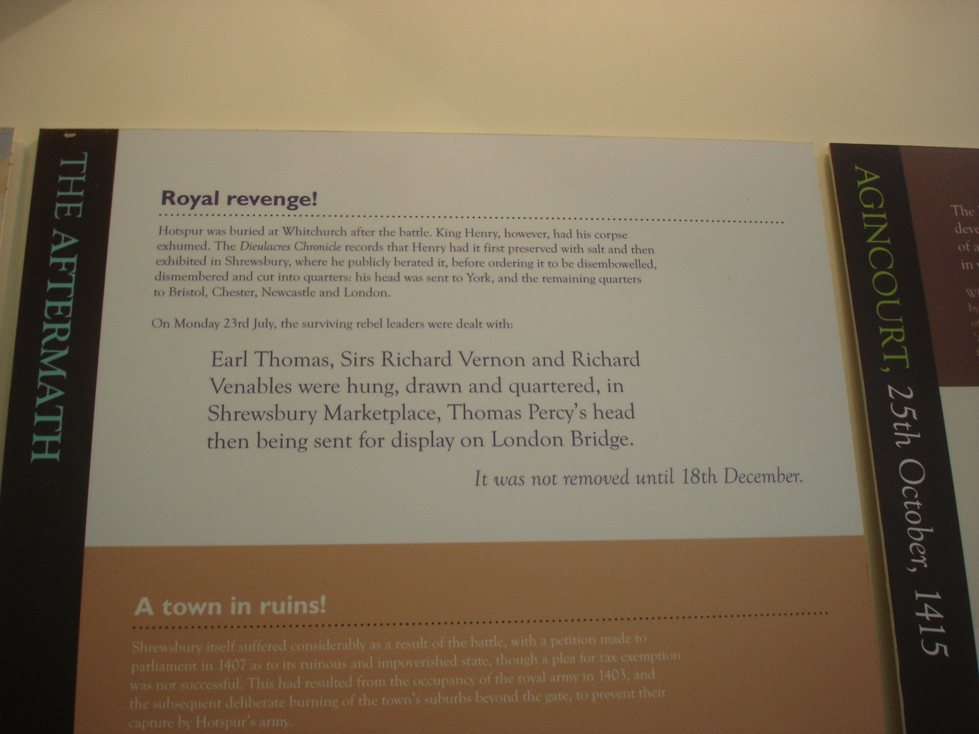

Slide 18
Battlefield Church of St Lawrence
A huge number of dead and wounded – at least 2,000 and perhaps up to 6,000
Many thought to have been buried in mass grave on site of the church (open to question)
The king ordered the church to be built to commemorate the slain
Clergy to say masses for the souls of the dead
Built in 1409 on Richard Hussey’s land
Now looked after by Church Conservation Trust

Slide 19
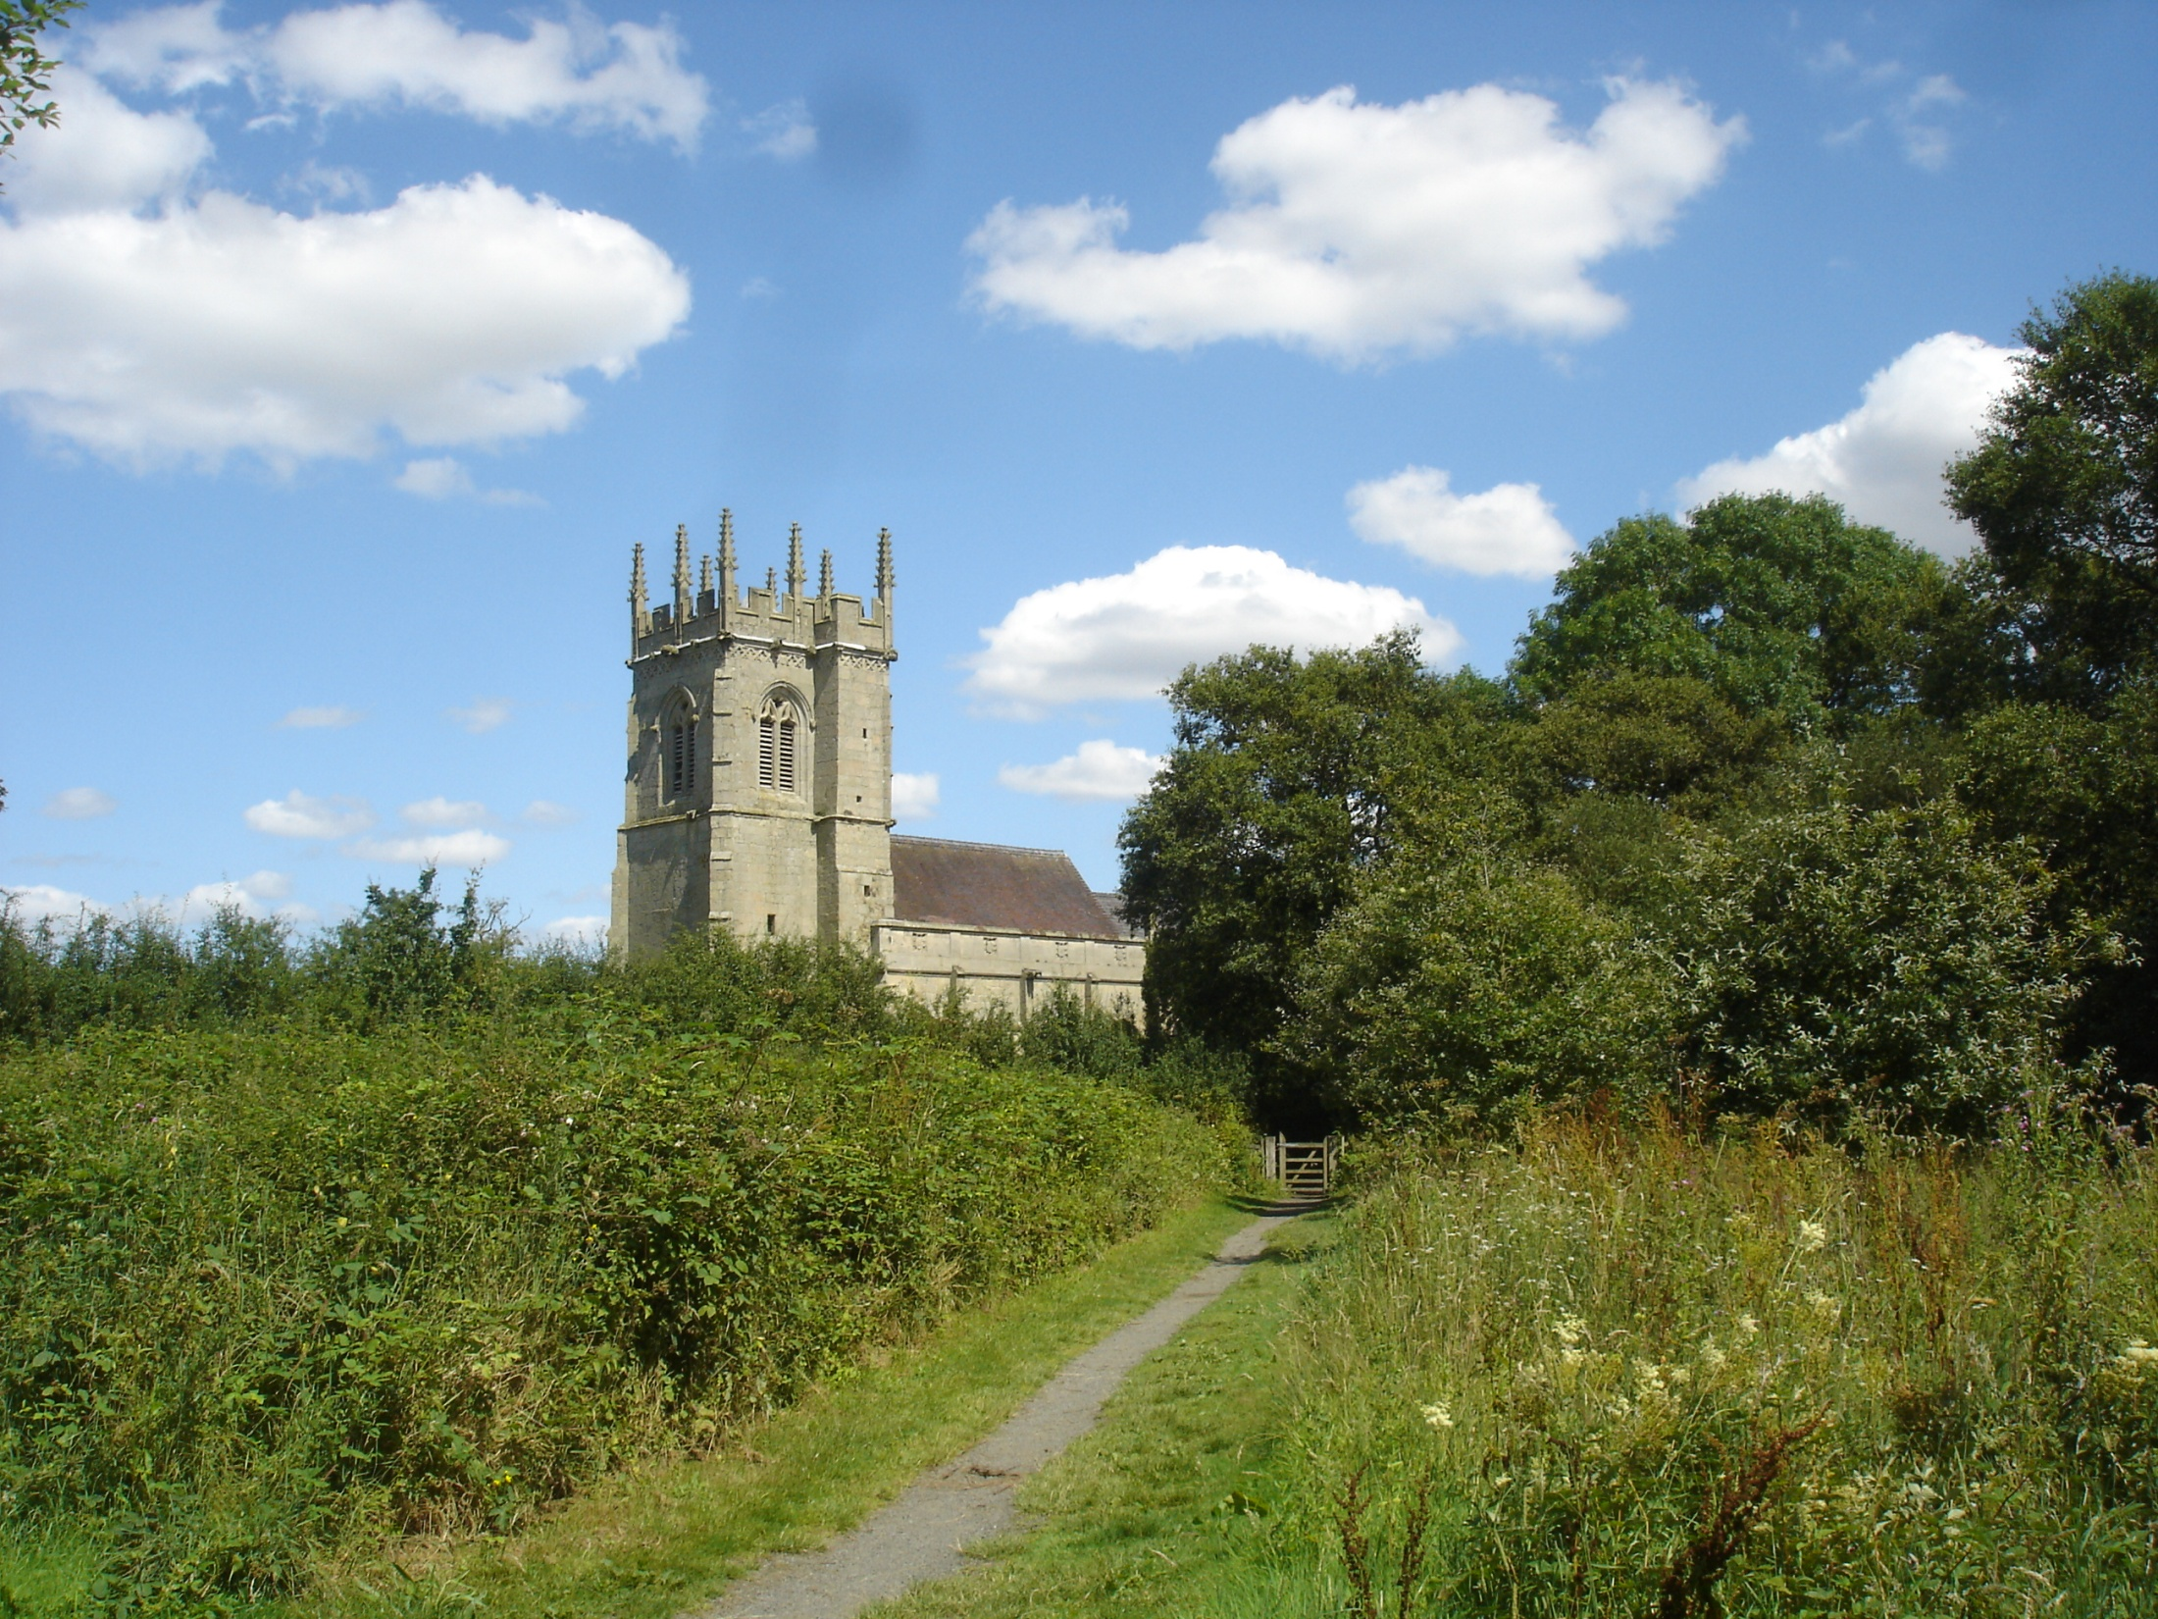

Slide 20
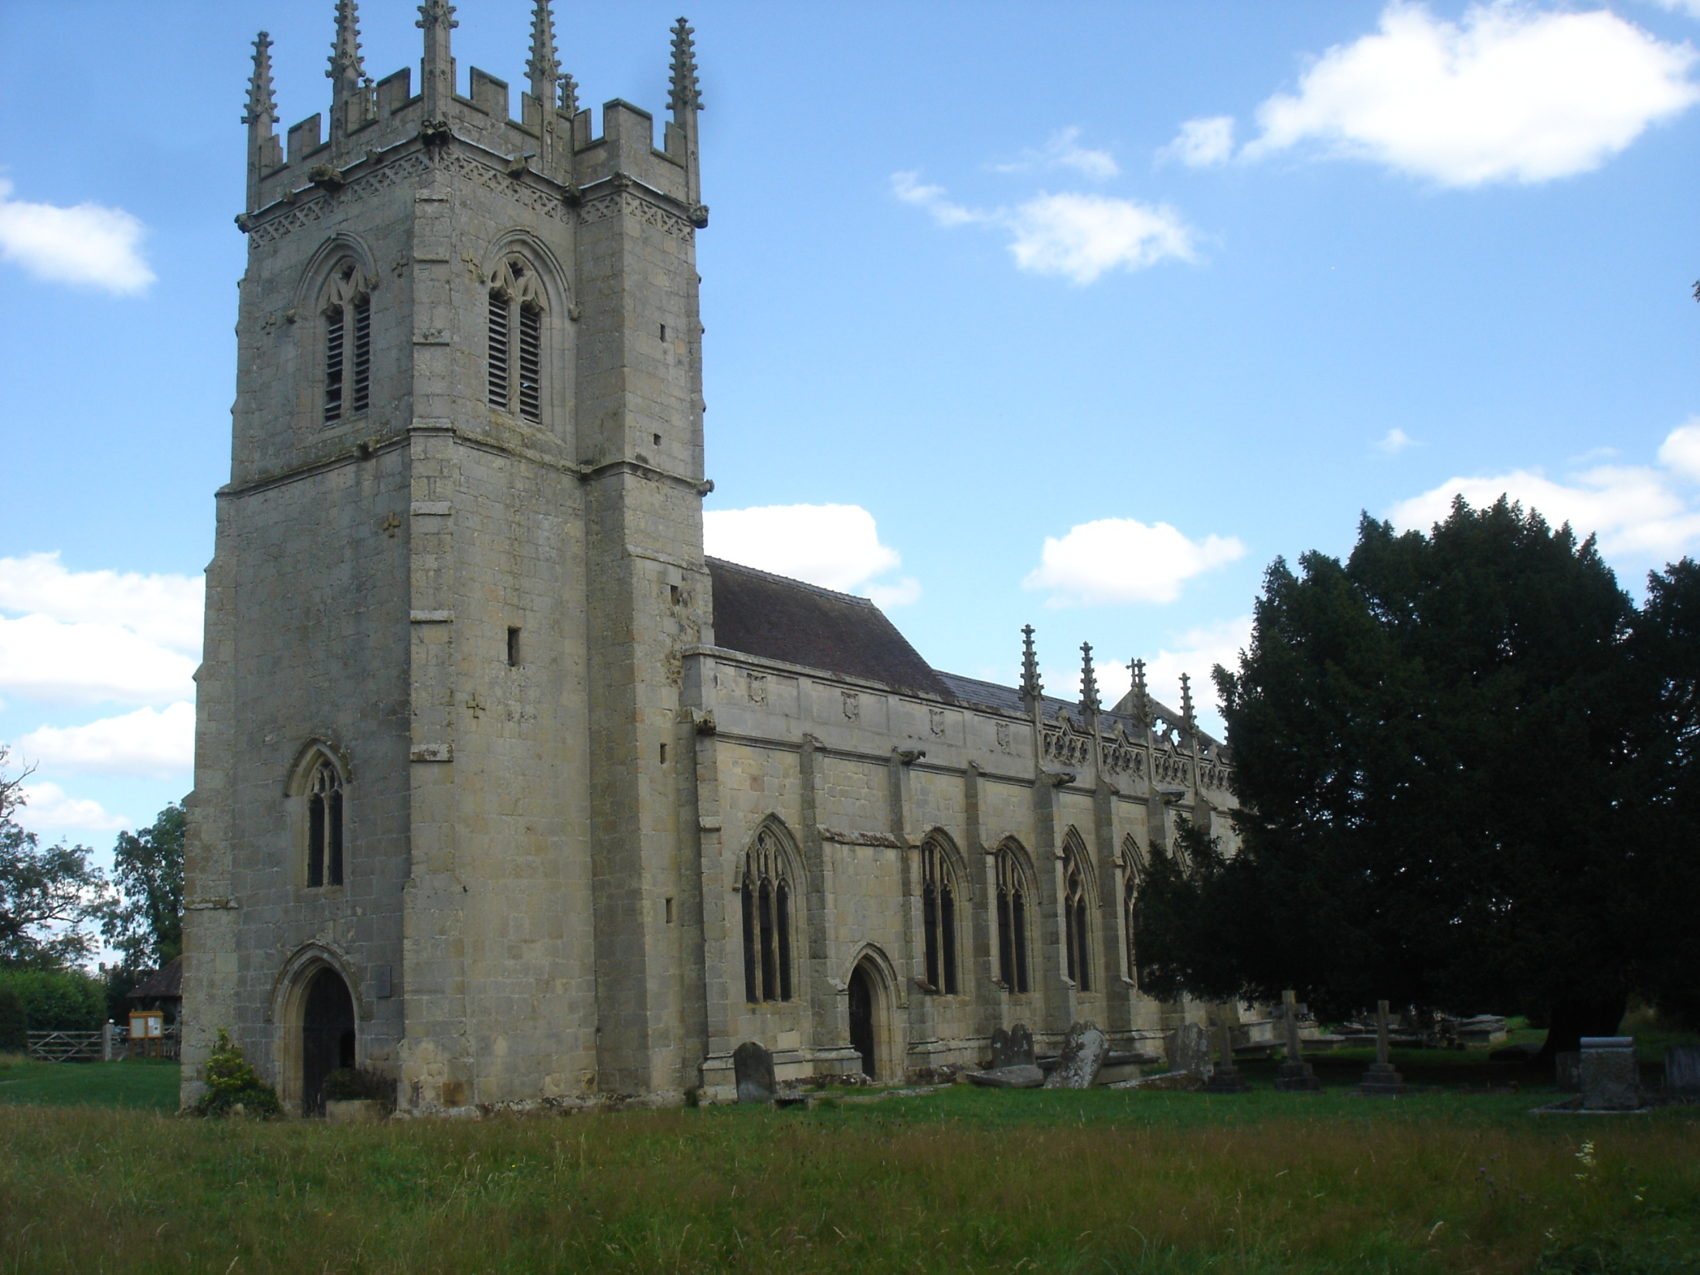

Slide 21
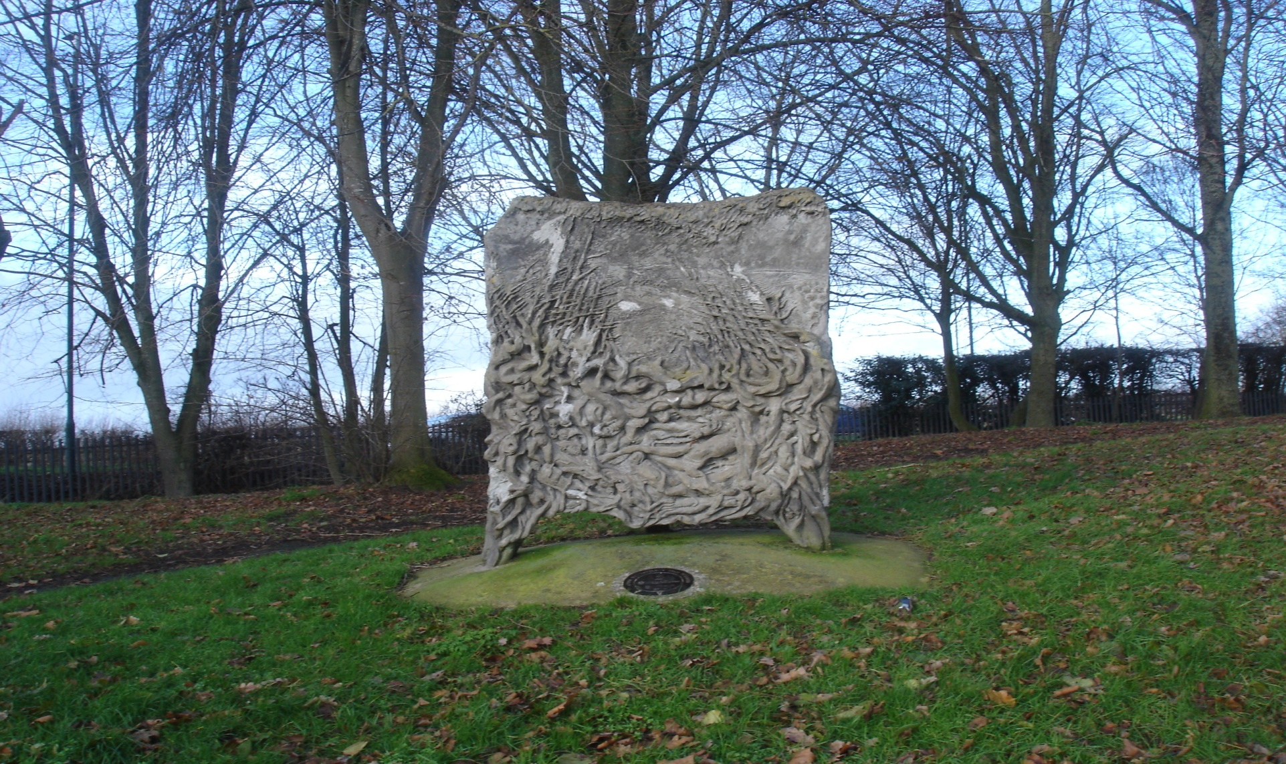
SCULPTURE TRAIL - HARLESCOTT

Slide 22
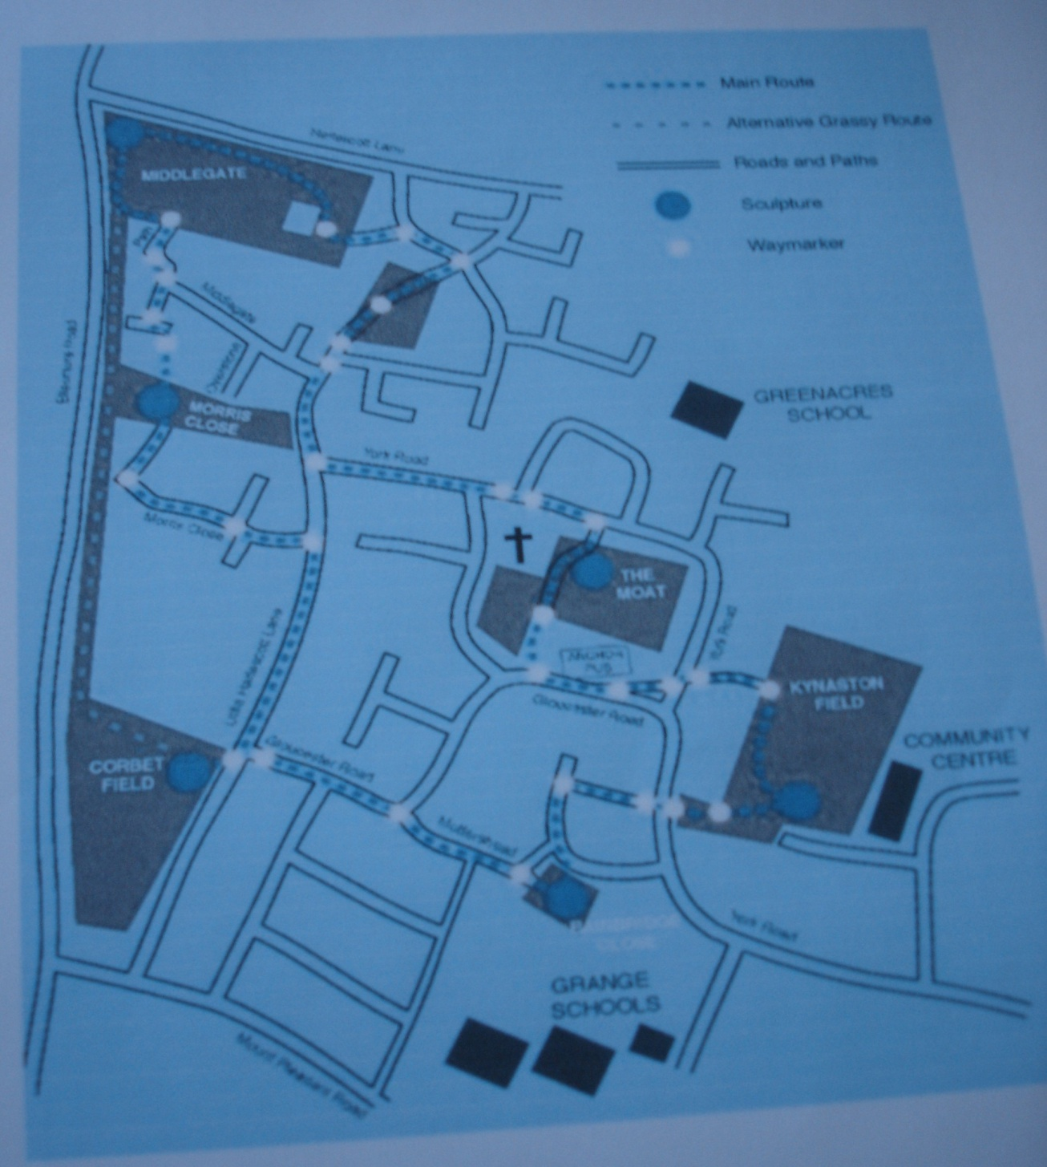

Slide 23
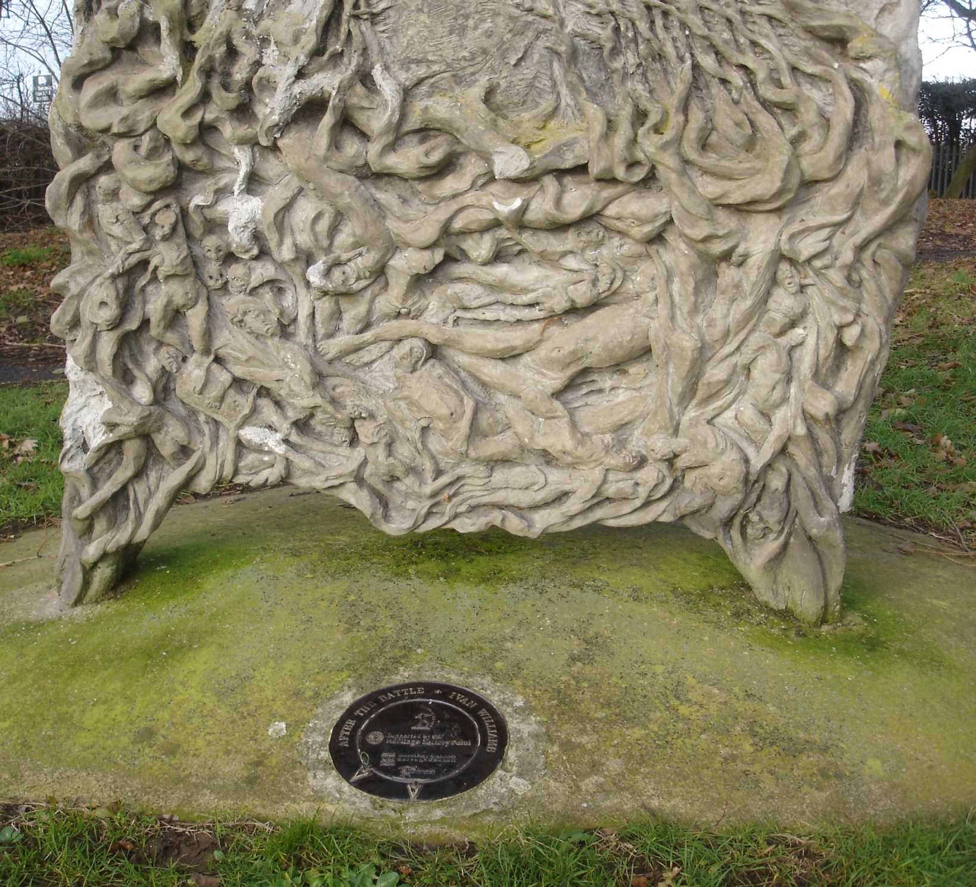

Slide 24
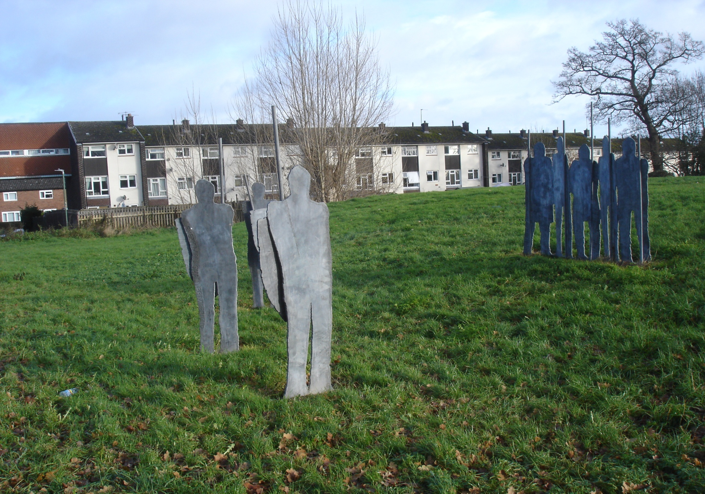

Slide 25
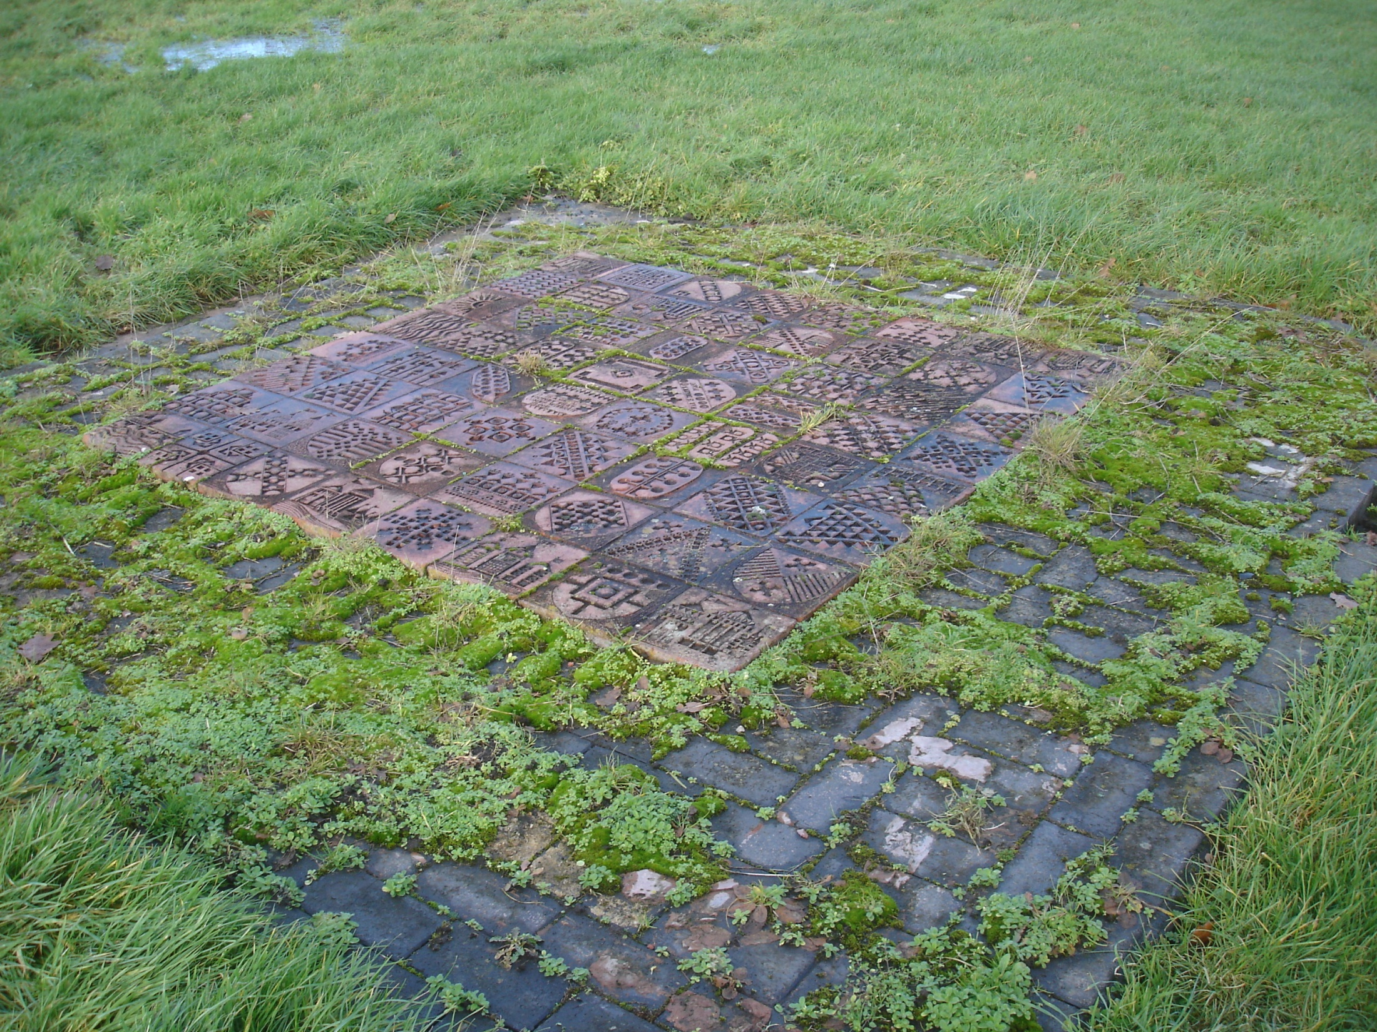

Slide 26
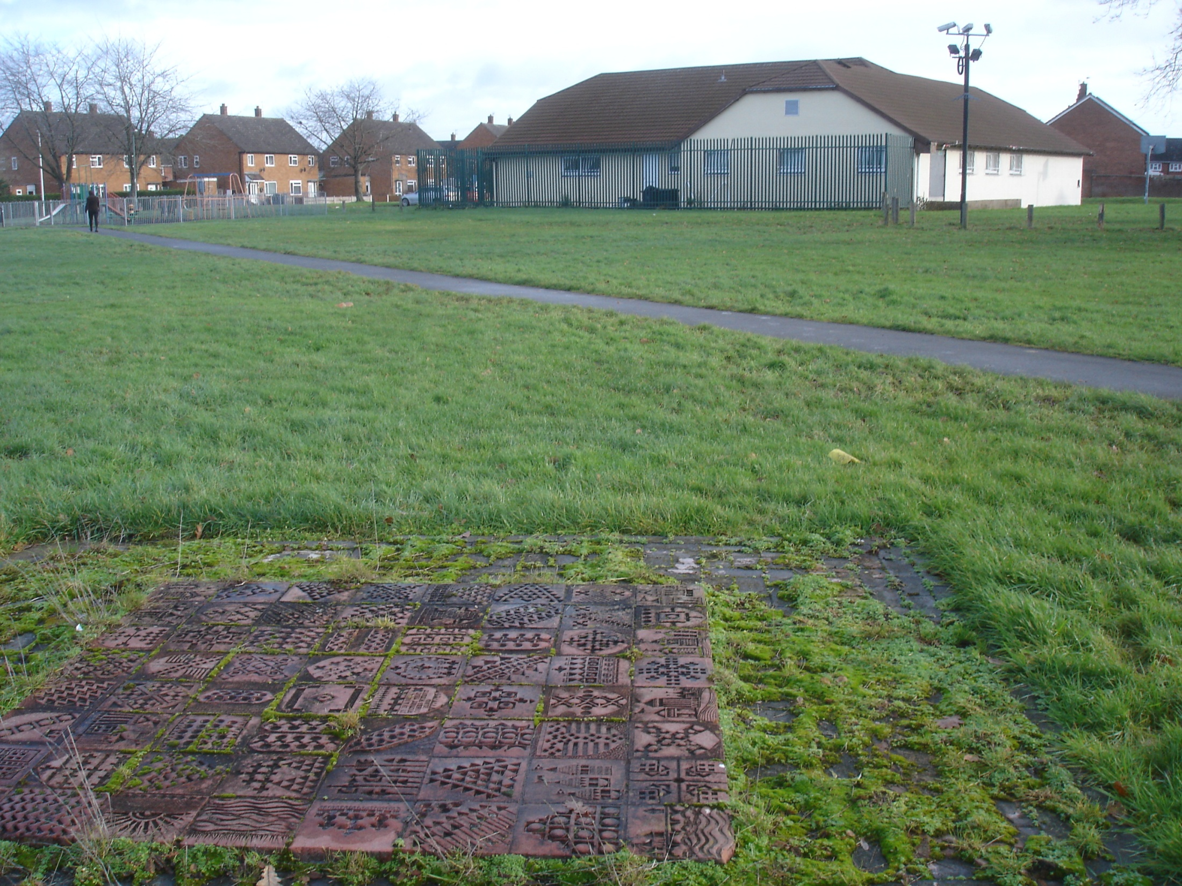

Slide 27
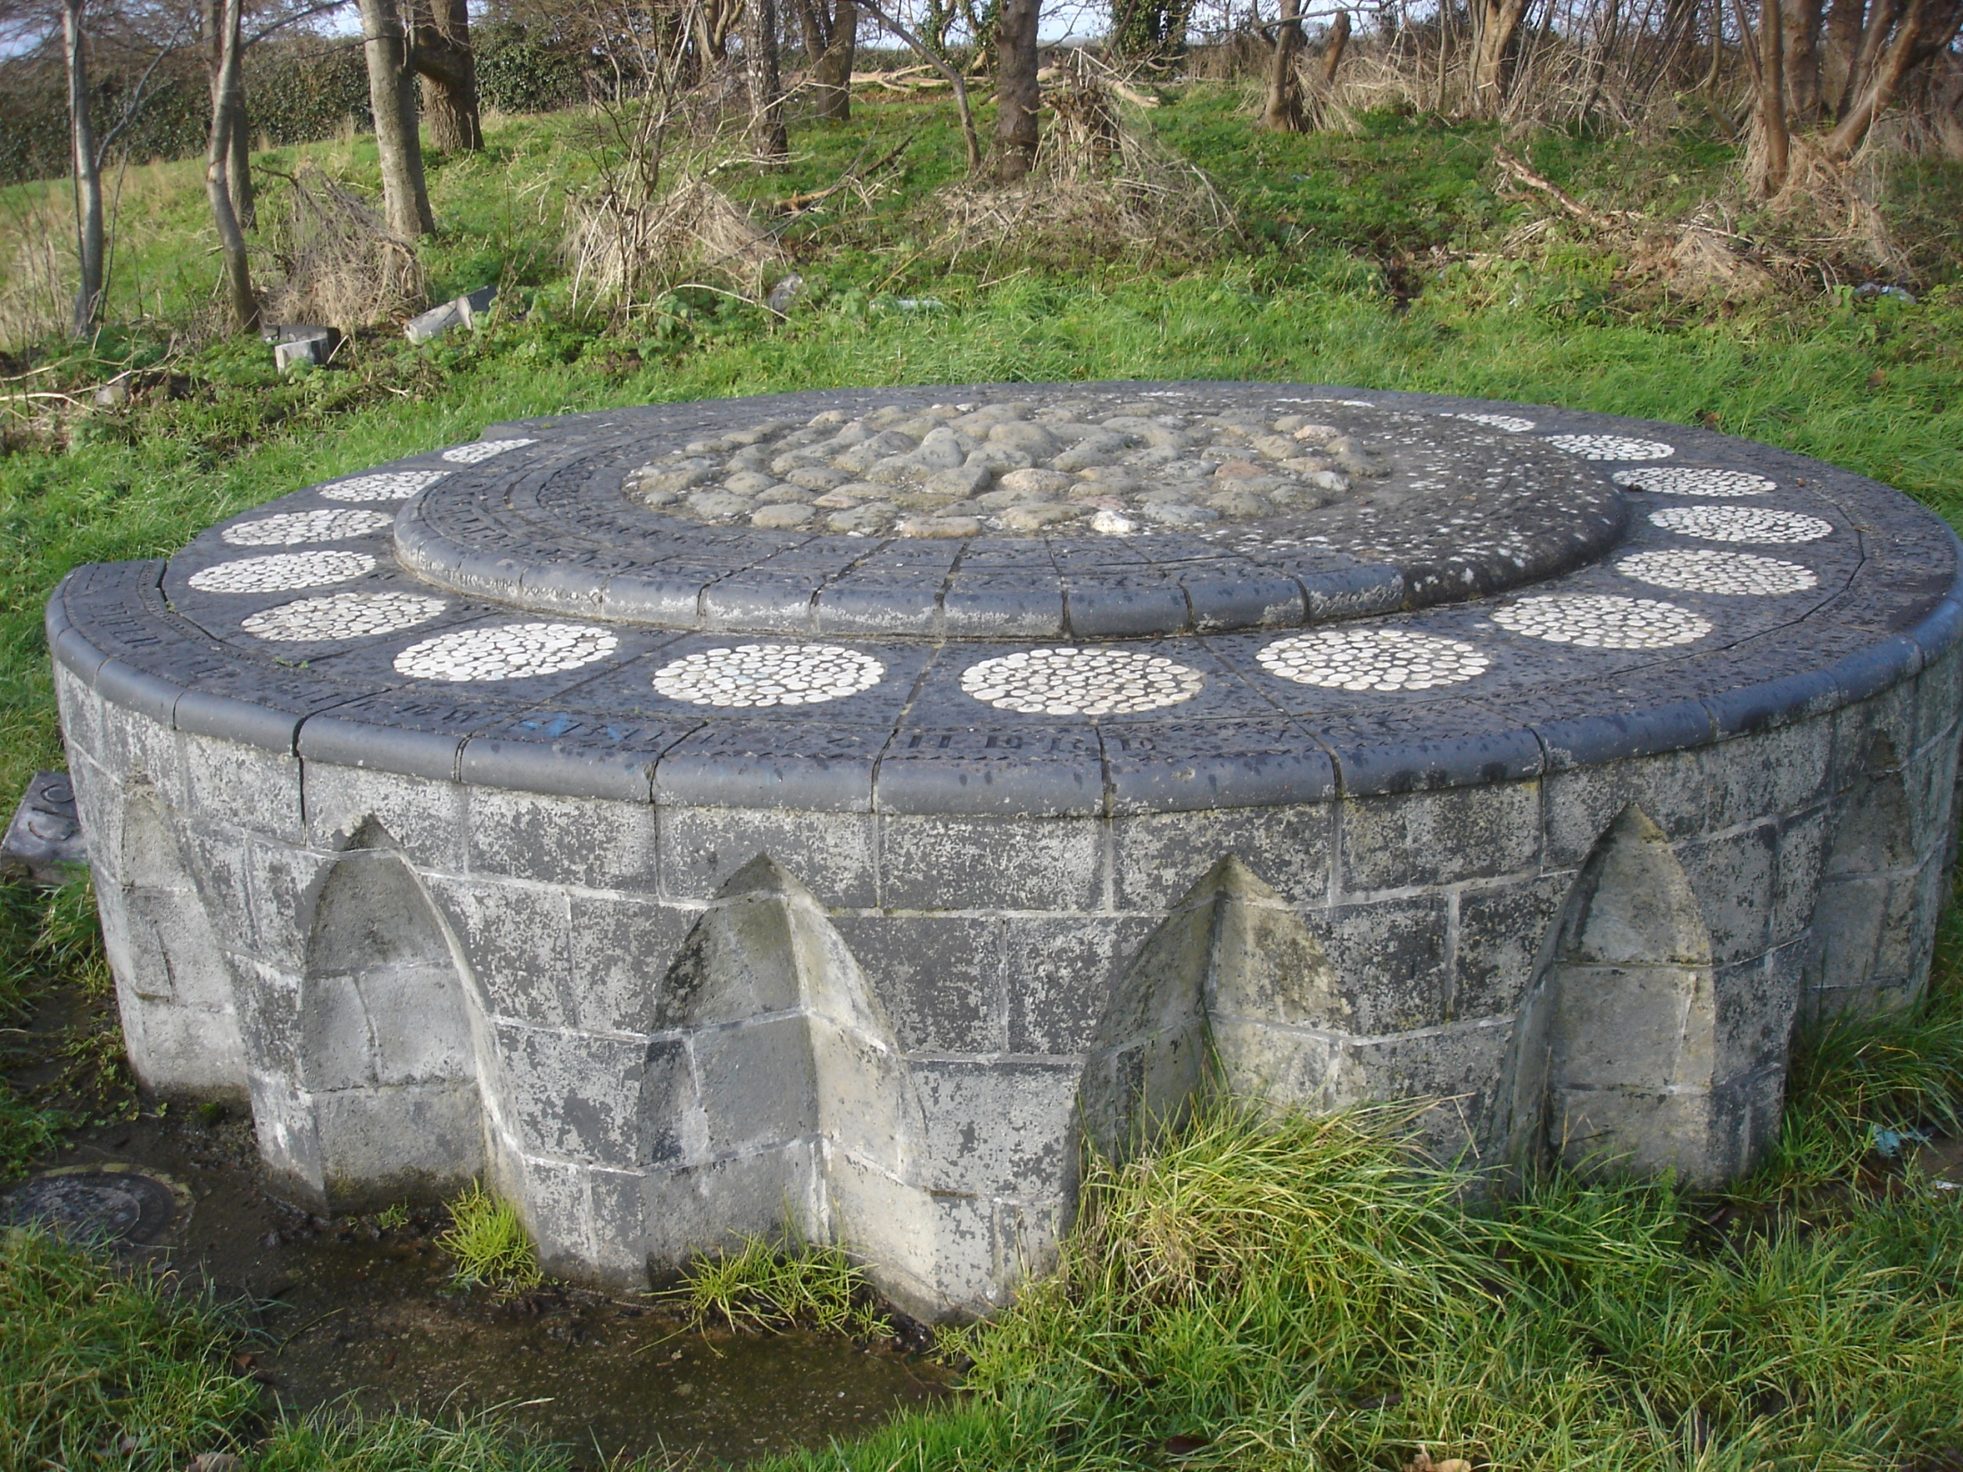

Slide 28
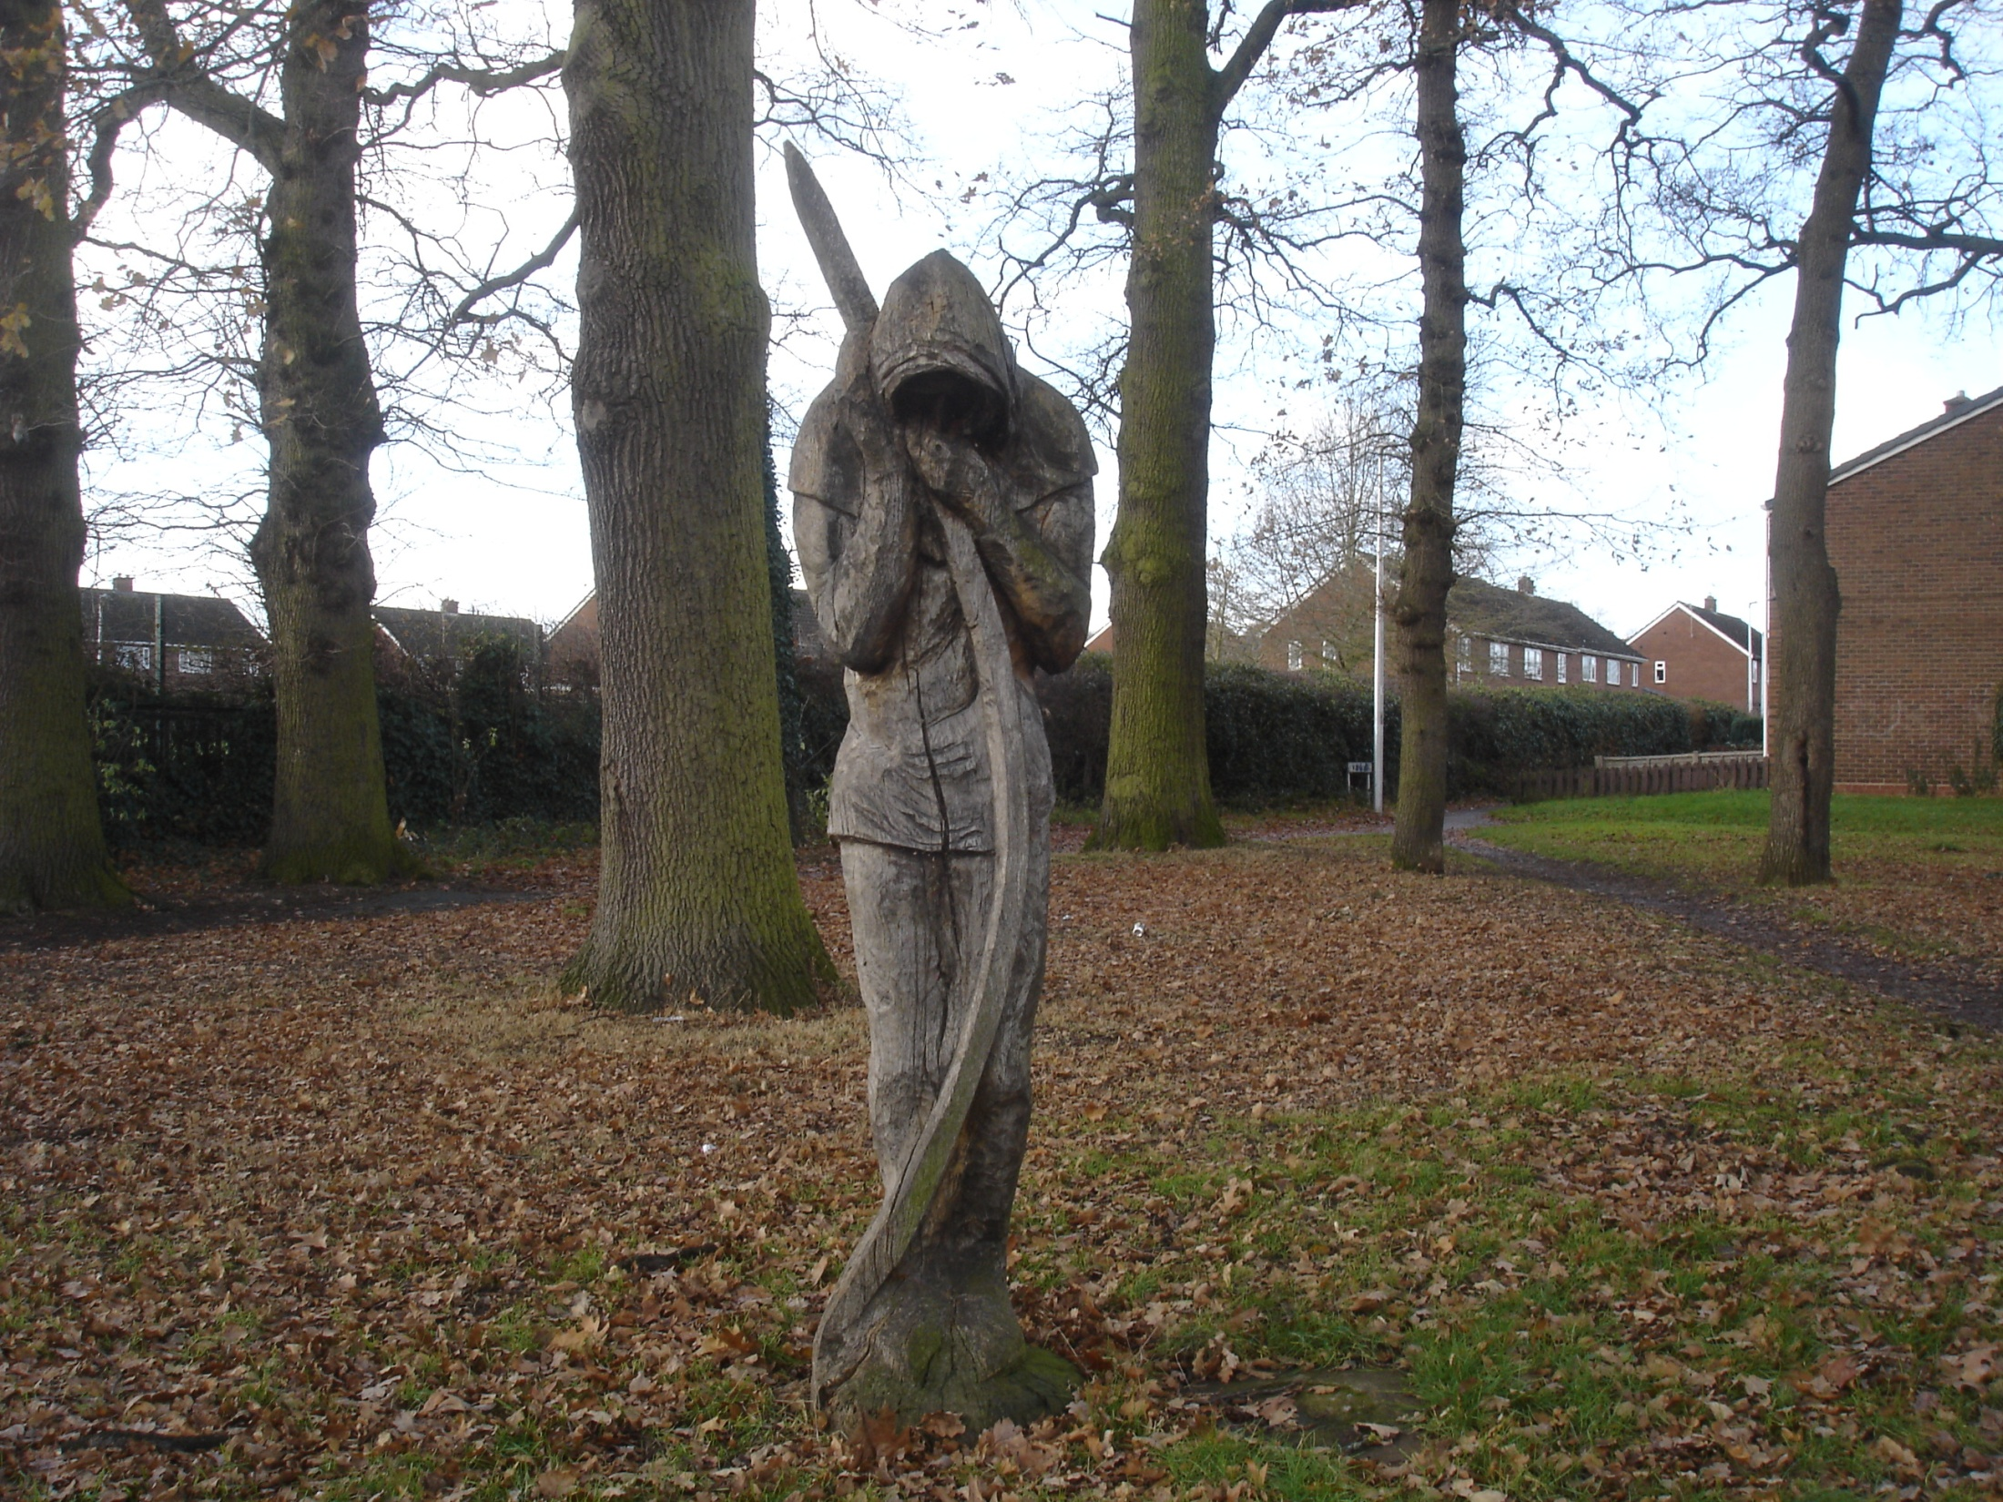
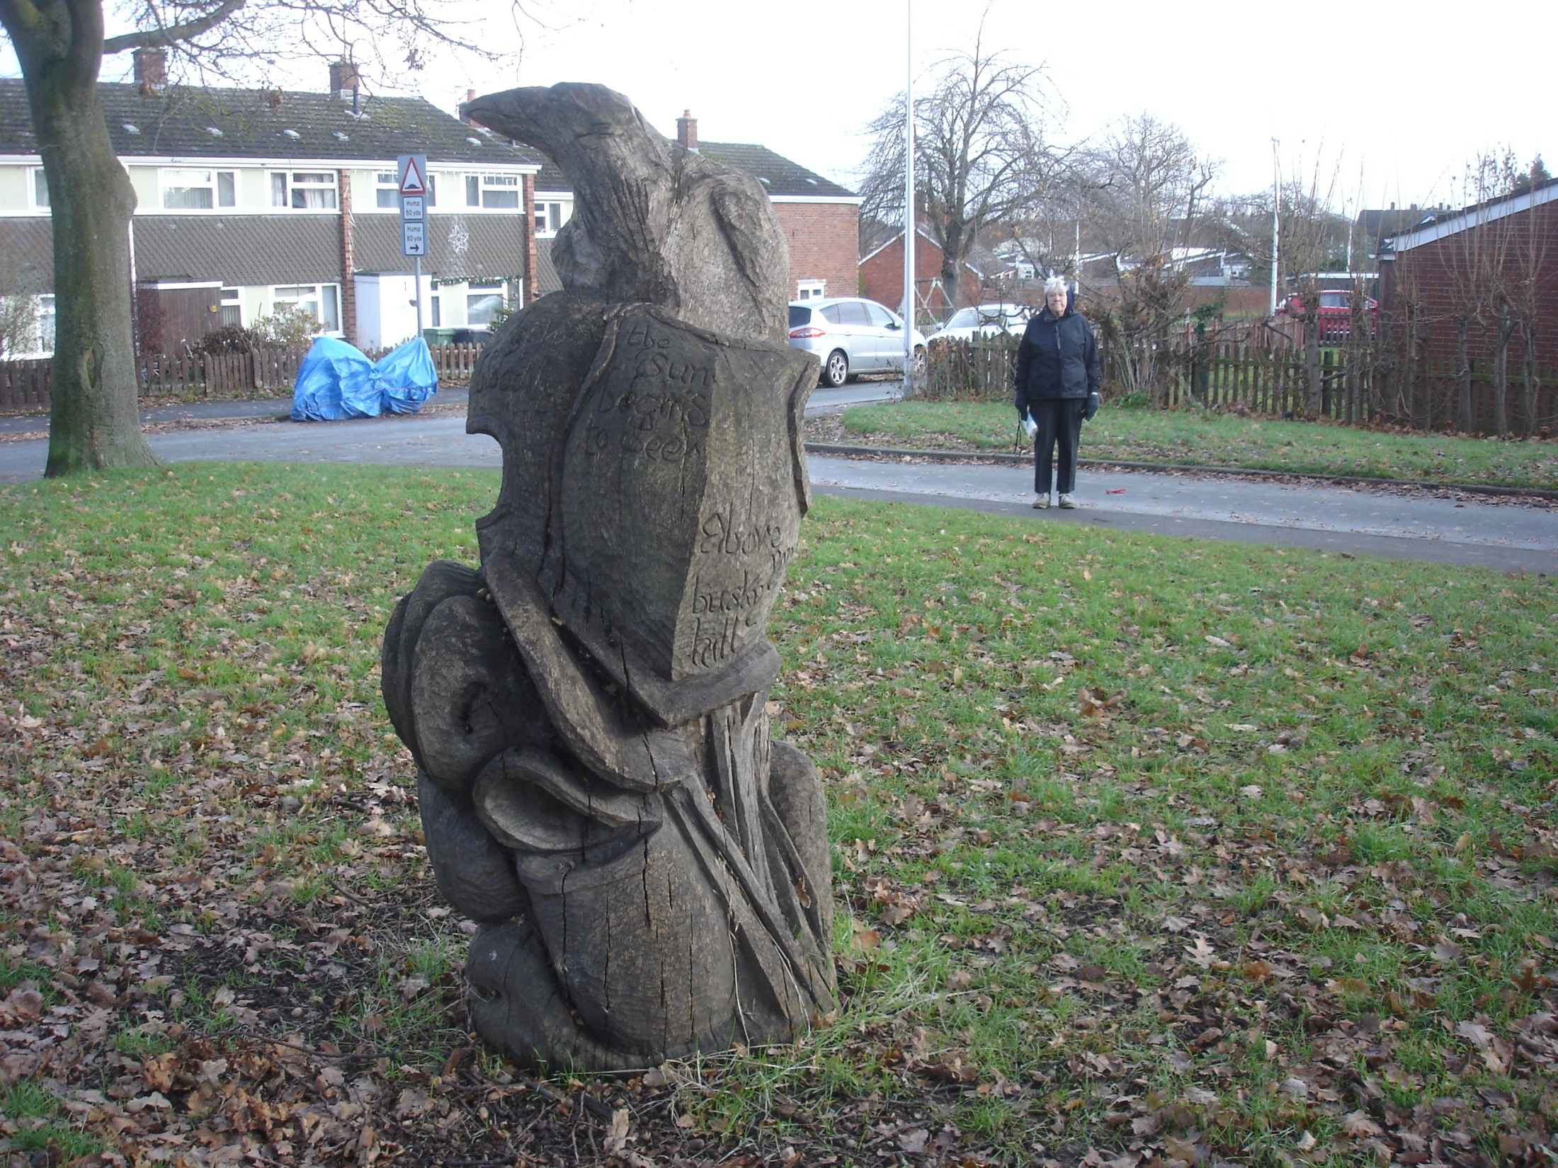

Slide 29
