Slide 1
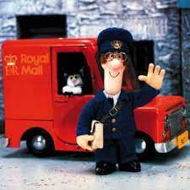
Shrewsbury
The Post Office
&
Post Boxes

Slide 2
Acknowledgements
The Postal Museum
‘Masters Of The Post’ by Duncan Campbell-Smith
‘The Letter Box’ by Jean Farrugia
The Letter Box Study Group
Shropshire Archives
‘The Chronicle’
‘Shropshire Star’
BBC
Wikepedia
“Shropshire Star” inc 14-10-2017 Shrewsbury Train Crash

Slide 3
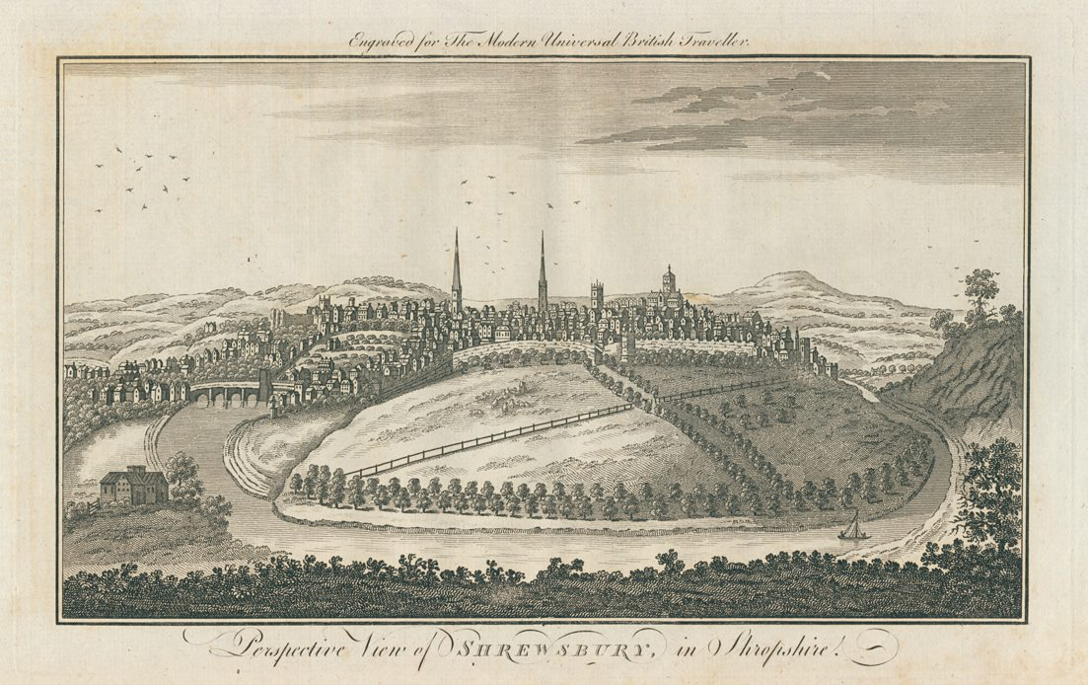
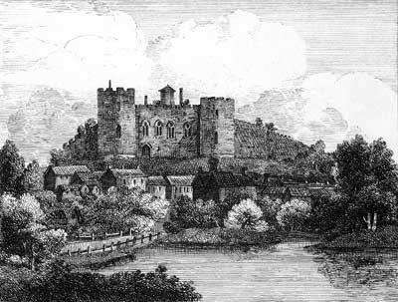
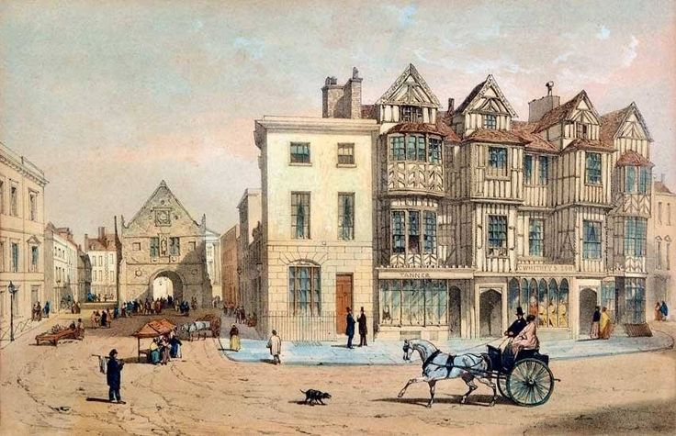
Shrewsbury
A prominent Market Town. An important By-Post.

Slide 4
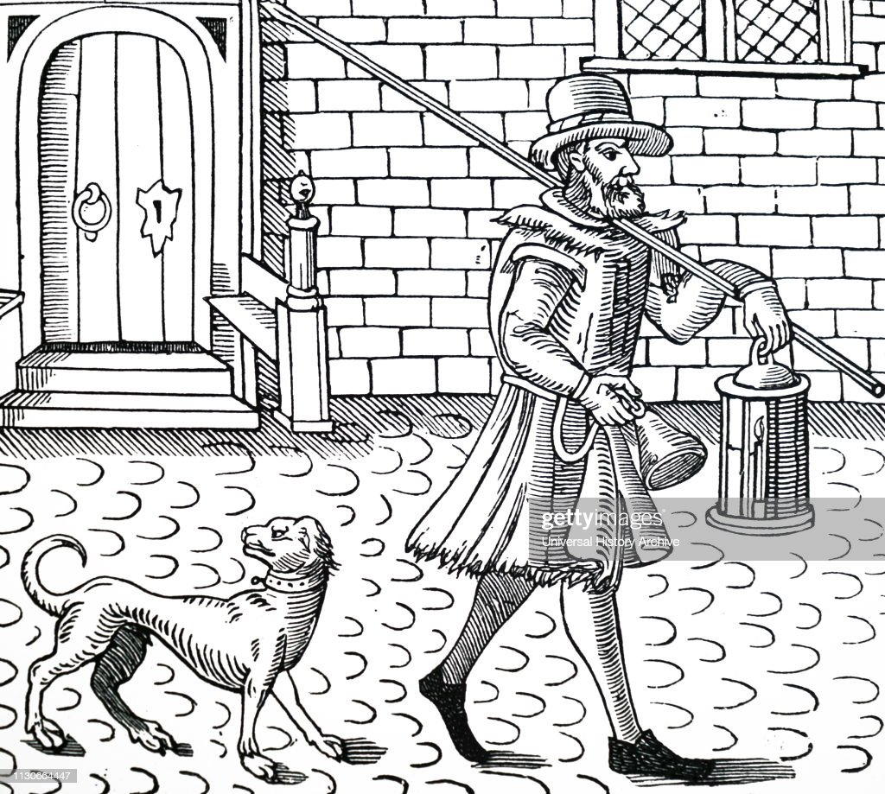
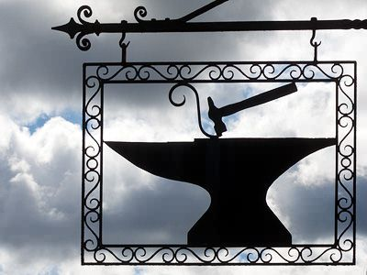
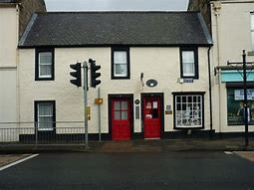
The British Postal System Before 1840
A Bellman
A Blacksmith Sign
Sanquhar the world’s oldest post office. 1712

Slide 5
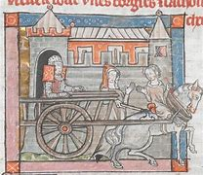
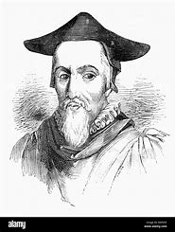
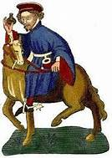

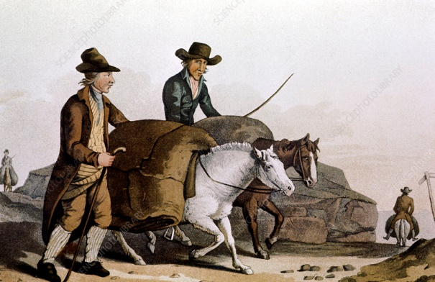
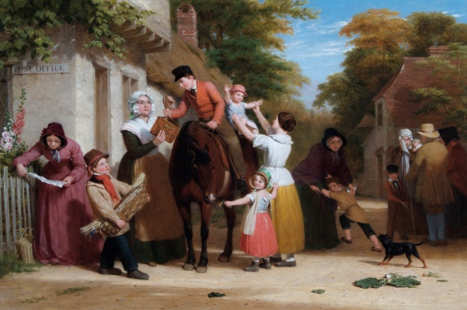
15th Century
Priest’s were trusted with letters
People travelling by cart
Pack horses
Merchants
Lawyers

Slide 6
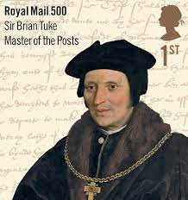
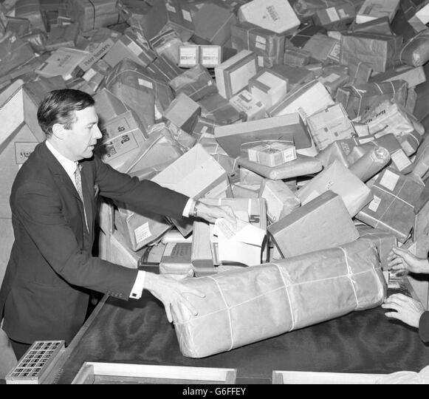
First & Last Postmaster Generals
John Stonehouse was the last Postmaster General in 1969
Sir Brian Tuke was the first Master of the post -Post Master General in 1516

Slide 7
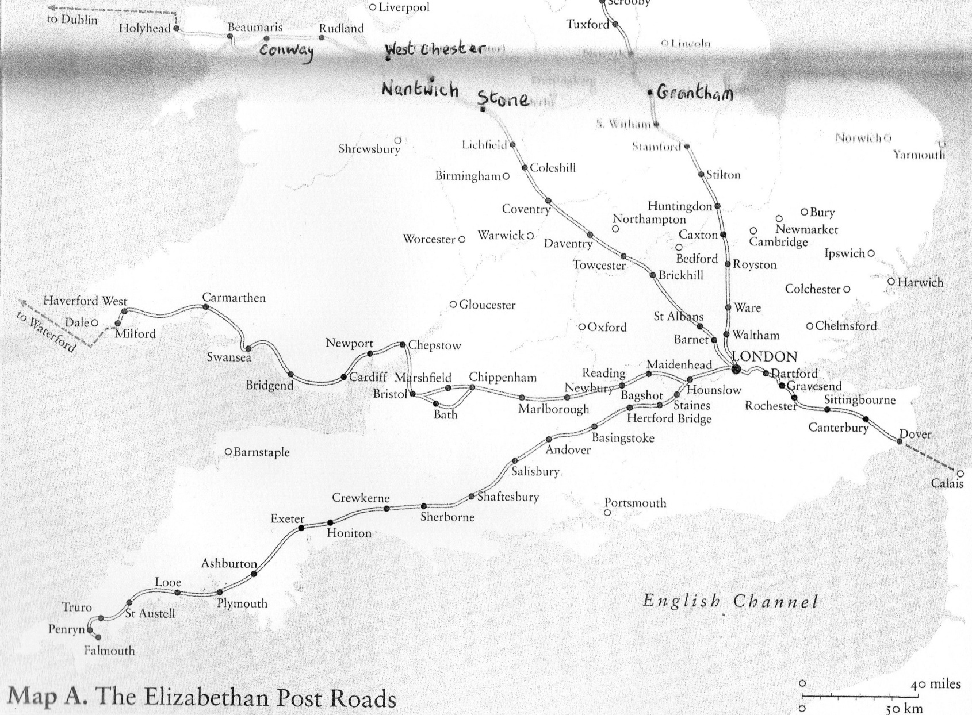
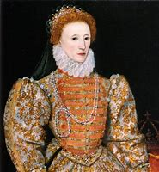
Elizabethan Post Roads
Shrewsbury

Slide 8
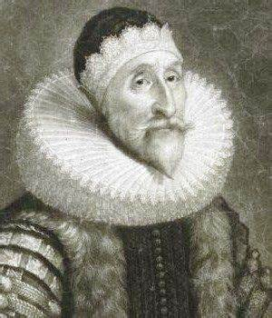
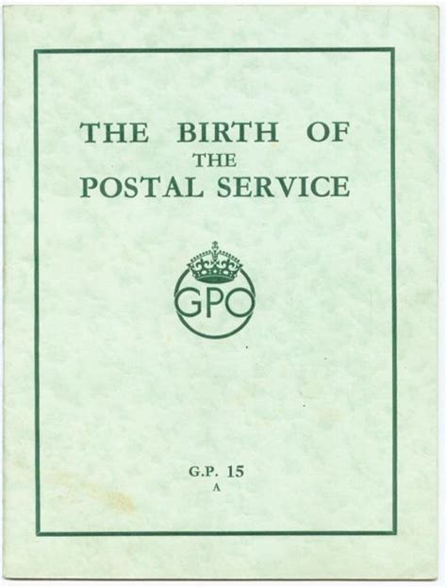
17th CENTURY
Thomas Witherings
“Father of The Post Office”
Sir John Coke

Slide 9
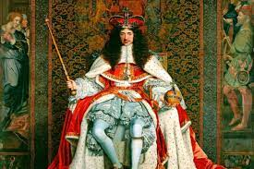
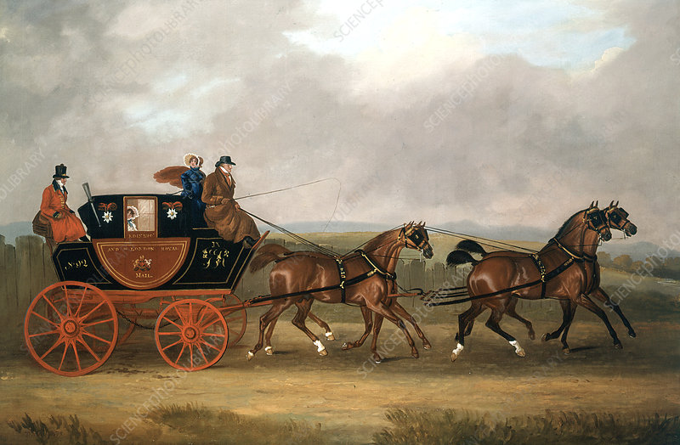
Edinburgh to City of London
“go thither and come back in 6 days”
King’s Proclamation – Bagshot 31st July 1635
Chester
London
2 days for post to arrive
via Shrewsbury

Slide 10
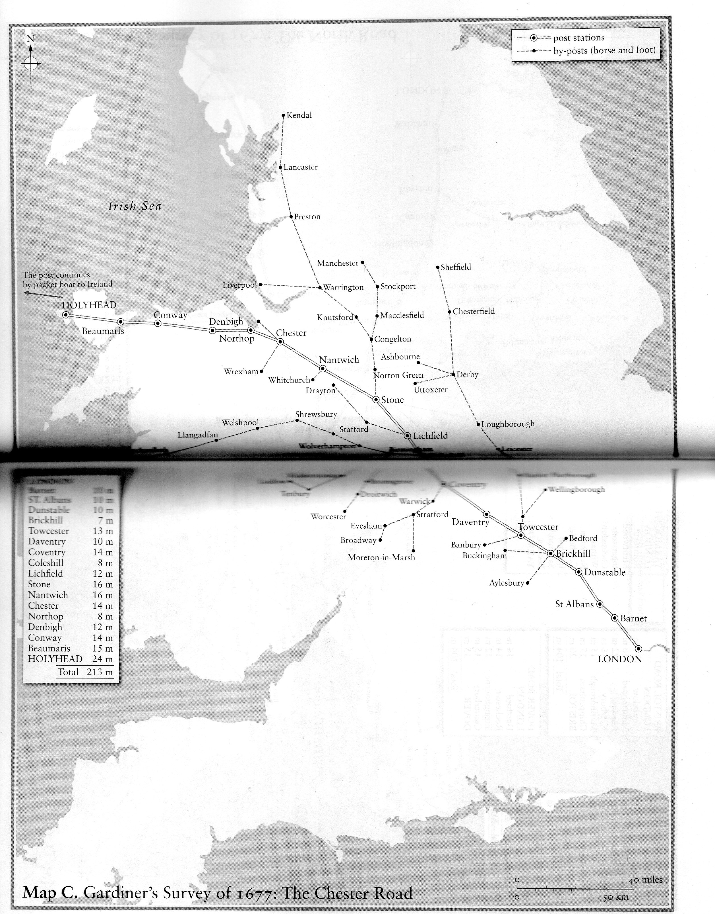
The Chester Road one of the main 6 postal routes.
Shrewsbury was an important By-Post
Shrewsbury

Slide 11
1654 . Oliver Cromwell granted a monopoly to the office of postage over the postal delivery’s services in England
1657… Fixed Postal rates were launched
1657…Cromwell’s Act Established GPO
Oliver Cromwell
Making changes to postal services
Charles 11
1653 - 1658
1660-1685
In the Charter of December of 1660 Charles 11 opened the continuation of the development of the Post Office
From 1660 to 1764 incoming mail arrived in London on Monday, Wednesday & Fridays each week.

Slide 12
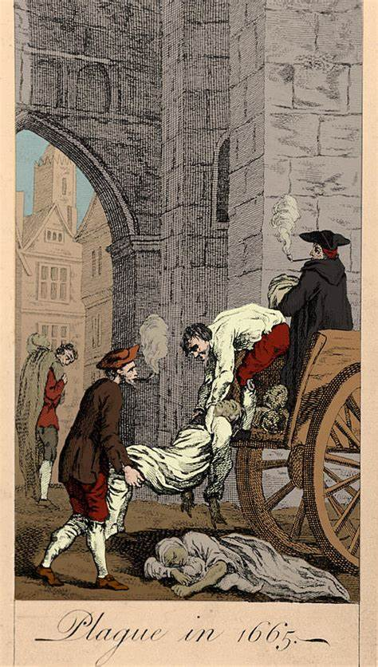
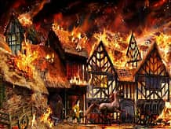
THE GREAT FIRE OF LONDON 1666
THE PLAGUE OF 1665

Slide 13
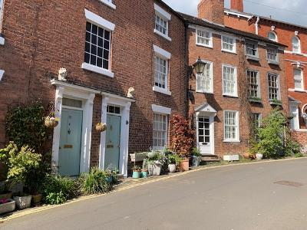
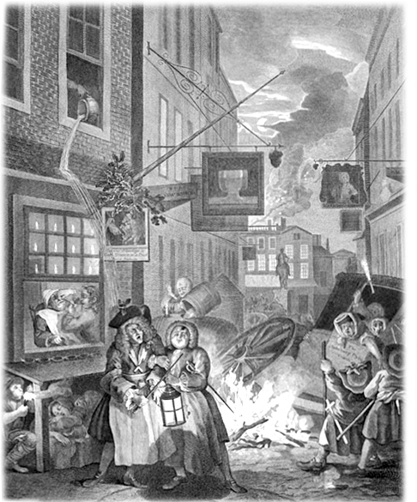
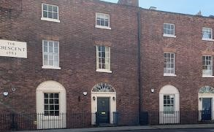
18th CENTURY
House numbering
“To my sister Jean up the Canongate, down a close, Edinburgh. She has a wooden leg”
Illustrated
business
signs
Claremont Hill, Shrewsbury.
Consecutive house numbering
The Local Authority is
responsible for
house numbering not
The GPO.

Slide 14
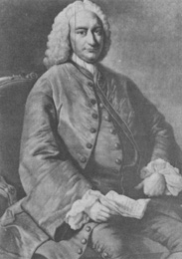
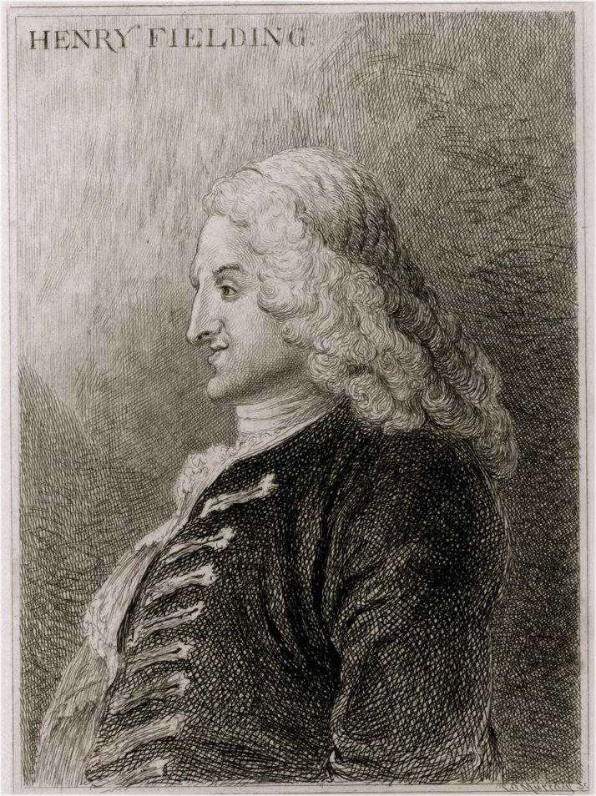
Ralph Allen
1693-1764
He was the model for
Squire Allworthy
in Fielding’s book
‘Tom Jones’
At 18 he was the Postmaster for Bath.
He worked for the Post Office for 44years.
He stamped out bad practice in the system.
Consequently, income increased from the mail.

Slide 15
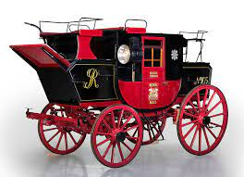
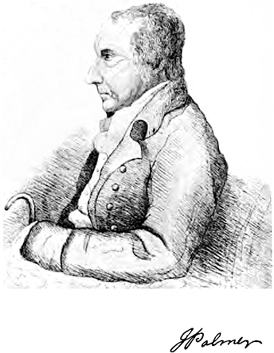
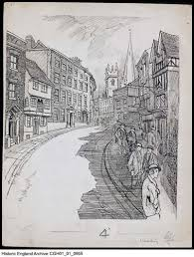
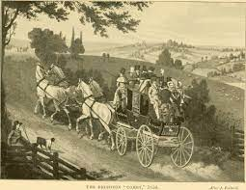
18th Century
John Palmer
1742-1818
1784
The first mail coaches ran between London and Bristol.
Mail coaches looked like family carriages but were recognised as postal coaches by their livery.
The Lion Inn Shrewsbury

Slide 16
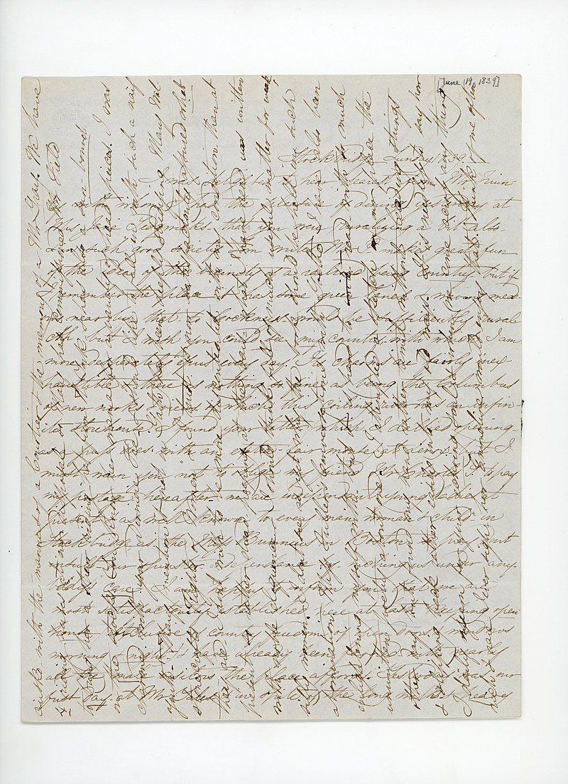
18th Century
Cross Writing

Slide 17
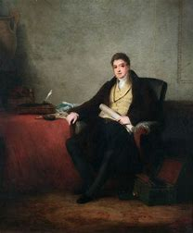
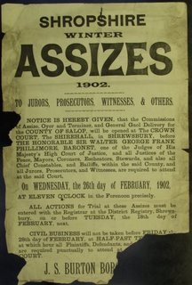
19TH CENTURY
Francis Freeling
1764-1836
Control of PO for nearly 40 years
1827
William Davies from Ludlow stealing from the PO. 7 years transportation
1828 – Thomas Hughes Deputy PM tried for fraud at Shropshire Assizes

Slide 18
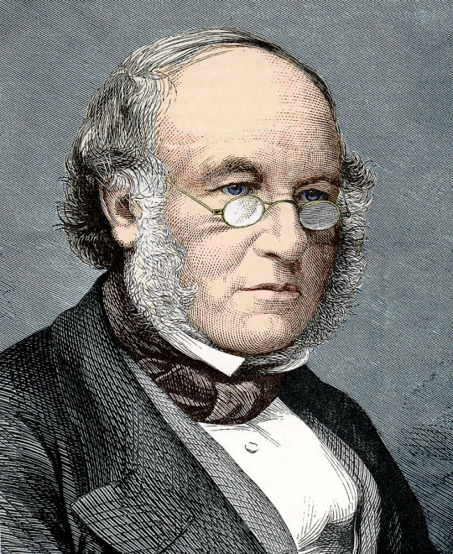
1840
POSTAL REFORM ACT
1827 Pamphlet
On
Postal reform
Low pre-payment
stamp
Born in Blackwell Street Kidderminster
Rowland Hill
Rowland Hill

Slide 19
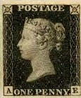
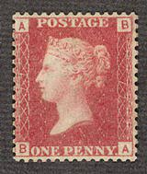
19th Century
Introduction of Post Office Money Orders
1st May1840
Penny Black stamps were realised to the public. For the use of letters post on or after the 6th May
By the middle of 1840s 9 out of 10 letters had a stamp on them and many were being posted in envelopes .
People had discovered how to reuse the Penny Black so February 1841 it was replaced by the Penny Red

Slide 20
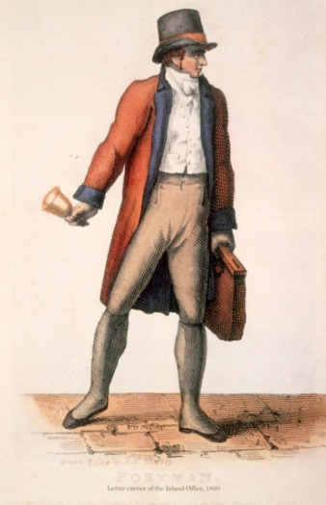
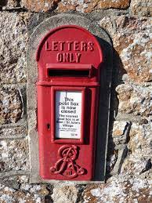
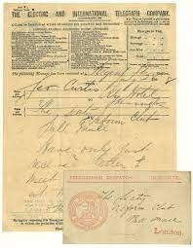
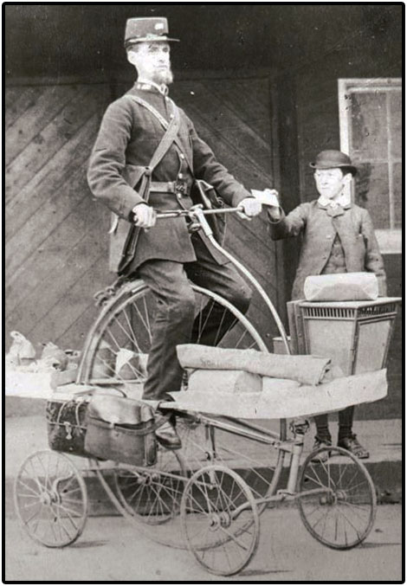
Progress made during the 19th Century
1846….the last bellman
1852 ..Red pillar box in St Helier Jersey
1846
1852
1853
1857
1870
1880
1883
1853 more pillar boxes across Britain
1874… in Shrewsbury Market House or Butter Cross changed to Post Office
1880 … First postmen on bicycles
1870… Telegraphs introduced

Slide 21
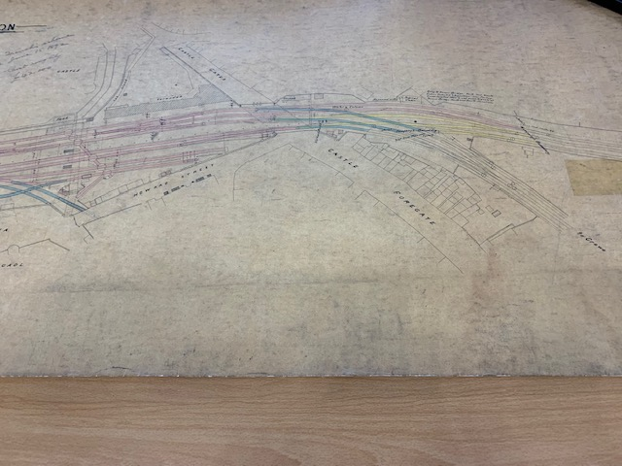
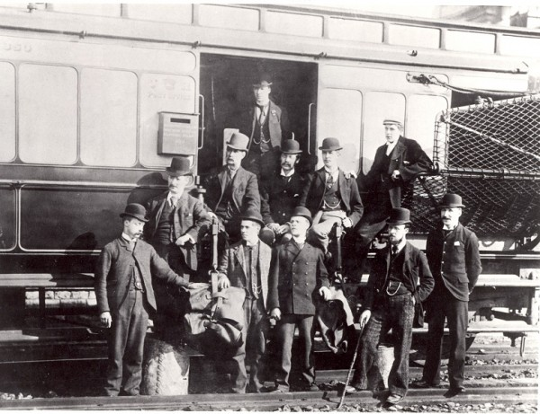
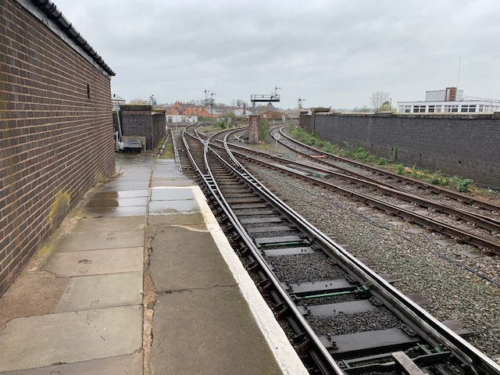
Shrewsbury Railway Station
1892 Plans of
Shrewsbury
Station
1900 A Travelling
Post office
2023 Shrewsbury Station
Platform 7.

Slide 22
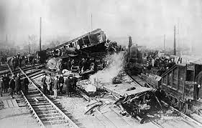
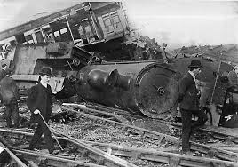
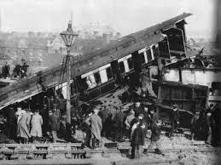
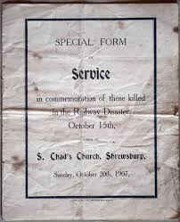
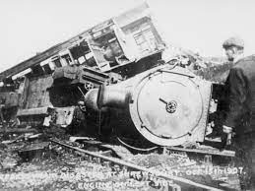

Shrewsbury Railway Crash 1907

Slide 23

MEMORIAL PLAQUE TO THE TPO WORKERS WHO LOST THEIR LIVES IN 1907 SHREWSBURY TRAIN CRASH

Slide 24



Who wrote the poem?
Mary Webb & her poem
George Gresswell’s poems
“It was on a Tuesday morning, a little after 2, a sad calamity o’etook the fast express from Crewe”.

Slide 25




20^{th/}21stCentury in a flash
1912 Post Office telephone system
1939- post boxes removed for WW11
& repainted red
1941 – GPO approved post women wearing trousers
1930- Blue airmail boxes
1959 – Leicester drive in post office
1968- 2nd class stamps
1969- GPO Nationalised
1974- postcdes
2012 – Olympic gold post boxes
2012 Christmas post box in market square Shrewsbury

Slide 26



Pillar Boxes
French Post Box
This is Anthony Trollope Novelist
Who in proposed the introduction of the post box in 1852.
Early
Post boxes

Slide 27

ROYAL POST BOX CYPHERS

Slide 28

Charles 111 vs Cristiano Ronaldo Cyphers

Slide 29



Lamp box
VICTORIAN & Edward V11 POST BOXES
NEAR
SHREWSBURY
On way to Oakengates garden centre Ellerdine
Cylindrical post box
Walled Post Box
Ellesmere
Pillar box

Slide 30


Shrewsbury Hexagonal Pensfold
VR Pillar Boxes

Slide 31


SHREWSBURY:
WALLED VR POST BOXES
One of the first boxes on wall outside St Winifred’s School

Slide 32



Post boxes around Shrewsbury
Edward V11 St Julian’s
George V1 by Greyfriars bridge
George V in Wenlock Road

Slide 33


A modern postman & his van
Edward V111 post box Welshpool

Slide 34






Decorated Post Boxes.
Have you seen these pillar boxes on your travels in and around Shrewsbury?

Slide 35





I- Spy Post Boxes in Shrewsbury

