Slide 1

What happens to my data when I die?
Geoff Lane
…. with some help: Mike Masterson
Notes:
We’re all going to die one day, but the same can’t be said for our online accounts. One of three things generally happen:
Some will persist forever (especially if you don’t tell them)
Others might expire due to a set period of inactivity,
and some have preparations in place for when you pass away
In all instances. You and your loved ones should think about – and indeed take action, before the time comes.
First though, lets talk about before you die.

Slide 2



Before you die
- but are losing control
Consider Lasting Power of Attorney.
Lets you appoint one or more, people to make decisions on your behalf if you lack ‘mental capacity’.
Or to help you make decisions if you know what is going on.
2 types:
  Health and Welfare
  Property and financial affairs.
Notes:
A lasting power of attorney (LPA) is a legal document that lets you (the ‘donor’) appoint one or more people (known as ‘attorneys’) to help you make decisions or to make decisions on your behalf.
This gives you more control over what happens to you if you have an accident or an illness and cannot make your own decisions (you ‘lack mental capacity’).
You must be 18 or over and have mental capacity (the ability to make your own decisions) when you make your LPA.
You do not need to live in the UK or be a British citizen.

Slide 3
Health & Welfare
your daily routine, for example washing, dressing, eating
medical care
moving into a care home
life-sustaining treatment
It can only be used when you’re unable to make your own decisions.

Slide 4
Property & Financial
managing a bank or building society account
paying bills
collecting benefits or a pension
selling your home
It can be used as soon as it’s registered, with your permission, or unable to make decisions.

Slide 5




You can do all this online
www.gov.uk/power-of-attorney
It costs £82 to register an LPA
Cancel or make a new one as required.
Register your LPA with the office of the Public Guardian
🙁 It can take up to 20 weeks!
Notes:
You can add additional Attorneys as spares in case your first nominated is unavailable. You do need witnesses to your signatures etc when setting it up.
Bear in mind if you do it both ways – You and your Spouse and your Spouse and you and do both Health & Welfare and Property and Financial it is 4 x £82.00 making £328.00.

Slide 6
Assuming you have passed on,
- proving the estate
Willed: Your executor applies for grant of probate.
Intestate: Your family, friends can apply for grant of probate, or the state appoints an administrator
Whatever, your grantee ‘steps into your shoes’,
  but not your passwords
Winds up your estate: ‘property’ and ‘chattels’, and ‘proves’ the valuation for distribution
  Is data a ‘chattel’? Not found.
… and your estate data? Data relating to the estate, is retained 5 years
After proving, wills and estates become public.
  So perhaps access to data should not be in the will
  Could use a ‘letter of wishes’
  Can use a digital will (same thing, I think?)
Notes:
Willed:
Your executor proves your estate, or appoints a legal person to do that.
Your estate (property and chattels) are distributed according to your wishes
Intestate:
Your family or friends can apply for grant of probate
Or the state appoints an administrator
Your estate is distributed by state set rules
So if you want your wishes respected, make a will
Your estate data: Financial / commercial / tax data is retained 5 years
Consider a ‘letter of wishes’, this remains private to the trustees. Is easily changed, not like a will

Slide 7
What about all that other data, your digital legacy?
Mike: 5 years of Creative Writing, so about 60 stories
Phil: All his films
Geoff & Sandra. Lots of artwork
All of us: thousands of digital photos
The Moral of the story:
- Unless you make a plan, gone in 5 years
Notes:
We all have lots of data. I could not find it addressed in the words for ‘property’ or ‘chattels’
Your PC / IT can be / will be distributed
……. but does that cover all data?
……. Including data on the cloud?

Slide 8
What is the oldest data?
How long can data survive?
San cave paintings: 73,000 years old.
  …hmm. I understood 5,000 years
Egyptian Hieroglyphs: 3400BCE
Papyrus scrolls: 2400BCE. Dead Sea Scrolls survive
Rosetta Stone: 196 BCE
Punched tape: used in looms 1725. Survived?
Phonograph: 1857, ‘Au Clair de Lune’, French folk song. Survives, though much lost
Punched cards: Herman Hollerith founded the Tabulating Machine Company (1896), used in US Census. Not surviving
Hard Drive: 5 to 10 years. Your experience?
Genetic code: Rhino tooth 1.7 million years. Data?
Notes:
San (bushmen) paintings are dated to at least 5000 years old, but there is a question as to what was originally there:
Some have only red ochre – from iron content
Other white, black, yellow colours were made from organic material, now gone
Other cave paintings in France are listed to 27,000 years old
Date survivability decreases with closeness to IT. EG. My book v my PC

Slide 9
Who are we talking about?
Multimedia
Google (Gmail, YouTube, Photos)
Apple
Microsoft
Social media
Facebook
Twitter
WhatsApp
Instagram
Notes:
Some will persist forever (especially if you don’t tell them)
Others might expire due to a set period of inactivity,
and some have preparations in place for when you pass away
Bear in mind that even if the account holder explicitly passes on ownership or login details. Whether or not that account can still be used depends ultimately on the service operator, and these policies differ quite wildly.
If you were hoping to pass on a digital library of movies and music, then you might be disappointed to hear that this is often forbidden in the terms and conditions. Or, if a family member needs information stored in your inbox, they might have to provide a subpoena or court order to gain access.
We are going to look at some of the options for serial 3. What we can do.

Slide 10

Google
Start with Google’s “Inactive Account Manager”
https://myaccount.google.com/inactive
Lets you decide when Google considers the account inactive.
Who they should notify – up to 10 people.
What to do with your data afterwards. Share or delete.
Notes:
Google states that it is unable to provide passwords or other login details, but will “work with immediate family members and representatives to close the account of a deceased person where appropriate.”
Since Google owns YouTube, and YouTube videos can continue to earn revenue even if the channel belongs to someone who has passed away, Google might pass on revenue to eligible family members or legal next of kin.
Google’s Inactive Account Manager https://myaccount.google.com/inactive Or go your Account settings and look towards the end of the Data & Privacy section.
This includes when your account should be considered inactive, who can access it and what they can access, and whether or not your account should be deleted. In the event of someone passing who hasn’t used the Inactive Account Manager, Google lets you submit a request to close accounts, request funds, and obtain data.

Slide 11
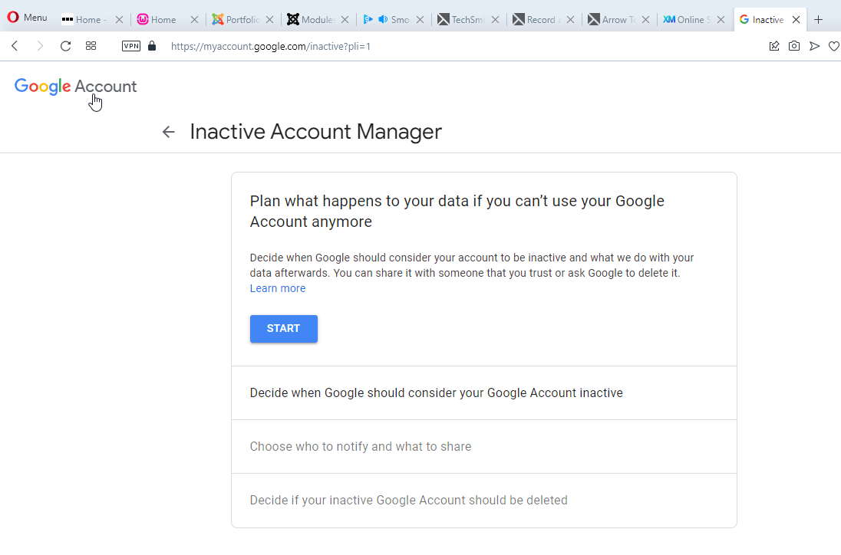
Notes:
******* Start

Slide 12
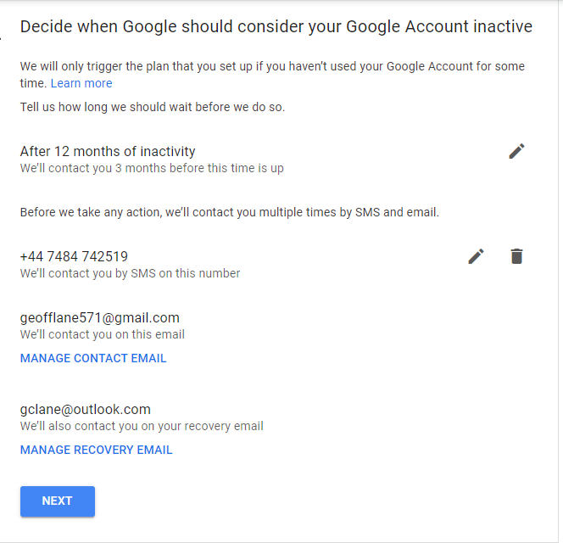
Default is 3 months. Select from 3, 6, 12 or 18 months
Notes:
******
Edit period of inactivity
*****
Edit mobile number
*****
Edit email addresses
*****
Next

Slide 13
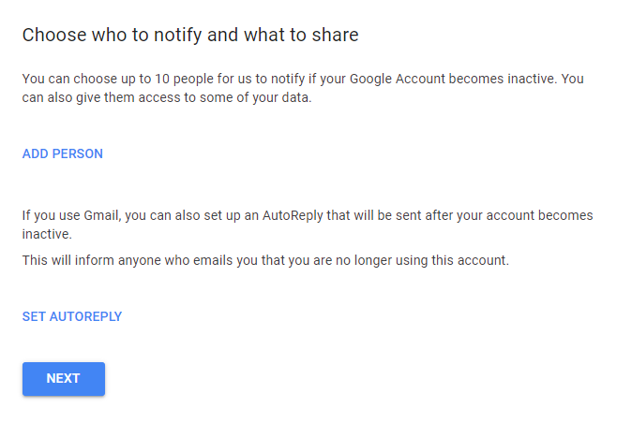
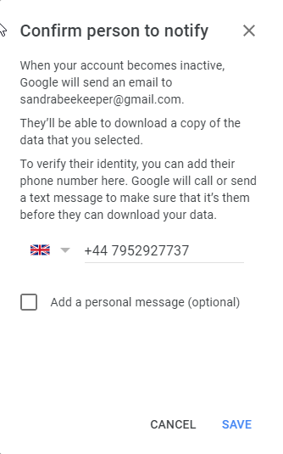
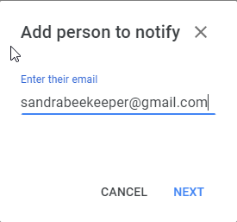
Notes:
******
Add Person
******
Confirm persons telephone no

Slide 14
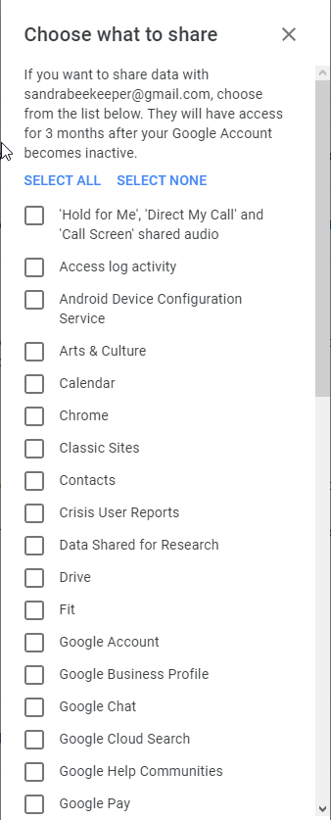
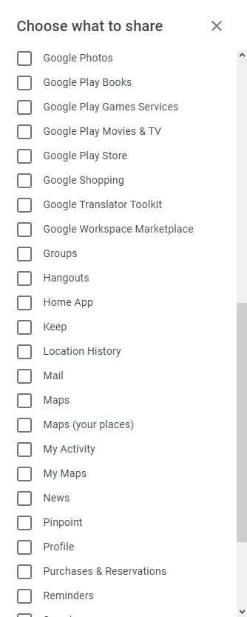
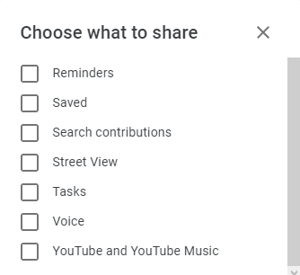
Choose
what
to
Share
You can share a lot of things!
Notes:
*****
More sharing options
*****
And again
*****
You can share a lot of things
In real life I selected them all – whether I’d used them or not.

Slide 15
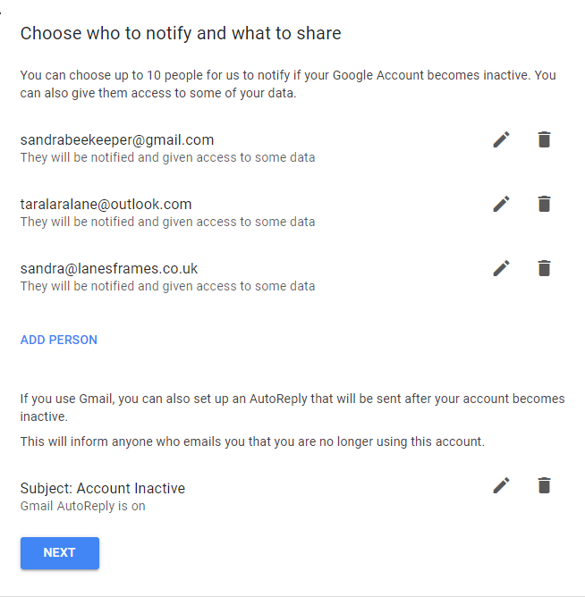
Notes:
Confirmation of the people being notified. I’ve no idea what email address might be using in 10, 20 years time, so I put her 3 main ones.

Slide 16
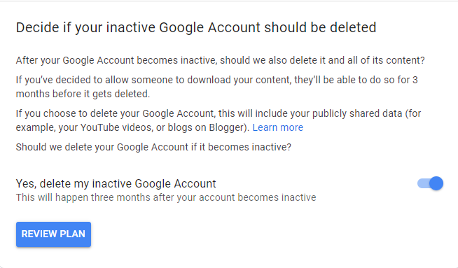
Notes:
******
Delete the account or not. (The screen shows the “Yes” position)

Slide 17
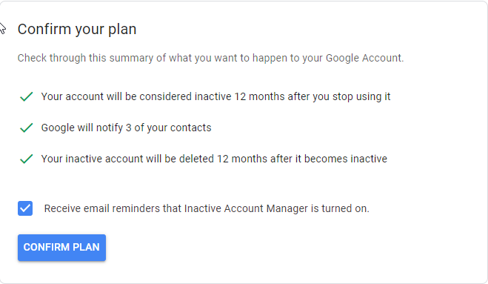
Notes:
Confirmation of what you have set up.

Slide 18
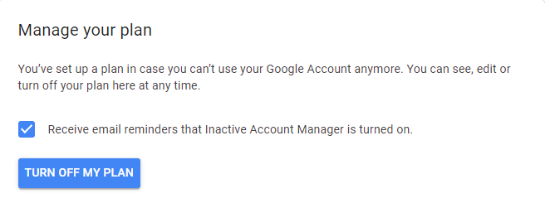
The Inactive Account Manager now lets you turn it off or edit it
Notes:
Turn off or edit you plan
(The edit part is not shown in this screenshot)

Slide 19

Apple
Chris Bluvshtein ‘Digital Legacy: What Happens to My Data after I Die?’ 6 April 2022
On December 13th, 2022, Apple released iOS update 15.2, which brought a new feature: digital Legacy Contacts.
As with Google, these are people who can take care of your affairs if you’re no longer around.
Notes:
Seems to out of date: Your Apple accounts will be terminated when you die. The “No Right of Survivorship” clause in their terms and conditions (which can differ between jurisdictions) states:
Unless otherwise required by law, You agree that your Account is non-transferable and that any rights to your Apple ID or Content within your Account terminate upon your death.
Once Apple receives a copy of the death certificate, your account will be deleted along with all associated data. That includes photos in your iCloud account, movie and music purchases, apps that you have bought, and the contents of your iCloud Drive or iCloud inbox.
There is no Right of Survivorship – you cannot pass on your music selection to your children/nephews or nieces. You only ever had a licence to listen to their music, it is not really yours to do with as you wish.

Slide 20

Microsoft
Official: “If you know the account credentials, you can close the account yourself.
If you don’t know the account credentials, it will be closed automatically after two (2) years of inactivity.”
If you don’t know the account credentials, only family members that are next of kin can request to close a Microsoft account
Notes:
The official terms and conditions state: “If you know the account credentials, you can close the account yourself. If you don’t know the account credentials, it will be closed automatically after two (2) years of inactivity.”

Slide 21

Facebook
Two options:
1. Have your account deleted
2. Have you account memorialised
  You name will have the word “Remembering” placed next to it.
  If your privacy settings permit it, friends will be able to share memories on your Timeline.
  Any content you previously shared will remain visible to the intended audience.
  Profiles that are memorialized won’t appear publicly such as in birthday reminders, advertisements etc.
  Your account will be basically locked, meaning no one can log into it.
  If you were the sole administrator of a page, it will be removed if Facebook receives a valid request.
  You need to appoint a “Legacy Contact”
Notes:
Facebook
Social media giant Facebook now allows users to nominate “Legacy contacts” to manage their accounts should they pass away. You can do this using your Facebook account settings, and Facebook will notify anyone who you specify.
Doing so requires that you decide between memorializing your account or permanently deleting it. When an account is memorialized, the word “Remembering” appears before the name of the person, and many account features are restricted.
Memorialized accounts remain on Facebook, and the content that they shared remains shared with the same groups. Profiles don’t appear in friend suggestions or the “People you may know” section, nor do they trigger birthday reminders. Once an account is memorialized, nobody can log in again.
Legacy contacts can manage posts, write a pinned post, and remove tags. Cover and profile pictures can also be updated, and friend requests can be accepted. They cannot log in or post regular updates from that account, read messages, remove friends, or make new friend requests.
Friends and family can always request memorialization by providing evidence of death, or they can request the removal of the account.

Slide 22

Twitter
Twitter doesn’t have any tools for deciding what happens to your account when you die.
The service has a 6-month window for inactivity, after which your account will be deleted.
Notes:
Twitter
Twitter doesn’t have any tools for deciding what happens to your account when you die. The service has a 6-month window for inactivity, after which your account will be deleted.
Twitter states that it “can work with a person authorized to act on behalf of the estate, or with a verified immediate family member of the deceased to have an account deactivated.” This can be done using the Twitter privacy policy inquiry form.
Twitter doesn’t currently allow profiles to be memorialised. This means that you have two options for managing your loved one’s profile; you can choose to leave it open as it is, or you can delete it.
Who can contact Twitter, and what happens?
If you would like to delete the account, an immediate family member or executor of the will should contact Twitter to tell them that the individual has died. Then, you’ll need to provide Twitter with the following information so that they can properly authorise the person’s account to be deactivated:
Proof of death certificate
Proof of your identification
Deceased’s details
Remember that Twitter isn’t able to provide any family member or friend access to a user’s account after death, for security reasons.

Slide 23

WhatsApp
Deleting the deceased’s account will remove the individual from all of their WhatsApp groups.
Deleting their membership doesn’t affect copies of information or messages that were sent by the individual to other users.
You can delete the account from the App: Settings | Account | Delete my Account | Enter the Phone No when prompted | Optional – Give a reason | Delete my Account
Notes:
If the deceased still has an active WhatsApp account, you can delete it.
Who can contact WhatsApp, and what happens?
Deleting the deceased’s account will remove the individual from all of their WhatsApp groups. You can follow these steps to delete it:
Open WhatsApp on the deceased’s phone
Go into Settings, then Account
Click ‘Delete My Account’
Enter the phone number when prompted
Select one of the drop-down reasons for closing the account, if you wish to
Tap ‘Delete My Account’
Remember that once the WhatsApp account is deleted, you won’t be able to regain access to it. Deleting their membership doesn’t affect copies of information or messages that were sent by the individual to other users.
Deleting the deceased’s account will remove the individual from all of their WhatsApp groups.

Slide 24

Instagram
Similar to Facebook.
Doesn’t have a legacy contact, but you can make their profile into an Instagram Memorial Page
Notes:
Who can contact Instagram, and what happens?
Only an immediate family member should contact Instagram to let them know a loved one has died, and request the account to be removed.
Once the request to memorialise their Instagram has been authorised, their account is frozen. No-one can add new posts, likes, tags or comments, nor can they send messages to or from the account. An Instagram memorial page is hidden from the ‘explore’ section and any other public spaces on Instagram.

Slide 25


Does Social Media create Legacy?
Hillary Clinton: Used her own mail server.
Did it affect her 2016 election campaign?
Donald Trump messages: Unusual relations with females.
Did it affect his 2016 election campaign?
Matt Handcock WhatsApp with Simon Case during pandemic.
Any impact? Ho-Hum
Notes:
Mike view: We will all have our own, personal view
But for many, it seems likely that social media strings does not create legacy
Legacy needs to be complete: a beginning, middle and end (story, film, photo)
A detachable artifact
Probably best off IT
But do make your plan

Slide 26
Things to Consider
Don’t rush, it won’t matter if you don’t do
anything for 6 months.
Think about the order you do things. You will need
email and their mobile phone number for 2FA.
Cancel subscriptions
If you have their login credentials, then log in and close the account yourself.
Notes:
***** Don’t rush
***** Think of the order
***** Cancel subscriptions
***** Delete the account yourself if you can rather than tell the service provider the person has died. You will probably need to send proof – copy of death certificate and furbish them with identity of the account, name, login, email address etc. Much simpler to do this yourself if you know the details.

Slide 27
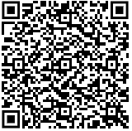
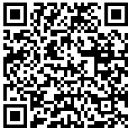
Resources
There are many resources online.
See Terms and Conditions for each service provider
Research for this presentation came from:
Dignity Funeral Directors How To Geek.com

Slide 28

Thank You

Slide 29




Team
Name
Name
Name
Name
Title
Title
Title
Title

Slide 30
Content
Subtitle
Subtitle
Add text, images, art, and videos.
Add transitions, animations, and motion.
Save to One Drive, to get to your presentations from your computer, tablet, or phone.
Add text, images, art, and videos.
Add transitions, animations, and motion.
Add text, images, art, and videos.
Add transitions, animations, and motion.
Save to One Drive, to get to your presentations from your computer, tablet, or phone.
Add text, images, art, and videos.
Add transitions, animations, and motion.

Slide 31

Content 2
Subtitle
Subtitle
Subtitle
Add text, images, art, and videos.
Add transitions, animations, and motion.
Save to One Drive, to get to your presentations from your computer, tablet, or phone.
Add text, images, art, and videos.
Add transitions, animations, and motion.
Add text, images, art, and videos.
Add transitions, animations, and motion.
Save to One Drive, to get to your presentations from your computer, tablet, or phone.
Add text, images, art, and videos.
Add transitions, animations, and motion.
Add text, images, art, and videos.
Add transitions, animations, and motion.
Save to One Drive, to get to your presentations from your computer, tablet, or phone.
Add text, images, art, and videos.
Add transitions, animations, and motion.

Slide 32


Summary
With PowerPoint, you can create presentations and share your work with others, wherever they are. Type the text you want here to get started. You can also add images, art, and videos on this template. Save to OneDrive and access your presentations from your computer, tablet, or phone.

