Slide 1
Fault-finding &
Disk Cleaning

Slide 2
Part I
Fault-finding

Slide 3
The issue: Laptop doesn’t boot up to windows.
A screen prompt offers to try and automatically fix it.
It can’t!
Notes:
The Laptop doesn’t boot up to Windows
*****Screen prompt to try and fix it
*****It can’t!

Slide 4
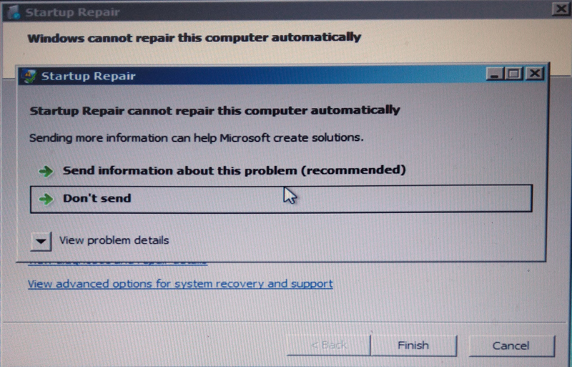
Notes:
Even though it can’t repair the computer automatically, you do get options for System Recovery and Support

Slide 5
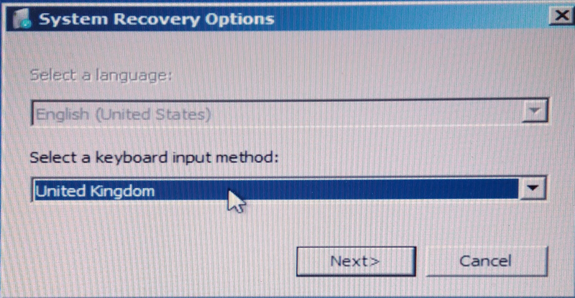

Slide 6
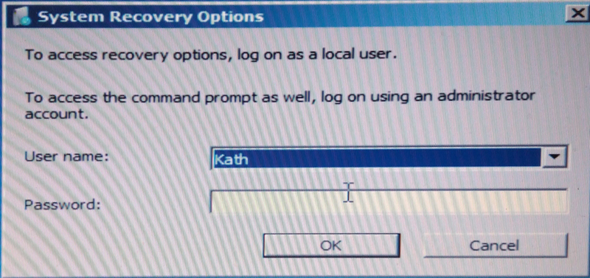

Slide 7
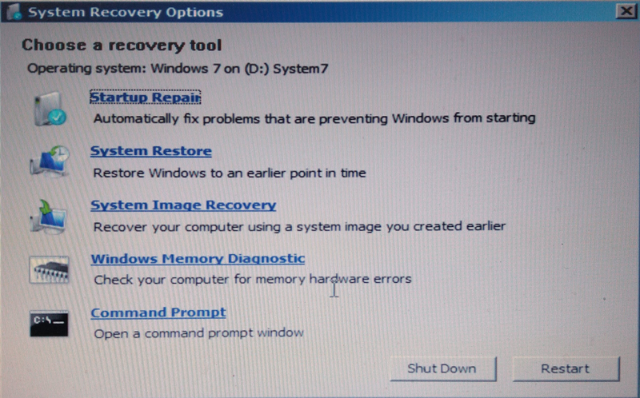
Notes:
The Startup repair couldn’t fix it.
System restore couldn’t fix it
We didn’t have a system image that would be any good
We are not interested in memory Diagnostics
We could use a Command Prompt……
The Command Prompt would have familiar with the tech savvy members amongst us from the old days – before the GUI (Graphical User Interface) – and many of the Commands would have been second nature.

Slide 8
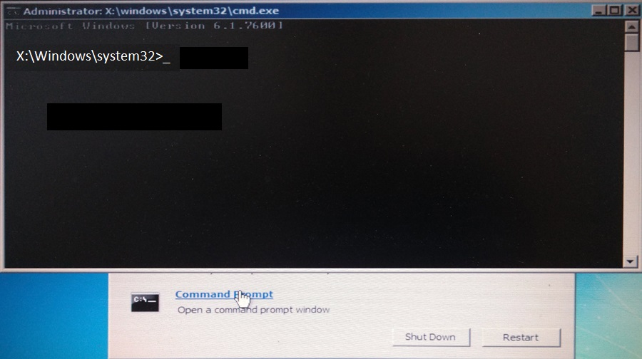
Notes:
I was surprised to see the Command Prompt on the X drive. It’s obviously a virtual drive.
I was interested to see the actual drive in the Laptop

Slide 9
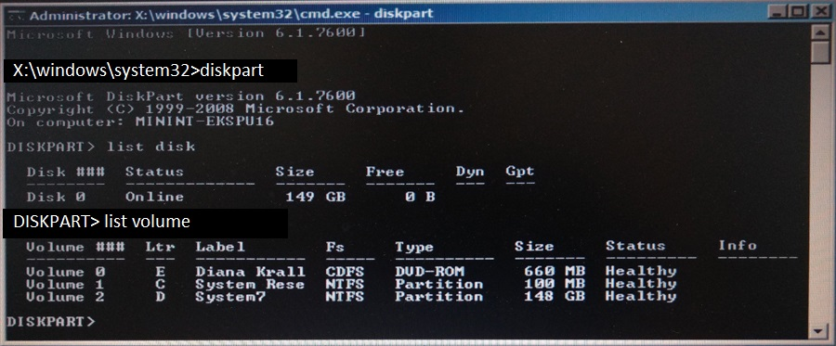
Notes:
*****To do that I used the “diskpart” command.
*****You can see there is one drive – Disk 0 with a size of 149GB.
*****I then used the List Volume command to see how many volumes there were.
*****I know there was a CD drive there, so I put a CD into it to make sure it was visible (Diana Krall)
Then Volume 1 and Volume 2 were the C & D drive. It was the D drive that had Windows installed (Windows 7) and the C drive was a small partition of 100MB for Rescue. As the laptop was 16 years old, the decision had already been made not to resuscitate it, but just to try and recover the Photos and Videos. (Most had been backed up, but there were a few directories that had been “Work in Progress” that hadn’t.

Slide 10
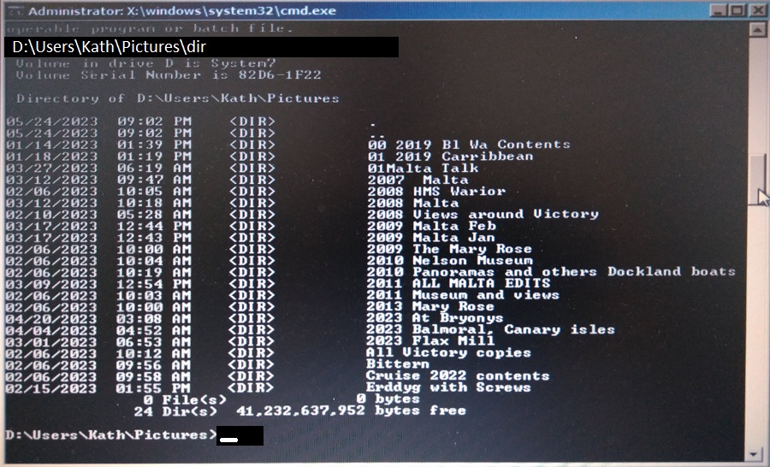
Notes:
*****Delving into the D drive: D:/Users/Kath/Pictures/Dir we could see the top level directories for her pictures. Nearly all these directories had sub directories in them and many also had sub-sub directories.
The aim was to copy them to a USB stick. Which became the F drive. (You’ll recall we had a C drive, D drive and E drive)

Slide 11
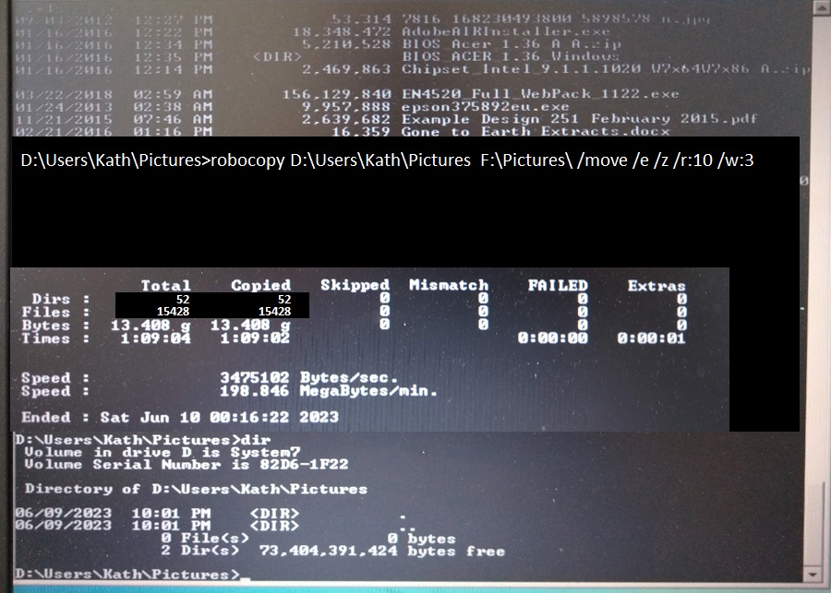
Notes:
*****To copy them I used the DOS command robocopy – this was new to me I had to look it up. I would have previously used the Copy command, but had forgotten the syntax for that anyway.
Robocopy stands for Robust copy and has replaced the copy command. Robocopy format: Source directory - Destination directory - Options
Options /move included directories mov is just files.
/e Copies subdirectories
/z Copies files in Restartable mode In restartable mode, should a file copy be interrupted, Robocopy can pick up where it left off rather than recopying the entire file.
/r Specifies the number of tries on failed copies, the default is 1,000,000 – yes one million.
/w Specifies the wait time between retries in seconds. The default is 30 (30 seconds)
*****At the end of the process, you get a summary of what has happened, ie, Dirs and files copied etc and failures;
*****I followed on with a Directry listing to see what dirs. Were left (if any)
*****You can see at the end of the screenshot here. There are only two directories . and .. These appear in every directory and contain information about the directory structure – you can safely ignore them. All the others have been moved, both the Pictures and the Videos.
I should have taken a screenshot of the F drive with two top level folders of Pictures and Videos – but I didn’t. Trust me they were there, so I can remove the USB drive with my files and all is done. We have finished with the laptop.

Slide 12
Pictures and Videos moved to the F drive.
(a USB Stick)
We’ve now finished with the Laptop, it can be retired / recycled.

Slide 13
Other Options
We know from the DOS screens that we can see the data. We just can’t get to it through Windows.
We could have removed the hard drive and plugged it in to another computer as the E/F or G drive
Then using File Explorer, we could have recovered the data that way.
Only works IF the drive was compatible with the new host computer. SATA interface from 2007, IDE interface before 2007.
Our laptop was built in 2007, so it could have been either.
(We could have bought an interface cable from Amazon for less than £20.00)
Notes:
In the event the drive was a newer SATA interface, so we could have done this. Most laptops these days have an easy to remove hard drive, this one wasn’t, you had to take the laptop apart. I choose not to do this but to move the data using DOS commands.

Slide 14
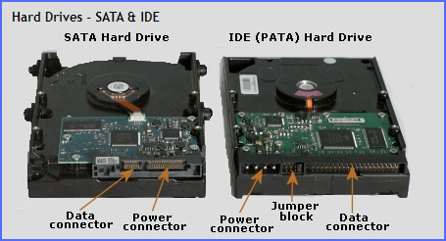

Slide 15
Part II
Disk Cleaning

Slide 16
Dead laptop, now wipe the disk clean.
Search “Hard Drive Data Shredder” in Google – lots of utilities available.

Slide 17
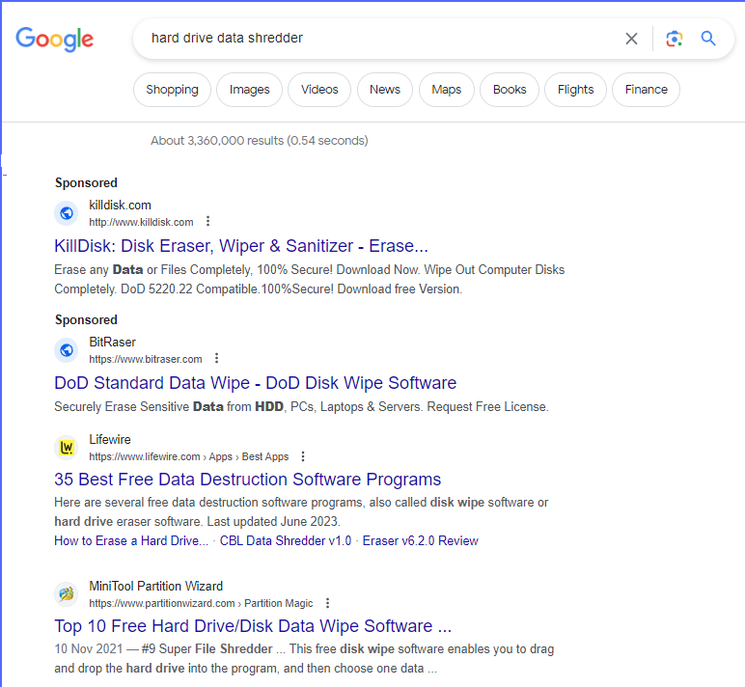

Slide 18
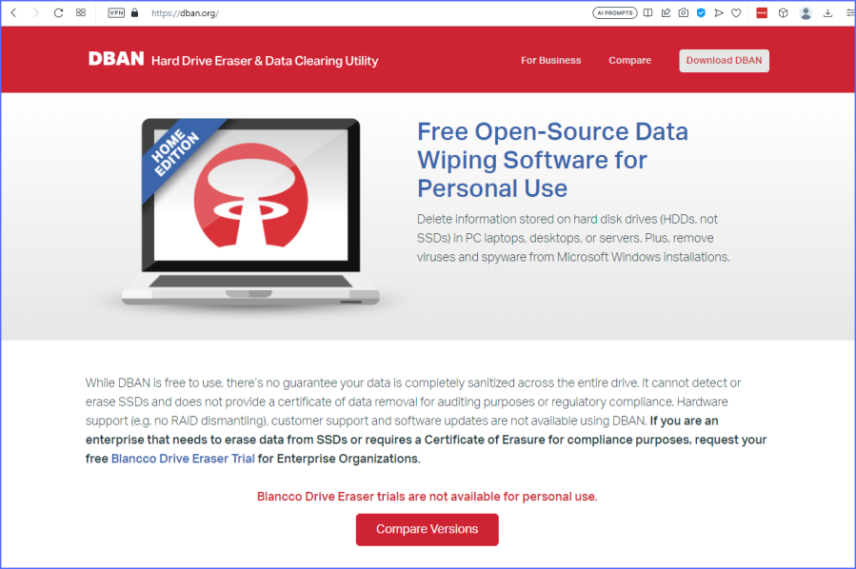
Darik’s
Boot
and
Nuke!
Notes:
An iso file can hold a large amount of data – think copies of Windows Operating systems, complete CDs, DVDs and so on.
It can be mounted as a virtual disk so is useful to run a program rather than Windows. Follow the instructions to create an iso file on a USB stick.
***** What does DBAN stand for? Darik’s Boot and Nuke! I liked that.

Slide 19
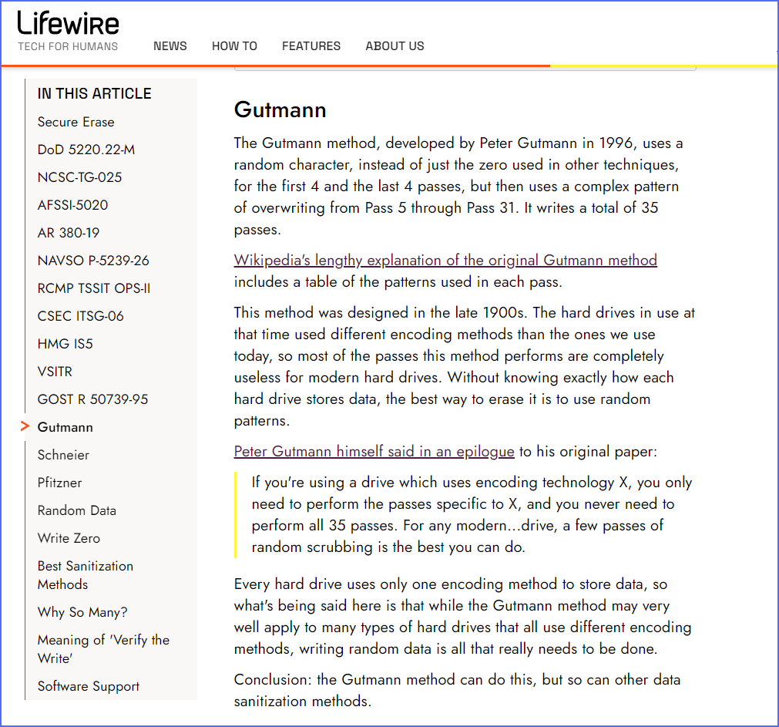
Notes:
There are lots of different standards to wipe a hard drive clean.
A “Quick” format just deletes the index that calculates where every bit of data is stored. The data is still there, you just can’t see it under normal circumstances. Your lovingly created novel of War and Peace whilst not visible in File Explorer, could be found and recovered by a data specialist.
Other formats overwrite all the data on the hard drive with a series such as all 1’s first, then overwrite all those 1’s with 0’s and then overwrite all those 0’s with a random character. Most of them use verification to check that the 1’s are all there the 0’s are there and so on.
In my case – as time wasn’t an issue, I used the Peter Gutmann method which overwrote the data 35 times!

Slide 20
Change the BIOS to run from a USB Stick
Notes:
As the Computer boots up, press the interrupt key, it might be one of the Function Keys or the Escape key. Google “Bios Interrupt” for your particular maker of PC to find out the interrupt for you.
Then you need to make sure that the Boot up sequence has a USB drive starting before the Windows Drive.

Slide 21
Power on the laptop with the USB stick inserted
The laptop will fire up with the programme on the USB stick ie DBAN (or whatever else you have used)

Slide 22
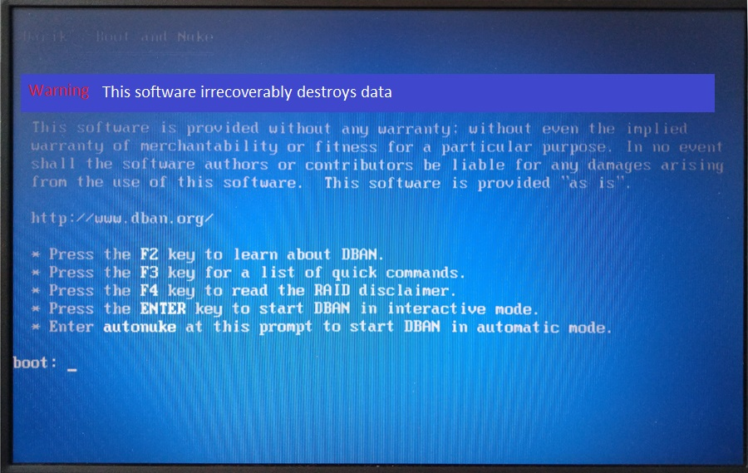
Notes:
Note the Warning: This Software irrecoverably destroys data
I used option 4 here and Pressed the Enter key to start DBAN in interactive mode.

Slide 23

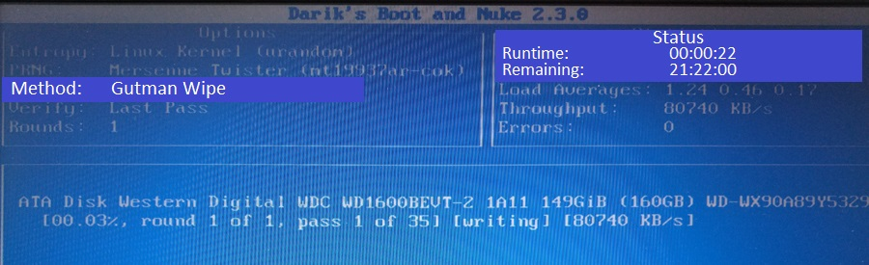
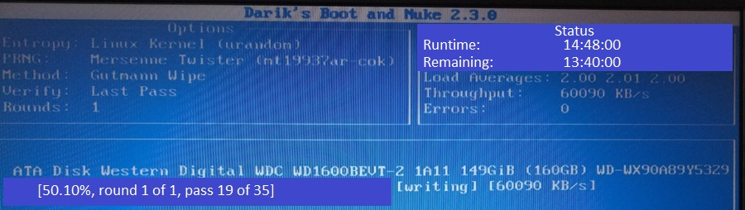
Notes:
Having selected the Gutman Wipe method (screenshot not shown of that) the programme has to first register any USB devices
***** Then we are off. 20 seconds in and 0.03 % complete!
***** 50% complete – less than 14 hours to go!

Slide 24
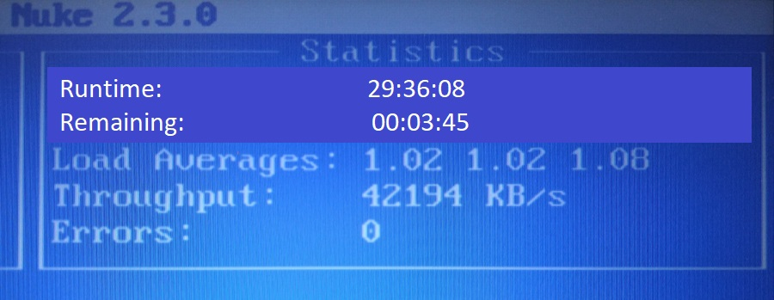
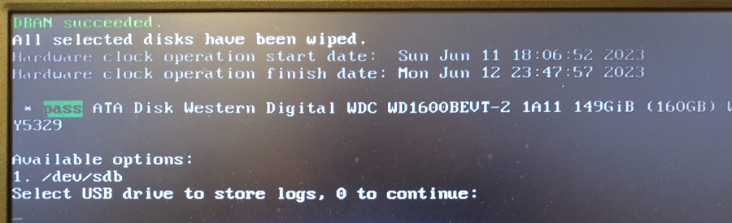
Notes:
Nearly finished.
***** and Succeeded
***** All selected disks have been wiped

Slide 25
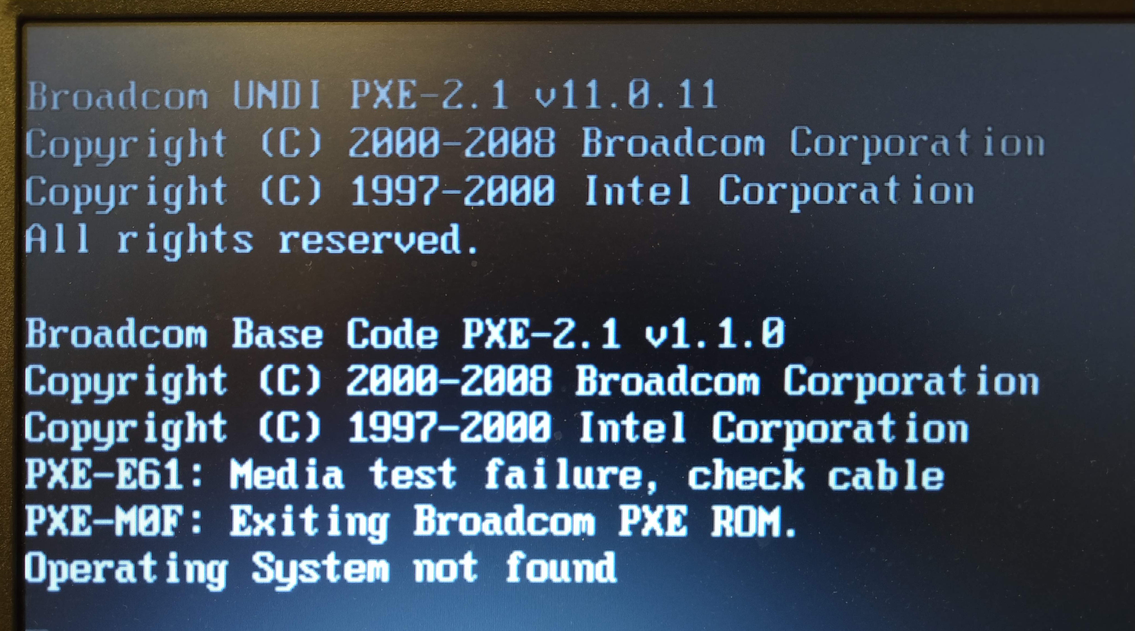
Notes:
Restart the computer: Boot up prompts
***** OS not found.
Data wiping is complete, you can now turn off the power and safely dispose of the laptop.

Slide 26


Introduction
With PowerPoint, you can create presentations and share your work with others, wherever they are. Type the text you want here to get started. You can also add images, art, and videos on this template. Save to OneDrive and access your presentations from your computer, tablet, or phone.

Slide 27
Topic one
Subtitle

Slide 28
Chart

Slide 29
Table
 | Category 1 | Category 2 | Category 3 | Category 4
Item 1 | 4.5 | 2.3 | 1.7 | 5
Item 2 | 3.2 | 5.1 | 4.4 | 3
Item 3 | 2.1 | 1.7 | 2.5 | 2.8
Item 4 | 4.5 | 2.2 | 1.7 | 7

Slide 30
The way to get started is to quit talking and begin doing.
Walt Disney

Slide 31
Team
Name
Title
Name
Title
Name
Title
Name
Title

Slide 32
Timeline
To start a presentation, go to the Slide Show tab, and select From Beginning.
1
To display Presenter view, in Slide Show view, on the control bar at the bottom left select the three dots, and then Show Presenter View.
2
During your presentation, the speaker notes are visible on your monitor, but aren't visible to the audience.
3
The Notes pane is a box that appears below each slide. Tap it to add notes.
4
If you don’t see the Notes pane or it is completely minimised, click Notes on the task bar across the bottom of the PowerPoint window.
5

Slide 33
Content
Subtitle
Subtitle
Add text, images, art, and videos.
Add transitions, animations, and motion.
Save to OneDrive, to get to your presentations from your computer, tablet, or phone.
Open the Design Ideas pane for instant slide makeovers.
When we have design ideas, we’ll show them to you right there.

Slide 34
Content
Subtitle
Subtitle
Subtitle
Add text, images, art, and videos.
Add transitions, animations, and motion.
Save to OneDrive, to get to your presentations from your computer, tablet, or phone.
Open the Design Ideas pane for instant slide makeovers.
When we have design ideas, we’ll show them to you right there.
This PowerPoint theme uses its own unique set of colours, fonts, and effects to create the overall look and feel of these slides.
PowerPoint has tons of themes to give your presentation just the right personality.

Slide 35


Summary
With PowerPoint, you can create presentations and share your work with others, wherever they are. Type the text you want here to get started. You can also add images, art, and videos on this template. Save to OneDrive and access your presentations from your computer, tablet, or phone.

Slide 36
Thank you
Presenter name
Email address
Website

