Slide 1

Securing you online Accounts

Slide 2
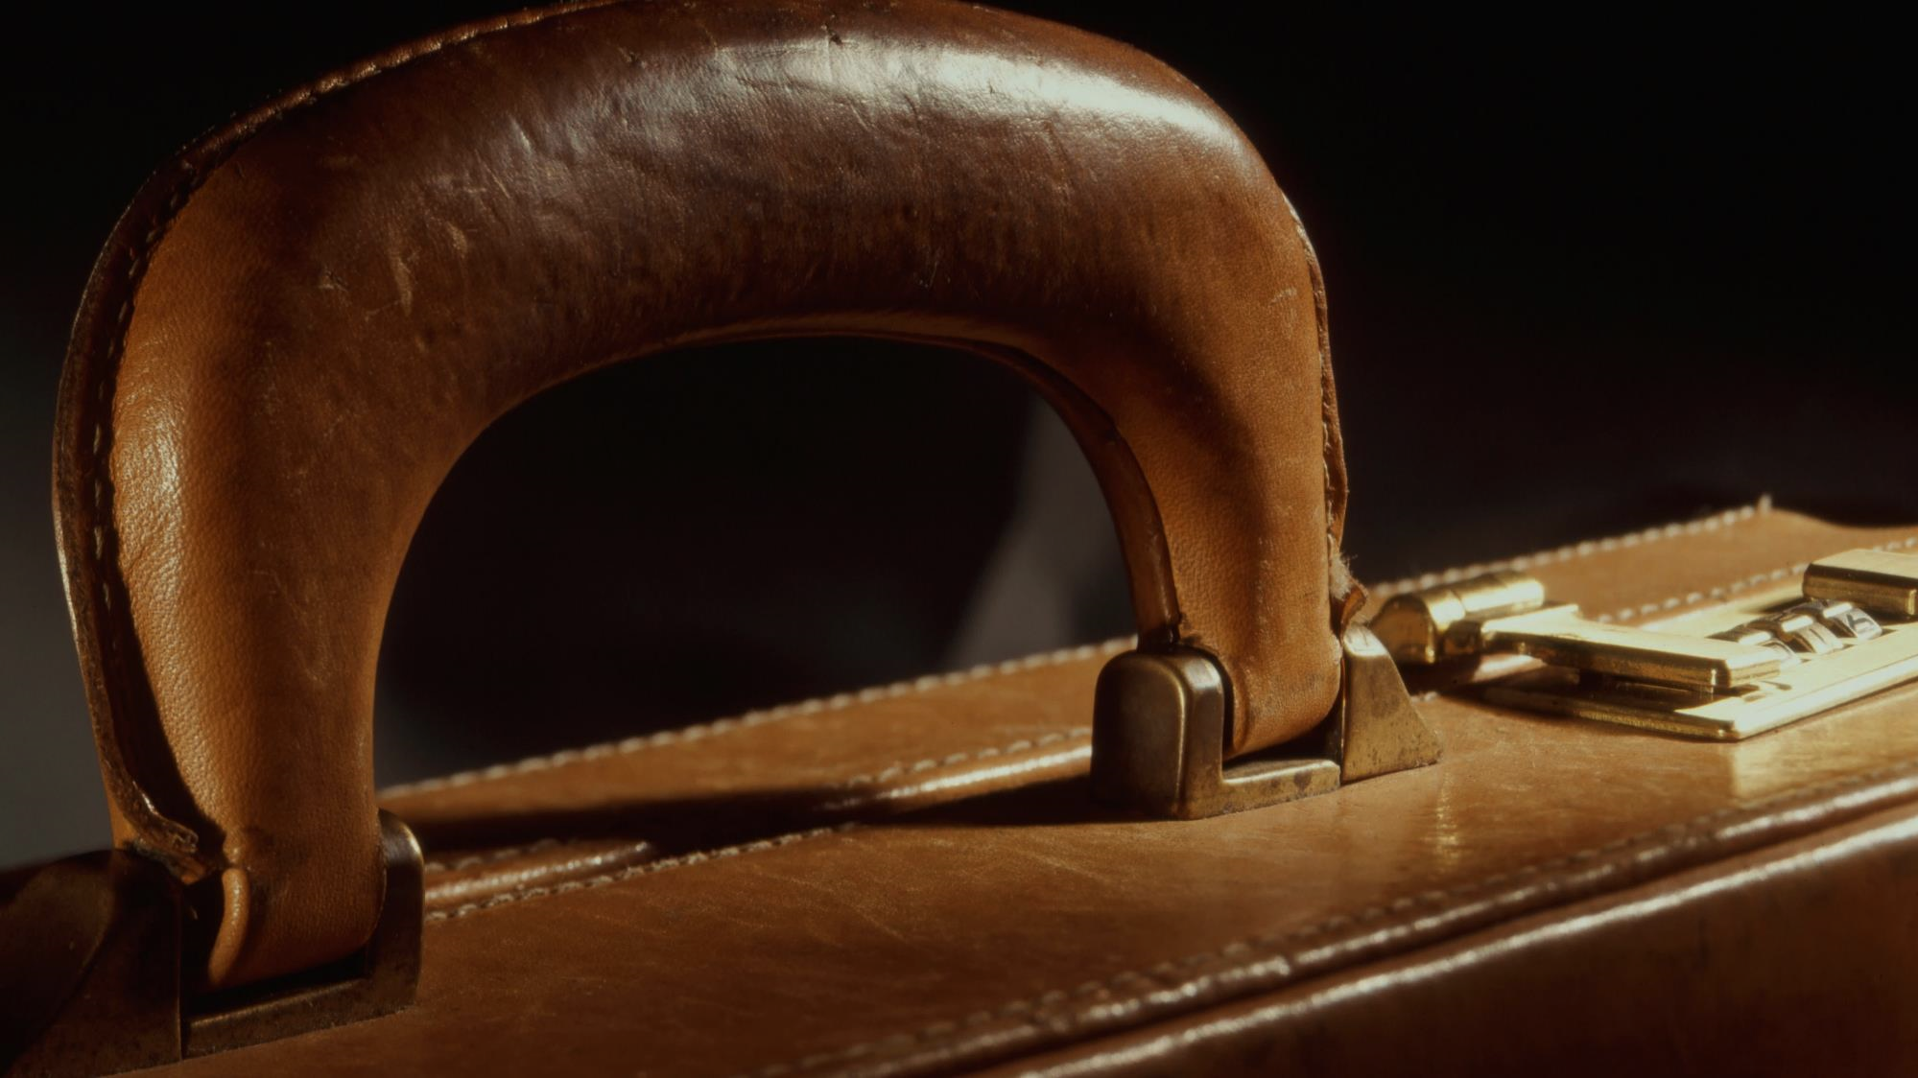
Securing your Accounts
Making your accounts more secure and recovery options
or “Help, I’ve locked myself out of my account!”
Notes:
Two instances in the recent past. MS and Google. MS whereby the user had changed their mobile phone number – but not updated their profile in their MS account. They had also forgotten their password, consequently they couldn’t prove who they were and had to wait 30 days before the new phone number became active.
And Google, I was asked to install a printer to a new laptop – this is a tale of woe. It was an old printer but still connected to the lady’s old laptop. I asked Bing Chat the AI search engine if that particular printer was compatible with Windows 11 – it said it was. In the event Windows didn’t recognise it and therefore asked for the printer makers specific drivers. I searched online but could find none, not listed on the HP support website. The lady mentioned that she “probably had the original installation discs” somewhere – and indeed she did. The next problem was that her new laptop didn’t have a disk drive. “Luckily” I had my laptop with me that did. I copied the content of the CD to my laptop, I didn’t have a large thumb drive with me, so I then moved it to my Google Drive thinking that I could just log in to google on her machine, nip across to Google Drive in the cloud and download the software to her laptop. This worked a treat. In the event the software didn’t work with Win 11, but that is a different story.
To keep things tidy, I then wanted to log out of my Google account on her laptop. Google doesn’t make it easy to log out of just one account (She was logged on to Google and I was logged on to Google). You only get to log out of all accounts. So I did this and then, again to keep things tidy I went to log back into Google for her account –she uses Webmail for her gmail. I knew her email, but not her password. And neither did she!!!!! So following the prompts to reset a password, it asks for your phone number. She was adamant that she had never provided one, even though it is impossible to create a Google account without one. I suspect that Grandchild had set it up for her, and her home phone was not the one that was in the account.
I was then stuck in a loop, I couldn’t change the password because they didn’t know who we were, and we couldn’t prove who we were because we couldn’t log into the account. I eventually solved it by trying every password she had in the bits and pieces of paper scattered around the place that constituted her office.
Both these instances have been in the back of my mind for months.

Slide 3
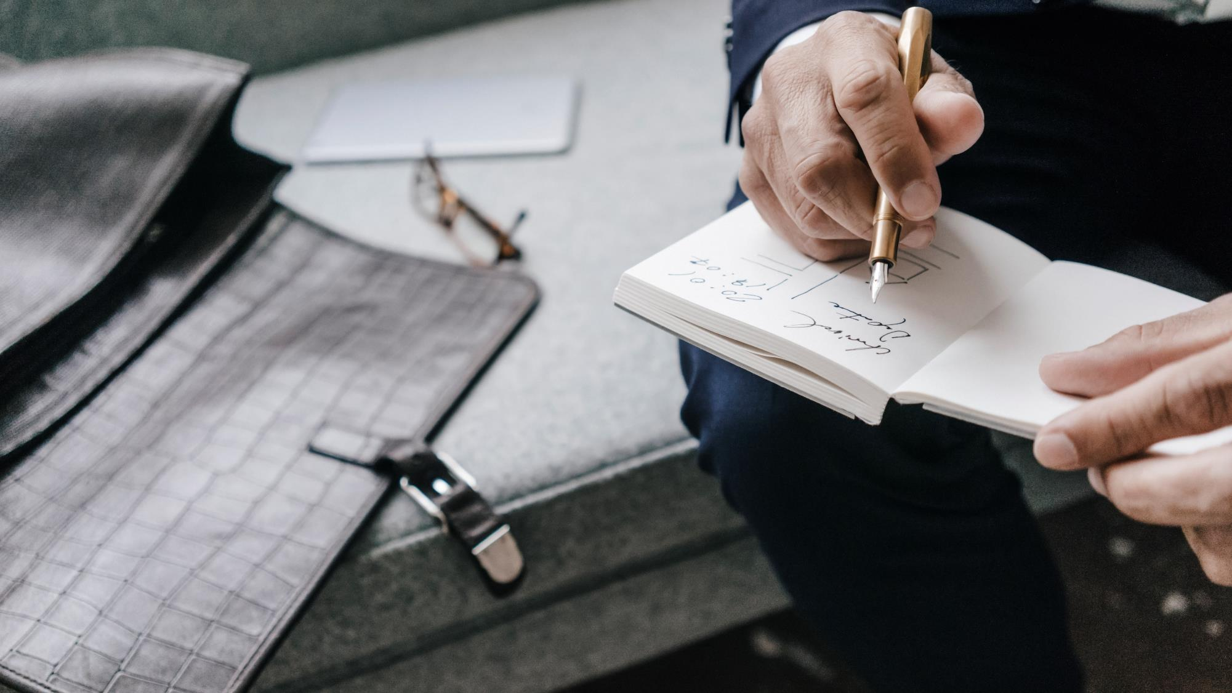
Agenda
Account security
Microsoft
Google
Apple
Advanced options
Account recovery
Notes:
So, we are looking at account security, specifically for Microsoft, Google and Apple, although the same principles will apply to all your online accounts.
What we can add to your profile to make account recovery easier should it be messed up and also how to make it more secure.

Slide 4
Worst case scenario
The Worst case scenario is if you have locked yourself out of your account.
Removing security information. Violating terms & conditions: Spam, Malware, Phishing (MS).
Forgetting a PW and unable to verify your identity through recovery options (Google).
Forgetting a PW with no access to any trusted device or phone numbers (Apple).
Notes:
For a Microsoft account, You can also lock yourself out by removing all the security info from your account and replacing it with new info, which triggers a 30-day waiting period before you can make any changes to your security info.
You can also lock yourself out by violating the Microsoft Services Agreement, such as sending spam, malware, phishing, or interfering with Microsoft networks or services. You can still log in and use email, but not change any Security info.
For a Google account, you can lock yourself out by forgetting your password and failing to verify your identity through the recovery options, such as phone number, email address, or security question3. You can also lock yourself out by entering an incorrect password too many times, which may temporarily disable your account
For an Apple account, you can lock yourself out by forgetting your password and not having access to any of your trusted devices or phone numbers that can receive a verification code. You can also lock yourself out by requesting to delete your account, which starts a 60-day grace period before your account and data are permanently erased.

Slide 5
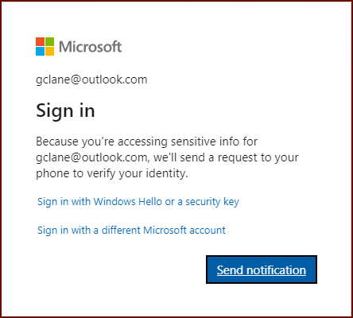
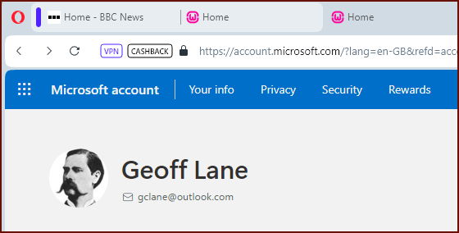
Microsoft
1
2
Notes:
Microsoft Account; ***** account.microsoft.com (login.live.com)
***** Security tab
***** Accessing Sensitive information
The default is to
***** “Send a Notification” to your phone to verify your identity.
***** There are other ways to sign in: Windows Hello or a security key.
Windows Hello allows you to sign in with face ID, a fingerprint or a PIN.

Slide 6

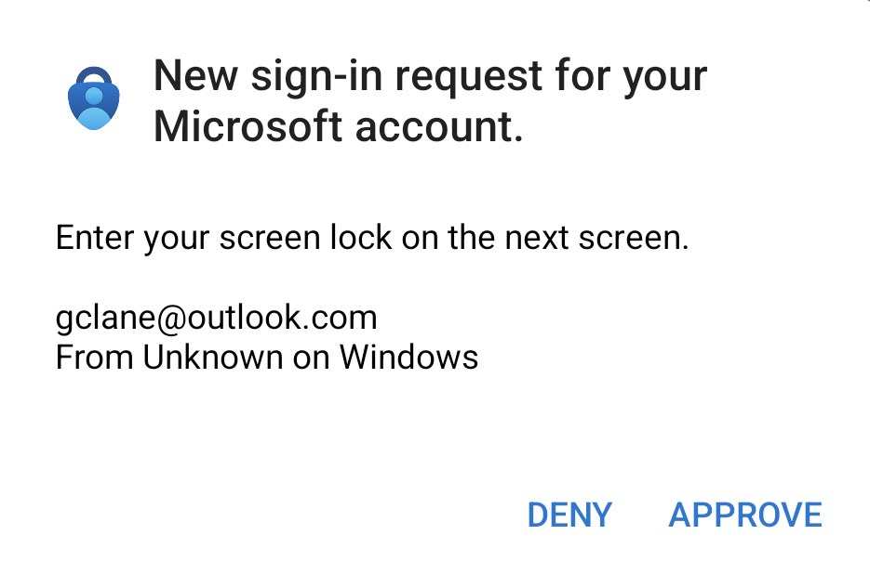
1a
Notes:
I’m using an authenticator app, so I get a
***** Deny or Approve response.

Slide 7
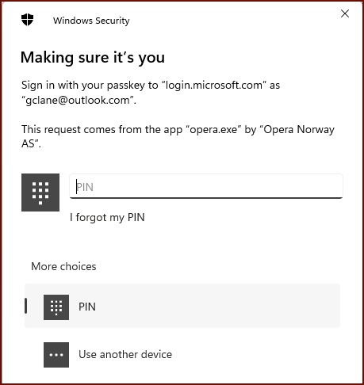
1a
Notes:
Or using Windows Hello which is face recognition, fingerprints or a PIN. Pins are good. (More on that later on)

Slide 8
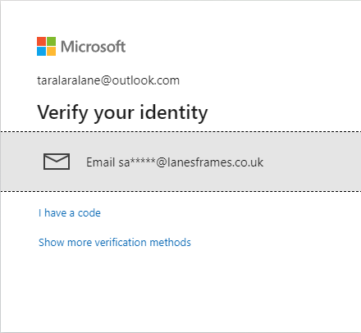
1b
Notes:
Sandra doesn’t use an authenticator app, so she needs to verify her identity another way
***** it doesn’t have to be via an email.

Slide 9
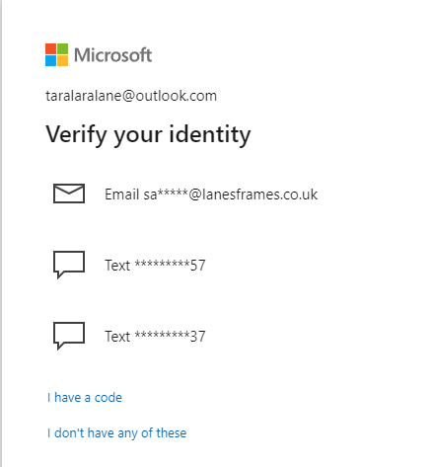
1b
Notes:
It could be via a text too. Notice that she has a choice of 2. Her mobile and the house landline.

Slide 10
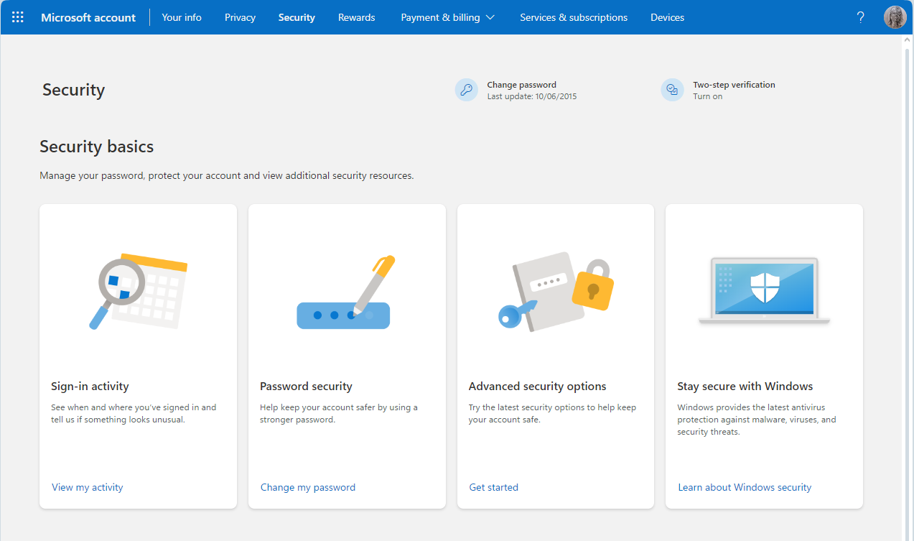
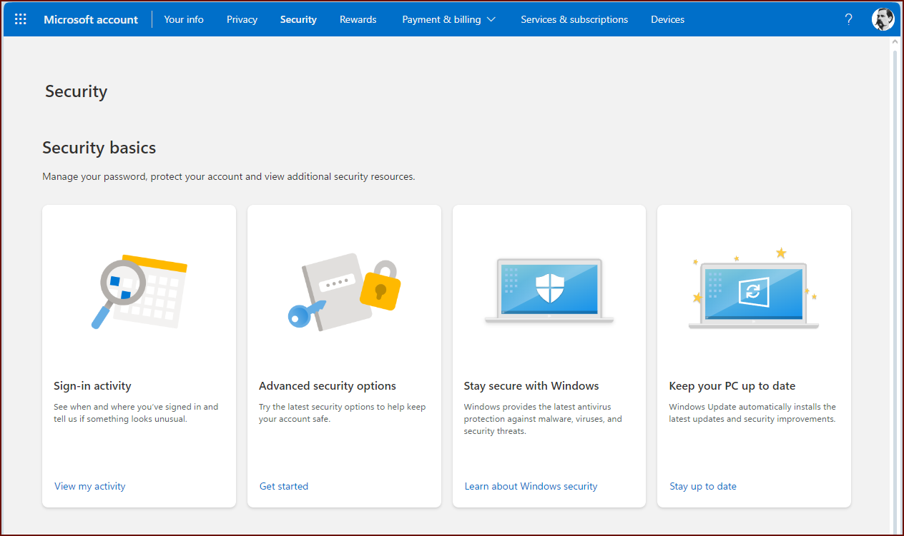
Notes:
Having now actually logged in and reached the Security page, we can see where we are.
******* Notice her password was last changed June 2015 and she is not using two step verification.

Slide 11
Notes:
Me on the other hand, don’t get those reminders because I’m a good boy!
We’re going to look at two areas of activity.
***** Sign-in activity, and
***** Advanced Security options
First we’ll look at the Sign-in activity or Recent activity

Slide 12
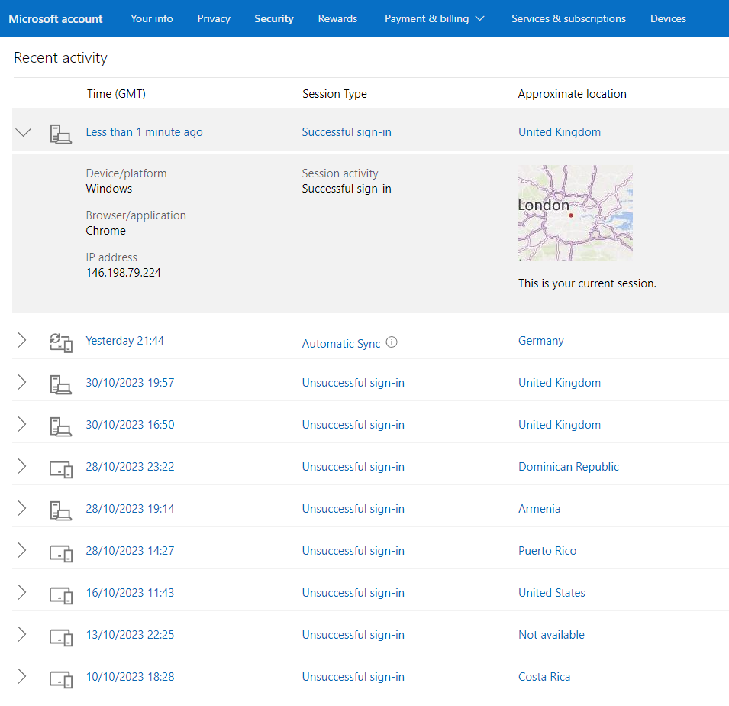
All unsuccessful
because of incorrect
password attempts
Notes:
Recent activity. 3 columns worth, a Date and Time, The type – it might be automatic email checking or someone trying to sign in to the account and finally a location.
***** Unsuccessful sign in
****** Incorrect passwords
Lets have a look at the advanced Security

Slide 13
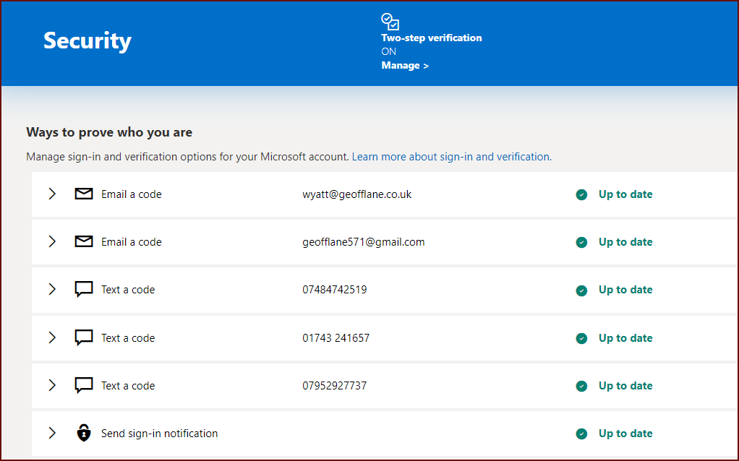
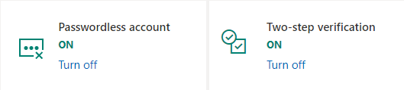
Notes:
Two email addresses and 3 phone numbers, note that you can include a landline , it doesn’t have to be a mobile number
***** Then you can see that I’ve changed to a passwordless account and also have Two step verification turned on.

Slide 14
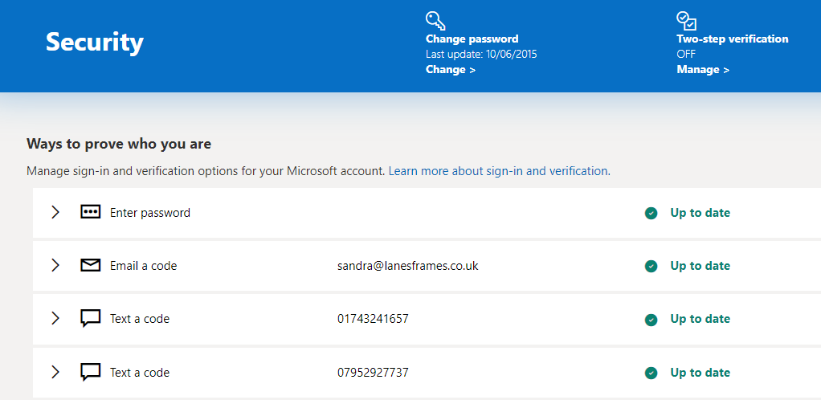
Notes:
Sandra is less ‘worried’ than me.
She is using a password from 2015, has only 1 extra email address and her mobile and home phone.
****** If you only have 1 or 2 ways to prove who you are, then increase your security and add some more.
****** This is strongly recommended.

Slide 15
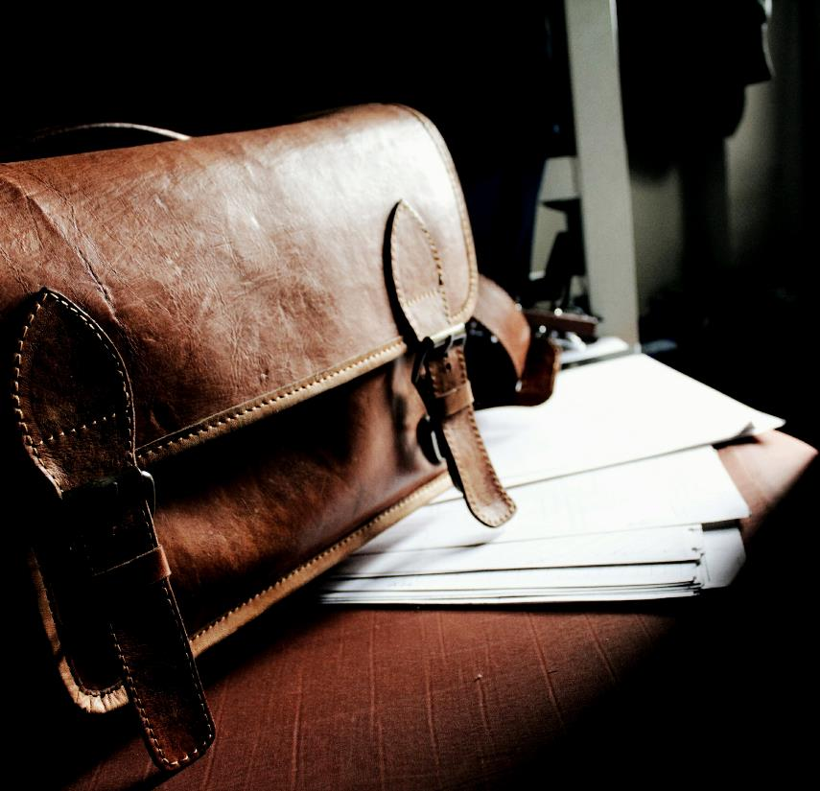
Additional ways to add
Security Information
No.1
Alternative email addresses to email a code
No.2
Contact Phone Numbers to text a code
No.3
Use an App on your Phone; an authenticator app.
No.4
Biometrics: Face, Fingerprint or PIN
No.5
Security Key: USB, Bluetooth or NFC device

Slide 16



If you can’t prove who you are….
Notes:
With a Microsoft account and if you can’t prove who you are – you might have changed your phone number for instance and now no longer have access to the old number.
***** You have to wait for 30 days before new security info becomes active.

Slide 17
Windows Hello
A biometric Security system for Win 10 & 11 using your Face, Fingerprint or PIN.
Local & unique to your device, can replace your password (although you’ll still need it for some actions).
A PIN is more secure than a password:
It is tied to the specific device on which it was set up.
It is never transmitted to any Microsoft servers
It is backed by the TPM Chip.
It can include special characters, letters and numbers, upper and lowercase.
Notes:
Windows Hello.
TPM Trusted Platform Module

Slide 18
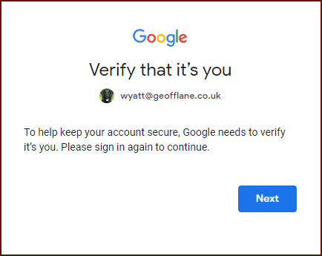
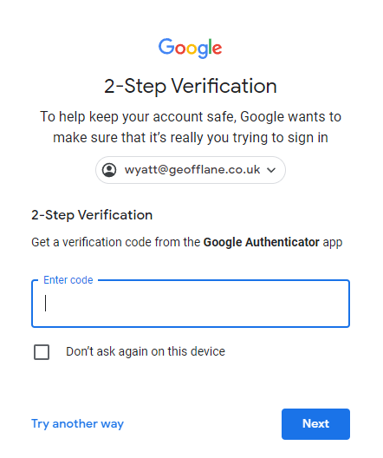
Google
Notes:
Signing in to Google. Even though it recognised me it wants me to sign in again.
****** This is a second account of mine, I’d almost forgotten about and certainly that I’d set up 2 Step Verification. You probably won’t have this set up (yet)

Slide 19
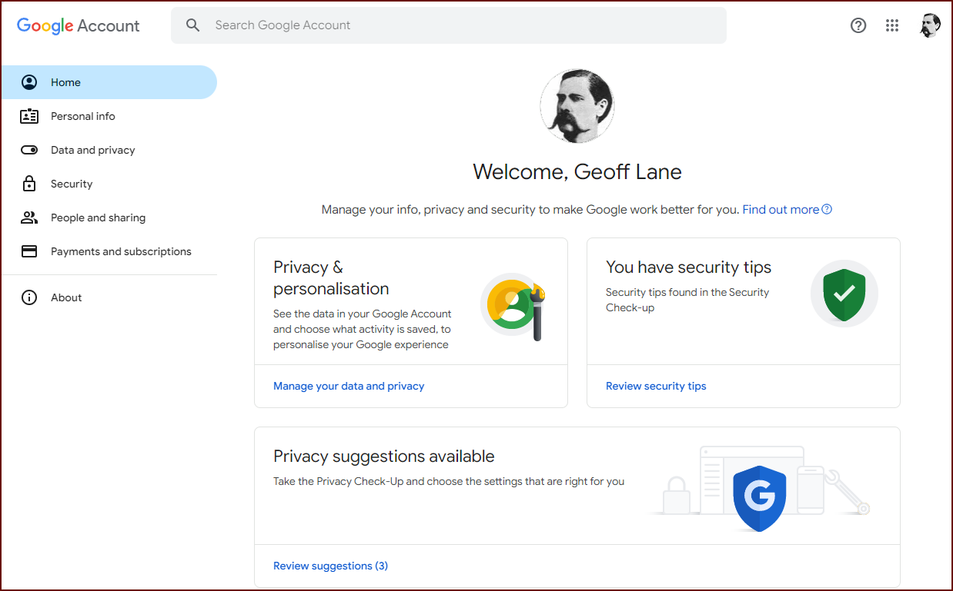
Notes:
From the Account dashboard, you can see that I have:
****** Some security tips that would improve my security
***** And some privacy suggestions. We’ll leave those for another day. ****** removed.
So, the security tips….

Slide 20
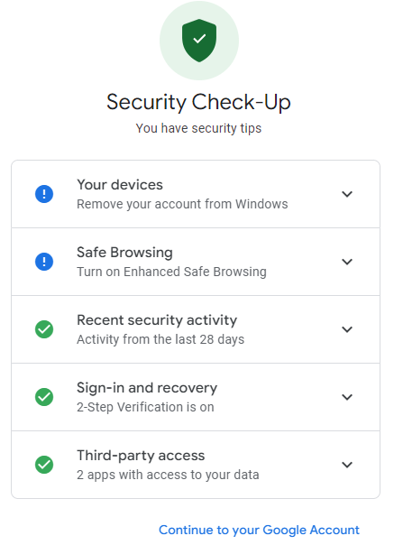
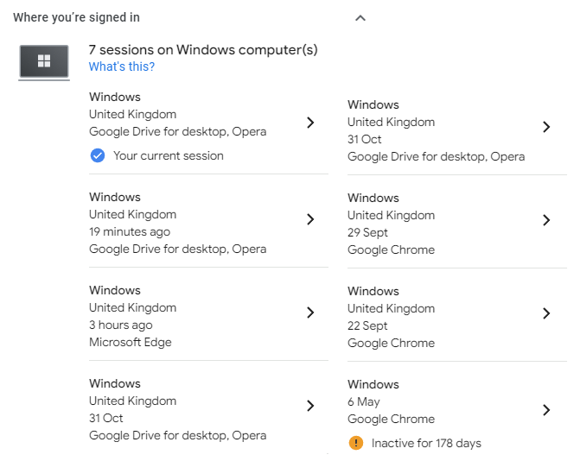
Notes:
Security Tips. Your devices
***** Where you are signed in, in this case one computer inactive for 178 days, so let’s remove it.
Safe Browsing ******
Google Enhanced Safe Browsing is a feature that provides more protection against phishing, malware, and other online threats when you use Google Chrome or Gmail. It works by checking the websites, downloads, and extensions you encounter against Google’s database of known risks and warning you before you proceed. It also helps you recover your account if it is compromised and alerts you if your passwords are exposed in a data breach1.
To use Google Enhanced Safe Browsing, you need to turn it on in your Google account settings or in your Chrome browser settings. You can also choose the level of protection you want, from standard to enhanced. When you turn on Enhanced Safe Browsing, you agree to share more information with Google about your browsing activity, such as the URLs of the pages you visit and a small sample of the content on those pages. Google uses this information to improve your security and the security of everyone on the web2.
Google Enhanced Safe Browsing is an optional feature that you can enable or disable at any time. It is designed to give you more peace of mind and control over your online safety.

Slide 21
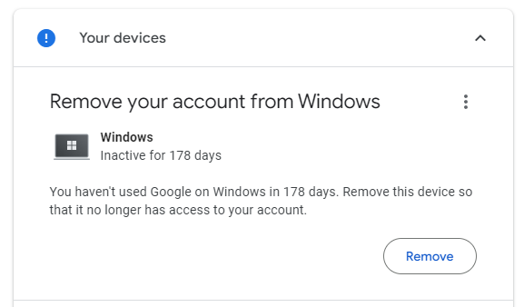
Notes:
Quite straight forward. Click remove to remove it.

Slide 22
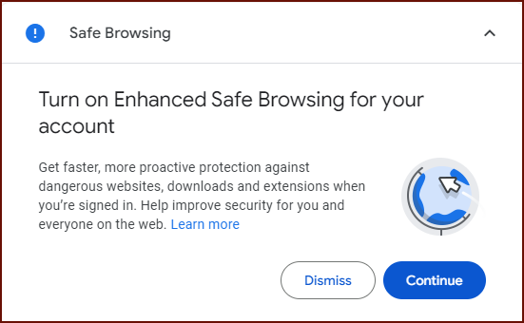
Notes:
Back to the Security Check up
Safe Browsing ******
Google Enhanced Safe Browsing is a feature that provides more protection against phishing, malware, and other online threats when you use Google Chrome or Gmail. It works by checking the websites, downloads, and extensions you encounter against Google’s database of known risks and warning you before you proceed. It also helps you recover your account if it is compromised and alerts you if your passwords are exposed in a data breach1.
To use Google Enhanced Safe Browsing, you need to turn it on in your Google account settings or in your Chrome browser settings. You can also choose the level of protection you want, from standard to enhanced. When you turn on Enhanced Safe Browsing, you agree to share more information with Google about your browsing activity, such as the URLs of the pages you visit and a small sample of the content on those pages. Google uses this information to improve your security and the security of everyone on the web2.
Google Enhanced Safe Browsing is an optional feature that you can enable or disable at any time. It is designed to give you more peace of mind and control over your online safety.

Slide 23
Google Enhanced Safe Browsing
Google Enhanced Safe Browsing is a feature that only works with the Chrome browser on desktop and Android devices. It is not available for iPhone and iPad. It also works with other Google products, such as Gmail, when you enable it in your Google account.
Enhanced Safe Browsing provides more protection against phishing, malware, and other online threats by checking the URLs, downloads, extensions, and system information of your device with Google’s servers. It also helps you avoid dangerous links across Google apps.
Notes:
I don’t normally use Google Chrome, so I’m not too bothered about this.

Slide 24
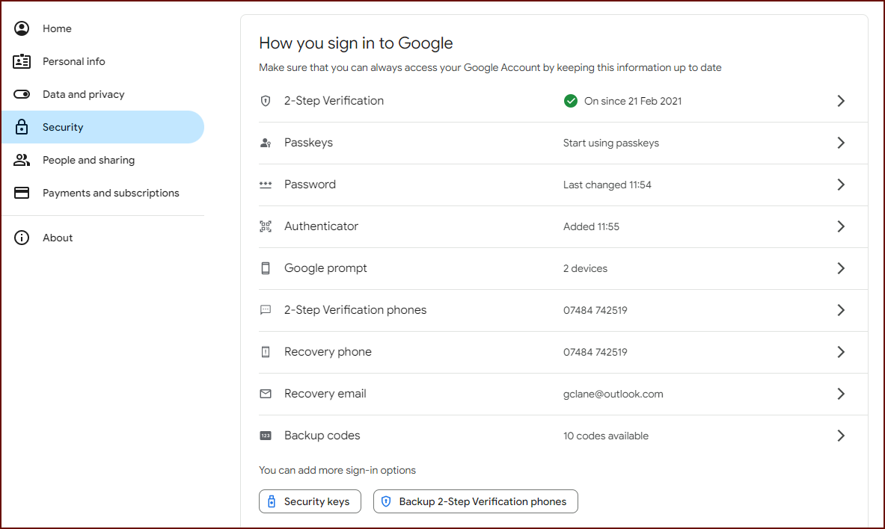
Notes:
You can see that I have a number of options to sign in with Google.
***** One caught my eye, is that I have two devices for Google prompt.

Slide 25
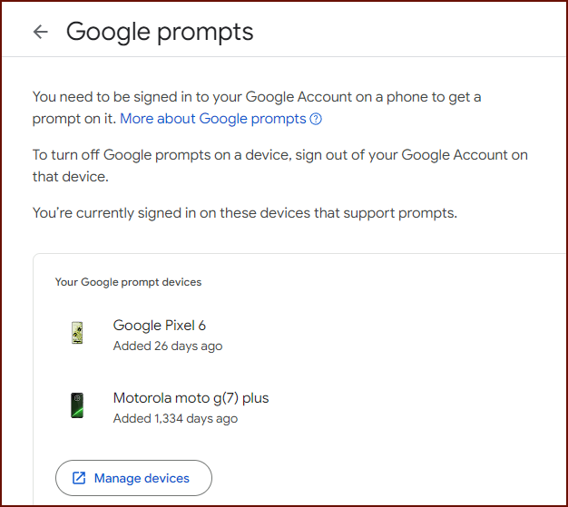
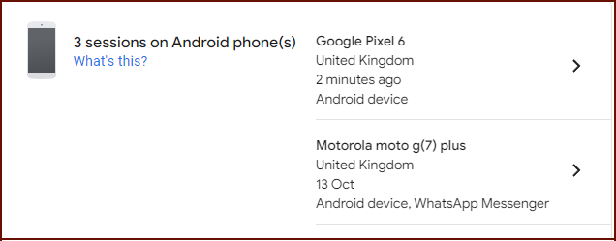
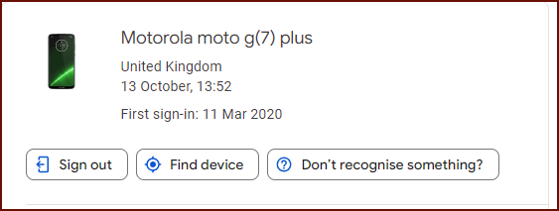
Notes:
I can see two phones, my new one and the
***** old one.
***** I can also see in Your Devices that I am still logged in to my old phone.
***** So let’s expand the selection,
***** and sign out and remove it.
Lets move on to Apple

Slide 26
Apple

Slide 27
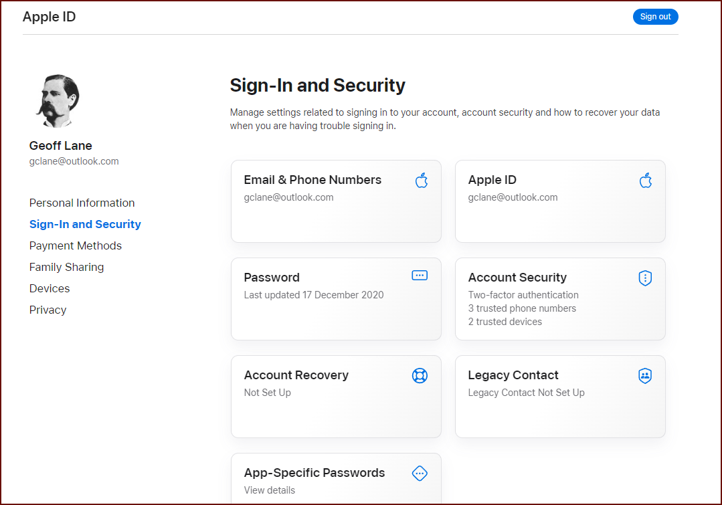
Notes:
***** No Phone Number, so I’ve added one. – Quite straight forward.
***** No Account Recovery
***** No Legacy Contact set up

Slide 28
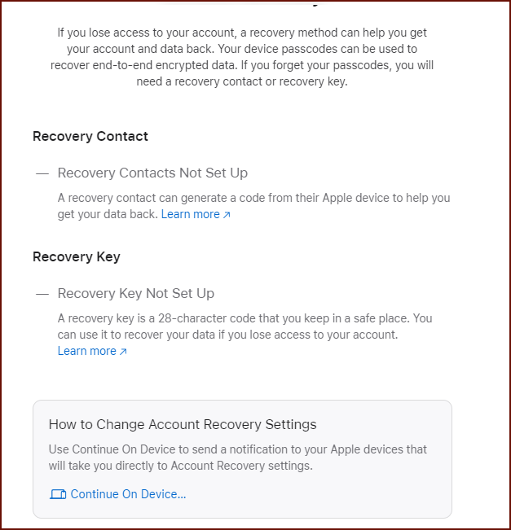
Account Recovery
Recovery Contact a person you know and trust, needs a device at least iOS 15.
You can list up to 5 recovery contacts.
You need to have 2FA turned on for your Apple ID.
Recovery Key. If you use this, you turn off Apple’s standard Account Recovery process.
Standard recovery process. Takes time – up to 72 hours
Notes:
To set up account recovery, follow the
****** “Continue on Device…” prompt/link.

Slide 29

Questions
?

Slide 30

Thank you
Geoff Lane
U3a Computer Club

Slide 31

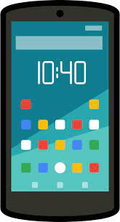
Recover your Account
Microsoft
Help I’m locked out
Google
Sometimes you get locked out of your account.
Depending on what you have set up previously, you can recover.
Apple
Notes:
Typically, you might receive an email, or a code to your smartphone.
It doesn’t always work like that. In some circumstances you might have to wait 30 days before you can change anything.
Microsoft: You removed all the security info (such as alternate email or phone number) from your account and replaced it with new info. This is done to protect your account from unauthorized access and to alert you of any changes. During the 30-day period, you can still access your account and emails, but you cannot make any new updates to your security info.
I have previously signed out of a clients Google account. When we came to sign back in, she didn’t know her password and was adamant that she hadn’t given them a phone number. We went around in a loop and didn’t get anywhere.

Slide 32
Background
As a high school student, Mirjam’s interest in American Sign Language sparked her desire to study communication, which led to her focus on technology and how it enhances communication.

Slide 33
Security Information
No.1
Alternative email addresses to email a code
No.2
Contact Phone Numbers to text a code
No.3
Use an App on your Phone
No.4
Biometrics: Face, Fingerprint or PIN
No.5
Security Key: USB, Bluetooth or NFC device
Notes:
Add any number of email addresses. Even your other half
Add any number of phone numbers. Even your other half. Include Landline and Mobile. It might be a code or a simple verify. Are you trying to sign in Yes or No. Or is this one of the numbers shown on your screen.
Use an app on your phone. An authenticator App. Similar to bank card readers where one card reader will work for all the banks, the same goes for the Authenticator App, You don’t have to use the Google Authenticator App for Google. I’m using Last Pass (for all but one of my accounts - MS) All the Authenticator Apps generate TOTP Time-based One Time Password
Use Face ID, fingerprint or a PIN
Security Keys

Slide 34
“If you can film an idea in your mind, follow that film idea shot for shot, scene for scene, that idea is worth making.
CRAIG MAPP

Slide 35
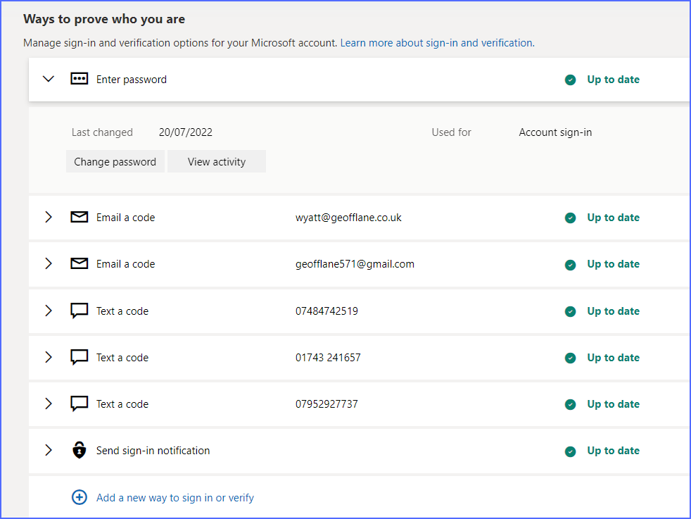

Slide 36


Slide 37
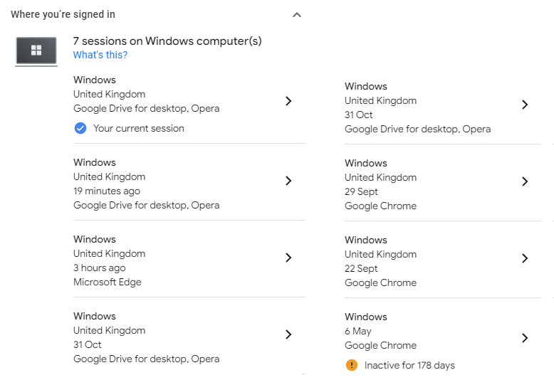
Notes:
Google Where you are signed in

Slide 38
Security Information
No.
1
Alternative email addresses to Email a code
No.
2
Contact Phone Numbers to text a code
No.
3
Use an App on your Phone

Slide 39
Securing your Accounts
Making your accounts more secure
or “Help, I’ve locked myself out of my account!”

Slide 40
Securing your Accounts
Making your accounts more secure
or “Help, I’ve locked myself out of my account!”

Slide 42
Percentage of communication tools

Slide 43

Making great products
Take risks to lead in product innovation
Listen to customers and learn what they need
Test with customers until you get the product right

Slide 44
Comparing Contoso to the competition
Contoso empowers businesses to communicate efficiently with technology that’s simple and easy to use.
The competition also offers similar technology, but their tools aren't user friendly.

Slide 46
History
LAUNCH CONTOSO
REQUEST FUNDING
PROCURE INVESTMENTS
Feb 20XX
May 20XX
Oct 20XX
2020
JAN
FEB
MAR
APR
MAY
JUN
JUL
AUG
SEP
OCT
NOV
DEC
2021
JAN
FEB
MAR
APR
MAY
JUN
JUL
AUG
SEP
OCT
NOV
DEC
HIRE DESIGNERS
OPEN OFFICES
START DEVELOPMENT
Feb, 20XX
July, 20XX
Dec, 20XX

Slide 47


Key takeaways
Virtual communication is the future
Contoso helps businesses communicate effectively
Contoso is leading in virtual communication
Contoso is free to try
and easy to use

Slide 48
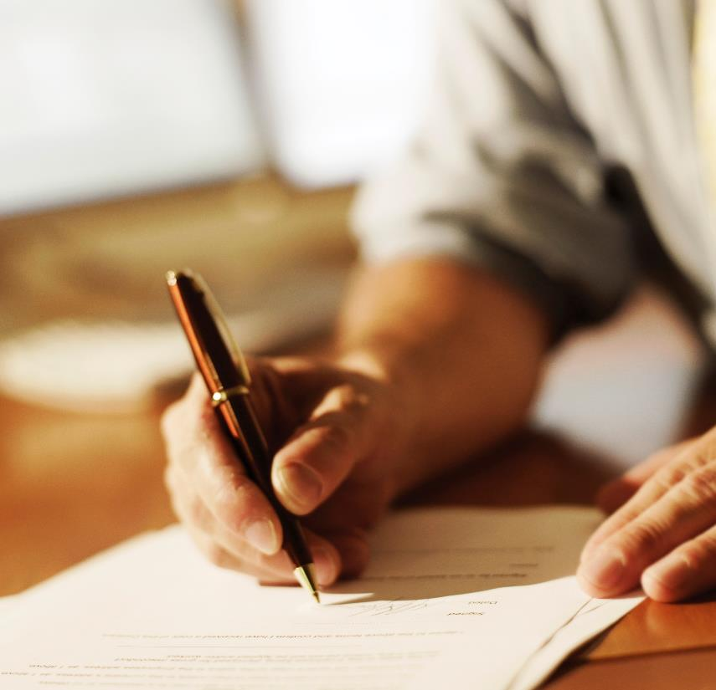
Tips for businesses
No.
1
Take risks to lead in product innovation
No.
2
Listen to customers and learn what they need
No.
3
Test with customers until you get the product right

Slide 49
Questions?

Slide 50
Thank you
Geoff Lane
U3a Computer Club

