Slide 1
What is happening to my landline?

Slide 2
Introduction
Landlines in the UK are going digital. By 2025, the existing analogue technology (the PSTN - Public Switched Telephone Network) which has supported phone and broadband services for decades will be switched off and replaced with newer digital technology.

Slide 3
Introduction
This industry wide, once in a generation upgrade will see the vast majority of customers provided with a broadband line, making calls the same as they do today, but using ‘Voice over IP’ technology that uses an internet connection. Most people have been using this type of technology for years through video or voice messaging apps used on connected mobile phones.

Slide 4
Introduction
The switch from analogue to digital landlines has already started in many countries including Germany, France, Australia and Japan and is a key step towards preparing the country for a Full Fibre future, in support of the UK Government’s gigabit connectivity ambitions. The switchover to ‘Digital Landlines’ should be complete by Dec 2025.
It may already have happened to you if you have changed your ISP or updated your current contract.
Notes:
In summary then, traditional landlines as we know them are going: your broadband and phone will both be data channels. Unless you have Fibre to the Premises, it will still be over the same wires but this time there will be no analogue signal there – for your phone, and no 50 volts for the ringer.
So the line will have gone from a phone line only, to a phone with a bit of broadband, and now broadband is the major part of it with a small part of the digital service being “Digital Voice”.

Slide 5
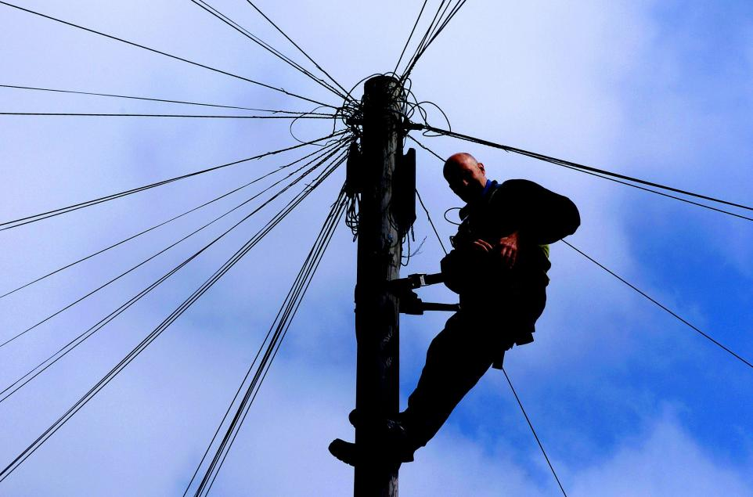
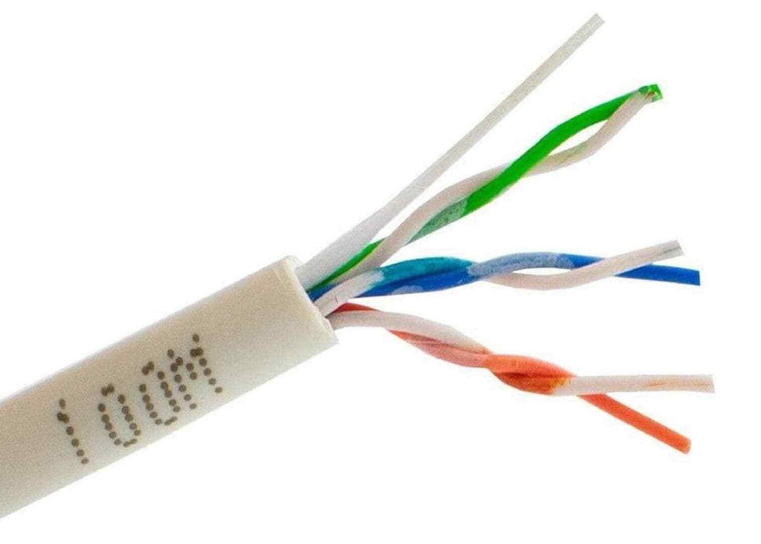
The System – as it was
Plain old Telephone System: POTS
Analogue Signal for your phone call
Notes:
PSTN – Public Switched Telephone Network

Slide 6
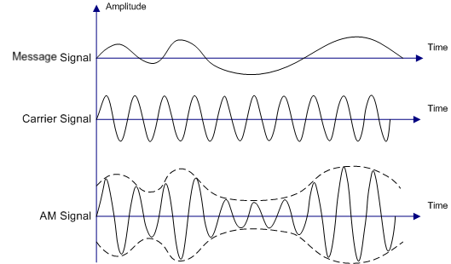

The System
- as it became
Amplitude Modulation – Your Phone Line
Digital Data: 1’s and 0’s – Your Broadband
Notes:
To keep the signals separate, do you remember you needed a filter to separate them – later incorporated into the BT master sockets.

Slide 7

The System – as it will be
Broadband and “Digital Voice”
Notes:
No filters required.
Broadband Data and Digital voice all together

Slide 8
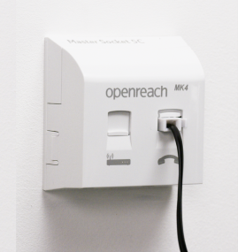
Physical Changes
Your Phone line will no longer plug into the Phone line socket

Slide 9
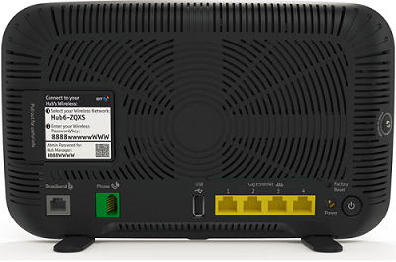
Physical Changes
Your Phone line will no longer plug into the Phone line socket.
Instead, it will plug into your Router.

Slide 10
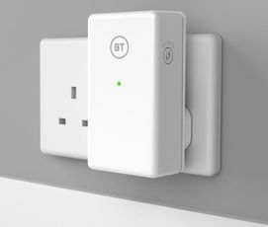
What about Wired extensions?
No problem, you will need a:
Digital Voice Adapter. (DVA).
Plug this into a mains socket near where you want your extension, plug your phone into the socket on the top (not shown here)
Then connect the DVA to your hub – it works wirelessly. You will need to press a button to synchronise them.
Your existing extension wiring will become redundant.

Slide 11
What about Cordless extensions?
No problem, plug your master base station into the router.
All cordless extensions should work as before.

Slide 12
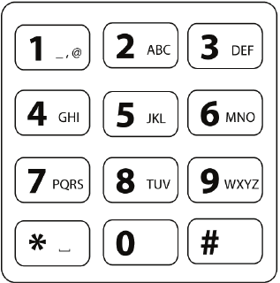
Can I keep my number?
In most cases you will be able to
keep your old landline number.
Ofcom have mandated that you should
be able to port your number.

Slide 13
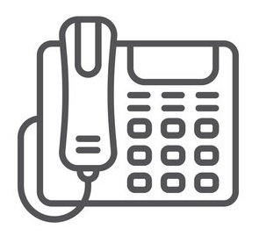
Warning
Not all Providers will offer a “Digital Voice” service:
BT, Sky, Talk Talk and Virgin Media do.
But Plusnet don’t. 🤔
For Plusnet you need a VoIP ATA which plugs into your router. And a contract with a VoIP provider – there are plenty available.
(ATA: Analogue Telephone Adapter)

Slide 14
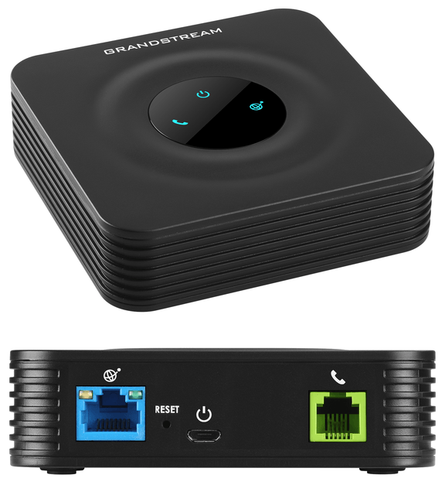
VoIP ATA
(about £50 - £75)

Slide 15
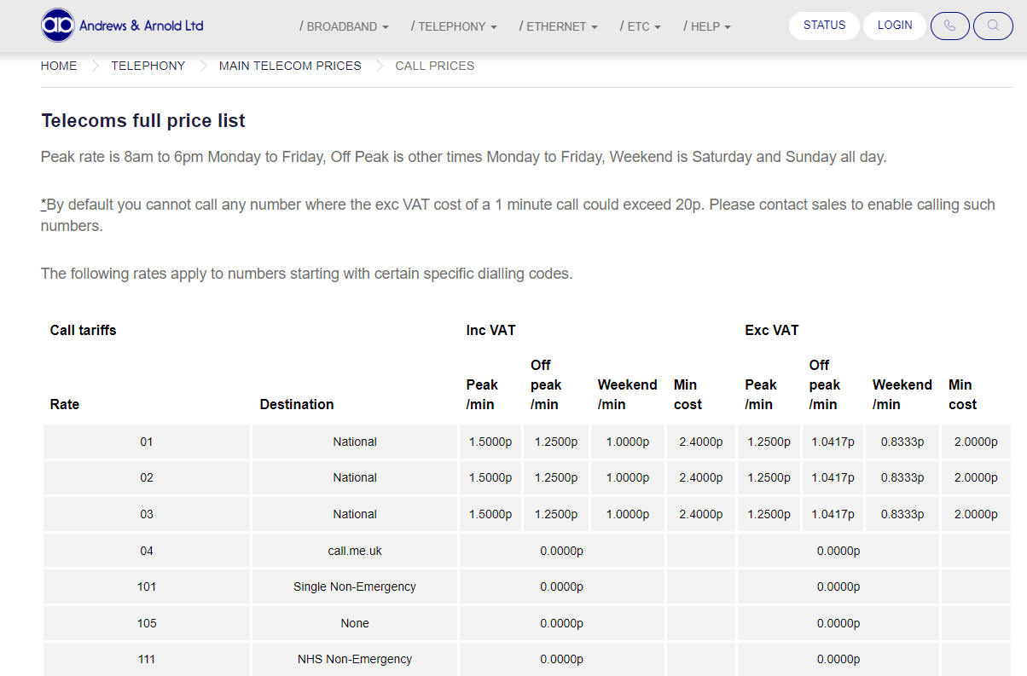
Typical VoIP Provider
Notes:
Call charges from a 3rd Party VOIP Provider
Andrews and Arnold: Setup, activation of a standard number £1.20. Monthly ongoing rental. £1.44

Slide 16

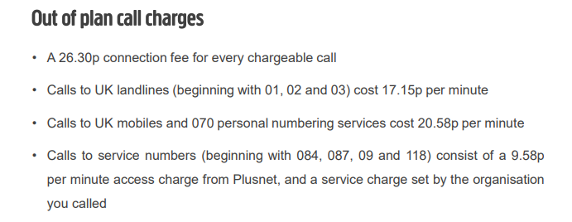
Plusnet

Slide 17
Prices?
You should not pay more for Digital Voices calls than you were paying before.
If you don’t have broadband – and don’t want it. Your provider should provide you with “Broadband Lite”. A digital service for voice only (not regular broandband (internet surfing)).

Slide 18
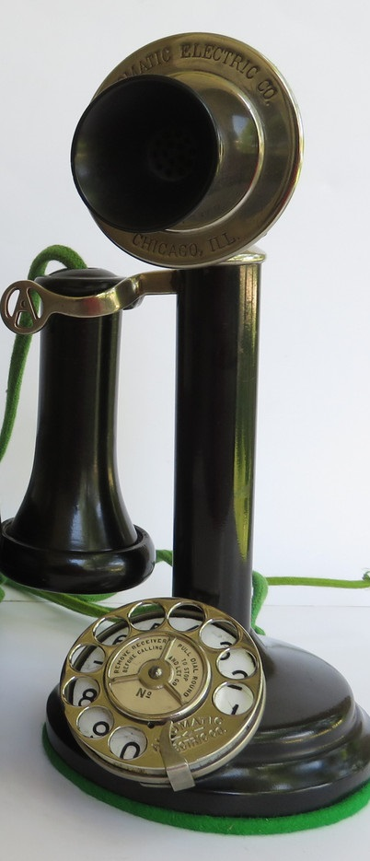
Potential Problems
Unlike the analogue phone line that was powered from the exchange (50v). Your router is powered from your home mains power. If this fails, you will not be able to make calls.
For local calls you will now need to dial the STD code as well as the number.
Most phones should work OK. (DECT yes, older phones, maybe not)
Telecare services and other alarms connected to the phone line won’t work

Slide 19
When is this happening?
It’s already started. From Sep 2023 you could no longer acquire a traditional landline.
Expected completion date: Dec 2025.
Your Phone provider will be in touch prior to the changeover – it’s happening area by area.
You may have switched already if you’ve changed your ISP recently or changed your contract.

Slide 20
References
Gov.uk. From the horse’s mouth
https://www.gov.uk/guidance/uk-transition-from-analogue-to-digital-landlines
BT: Switching from Analogue to Digital landlines
https://www.bt.com/about/all-ip
Draytec: The end of Analogue Phone lines (Quite a teccy article)
https://www.draytek.co.uk/information/blog/the-end-of-analogue-phone-lines-pt1
Age UK. Changes to landline telephones: (There are lots of similar articles like this)
https://www.ageuk.org.uk/information-advice/money-legal/consumer-issues/changes-to-landline-telephones/
BT: Digital Voice Adapter
https://www.bt.com/help/user-guides/phones/digital-voice/digital-voice-adapter
OfCom
Upgrading landlines to digital technology – what you need to know – Ofcom

Slide 21
Questions?

Slide 22
Thank you
Geoff Lane
U3A Computer Club

