Slide 1
Computing, from the beginning,
….. and a little later
Mike Masterson
Notes:
This presentation describes computing from 1945 to about 1985, after which I became more distant from developments, and IBM which was the global engine of computerisation, in my view, fell from focus. That might be controversial
However, a thought: was 1945 the ‘beginning’?
2 developments preceded 1945 by as much as a hundreds years:
Boolean logic, which uses functions of just 2 values: true and false values. Dates from 1847. Boolean logic, using 0 and 1 is the foundation of all modern computer logic.
Babbage calculating machines: 1837. These were wooden constructions of interlocking wheels that could calculate. I suppose similar to slide rules, which some of us used in our youth, or an abacus, but much more sophisticates
So, from mid 1800 mathematicians realised the theory of computers, however they just could not make them. There was a very considerable technological journey to be navigated.

Slide 2
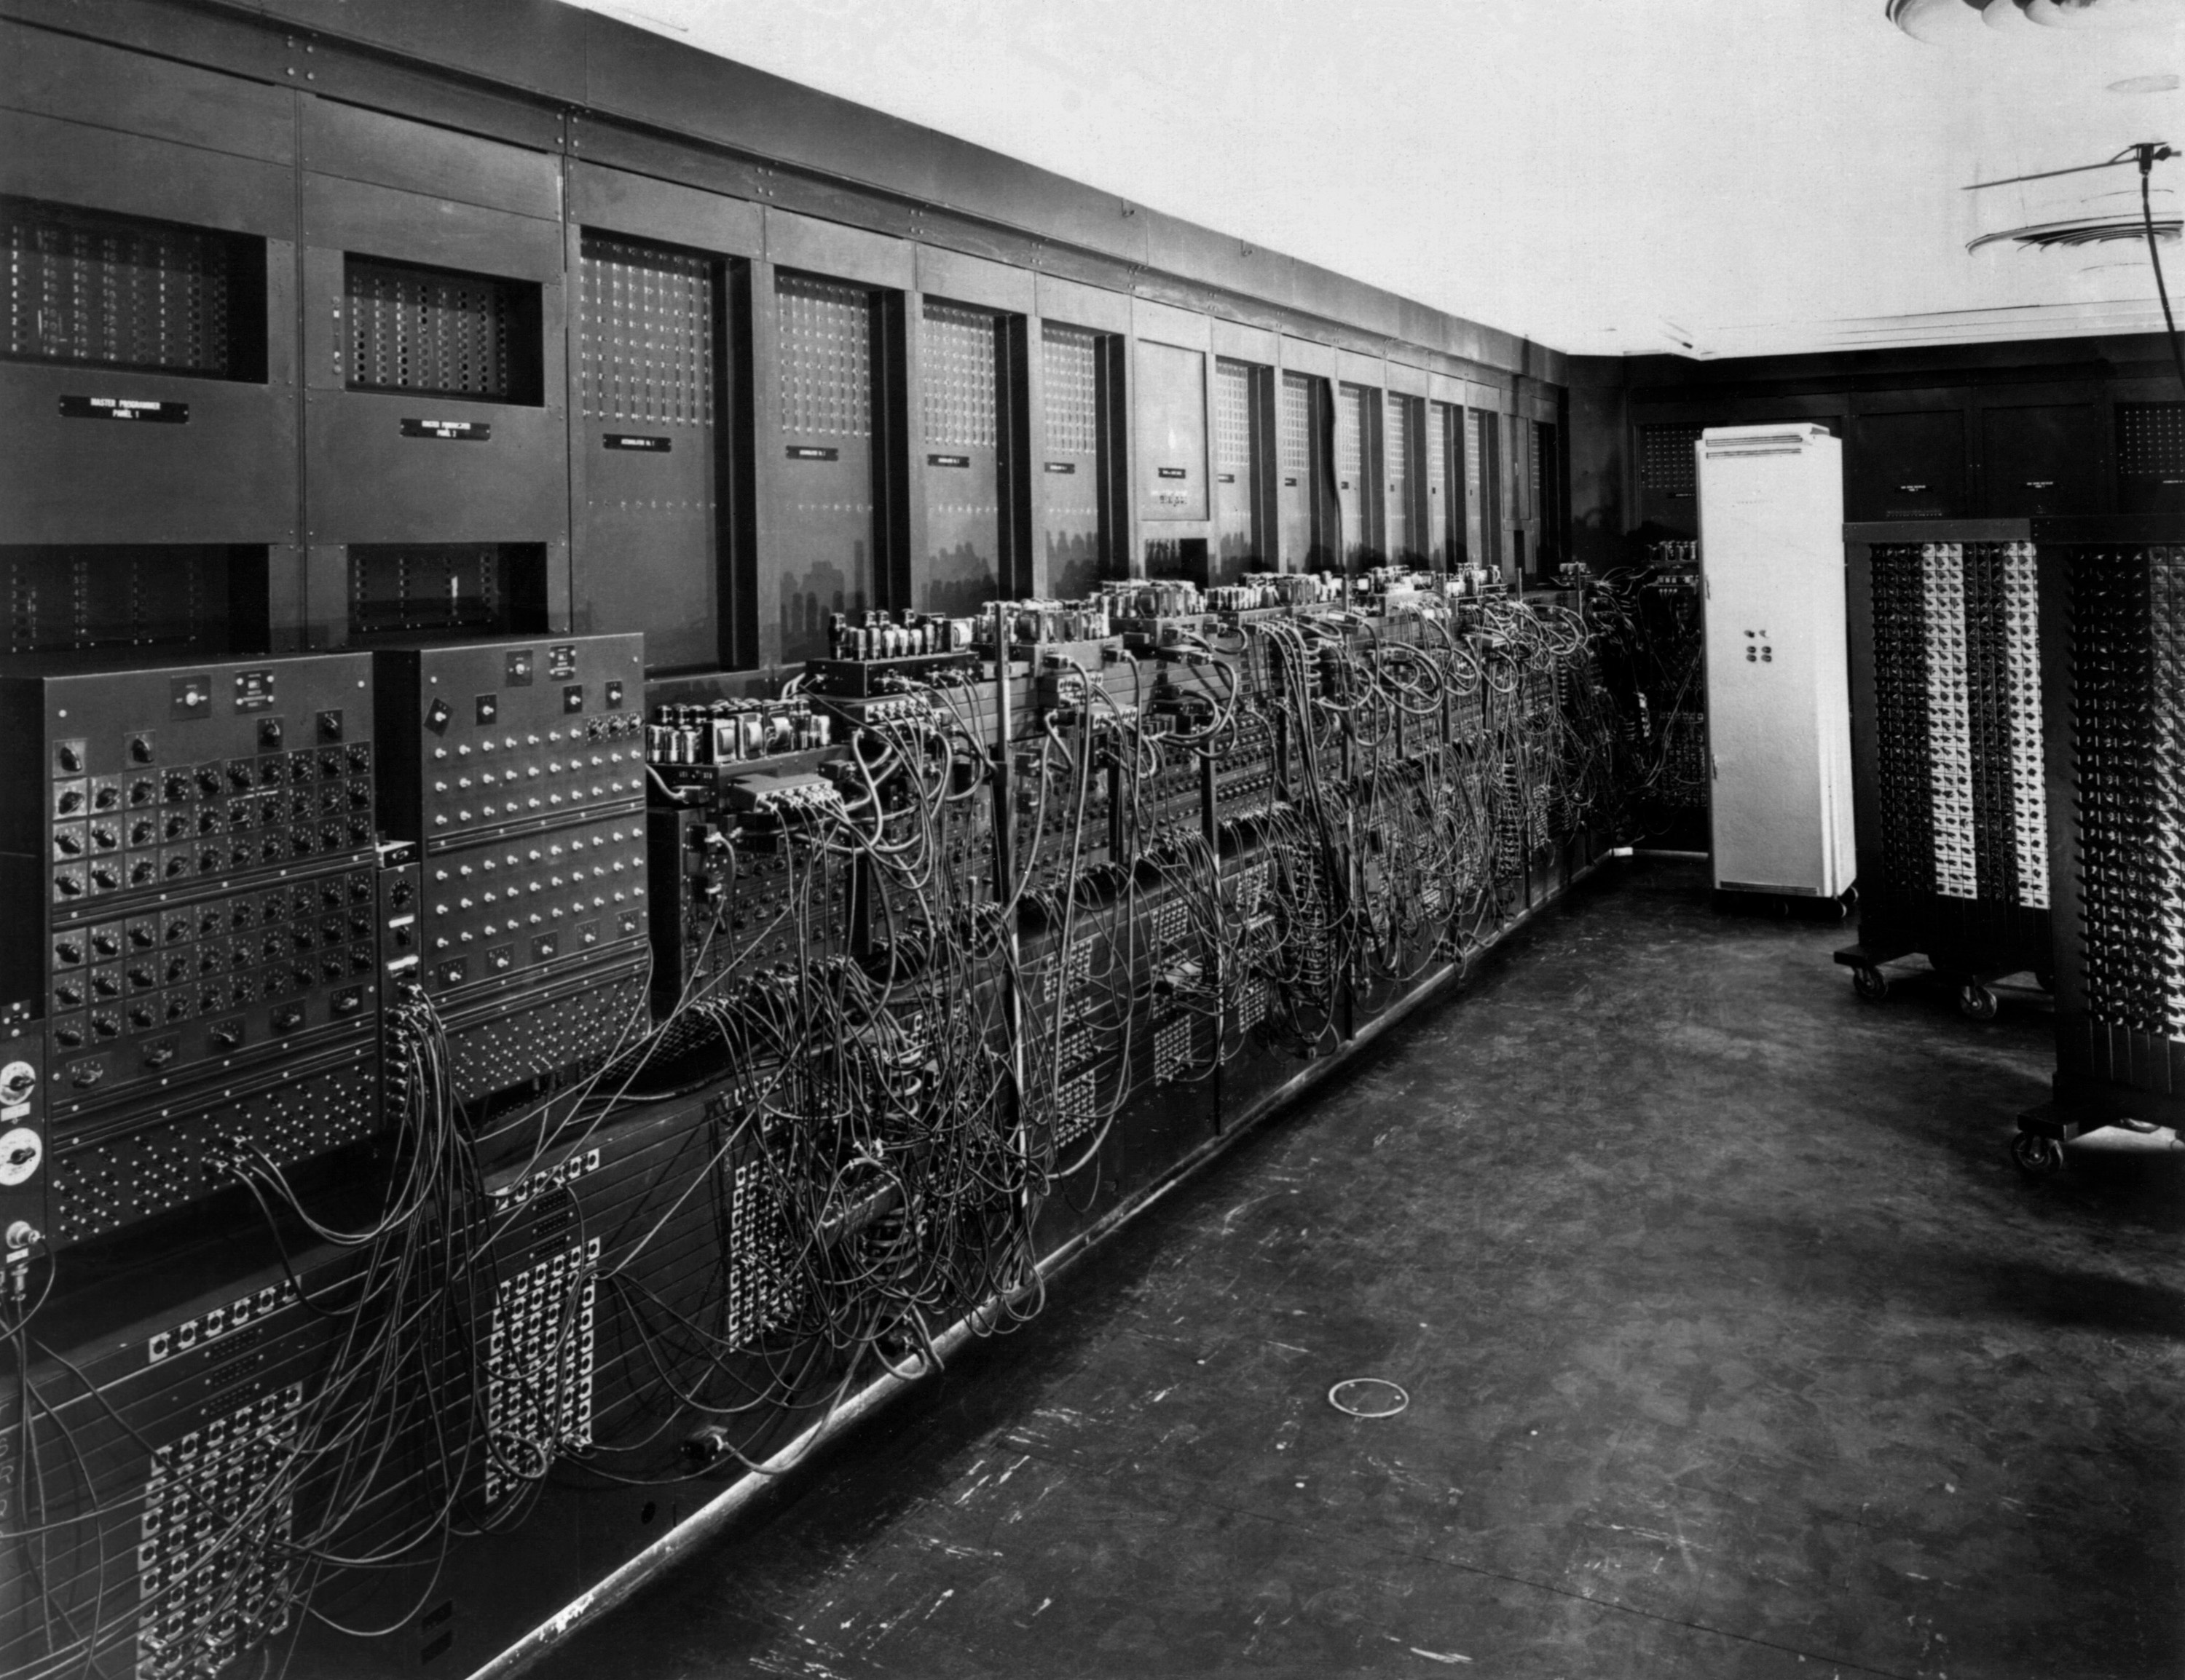
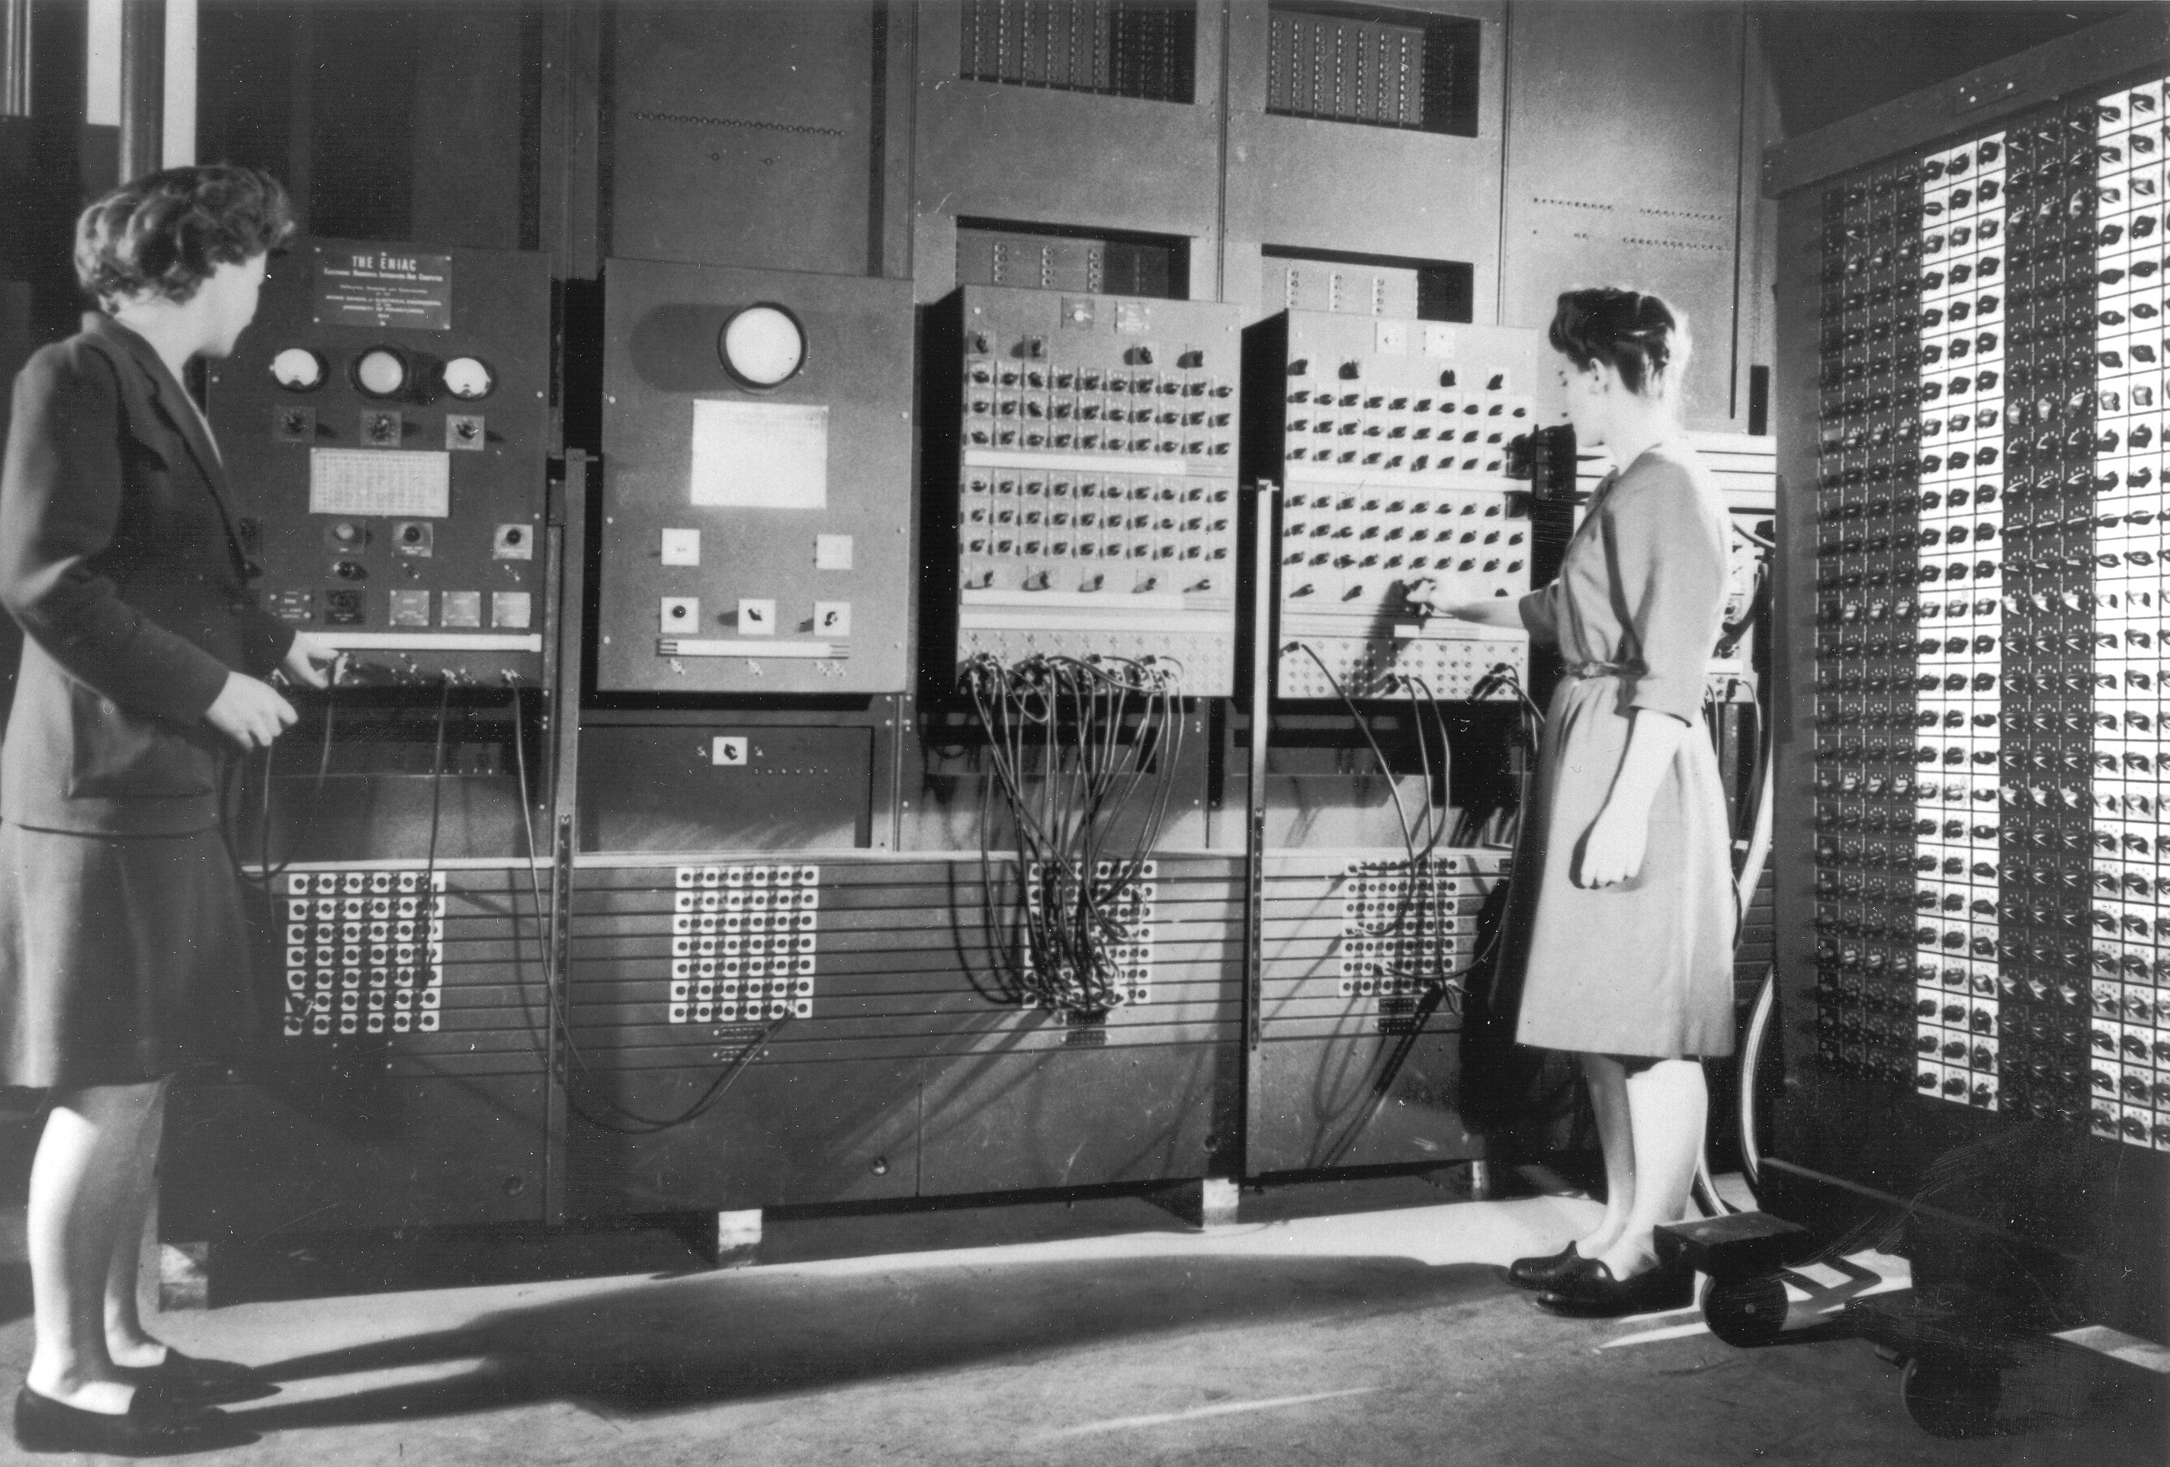
Earliest days - ENIAC
Electronic Numerical Integrator and Computer
1945 to 1955
18k vacuum tubes, 500k hand soldered junctions
….had no memory
5k operations/sec,
….existing mechanical m/c needed 2 sec/op.
Tubes burnt every day, could only work ½ day
30 tons
8ft tall x 3ft deep x 100ft long
Programmed by altering config of the racks
….required weeks
50th anniversary, replica chip 7mm x 5mm
Image from Shutterstock
US Army photographer
Notes:
ENIAC was the first programmable general purpose computer
Its in the name: Electronic Numerical Integrator and Computer
Performed a mathematical task: calculating US Army artillery trajectories
In simple terms it solved differential equations using functions of trigonometry and Newtonion laws of motion: performing calculus of acceleration / deceleration of artillery rounds
Built by 1945, it was in continuous use to 1955
@@@@@@ fly in 18k tubes
Until semiconductor transistors were invented in 1954, computers used vacuum tubes
A tube could be ‘on’ or ‘off’. Each character / value in the maths function might have required 8 to 12 tubes.
Other tubes were needed for the mathematical operand: eg: add
So 18,000 tubes might have contained just 100 / 200 values, not a lot in a set of 8 to 10 differential equations
The logic units (central process unit and arithmetic logic unit) also used vacuum tube transistors to provide registers, just 20, there was no mass memory
We begin to encounter the ‘tyranny of numbers’: computers were required to manage data in the 000’s, and each data value uses lots of 0 & 1. So, ‘a million’ began to be a small value
@@@@@@ fly in 5k ops / sec
Was 10,000 X faster than the electro-mechanical calculators of the day
@@@@@@ fly in tubes burnt
Tubes burned every day, so was only operable 50%
Heating and cooling tubes at day start and end, was cause of tube burn. Another was insect bodies fried on tube glass or junctions: hence the word ‘bug’ for computer error, with de-bugging to clear errors
Did improve to 5 days continuous operation – 1954. The year I was born
@@@@@@ fly in 30 tons
There was only ever one. It was massive.
@@@@@@ fly in reprogramming
Required weeks to re-program
@@@@@@ fly in Women picture
In those days ‘computers’ were all women, so the 6 programmers were all women. Reference: recent movie ‘Hidden Figures’
labelled ‘sub-professional’, while men were ‘professional’
@@@@@@ fly in replica
Replica built on 50th anniversary: 7mm x 5 mm
Was succeeded by EDVAC, EDSAC, IAS, Manchester Baby and Univac 1

Slide 3
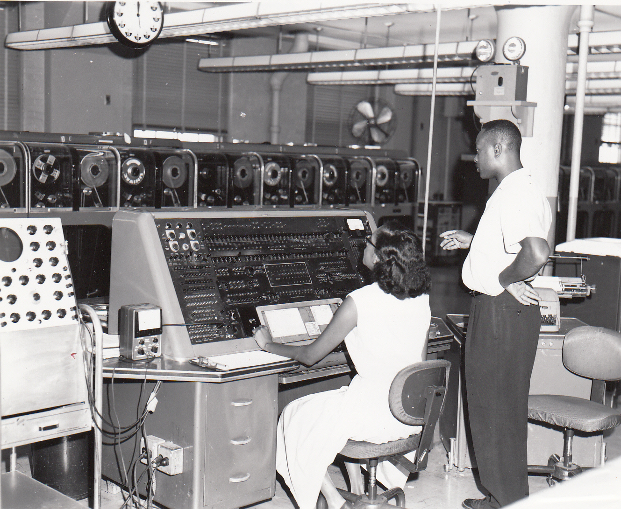
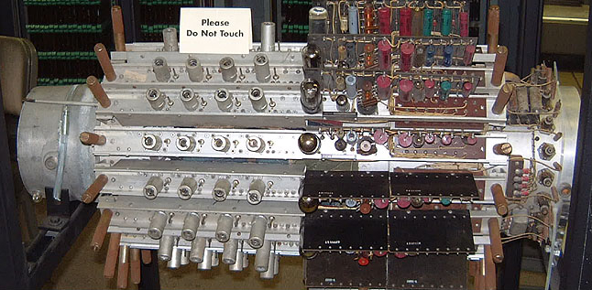
UNIVAC 1
Universal Automatic Computer 1
1951 to 1963
16 clients, used 46 m/c
‘Only’ 6100 vacuum tubes, in CPU / ALU
2k operations/sec,
8 tons
8ft tall x 5ft deep x 14ft long
12k memory, in 100 mercury delay-line registers
Art Stratman told me (1979) you needed to calculate when your desired data would be available:
  Addition: 525 microsecs
  Multiplication: 2150 microsecs
  It seems there might have been 12 datas in each bath
By US Census Bureau Employees, from Wiki
Mercury Delay Line Register
- By Ed Thelen, in Computer History Museum, from Wiki
Notes:
The UNIVAC I (Universal Automatic Computer I) was the first general-purpose electronic digital computer design for business application produced in the United States. It was designed principally by J. Presper Eckert and John Mauchly, the inventors of the ENIAC.
@@@@@ fly in 1: 16 clients, who used 46 machines
The clients were big govt departments (Air Force, Navy), universities, insurance companies, big manufacturers, including General Electric. I will come back to GE
@@@@@ fly in 2: 6100 tubes
Now ‘only’ 6100 vac tubes
It seems there was a parallel CPU / ALU with statistical comparison of the 2 calcs, in order to find CPU / ALU burn out.
Seems to me, perhaps that is why it was slower than ENIAC: just 2k/ ops / sec
@@@@@ fly in 3: Big advance on ENIAC
Main reasons for failure were still tube burns. A production lot would be burned in. Typically ½ were discarded.
Had to be kept hot – 40deg C. With improved tubes and temp control, MTBF was as long as many days, and eventually a few weeks
Still big, but less than half size, and much improved up-time
@@@@@ fly in 4: 12k random access memory, and in-line batch memory
Mass memory was used for data retrieval and input / output
The Univac had mass memory, 12k, in addition to CPU / ALU.
Random Access Memory (aka RAM), with in-line mass memory (tapes) were the big step away from ENIAC, towards commercial architecture
@@@@@ fly in 5: Mercury delay lines
These were the mercury delay lines
@@@@@ fly in 6: Art Stratman
One of my earliest supervisers, Art Stratman, was a programmer on an UNIVAC 1. In 1979 he told me:
You had to calculate when your desired data would be available: the data reflected up and down the mercury bath, see the speeds
As I read it, appear to have been 12 datas in each mercury bath, so get it wrong and *@*@
The speed of the registers was very sensitive to temperature: they were kept at 40deg c.
@@@@@ fly in 7: football players
He also told me that the tapes aluminium with a magnetic surface. You needed young football players to change the tapes

Slide 4

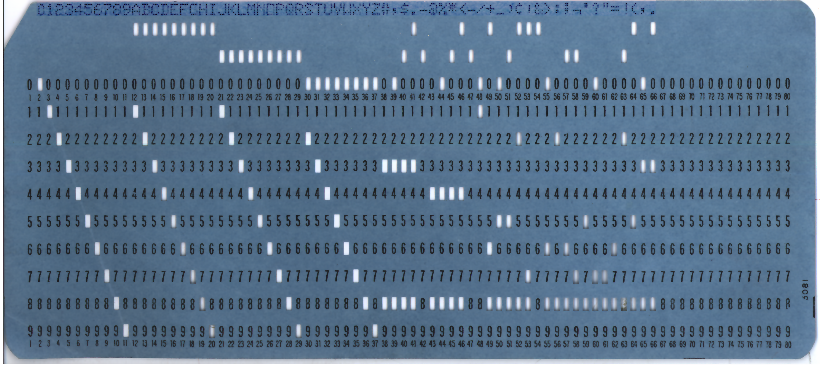
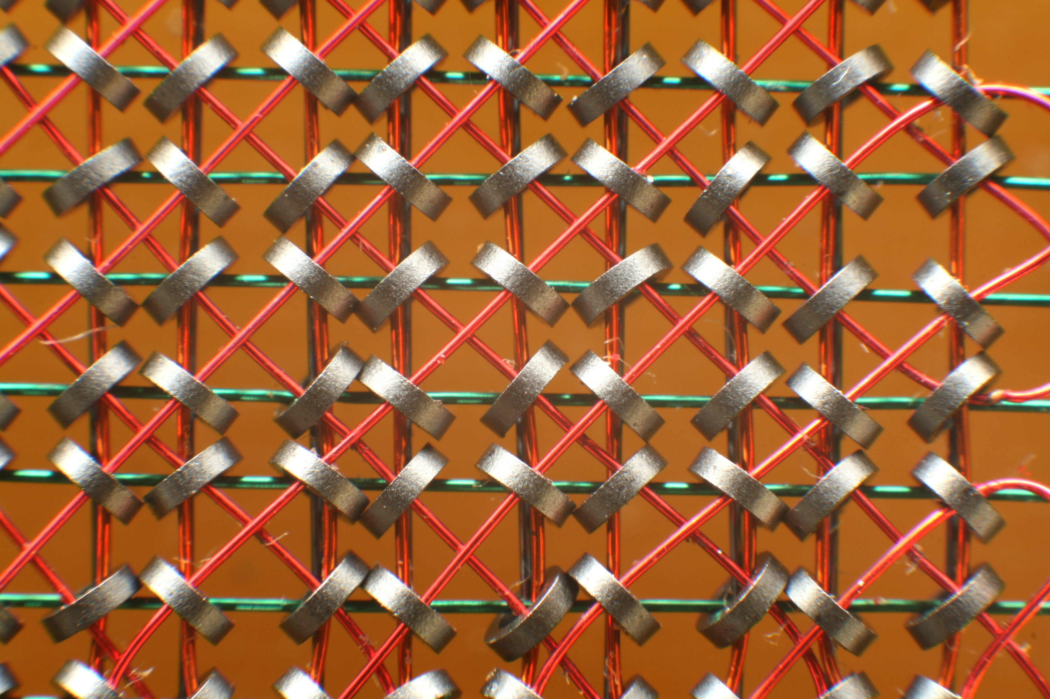
Growth of IBM
- aka Big Blue
To 1954, IBM was America’s leading tabulating machine company, based on punched cards
  Thomas Watson Sr created the iconic IBM culture
  Famously mis-quoted
1954 Thomas Watson Jr took over, until 1971
IBM 701 / 704
  Set global stds for data architecture, bits and bytes
  Mag core memory – ’55 to ‘75
By Konstantin Lanzet, from Wiki
Notes:
Much of the rest of this discussion is about one company: the really iconic IBM
@@@@@ fly in 1: big blue
@@@@@ fly in 2: by 1954 …. monoploy
By 1954 IBM had already grown to near US monopoly, of tabulating m/c’s, based on punch cards
@@@@@ fly in 3; punched card
@@@@@ fly in 4: red circle
for ‘0’ you pressed 0
@@@@@ fly in 5: green circle
for ‘a’ you pressed 2 keys simultaneously
In 78 / 79 we still used punched cards: We had a manual card punch:
80 columns to a card
If you made a mistake on say column 50, you licked your finger, adhered one of the chads from the chad tray to your finger, and pushed it back into place
then you quickly edited that single card into the program, using the card reader, praying all the while
@@@@@ fly in 6: Culture of IBM and Thomas Watson
It was Thomas Watson senior who created the iconic IBM salesman: clean shaven, young man, dark suit (generally blue), mono colour tie (dark), shiny black shoes
@@@@@ fly in 7: famously misquoted
He is misquoted as saying there is a market for only 5 computers
Actually the market was as many as 30, in the US
US trust law broke IBM’s monopoly - 1954
@@@@@ fly in 8: Tom Watson Junior
Thomas Watson Jr realised IBM had to develop computer market
Invested heavily in research
Set global standards: 1 core = 1 ‘bit’. 8 bits make a byte = 1 character, 256 possible = 2 power 6
2 further bits: sign and position floating decimal point
Led IBM until 1971 : Legendary ‘…from the desk of Thomas Watson Jr’. Even if we were not with IBM, we paid attention. He set the industry expectation
IBM designed the data architecture, and the programming method
@@@@@ Fly in 9: RAM
Big break into RAM concepts: Magnetic core memory became universal std to 1975
@@@@@ fly in 10: mag core picture
Initially only 8k memory, grew to Mega Bytes
Described as Random Access Memory
Better word was direct access, there was nothing random about the access
Cost / core £0.33 (1953) to $0.0003 (1970), when IBM made 20 billion cores / ann
KAPOW: from 1960 IBM had made built the capability for computerisation to be commercialised, globalised
DIRECT ACCESS MEMORY, in-line mass memory, data architecture, publically accessable programming languages
IBM really were the global leaders

Slide 5
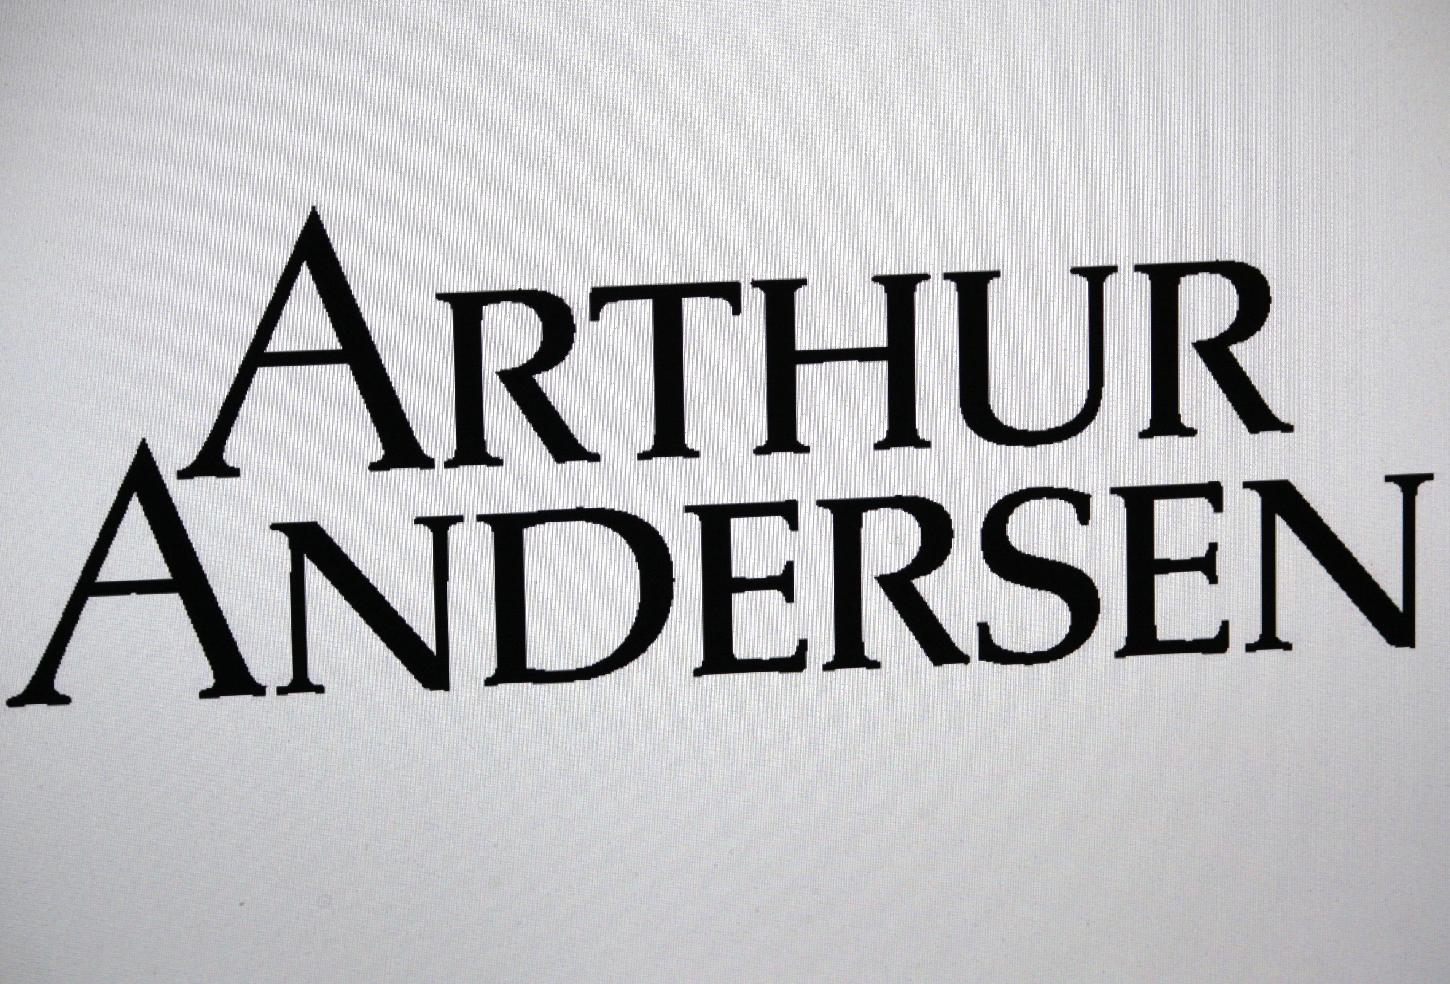
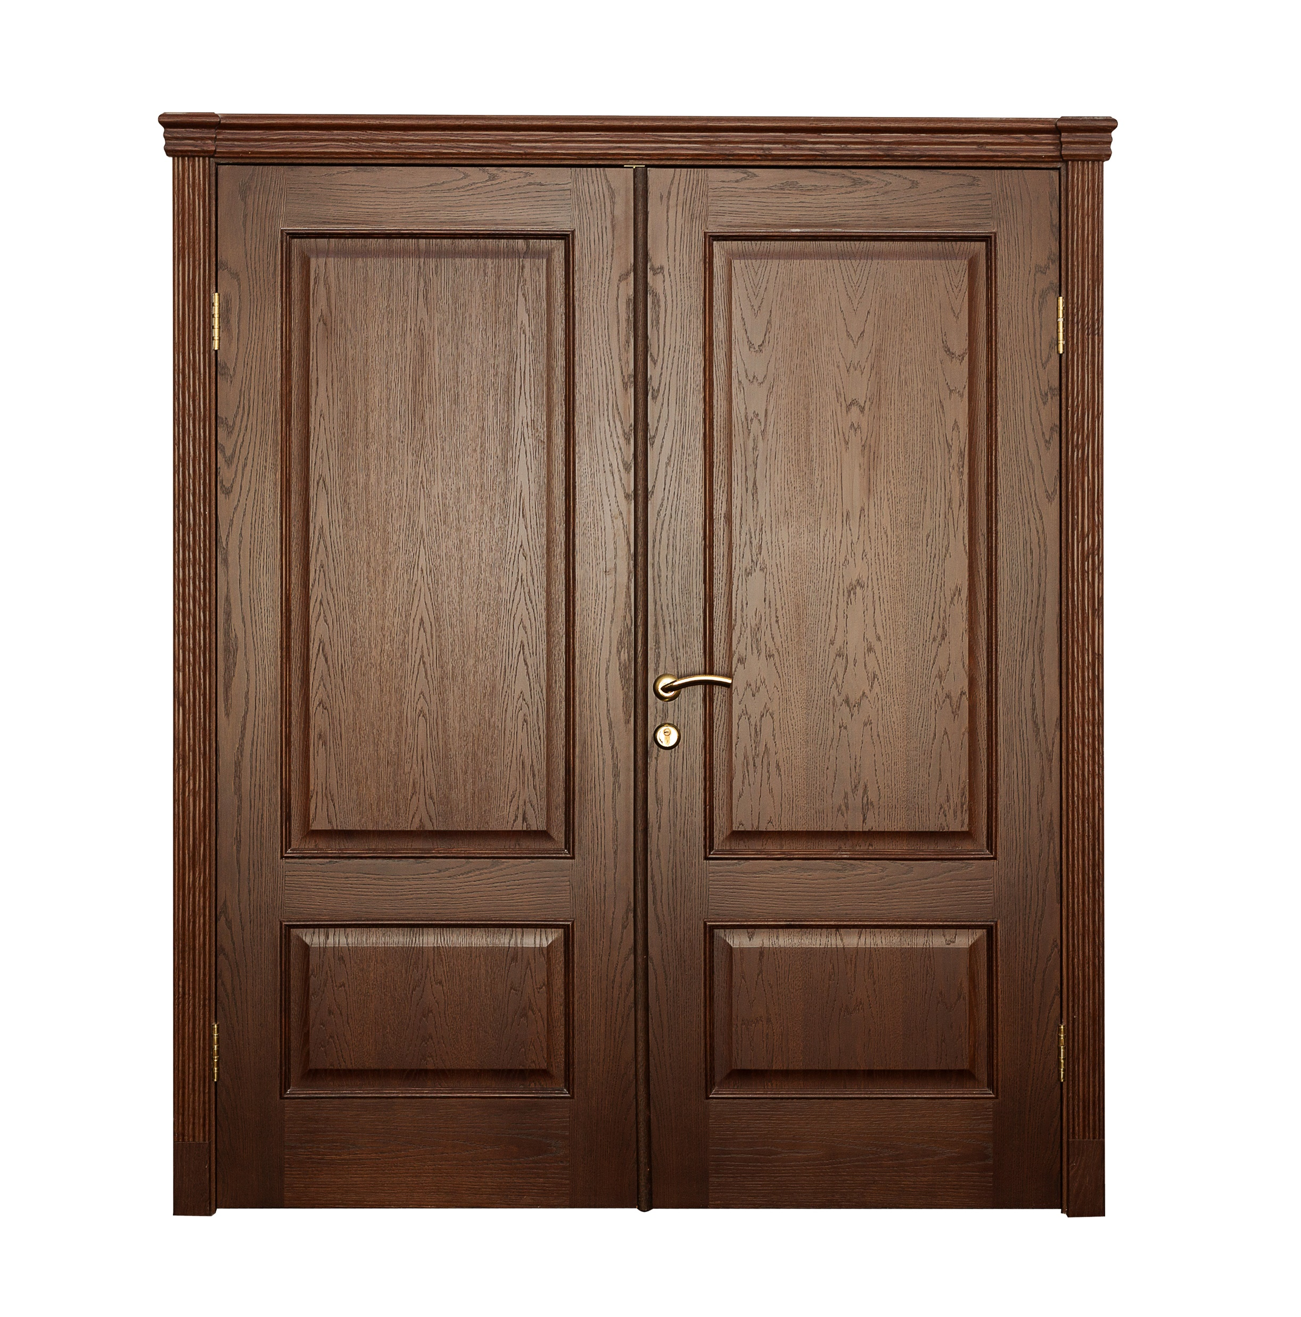
Globalisation of commercial computing
1950’s AA partner, Joseph Glickhauf built the ‘Glickiac’, a small ALU demonstrator
Early client: General Electric 1953
….weekly payroll. Said to be 1st commercial prog
….took more than a week to run
Offered stock sub-routines to IBM, rejected
1978 I joined Arthur Andersen, MICD
.....approx 8K staff worldwide
…..in 200 offices
…..in 100 countries
Notes:
The development of mag core memory, data architecture and simple languages meant by the mid 50’s businesses had begun to realise that computers were accessible to them
…. and that realisation was global …… even in tiny Rhodesia (less than ½ million people in the cash economy) needed computerised banks / building societies
@@@@@ Fly in 1; Art Ander picture
The audit firm Arthur Andersen was a leading US auditor: member of the Big 8. Had a reputation for professional excellence, whatever happened later.
@@@@@ Fly in 2: double doors
Very strong global culture, typified by the double doors: wherever in the world, behind the doors there is the same global value
@@@@@ Fly in 3: Joe Glick
The Arthur Andersen partner, Joseph Glickhauf had attracted this firm of auditors to set up Management Information Consulting Division (MICD)
- he built the Glickiac, to demonstrate automatic arithmetic functions
- I have seen, seen in the museum in St Charles, outside Chicago
@@@@@ Fly in 4: Gen Elec
One of the early clients was General Electric, who felt they had to be at the forefront of information processing
- assigned to AA to computerise their weekly payroll, using UNIVAC 1
- it required more than a week to run
- GE said: do it again
- successful
@@@@@ Fly in 5: IBM letter
With their growing experience MICD realised that they were using subroutines repeatedly
- for example: data sorts
- offered these to IBM
- rejected IBM did not see the need for these
- Reminder of CEO (Thomas Watson Sr) …. few
@@@@@ Fly in 6: I join MICD
By 1978, when I joined MICD, the division was nearing the size of the Audit practice
- and it had become global

Slide 6
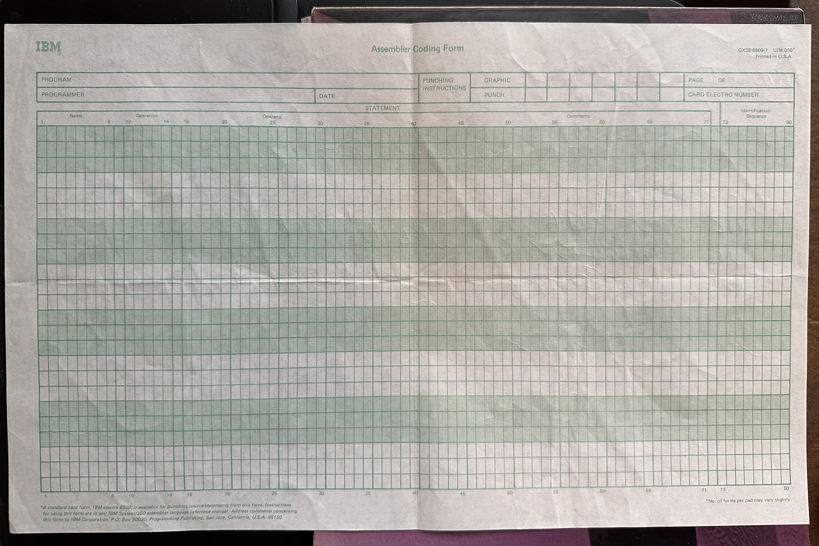
We learned Basic Assembler Language - BAL
St Charles, Chicago
Our task: calculate and print the payroll of ten staff
Took 4 days to success
This is a comment line
Load the fullword integer stored at the location labeled ‘wage' into general register 3
L 3,wage
SLA 4,5 shift the value in general register 4 left by 5 bits
MVC TARGET,SOURCE move characters from location 'SOURCE' to 'TARGET’
AP COUNT,=P'1’ add 1 to value in memory location 'COUNT' (packed decimal format)
B NEXT unconditional branch to label
Notes:
I trained in Basic Assembler Language, said to be one step up from machine code = 0110100111
@@@@@ Fly in 1: picture of BAL
We had 27 operands such as L (load), AP (add packed), B (branch)
@@@@@ Fly in 2: picture of coding sheet
We pencilled our code onto the sheets, which were then put onto punched cards
Our program - to calc and print the payroll of 10 people - required 800 to 1000 cards
At least one box was dropped. 3 people took a full day to re-sequence the box

Slide 7
De-bugging Basic Assembler programs
Each run failure gave you a HexDec dump
….40 pages of memory contents at crash, printed in Hexadecimal
Hexadecimal (base 16) uses 256 couplets to provide the alphabet / numbers / special characters
….* = 2a, a = 61, b = 62, l = 6c, e=65, A=41, B=42
Register block gave the address of instruction at time of crash
….notorious failure ’branch into low core’
Probably got 2 to 3 runs / day
Took 4 days to success
As we write:
Table with TABs (09)
1 2 3
3.14 6.28 9.42
The same, expressed in hexdec:
00000040 2a 2a 20 2a 2f 0a 09 54 61 62 6c 65 20 77 69 74 |** */..Table wit
00000050 68 20 54 41 42 73 20 28 30 39 29 0a 09 31 09 09 |h TABs (09)..1..
00000060 32 09 09 33 0a 09 33 2e 31 34 09 36 2e 32 38 09 |2..3..3.14.6.28.
00000070 39 2e 34 32 0a |9.42.
00000075
Notes:
@@@@@ Fly in 1: HexDec dump
Around 40 pages showing the contents of memory at the time of the crash
@@@@@ fly in 2: HexDec
People cannot read machine code, where any character is a string of eight 0’s and 1’s
But hexdec represents the m/c code in a single ‘2 letter’ couplets
@@@@@ fly in 3: picture of table
@@@@@ fly in 4: the same on Hex Dec
@@@@@ fly in 5: red circle
@@@@@ fly in 6: hexdec circled
@@@@@ fly in 7: interpretation, circled
@@@@@ fly in 8: yellow circle
@@@@@ fly in 9: hexdec circled
@@@@@ fly in 10: interpretation circled
Don’t worry if you did not follow that. A lesson I do want to show is that programming required you to design, and then read, and so manage each location in the computer
@@@@@ fly in 11
You used the register block to find the address that caused the crash
Then read the dump to note the values that were in memory at the time of the crash
Then compared that to what you had intended, by cross checking with your code sheets
Then you wrote out new code sheets, sent those for punching, assembled the cards back into your box, and re-submitted
We all thought it very funny when a programmer lost track of where his / her program resided in memory
The operating system was in the first stacks of core
- So, a ‘branch into low core’ meant that your program had attempted to get into the operating system, leading to an instant crash
@@@@@ fly in 12:
Probably got 2 runs / day
Most took 4 days.
If you could not complete in a week, you failed, and left the Firm
In truth BAL was used as programmer training, it was very seldom used in everyday programming
It trained you to read errors, how to design efficient branching, looping, labelling.
When to use a sub-routine, and how to return safely from a sub-routine: often the cause of ‘branch into low core’
You closely understood the programs function in memory

Slide 8
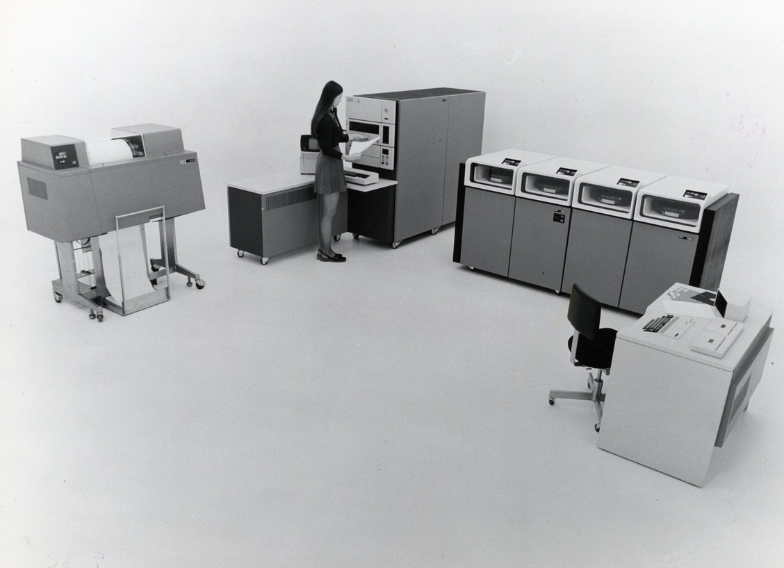
IBM SYSTEM 3 15D
2 years I worked on the IBM System 3
64KB as 512,000 mag core memory
  Big box, in front of the operator
  Small box was the CPU
Hard disc drives: 2.5 MB / disc
Invariably had tape drive. Not shown
Required an a/c computer room
  Gas flood in case of fires
  Restricted access
A further room contained:
  IBM manuals
  Program print outs
  Archives
  Stationary
The operators spent the day walking about the rooms: changing discs, tapes, loading / unloading paper, cleaning the printer
Notes:
Very similar to the m/c I worked on for 2 years
@@@@@ fly in 1: 64kb, or 500,000 mag cores
@@@@@ fly in 2: yellow star
@@@@@ fly in 3: disc drives. 2.5Mb / disc
@@@@@ fly in 4: yellow star
By 1980, the punched cards had disappeared (front box, with chair). We wrote new code into terminals: editing programs edited the new code into the program then under development.
Not shown is the bank of tape drives, now on plastic, magnetized tape, no longer aluminium
@@@@@ fly in 5: required a suite of rooms
Gas flood in case of fires, you had to escape FAST
@@@@@ fly in 6: the operators
As the caption says, the operator spent little time in the chair in front the console, operating the days schedule. Most of the time the operator was walking thru both rooms, changing, managing the peripherals.
Lots of time went into the printer. Changing, cleaning, clearing tractor tears. It was a rather manual job
A vital role was to manage the tape (or disc) library: son, father, grandfather back-ups of magnetic tapes

Slide 9
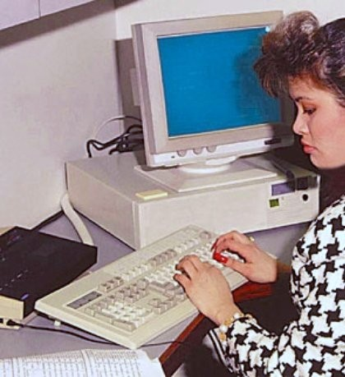
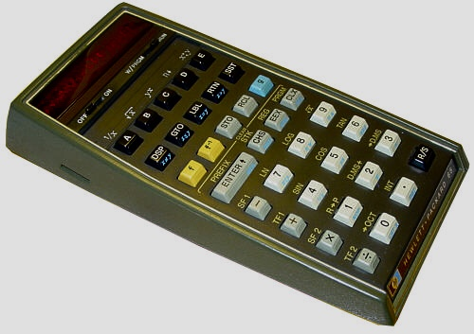
Mid range computers
- most commercial companies
Commercial / technological landscape – 1975’s
Computers globalised, and in mid sized companies
We knew batch processing was becoming obsolete
We recognised we needed massive online memory
We were already familiar with integrated chip / microprocessors
Using the System 3
64KB in 3 partitions
  16 KB - Manufacturing, sales, finance batch processing
  12 KB - Payroll, other smaller progs
  36 KB online data capture and validate
Typical batch program
  4 to 5 KB
  Leaving just 10KB to buffer data
  Causes frequent read / write to disc / tape – slow
Online partition also limited
  Limit: 20 / 25 terminals
  Again, frequent disc reads
64KBytes requires 516,000 magnetic cores
  Regular IBM services left small piles of cores on our desks
  I could never work that out, how is it still working?
Direct Random Access Memory
1973 – 4KB DRAM, began to replace mag cores
Notes:
Most companies that were not banks, oil co’s, insurance could use the mid range computers
@@@@@ fly in 1: Using a mid range computer
In the 70’s most programming was batch – not online
Working off a written schedule:
@@@@@ fly in 2: batch processing
16KB for the manufacturing partition was also small
- I estimate that a larger program used 5KB of code
- which leaves just 11 KB to buffer data. Only 20 stock records
- again leading to frequent / slow disc operations
But we knew we needed at least online data capture and validate, so as to reduce ‘snail mail’ transfers of data, tapes, to/from remote locations
@@@@@ fly in 3: on-line capability of a mid range computer
36KB for the online environment was small
- limited to 20 / 25 terminals
- a stock master file may be 1MB
- so validation of entered tx or inquiry, to the master file required frequent disc reads. Much slower than memory reads
- seems likely that we had to schedule DDE sessions: stock in AM, sales in PM just so the operator could have the right discs on-line
Full online processing required all the data on-line, or near on-line, all the time
- leading to multiple MegaBytes of Memory, and banks of discs
So, we always wanted more memory
In 1978 I remember being staggered by the announcement of a 64K RAM chip.
At the time I was working on a 32k ICL 2903, and it was not a chip
@@@@@ fly in 4:
Relate story of servicing of cores
@@@@@ fly in 5: arrow head going forward
@@@@@ fly in 6: mid 70’ landscape
500k mag core, or millions in ‘mainframes’, were now nowhere near enough
Someone called it the ‘tyranny of numbers’
@@@@@ fly in 7: handheld calculator
Based on microchip working with register stacks
Rather like ENIAC, but now in our hand
@@@@@ fly in 8: Direct Data entry / online terminals
Became common place, required local and distance comm networks
@@@@@ fly in 9: DRAM began to address the ‘Tyranny of Numbers’
1973: 4k DRAM, 1978 256k DRAM, 64 X in 60 months
which is faster than Moore’s Law : ‘memory doubles every 18 months
Relate the story of Moores comment
Comment: in same year articles were offering 1Mb future

Slide 10
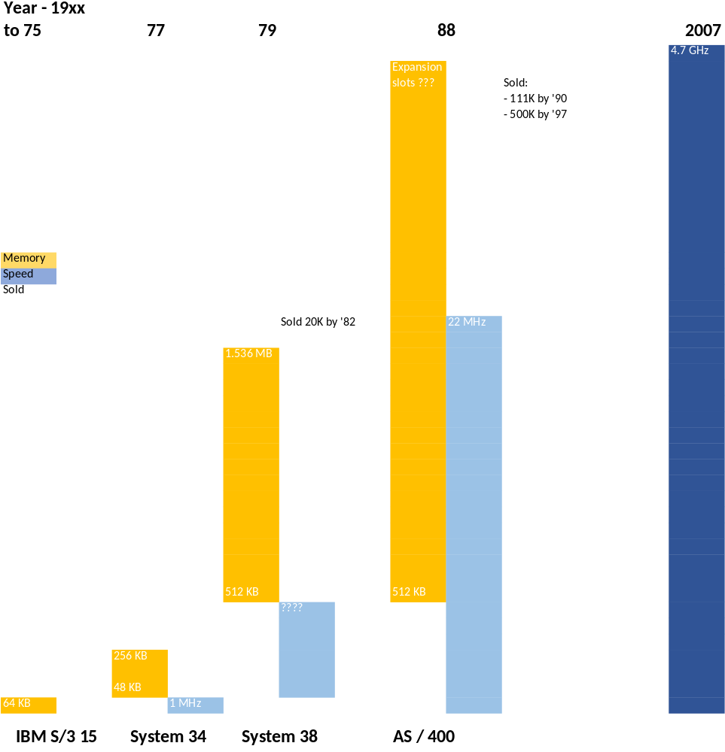
Development of mid range computers
ICL was formed by the UK govt to compete with IBM
Make the comparison between IBM and ICL
IBM System 3 (69), innovated thru 70’s and ‘80’s
  Memory: 48KB to ‘how much do you want?’
  Speed: 1MHz to 1,470 MHz
  Sold: 111,000 (1990) 500,000 (1997)
ICL 2903/04, 1974
  ‘me too’ IBM / 34, only 32KB memory
  Sold 3,000, ten X more than expected
  No innovations / expansions thru 70’s
  Focussed on UK govt clients
ICL did offer a mainframe
  Well liked
  Could not keep pace
  Began to market Fujitsu m/c’s, clone of IBM
  Fujitsu bought portion of ICL
  Then all of ICL
Notes:
@@@@@ fly in 1: mid range graph
Over 5 years from 75 to 79 / 80 IBM announced 3 significant new generations of mid range computers
Each bigger, faster by multiples
And each was sold in numbers of 10 of thousands to multiple 100,000
@@@@@ fly in 2: ICL
International Computers Limited formed by UK govt, by merging the leading UK co’s: ‘Ferranti’, ‘UK tabulators’
@@@@@ fly in 3: make the comparison
@@@@@ fly in 4: IBM innovation journey
@@@@@ fly in 5: ICL journey thru same time
ICL was a ‘me to’
Relate story of the new sort
ICL had a protected market, if the ICL was OK for the purpose govt depts had to buy ICL
@@@@@ fly in 6: ICL mainframe
It was well liked, but little / no innovstion
Introduce Fujitsu, which was anyway, a Japanese clone of IBM
How they must rue the day
I will always decode Fujitsu UK, as ICL
Fujitsu Japan did not breed the Horizon scandal

Slide 11
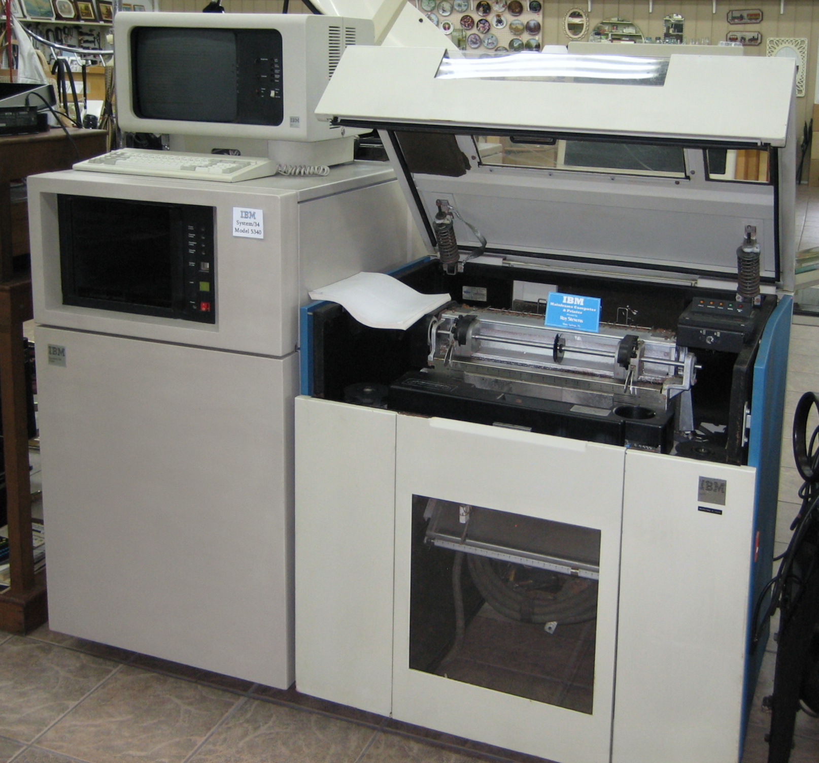
Pering Mine Information System
Jenny and I met over the Pering Mine IBM System 36
Lead / Zinc new prospect in N Transvaal
  The place is so flat / arid there are no features
  So they used the missionaries name: Olivier
  This way the town was called Reivilo. Geddit?
PMIS
  I was assigned to develop the information system with Jenny on the client side
  Program Generators were becoming more common.
  We decided to use Fortran to write a Program Generator
  Most of the time was spent with users painting the inputs on the screen. Also the reports
  Then we built the data definitions, and linked those the painted screens / reports
  Then we wrote the Prog Generator to auto generate PMIS programs
  Worked until the mine closed about 20 years later
IBM system 34 mid-range computer. Now in office environment
The small box beside the printer is the computer
Likely 8 x more memory than S / 3
Notes:
Our work on mid-range computers was smaller than the mega projects performed on the mainframes
That might have been a blessing: I don’t recall the same level of spectacular blow-outs that mainframe projects did experience
@@@@@ fly in 1: Jenny
I started at the Pering Mine early in 1986. Shell Metals had found this new prospect that had proven viable to develop.
Through 86 I led the team that installed financial, payroll, stock mgt and maintenance mgt modules.
One of their geologists was Jenny.
@@@@@ fly in 2: relate story or Reivilo and Pering
@@@@@ fly in 3: PMIS
About to roll away Pering mgt found enough / light budget to ask for a Mine Information system: gathering and reporting throughput of the ore milling, ore separation, slimes dumping operation
@@@@@ fly in 4: Program Generators
We could find no commercial packages in this space. There were few users. Jenny and I had worked together on a coal stockpiling and transport system which was relevant
Recently I had worked on two early Program Generators: a master program that used user defined inputs to generate the code to manage the inputs.
Jenny knew fortran, a language more suited to management of ‘arrays’. An array could be seen as a table of values in logic.
@@@@@ fly in 5:
We decided that we could;
- paint the input screens on the S/34 screen by interview with the users,
- Use fortran to describe the inputs in arrays, together with validation conditions
- Write sub-routines to perform the arithmetic and updating
@@@@@ fly in 6: wrote the Prog Gen
Then we wrote the program that read the arrays and generated the input screens and included the appropriate sub-routines
Similarly the reports
@@@@@ fly in 7:
One–day, time all gone, Jenny pressed the button and the program wrote the Pering Mine Information System, about 20 programs
This ran for about 20 years, until the mine closed
Advantages: hugely user focussed. Provided the user has expressed the needs accurately, little testing is required

Slide 12
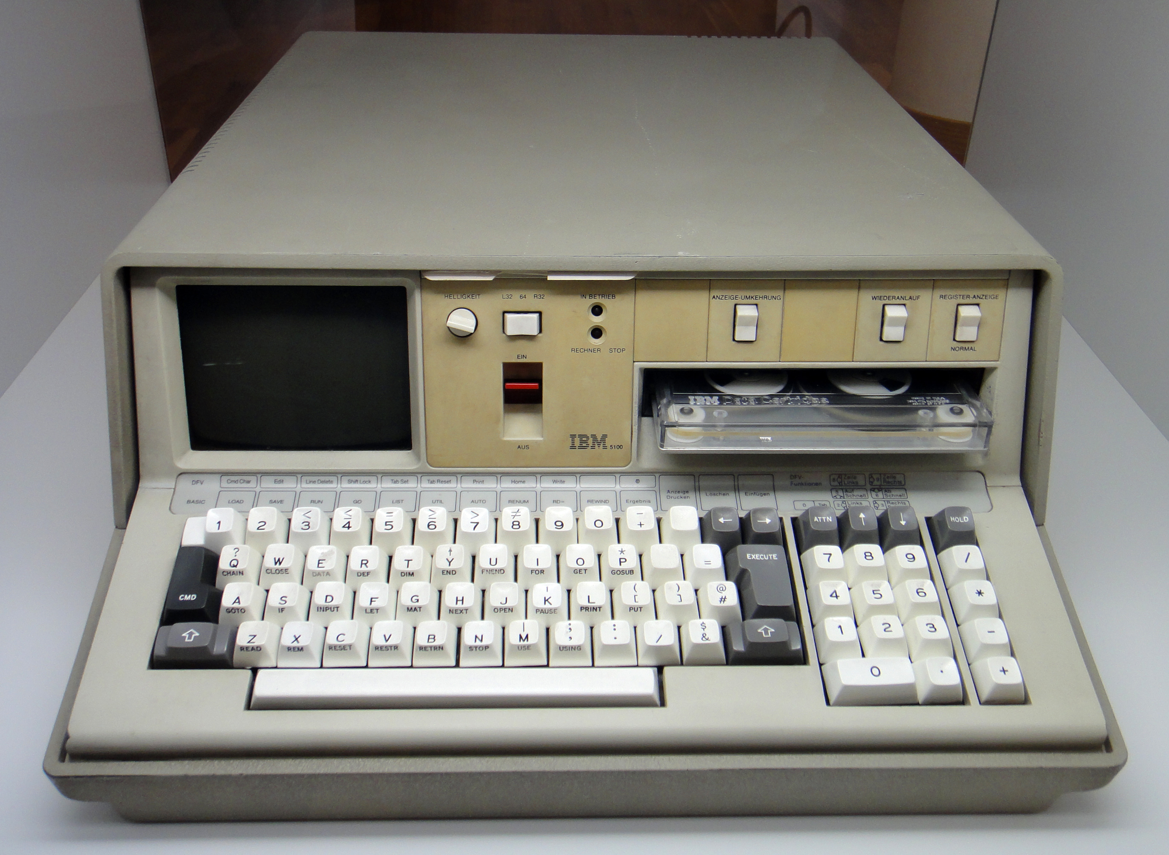
IBM Portable
IBM 5100 - 1975
55 lbs (25 KGs), these were ‘luggable’, not portable
Tiny CRT, not shareable
  Hot and heavy
  Not networked
Based on a niche CPU, not the Intel 8088
Decent capacity
  16-64 KB
  Clock: 1.9MHz
  Removable disc
By ‘Sandstein - Own work’, from Wiki
Notes:
This was my earliest sight of a desktop minicomputer
It was bairly luggable. I only ever saw one, in about 1986
- you could lug it down to your car
- then drive to your place of work (eg. Pering Mine)
- then lug it into your desk place (where the field geologists used it in their meetings together)
It did have good value, considering the alternative (pencil and paper)
The screen is Cathode Ray Tube, not a flat screen
- so, it was heavy. Needed a young man to haul it.
I once watched a colleague come out the lift heading for his car. It looked like Basil of Fawlty Towers might ham up the guests heavy luggage
But it was the precursor of the Personal Computer

Slide 13
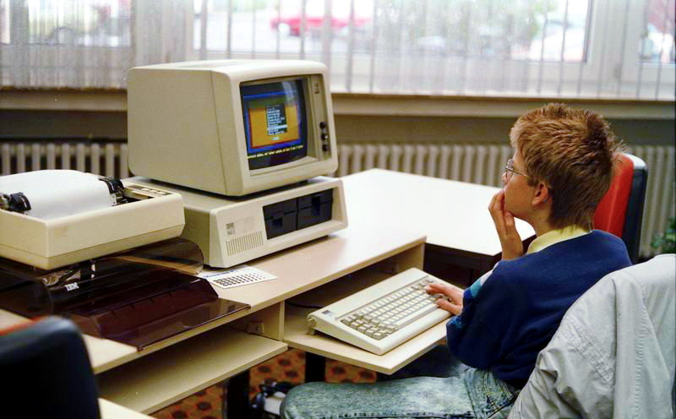
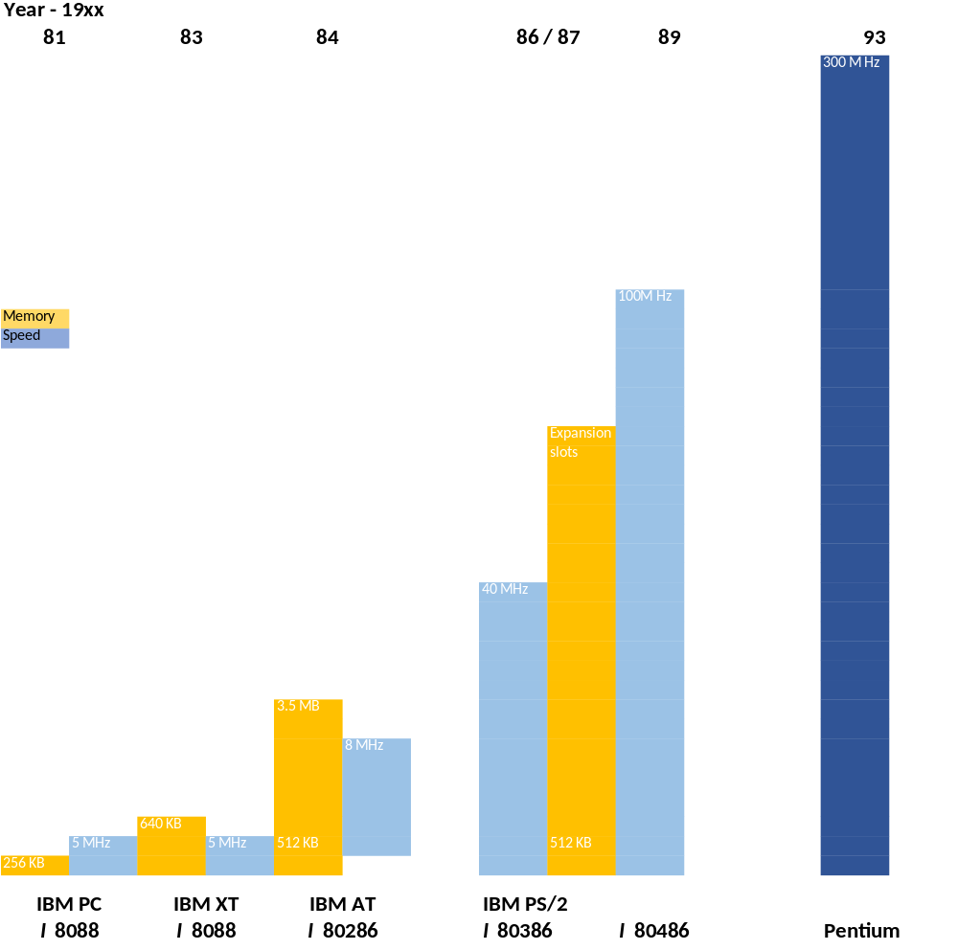
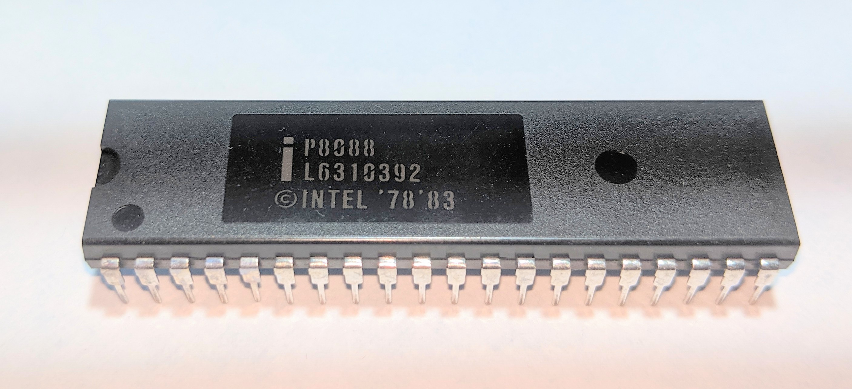
Personal Computers
By Bundesarchiv, from Wiki
….real story: Intel inside
Notes:
Do not try to read the graph, it is not to scale
Do read as far as to see Moore’s Law in operation, memory doubling every 18 months
Also note that the entry point (IBM PC in 1981) was 4 x bigger than my System 3 15D m/c used in 1978
- my System 3 required a suite of rooms, in a controlled environment
- the Personal Computers sat on your desk, did take most of the desk, as you see in the slide
However the real stories, as I show at bottom right, are:
- Intel inside
- IBM left the scene around 1984, after the IBM AT
What is the WOW factor: The ‘Personal Computers’ label is a misnomer. The real value of these workstations came from networking them together in local and wide area networks, using a server, while at the same time having a powerful suite of ‘apps’ on their desk. Eg. Word processors (Wang Laboratories, remember them), and Lotus 1-2-3
For example: the geologists and maintenance mgt of Pering Mine in remote N Transvaal, RSA.
- The geologists could do powerful geo modelling on their desk (no more luggable PC’s) then network their results back to H/O, or consultants at the University of Witwatersrand
- The maint engin could receive stores, update the stock records and interface the invoice to the finance group, in another office. Then they could go www to research the maintenance / repair tasks on their really big, expensive machinery

Slide 14
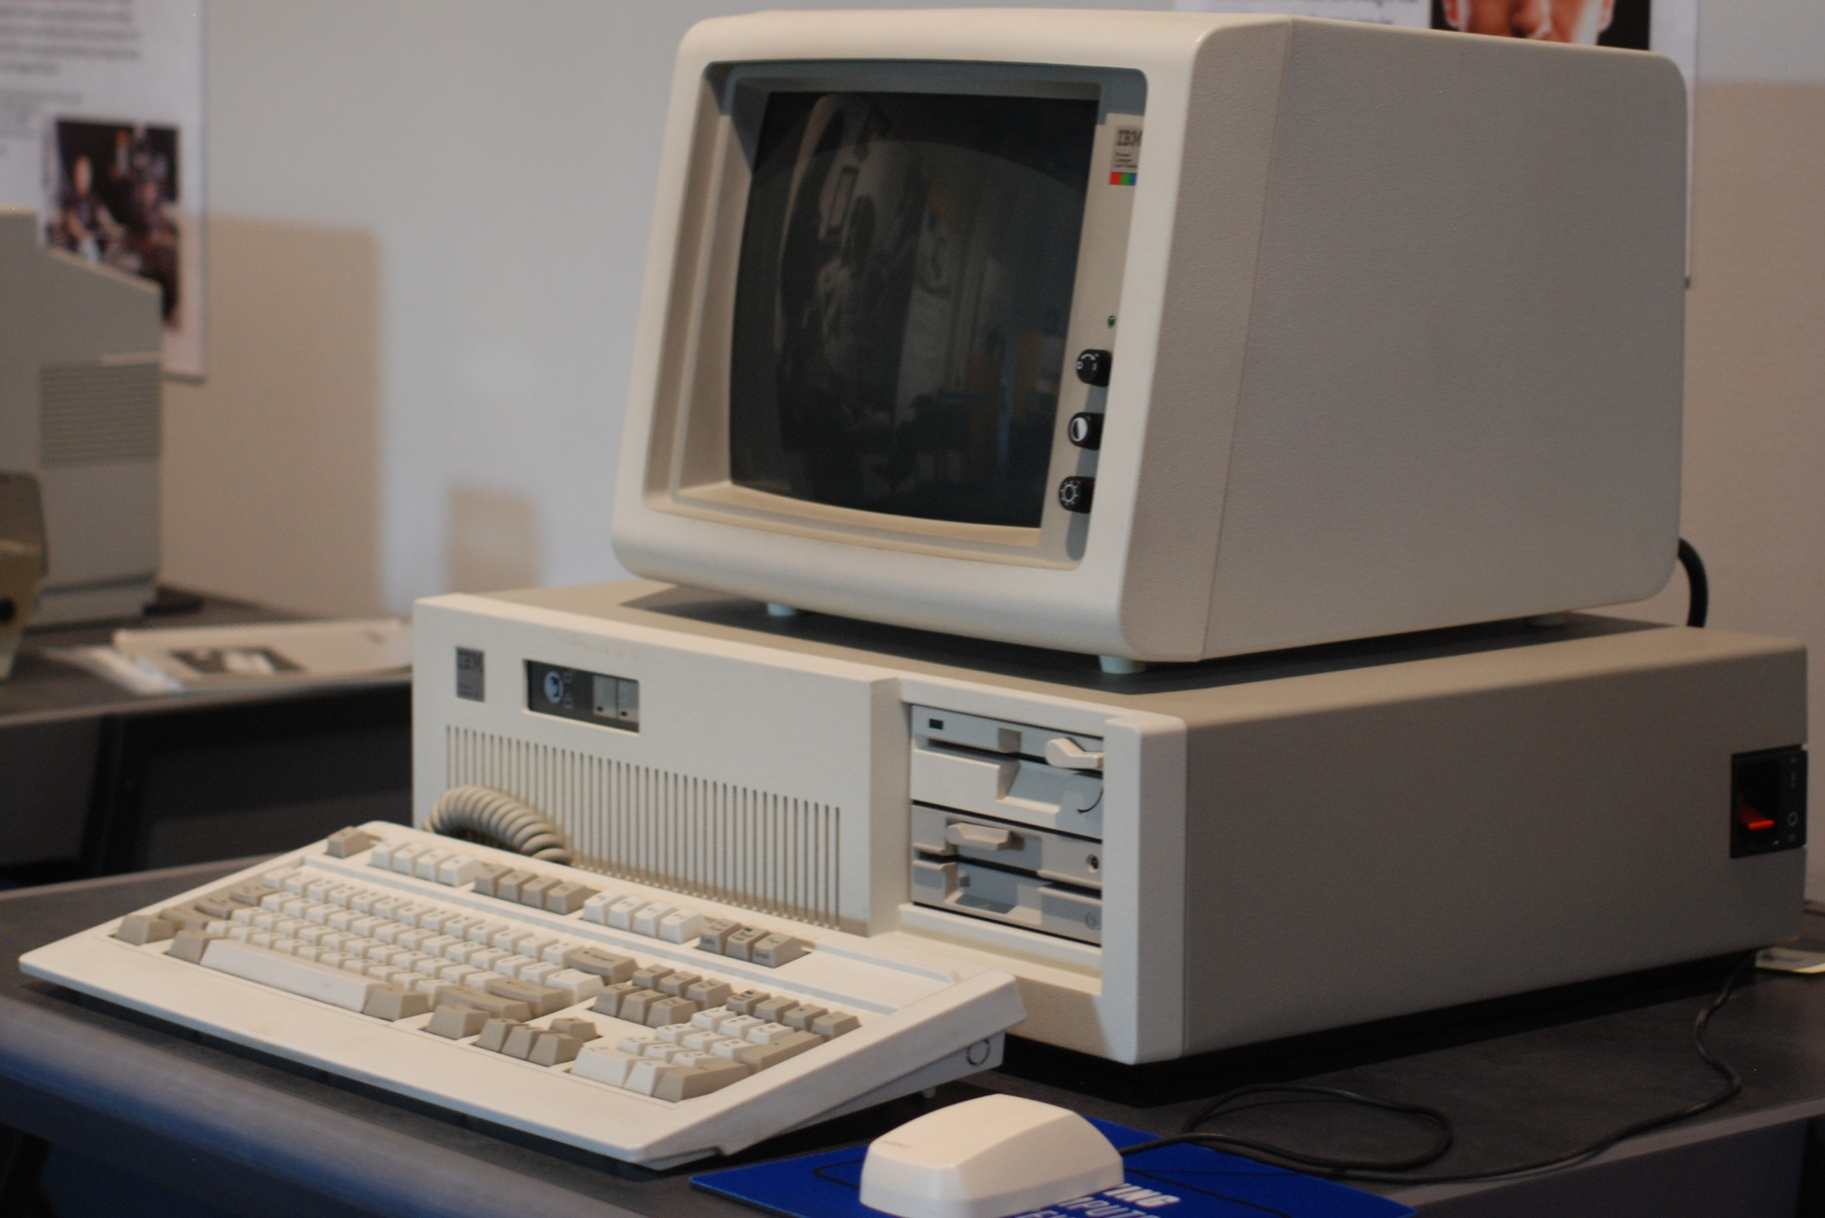
Giving a perspective:
- early ‘70s to the mid ‘80s
- and now
At its smallest, the IBM AT sitting on the System / 3 desk:
- was 8 X larger than the S/3
- it could be expanded to 50 X
The AT was no longer sold by 1987
Mike’s current laptop:
- HP Envy 17
- Memory: 16 GB
- Disc: 175 GB
- Speed: 2.1 MHz
But, really, who cares?
Notes:
@@@@@ fly in 1: the words in left col
@@@@@ fly in 2: the AT
Discuss the AT relative to S/3, using the slide
Discuss that the AT was over in just 4 years
Discuss current PC’s, by using Mike’s PC
Discuss: who really cares, or needs to care?

Slide 15
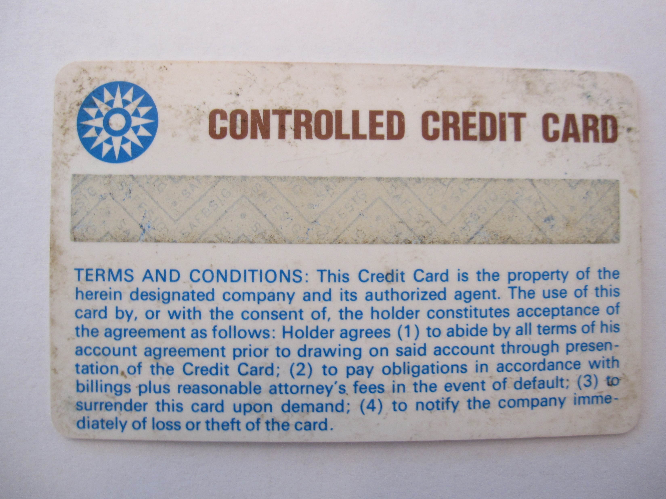

IBM’s impact on bus and consumers
.
From nowhere in the mid 50’s, (at least in the computer industry)
  ……by the 80’s IBM sold 80% of computers in the US and 70% worldwide
From just 30 sales possible in 1955
  …..IBM sold (say) 30K mainframes and 500k mid frames by the end 80’s
IBM inventions significantly changed business and consumer life:
- 69, IBM invented mag stripe cards: Cr / Dr cards, ATM’s
- 74, IBM invented bar-coding:
- Banks needed huge networks, every stockroom needed a terminal
- Cash registers needed to be able to use bar codes and Cr cards
Thru the 70’s every piece in an IBM installation was IBM made
…… however, other companies were making ‘plug compatible’ discs, printers, terminals, network components
….. these were not-core to IBM
Only in hindsight did we realise the watershed of 1982 / 84:
…..Open architecture
…..Distributed Data Processing
…..anti-trust cases
Source: Wiki - search IBM
Notes:
@@@@@ fly in 1:
Discuss growth of IBM, dominance of IBM using slide
By the early 80’s IBM had secured global dominance of the computer industry. However, we were aware of trends:
- Handheld calculators were becoming hugely more sophisticated, built by not IBM (Texas Instruments, Hewlett Packard)
- Customers wanted ever more online processing: terminals were being distributed thru the office space, for data entry and inquiry. That spurred still further the need for on-line update
- Batch processing must be replaced by online architecture, requiring larger memory and processing speed. Fortunately Moores law was in full operation, and capacity could grow fast
- Online terminals were growing more intelligent.
@@@@@ fly in 2: Key IBM inventions,
@@@@@ fly in 3: Cr card picture
Banks needed ATM’s, with huge networks
@@@@@ fly in 4: bar code
@@@@@ fly in 5: bar code picture
@@@@@ fly in 6: discuss impacts on computer indistry
NCR needed to make more intelligent cash registers, each networked
every stockroom needed a terminal, networked, using modems and routers
Discuss germination of innovations: bar codes took 20 years
@@@@@ fly in 7: challenge to OBM monopoly
Discuss using slide
@@@@@ fly in 8: in hindsight
It was only in hindsight that we realised what a watershed was the moment around 1984:
- the computer industry wanted open architecture, where products that were not IBM were able to be hosted on IBM mainframes, used in the network
- the rapid growth of demand for computing suggested that many nodes needed to work together in a network, rather than to one ever more massive hub. IBM called this Distributed Data Processing
- 69, US brought a of violation of Anti-trust Law. IBM unbundled software & services: US case dropped as without merit
IBM began to open its architecture to other suppliers, and began to divest itself of components not seen as core. These divestments were the ‘baby blues’: suppliers of discs, network components, printers, terminals
In early 80’s gave PC operating system contract to a fledgling company: Microsoft - and to use Intel Microprocessors in the IBM PC’s

Slide 16
IBM into the future
IBM remains the largest industrial research organization in the world,
…..and held the record for most annual U.S. patents for 29 consecutive years from 1993 to 2021.
IBM's market capitalization was valued at over $167B as of 2023
…..49th Fortune 500 rankings of the largest US corporations
…..though revenue and ee’s down 40% over last 10 years
…..now ‘only’ 290,000 employees
The competitors, from before ‘84:
  Burroughs acquired Sperry, became Unisys, now a software, consulting business. M/cap: $0.5B
  NCR quit computers, back to cash registers
  ICL acquired by Fujitsu: m/cap $32B.
What happened to the ‘Baby Blues’ / other suppliers?
Microsoft: Founded ‘75. M/cap $3.1T
Intel. Founded ’68, still going. M/cap: $180B
Lenovo. Founded ‘84, bought IBM PC. Still going. Chinese. Revenue $70B. Est m/cap $13B
Cisco. Founded ‘84, still going. M/cap: $202B
Dell. Founded ’84, still going. F/500: 71. M/cap: $60B
DEC. Founded 60’s, defunct ‘98. Acquired by Compaq for $9.6B
Compaq. Founded 1982, defunct 2002. Acquired by HP.
HP. Founded ’68, still going, not so strong. M/cap: $20B. Have made poor investments.
Hitachi and Siemens, both industrial giants, quit computers
Source: Wiki - search M’soft, Cisco, Intel, DEC, Compaq, HP, etc
Notes:
@@@@@ fly in 1: IBM research
@@@@@ fly in 2: IBM as a global ‘big co’
Discuss:
IBM began to open its architecture to other suppliers, and began to divest itself of components not seen as core. These divestments were the ‘baby blues’: suppliers of discs, network components, printers, terminals
@@@@@ fly in 3: what happened
So what happened to the competition, and to the ‘Baby Blues’ that acquired divestments from IBM?
Microsoft: In ‘80’s IBM awarded M/soft the role of developing their PC operating system: Bill gates called it the ‘disc operating system’ or ‘MS/dos’. In the 80’s we bought numbers of dos manuals. M/soft adopted the windows logo, and developed really many more versions of the operating system, up to Windows 11, and developed M/soft Office: word, excel, powerpoint. The rest is history
Though remember: IBM made M/soft.
@@@@@ fly in 4: intel
Intel became the bedrock to the desktop / laptop business. Faced strong competition from Japan, then Taiwan. Now re-growing again.
@@@@@ fly in 5: Lenovo
Lenovo acquired IBM’s PC business. Still going, but as a Chinese co, the relationship with the west is ‘cloudy’. I suggest is outside the F/500
@@@@@ fly in 6: Cisco
Cisco got into the network hardware, servers, data farms. Has done very well
@@@@@ Fly in 7: Dell, Dec, Compaq
Dell was very common in my UK experience, now less so, but still going. Seems really big in US and Texas.
DEC fell into COMPAQ fell into HP, and have experienced bad times, reflecting a rather low m/cap.
@@@@@ fly in 8: HP
@@@@@ fly in 9: Japan
For a time I thought Hitachi and Fujitsu would be the coming wave, but not so. Fujitsu were IBM clones and have not become giants. Dell, now not well known (my view), are 2 x Fujitsu.
Hitachi is an Industrial giant, but selected to quit computers. Siemens, another industrial giant, tried to enter the computer business, but also quit their computer business, their piece falling into Fujitsu.
@@@@@ fly in 10: old guard
The competition that I knew in the 80’s (ICL, Burroughs, Sperry, NCR) were starved of market by IBM. Remnants of Burroughs and Sperry continue as Unisys with a m/cap of only $500M as a s/ware and consulting business.
@@@@@ fly in NCR
NCR returned to their cash register business.
@@@@@ fly in ICL
As we know, ICL fell into Fujitsu.

