Slide 1
Microsoft Will End Support for Windows 10 in 2025
What should I do about that?

Slide 2
Windows 10 End-of-Life
Microsoft will cease to support Windows 10 Home and Pro on 14th October 2025
You can continue to use Windows 10 after that date, but your PC will become increasingly vulnerable to various security risks
Upgrade your PC to Windows 11 if possible - see www.microsoft.com/en-gb/windows/get-windows-11

Slide 3
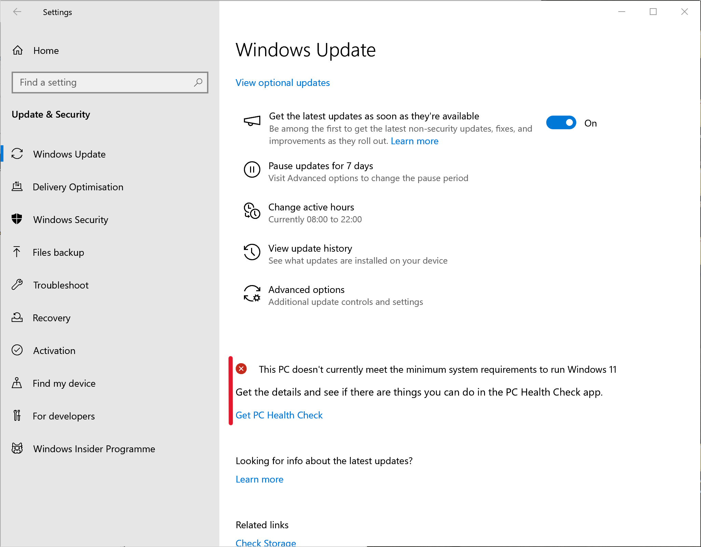

Slide 4
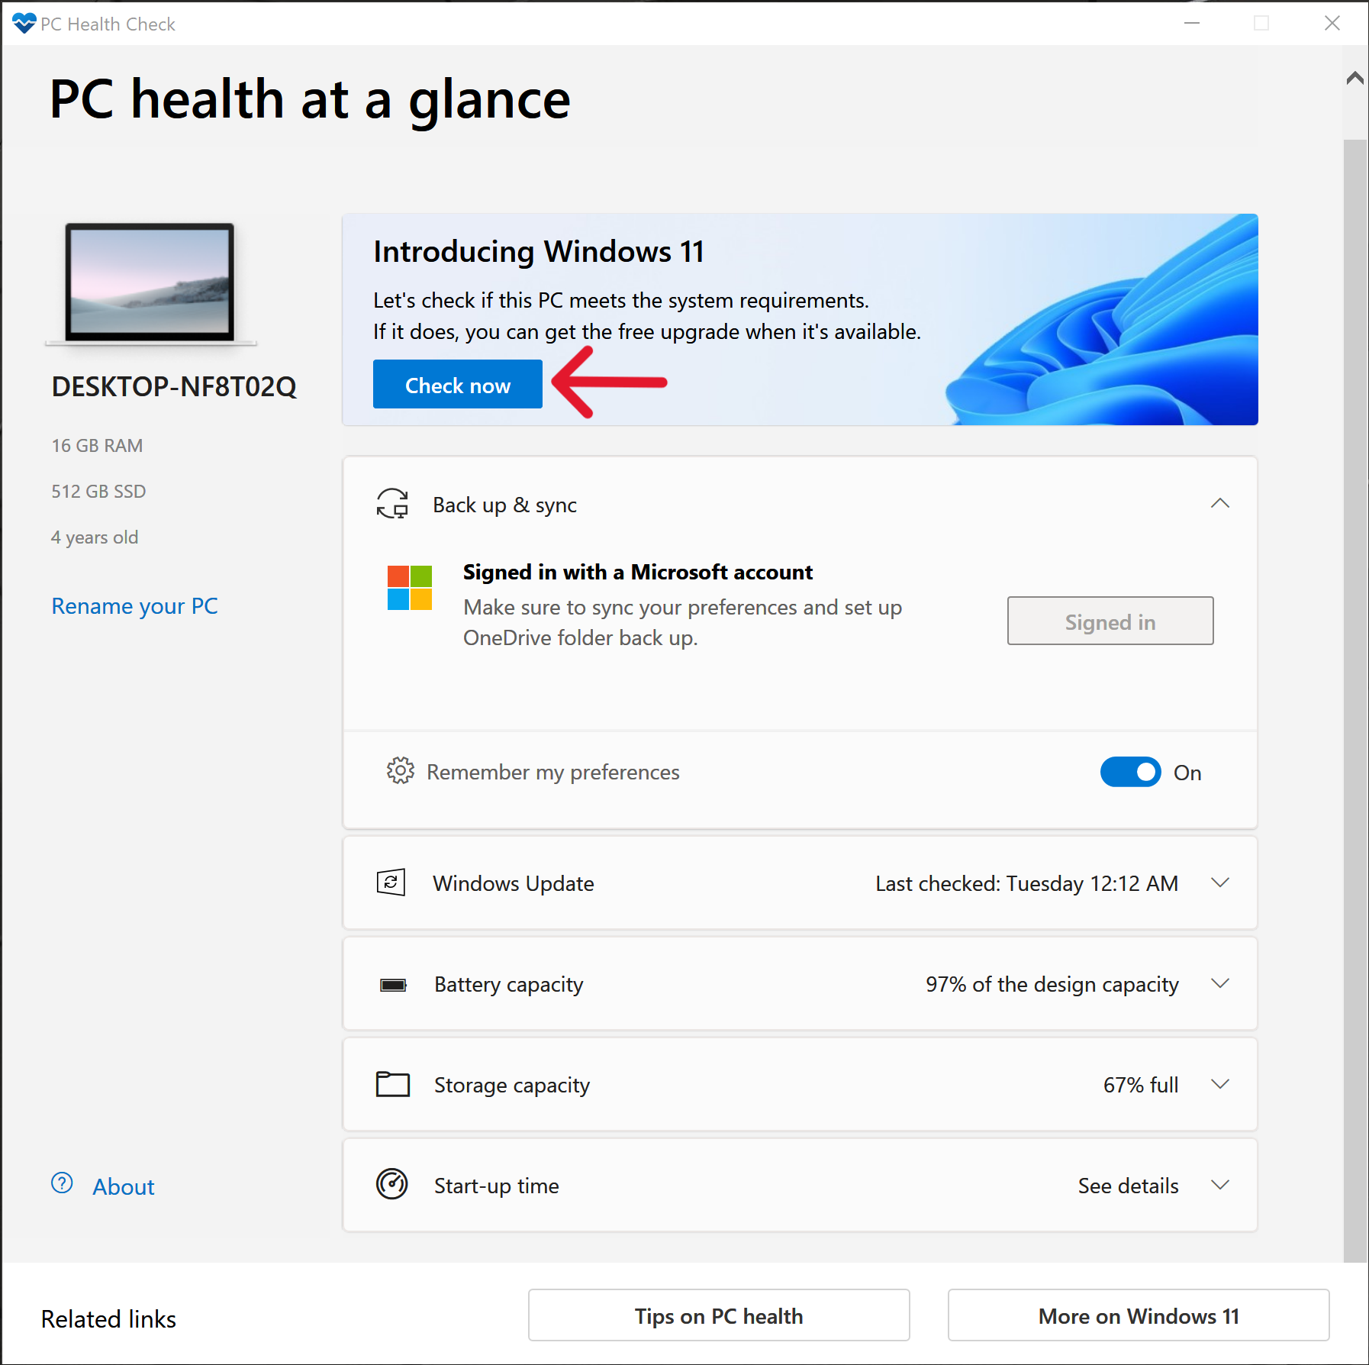

Slide 5
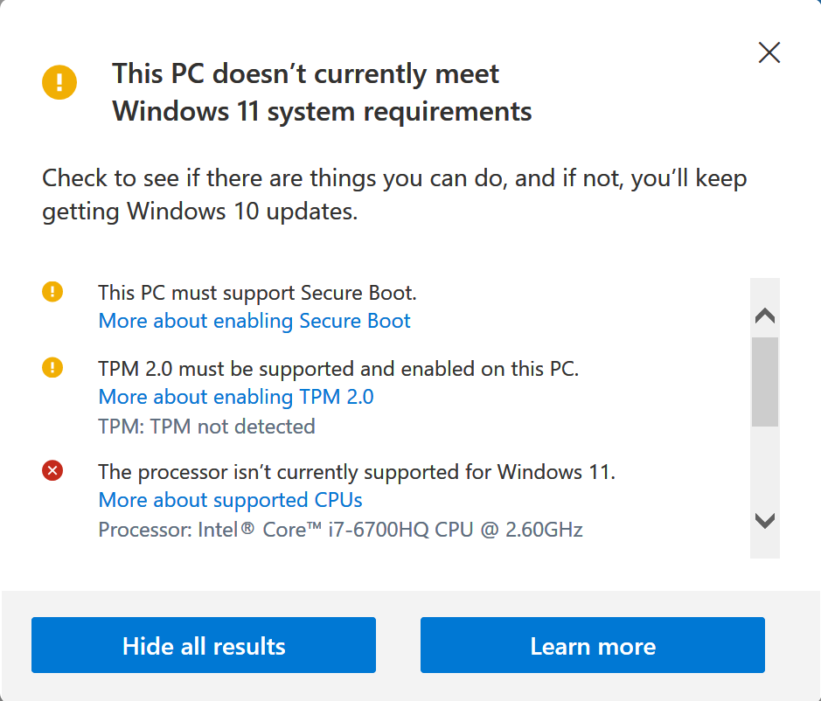

Slide 6
My PC Doesn’t Meet Windows 11 Requirements.
What Are My Options?
Depends on your preferences and how far short of the min. requirements your PC falls...
1: Buy a new PC
2: Try some work-arounds
3: Switch to an alternative OS

Slide 7
A New PC
Safest & most comfortable outcome for many users
Will cost ~£200 upwards
Need to transfer across your data, online accounts, licences, email accounts & configuration info as described in Geoff’s Feb ‘24 presentation on reinstalling Windows 10
But perhaps you’d rather not be forced to splash out on a new PC when your existing one is working fine?

Slide 8
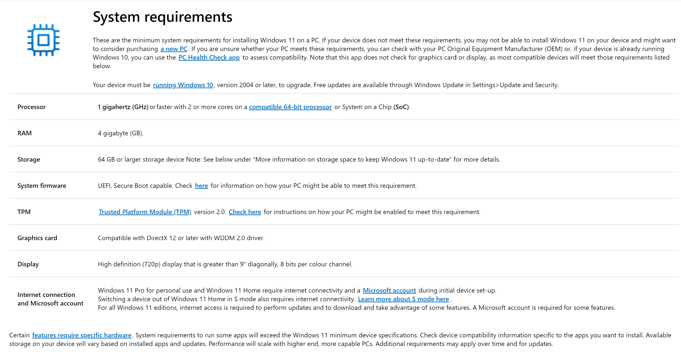

Slide 9
A Few Tweaks
Secure Boot may be available on your PC but has not been enabled in UEFI
If your PC has a TPM 1.2 then Microsoft provide a registry hack to work around this and the CPU requirements
There’s a good walk-through on How-To Geeks webpage ‘How to Install Win 11 on an Unsupported PC’

Slide 10
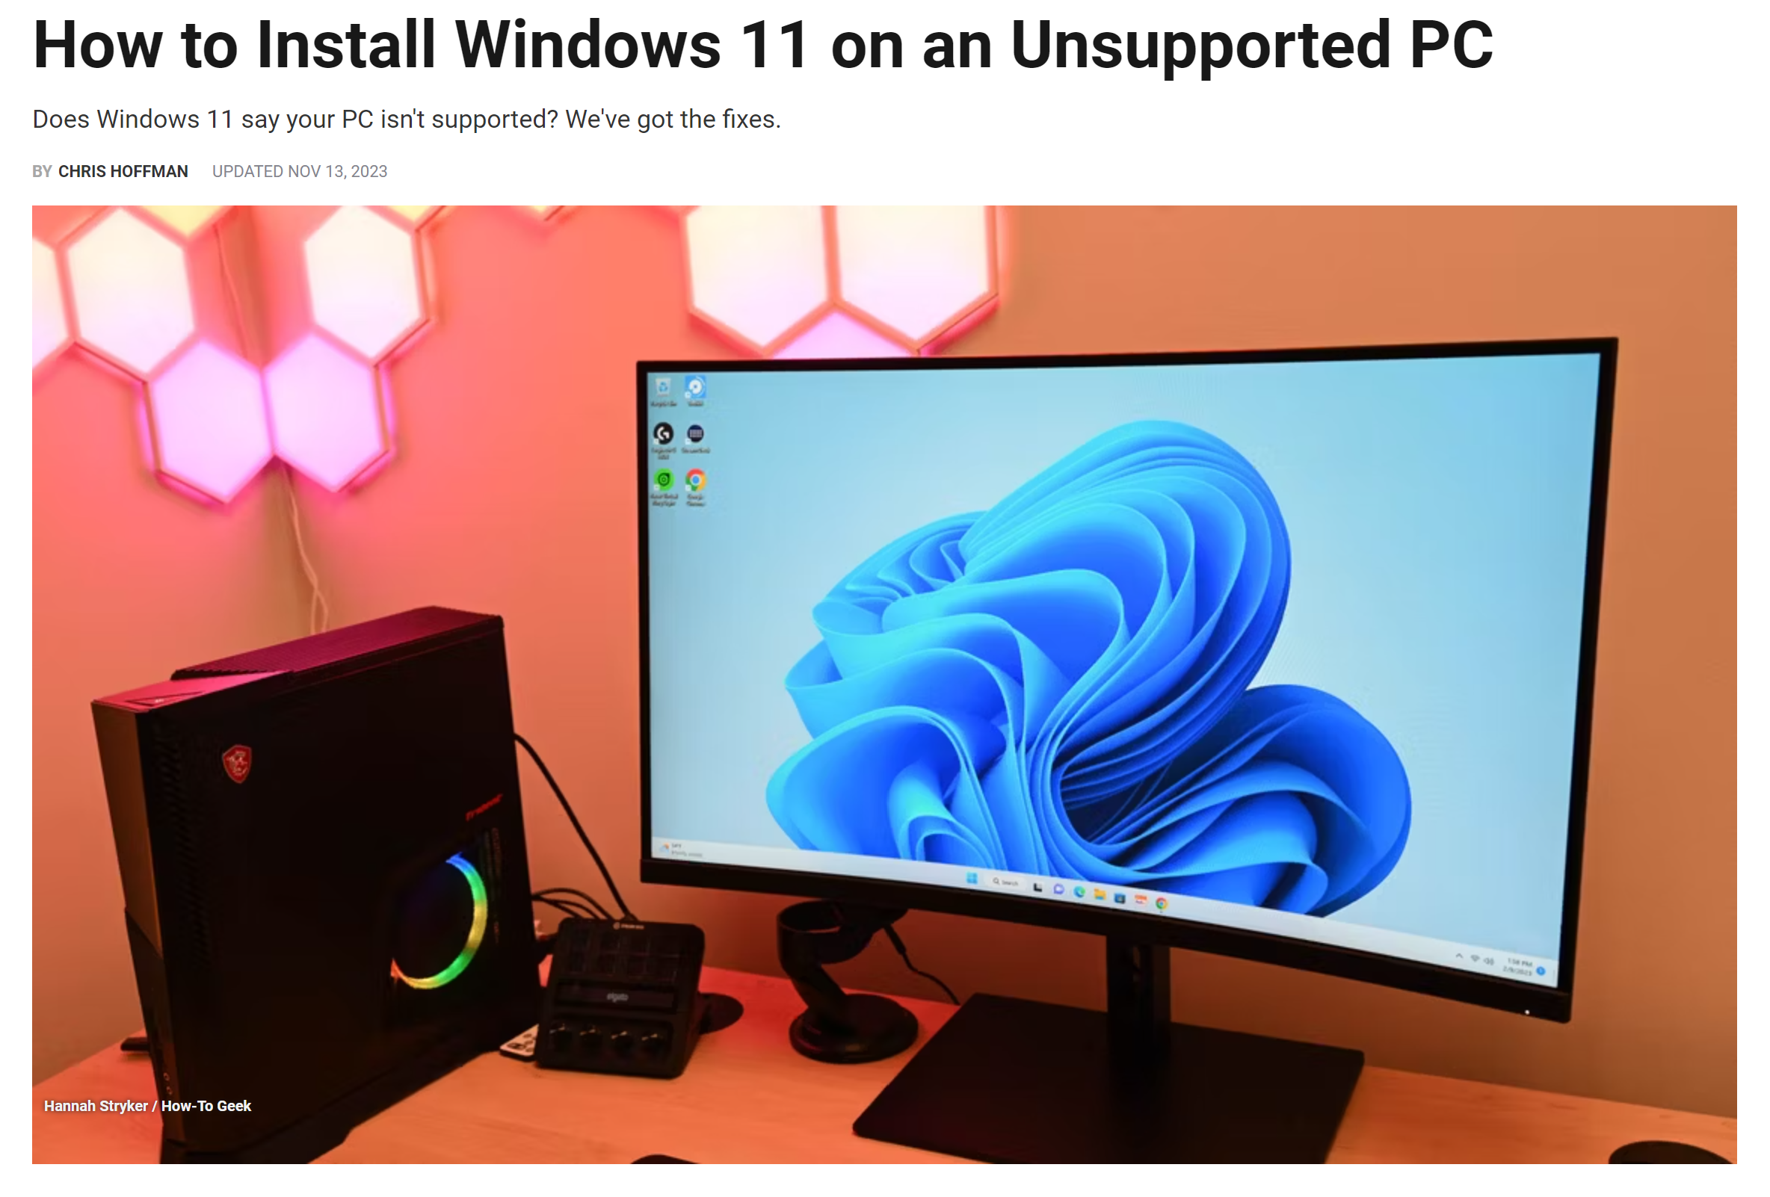

Slide 11
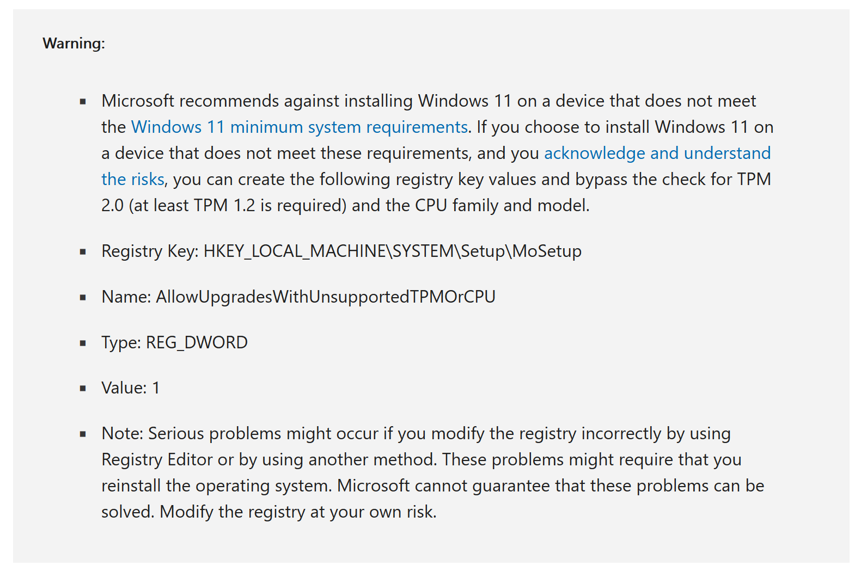

Slide 12
Try Something Different?
If your PC has no TPM then Win 11 isn’t going to work
You can try out ChromeOS Flex and some Linux distros from a live boot USB without affecting your PC
ChromeOS has some limitations with hardware compatibility and requires a Google account
My favourite Linux distro is Ubuntu – open source, cross-platform, widely used & supported, free, secure...

Slide 13
What Do I Need to Make a Live Boot USB?
A USB 3.0 memory stick – 16GB will be fine
A downloaded image of the OS you’d like to try out
A computer running Windows or Linux
Some software to flash the image to the USB stick

Slide 14


Slide 15
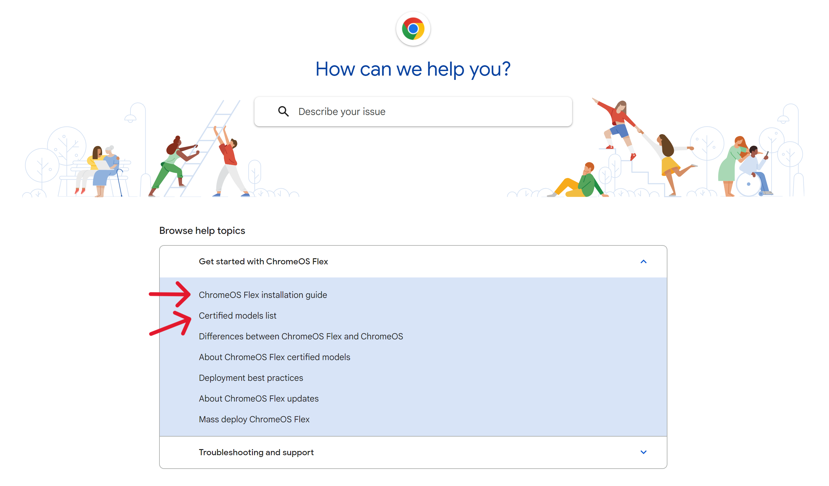
ChromeOS Flex Help page:
Follow USB creation steps given here

Slide 16
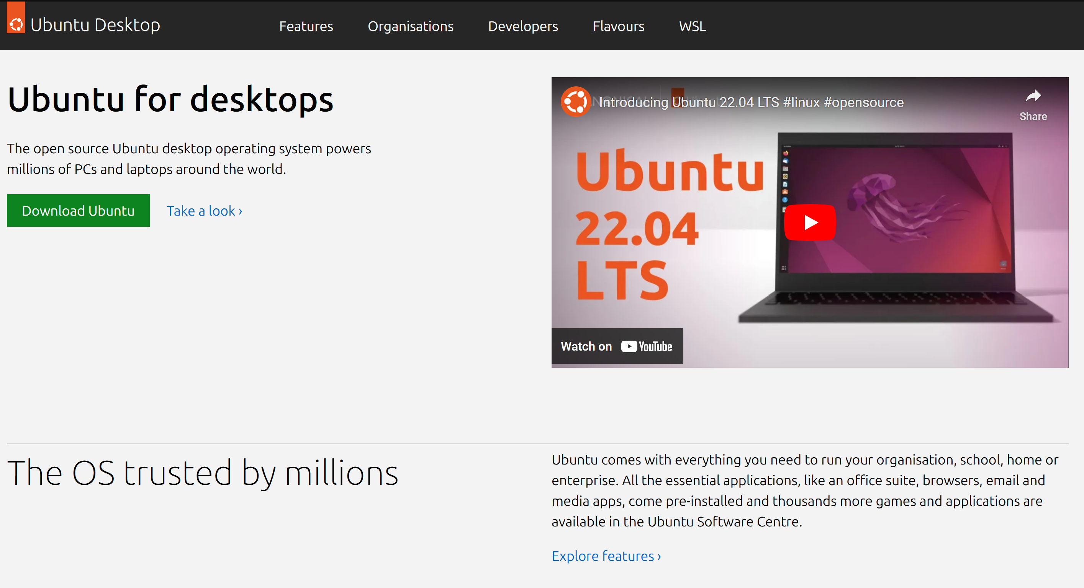

Slide 17
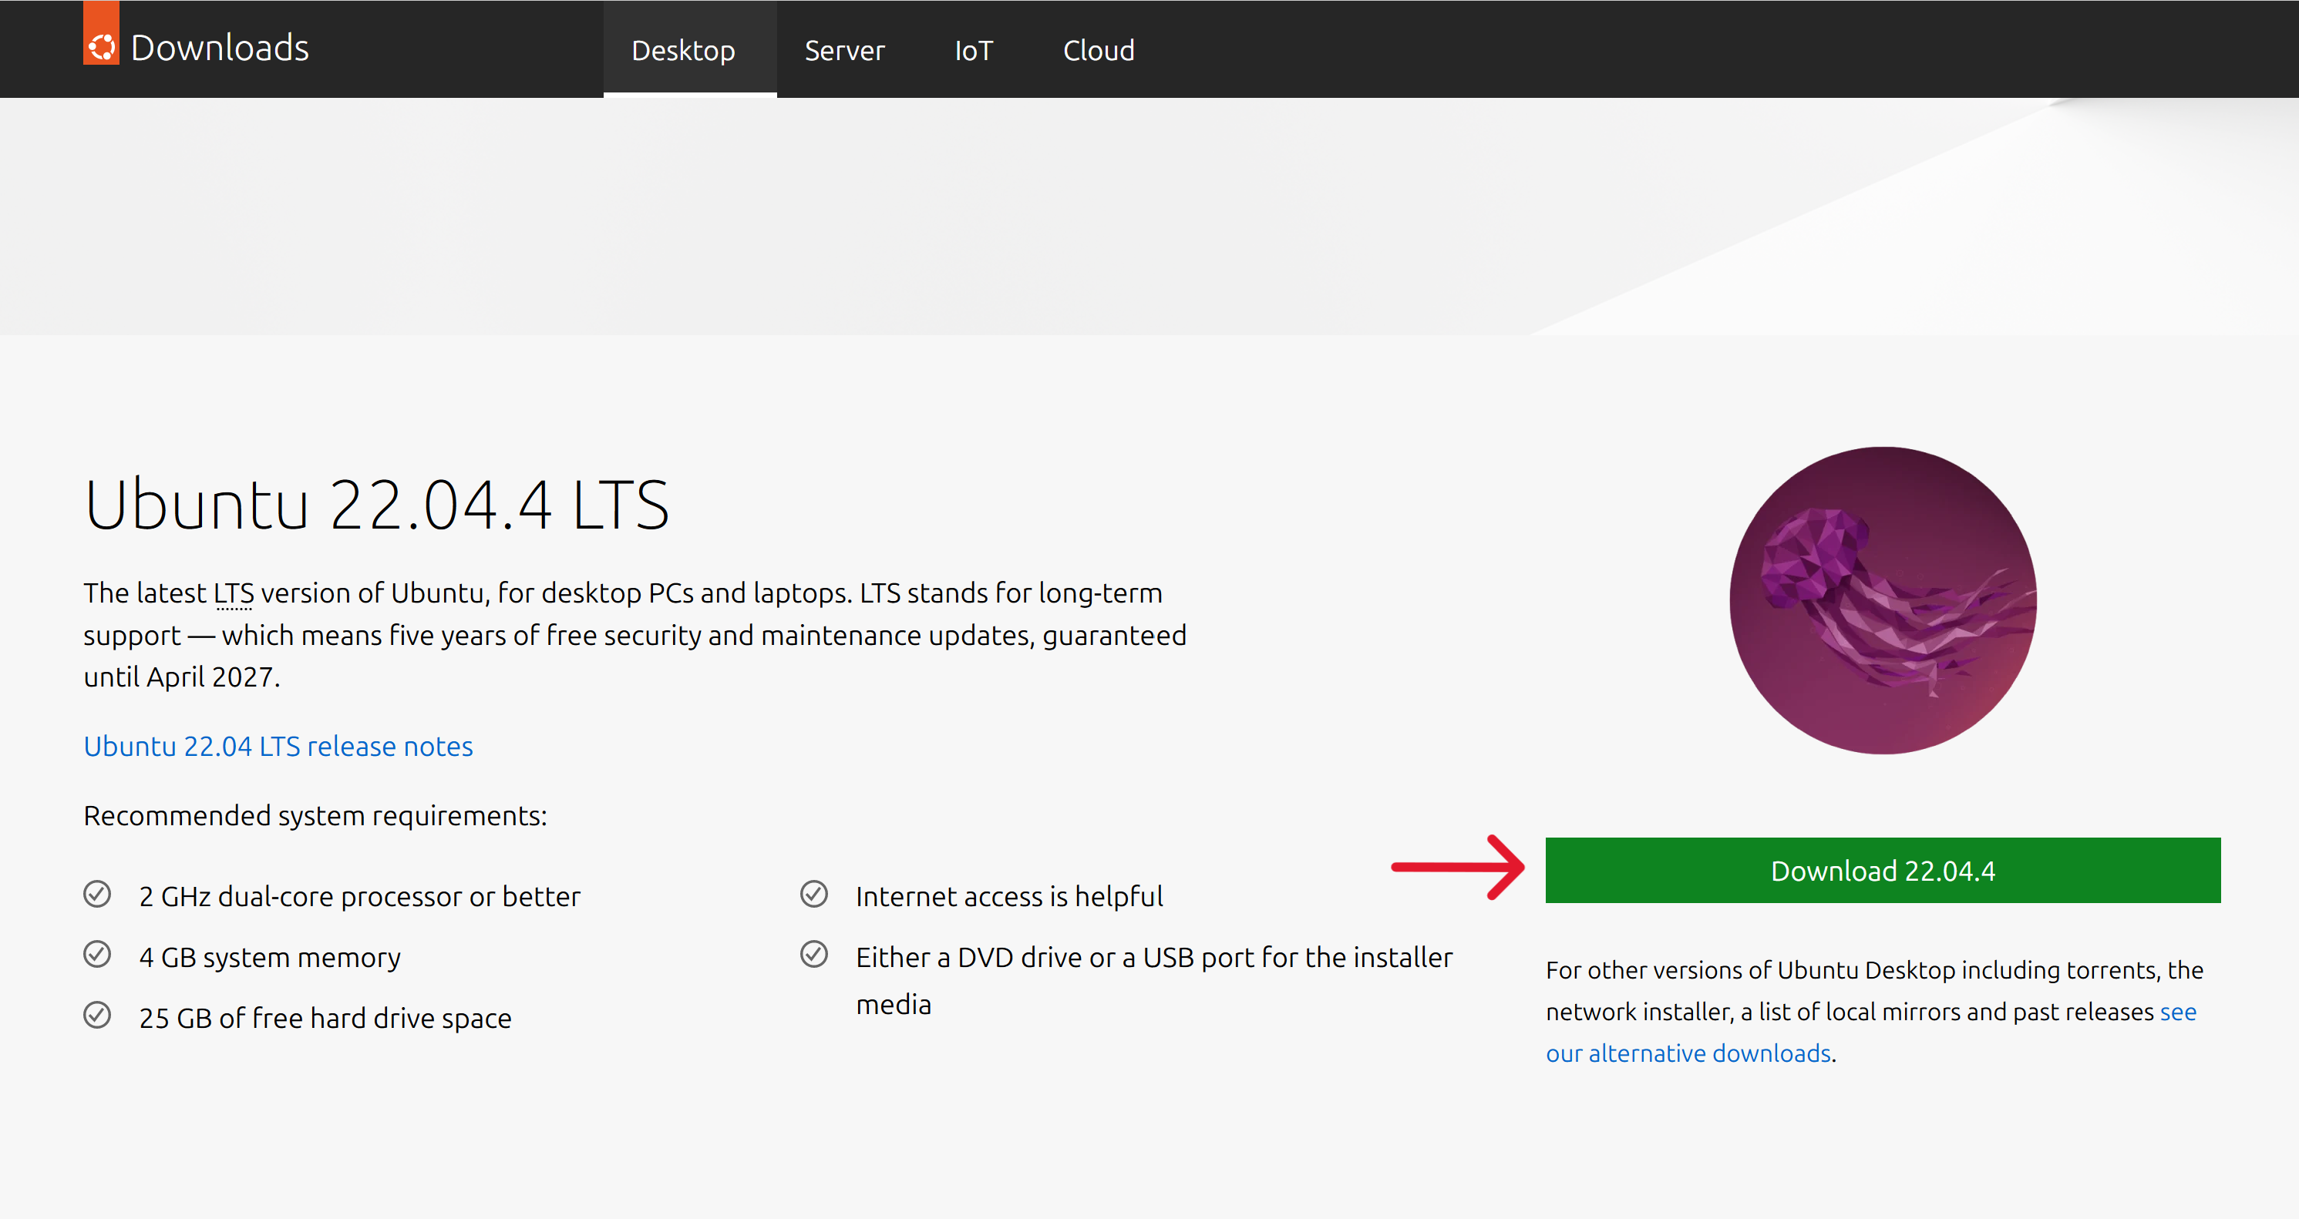

Slide 18
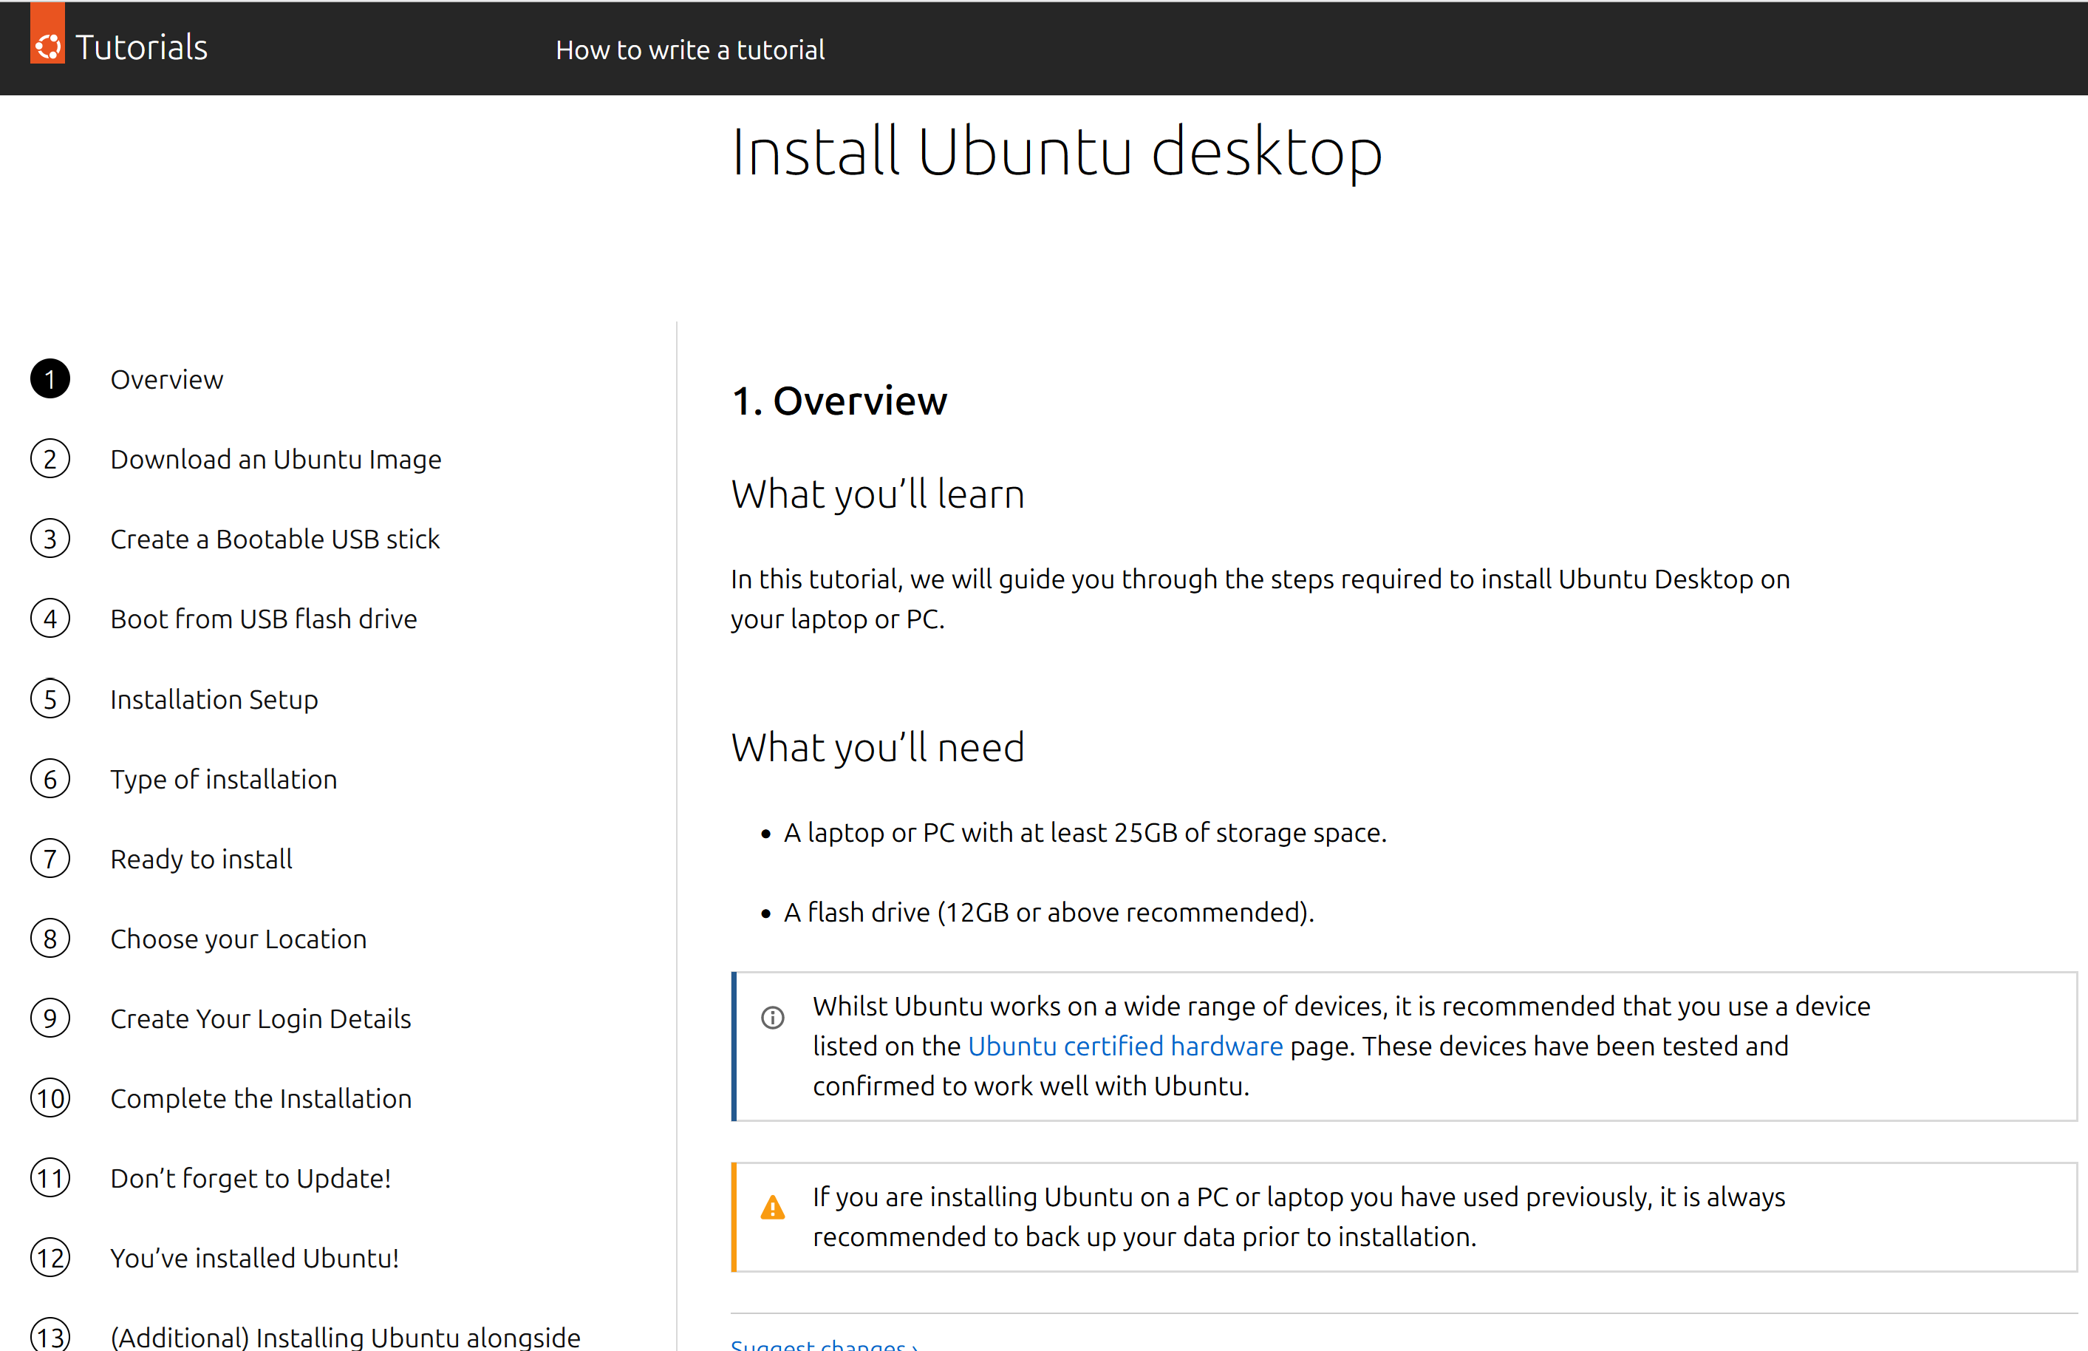

Slide 19
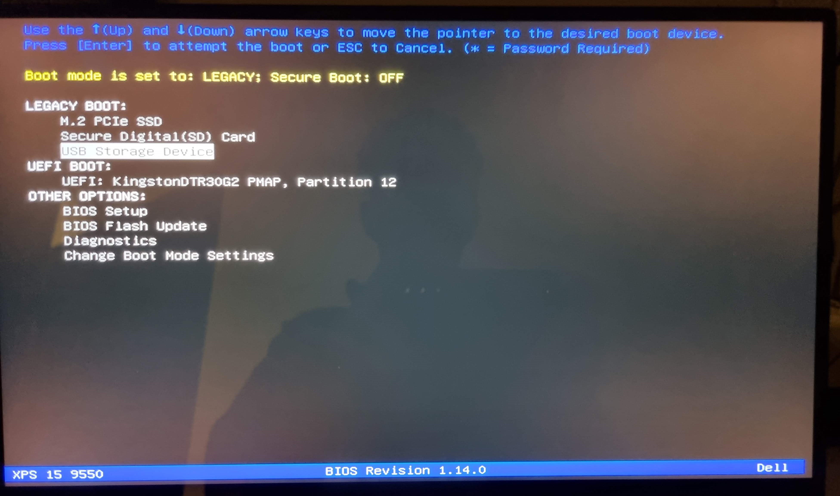

Slide 20
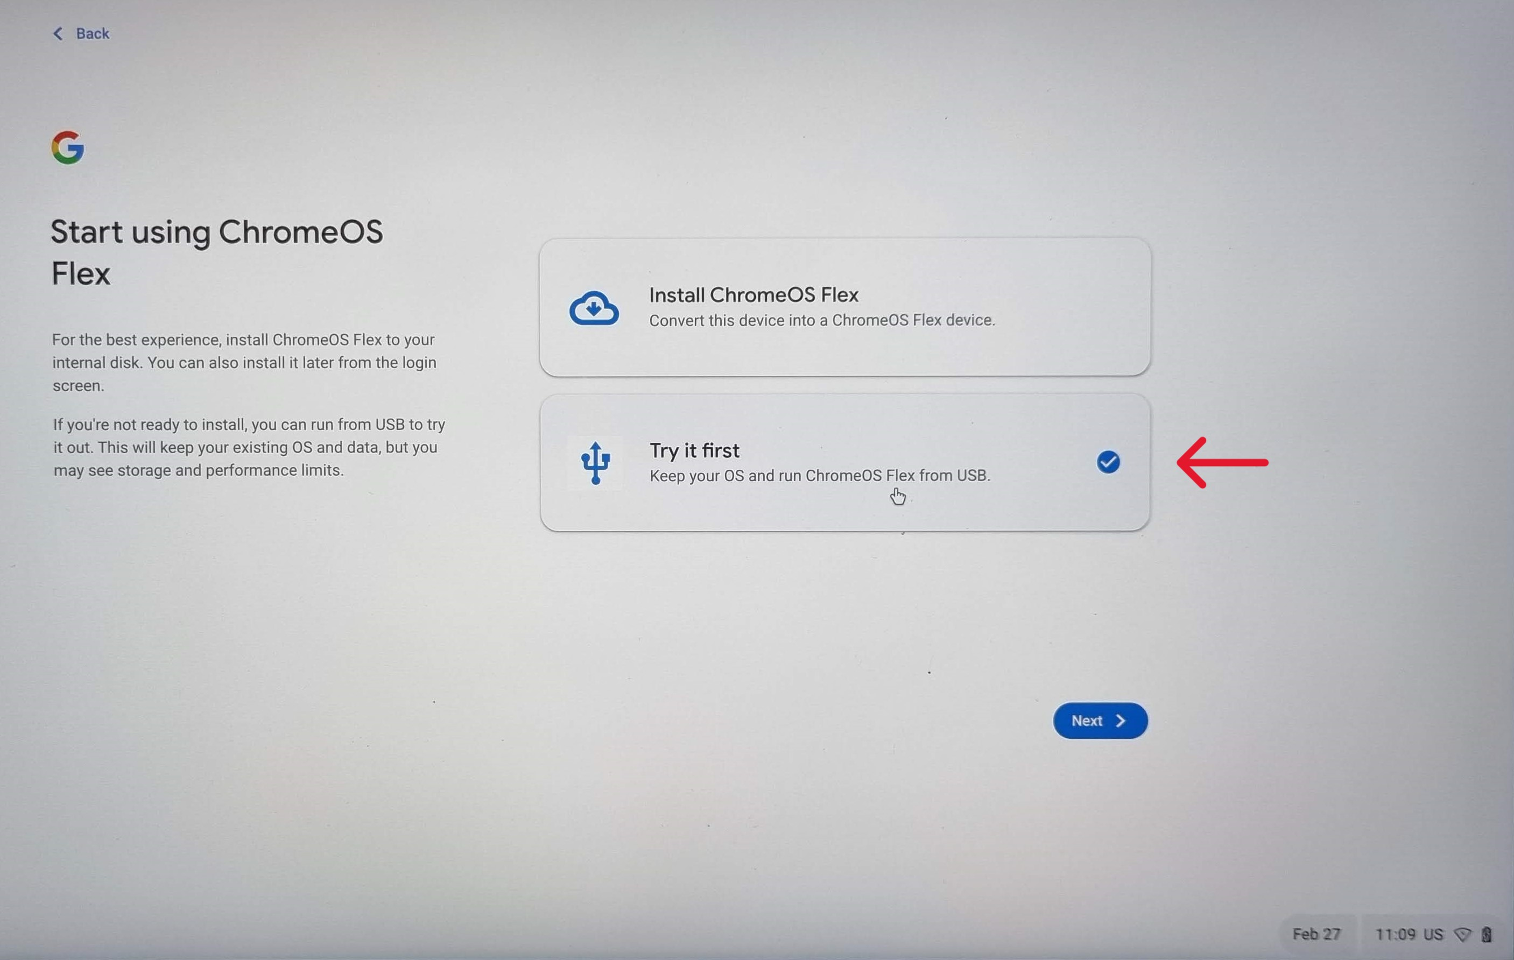

Slide 21
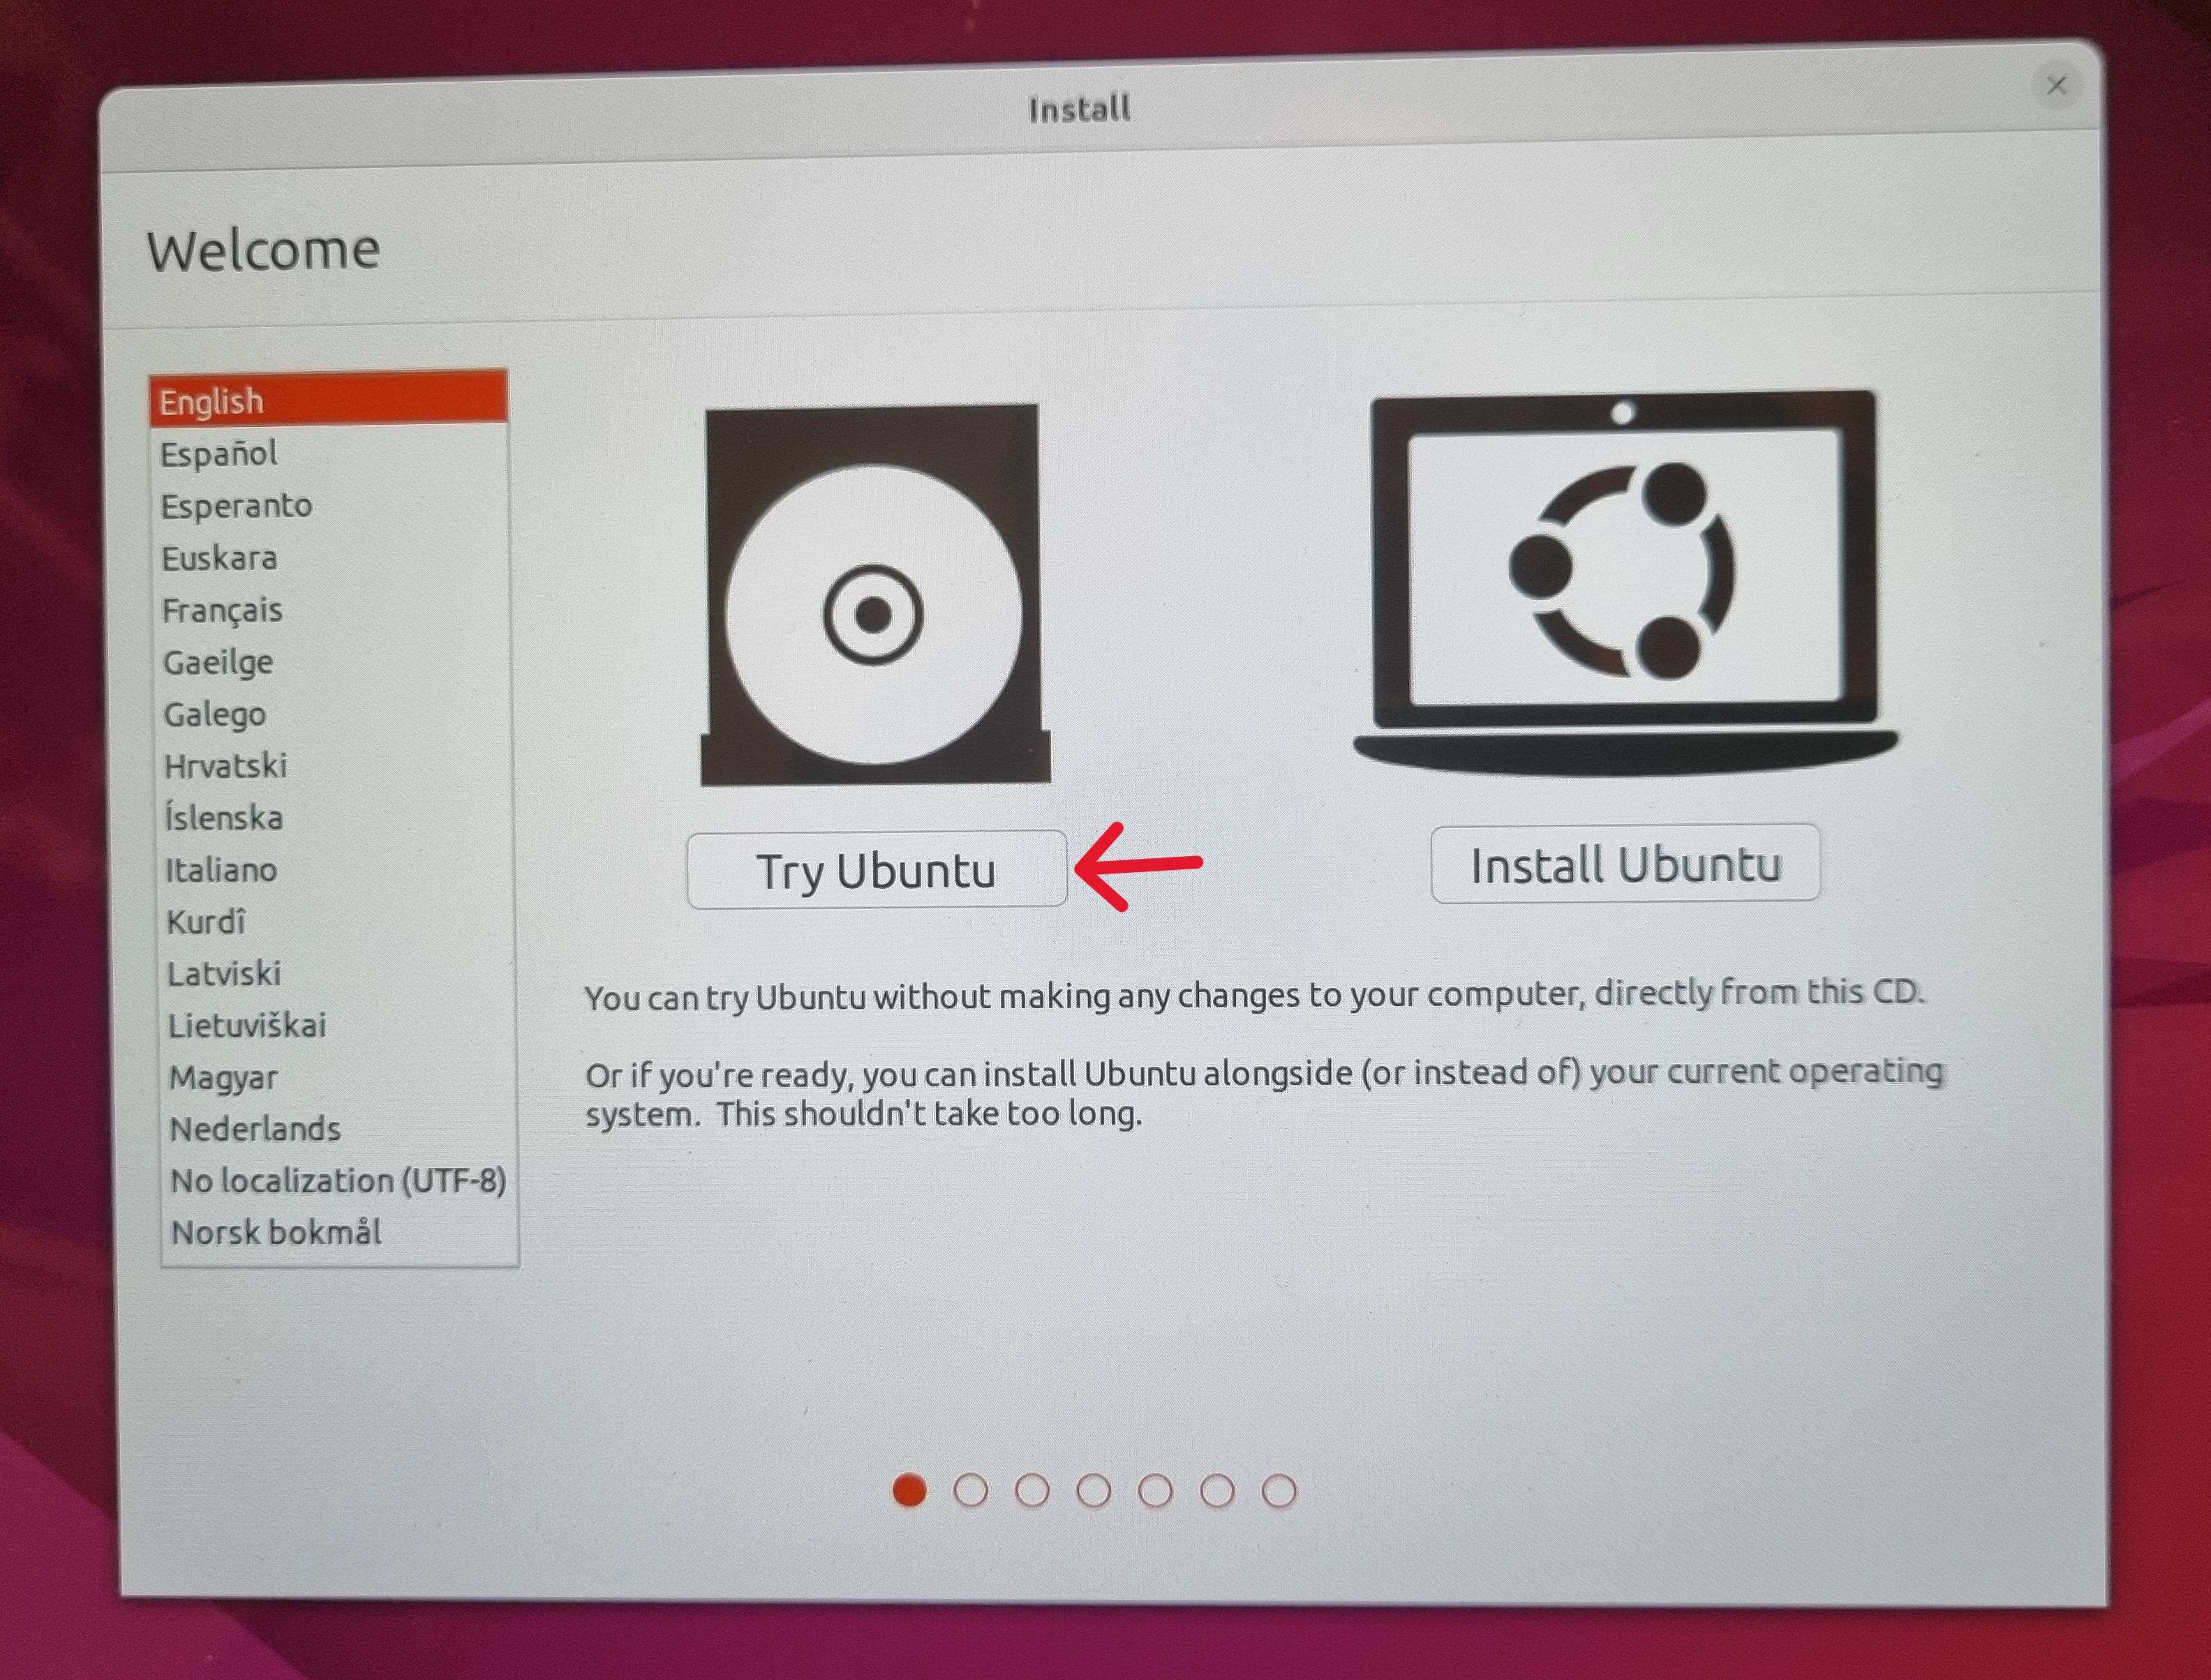

Slide 22
Before You Update or Upgrade
Please back up all your data etc, preferably in more than 1 location, and check you can access all the backed-up files without encountering any errors.
USB sticks and external drives can fail!

Slide 23


And Finally:
If you wish to dispose of your old PC or laptop, please consider donating it to charity – see slide ‘Resources 3’
Otherwise take it to your nearest Household Recycling Centre

Slide 24
Resources 1 – Upgrade to Win 11
How to Get Windows 11:
https://www.microsoft.com/en-gb/windows/get-windows-11
Windows 11 Computer Requirements:
https://www.microsoft.com/en-gb/windows/windows-11-specifications
Get number of CPU cores from Task Manager > Performance > CPU or use Speccy app
How to Install Win 11 on an Unsupported PC:
https://www.howtogeek.com/759925/how-to-install-windows-11-on-an-unsupported-pc/

Slide 25
Resources 2 – Alternative OS
ChromeOS Flex:
https://chromeenterprise.google/os/chromeosflex/
ChromeOS Flex Help:
https://support.google.com/chromeosflex#topic=11618314
Ubuntu Linux:
https://ubuntu.com/download/desktop
Install Ubuntu Desktop Tutorial:
https://ubuntu.com/tutorials/install-ubuntu-desktop#1-overview

Slide 26
Resources 3 – Donation
Air Ambulance Service:
https://theairambulanceservice.org.uk/ways-to-give/reuse-recycle/donating-laptops-computers-to-charity/
Turing Trust:
https://turingtrust.co.uk/give-computers/give-computers-individuals/
End Laptop Poverty:
https://endlaptoppoverty.org/

