Slide 1

Viewing my Photographs
Geoff Lane
21 Jan 2025

Slide 2


An alternative view to:
_{Google Photos}
_{Apple Photos}
_{Windows Explorer &}
_{MS Photos}
Notes:
We’re not talking full on professional editors; Adobe photoshop and the like. We are talking about viewing your photos.
Frustrating for Win Explorer is that it takes forever to load the thumbnails – if they load at all if you have folders of many many files.
So what do we want in a Photo Viewer?

Slide 3

Things to Consider
Things to consider:​​
Time to load – How quick is it?
Intuitive and easy-to-navigate interface
Cropping, Rotation, Batch Processing
Simple edit tools: Brightness Contrast
& Saturation adjustments
Slideshow,
Map Integration
Face recognition
Metadata Management
Support for RAW files
Notes:
Things to consider.
Lets look at somealternatives.

Slide 4







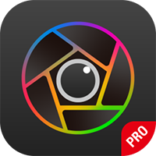


Some alternatives
Faststone
IrfanView
XNView MP
digiKam
PhotoPrism
qView
WidsMob Viewer
Endless Slideshow Screensaver
Notes:
If you do a Google search for “Top Ten Photo Viewers” all these regularly appear in the results. I’ve added the Screen saver at the end myself.
The first three are good basic viewers, anyone could be a good replacement for you.
Four & Five do a bit more
And I didn’t really rate the last two….😒
FastStone Image Viewer: Known for its speed and ease of use, with features like batch processing and slideshows.
IrfanView: A lightweight and powerful image viewer with extensive features.
XnView MP: Offers a wide range of editing tools and supports many file formats.
digiKam: A comprehensive photo management application with advanced editing capabilities.
PhotoPrism: A self-hosted photo management tool that integrates with cloud storage and offers slideshows.
qView – only view pictures that you select. No editing tools.
WIdsMob Viewer. One of a family from the WidsMob team. WidsMob Montage, Retoucher, Image Convert, HDR, Portrait, Panorama and so on. They reckon the viewer is “Superfast”
Endless Slideshow – I love this – I bought the forever licence.
Others
ImageGlass 9 - Photoviewer Free Trail - £8.39 to buy. From the Microsoft Store
123 Photos - also from the Microsfot Store - Very bad, "Free" trial but you need to put subscription details in up front - then you can't cancel from the app

Slide 5

Faststone
Classis design & layout.
Resize, slideshow.
Photo editor: Crop, Red-eye, clone & heal.
Colour Adjustments: levels, curves, sharpen/blur,greyscale etc
Effects: Borders, watermarks, Lens, Oil Painting etc
Batch processing & file conversion
​

Slide 6
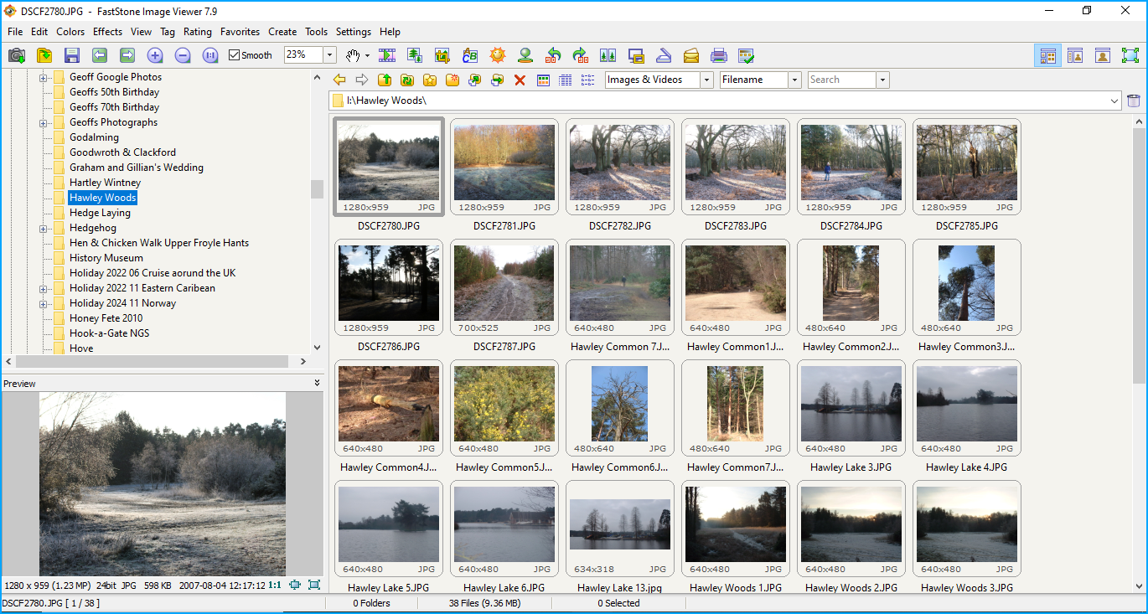
Faststone
Notes:
My business friend in Lampeter uses this and loves it.

Slide 7
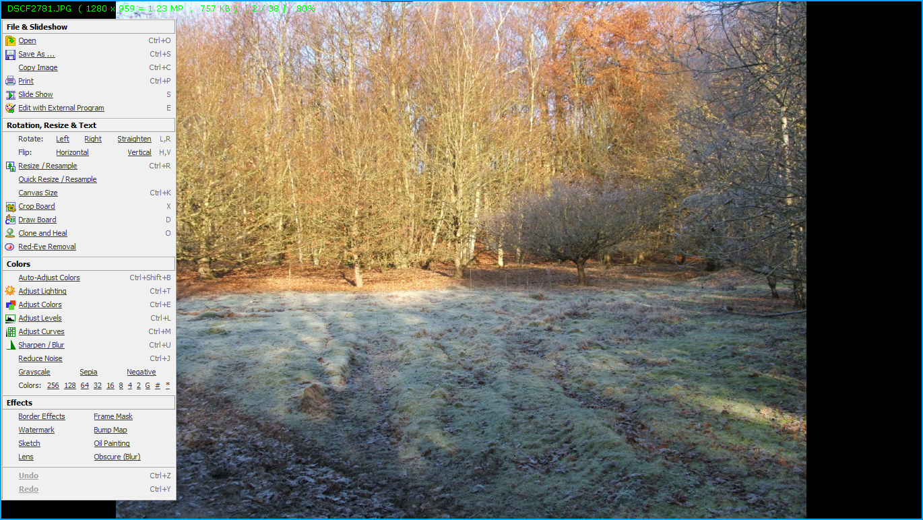
Edit mode: Move cursor to the borders to see:
Tools, Filmstrip, Properties & Toolbar.
Notes:
If you open the photo to full screen, the menus are hidden at the sides. Move the mouse cursor to the sides to see them.

Slide 8

IrfanView
Simple design and Functionality. Works on older PCs.
Resize, slideshow.
Photo editor: Crop, Red-eye,
Colour Adjustments: levels, curves, sharpen/blur, greyscale etc
Effects: Borders, watermarks, text overlay, shapes
Batch processing & file conversion
​
Notes:
The main programme opens one photo at a time. Use the Thumbnails icon to navigate to and select a whole directory. Opens in a new window.

Slide 9
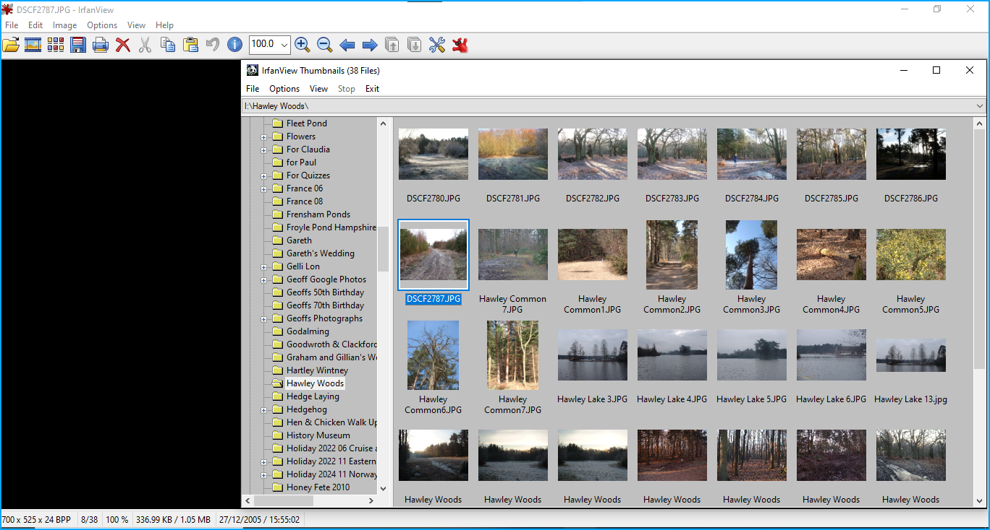
IrfanView
Notes:
Thumbnail view – select a photo to now go back to the main window to edit.

Slide 10
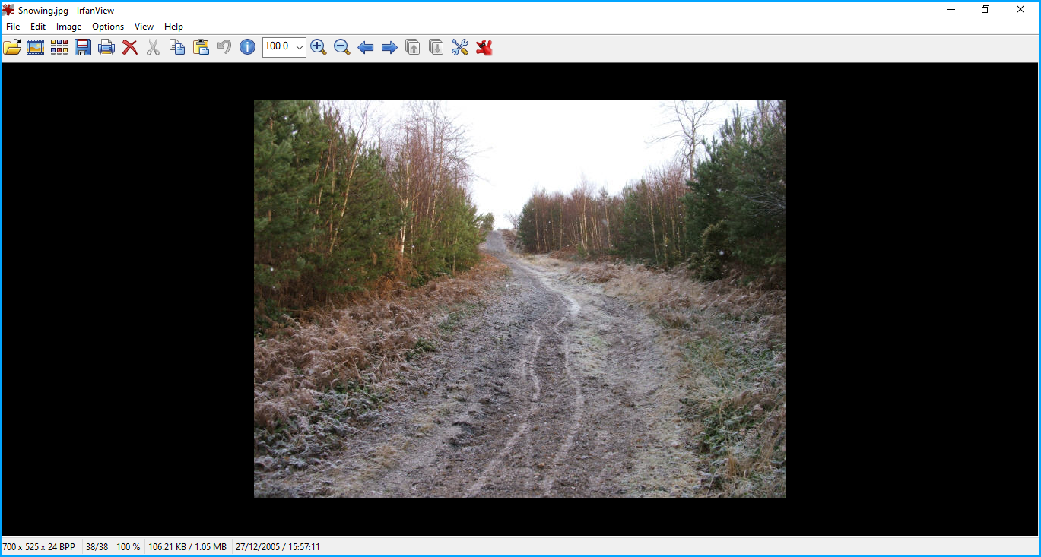

Slide 11

XnView MP
Fairly lightweight program with simple functionality.
Resize, slideshow.
Photo editor: Crop, Red-eye.
Colour Adjustments: levels, curves, sharpen/blur, greyscale etc.
Effects: Borders, watermarks, Lens, Oil Painting etc
Batch processing & file conversion
​

Slide 12
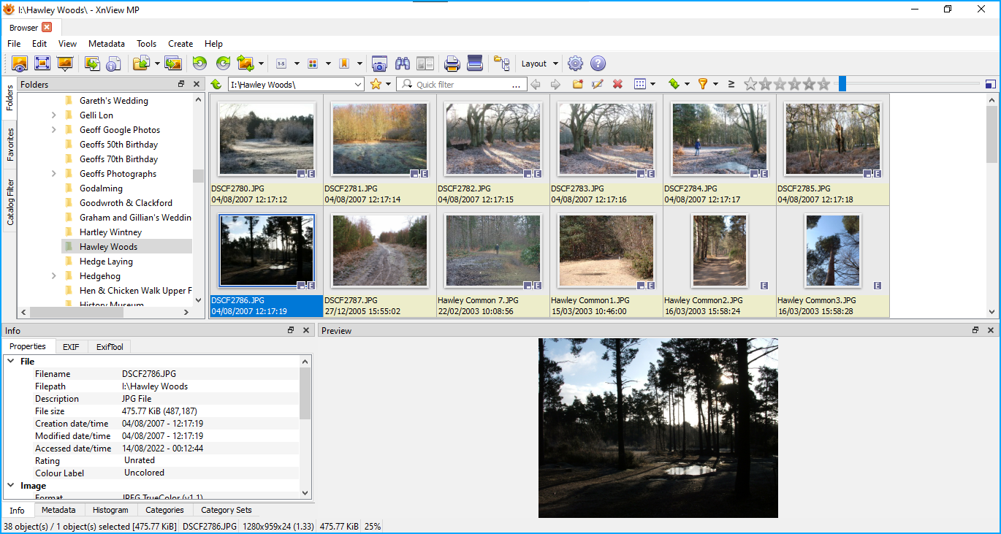
XnView MP
Notes:
Very configurable

Slide 13
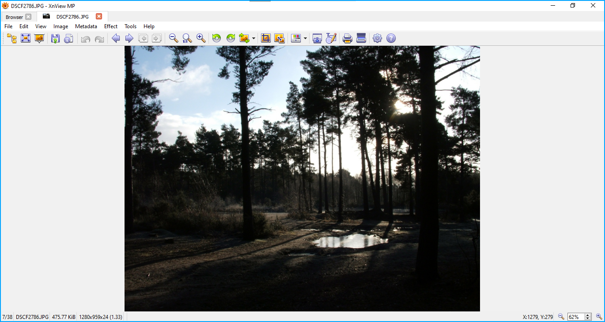

Slide 14

digiKam
Open source software.
Requires a little setting up. 4 Databases.
Comprehensive Photo Management with advanced editing capabilities
Extensive use of Albums, tagging & filtering to organise/find photos.
Add in addition plugins for extra functionality.
Face recognition
Read the documentation for help.
Includes standalone Showfoto – advanced image editing.
​
Notes:
4 Databases: All collection properties, compressed thumbnails, face recognition & similarity fingerprints.
digiKam itself is a complete “digital Asset Management” application. It includes Showfoto which is more of an advanced Picture Editor.

Slide 15
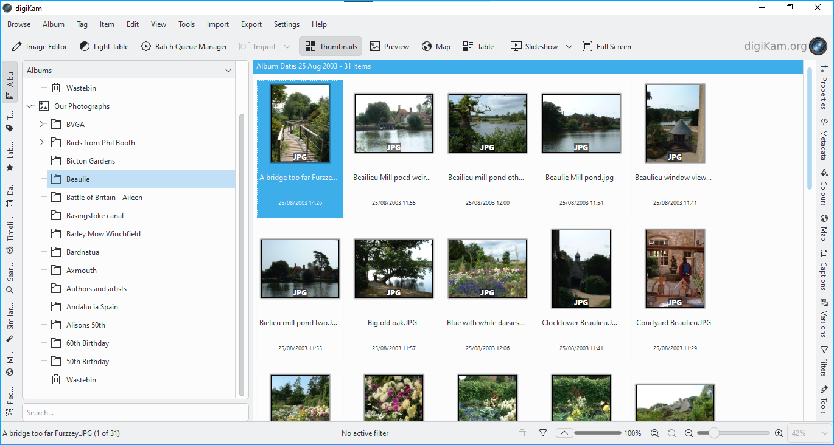
DigiKam

Slide 16
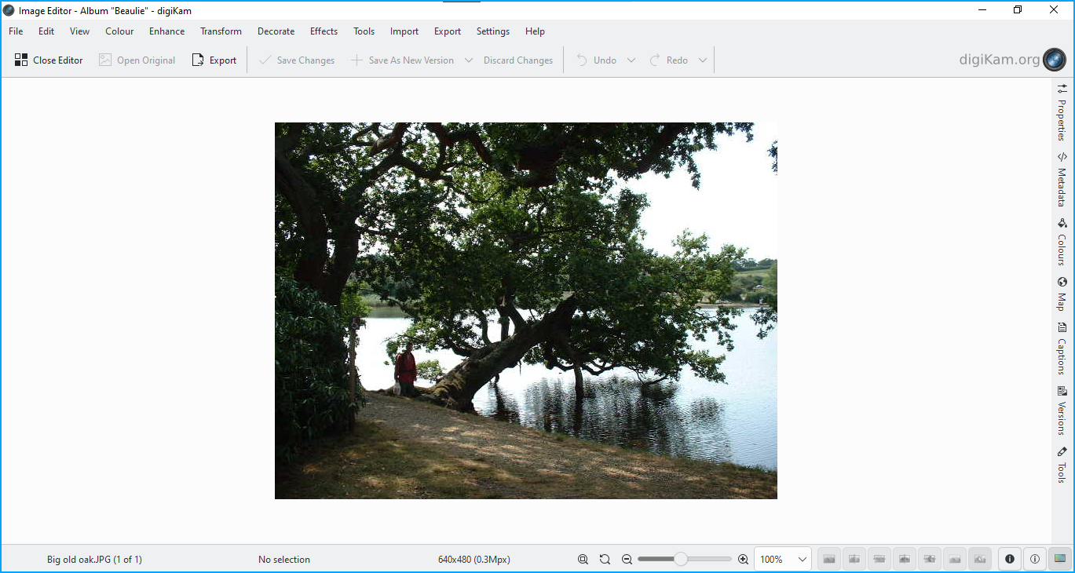
Notes:
Allows Perspective Adjustment (In the Transform Menu)
Good Documentation

Slide 17
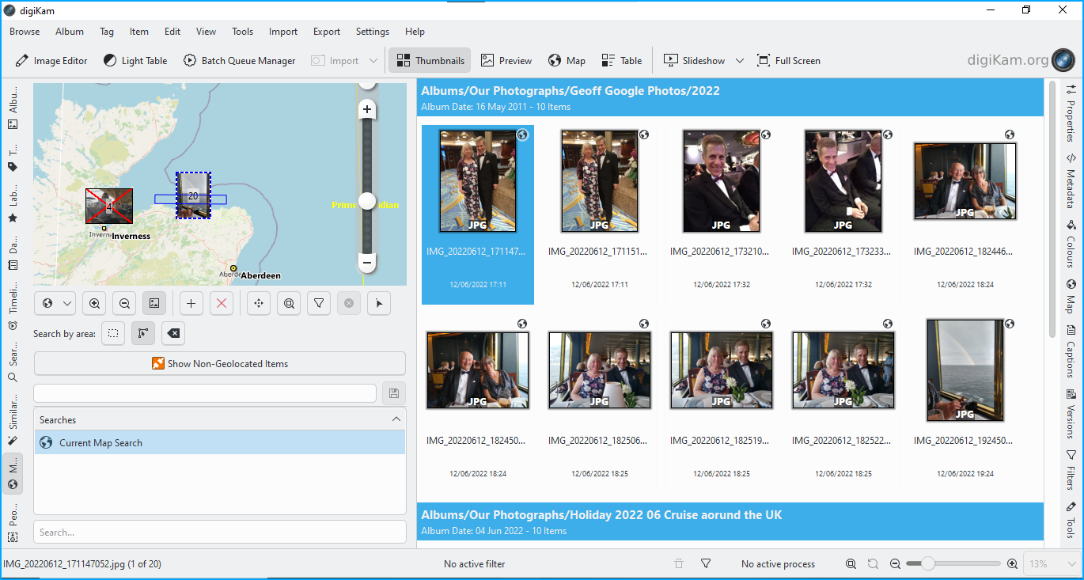
Notes:
Map view One of 9, Albums (Folders), Tags, Labels, Dates, Timeline, Search, Similar, Maps, & People

Slide 18
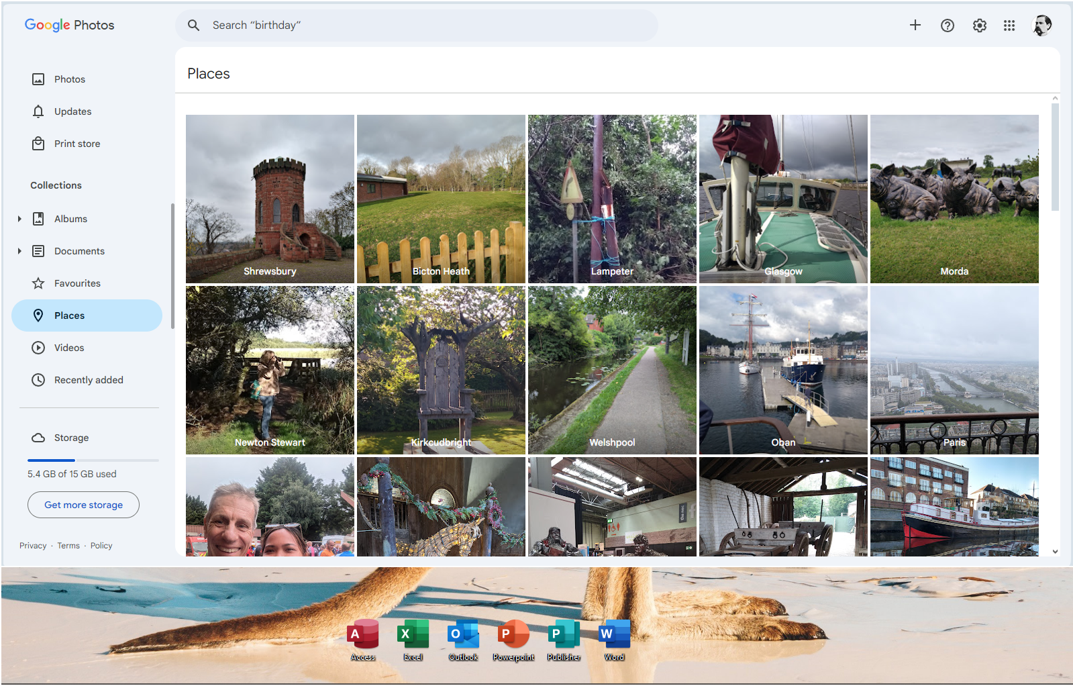
Notes:
Google’s version of Map view – Places

Slide 19
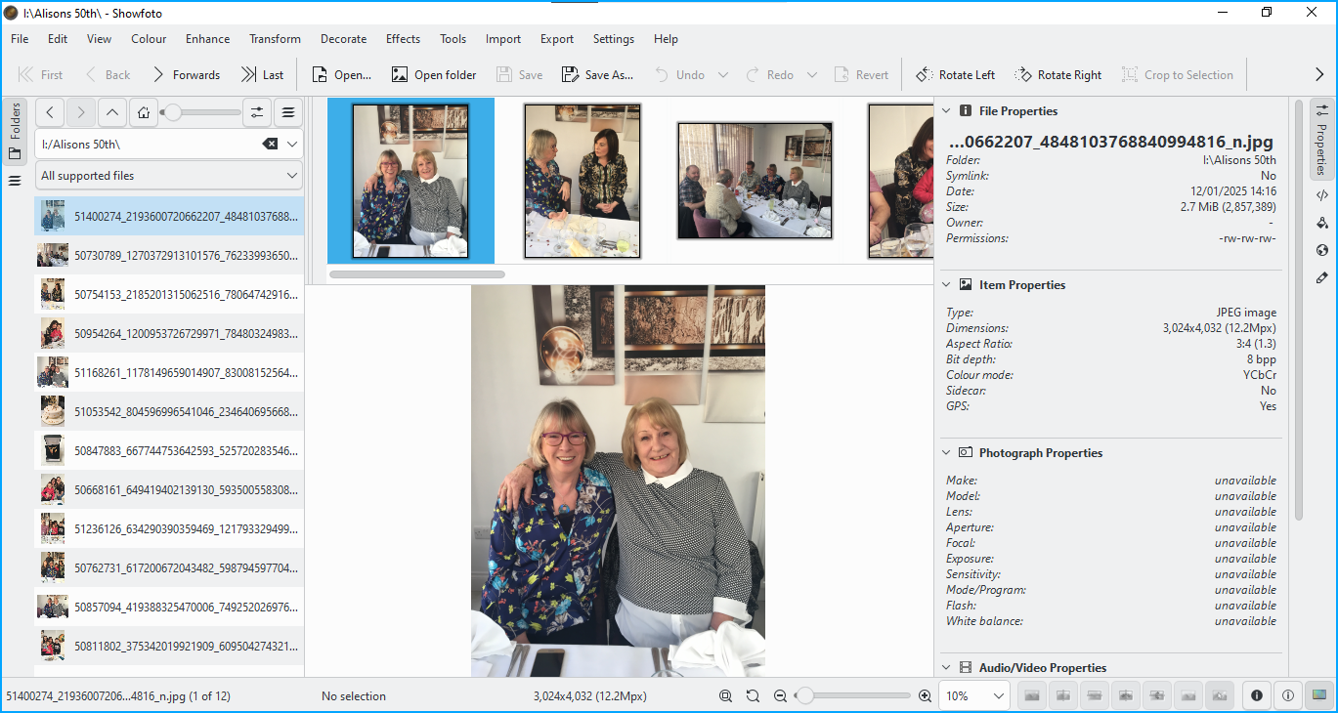
Showfoto

Slide 20

PhotoPrism
Open source software viewer. Needs setting up.
PhotoPrism® is an AI-Powered Photos App for the Decentralized Web.
It makes use of the latest technologies to tag and find pictures automatically without getting in your way. You can run it at home, on a private server, or in the cloud.
Face recognition
Map & Places. Shared Albums.
A good online demo
Needs a server if you want it online:
Online from $5:00 per month ​Or local to your PC
See https://www.photoprism.app/
Notes:
4 Databases: All collection properties, compressed thumbnails, face recognition & similarity fingerprints.

Slide 21
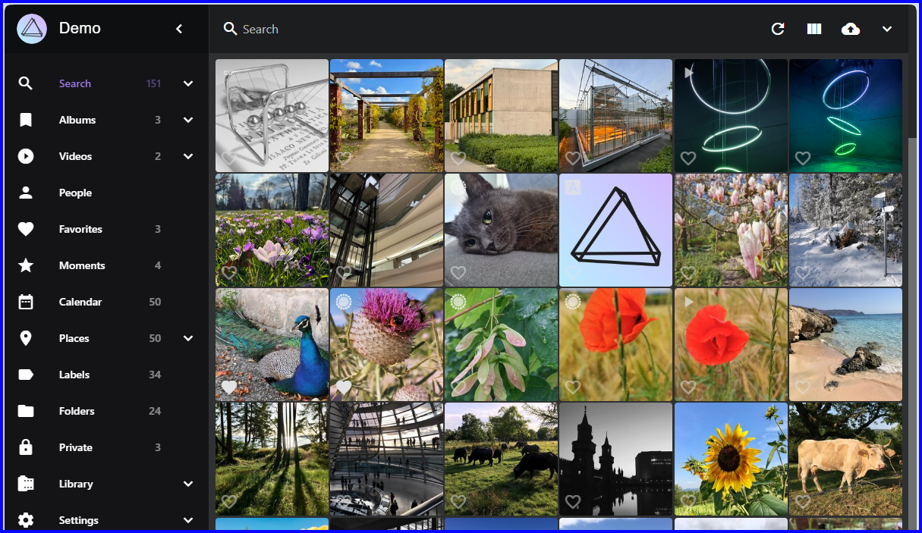

Slide 22
qView
The simplest viewer available?
Open a photo at a time
Slideshow shows all photos in that directory
Notes:
Not worth the effort IMHO

Slide 23
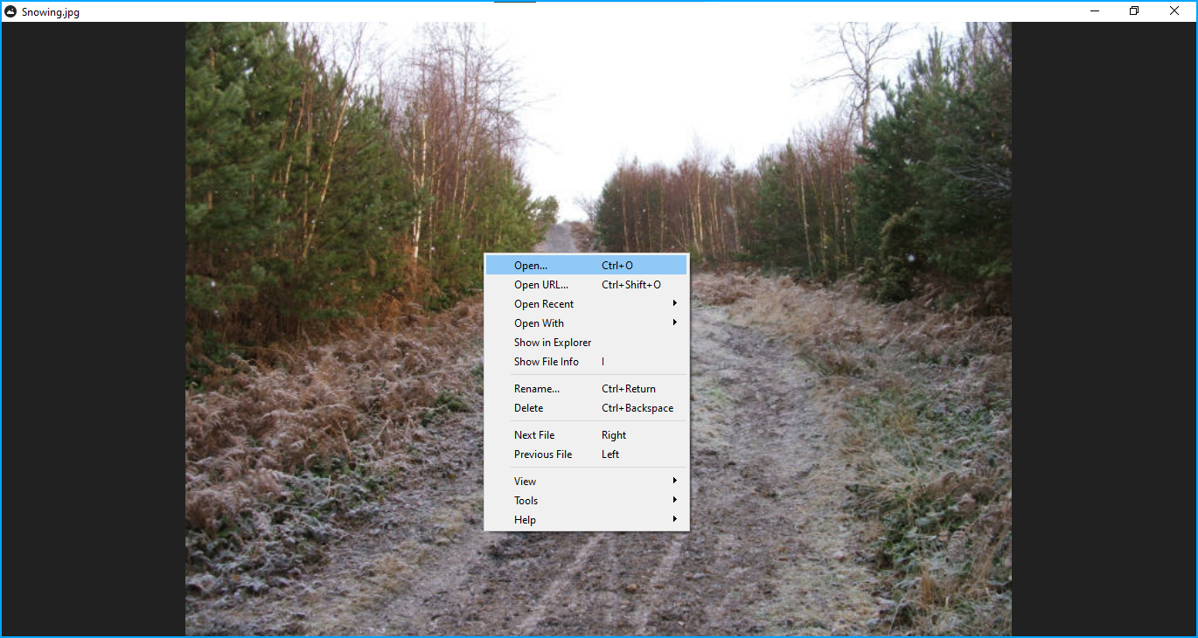

Slide 24
WidsMob
Viewer Pro
Free trial. Lifetime license $45.99
Viewer Only

Slide 25
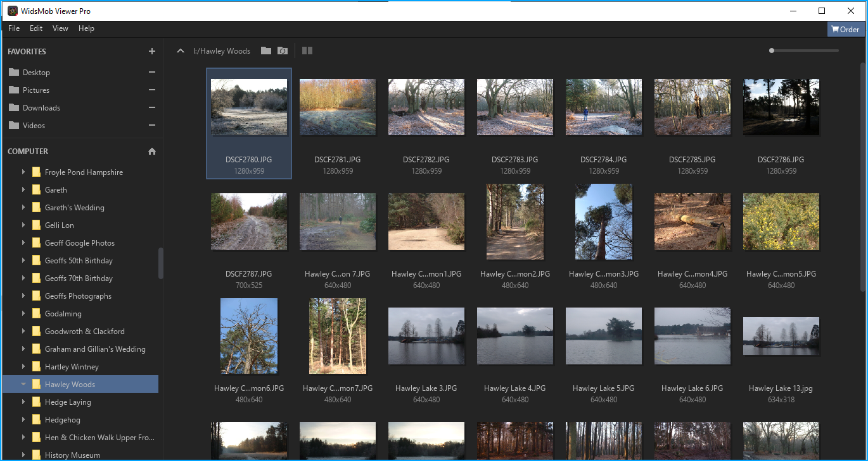
WidsMob Viewer Pro
Notes:
Not very exciting

Slide 26
Endless Slideshow screensaver
Windows Screensaver
Up to 20 pictures per monitor
Transition effects
Overlay text
Option to play music
Pro version available
I love it.
Notes:
I love this.

Slide 27


Does anyone have any Questions? Or want to try some of these programmes, most are on my laptop here​

Slide 28
Hypothesis
Contoso’s technology helps people and businesses communicate efficiently through a virtual world.​
Virtual communication will be more common in the next 5 years. ​
​

Slide 29
Percentage of communication tools
9%
10%
Text messages
Social media
23%
58%
Message boards
Virtual reality

Slide 30

Making great products
Take risks to lead in product innovation​
Listen to customers and learn what they need​
Test with customers until you get the product right​

Slide 31

Comparing Contoso to the competition​
Contoso empowers businesses to communicate efficiently with technology that’s simple and easy to use.​
​
The competition also offers similar technology, but their tools aren't user friendly.​

Slide 32
History
Launch Contoso​
Request
funding​
Procure investments​
20xx
Jan
Feb
Mar
Apr
May
Jun
Jul
Aug
Sep
Oct
Nov
Dec
Hire designers​
Open offices​
Start development​
20xx
Jan
Feb
Mar
Apr
May
Jun
Jul
Aug
Sep
Oct
Nov
Dec

Slide 33

Key takeaways​
Virtual communication is the future​
Contoso is leading in virtual communication​
Contoso helps businesses communicate effectively ​
Contoso is free to try and easy to use​

Slide 34

Tips for businesses​
Take risks to lead in product innovation​
Listen to customers and learn what they need​
Test with customers until you get the product right​

Slide 35

Call to action
Contoso is the best technology platform on the market​
Download Contoso to try it out and provide feedback​
​

Slide 36

Thank you
Mirjam Nilsson​​
206-555-0146​
mirjam@contoso.com​
www.contoso.com​

