Slide 1
Understanding Mobile Phone Contracts
Notes:
Mobile phone contracts are agreements between customers and service providers that outline the terms of mobile service. It's vital to understand the different types available, as they can significantly impact your usage and expenses.
I expect some of you are better qualified than myself to give this presentation, but then I also suspect that many of you are confused by the array and variety of contracts on offer.

Slide 2
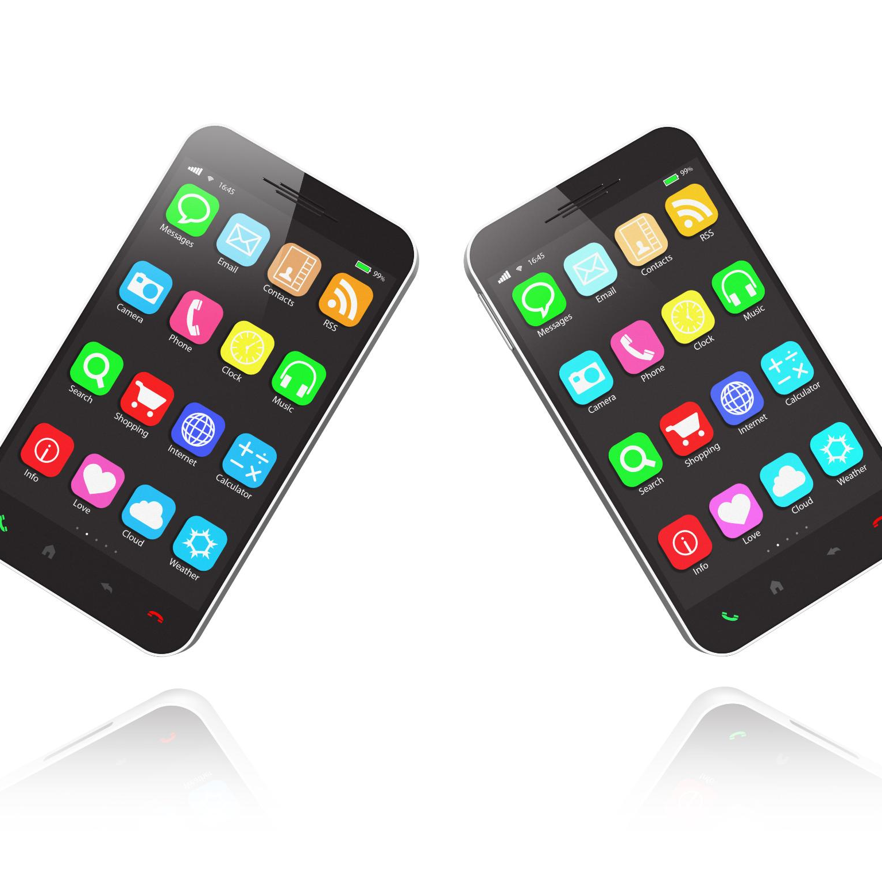
Understanding Different Types of Mobile Phone Contracts and Bundled Services
Exploring options for informed mobile communication choices
Notes:
In this presentation, we will explore the various types of mobile phone contracts available and the bundled services that often accompany them. It is essential to understand these options to make informed choices that suit your communication needs.

Slide 3

Agenda Items
Overview of Mobile Phone Contracts
Understanding ‘Minutes’, ‘Text’ & ‘Data’
eSIMS
Pay-As-You-Go (PAYG) Contracts
Monthly Pay Contracts
SIM-Only Contracts
Bundled Services: Home Broadband, TV, and Phone
Comparing Contract Types and Bundled Services
Notes:
We will begin with an introduction to mobile phone contracts, covering different types and their significance. Following that, we will examine specific contract types, including Pay-As-You-Go, Monthly Pay, SIM-Only & Bundled contracts. We will conclude with a comparison of these options.

Slide 4

Overview of Contract Types
Pay-As-You-Go Contracts
  Pay-As-You-Go contracts offer flexibility without long-term commitments, allowing users to pay for what they use.
Monthly Pay Contracts
  Monthly Pay contracts involve a fixed monthly fee, providing a set amount of data, texts, and calls each month.
SIM-Only Contracts
  SIM-Only contracts provide a SIM card without a phone, ideal for users who already have a device and wish to save costs.
  Bundled Services
  Internet, TV, Landline and Mobile phone all in one contract
Notes:
There are several types of mobile phone contracts: Pay-As-You-Go, Monthly Pay, SIM-Only contracts & Bundled Contracts. Each type has its own features and benefits, catering to different customer needs and usage patterns.

Slide 5
Importance of Choosing the Right Contract
Understanding Usage Habits
Knowing your data, call, and text usage is vital to choose a mobile plan that fits your needs.
Budget Management
Choosing the right contract helps manage your budget effectively by aligning costs with your usage habits.
Avoiding Unexpected Charges
A suitable contract reduces the risk of unexpected fees and ensures a more predictable monthly bill.
Notes:
Selecting the right mobile contract is crucial to ensure you have the appropriate plan for your usage habits. It can help in managing budget constraints and avoiding unexpected charges.

Slide 6
Minutes, Text and Data

Slide 7

Understanding Minutes, Texts, and Data
Minutes refer to the time you can talk on your mobile phone.
Texts are the written messages sent between phones.
Data allows you to access the internet and use apps on your phone.
Notes:
*****
In mobile contracts, 'minutes' are the allocated time for voice calls, often measured per billing cycle.
*****
'Texts' are the short messages sent and received, typically with a character limit.
*****
'Data' is the amount of information transferred when using the internet, crucial for browsing, streaming, and using apps. Understanding these terms helps consumers choose the right plan for their usage.

Slide 8
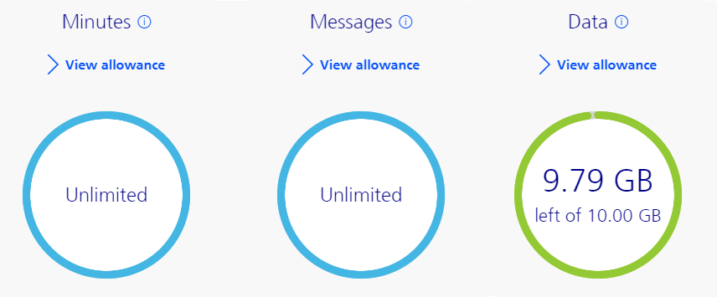
Analysing Usage
Minutes and Texts (Messages) are unlimited.
This contract has an allowance of 10GB for Data each month.
You would pay extra if you went above this.
Notes:
Unlimited UK Minutes and Texts.
10 GB of Data.

Slide 9
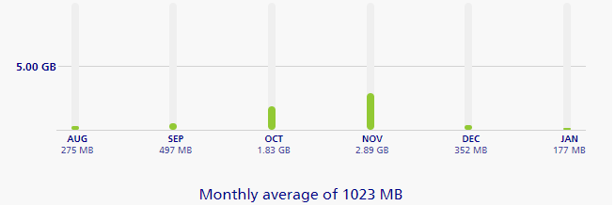
Analysing Usage
6 Monthly graph of data used.
During November we were on a cruise to Norway.
Notes:
This is a 6 month graph for Sandra’s phone. On average just over 1GB per month. So all the adverts that say 30GB or 40GB can be ignored

Slide 10
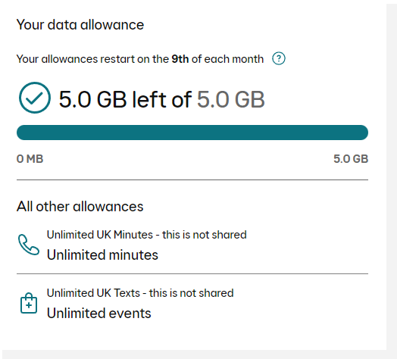
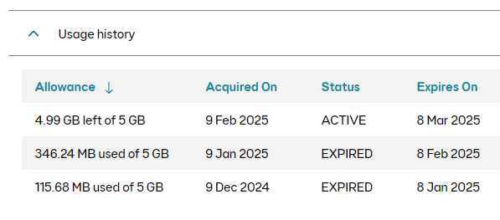
Analysing Usage
This account also has unlimited UK Minutes and Texts.
Data allowance is smaller, 5GB for Data per month.
I don’t use much at all.
Notes:
Also unlimited Minutes and Texts
5GB of Data. Half that of Sandra, but still more than enough for me.
Look at your history to see how much you use.

Slide 11
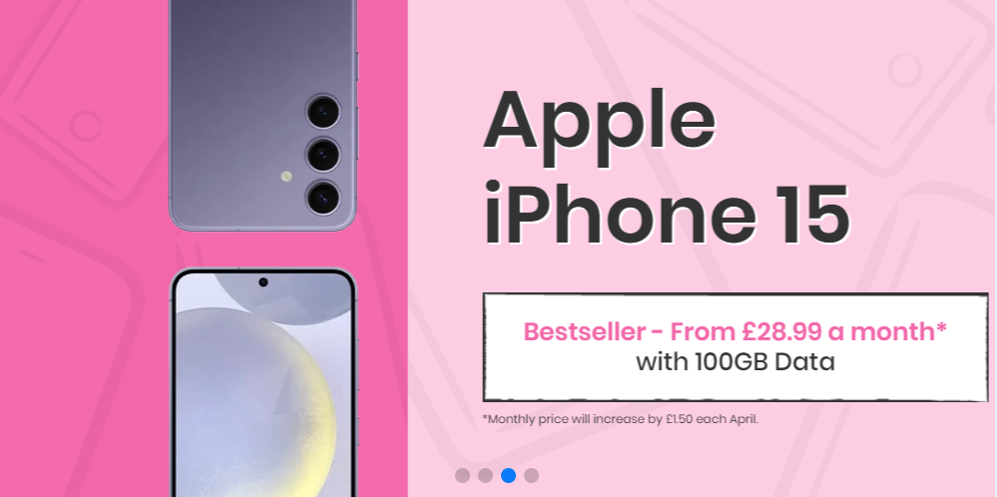

Slide 12
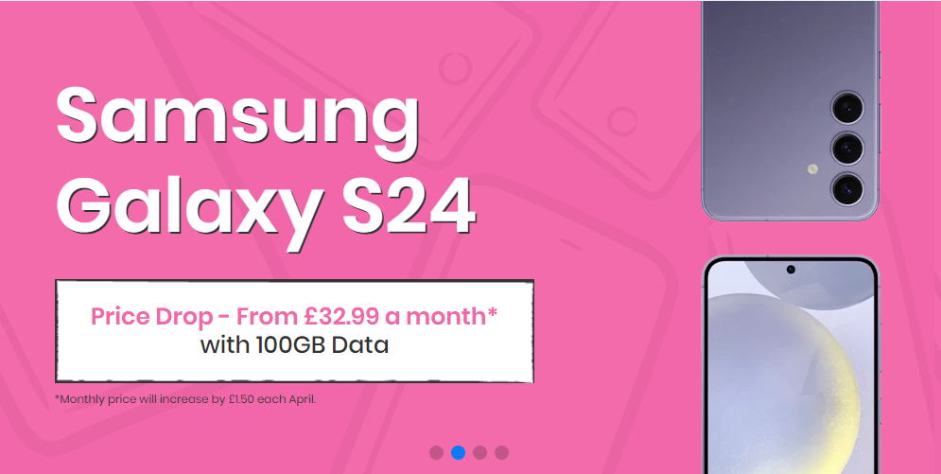

Slide 13

Understanding eSIM Technology
eSIMs are embedded SIM cards that eliminate the need for physical SIMs.
They allow users to switch carriers without physically changing SIM cards.
eSIMs support multiple profiles, making travel and network switching easier.
Notes:
eSIM technology is a significant advancement in mobile connectivity. Unlike traditional SIM cards, eSIMs are embedded directly into devices, allowing for easier switching between carriers. This technology supports multiple profiles, making it convenient for users who travel frequently or want to manage multiple network subscriptions without dealing with physical cards.

Slide 14

Benefits of eSIMs
Enhanced convenience for users by removing the need for physical SIM cards.
Improved security as eSIMs are less prone to loss or damage.
eSIMs can be remotely activated, simplifying the process of changing carriers.
Notes:
The benefits of eSIMs extend beyond convenience. They enhance security by being embedded in the device, reducing the risk of loss or damage. Additionally, eSIMs can be activated remotely, making the process of changing carriers seamless and straightforward for users.

Slide 15
Pay-As-You-Go (PAYG) Contracts
Notes:
PAYG contracts allow users to pay for their mobile services as they go, without committing to monthly fees. This flexibility makes them ideal for occasional users.

Slide 16
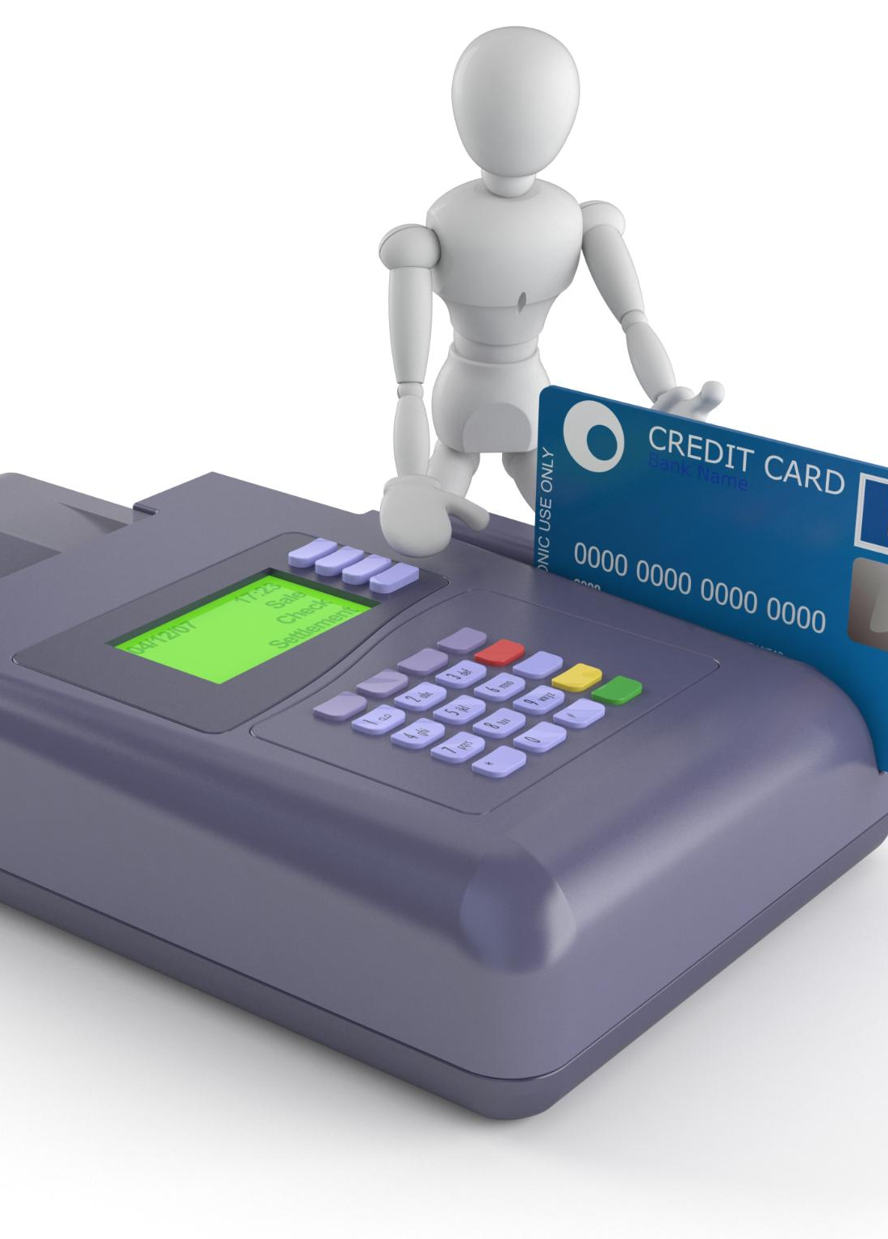
Description and How It Works
Prepaid Credit System
  PAYG contracts allow users to purchase credit in advance for services, ensuring they only pay for what they use.
Flexible Spending Control
  Users can easily track and control their spending as there are no fixed monthly payments, promoting budget management.
Usage Until Credit Runs Out
  The system allows users to utilize the credit until it is depleted, providing a straightforward usage model.
Notes:
With PAYG contracts, users purchase credit in advance and use it until it runs out. There are no fixed monthly payments, making it easy to control spending.

Slide 17

Pros of PAYG Contracts
No Long-Term Commitments
  PAYG contracts offer flexibility by eliminating long-term commitments, allowing users to adjust their services as needed.
Control Over Spending
  With PAYG contracts, users have better control over their spending, paying only for what they use without extra charges.
Easy Provider Switching
  Users can easily switch service providers without penalties, ensuring they can find the best deals and services.
Notes:
The main advantages of PAYG contracts include no long-term commitments, control over spending, and the ability to switch providers easily without penalties.

Slide 18

Cons of PAYG Contracts
Higher Rates
  PAYG contracts often come with elevated per-minute or per-text rates, making them potentially more expensive than monthly options.
Inconvenient Credit Reloads
  Users of PAYG contracts may find the need to reload credit frequently to be inconvenient and time-consuming.
Notes:
However, PAYG contracts may have higher per-minute or per-text rates compared to monthly contracts, and users might find it inconvenient to reload credit frequently.

Slide 19
Monthly Pay Contracts
Notes:
Monthly pay contracts require users to commit to a fixed monthly fee for a specified duration, typically 12 or 24 months. This is a common choice for users who need consistent service.

Slide 20
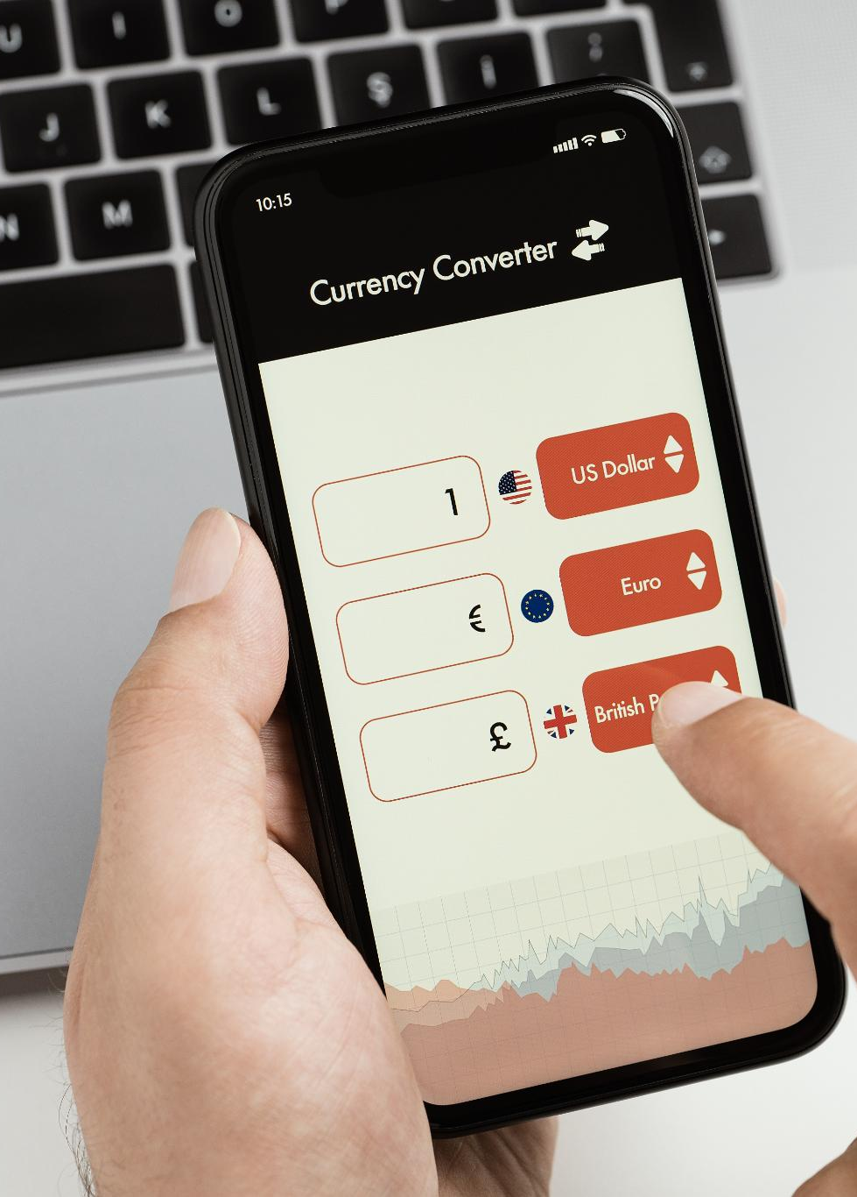
Description and How It Works
Monthly Service Package
  Monthly pay contracts offer a predefined package of minutes, texts, and data for users each month.
Regular Billing Cycle
  Users are billed monthly, ensuring a predictable payment schedule for their communication services.
Contract Duration
  Services continue until the end of the contract, providing uninterrupted access during the contract term.
Notes:
Monthly pay contracts provide users with a set number of minutes, texts, and data each month. Users are billed every month, with services continuing until the contract ends.

Slide 21

Pros of Monthly Pay Contracts
Lower Rates for Services
  Monthly pay contracts typically offer lower rates for calls and texts, making communication more affordable.
Bundled Data Plans
  These contracts often include bundled data, providing better value for users who rely on mobile data.
Subsidized New Phones
  Signing a monthly pay contract can lead to obtaining a new phone at a subsidized price, enhancing user experience.
Notes:
These contracts often come with lower rates for calls and texts, bundled data, and the potential for obtaining a new phone at a subsidized price when signing up.

Slide 22
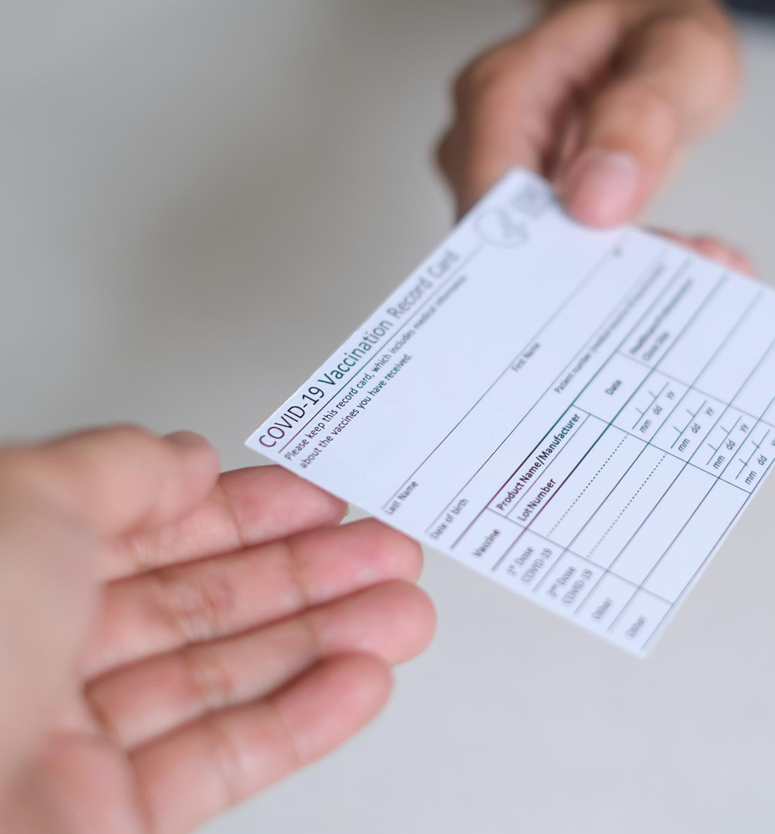
Cons of Monthly Pay Contracts
Early Termination Fees
  Users may incur significant fees if they decide to terminate their monthly pay contract before it expires.
Paying for Unused Services
  Customers might end up paying for services they do not use, leading to wasted expenses.
Notes:
On the downside, users may face early termination fees if they wish to cancel the contract before the term expires, and they may end up paying for unused services.

Slide 23
SIM-Only Contracts
Notes:
SIM-Only contracts offer a middle ground between PAYG and monthly pay contracts. Users pay a monthly fee for a SIM card without committing to a phone.

Slide 24
Description and How It Works
What is SIM-Only?
SIM-Only contracts allow customers to use their existing phones while receiving a package of calls, texts, and data.
Benefits of SIM-Only
These contracts offer flexibility and cost-effectiveness for customers who do not need a new phone.
Target Audience
Ideal for individuals who already own a compatible phone and want to minimize their monthly bills.
Notes:
With SIM-Only contracts, customers get a SIM card that provides a package of calls, texts, and data. This is ideal for those who already own a compatible phone.

Slide 25
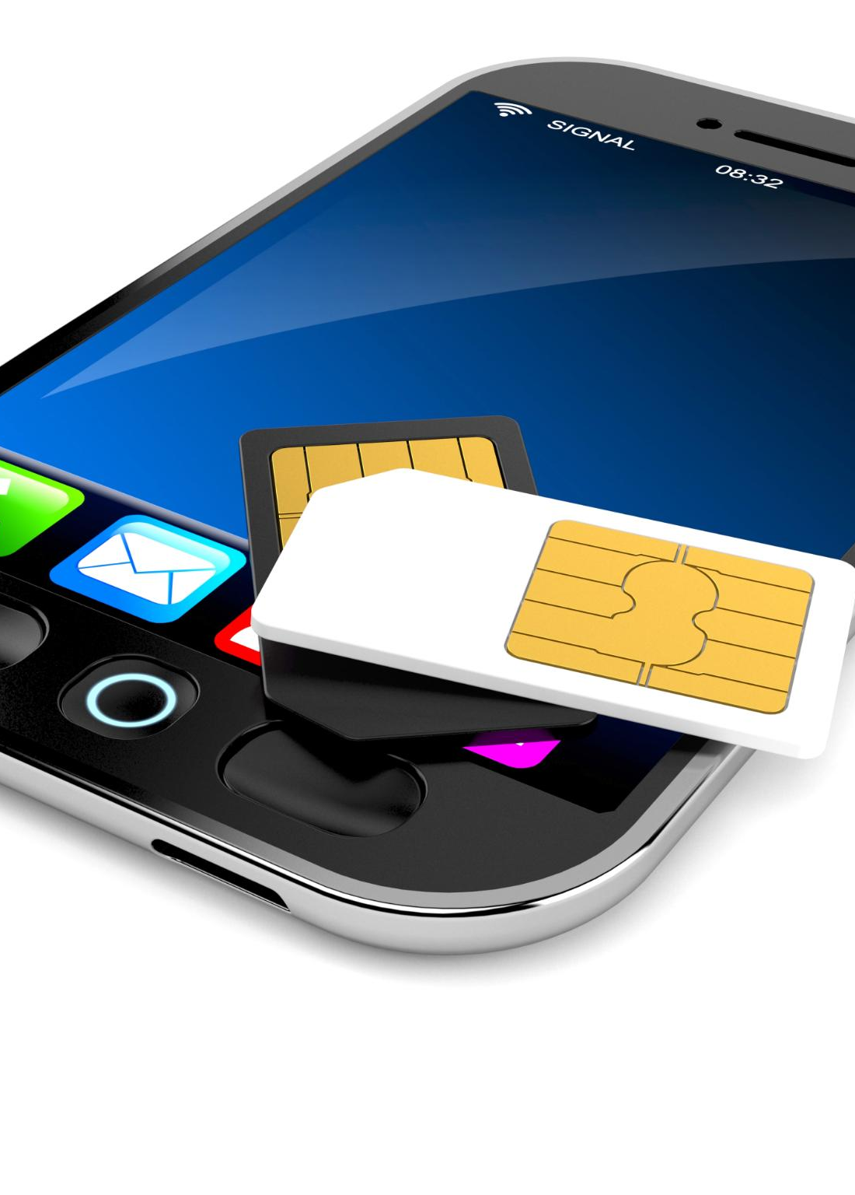
Pros of SIM-Only Contracts
Lower Monthly Costs
  SIM-only contracts typically offer lower monthly fees compared to traditional phone contracts, saving consumers money.
Flexibility to Change Providers
  Users enjoy the flexibility to switch providers easily without being tied to a long-term contract, promoting better service choices.
No Long-Term Commitment
  SIM-only contracts do not require a long-term commitment, allowing users to cancel or change plans at any time.
Notes:
The advantages include lower monthly costs compared to phone contracts, flexibility to change providers more easily, and no need for a long-term commitment.

Slide 26

Cons of SIM-Only Contracts
Limited Phone Upgrade Options
  SIM-only contracts may restrict users' choices for upgrading their mobile devices, making it less flexible.
User Device Responsibility
  Users must take full responsibility for their device, which can be a barrier for those who prefer bundled plans.
Notes:
However, there may be limited choices regarding phone upgrades, and users are responsible for their device, which can be a barrier for some.

Slide 27
Bundled Services: Home Broadband, TV, and Phone
Notes:
Bundled services allow customers to combine multiple services into one package, often resulting in cost savings. This section will explore the benefits and drawbacks of such bundles.

Slide 28

Bundled Services
Value of Bundled Services
  Bundled services provide consumers with added value by combining multiple communication solutions into one package.
Convenience for Consumers
  Consumers benefit from the convenience of managing multiple services through a single provider, simplifying their communication needs.
Comprehensive Solutions
  Bundled services offer a comprehensive approach to communication, including internet, TV, and landline features.
Notes:
Bundled services often include additional features, such as home broadband, TV packages, or landline services, which can provide value and convenience for consumers looking for comprehensive communication solutions.

Slide 29

Overview of Bundled Services
Convenience of Bundling
  Bundled services offer convenience by consolidating multiple services into one package, making management easier for customers.
Cost Savings
  Customers can enjoy potential cost savings by opting for bundled services rather than purchasing each service individually.
Service Variety
  Bundled services often include a variety of options, catering to different customer needs, from mobile plans to entertainment subscriptions.
Notes:
Bundled services typically include mobile phone plans, home broadband, and TV subscriptions, providing convenience and potentially reduced costs for customers who need multiple services.

Slide 30

Pros of Bundled Services
Discounted Pricing
  Bundled services often come with discounted pricing, providing significant savings compared to purchasing services individually.
Simplified Billing
  With bundled services, billing is simplified, allowing users to manage their payments more easily and efficiently.
Convenient Management
  Managing all services through a single provider increases convenience and improves the customer experience.
Notes:
The benefits of bundled services often include discounted pricing, simplified billing, and the convenience of managing all services through a single provider.

Slide 31
Cons of Bundled Services
Limitations on Flexibility
Bundled services can restrict customer choices, making it difficult to select individual services that best fit their needs.
Tied to One Provider
Users may become dependent on a single provider, which could lead to dissatisfaction if the service quality declines.
Potentially Higher Costs
Bundled packages may not always provide the best price; customers could save more by choosing services individually.
Notes:
On the contrary, bundled services may limit customer flexibility and tie users to a single provider, which may not always offer the best service or price.

Slide 32
Comparing Contract Types and Bundled Services
Notes:
Understanding how different contract types and bundled services compare is essential for making informed decisions regarding your mobile and communication needs.

Slide 33

Cost Comparison
Total Cost Evaluation
  Evaluating the total cost of each contract type is crucial for making informed decisions over time.
Monthly Fees Assessment
  Monthly fees should be carefully assessed to understand their impact on the overall cost of contracts.
Additional Charges
  It's essential to factor in additional charges as they can significantly affect the total expenses incurred.
Potential Savings
  Identifying potential savings helps to make more cost-effective choices when selecting contracts.
Notes:
It's important to evaluate the total cost of each contract type and bundle over time, taking into account monthly fees, additional charges, and potential savings.

Slide 34

Flexibility and Commitment
Contract Length Flexibility
  Evaluate how flexible the contract lengths are for each option, ensuring they meet your needs.
Switching Providers Ease
  Consider the ease with which you can switch providers without facing penalties or complications.
Service Modification Options
  Look into how easily you can modify services to better suit your changing needs or preferences.
Notes:
Consider the flexibility of each option, especially regarding contract length and the ability to switch providers or modify services without incurring penalties.

Slide 35

Best Options for Different Needs
Understanding User Needs
  Different users have unique requirements that influence their choice of services and contracts.
Cost-Effective Choices
  Identifying the most cost-effective solutions ensures that users receive maximum value for their investment.
Beneficial Service Selection
  Choosing services that align with your lifestyle can lead to improved satisfaction and better outcomes.
Notes:
Finally, different users have different needs. Understanding which contracts and services best suit your lifestyle will help you make the most cost-effective and beneficial choice.

Slide 36
Conclusion
Understanding Mobile Contracts
It's important to understand the different types of mobile phone contracts available, including prepaid and postpaid options.
Analysing Usage
Analyzing your mobile usage is essential in selecting the best plan that fits your needs and lifestyle.
Choosing the Best Option
Selecting the best option involves balancing value and convenience to meet your individual requirements.
Notes:
In conclusion, understanding the various types of mobile phone contracts and bundled services is crucial for making informed decisions. By analyzing your usage and needs, you can select the best option that provides both value and convenience.

Slide 37
Discuss….
Notes:
Questions & Discussion

