Slide 1
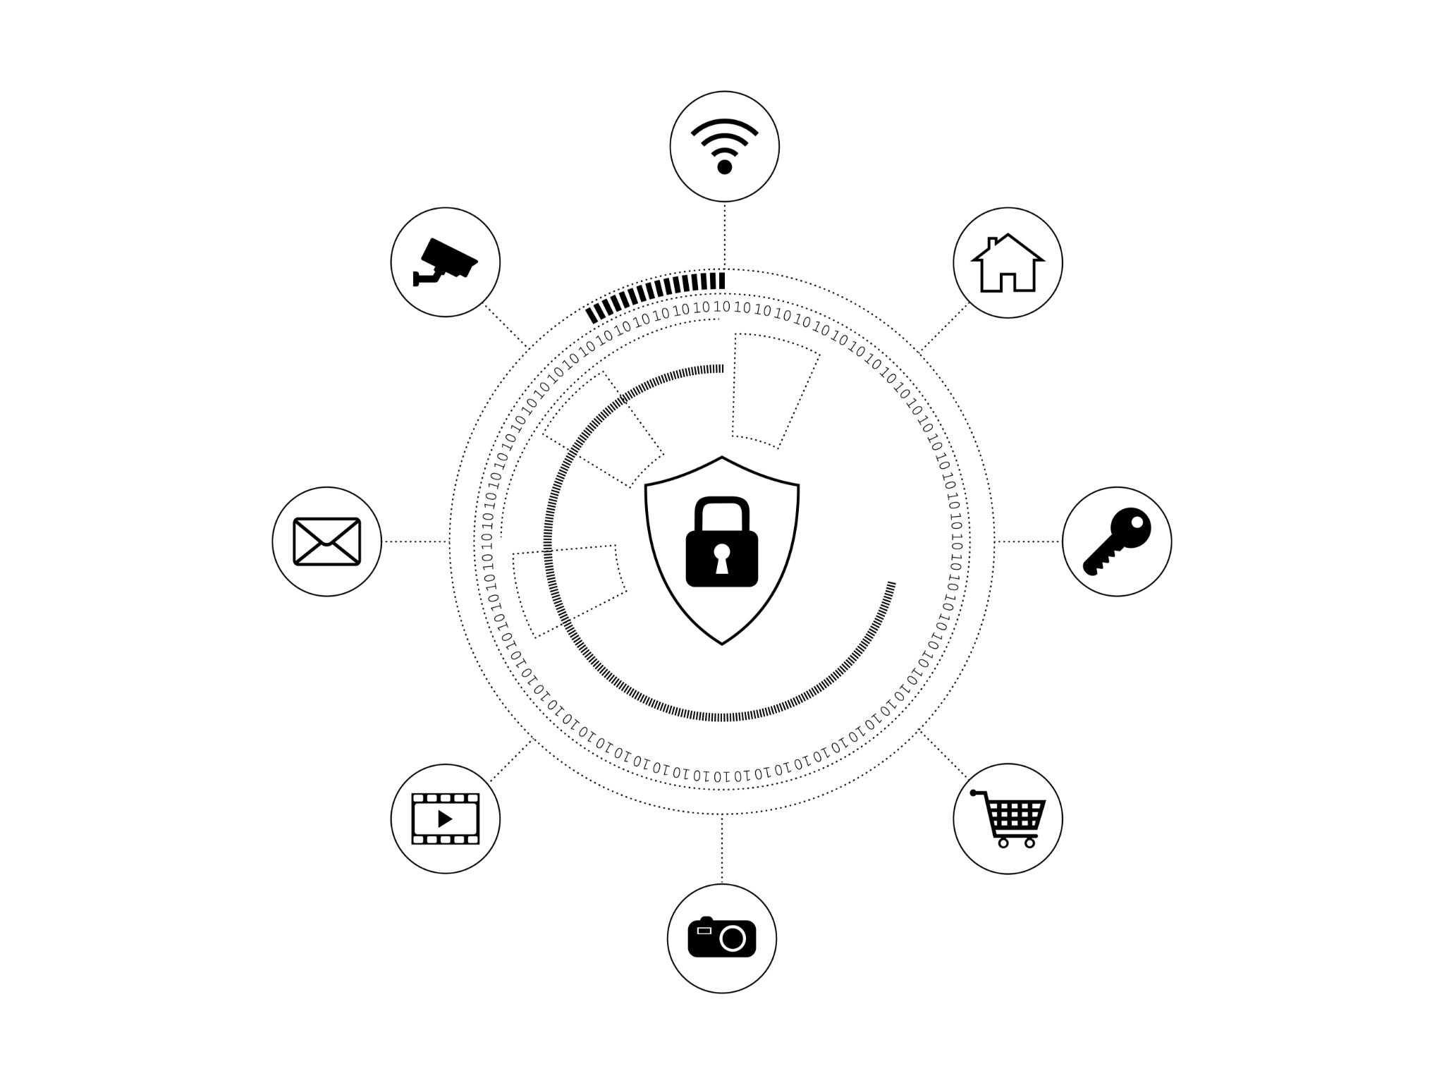
Passkeys: The Future of Secure Authentication
Exploring modern solutions for enhanced digital security
Notes:
As we navigate the digital landscape, ensuring secure authentication is crucial. This presentation will explore passkeys, a modern solution designed to enhance security and eliminate vulnerabilities associated with traditional passwords.
What do we mean by Authentication? The process or action of verifying the identity of a user or process.

Slide 2
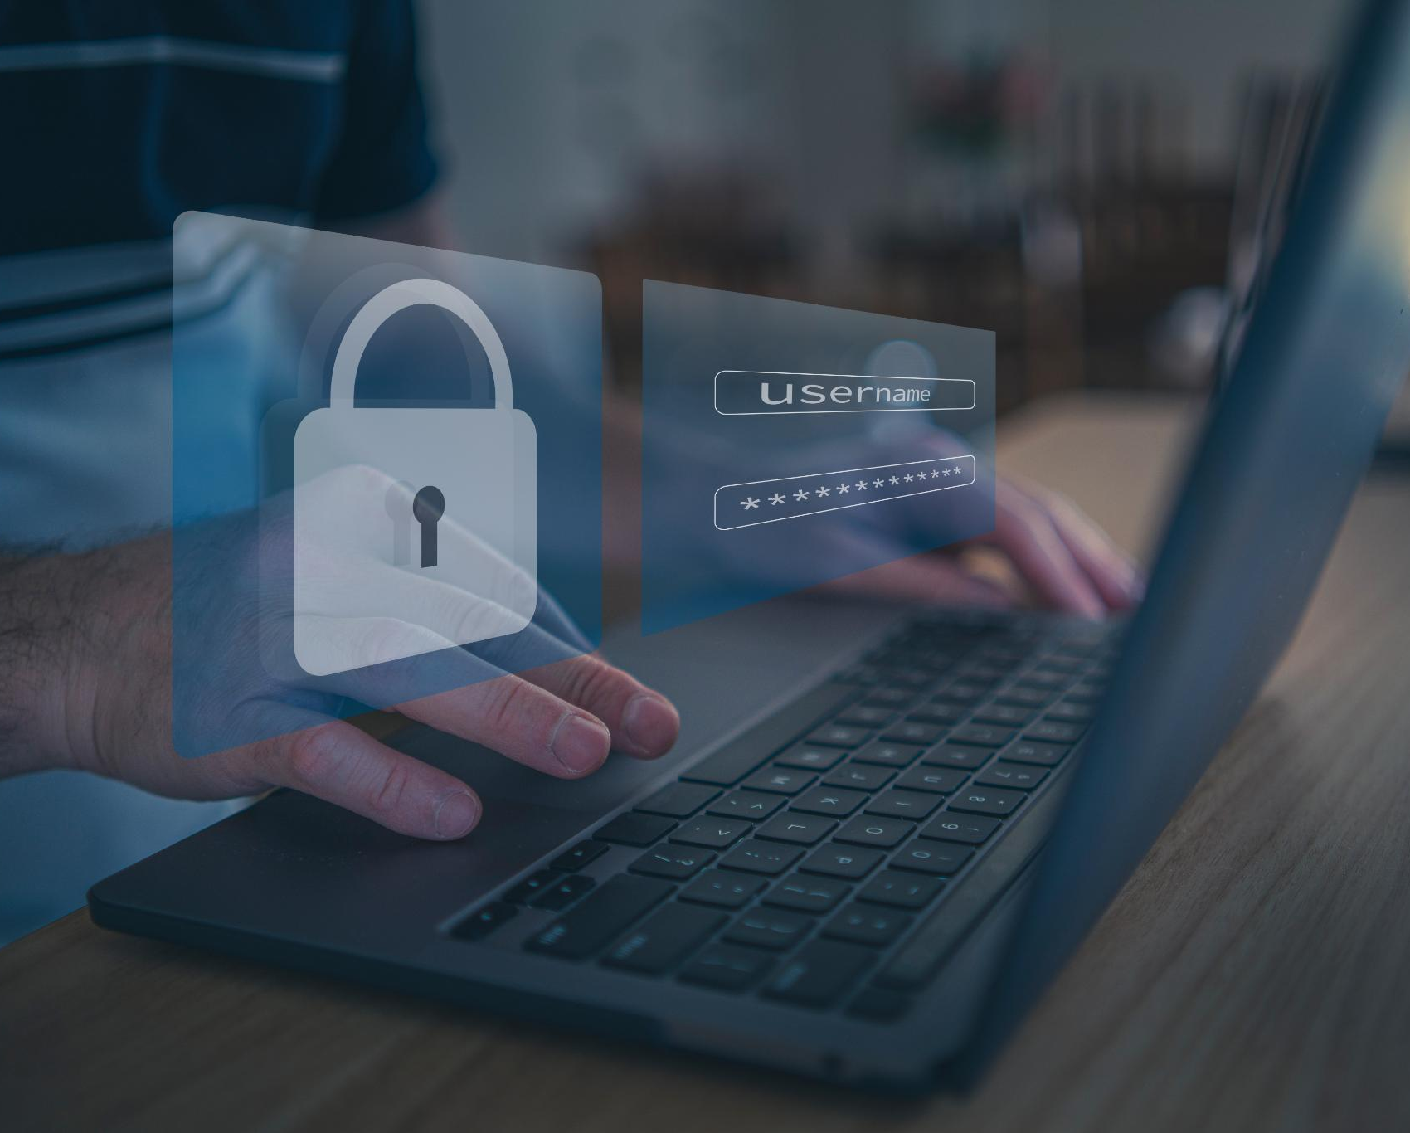
Agenda Items
Weaknesses of Traditional Passwords
Introduction to Passkeys
Eliminating Phishing with Passkeys
Implementing Passkeys
Future of Authentication
Notes:
We will start with the weaknesses of traditional passwords and the statistics surrounding password breaches. Followed by an introduction to passkeys, defining what they are and how they function. Next, we will discuss how passkeys tackle phishing attacks and conclude with the process of implementing them along with future trends in authentication technology.

Slide 3
Weaknesses of Traditional Passwords
Notes:
Despite being a longstanding method of authentication, traditional passwords come with numerous vulnerabilities that can compromise security. Understanding these weaknesses is essential for improving authentication methods.

Slide 4
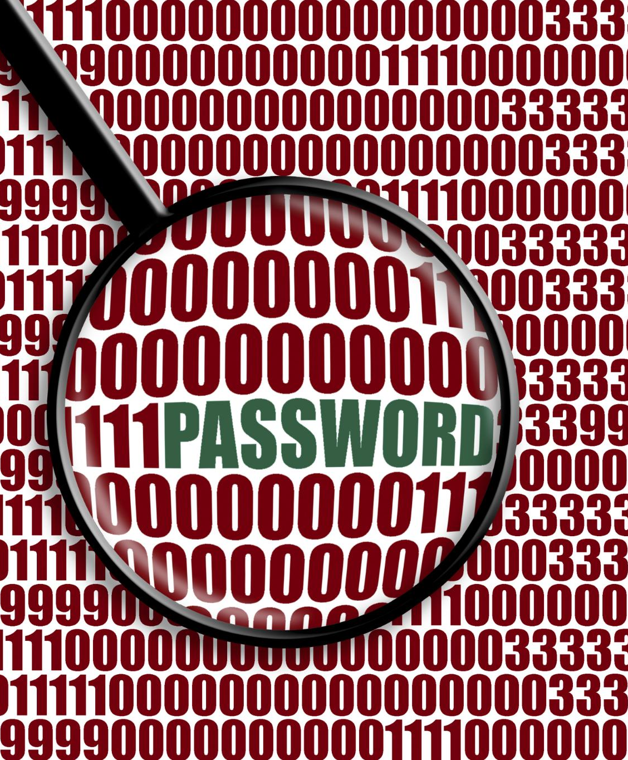
Common Password Vulnerabilities
Weak Passwords
  Using weak passwords such as '123456' or 'password' significantly increases the risk of unauthorized access to accounts.
Password Reuse
  Reusing passwords across multiple accounts can lead to widespread access if one account is compromised.
Easily Guessable Passwords
  Choosing easily guessable passwords, like names or birthdays, makes accounts vulnerable to attacks.
Notes:
Common vulnerabilities include weak passwords, reuse of passwords across multiple accounts, and the tendency to choose easily guessable passwords. These practices make accounts susceptible to unauthorized access.

Slide 5
Common Password Problems
Brute Force attack
  Someone guesses your password
  Man in the Middle Attack
  Someone intercepted it
Phishing Attack
  Someone tricked you into divulging it
  SQL Injection Attack
  Someone cracked it after getting hold of your database / configuration file
Notes:
Common Password Problems
Brute Force Attack
Man in the Middle Attack
Phishing Attack
SQL Injection Attack.

Slide 6
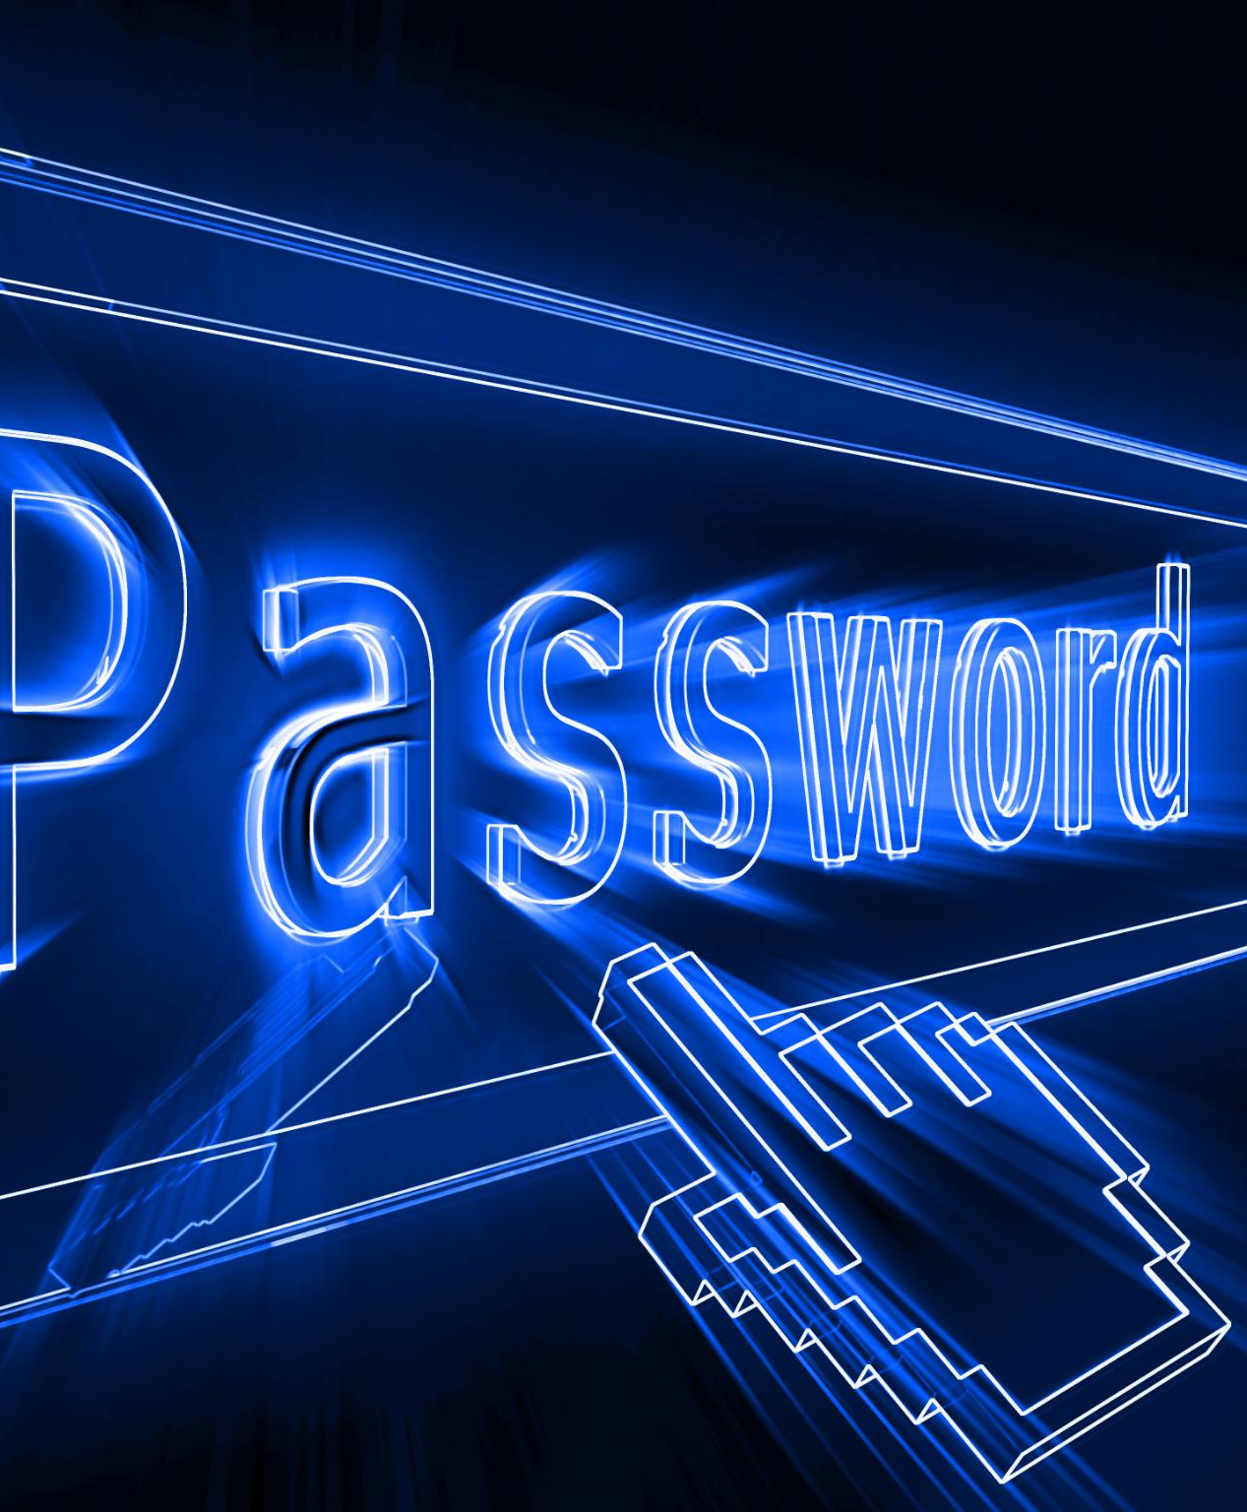
Challenges of Password Management
Multiple Passwords Challenge
  Managing numerous passwords can be overwhelming for users, leading to poor security practices.
Insecure Practices
  Users often resort to insecure methods, like writing down passwords or using easy variations, increasing vulnerability.
Risk of Breaches
  Poor password management can lead to significant security breaches, compromising personal and sensitive information.
Notes:
Managing multiple passwords is a significant challenge for users. Many resort to insecure practices, such as writing passwords down or using simple variations, which can lead to breaches.

Slide 7

Statistics on Password Breaches and Attacks
Alarming Statistics
  Millions of accounts are compromised each year due to weak or stolen passwords, causing significant security risks.
Need for Stronger Security
  The rising number of breaches emphasizes the urgent need for implementing more secure authentication methods like passkeys.
Notes:
Statistics reveal alarming trends: millions of accounts are compromised each year due to weak or stolen passwords. This highlights the urgent need for more secure authentication methods like passkeys.

Slide 8
Introduction to Passkeys
Notes:
Passkeys represent a new paradigm in secure authentication, moving beyond traditional passwords. They offer a more secure and user-friendly way to access accounts and services in today's digital world.

Slide 9

The FIDO Alliance
Passkeys have been created by the FIDO Alliance.
FIDO: Fast Identity Online.
Provide a secure, passwordless authentication method using biometrics, Password Managers, PINs, or patterns tied to cryptographic credentials.
Modern devices can cope with this; TPM, Secure Dongles etc.
Notes:
The Fido Alliance: Mocrosoft, Apple, Google, Amazon, Visa, Mastercard, Password Managers (Dashlane, LastPass, 1 Password, keeper Security, Bitwarden and Enpass Technologies) and a whole host of others.

Slide 10
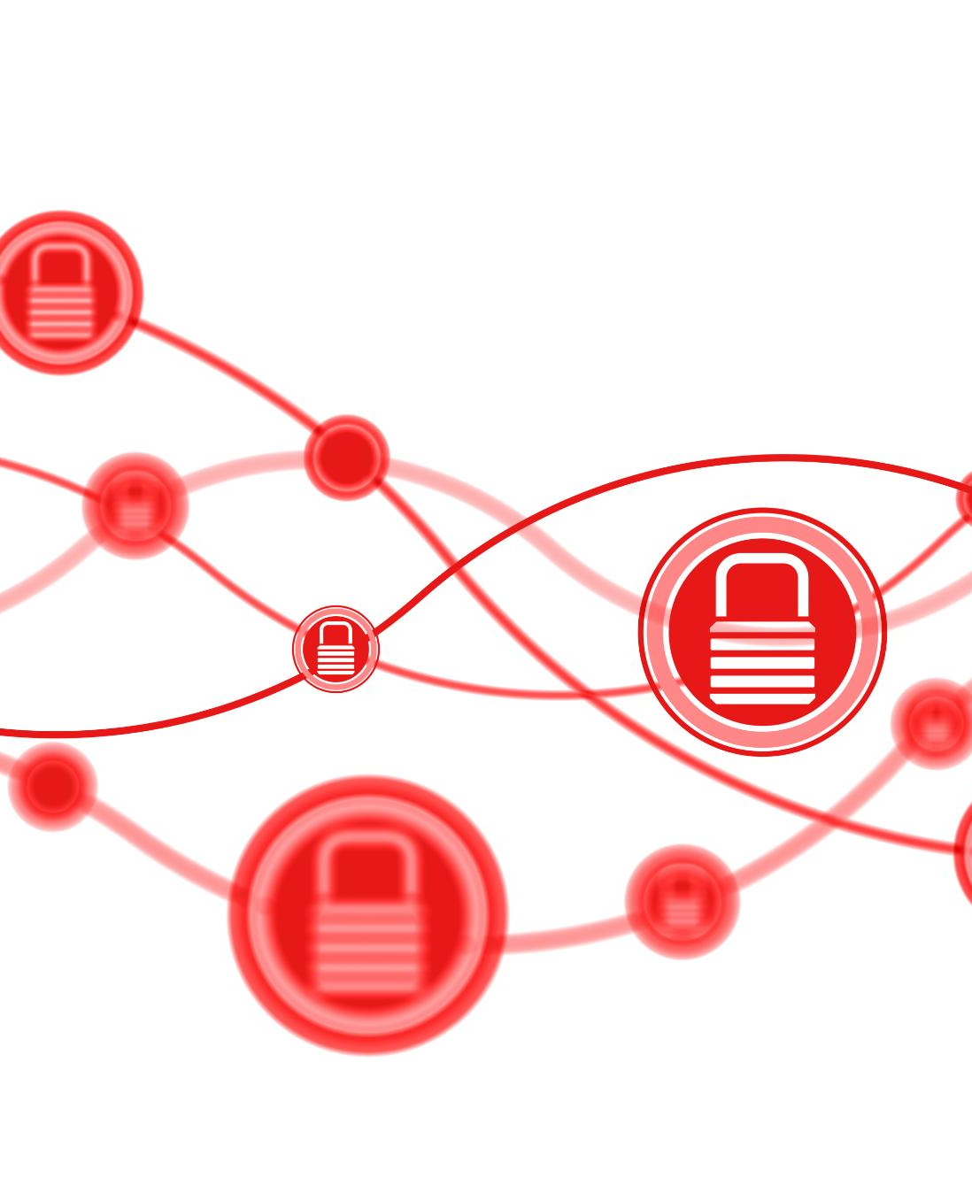
Overview of the Benefits of Passkeys
Enhanced Security
  Passkeys offer enhanced protection against phishing and brute-force attacks, making online transactions safer.
Improved User Experience
  Using passkeys simplifies the login process, providing a more user-friendly and efficient experience.
Reduced Password Management
  Passkeys lessen the need for complicated password management systems, simplifying user authentication.
Notes:
The benefits of passkeys include enhanced security against phishing and brute-force attacks, improved user experience, and reduced reliance on password management. This shift can significantly lower the risks associated with online authentication.

Slide 11
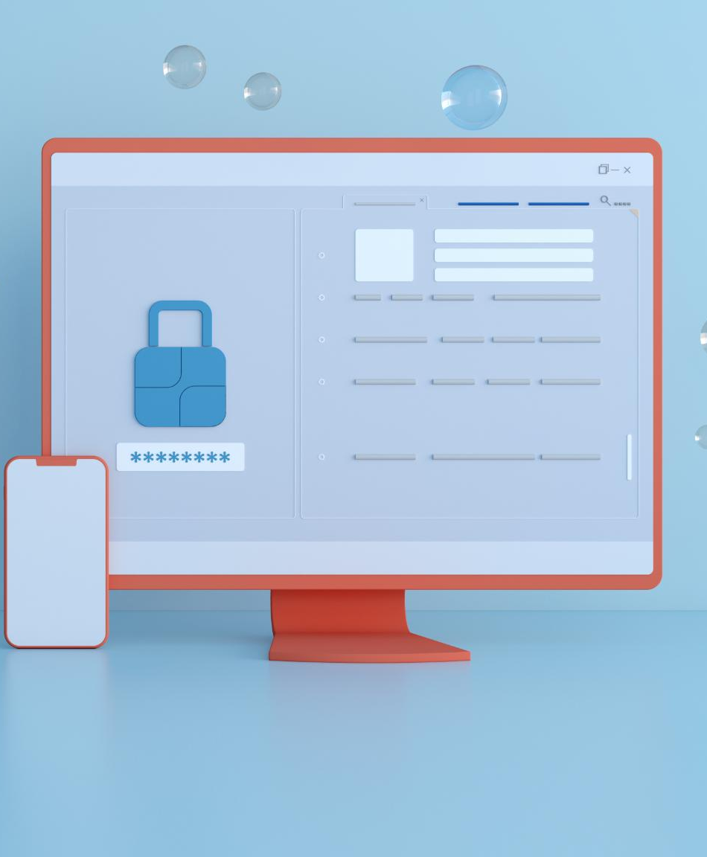
What Are Passkeys?
Cryptographic Key Concept
  Passkeys are cryptographic keys designed to enhance security by replacing traditional passwords, making authentication safer.
Simplified User Experience
  With passkeys, users no longer need to remember multiple passwords, simplifying the login process significantly.
Secure Storage on Devices
  Passkeys are securely stored on devices, ensuring that they are only accessible to authorized users, enhancing overall security.
Notes:
Passkeys are cryptographic keys that replace traditional passwords. Instead of remembering multiple passwords, users can authenticate using a unique key stored securely on their devices. Modern devices have the TPM Trusted Platform Module or can use secure dongles; Yubikey etc.

Slide 12
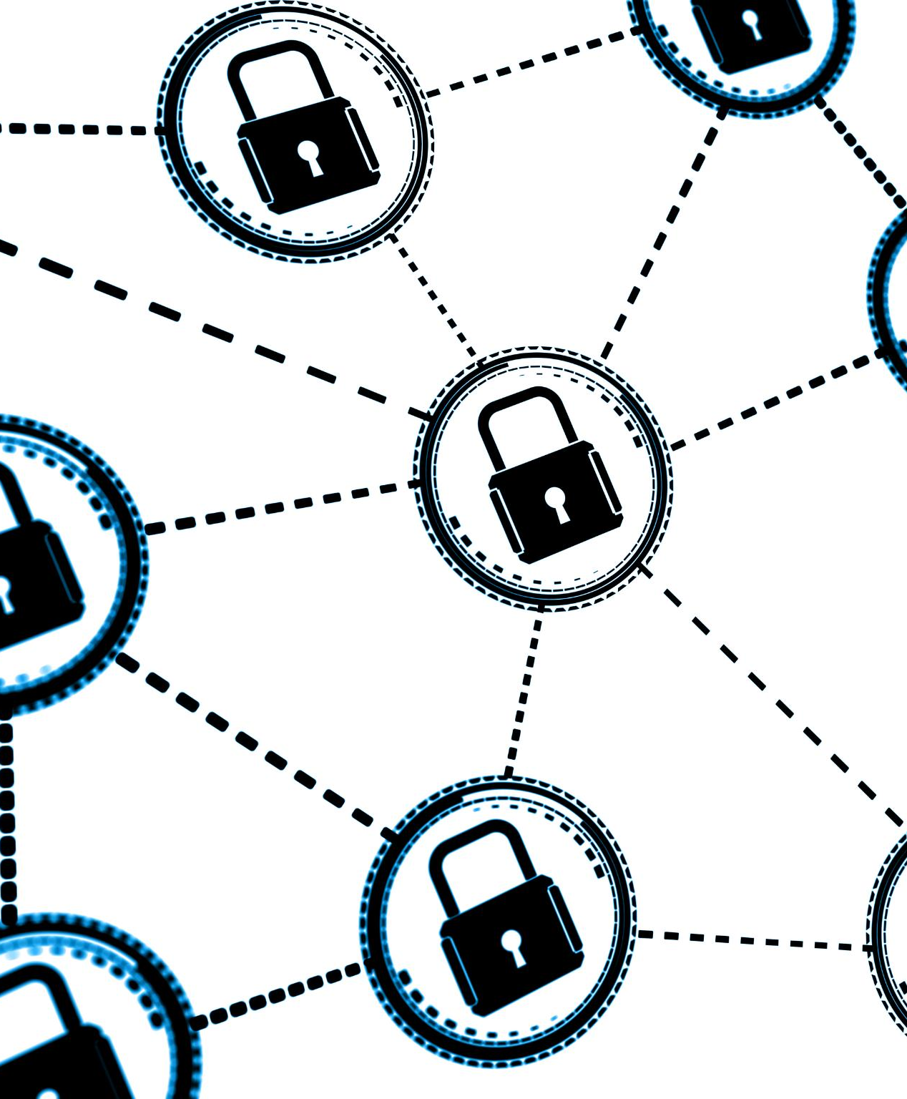
How Do Passkeys Work?
Public Key Cryptography
  Public key cryptography uses a pair of keys to secure user credentials, enhancing security over traditional methods.
Private Key Storage
  The private key is securely stored on the user’s device, preventing unauthorized access from external sources.
Server Security
  Even if a server is compromised, user credentials remain safe as attackers cannot access the private keys.
Notes:
Passkeys utilize public key cryptography, where a private key is stored on the user's device and a public key is stored on the server. This method ensures that even if attackers breach the server, they cannot access user credentials.

Slide 13
How Do Passkeys Work?
Public and Private Keys: These keys are a pair—like a lock and key combination.
The public key is shared openly and used to verify authenticity, while the private key is kept secret and is used to create a secure signature.
Role in Passkeys:
When you create a passkey, your device generates a unique key pair – one of each; a public key and a private key.
The public key is stored with the service you're authenticating with (like a website or app).
The private key stays securely on your device (it never leaves).
Notes:
Passkeys utilize public key cryptography, where a private key is stored on the user's device and a public key is stored on the server. This method ensures that even if attackers breach the server, they cannot access user credentials.
The Public key is stored on the website server you are trying to access. For the Private key you need an authenticator: Be that biometrics, a PIN code, a Password Manager or a hardware device like a Yubikey

Slide 14
How Do Passkeys Work?
Authentication Process:
When you log in to a service, the server sends a challenge (a random piece of data) to your device.
Your device uses the private key to sign this challenge and send it back to the server.
The server uses your public key to verify that the signature is valid thus proving your identity.
This approach ensures:
Security: The private key remains private and safe on your device.
Convenience: No need to remember or type a password.
Phishing Resistance: Even if someone tricks you into visiting a fake website, they won’t have your private key to authenticate.
Notes:
When your device signs the challenge from the server, it sends back the following data for verification:
The Signed Challenge: This is the original challenge data (sent by the server) that has been cryptographically signed using your private key. The signature proves that your device, which holds the private key, processed the challenge.
Public Key Information: While the server already has your public key stored, the response might sometimes include an identifier to associate the signature with the correct public key on the server.
Any Protocol-Specific Metadata: Some authentication protocols include additional metadata to ensure secure and consistent verification. This can vary based on the implementation.
The server then uses your public key to verify the signature. It essentially checks:
That the signature matches the challenge data it sent earlier.
That the signature was indeed created using the private key corresponding to your stored public key.
Because the private key never leaves your device, this method ensures secure authentication without exposing sensitive data. It’s quite ingenious, isn’t it?

Slide 15
Eliminating Phishing with Passkeys
Notes:
Phishing attacks remain one of the most common cyber threats. Passkeys provide a robust defense against these attacks, ensuring that users can authenticate without the risk of divulging sensitive information.

Slide 16
Understanding Phishing Attacks
Definition of Phishing
Phishing attacks involve tricking users into revealing personal information by pretending to be trustworthy sources.
Common Delivery Methods
Phishing attacks frequently occur through deceptive emails or fake websites to lure unsuspecting victims.
Targeted Victims
Phishing attacks primarily target unsuspecting users, exploiting their trust and lack of awareness.
Notes:
Phishing attacks deceive users into providing personal information by masquerading as legitimate entities. They often occur through emails or fake websites, targeting unsuspecting users.

Slide 17
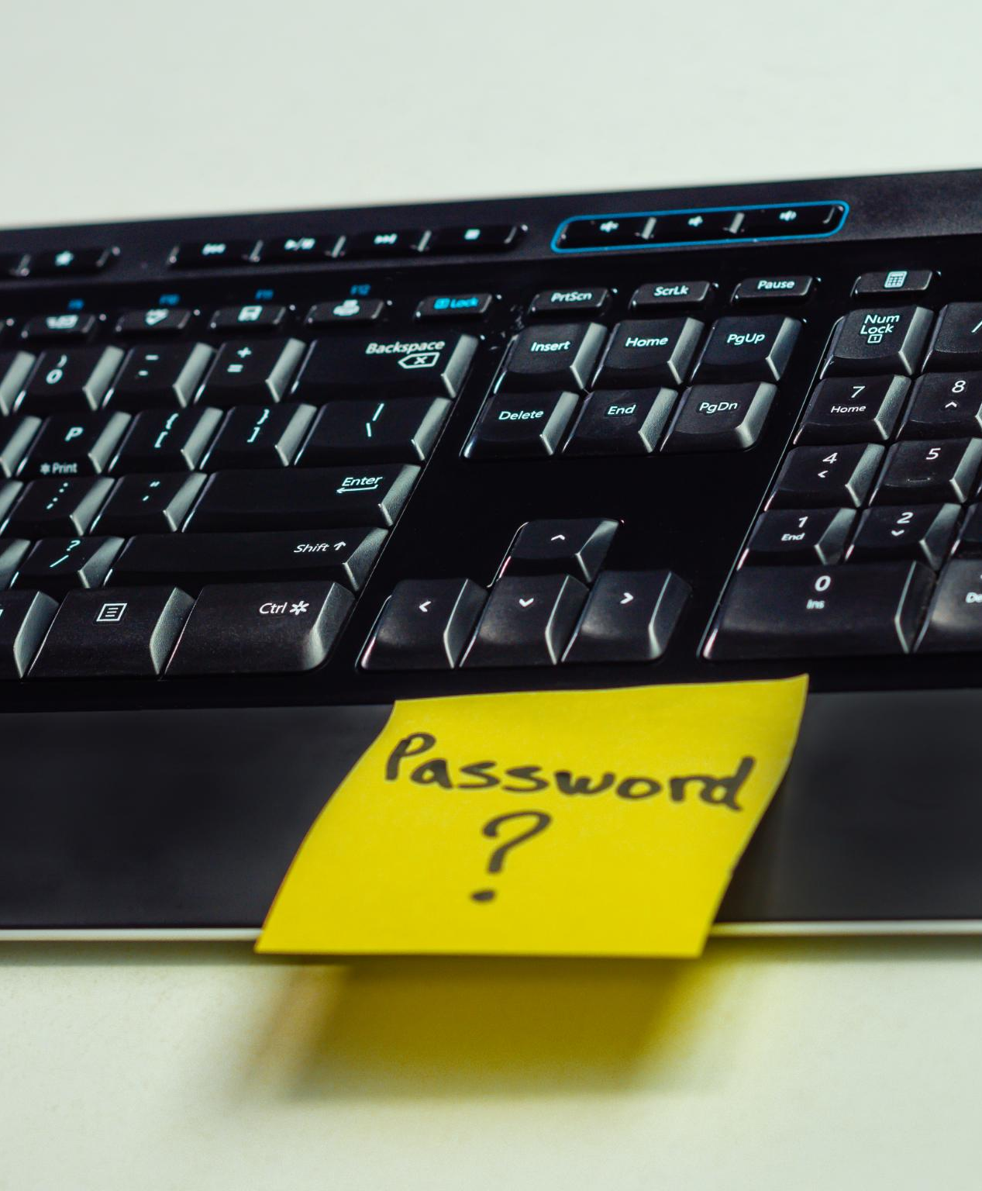
How Passkeys Prevent Phishing
Understanding Passkeys
  Passkeys use cryptographic keys instead of shared secrets, enhancing security against phishing attempts. There is no need to send a password to the internet
Phishing Attacks
  Phishing attacks trick users into revealing sensitive information, but passkeys mitigate these risks effectively. You don’t have to remember (or even know) your private key
Security Benefits
  Even if users are misled to phishing sites, attackers cannot access accounts without the cryptographic key. Your key combination will only work on one specific site.
Notes:
Since passkeys rely on cryptographic keys rather than shared secrets, even if a user is tricked into visiting a phishing site, the attacker cannot obtain the necessary key to access the account.

Slide 18

Real-World Examples and Case Studies
Adoption of Passkeys
  Organizations are increasingly adopting passkeys to effectively combat phishing attacks and enhance cybersecurity. Started in 2022 with Apple & Google.
Effectiveness of Passkeys
  Case studies highlight the effectiveness of passkeys in significantly reducing security vulnerabilities and enhancing protection.
Combating Phishing Attacks
  Passkeys serve as a robust solution for organizations to mitigate the risks associated with phishing attacks.
Notes:
Various organizations have adopted passkeys to combat phishing attacks successfully. Case studies demonstrate the effectiveness of passkeys in enhancing security and reducing vulnerabilities.

Slide 19
Implementing Passkeys
Notes:
Transitioning to passkeys requires careful planning and execution. Organizations must consider compatibility with existing systems and facilitate user adoption through training.

Slide 20

Steps to Integrate Passkeys in Your System
Assess Current Systems
  Begin by evaluating the existing systems to understand their compatibility with passkey integration and identify necessary updates.
Secure Key Storage Architecture
  Develop a robust and secure architecture for storing passkeys that protects against unauthorized access and breaches.
Seamless User Experience
  Ensure that the integration of passkeys provides a seamless and intuitive experience for users during the authentication process.
Notes:
Integrating passkeys involves assessing current systems, developing a secure architecture for key storage, and ensuring seamless user experiences during the authentication process.

Slide 21

Compatibility with Existing Technologies
Seamless Integration
  Passkeys can be seamlessly integrated with current authentication technologies, enhancing security measures without full system replacements.
Enhanced Security
  Using passkeys improves overall security by adding an extra layer of protection without disrupting existing systems.
Smooth Transition
  The compatibility of passkeys with existing technologies ensures a smooth transition for organizations upgrading their security.
Notes:
Passkeys can be integrated with existing authentication technologies, allowing organizations to enhance their security without a complete overhaul of their systems. This compatibility is crucial for smooth transitions.

Slide 22

User Adoption and Training
Importance of User Adoption
  User adoption is crucial for the effective implementation of passkeys in any organization, affecting overall security.
Comprehensive Training Programs
  Providing comprehensive training programs helps users understand how to effectively utilize passkeys and enhances security practices.
Ongoing Support for Users
  Offering ongoing support is essential to assist users with any challenges they face while using passkeys.
Notes:
Successful implementation of passkeys hinges on user adoption. Organizations should provide comprehensive training and support to ensure that users understand how to utilize passkeys effectively.

Slide 23
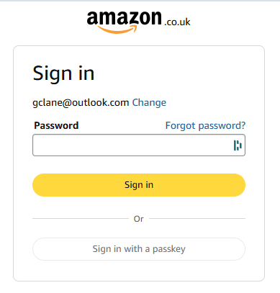
Creating a Passkey in Practice
Check first that your website account is geared up for Passkeys.
Sign in as normal first.
Then Your Account | Settings | Login & Security (or words similar to that)
Look for Create Passkey or Add a Passkey.
Follow the prompts

Slide 24
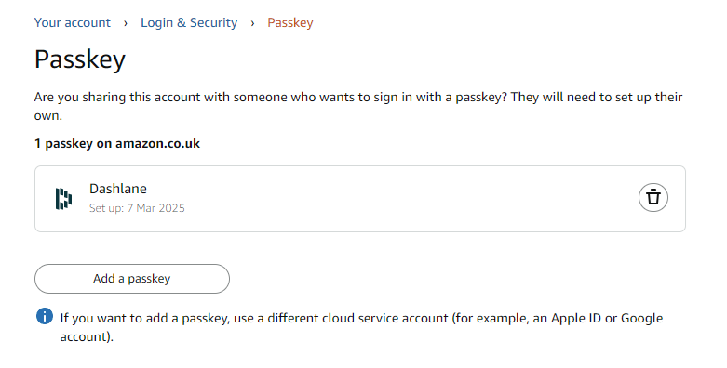
Notes:
Easy to create and easy to delete

Slide 25
Future of Authentication
Notes:
As technology evolves, authentication methods will continue to advance. Passkeys represent a significant step towards a more secure digital future, but challenges remain.

Slide 26
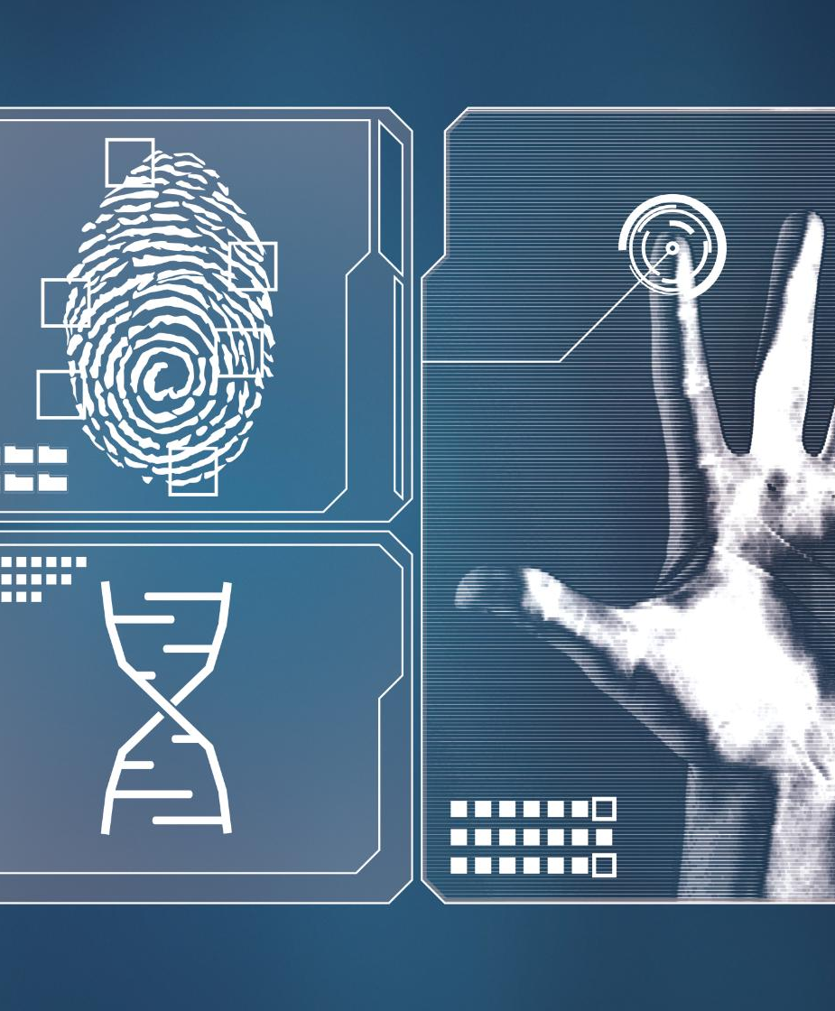
Advancements in Authentication Technology
Biometric Authentication
  Biometric authentication utilizes unique physical traits for securing access, enhancing identity verification processes.
Artificial Intelligence Integration
  Artificial intelligence enhances authentication methods by analysing patterns and identifying anomalies in user behaviour.
Enhanced Security Systems
  The combination of biometrics and AI provides multilayered security, making unauthorized access significantly more difficult.
Notes:
There are ongoing advancements in authentication technologies, including biometric authentication and artificial intelligence, which will enhance security further and complement passkey systems.

Slide 27

Potential Challenges and Solutions
User Confusion
  User confusion can hinder the adoption of passkeys, leading to resistance in utilizing this technology effectively.
Technological Barriers
  Technological barriers may arise due to compatibility issues or lack of infrastructure, impacting the effectiveness of passkeys.
Developing Solutions
  Identifying challenges and creating solutions is vital for the successful adoption of passkeys in various applications.
Notes:
While passkeys offer numerous benefits, challenges such as user confusion and technological barriers may arise. Identifying these challenges and developing effective solutions is vital for successful adoption.

Slide 28
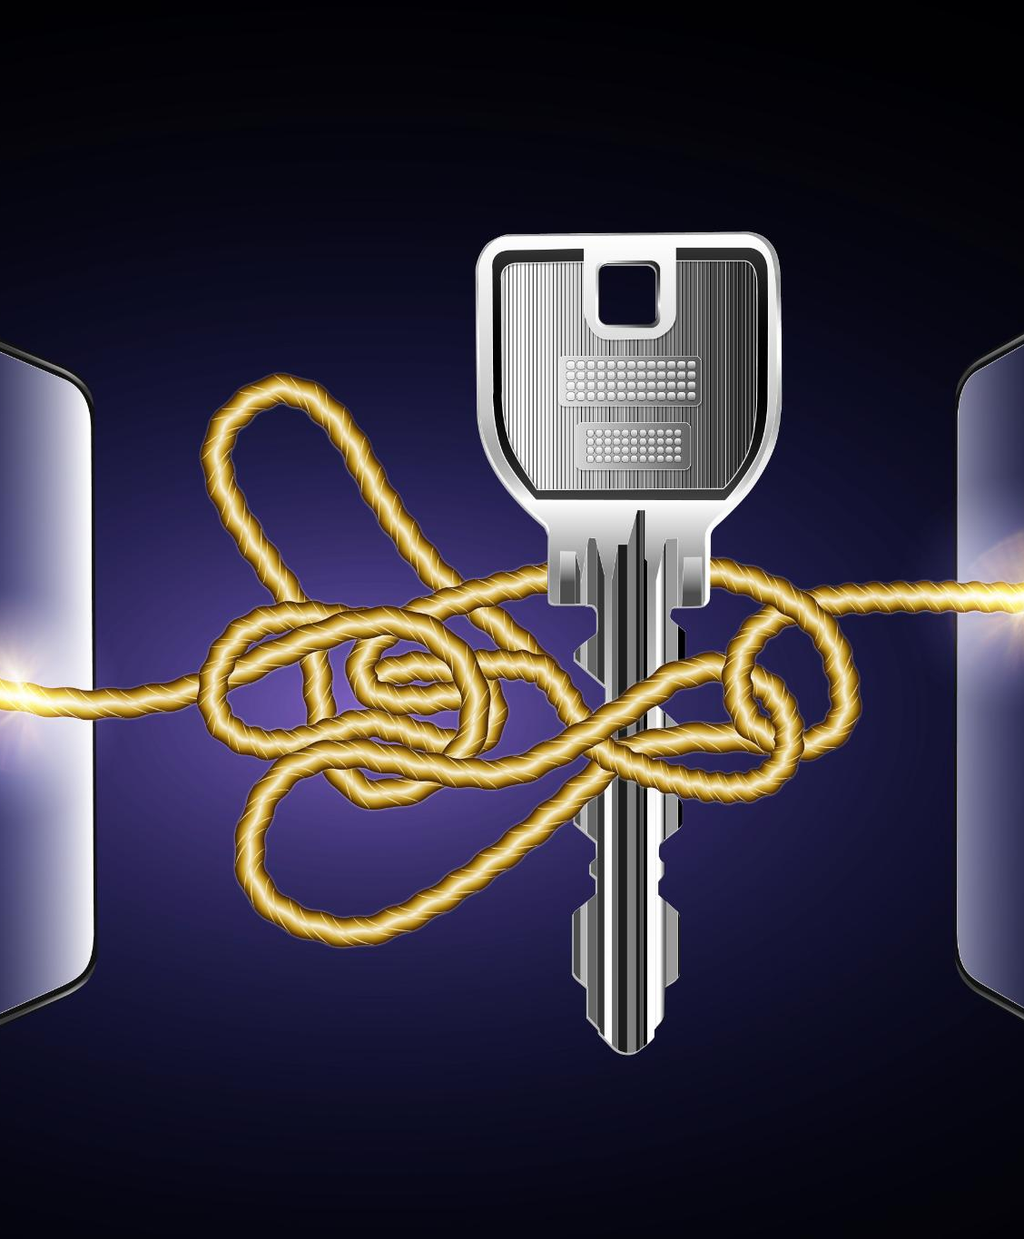
Predictions for Widespread Adoption
Growing Awareness of Passkeys
  As awareness of the benefits of passkeys increases, more organizations are likely to adopt them as a secure authentication method.
Shift Towards Enhanced Security
  Organizations are prioritizing security, which is leading to a significant rise in the adoption of passkeys.
Standardization of Authentication Methods
  Experts predict that passkeys will become a standardized approach in secure authentication practices across various sectors.
Notes:
Many experts predict that passkeys will become a standard in secure authentication as awareness of their benefits grows. As organizations prioritize security, the adoption of passkeys is expected to rise significantly.

Slide 29
Conclusion
Future of Authentication
Passkeys represent a significant advancement in secure authentication methods, overcoming the vulnerabilities of traditional passwords.
Cybersecurity Importance
As technology evolves, adopting passkeys will be crucial for enhancing cybersecurity measures and protecting sensitive information.
Notes:
In conclusion, passkeys offer a promising future for secure authentication by addressing the limitations of traditional passwords. As technology advances, embracing passkeys will be essential for robust cybersecurity.
Lets see it in action:
Google.
Git Hub
Amazon
BMW

Slide 30
Demonstration & Discussion
Notes:
Discuss

Slide 31
Further Reading
The Fido Alliance Directory of sites using Passkeys
https://fidoalliance.org/passkeys/ Passkeys Directory
DashLane Password Manager
https://support.dashlane.com/hc/en-us/articles/21781136724114-Learn-about-passkeys
Joomla (CMS) Magazine article
https://magazine.joomla.org/all-issues/december/passwordless-authentication-for-secure-fast-easy-logins-in-joomla-4
Notes:
Discuss

