Slide 1

Raspberry Pi Practical Demo
Notes:
The Raspberry Pi has transformed how we think about computing, making it accessible and affordable. In this presentation, we will explore the fundamentals of Raspberry Pi, its features, its educational and creative uses, practical applications, and future developments.

Slide 2
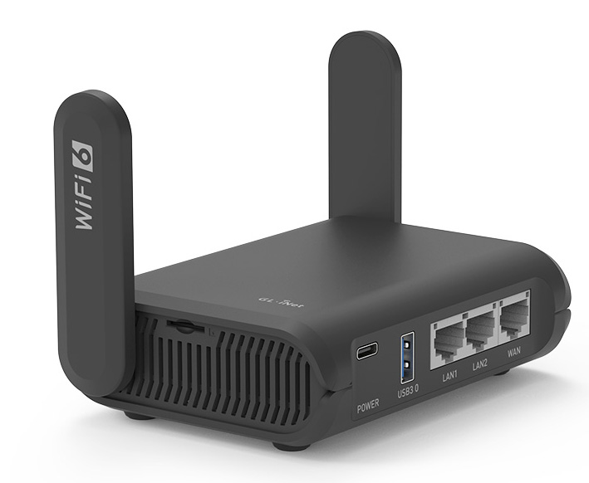
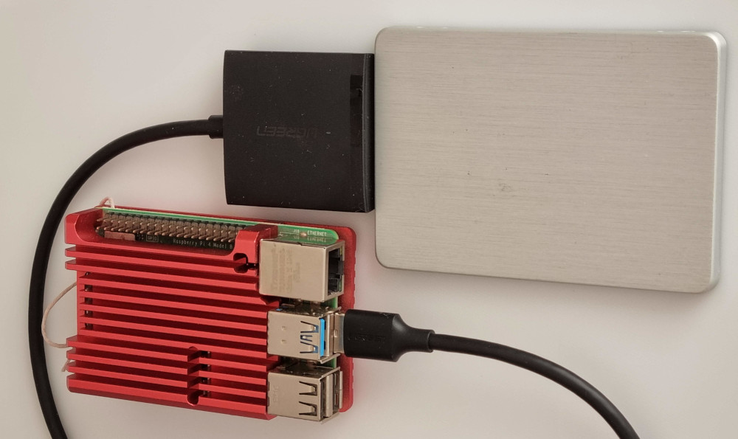
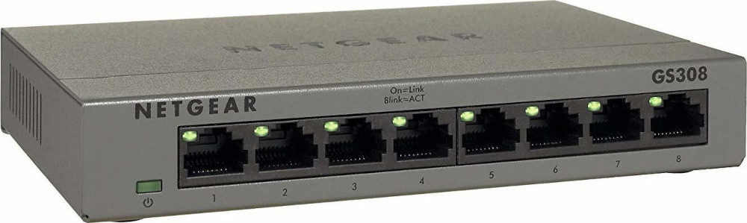
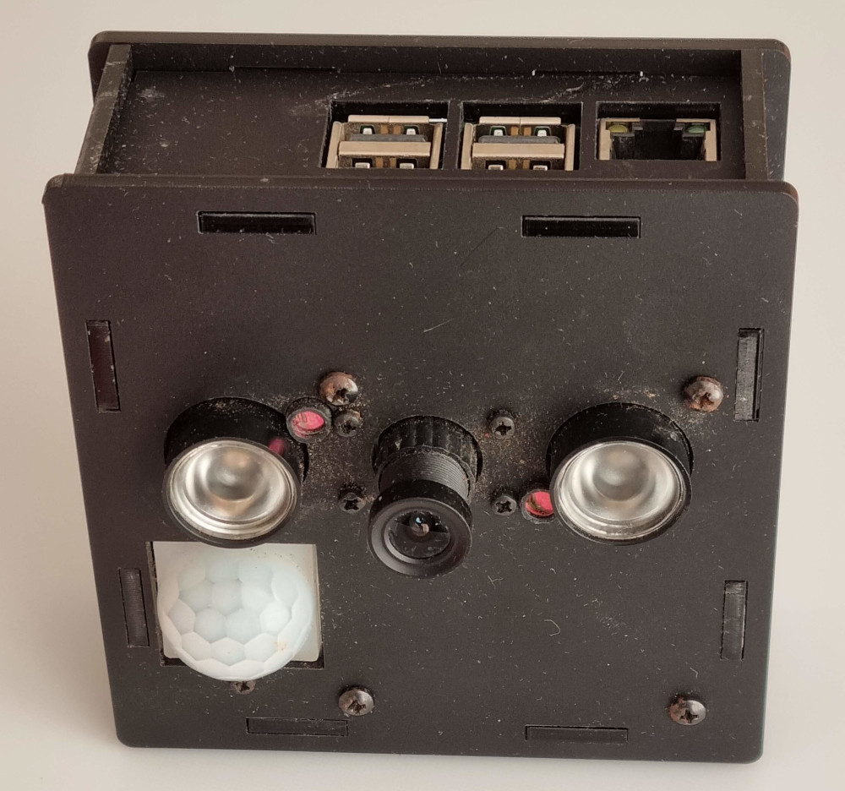
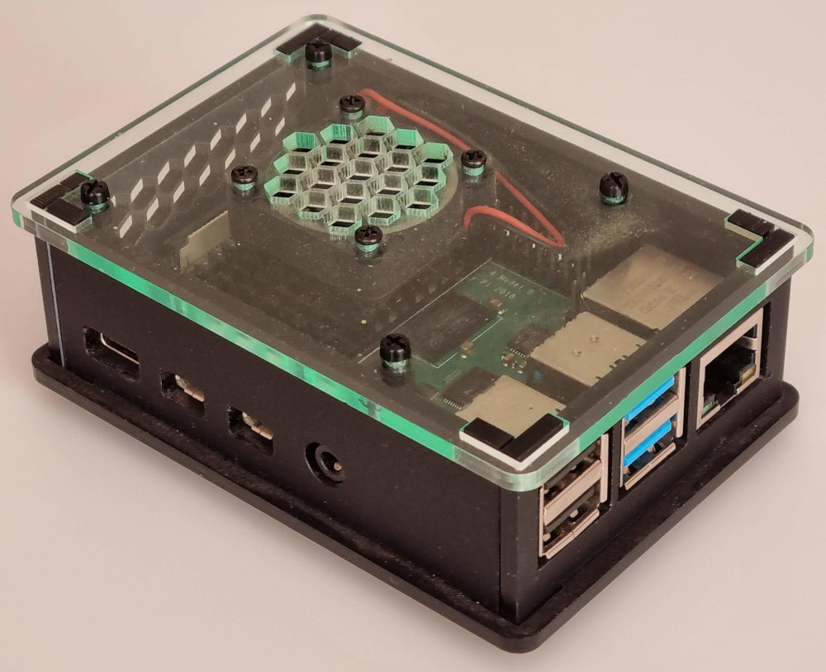
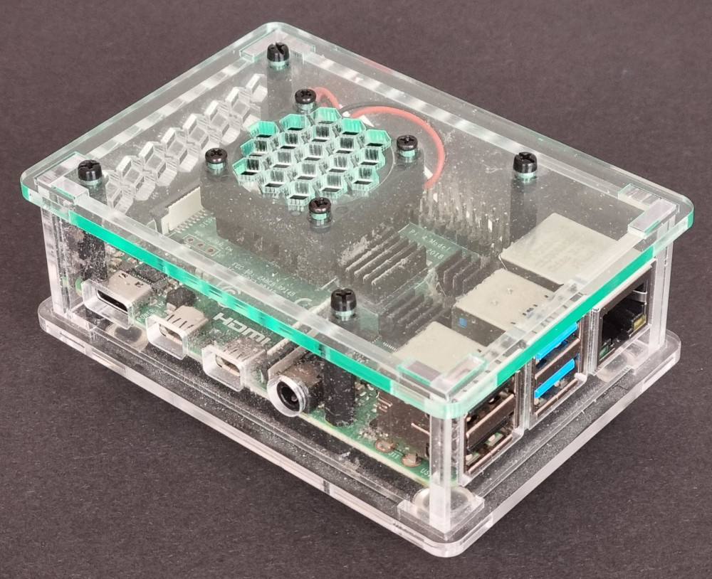
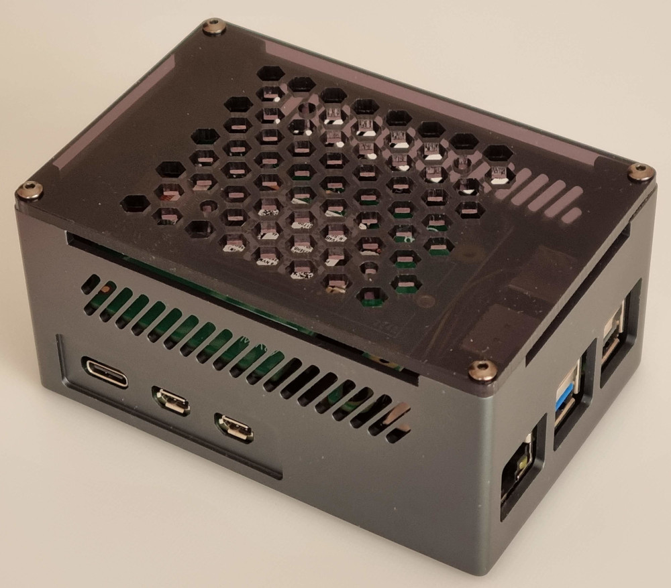
Networked Hardware
RP
Router
RPi-red NAS
8-way Switch
MotionEye
RPi-black
RPi-clear
RPi5
Notes:
The Raspberry Pi has transformed how we think about computing, making it accessible and affordable. In this presentation, we will explore the fundamentals of Raspberry Pi, its features, its educational and creative uses, practical applications, and future developments.

Slide 3
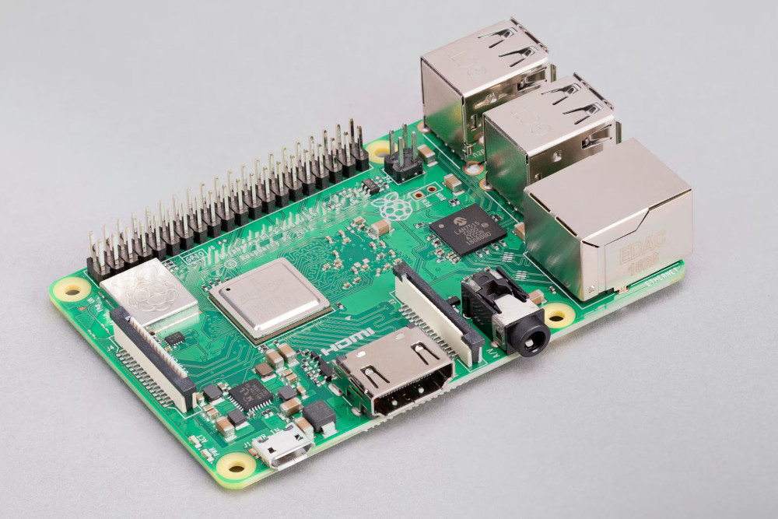
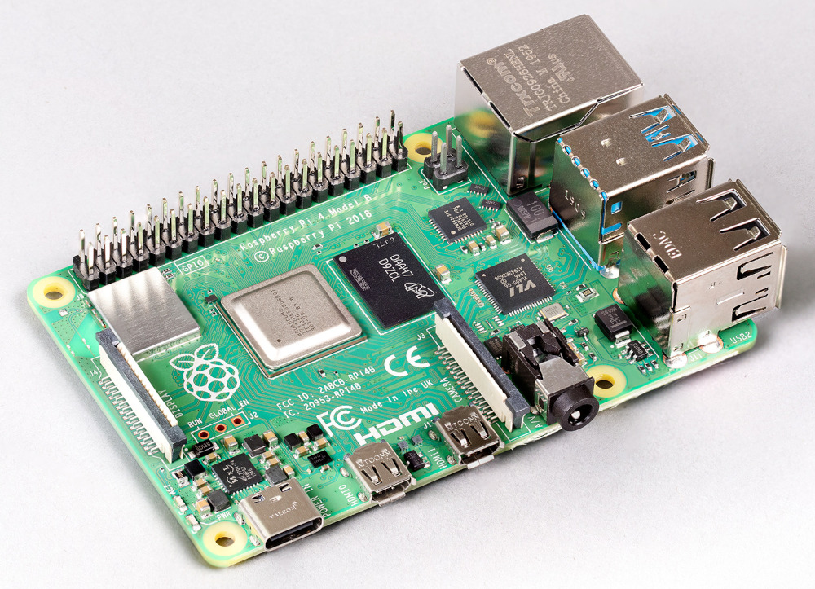
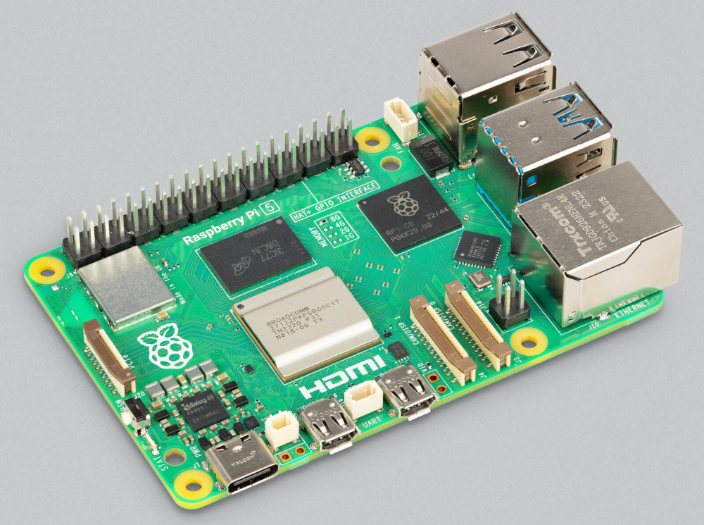
Raspberry Pi Devices Inside
Raspberry Pi 4B
in red, black & clear
Raspberry Pi 3B+
in MotionEye
Raspberry Pi 5
in RPi5
Notes:
The Raspberry Pi has transformed how we think about computing, making it accessible and affordable. In this presentation, we will explore the fundamentals of Raspberry Pi, its features, its educational and creative uses, practical applications, and future developments.

Slide 4
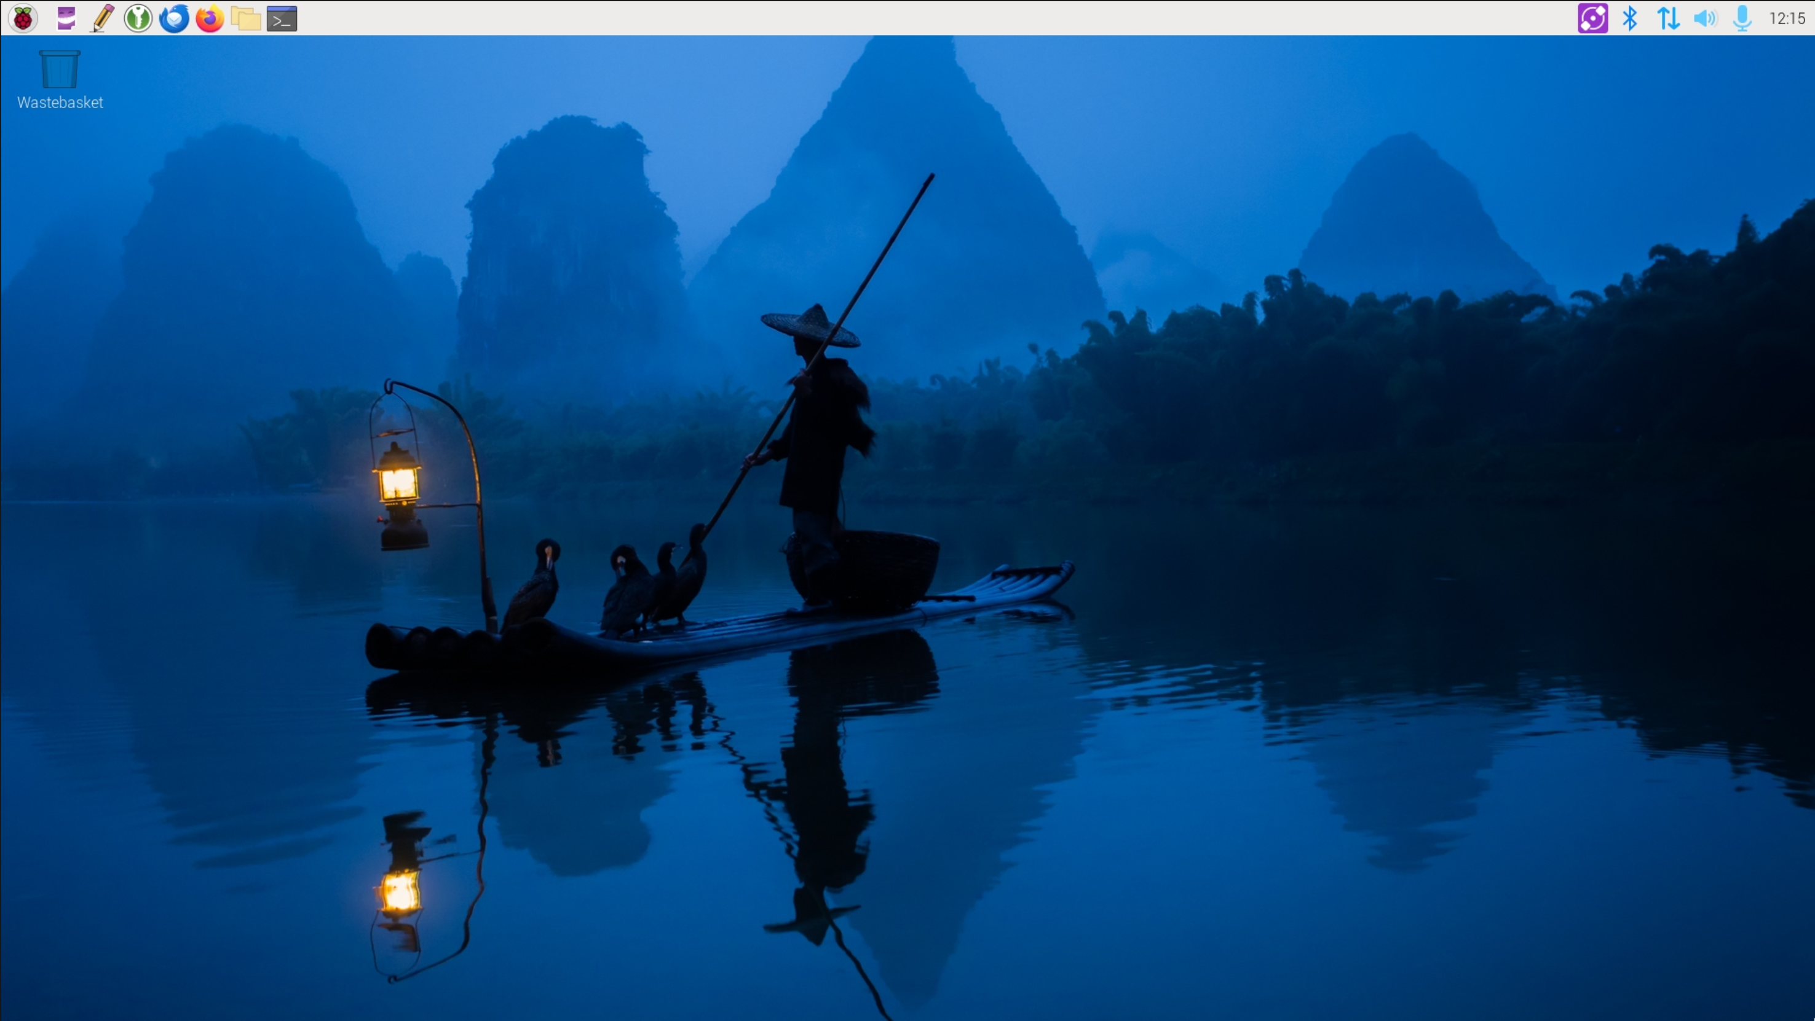
Raspberry Pi OS Home Screen
Notes:
The Raspberry Pi has transformed how we think about computing, making it accessible and affordable. In this presentation, we will explore the fundamentals of Raspberry Pi, its features, its educational and creative uses, practical applications, and future developments.

Slide 5
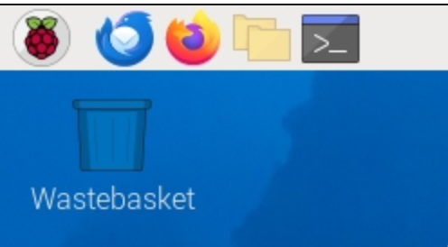
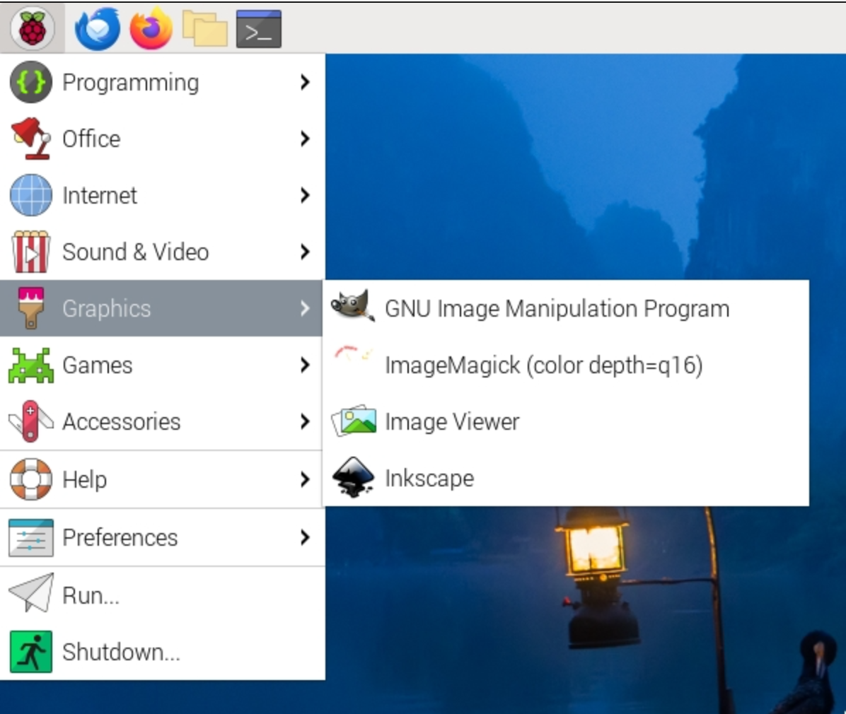
Navigation
Notes:
The Raspberry Pi has transformed how we think about computing, making it accessible and affordable. In this presentation, we will explore the fundamentals of Raspberry Pi, its features, its educational and creative uses, practical applications, and future developments.

Slide 6
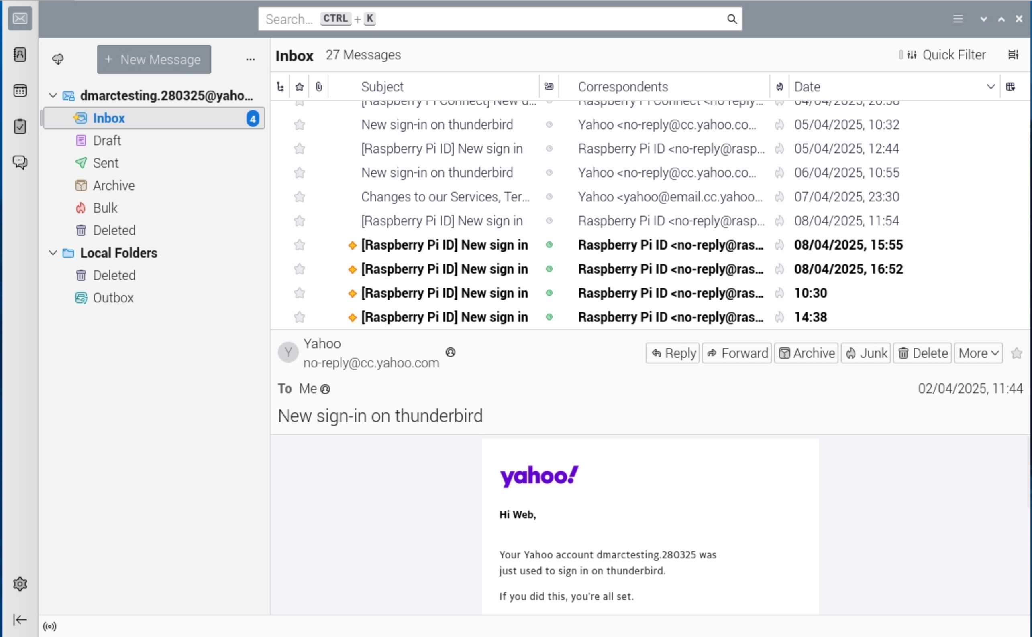
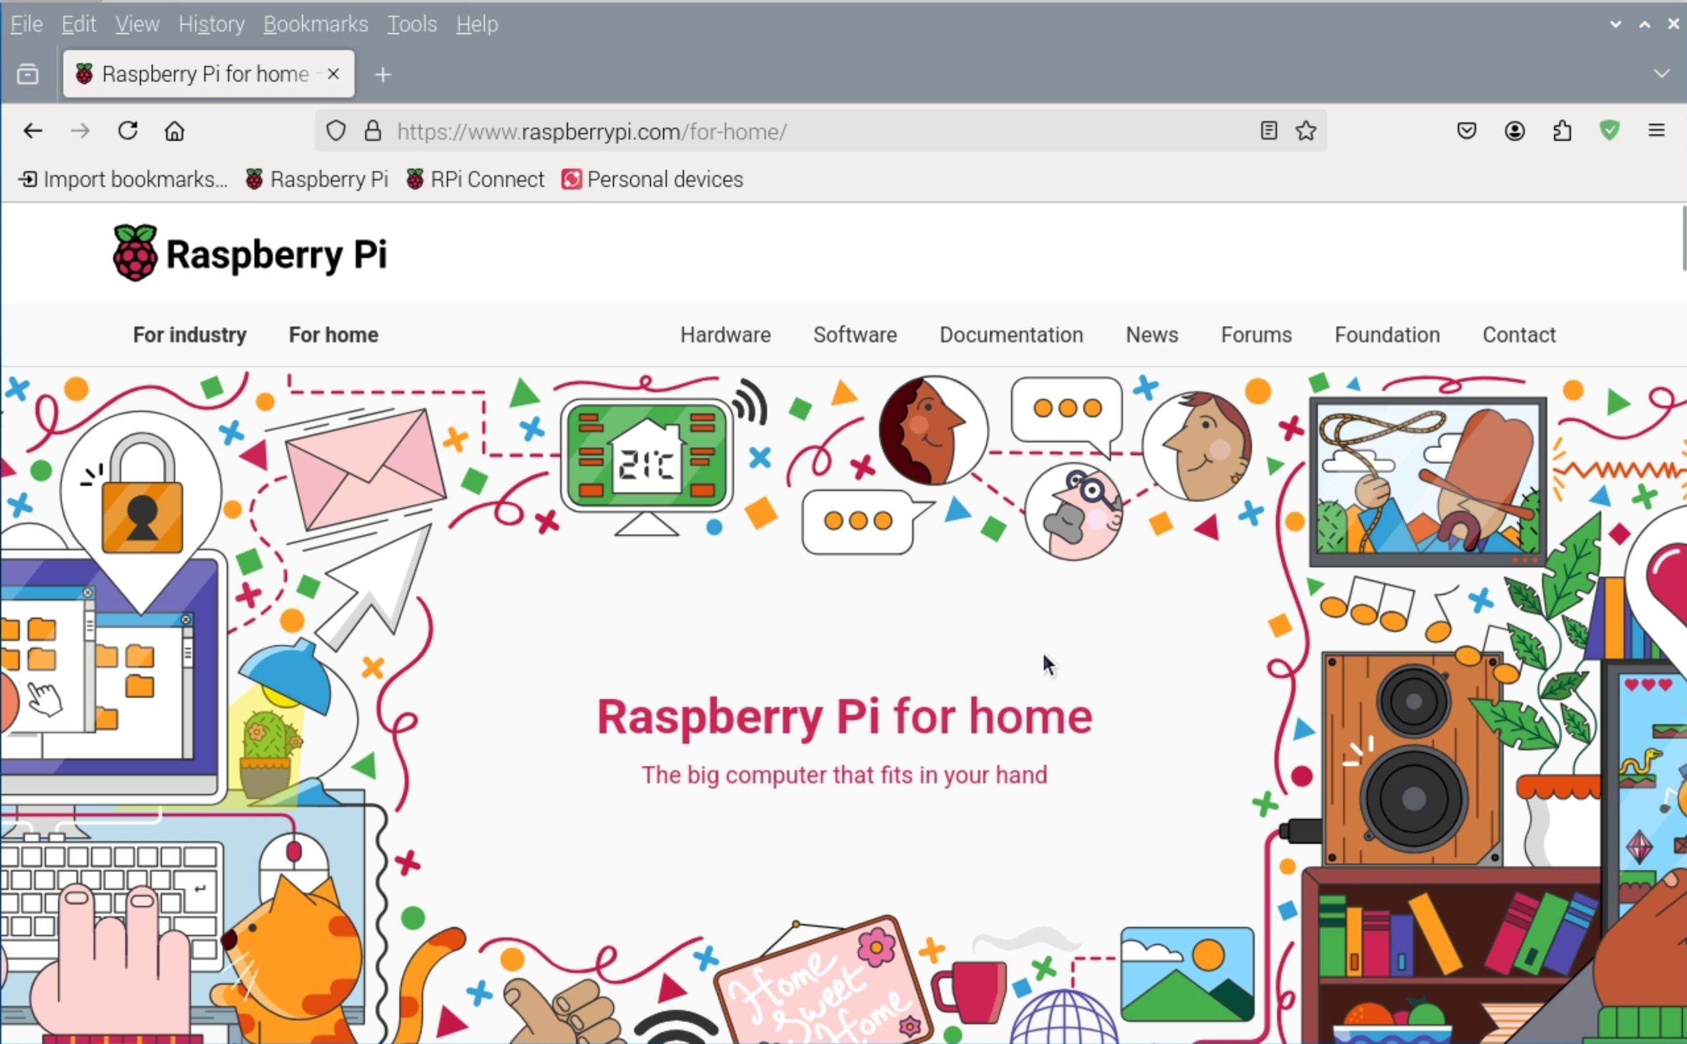
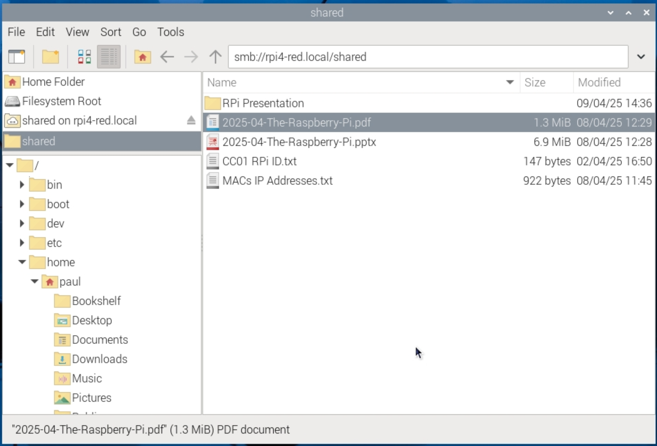
Notes:
The Raspberry Pi has transformed how we think about computing, making it accessible and affordable. In this presentation, we will explore the fundamentals of Raspberry Pi, its features, its educational and creative uses, practical applications, and future developments.

Slide 7
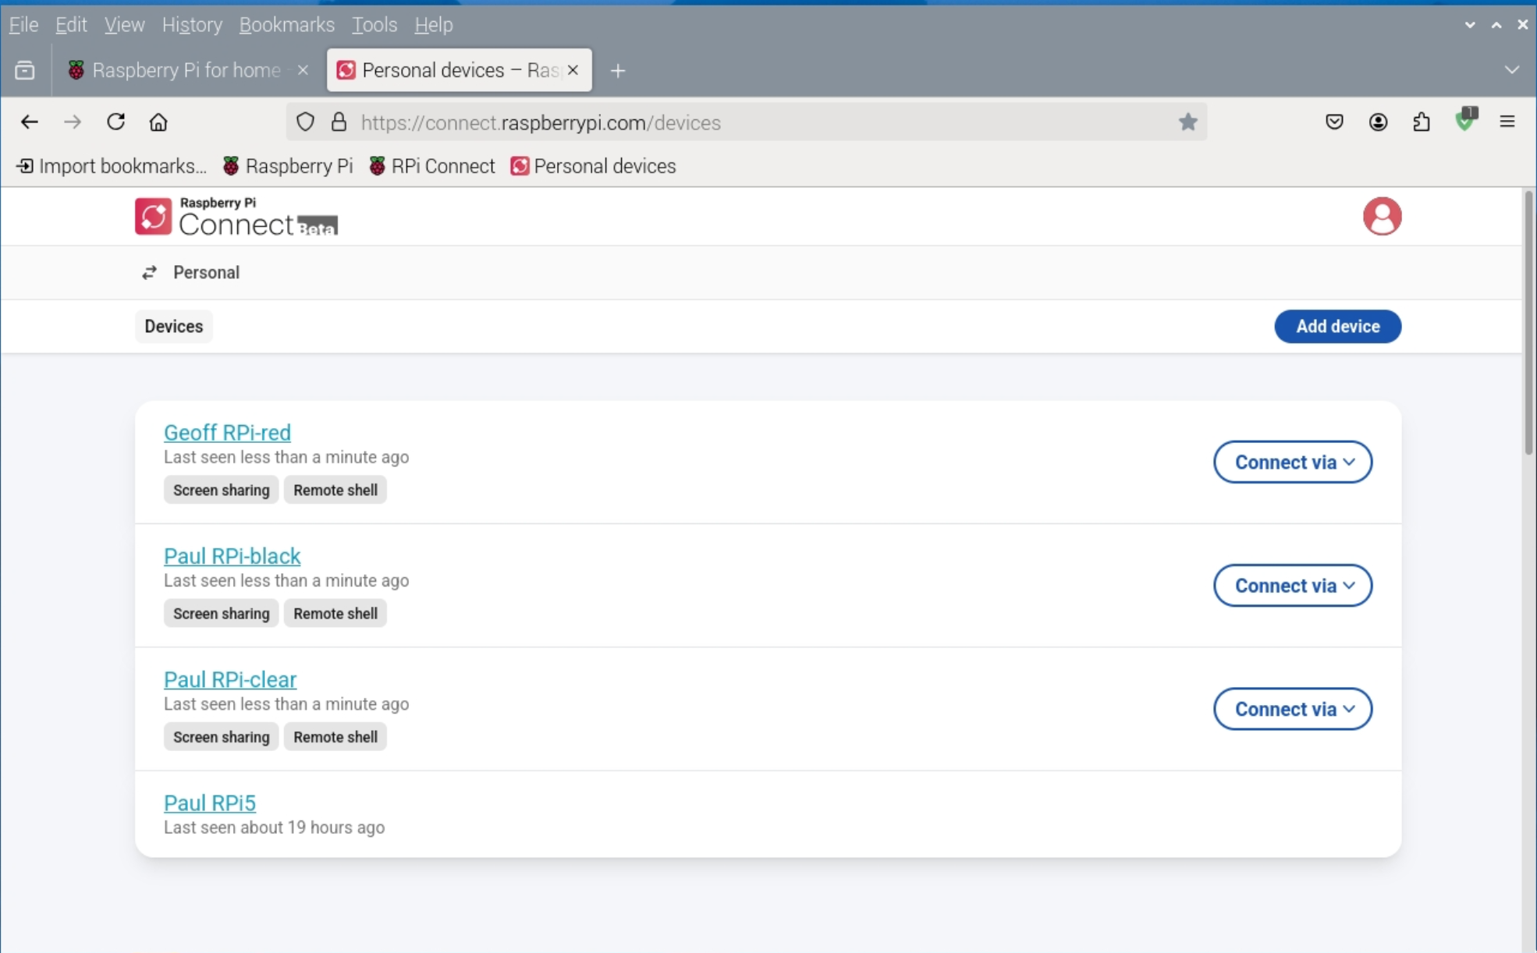
Raspberry Pi Connect
Notes:
The Raspberry Pi has transformed how we think about computing, making it accessible and affordable. In this presentation, we will explore the fundamentals of Raspberry Pi, its features, its educational and creative uses, practical applications, and future developments.

Slide 8
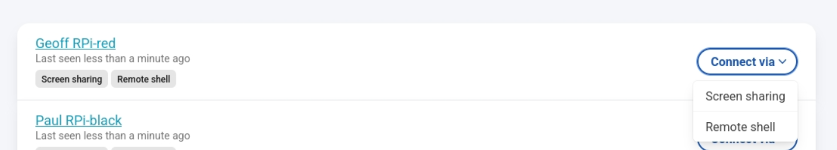
Raspberry Pi Connect – Step 2
Notes:
The Raspberry Pi has transformed how we think about computing, making it accessible and affordable. In this presentation, we will explore the fundamentals of Raspberry Pi, its features, its educational and creative uses, practical applications, and future developments.

Slide 9
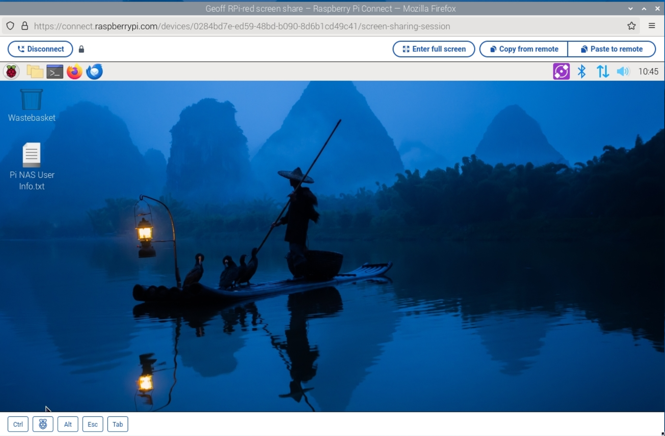
Raspberry Pi Connect – Step 3
Notes:
The Raspberry Pi has transformed how we think about computing, making it accessible and affordable. In this presentation, we will explore the fundamentals of Raspberry Pi, its features, its educational and creative uses, practical applications, and future developments.

Slide 10
Getting Your Laptop Connected
GL-AXT1800 router WiFi:
SSID: GL-AXT1800-594, GL-AXT1800-594-5G
Password: ComputerClub-01
MotionEye:
http://192.168.0.63 User: Geoff - no password
Notes:
The Raspberry Pi has transformed how we think about computing, making it accessible and affordable. In this presentation, we will explore the fundamentals of Raspberry Pi, its features, its educational and creative uses, practical applications, and future developments.

Slide 11
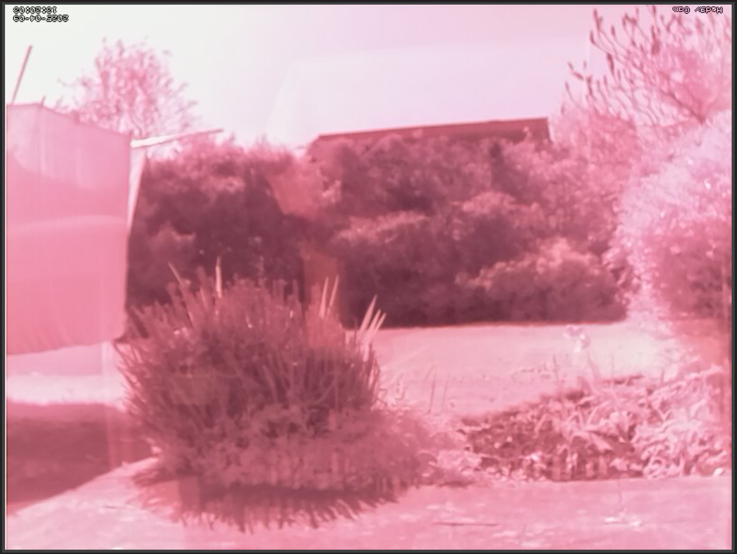
MotionEye Output - IR Camera
Notes:
The Raspberry Pi has transformed how we think about computing, making it accessible and affordable. In this presentation, we will explore the fundamentals of Raspberry Pi, its features, its educational and creative uses, practical applications, and future developments.

Slide 12
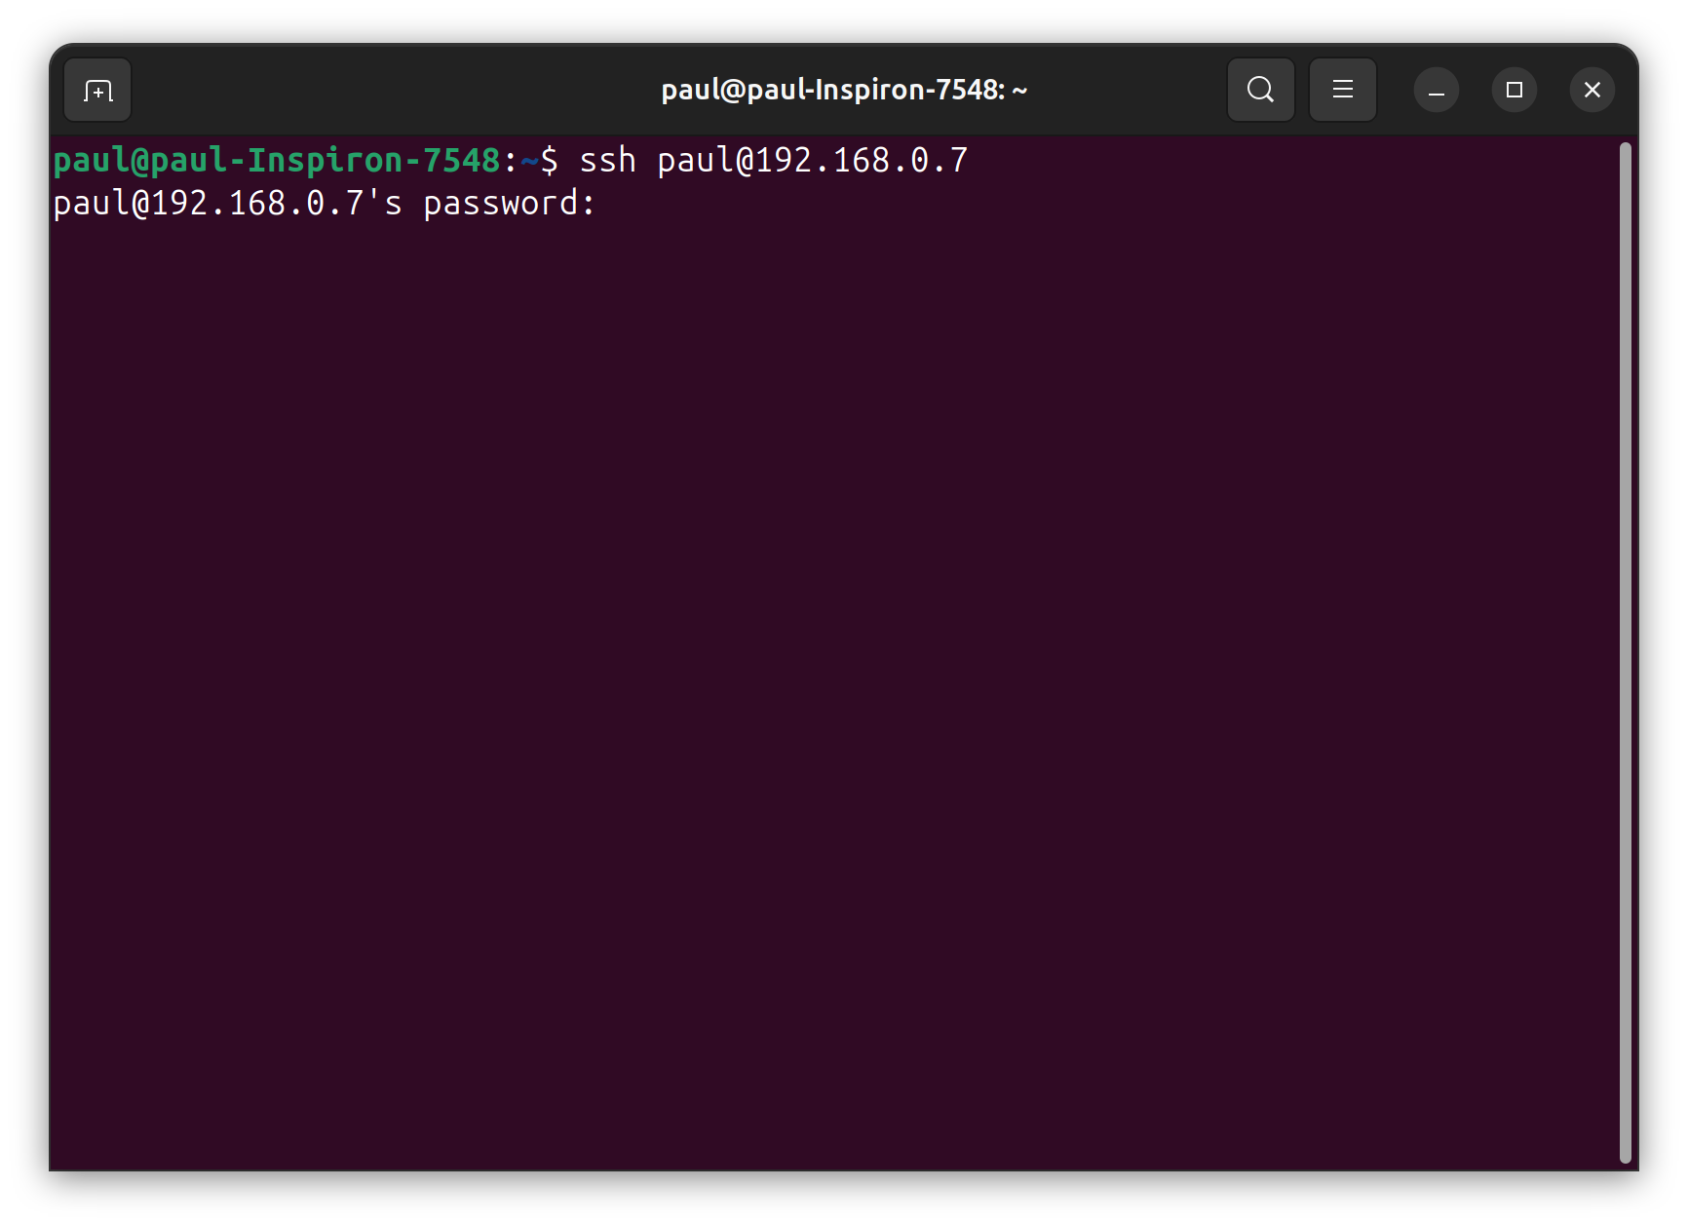
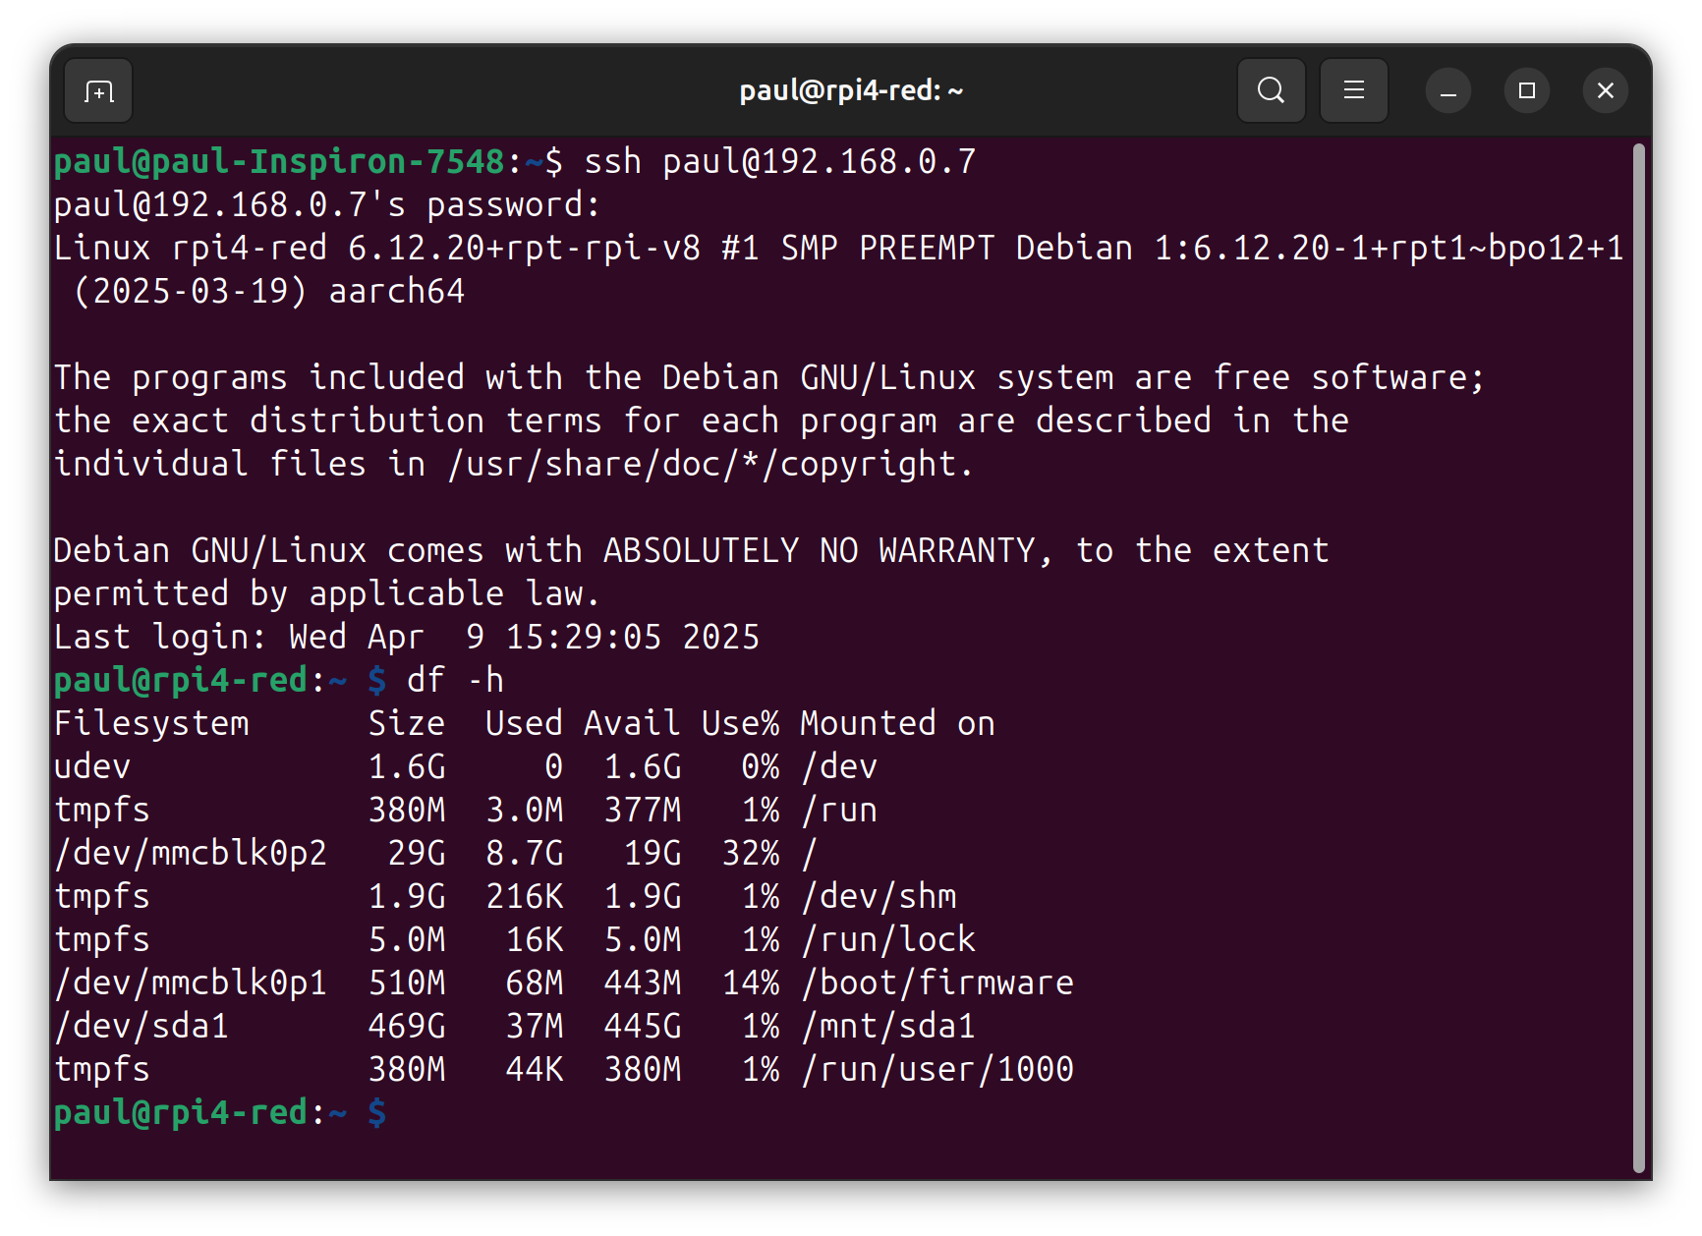
Connecting to Networked Devices Using SSH
Notes:
The Raspberry Pi has transformed how we think about computing, making it accessible and affordable. In this presentation, we will explore the fundamentals of Raspberry Pi, its features, its educational and creative uses, practical applications, and future developments.

Slide 13
Useful Links
Raspberry Pi:
https://www.raspberrypi.com/
Raspberry Pi Connect:
https://www.raspberrypi.com/software/connect/
Raspberry Pi Projects:
https://projects.raspberrypi.org/en
More Pi Projects:
https://pimylifeup.com/raspberry-pi-index/
Pi Hut:
https://thepihut.com/collections/raspberry-pi-store
Notes:
The Raspberry Pi has transformed how we think about computing, making it accessible and affordable. In this presentation, we will explore the fundamentals of Raspberry Pi, its features, its educational and creative uses, practical applications, and future developments.

