Slide 1
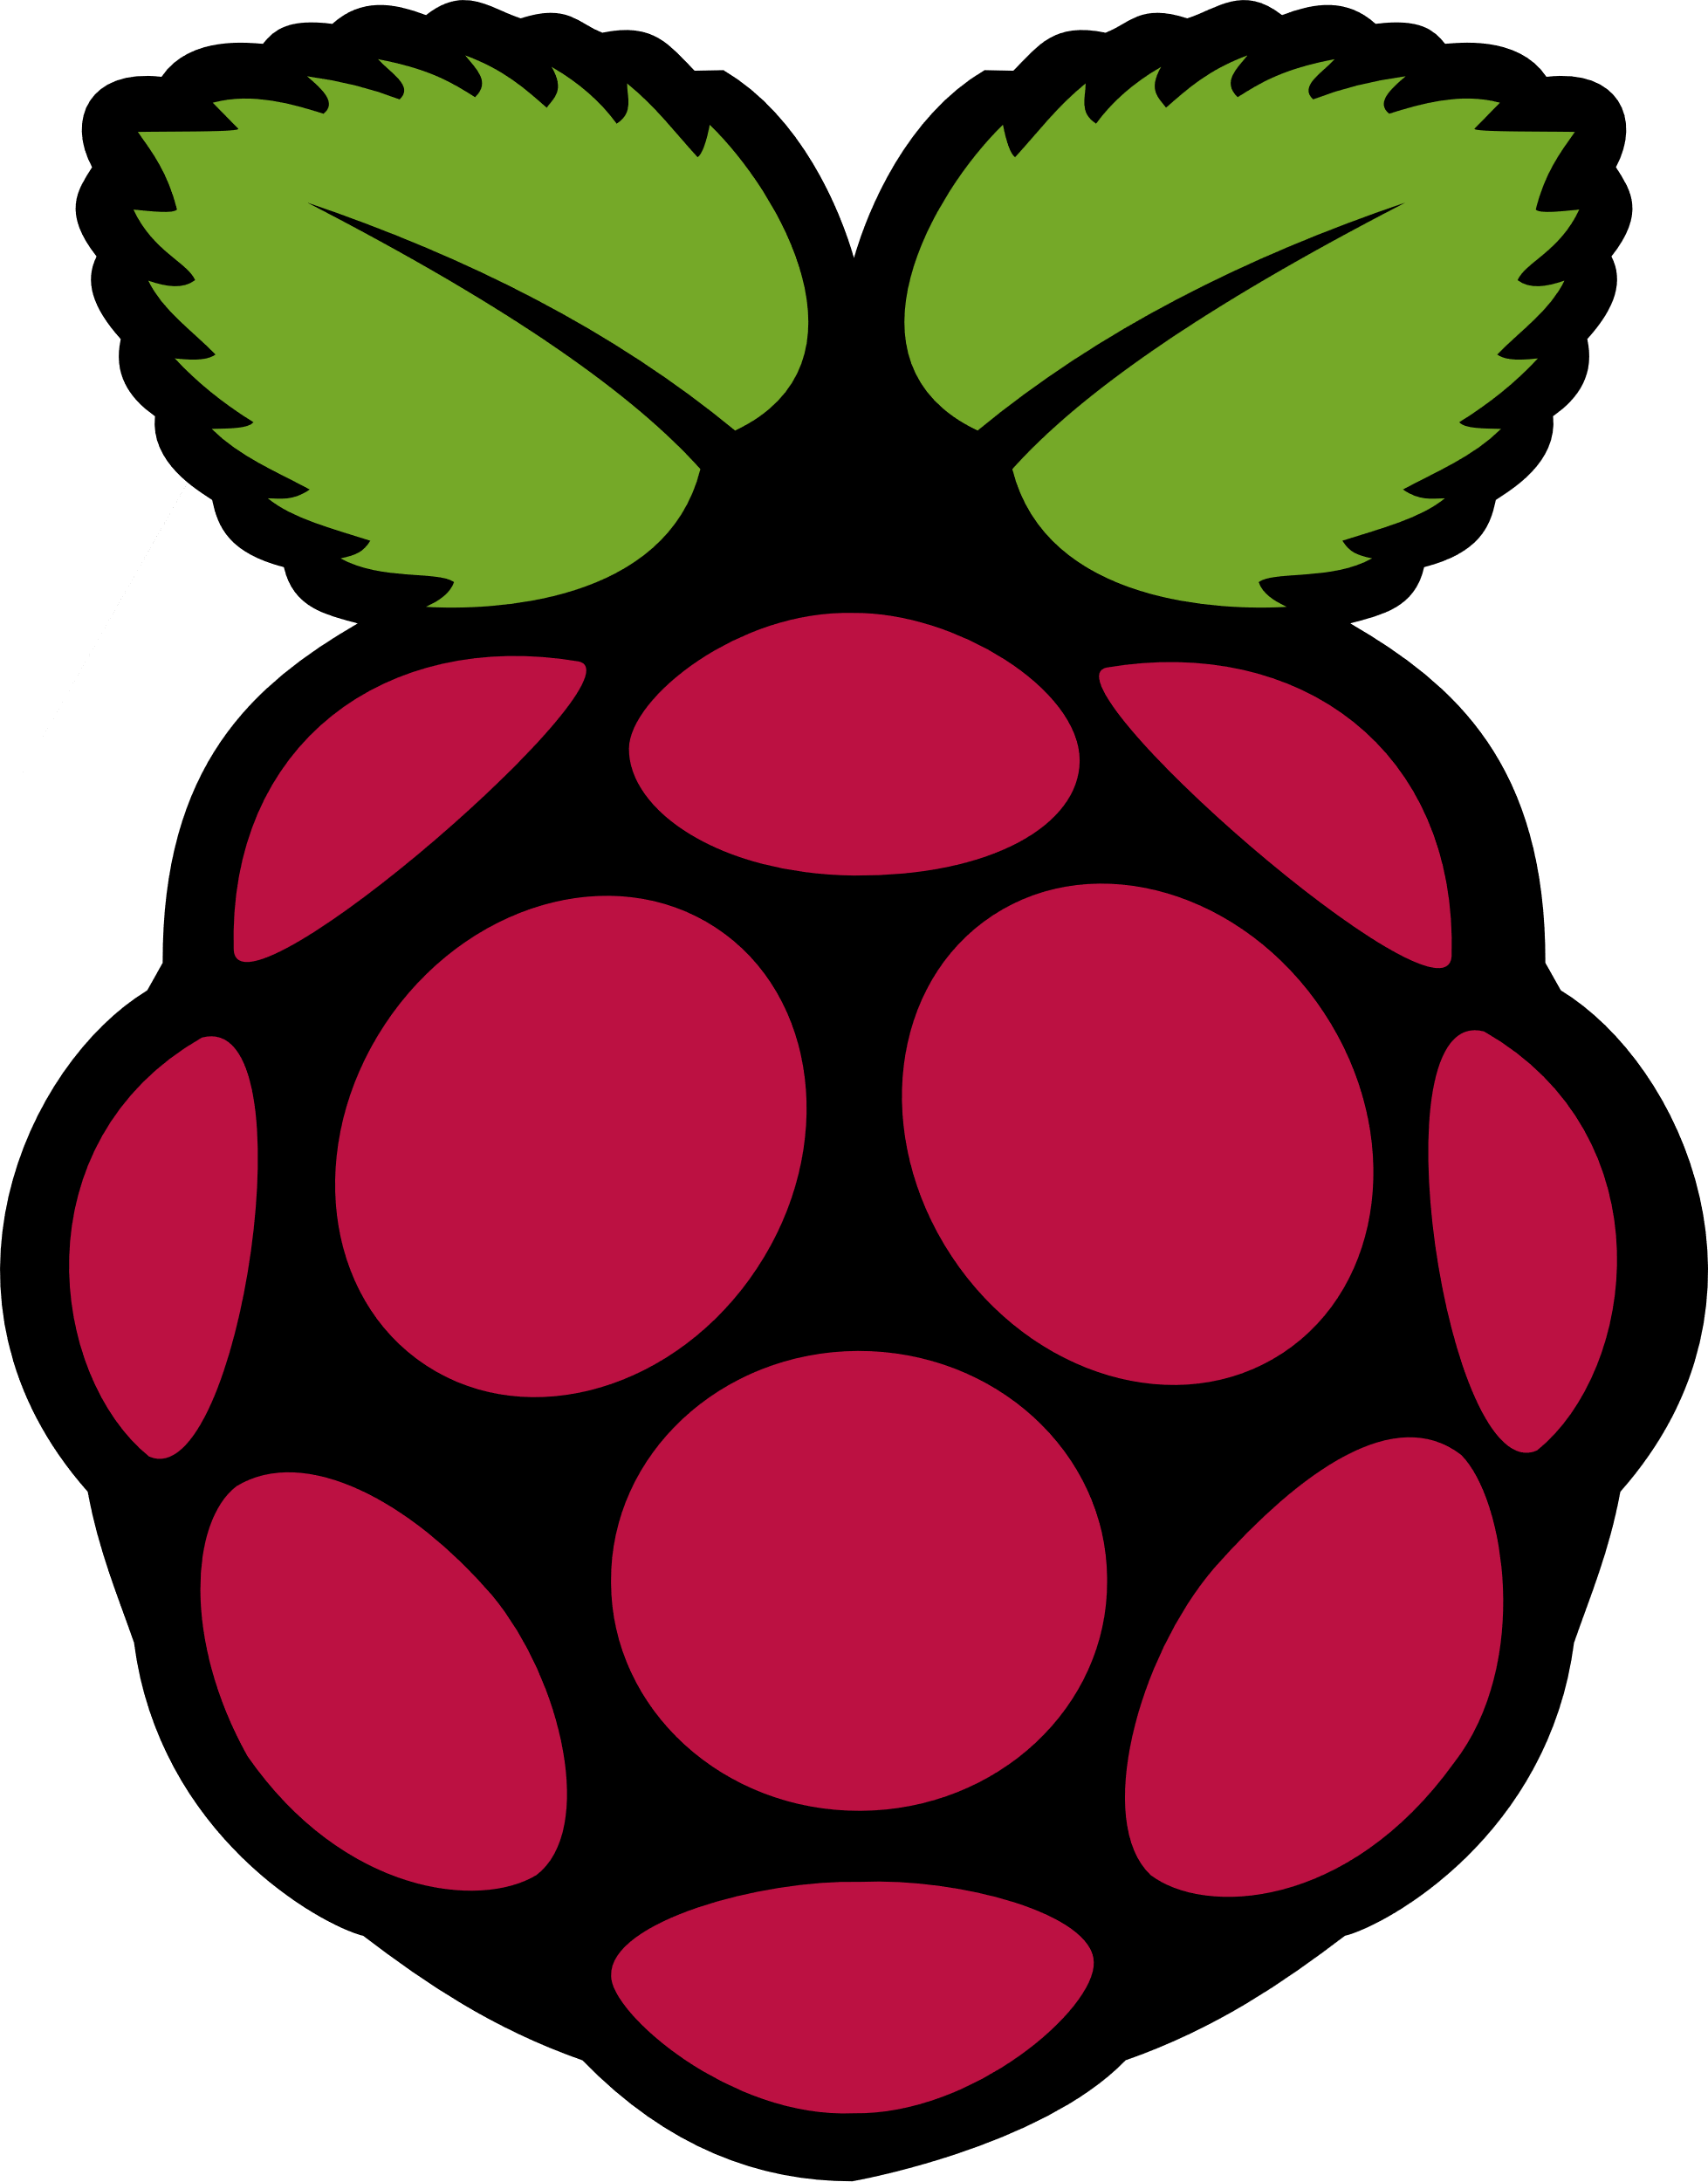
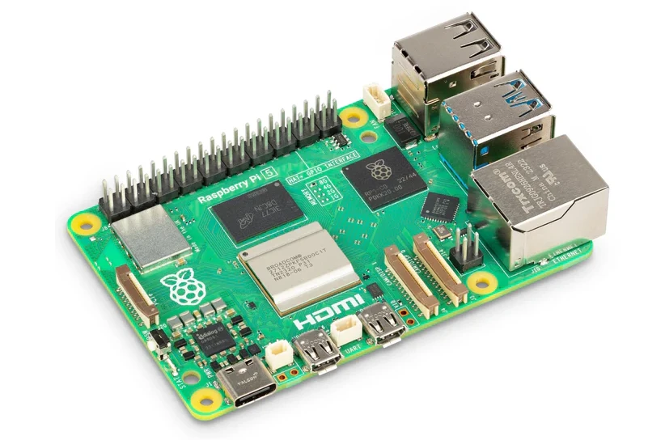
The Raspberry Pi:
The computer you can hold in the palm of your hand.
Notes:
The Raspberry Pi has transformed how we think about computing, making it accessible and affordable. In this presentation, we will explore the fundamentals of Raspberry Pi, its features, its educational and creative uses, practical applications, and future developments.

Slide 2
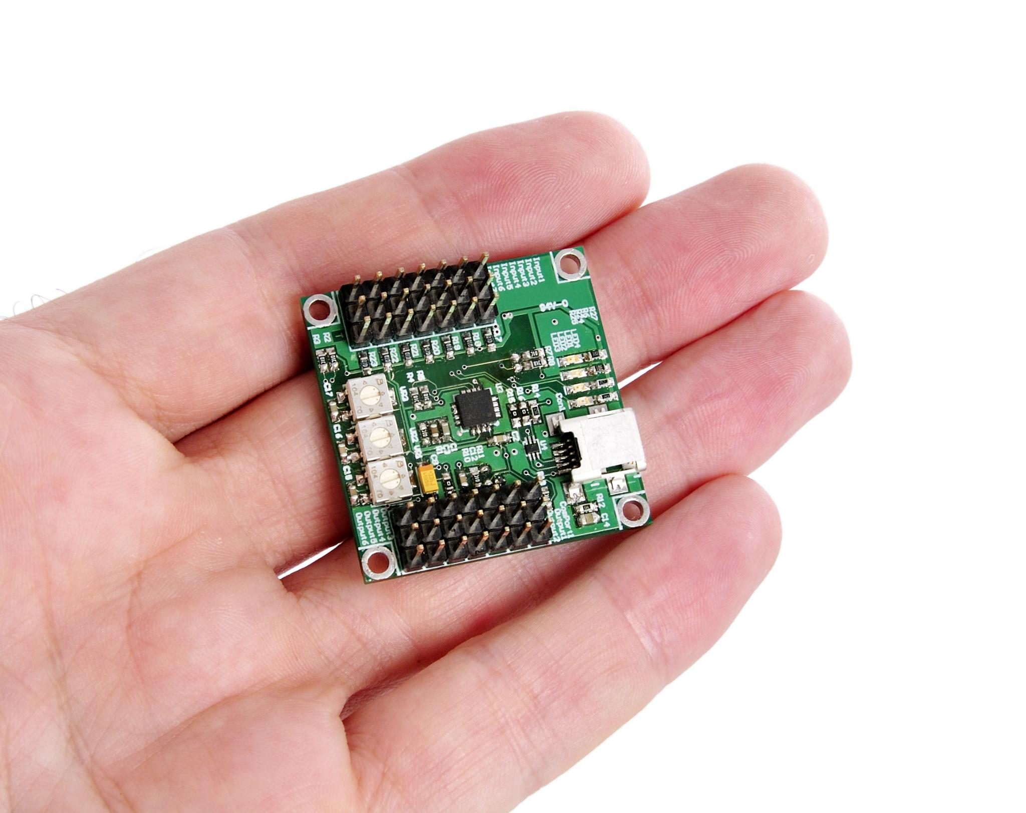
Agenda for Today's Presentation
Introduction to Raspberry Pi
Features and Specifications
Educational and Creative Uses
Practical Applications and Projects
Future Developments and Community Impact
Notes:
We will begin with an introduction to Raspberry Pi, covering its definition, history, and various models. Next, we will delve into its features and specifications, including hardware components and software. We will also examine its role in education and creativity, explore practical projects, and look at future developments in the Raspberry Pi community.

Slide 3
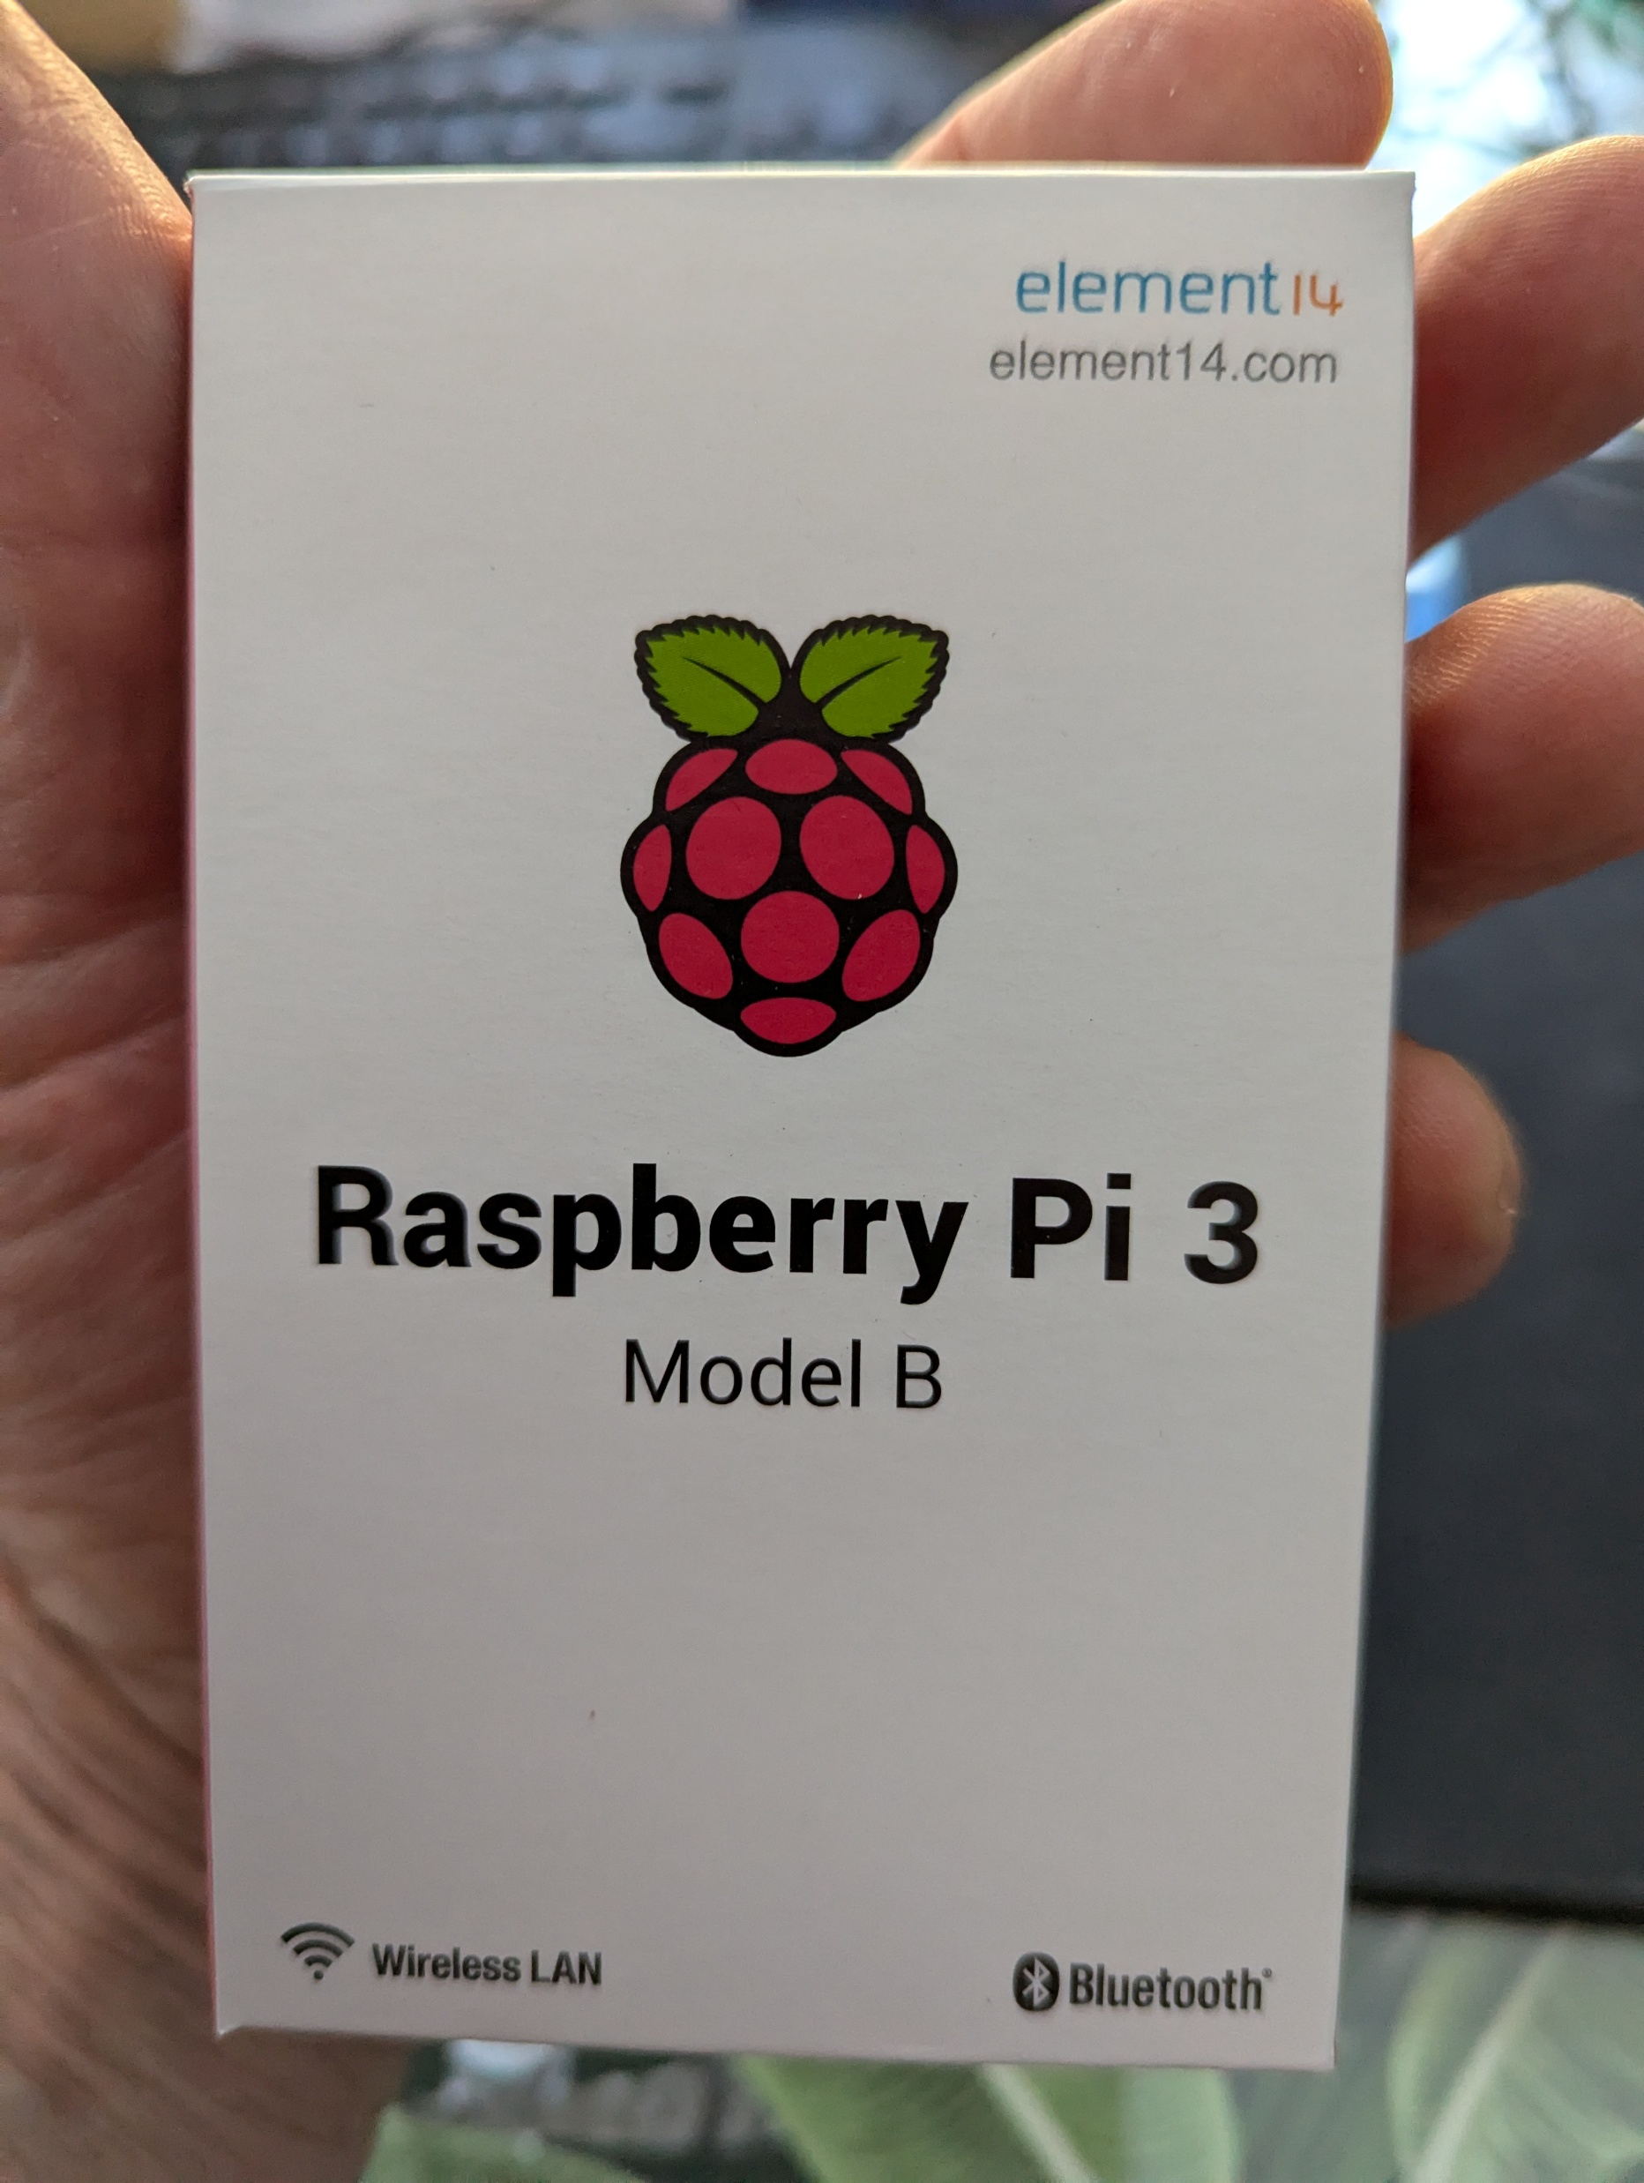
Introduction to Raspberry Pi
Notes:
Raspberry Pi is a small, affordable computer that enables users to learn programming and explore computing. It has gained immense popularity due to its versatility and accessibility for all ages. You can fit it in the palm of your hand (my hand in the photo!)

Slide 4
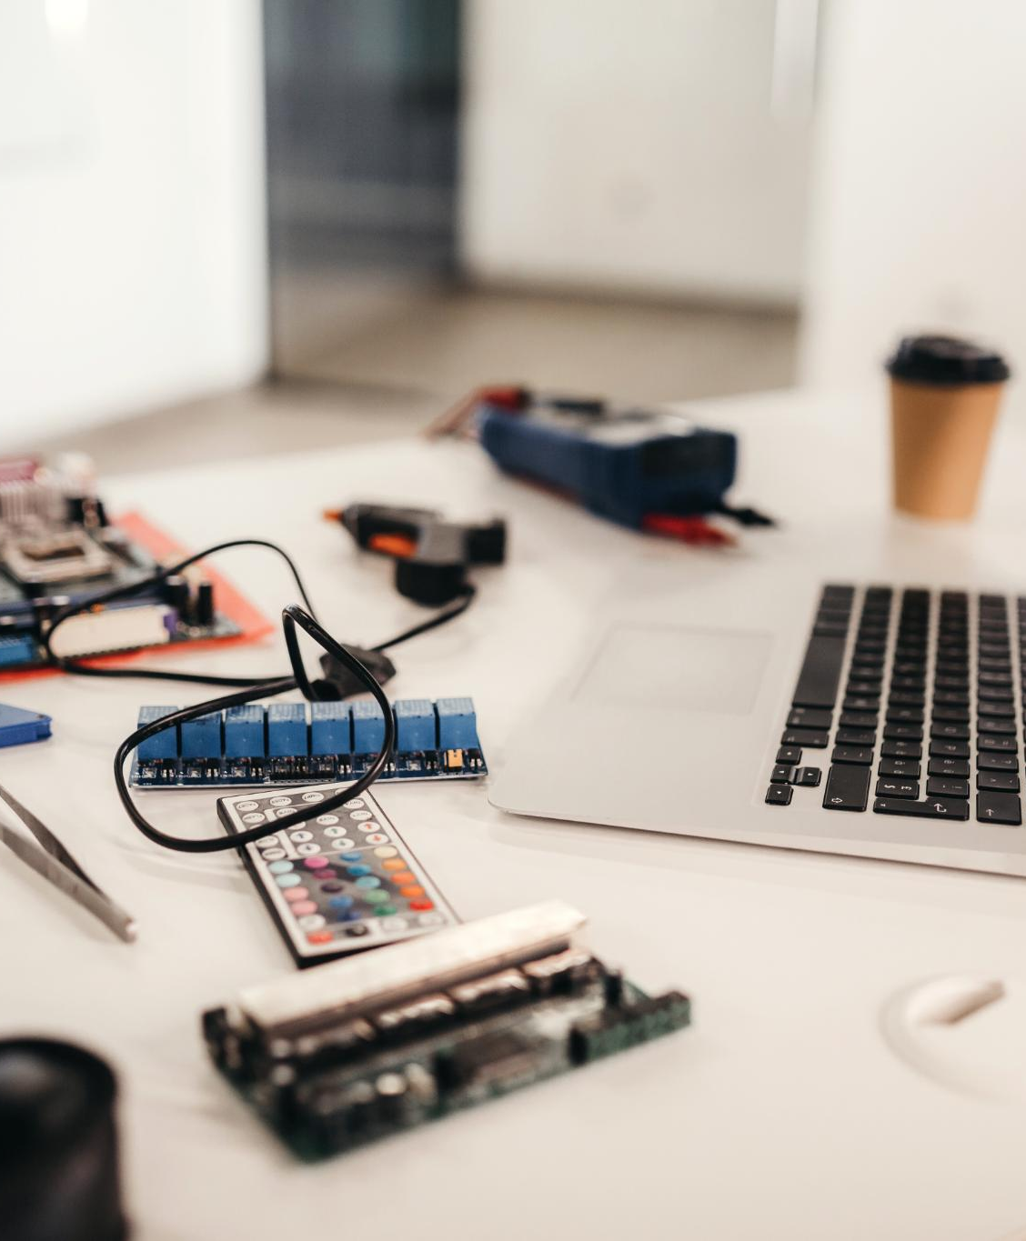
What Is Raspberry Pi?
Compact Design
  First of all, It’s a real computer.
  Raspberry Pi's credit-card-sized design makes it portable and easy to use for various projects.
  Educational Purpose
  Developed primarily for educational purposes, Raspberry Pi encourages learning through hands-on experience with technology.
Accessible Computing
  Raspberry Pi makes computing more approachable for beginners, promoting skills in coding and electronics.
Notes:
Raspberry Pi is a credit-card-sized computer developed for educational purposes. It allows users to engage with technology and coding in a hands-on manner, making computing more approachable.

Slide 5
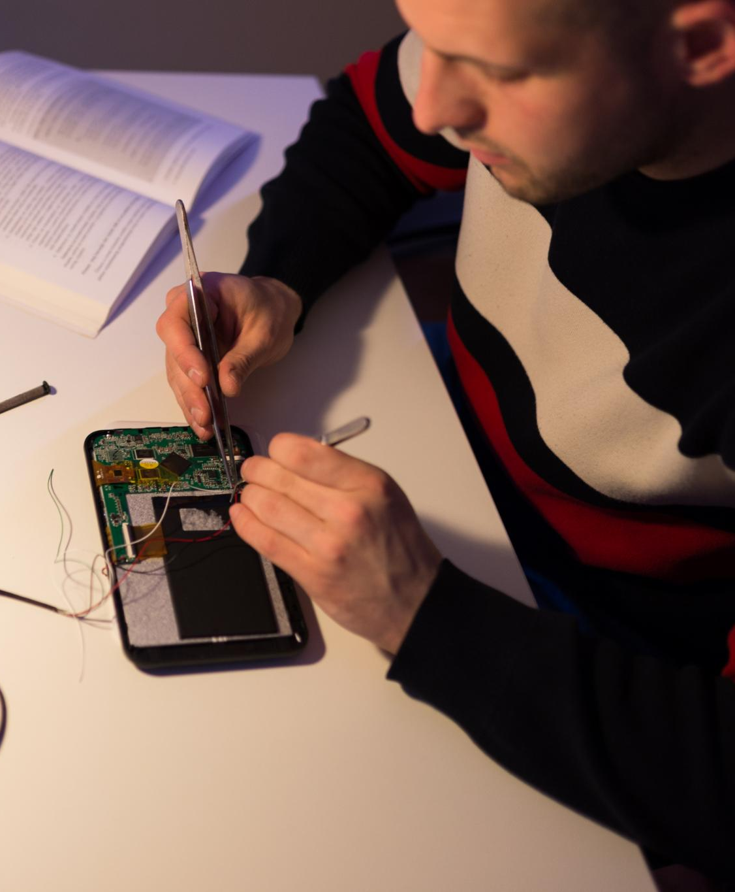
History and Development
Creation of Raspberry Pi
  Launched in 2012, Raspberry Pi aimed to promote computer science education globally, fostering programming skills in students.
Evolution Over Time
  Since its inception, Raspberry Pi has undergone several iterations, improving its capabilities and performance for various applications.
Impact on Education
  Raspberry Pi has significantly impacted computer science education, making programming and computing accessible to a wider audience.
Notes:
The Raspberry Pi was created in 2012 by the Raspberry Pi Foundation to promote computer science education. Since then, it has evolved through several iterations, enhancing its capabilities and performance.

Slide 6
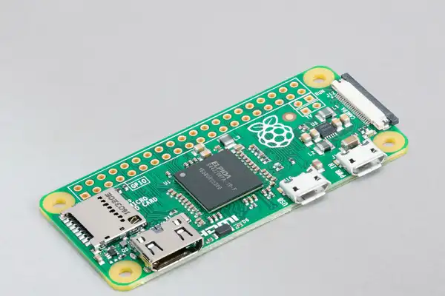
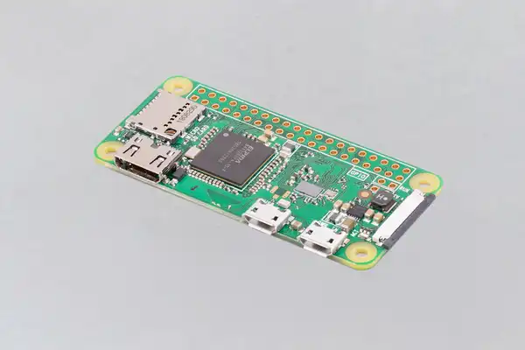
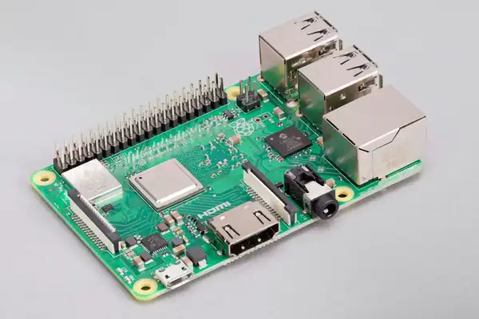
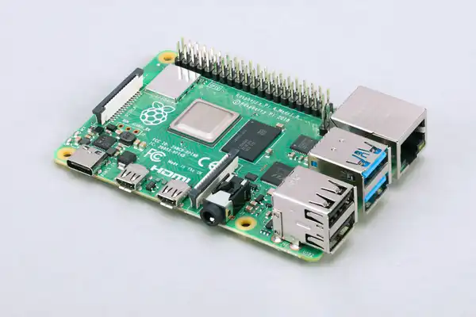
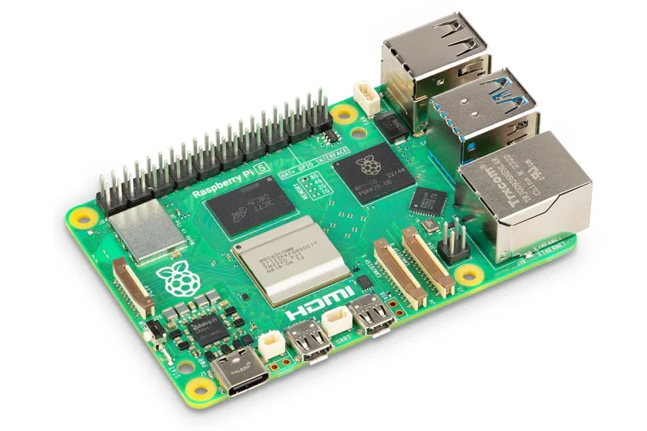
Versions and Models
Raspberry Pi Models
  Several models of Raspberry Pi have been developed, each offering unique features and enhancements over its predecessor.
Processing Power Improvements
  Each new model of Raspberry Pi introduces significant improvements in processing power, enhancing performance for various applications.
Memory and Connectivity
  The Raspberry Pi models have evolved with increased memory and advanced connectivity options, making them more versatile for users.
Raspberry Pi Zero With Wifi
Raspberry Pi 3 Model B+
Raspberry Pi 4 Model B
Raspberry Pi 5
Raspberry Pi Zero No Wifi
Notes:
Various versions of Raspberry Pi have been released, including the Raspberry Pi 1, 2, 3, and 4. Each model brings improvements in processing power, memory, and connectivity options.

Slide 7
Features and Specifications
Notes:
Raspberry Pi offers an array of features that make it suitable for various applications. Let's take a closer look at its hardware components, software capabilities, and connectivity options.

Slide 8
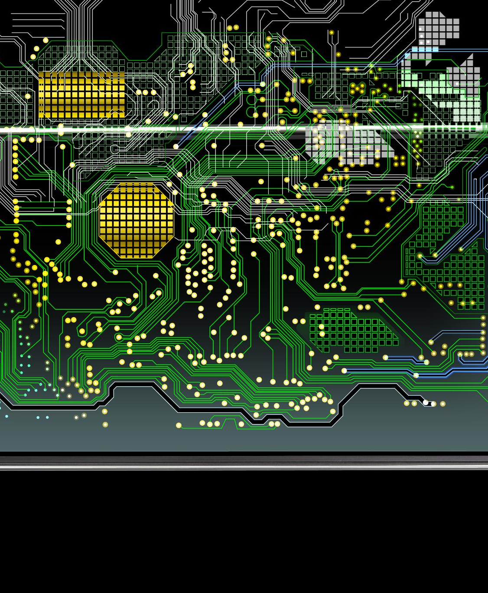
Hardware Components
Key Hardware Components
  Raspberry Pi boards feature essential hardware components like CPU and RAM, crucial for various projects. The Pi 5 has up to 16GB RAM and a 2.4GHz Processor,
USB Ports and HDMI Output
  The inclusion of USB ports and HDMI output allows for easy connectivity to peripherals and displays.
  Many Raspberry Pis are run “headless”.
GPIO Pins for Projects
  GPIO pins on Raspberry Pi enable users to connect various sensors and components for hands-on projects.
Notes:
Raspberry Pi boards come equipped with essential hardware components such as the CPU, RAM, USB ports, HDMI output, and GPIO pins, allowing for numerous hardware projects.
Headless – without a Monitor, keyboard or mouse. Access is done remotely. Via SSH or VNC. (More on that from Paul).
Micro SD Card could in theory be up to 2 TB. (Expensive). Mostly people use 64 GB up to 256 GB.

Slide 9

Operating Systems and Software
Supported Operating Systems
  Raspberry Pi doesn’t run “Windows” it does support other operating systems like Raspbian, Ubuntu, and Windows IoT,
Project Flexibility
  The flexibility of choosing an OS allows users to select a system that best fits their specific project requirements.
Notes:
The Raspberry Pi supports multiple operating systems, including Raspbian, Ubuntu, and Windows IoT. This flexibility allows users to choose an OS that best fits their project needs.
My Motion eyes camera uses it’s own operating system so you don’t even have to run Raspbian.

Slide 10
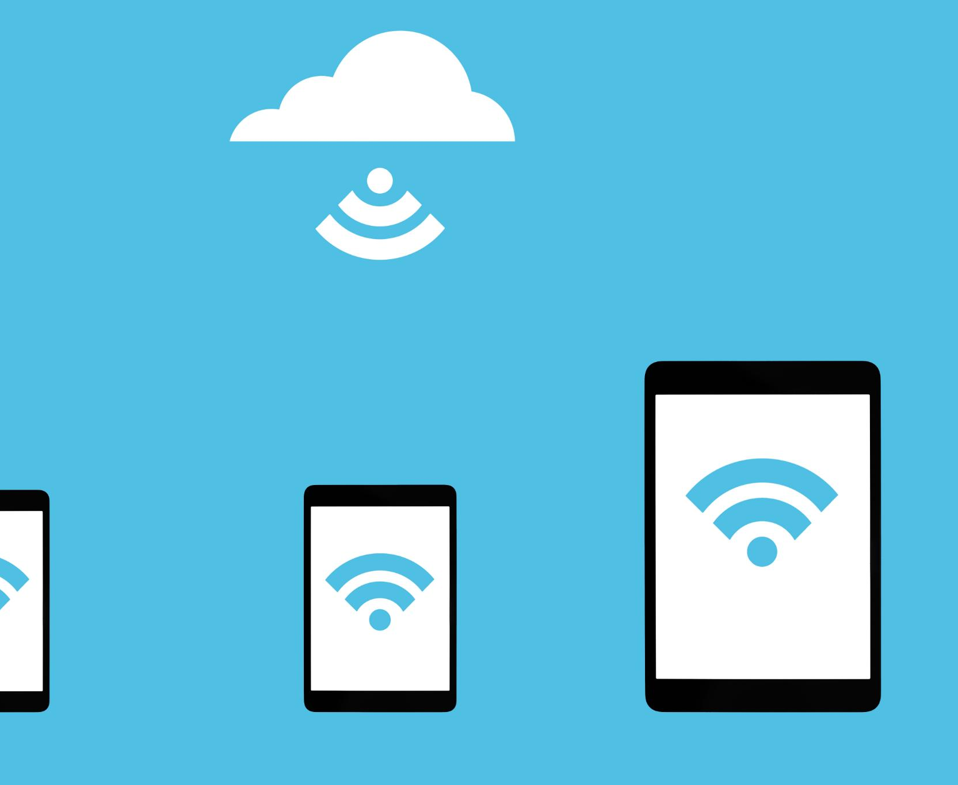
Connectivity and Peripherals
Diverse Connectivity Options
  Raspberry Pi offers multiple connectivity options including Wi-Fi, Bluetooth, USB, and Ethernet for versatile networking.
Peripheral Compatibility
  Users can easily connect a variety of peripherals such as cameras, sensors, and displays to enhance functionality.
Notes:
Raspberry Pi provides various connectivity options, such as Wi-Fi, Bluetooth, USB, and Ethernet. Users can connect a wide range of peripherals, including cameras, sensors, and displays.

Slide 11
Educational and Creative Uses
Notes:
Raspberry Pi has emerged as a powerful tool in education and creativity, enabling students and hobbyists to engage with computing concepts through projects and exploration.

Slide 12

Promoting Computer Science Education
Interactive Learning
  Raspberry Pi enables hands-on learning experiences that engage students in computer science concepts and programming.
Fostering Curiosity
  Using Raspberry Pi sparks curiosity in students, encouraging them to explore programming and technology creatively.
Building Innovation Skills
  Raspberry Pi helps develop innovation skills, equipping students with the tools needed for future tech challenges.
Notes:
Raspberry Pi is widely used in schools to teach computer science concepts and programming skills. It provides an interactive learning experience that fosters curiosity and innovation.

Slide 13

DIY Electronics Projects
Raspberry Pi Usage
  Raspberry Pi serves as a versatile platform for various DIY electronics projects, fostering innovation and creativity.
Building Robots
  Enthusiasts use Raspberry Pi to create robots, enhancing their programming and engineering skills through hands-on projects.
Weather Stations
  DIY weather stations built with Raspberry Pi provide real-time data collection and analysis for weather enthusiasts.
Home Automation
  Using Raspberry Pi, enthusiasts can automate home systems, enhancing efficiency and convenience in daily life.
Notes:
Many enthusiasts use Raspberry Pi for DIY electronics projects, such as building robots, weather stations, and home automation systems. These projects encourage hands-on learning and creativity.

Slide 14
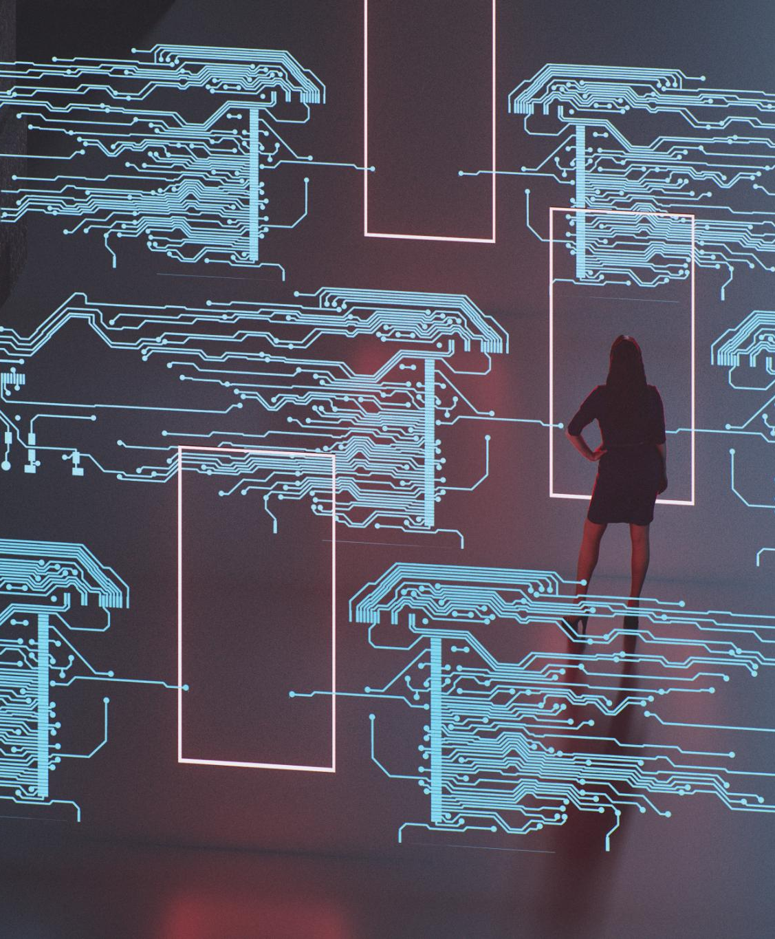
Creative Applications in Art and Design
Interactive Installations
  Artists create engaging interactive installations using Raspberry Pi, enhancing viewer participation and experience.
Digital Art Creation
  Raspberry Pi facilitates the creation of innovative digital art, allowing artists to explore new mediums and techniques.
Innovative Design Projects
  Designers leverage Raspberry Pi for innovative projects, merging technology with artistic vision for unique outcomes.
Notes:
Artists and designers utilize Raspberry Pi to create interactive installations, digital art, and innovative design projects. Its versatility allows for a wide range of creative expression.

Slide 15
Practical Applications and Projects
Notes:
Raspberry Pi's practical applications extend beyond education into everyday life. It has been used in projects that enhance home automation, IoT solutions, and entertainment systems.

Slide 16
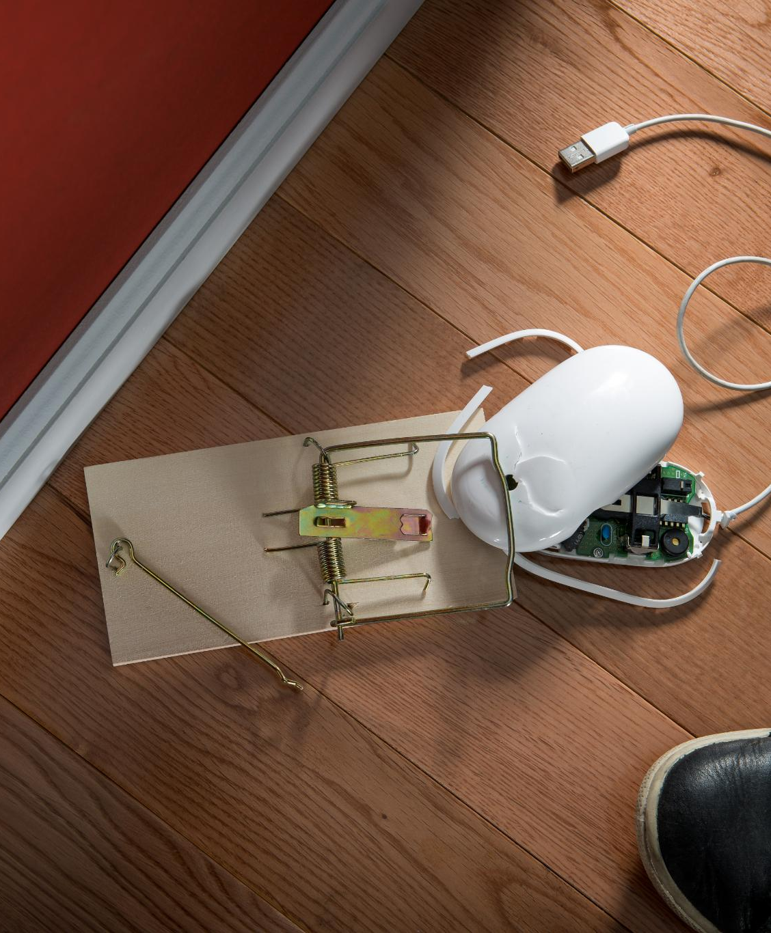
Home Automation
Central Hub Functionality
  Raspberry Pi acts as a central hub, connecting various home automation devices for seamless control and integration.
Remote Control Features
  Users can control lighting, appliances, and security systems remotely, enhancing convenience and security in their homes.
Simple Programming
  Raspberry Pi allows for easy programming, making it accessible for users to customize and automate their home systems.
Notes:
Raspberry Pi can serve as the central hub for home automation systems, enabling users to control lighting, appliances, and security systems remotely through simple programming.

Slide 17
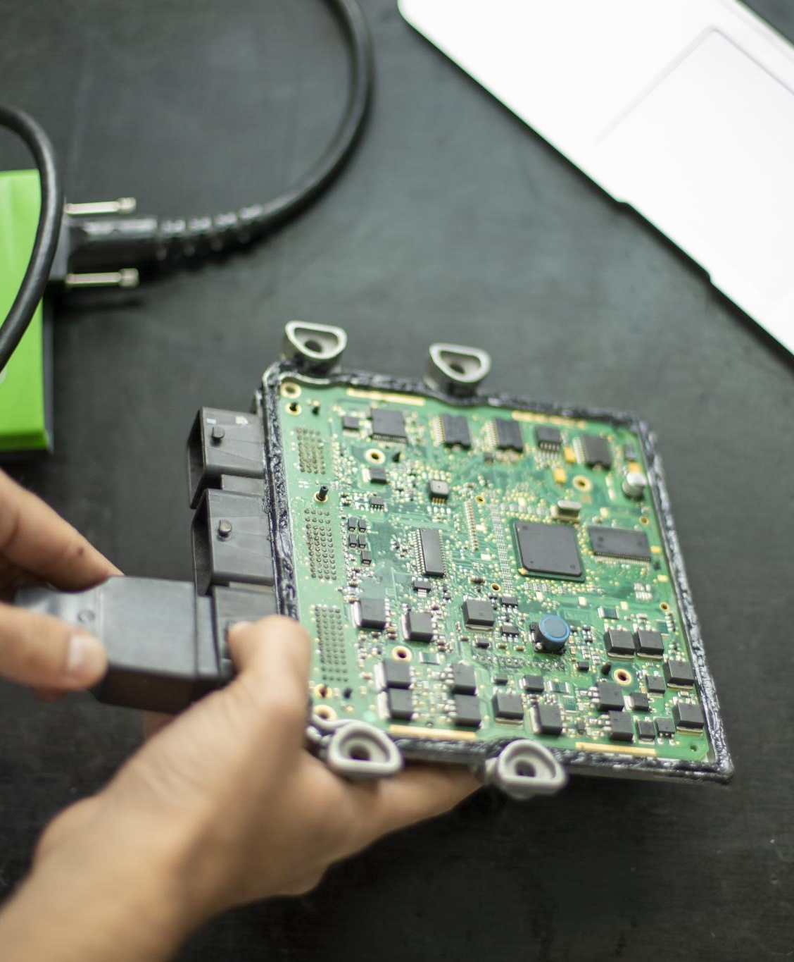
Internet of Things (IoT) Projects
Connecting Devices
  Utilizing Raspberry Pi, users can connect various devices to the internet, enhancing their functionality and accessibility.
Data Collection
  Raspberry Pi allows users to collect and analyze data from connected devices to gain valuable insights.
Automating Processes
  With IoT projects, users can automate various processes, improving efficiency in daily tasks using Raspberry Pi.
Notes:
With Raspberry Pi, users can create innovative IoT projects, connecting devices to the internet, collecting data, and automating processes, all while learning valuable programming skills.

Slide 18
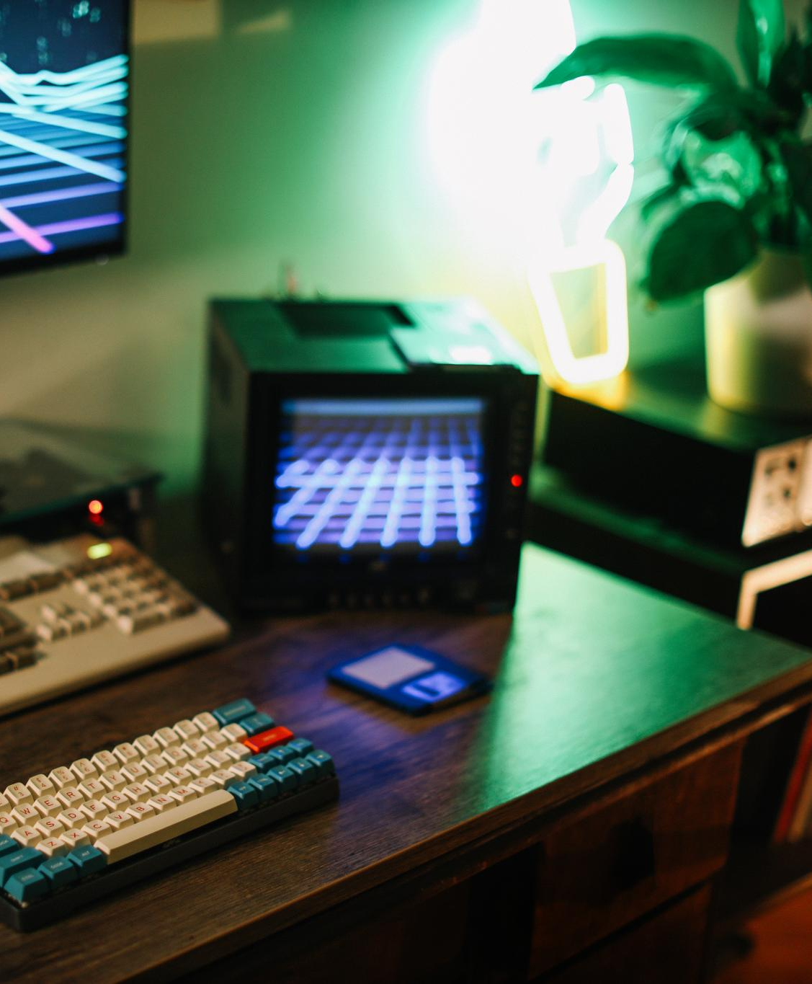
Media Centers and Gaming Consoles
Versatile Raspberry Pi
  The Raspberry Pi can easily be transformed into a media centre, allowing seamless streaming of content.
Classic Gaming Experience
  Users can play classic games on the Raspberry Pi, making it a unique gaming console option.
Popular Among Enthusiasts
  The versatility of Raspberry Pi as a gaming console and media centre makes it popular among tech enthusiasts.
Notes:
Raspberry Pi can be transformed into a media center or gaming console, allowing users to stream content and play classic games. This versatility makes it a popular choice among tech enthusiasts.

Slide 19
Future Developments and Community Impact
Notes:
As technology evolves, Raspberry Pi continues to adapt and thrive. The community around it plays a crucial role in its development, contributing to open-source projects and collaborative innovations.

Slide 20
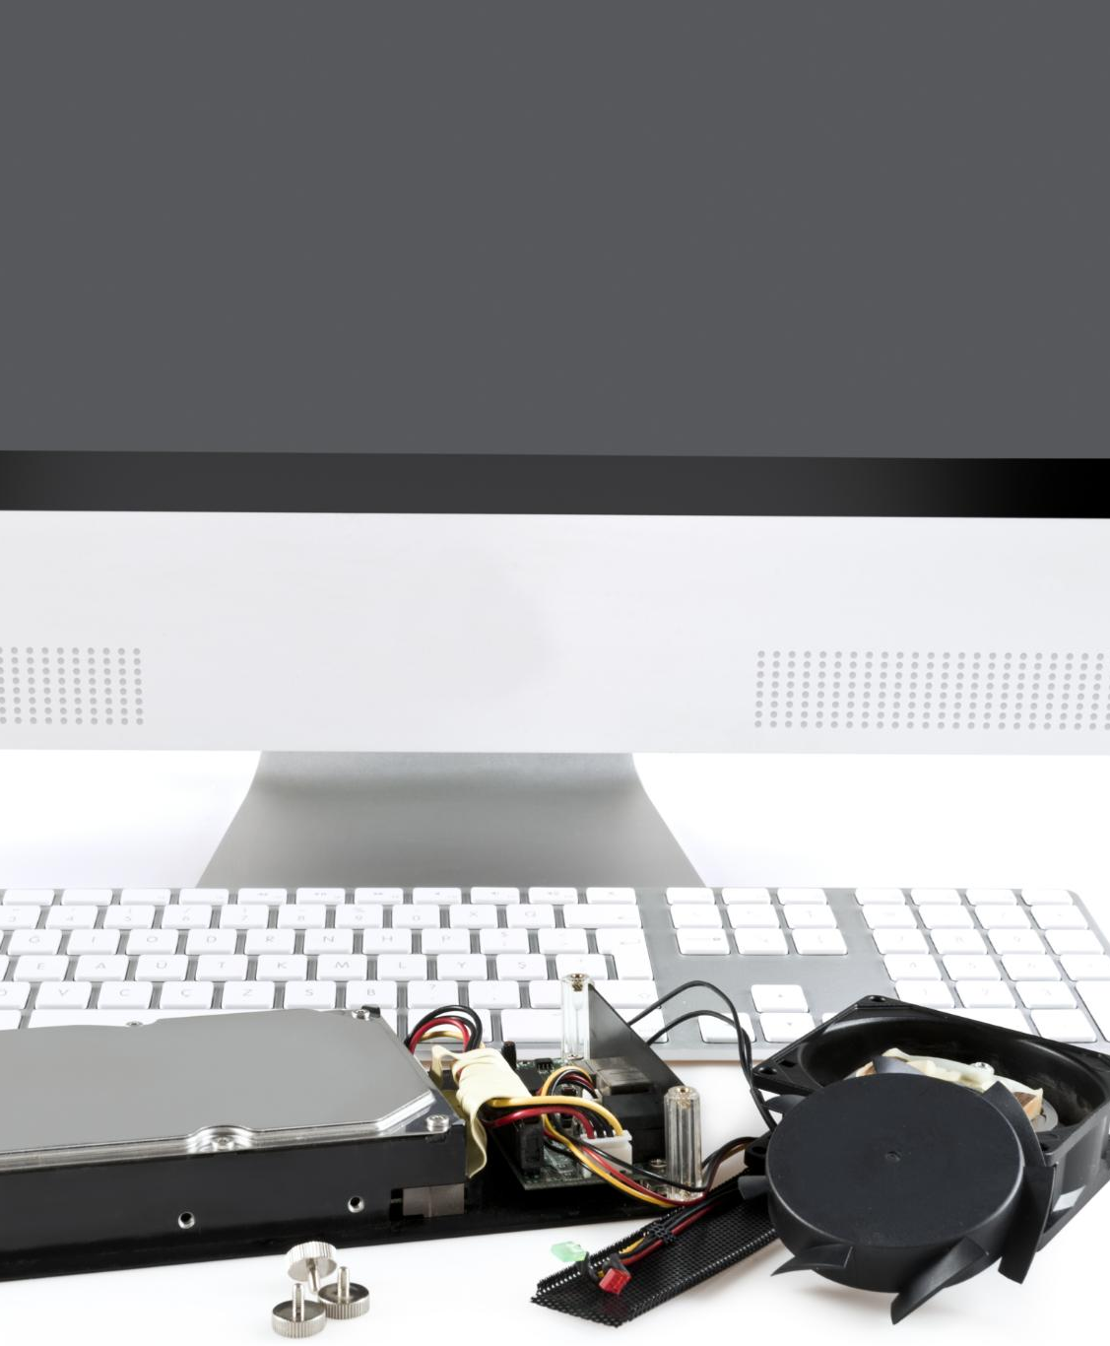
Upcoming Models and Upgrades
Performance Enhancements
  New Raspberry Pi models are designed to enhance processing power, allowing for more complex applications and better multitasking.
Improved Connectivity
  Upgrades will include better connectivity options, making it easier to integrate Raspberry Pi into various projects and environments.
User Experience Improvements
  Anticipated models focus on improving user experience, ensuring easier setup and more intuitive interfaces for users.
Notes:
The Raspberry Pi Foundation regularly releases new models and upgrades, enhancing performance, connectivity, and user experience. Anticipated advancements will further expand its applications.

Slide 21
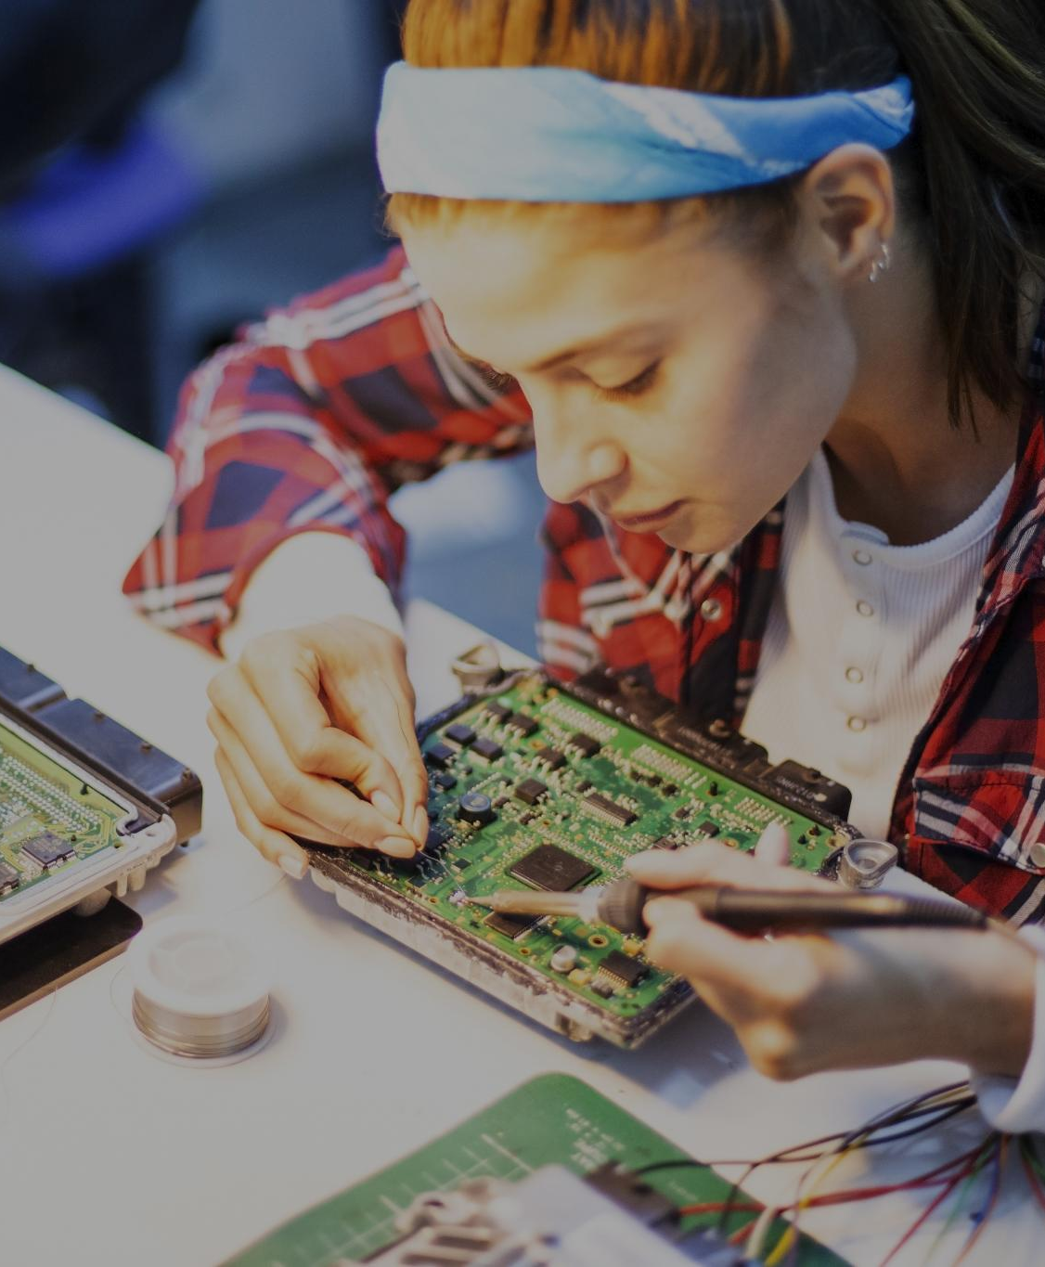
Impact on the Tech Community
Accessibility of Computing
  Raspberry Pi has made computing accessible to a wider audience, allowing more individuals to learn and experiment with technology.
Fostering Innovation
  The Raspberry Pi has fostered innovation by enabling hobbyists and educators to create projects that push technological boundaries.
Inspiring Initiatives
  Raspberry Pi has inspired countless initiatives in education and community development, encouraging collaboration and creativity.
Notes:
Raspberry Pi has significantly impacted the tech community by making computing accessible to a broader audience, fostering innovation, and inspiring countless projects and initiatives.

Slide 22
Collaborations and Open-Source Contributions
Community Collaboration
The Raspberry Pi community fosters collaboration, enabling users to work together on various projects and share insights.
Open-Source Contributions
Open-source contributions are vital for the growth of the Raspberry Pi community, allowing users to innovate and build upon shared resources.
Continual Growth
The collaborative spirit within the community drives continual learning and growth, expanding knowledge related to Raspberry Pi.
Notes:
The Raspberry Pi community thrives on collaboration and open-source contributions, allowing users to share projects, resources, and knowledge. This collaborative spirit drives continual growth and learning.

Slide 23
Conclusion
Affordable Computing
Raspberry Pi offers an affordable platform for individuals to learn and experiment with computing, enhancing accessibility.
Versatile Applications
Its versatility allows users to create a wide range of projects, from simple programs to complex robotics.
Impact on Education
Raspberry Pi has transformed education by providing hands-on learning experiences in programming and electronics.
Innovation in Arts
Artists and creators use Raspberry Pi to explore new forms of digital art and interactive installations.
Notes:
In conclusion, Raspberry Pi has revolutionized the computing landscape by providing an affordable and versatile platform for learning, creativity, and practical applications. Its impact is felt in education, technology, and the arts, shaping the future of computing.

