Slide 1
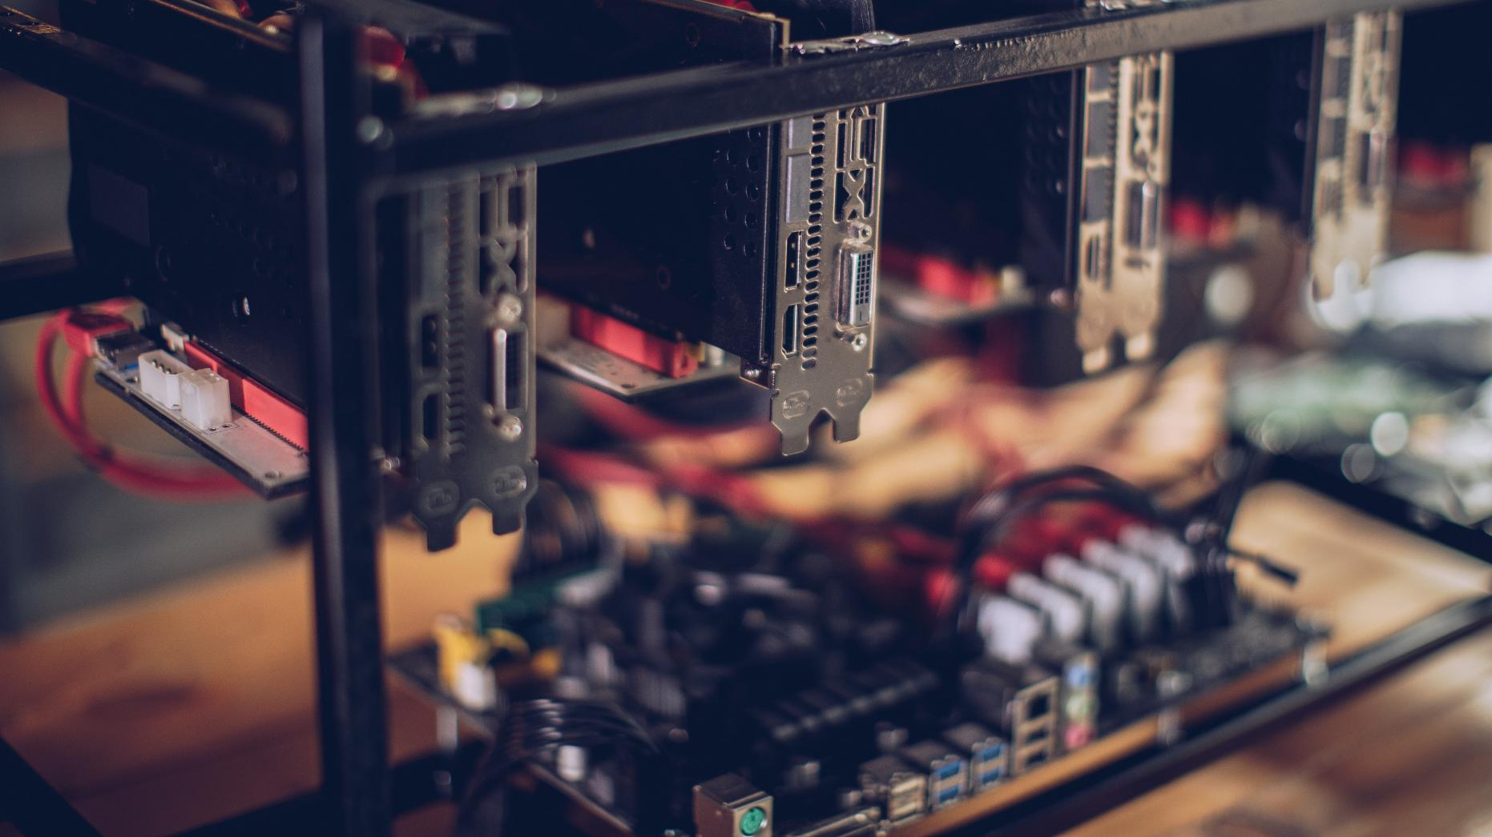
My Journey to Windows 11 - On a PC that Doesn't Have the Hardware to Support It
Exploring the upgrade experience and computer components
Notes:
In this presentation, I will share my experience of upgrading to Windows 11 on a PC that didn’t meet the hardware requirements.
We will explore the essential components of a computer, my PC specifications, preparation for the upgrade, the installation process, post installation niggles and
finally, upgrading it to a better spec

Slide 2
Setting the Scene

Slide 3
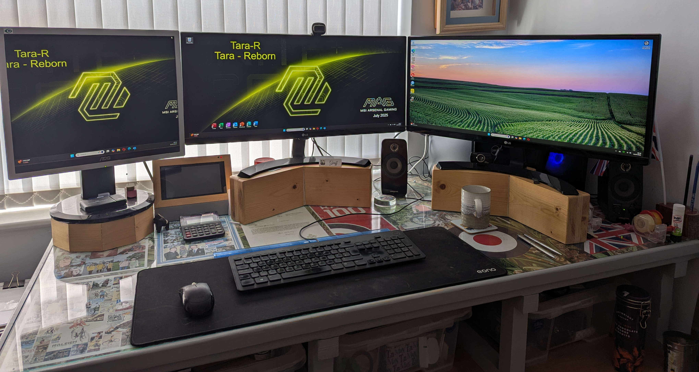
Notes:
I have 3 computers. Here’s two of them
1. *****Screens 2. ***** Box
3. ***** Screen 4.******* Box
5. ***** remove
Every 5 years or so I buy a new one. This is then becomes the new No 1 PC. The other two trickle down the line and the last one falls off the perch – (or gets passed to my brother)

Slide 4

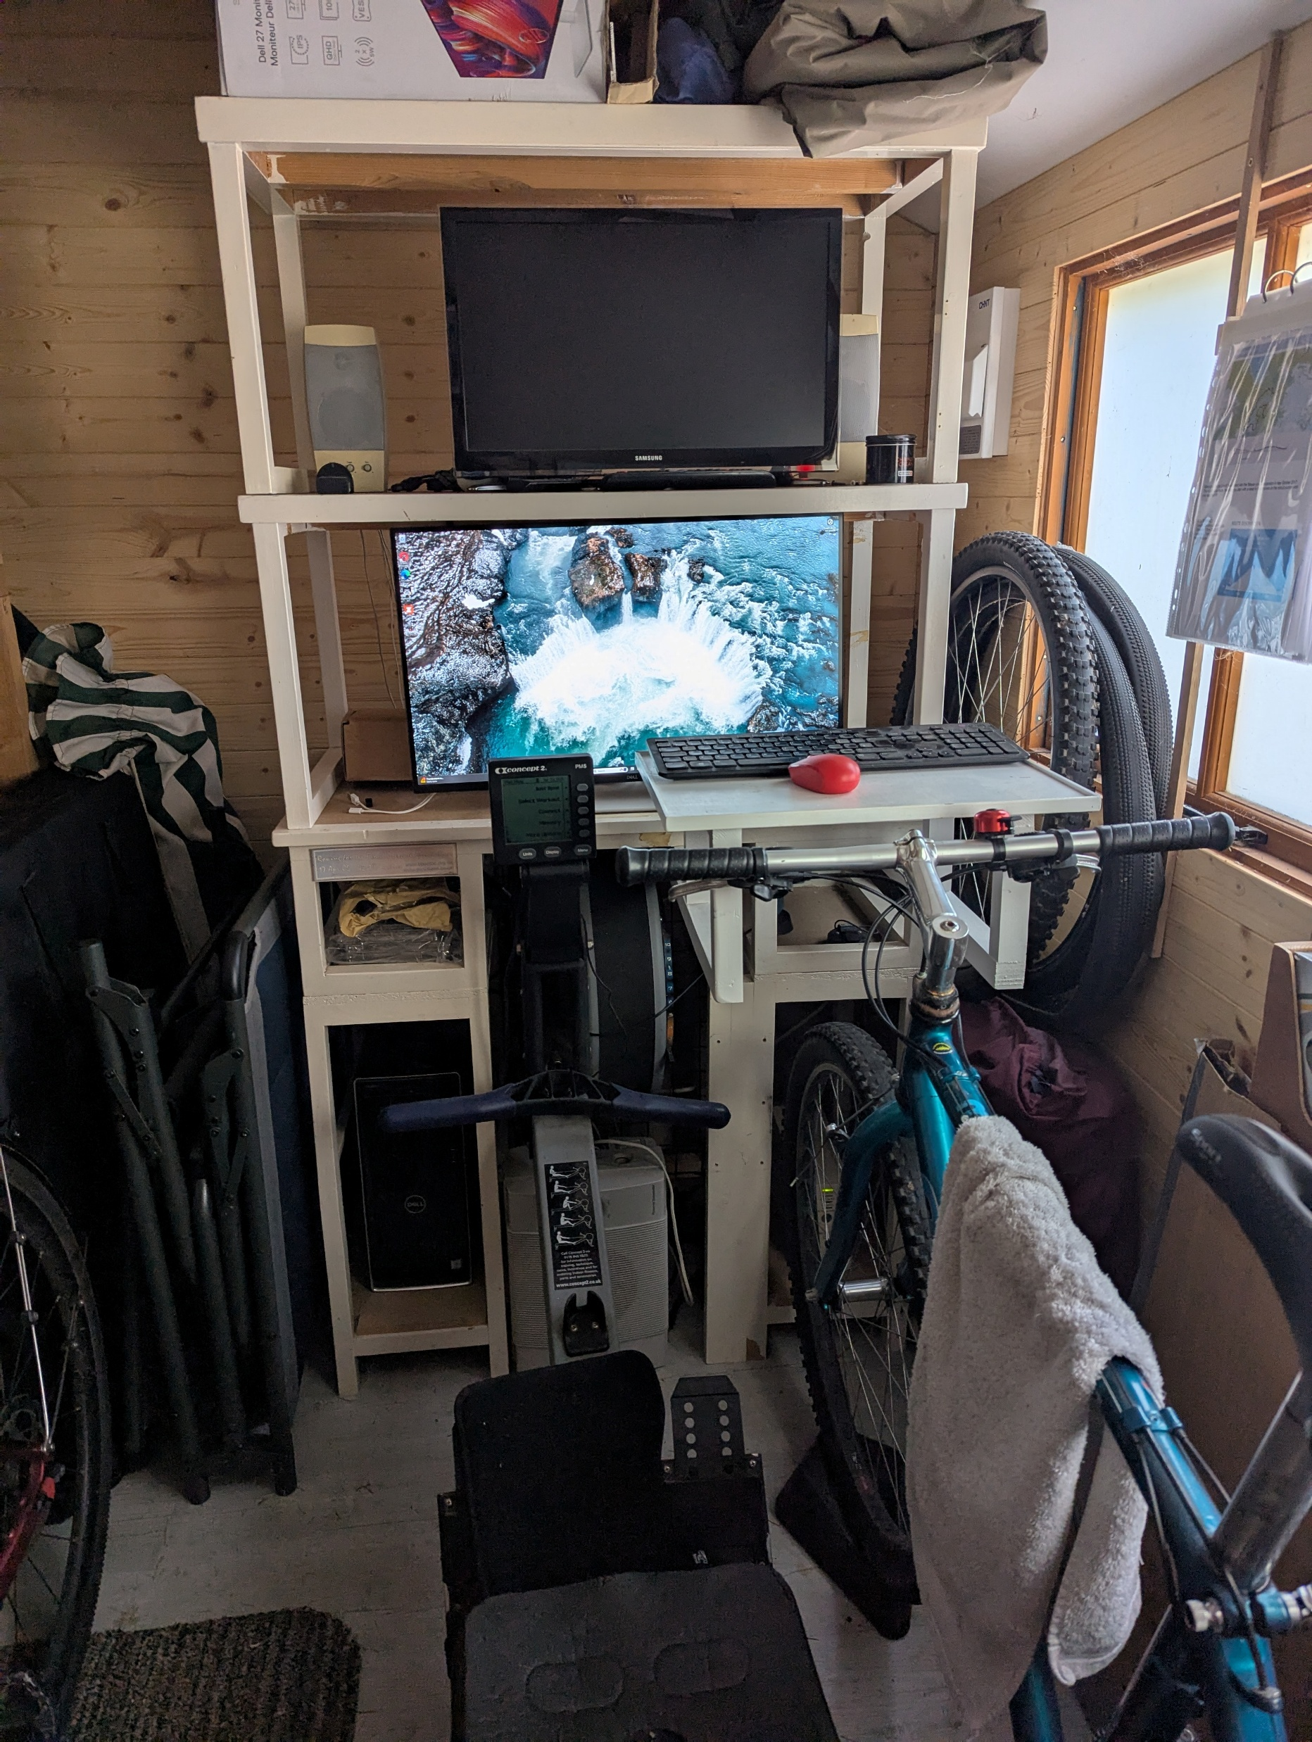
Fitness Control Suite
Aka Garden Shed
Notes:
The 3rd PC lives in the Fitness Control Suite
****** Indoors ***** Screen **** Box
In this case No 3 PC doesn’t have the hardware to support Win 11
Bright Idea! Let’s replace the motherboard so that it can upgrade.
So let’s have a look at the hardware inside to see what I need to replace

Slide 5
Understanding Computer Hardware
Notes:
Understanding the inner workings of a computer is crucial for any upgrade. Knowing the key components helps users assess compatibility and performance when considering software updates.

Slide 6
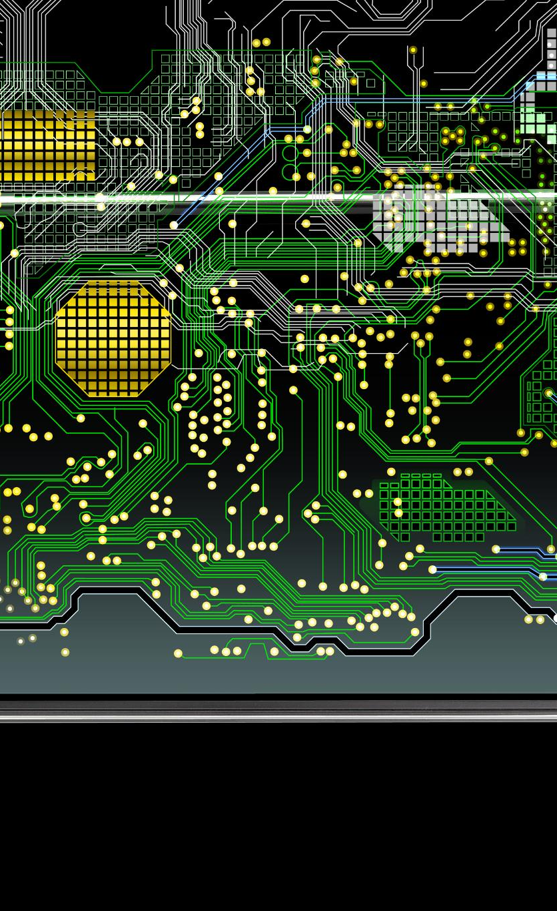
Roles of CPU, RAM, and Storage
Central Processing Unit (CPU)
  The CPU serves as the brain of the computer, executing instructions and playing a vital role in data processing.
Random Access Memory (RAM)
  RAM provides temporary storage for active tasks, allowing quick access to data for efficient computing.
Permanent Storage Solutions
  HDDs and SSDs serve as permanent storage options, holding data even when the computer is powered off.
Notes:
Roles of CPU, RAM & Storage
The CPU, or Central Processing Unit, acts as the brain of the computer, executing instructions and processing data.
RAM (Random Access Memory) provides temporary storage for active tasks, allowing quick access to data for efficient computing.
Adding more memory is probably the easiest way to improve your computers performance
HDDs and SSDs, hold data permanently – these are your main storage Most computers these days come with 1TB or 1/2 TB of SSD storage.

Slide 7
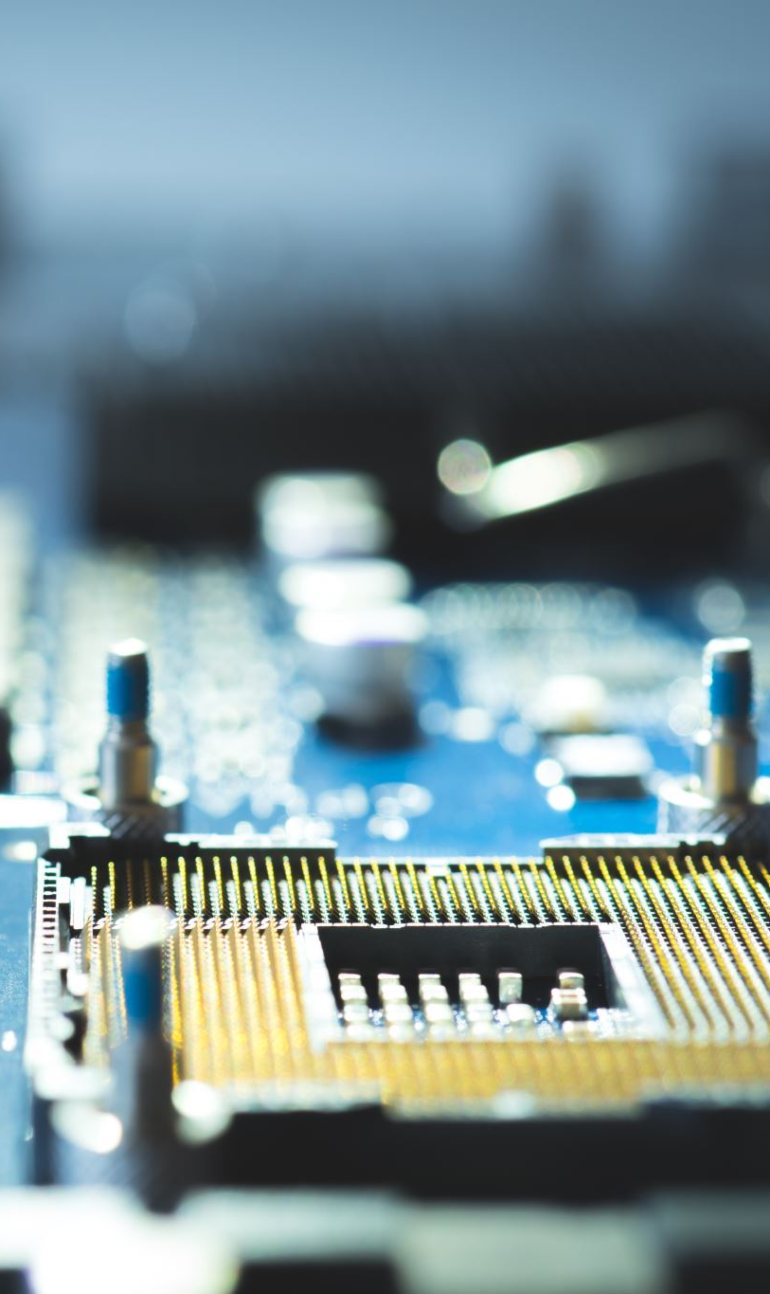
Motherboard and Power Supply
Motherboard Functions
  The motherboard serves as the backbone of the computer, housing key components like the CPU and RAM for optimal communication.
Power Supply Role
  The power supply converts and distributes electrical energy to the computer's components, ensuring stable operation and performance.
Component Interaction
  The motherboard and power supply work together to ensure all components are connected and receive the necessary power.
Notes:
Motherboard and Power Supply
The motherboard houses the CPU, RAM, and other components, facilitating communication between them. It’s the backbone of the computer
The power supply converts electrical energy and distributes it to all parts of the computer. It gives out a number of different voltages.
+12v Powers the CPU, GPU’ fans, hard drives and optical drives.
+5v Used for older devices, some motherboard components and USB ports
+3.3v Chipsets, memory slots and other low voltage motherboard circuitry
+5vSB The ‘standby’ power used to support wake-on LAN and other features when the computer is “off”

Slide 8
My PC Specifications
Notes:
Now let's take a closer look at my computer's specifications. Understanding these details will shed light on the challenges of upgrading to Windows 11.

Slide 9
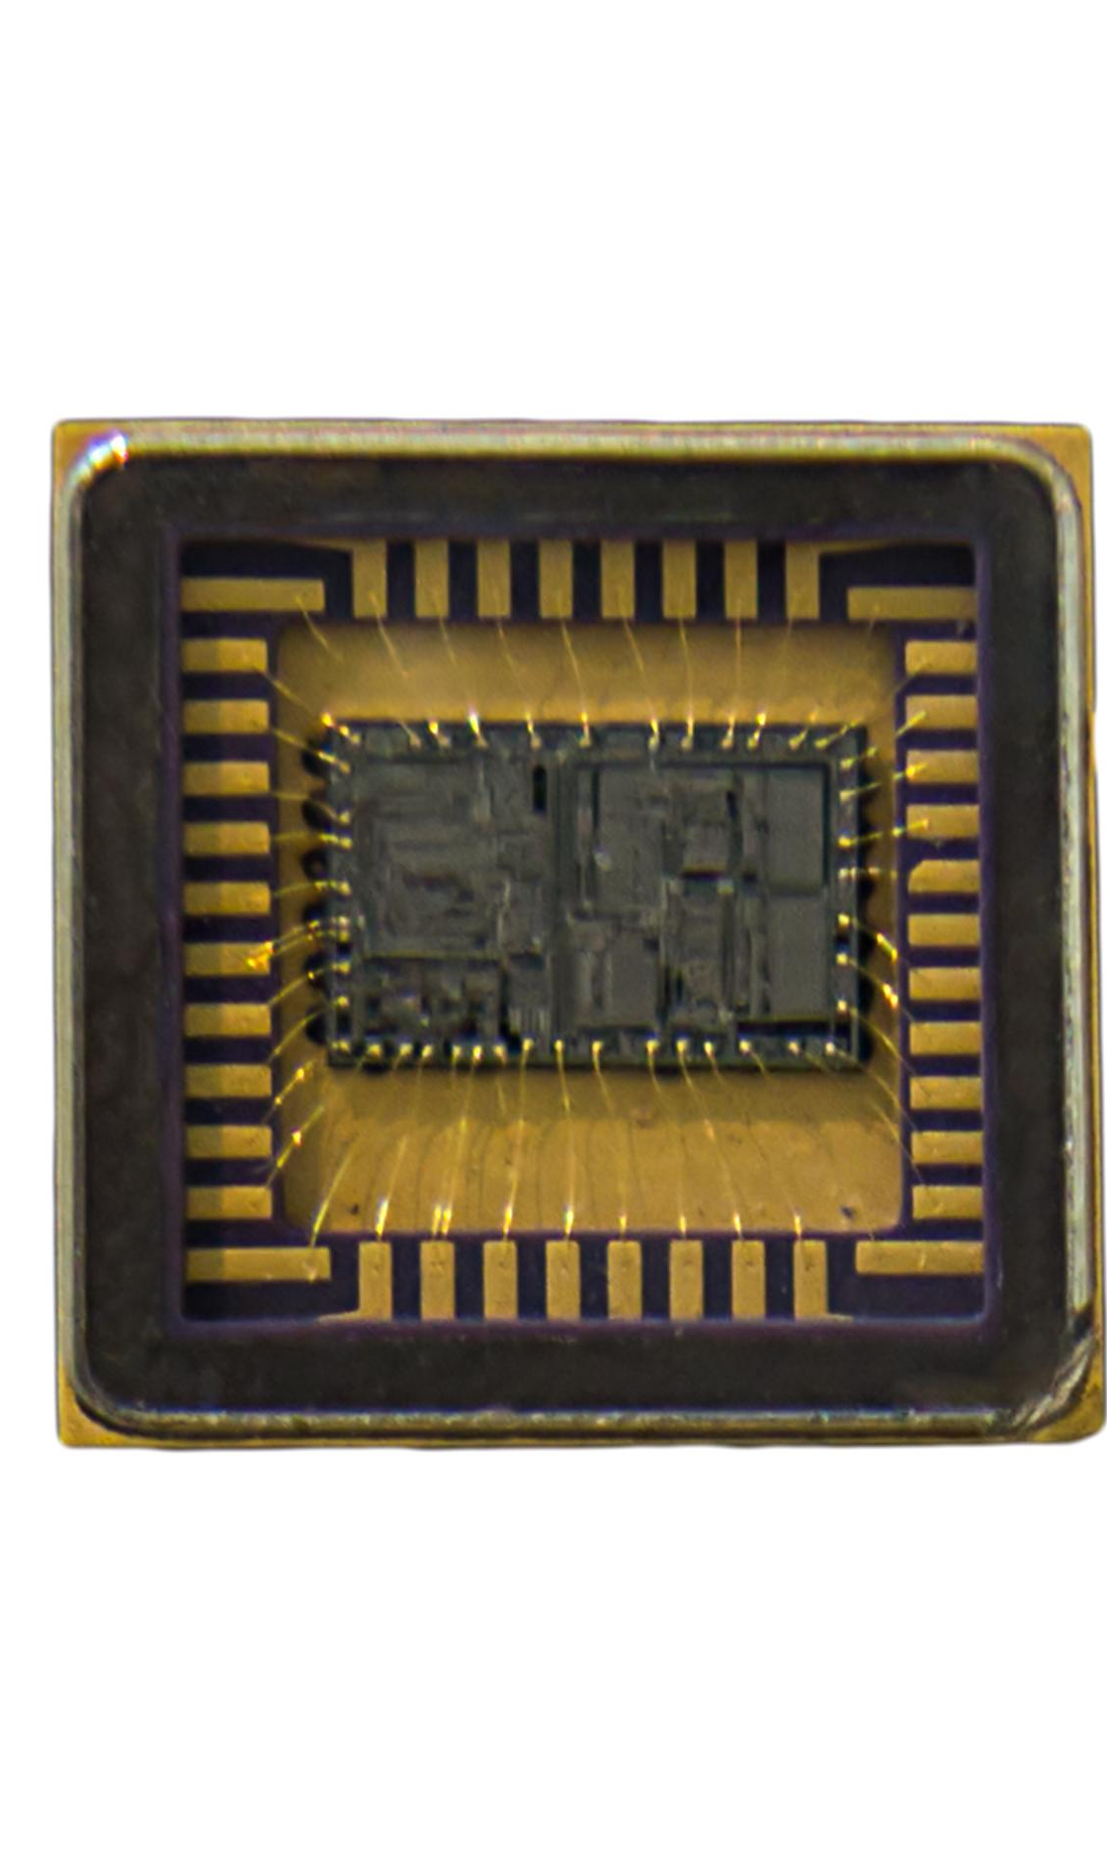
Overview of The Computer's Hardware
Older CPU Specifications
  An Intel i5-4460 processor
  RAM (Memory)
  Originally 8GB,
  now16GB of RAM
Traditional HDD Storage 1TB
April 2019 added an SSD
  Motherboard
  Dell OEM board Intel H81 chipset, LGA 1150 Socket for the processor
  Power Supply
  300W power supply
  Chassis
  Mini Tower. ATX format
Notes:
My computer consists of an older CPU, limited, but enough RAM, and traditional HDD storage. While it has served me well, it lacks many features that modern operating systems require.
Intel Core i5-4460 4 cores @3.2 GHz 84W TDP
RAM maxed out at 16GB
HDD Storage 1TB. ½ TB SSD Storage added in April 2019
A Dell motherboard
300W Power Supply – small by todays standards
Chassis Mini Tower ‘ATX’ Format

Slide 10
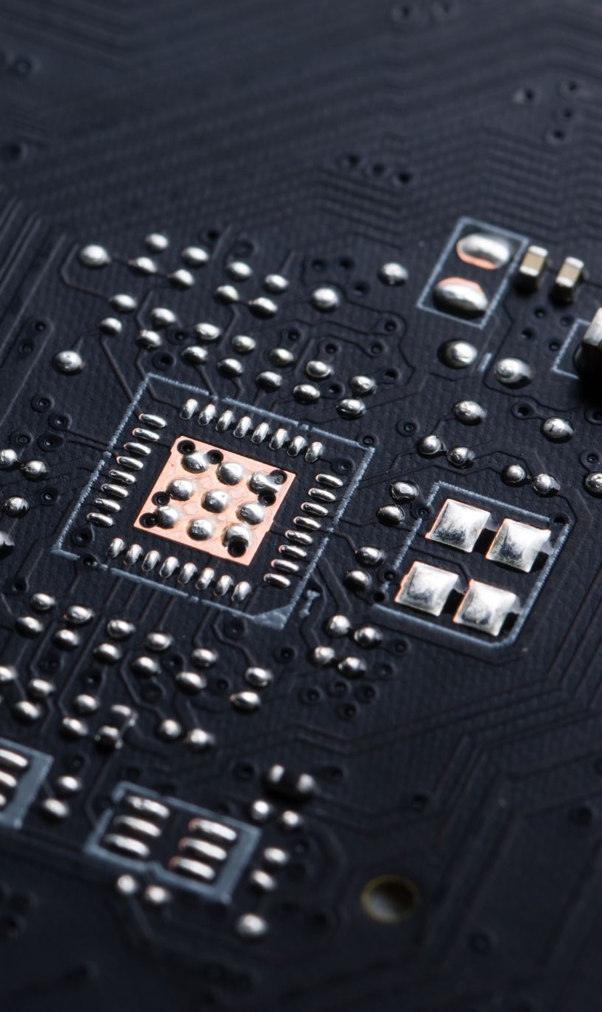
Challenges with Hardware Compatibility for Windows 11
Lack of TPM 2.0
  Without TPM 2.0 on the motherboard, security features required by Windows 11 cannot be utilized, affecting compatibility and security.
Secure Boot Capability
  The absence of secure boot capability poses risks, as the operating system cannot ensure trusted startup processes.
Insufficient RAM
  Having insufficient RAM limits system performance and can prevent the smooth operation of Windows 11. (Not in my case)
Notes:
Minimum requirements for Win 11:
64 bit architecture. At least 2 cores. Minimum of 1GZ Clock speed.
Minimum 4GB of RAM. Minimum 64GB of Storage
Firmware UEFI (replaced BIOS)
Secure Boot
TPM
Graphics. DirectX 12 or later or WDDM 2.0 or higher
The main challenges for me are the lack of:
TPM 2.0,
Secure boot capability,
I have sufficient RAM – 16GB. Minimum for Win 11 is 4GB (although it won’t run very well)
Let’s have a look at the TPM

Slide 11
TPM: Trusted
Platform Module
A secure crypto-processor for:
Storing encryption keys
Enabling secure boot
Supporting BitLocker, Windows Hello, and more
Type | Location | Comments
Discrete TMP | Separate chip on Motherboard | Found in business laptops and modern motherboards
Firmware TPM | Inside CPU Firmware | Intel call it PTT AMD call it fTPM
TPM Header | Motherboard connector | For Optional TPM modules
🧠 Why It Matters
Required for Windows 11
Protects against firmware-level attacks
Enables measured boot and device attestation
Notes:
The TPM is the Trusted Platform Module – a chip that gives us the security delivered by Win 11. It:
Stores encryption keys
Enables Secure Boot
Supports Bit Locker, Windows hello, PINs and more
The TPM Module, might be a chip on the motherboard
It might be inside the CPU firmware
It might be a separate part connected to the motherboard
🔐 What Is Secure Boot?
Secure Boot is a security feature built into modern PCs that ensures your system only boots using software that is trusted by the manufacturer.
It’s part of the UEFI firmware (which replaced the old BIOS) and is designed to prevent malware—like rootkits and bootkits—from loading before your operating system even starts.
🧠 How Secure Boot Works
Imagine Secure Boot as a bouncer at the club:
Every piece of software that wants to load during startup—bootloaders, OS files, drivers—must present a digital signature.
If the signature matches one from a trusted certificate authority, it’s allowed in.
If it’s unsigned or tampered with, the system blocks it from running.
This protects your PC at its most vulnerable stage—before antivirus software or Windows even loads.
🧪 Why It Matters
Benefit Description
🛡️ Prevents Malware Stops rootkits and bootkits from hijacking your system at startup.
🔐 Protects Integrity Ensures only verified, untampered software runs during boot.
💻 Required for Windows 11 Microsoft mandates Secure Boot (and TPM 2.0) for Windows 11 installations.
⚠️ Downsides & Considerations
Dual-booting Linux or running unsigned OSes may require disabling Secure Boot.
Some older hardware or unsigned drivers may not be compatible.
Secure Boot does not encrypt data or require TPM—but it pairs well with both.
🧰 Real-World Analogy
“Secure Boot is like airport security for your PC. Only passengers (software) with valid boarding passes (digital signatures) are allowed on the plane (your system). Anyone suspicious gets turned away before takeoff.”

Slide 12
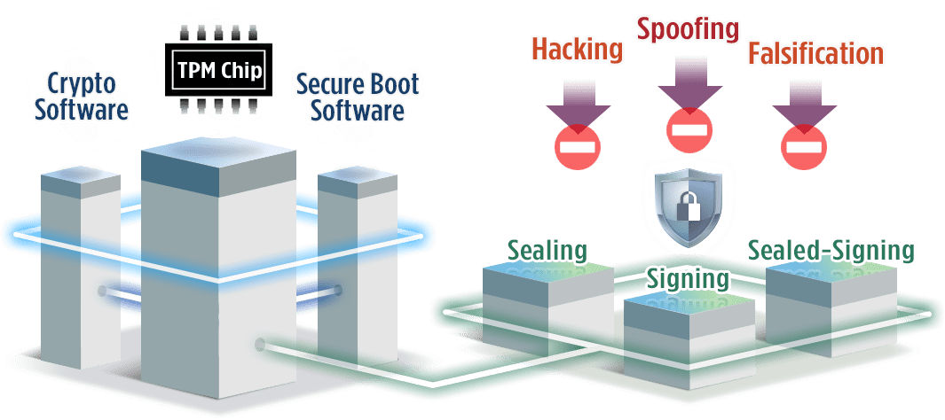
TPM: Trusted Platform Module
Notes:
TPM guards against Hacking, Spoofing and Falsification

Slide 13
Preparing for the Upgrade
Notes:
Preparation is key to a successful upgrade. This section covers essential steps to ensure a smooth transition to Windows 11.

Slide 14
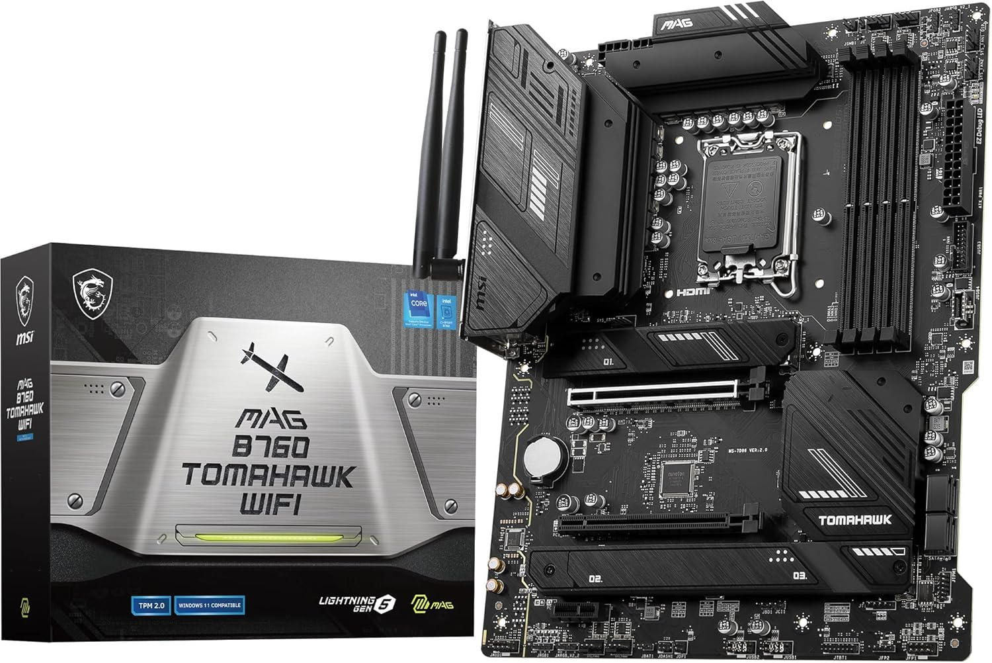
A motherboard with TPM2
My Dell Inspiron has an ATX case, so I elected to go with a MSI MAG B760 Tomahawk Wi-Fi ATX Motherboard
(as recommended by Copilot)
Great value without breaking the budget. £150
This MB uses a different socket for the processor, so we need a new Processor!
Notes:
My Dell supports an ATX motherboard, so I elected to go with an MSI MAG B760 Tomahawk Wi-Fi ATX Motherboard – as recommended by CoPilot (More on him later) it cost £150
MSI have four series of Motherboards: MEG, MPG, MAG & PRO
MEG: Enthusiast Gaming. Extreme Gamers & Overclockers. Flagship range.
MPG: Performance Gaming. Mainstream gamers power users.
MAG: Arsenal Gaming. Budget conscious gamers. Durable Functional, fewer frills, great value
PRO: Professional Series. Office, creators stable builds
MSI The Manufacturer
MAG The Range
B760xxxxx The Model
This MB uses a different socket for the processor, so we need a new processor, but first, lets look at Motherboards

Slide 15
Motherboard formats and Sizes
Format | Dimensions (mm) | Use Case
ATX | 305 x 244 | Standard desktops, gaming rigs
Micro-ATX (mATX) | 244 x 244 | Budget builds, compact towers
Mini ITX | 170 x 170 | Small form factor (SFF)
Extended ATX (E-ATX) | 305 x 330 | Workstations, dual CPU boards
Flex ATX | 229 x 191 | Ultra Compact Systems
Balanced Technology Extended (BTX) | 325 x 267 | Intel’s short-lived successor to ATX (discontinued)
DTX / Mini DTX | 244 x 203 / 203 x 170 | Niche compact builds
Notes:
🕰️ When Was ATX Introduced?
ATX (Advanced Technology Extended) was introduced by Intel in 1995 as a successor to the aging AT and Baby AT standards. It revolutionized desktop PC design by:
- Rotating the motherboard layout for better airflow
- Standardizing power connectors and I/O panel placement
- Improving compatibility across cases, motherboards, and PSUs
It quickly became the de facto standard for consumer desktops and remains dominant today.
There are also case formats like:
Mid Tower (most common)
Full Tower (for E-ATX and extreme cooling)
Mini Tower (for mATX)
SFF / Cube / HTPC (for Mini-ITX)
Bench / Open Frame (for testing and showcasing builds)

Slide 16
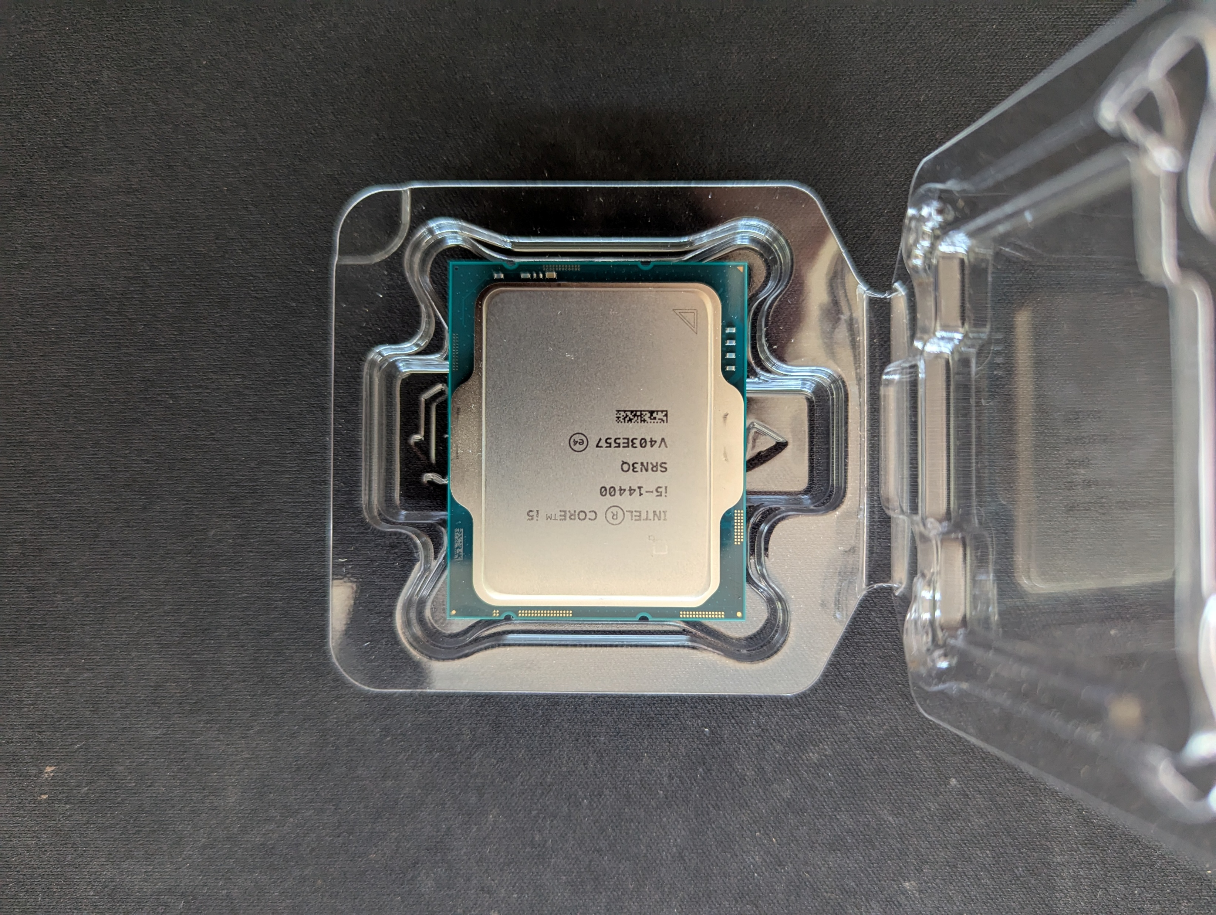
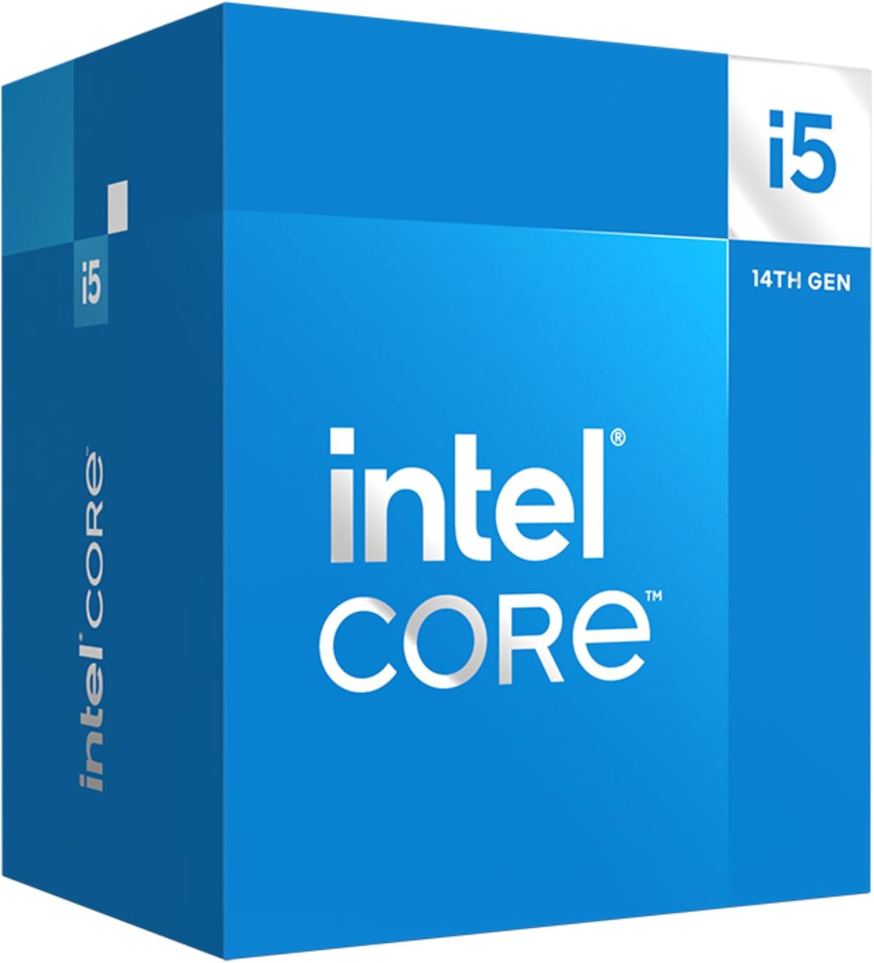
A processor
The Socket on the Motherboard is an LGA1700, So I need an LGA1700 format processor.
I chose an intel i5 14400 (14th Generation)
£159
The processor comes with a fan included.
Notes:
Let’s look and Sockets and Processors
What do all the figures and numbers mean?
LGA is the Land Grid Array – been around since 2004, the number 1700 is the actual number of connectors – it’s gets larger and larger every time.

Slide 17
Processor SOCKETS
Socket | Year | Key CPUs | Notable Features
Socket 7 | 1995 | Pentium, Pentium MMX | Early multi-CPU support
Socket 370 | 1999 | Pentium III, Celeron | Compact design, low power
Socket 478 | 2000 | Pentium 4 | Higher FSB, early DDR support
LGA 775 | 2004 | Pentium D, Core 2 Duo | First LGA socket (pins on board)
LGA 1156 | 2008 | Core i3/i5/i7 (Nehalem) | Integrated memory controller
LGA 1155 | 2011 | Sandy Bridge, Ivy Bridge | PCIe 3.0, USB 3.0 support
LGA 1150 | 2013 | Haswell, Broadwell | Improved power efficiency
LGA 1151 | 2015 | Skylake to Coffee Lake | DDR4 support, multiple revisions
LGA 1200 | 2020 | Comet Lake, Rocket Lake | Refined power delivery, Wi-Fi 6
LGA 1700 | 2021 | Alder Lake, Raptor Lake | DDR5, PCIe 5.0, hybrid architecture
Notes:
🧬 Intel Socket Evolution: From Legacy to LGA 1700 (LGA Land Grid Array)
Socket Year Key CPUs Notable Features
Socket 7 1995 Pentium, Pentium MMX Early multi-CPU support
Socket 370 1999 Pentium III, Celeron Compact design, low power
Socket 478 2000 Pentium 4 Higher FSB, early DDR support
LGA 775 2004 Pentium D, Core 2 Duo First LGA socket (pins on board)
LGA 1156 2008 Core i3/i5/i7 (Nehalem) Integrated memory controller
LGA 1155 2011 Sandy Bridge, Ivy Bridge PCIe 3.0, USB 3.0 support
LGA 1150 2013 Haswell, Broadwell Improved power efficiency
LGA 1151 2015 Skylake to Coffee Lake DDR4 support, multiple revisions
LGA 1200 2020 Comet Lake, Rocket Lake Refined power delivery, Wi-Fi 6
LGA 1700 2021 Alder Lake, Raptor Lake DDR5, PCIe 5.0, hybrid architecture

Slide 18

Processor Terminology
Socket | Purpose
i3 | Entry level
i5 | Mid range
i7 | High performance
i9 | Enthusiast/workstation-grade
Notes:
Intel chose odd numbers like i3, i5, i7, and i9 for marketing clarity, not technical reasons. They are all being produced
I3 Entry level Your first car, cheap and Cheerful
I5 Mid range “Mondeo” man
I7 High Performance The GT Version. My Ford Capri GT XLR was the best car I ever had
I9 Enthusiast Ferrari, Lamborghini
AMD followed suit with Ryzen 3, 5, 7, and 9, reinforcing the pattern across the industry.

Slide 19
Processor Identity (1)
A typical processor name i5-14400K
i5 – Mid range
14 – 14th Generation
400 – Higher numbers usually mean better specs for the same tier
There might be a suffix letter in this case K:
Unlocked for overclocking
Check yours from Settings | System | About
Notes:
Intel’s Core series began in 2008 with the 1st generation (Nehalem). Each new generation typically brings architectural improvements, better efficiency, and new features.ics
Letter Suffix:
K Unlocked for overclocking F No Integrated graphics
T Power-efficient desktop chip H High performance laptop chip
U Ultra-low power for laptops HX Extreme mobile performance
P Performance for thin laptops G Enhanced graphics (Often AMD Radeon)
X/XE Extreme desktop performance
Check yours from: Settings | System | About

Slide 20
Processor Identity (2)
Cores and Threads
🧠 What Are CPU Cores?
A core is a physical processing unit inside a CPU. Each core can independently execute instructions — like a mini CPU within the CPU.
Single-core: Can handle one task at a time.
Multi-core: Can handle multiple tasks simultaneously — e.g., dual-core (2), quad-core (4), octa-core (8), etc
Notes:
Think of cores as chefs in a kitchen — each one can prepare a dish independently. More chefs = more dishes at once.
Cores can be either P-Cores for performance or
E-Cores for efficiency
Performance cores can be multithreaded and handle demanding tasks like rendering, compiling and gaming
Efficiency cores tackle lighter workloads, background processes and improve energy efficiency

Slide 21
Processor Identity (3)
Cores and Threads
🧠 What Are CPU Threads?
A thread is a virtual sequence of instructions that a core can execute. Threads are the software-level representation of tasks.
One core = one thread (without multithreading)
One core = two threads (with Hyper-Threading or SMT)
Notes:
Threads allow a core to switch between tasks more efficiently, improving responsiveness.
Imagine threads as waiters organizing orders for the chefs. More threads = better task management, even if the number of chefs stays the same.
Intel uses: Hyper-Threading
AMD uses Simultaneous Multi-threading (SMT)
Real world analogy
“Cores are chefs, threads are waiters. More chefs = more meals cooked. More waiters = better coordination. Hyper-threading gives each chef two hands — not a second chef, but a boost in efficiency.

Slide 22
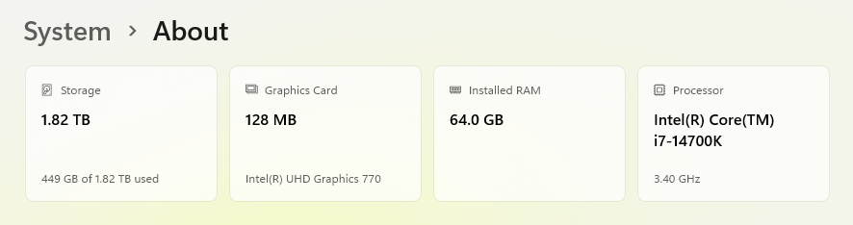
Settings | System | About
Notes:
Settings | System | About

Slide 23
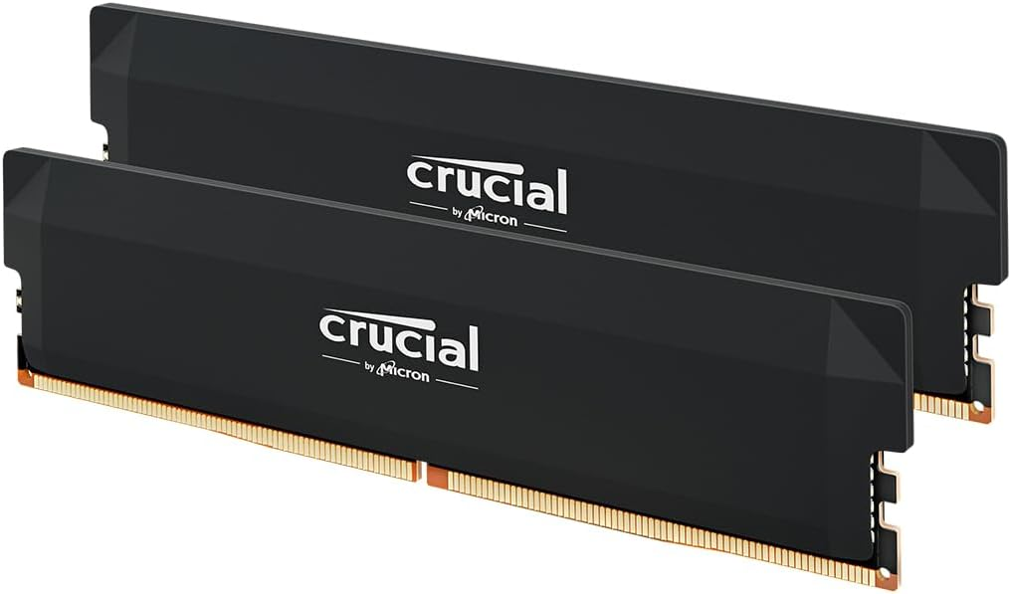
Memory
Original memory is DDR3.
New Motherboard accepts DDR5 memory.
Max Capacity of my Motherboard is128GB
32GB cost me £80
Notes:
Original Memory DDR3. New MB accepts only DDR5.
Max capacity of mine is now 128GB. 32GB cost me £80.
DDR stands for "Double Data Rate", and it refers to how memory transfers data.
Traditional memory (like SDRAM) transfers data once per clock cycle — usually on the rising edge of the signal. DDR memory, however, transfers data twice per cycle:
Once on the rising edge
Once on the falling edge
This effectively doubles the data throughput without increasing the clock speed — hence the name.
Generation Introduced Speed range Voltage
DDR3 2007 1066 – 2133 1.5 – 1.35V
DDR4 2014 2133-5100 1.2V
DDR5 2020 4800-8400+ 1.1V

Slide 24
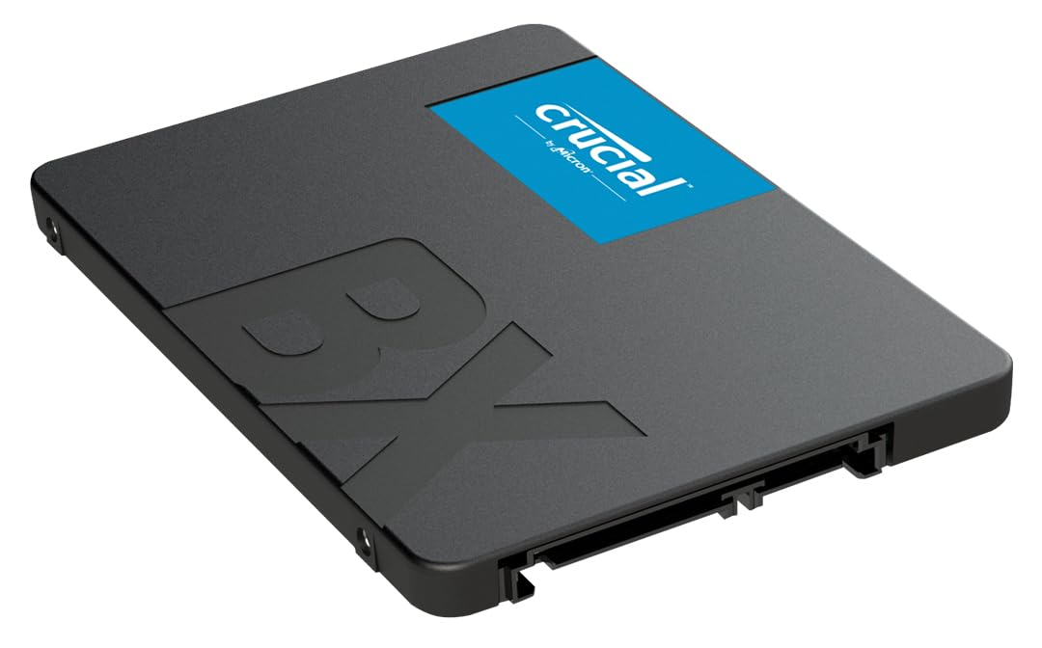
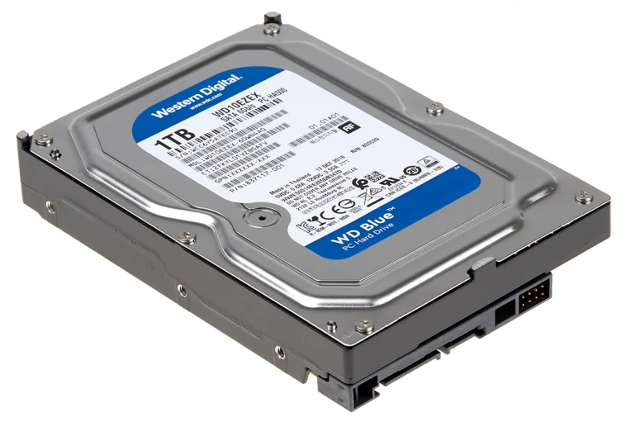
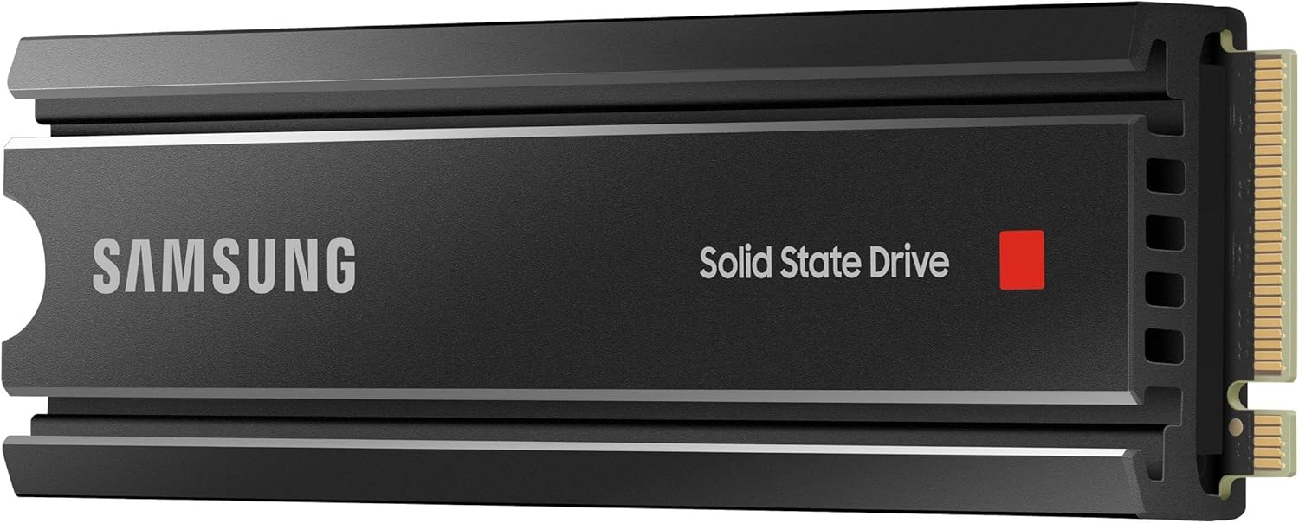
Storage
Original Storage. 1TB HDD
Upgraded (2019) to 1 TB SSD
New Motherboard Accepts NVME.
I purchased 1TB worth for £74
Notes:
***** Original HDD Hard Disk Drive. Mechanical, slow by todays standards. Needs a data connection to the MB and a power connection to the Power Supply
***** Upgrade to SSD Solid State drive. Much much quicker than the mechanical HDD. Usually fits into a bracket that holds a regular HDD. Still needs data and power connectors
***** New motherboard accepts NVMe Non Volatile Memory Express. Fits directly INTO the motherboard. Quicker than the quick SSD
1TB cost me £74
I still have the original 1TB SSD to add in as an extra drive

Slide 25
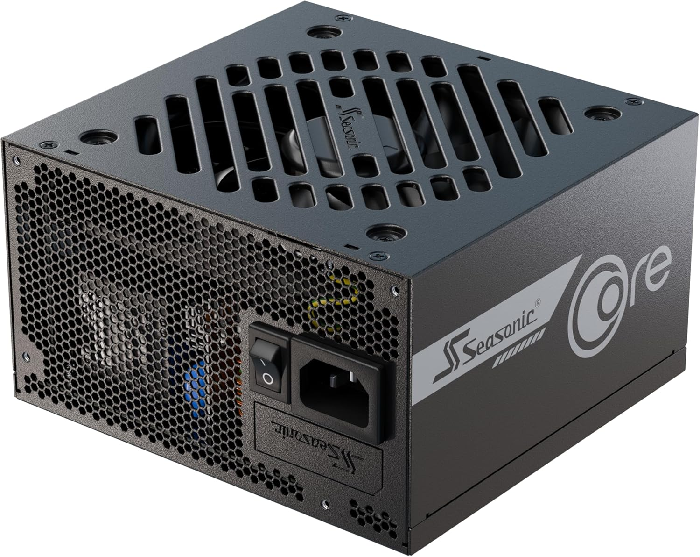
Power Supply Unit
Original PSU 300W.
New components draw much more power.
Use a PSU calculator
I purchased a Seasonic 650W Fully Modular PSU. Cost £113
Notes:
Original PSU 300W
New components draw more power
List all the components that draw power. Add a reserve 20-30% or
Use a PSU Calculator www.newegg.com www.coolermaster.com www.msi.com
I purchased a 650W modular power supply for £113.

Slide 26
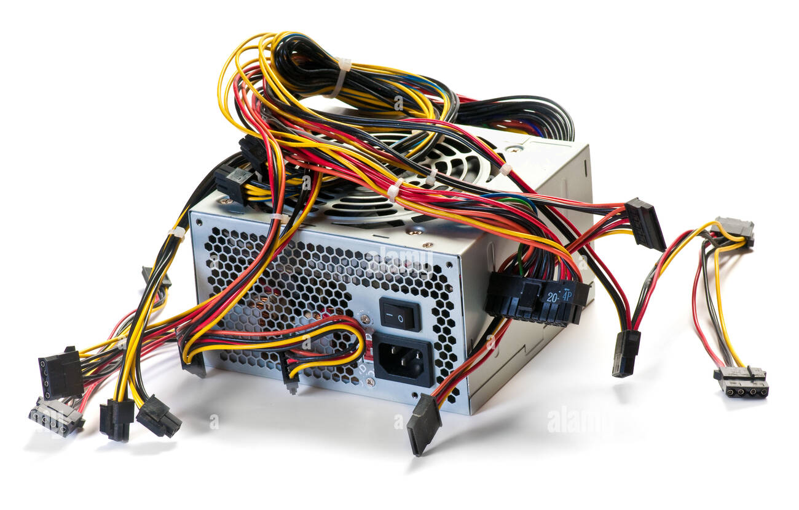
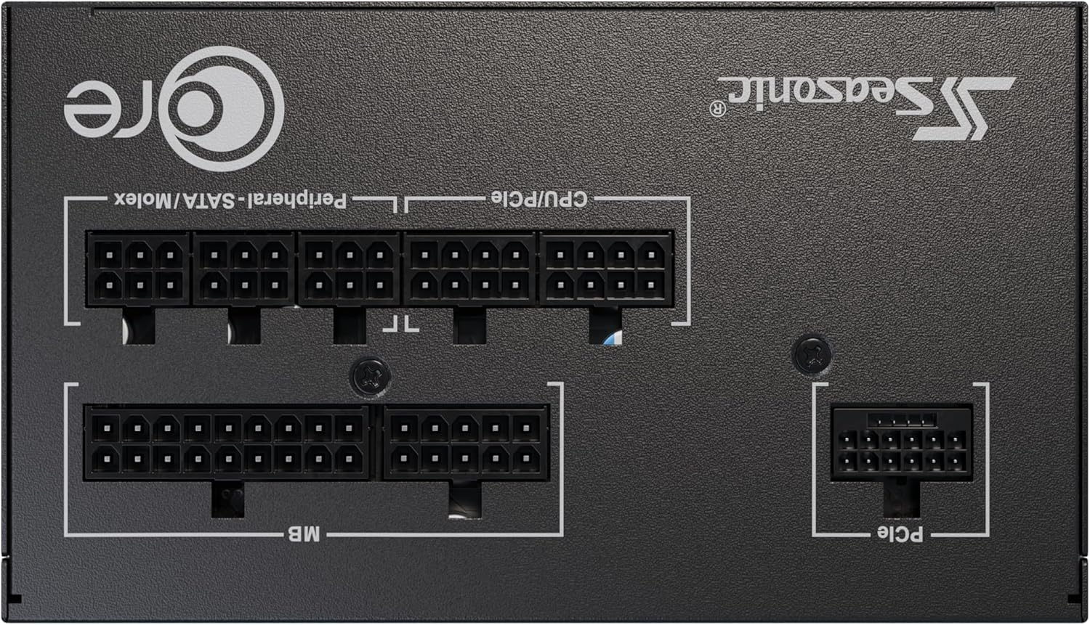
Power Supply – Rear Connections
Original PSU not powerful enough
Original was “Wired”.
Replacement is “Modular” meaning you plug in the cables at both ends that you need.
Notes:
Original was wired – like this. My new one is modular meaning you plug in the cables at both ends, not just to the Motherboard and HDDS etc
***** to show rear of my Power Supply with socket connections

Slide 27
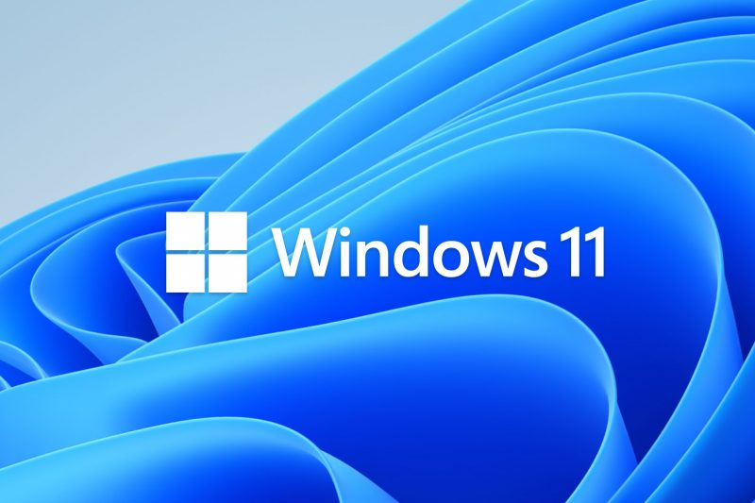
Windows 11 Licence
I rather lately realised that I would need a licence as everything had been replaced.
I purchased a ‘grey area’ licence for £18.00
Notes:
I rather lately realised that I would need a licence as I had replaced everything
A licence from Microsoft costs £119. I bought a ‘grey area’ licence
Here’s the deal: if your Windows 10 license was a retail version and linked to your Microsoft account, you can usually reactivate it after a hardware change using the Activation Troubleshooter. But if it was an OEM license (preinstalled on your Dell), then yes—replacing the motherboard and CPU typically voids the license, because OEM licenses are tied to the original hardware.
How to Check What You Had
If you still have access to the old system or backup:
Open Command Prompt and run:
slmgr /dli
If it says OEM_DM or OEM_COA, it’s an OEM license. If it says Retail, you’re in luck.
My licence was an OEM licence – tied to the actual PC. Not a retail licence

Slide 28

Shopping list
Item | Cost
Motherboard | £150
CPU | £159
RAM | £80
Storage | £74
Power Supply | £113
Windows 11 Licence | £18
Thermal Paste | £5.50
Total | £599.50
Notes:
For these specs you can expect to pay between £700 – 1200 for a production PC
50p inside my budget – nice.

Slide 29
The Build
Notes:
Pre-requisites
Static free environment, I worked in my workshop, concrete floor with rubber mat
Good lighting – tick
The right tools. Small screwdrivers Philips and star points
Anti Static wristband and earth strap
Everything arrived over 3 days. Once it was all together, I took everything out of the old PC. Took the new motherboard out of the box and realised that it wouldn’t fit.

Slide 30
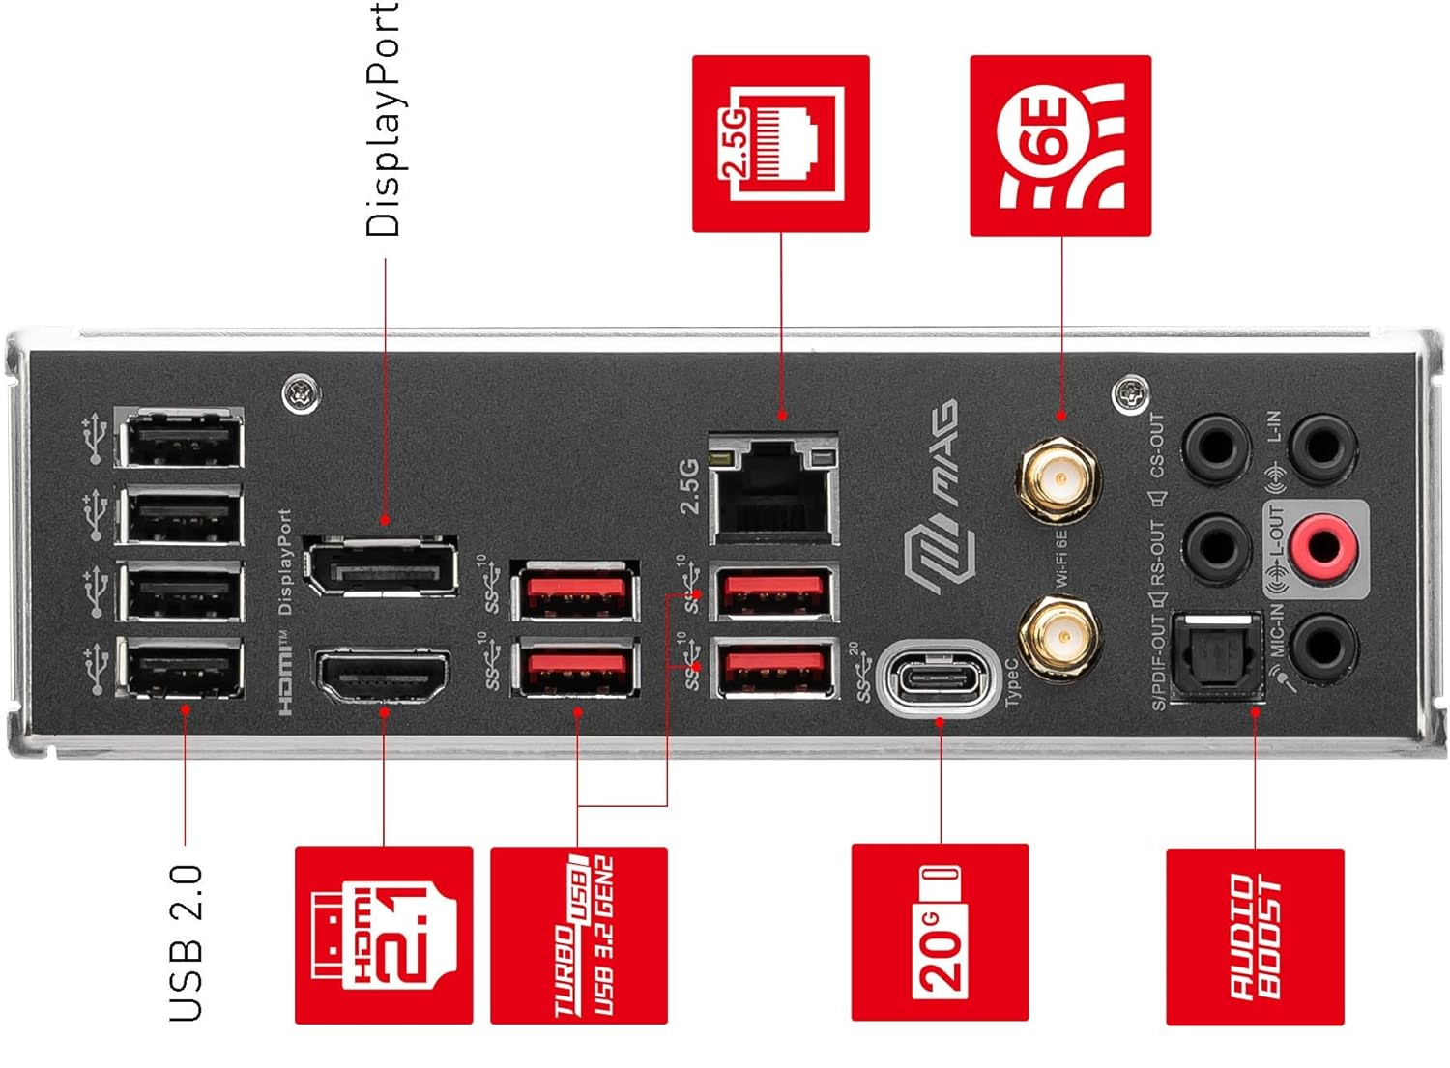
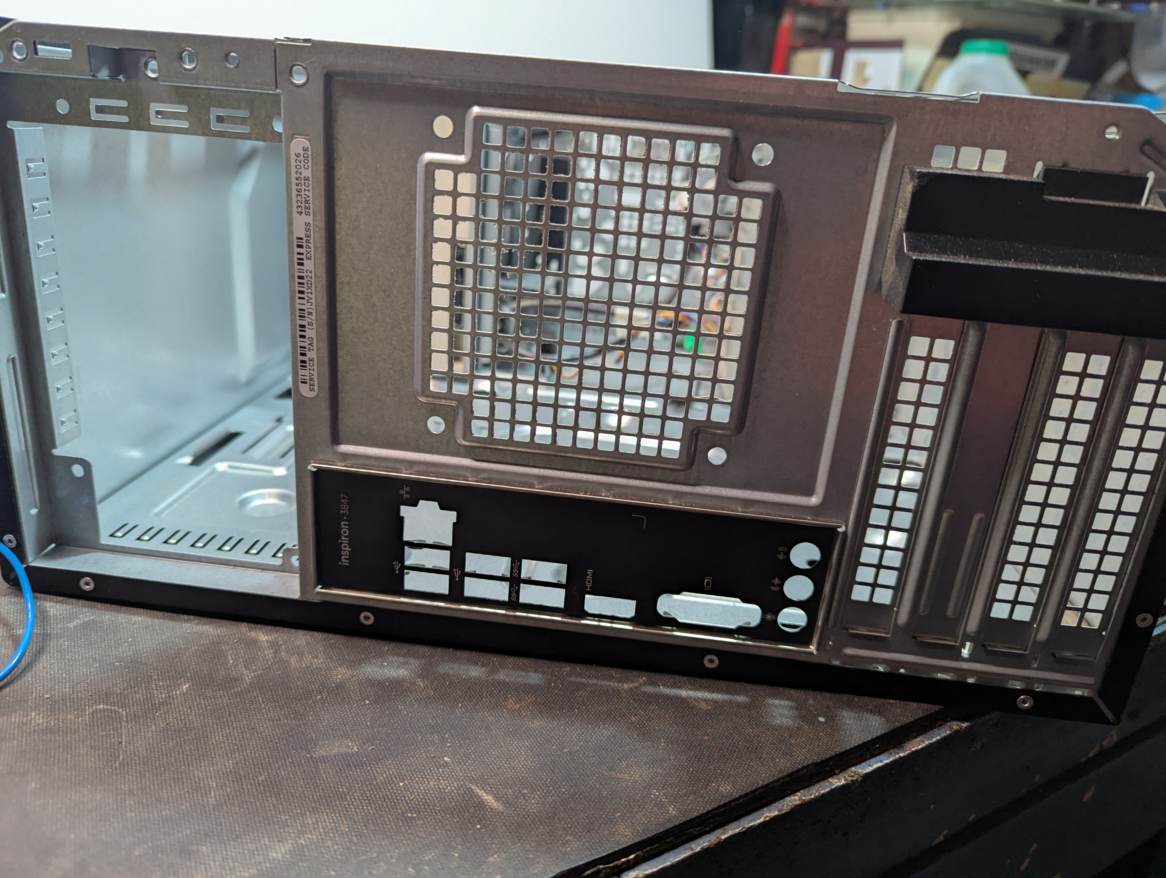
Dell Case MSI Case
Notes:
In the case of the Dell, the IO Panel is in the middle of the chassis, for my new motherboard, the IO panel is hard up to the left hand edge 😒😒.
You can see that the power supply goes at the top of the case – left hand side here as laid down.
Only one real option – more shopping.

Slide 31
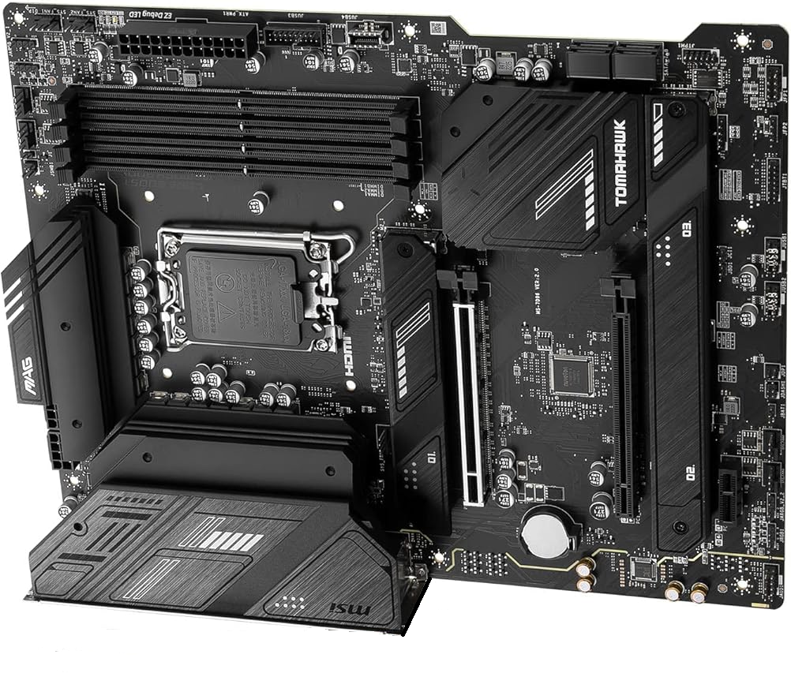
MSI
Motherboard
IO Panel, hard up to left hand side
Notes:
Turn this 90 degrees anti clockwise

Slide 32
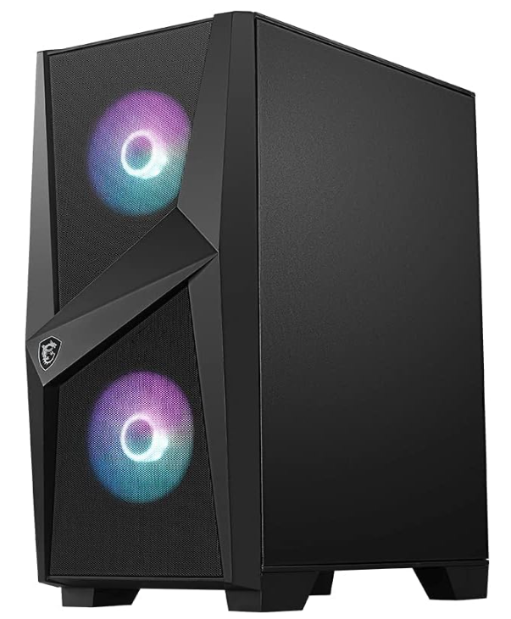
The Chassis (Case)
As it’s an MSI Motherboard, I bought an MSI case.
This has fancy addressable lighting in it (meaning you can make it do things)
It cost £55.00

Slide 33
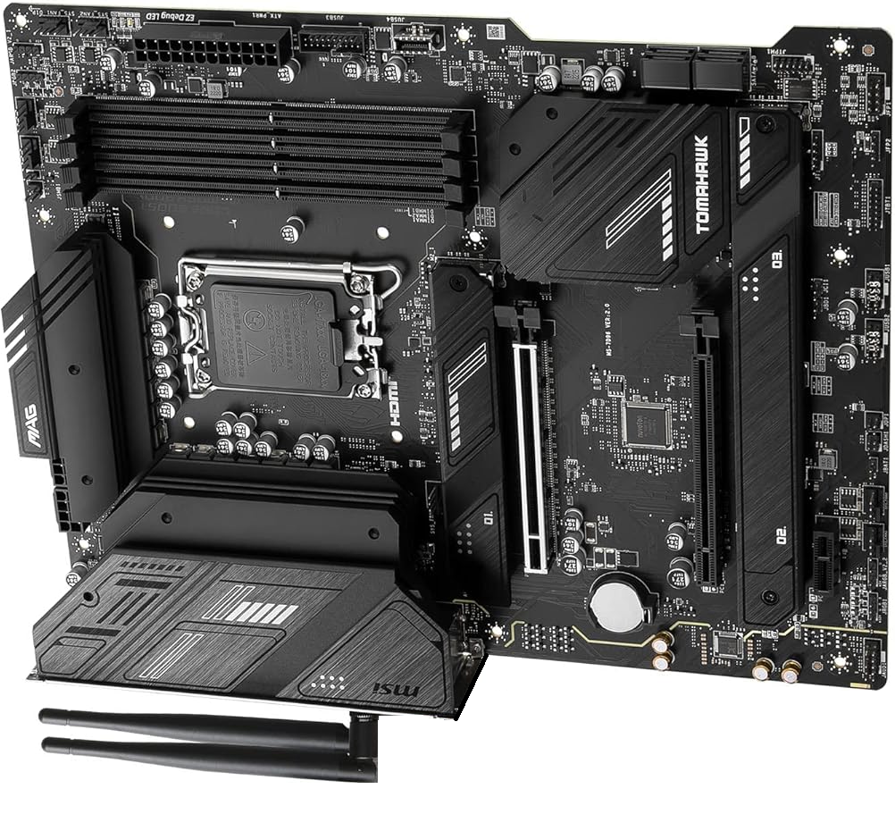
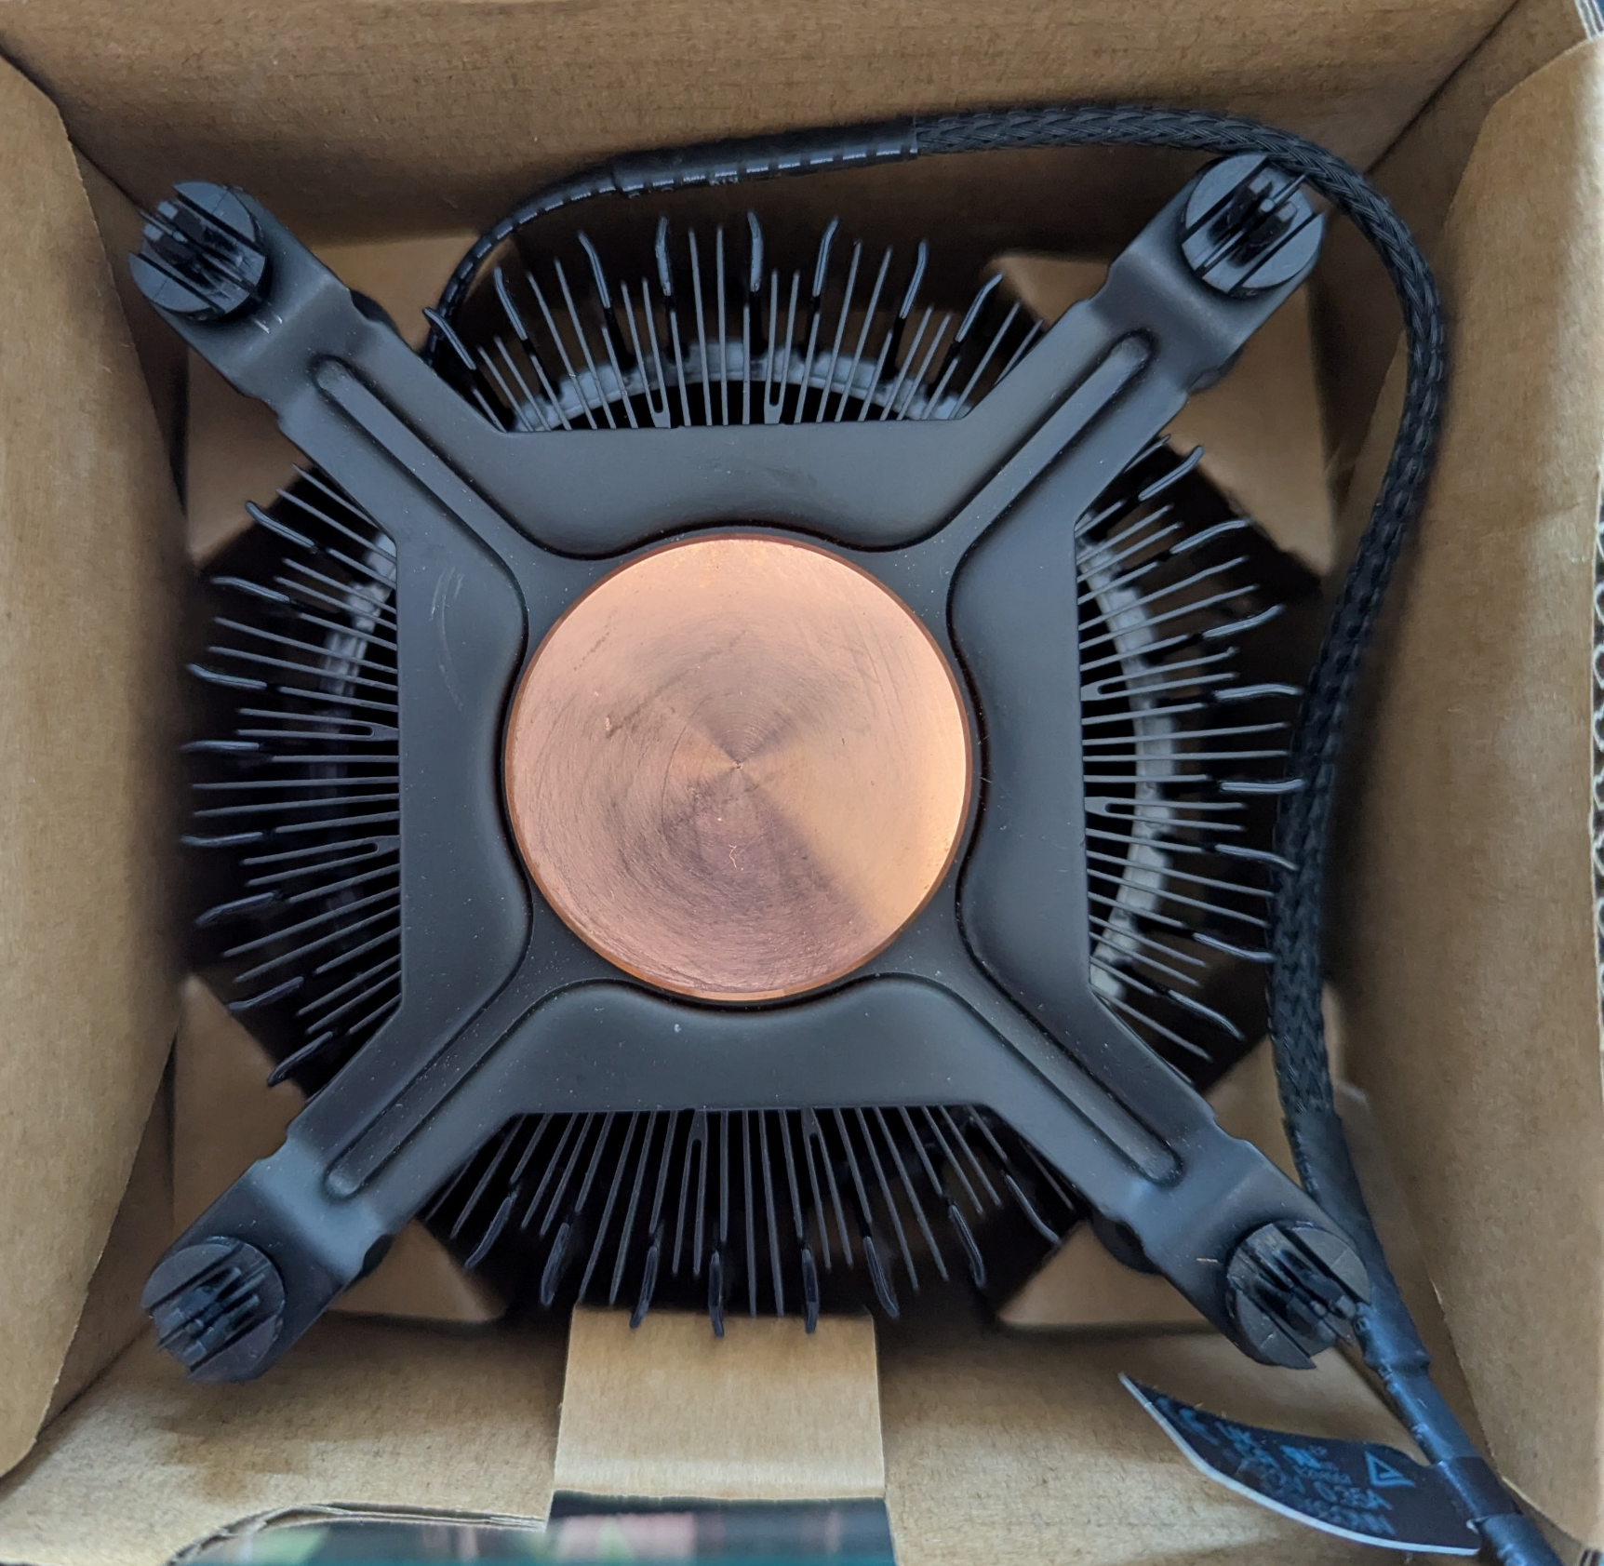

Notes:
If you hadn’t noticed by now, I have enough components to build a whole new computer…….

Slide 34
Motherboard
Notes:
Install the Motherboard

Slide 35
Processor
Processor
Notes:
Install the Processor

Slide 36
Cooling fan
Notes:
Install the cooling fan

Slide 37
Memory
Notes:
Install the memory

Slide 38
NVMe Storage
Notes:
Install the NVME storage

Slide 39
Power Supply
Notes:
Install the Power Supply

Slide 40
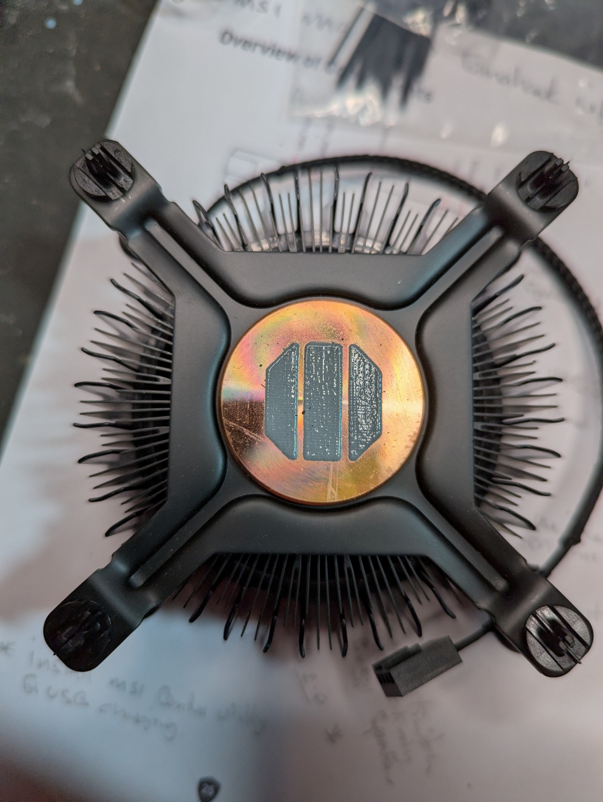
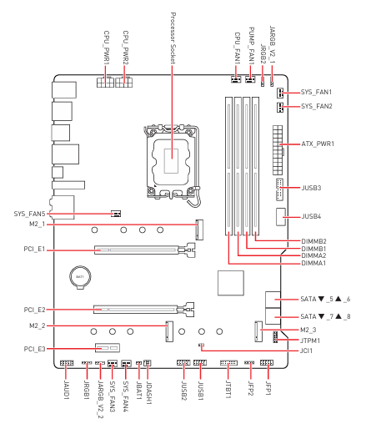
The Build – Part 2
A lot of fiddly connections for the Motherboard – but all marked.
Processor, NVMe SSD and Memory were easy.
Cooling fan already has thermal paste applied, just bolt on top.
Modular Power Supply was awkward getting plugs into the rear of the PSU, not much space.
Notes:
User manual for the motherboard very helpful, I read it right through before I started…..
A lot of fiddley connections but all marked
And the manual for the processor and fan (not much to read there). Installing the Processor, NVMe and memory were easy. They are all keyed or marked so you get them the right way around.
***** Cooling fan
Already had thermal paste applied, just bolt on top of the processor
The Power supply was awkward, not much space behind to get the connections
Original Intention was to just install the minimum parts to get it working – and then install the extra SAT SSD that I already had. In the event I added it in as part of the build.

Slide 41
Let’s Turn it on!

Slide 42


I switched on the Power Supply
And nothing happened.
I felt a bit of a fool when I realised that I hadn’t pressed the Power button on the front panel!
Success, it bursts into life.
Notes:
I switched on the Power Supply at the rear of the unit.
**** Nothing happened - Dim Workio.
**** A fool
***** Success

Slide 43
Installing Windows
‘Fairly’ straight forward.
Issues with connecting to the internet.
An own goal! Installed to the wrong Drive
Changed OneDrive from the default C drive to the D Drive
Notes:
Windows going through it’s setup – asks to connect to the internet.
**** Network Issues. I have a network cable plugged in but the prompt tells me to “Install a Driver”. I download the driver from the MSI website on my other computer. It’s a ZIP file so I extract all the files and put them on a USB stick to use from the new PC.
Here the fun starts. Once in the new PC, I can see the FOLDERS on the USB stick, but not any FILES.
It turns out that I’m still in the Windows Setup environment, not the full desktop yet. That limited File Explorer is part of the Out-of-Box Experience (OOBE), and it doesn’t support full file browsing or advanced view options.
The answer was to open up Device Manager from a Command Prompt and install from there – Installation of the driver seemed to work, but still had the Cannot connect to the internet prompt. No option available to skip that bit, so I was stuck.
The Answer was to install Windows without the internet. From the Command Prompt I entered this Command: oobe\bypassnro
That immediately rebooted the PC and the setup screen now gives me an option to tick a box that says “I don’t have internet” option. If you follow that through, you create a local account rather than your regular Microsoft account. Once it’s all done and you are at the desktop, I was able to properly install the Network drivers and then once connected to the internet, add in my proper Microsoft Account and then for tidiness, delete the local account. Tah dah.
There was a section in the Motherboard manual that said I had to update some drivers before installation of any Operating Software, I didn’t quite understand it, so carried on without, and thus experience the above. Reading it again, it now makes sense…..
****** An Own Goal
I mentioned earlier that I didn’t take my own advice and during the build I also installed my second SSD. Disk drives are numbered numerically from 0. 0, 1, 2, 3 etc.
Windows is installed on the first available drive. I hadn’t realised that the Proper SSD for the computer, the NVMe drive is installed at position 1 and that my additional 1TB SATA SSD was in position No 0, So that was where Windows was installed…… Grrr,
I had to install it again.
****** Once I was in Windows, I changed the default location for the One Drive to my SSD D Drive.

Slide 44
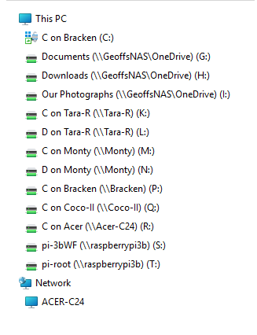
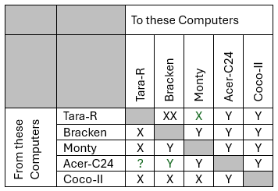
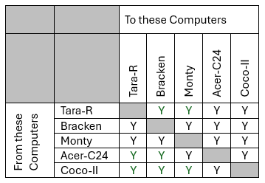
Post Windows Niggle
Mapped Drives
File Explorer, I like to be able to navigate to other computers. I use “Mapped Drives”. This is what I like to see:
It doesn’t always work – I’ve been here before - lots of times
Notes:
Now that Windows is installed and working, I like to set up my Mapped Drives.
So from File Explorer, I can see all the other computers on my Network.
***** It doesn’t always work
Ensure some specific services (4) are set to automatically run
Function Discovery Provider Host
Function Discovery Resource Publication
SSDP Discovery &
UPnP Device Host
Login credentials for destination computer
Private network
Added in Traffic rules for Norton
***** This is what I had
***** This is how I ended up.

Slide 45
An Upgrade not good enough?
Notes:
This upgrade was meant to be a modest upgrade to a Backroom Support PC. In the event it now has pride of place on my desktop.
Perhaps I should up the Specs a bit.
I installed an extra 32GB of RAM – So I now have 64.

Slide 46
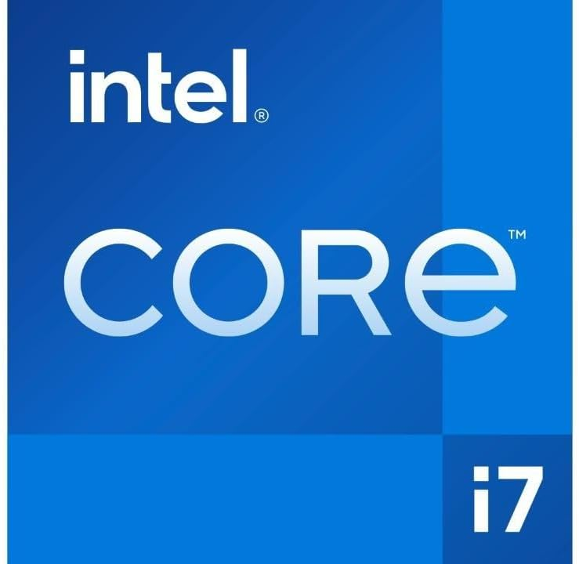
The Processor
Socket | Purpose
i3 | Entry level
i5 | Mid range
i7 | High performance
i9 | Enthusiast/workstation-grade
Notes:
And I decided to upgrade the Processor. The one I initially bought was an i5 14th generation
I replaced it with an
******** i7
i7 Processor is 14th Generation 14700K
20 Cores up to 5.6GHz
Cost £290
***** Here’s a reminder of the scale
An i9 cost nearly £660.00!

Slide 47
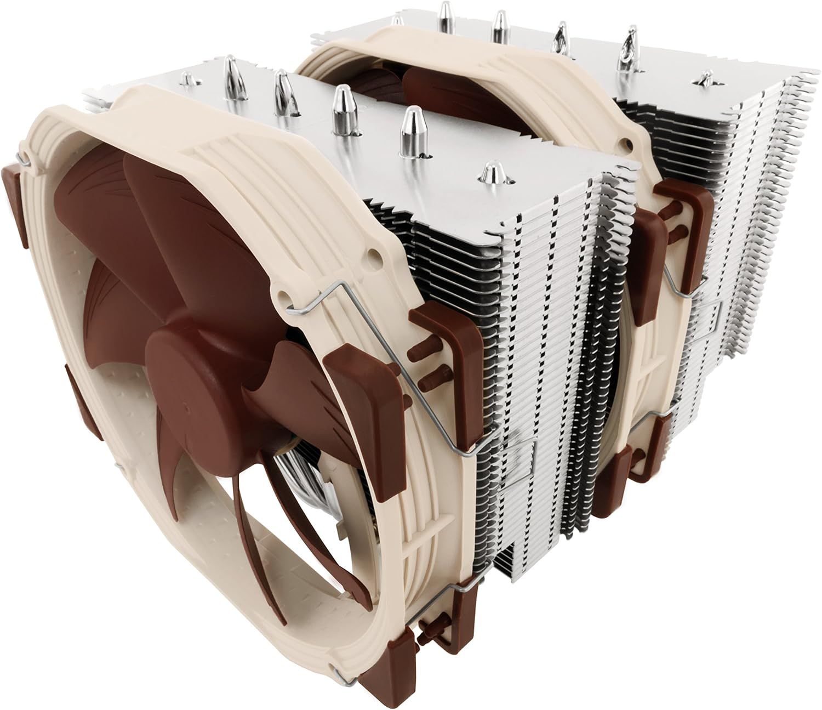
Cooling: A problem
The i7 Processor runs a lot hotter than the i5 and doesn’t come with its own fan.
Options: Air Cooled or Liquid Cooled.
Memory modules too tall – 44mm, this
air cooled fan won’t fit.
Notes:
The i7 processor runs hotter than the i5 – and doesn’t come with it’s own fan
Options: Air Cooled or Liquid cooled
I originally thought I would go for Air cooled. This is what was recommended. It’s massive, its 165 mm tall.
Copilot tells me I have 167 mm in my case. 2mm spare is a bit tight.
****** Memory too tall
Secondly, the footprint is too large, it will interfere with my memory – which is very tall.

Slide 48
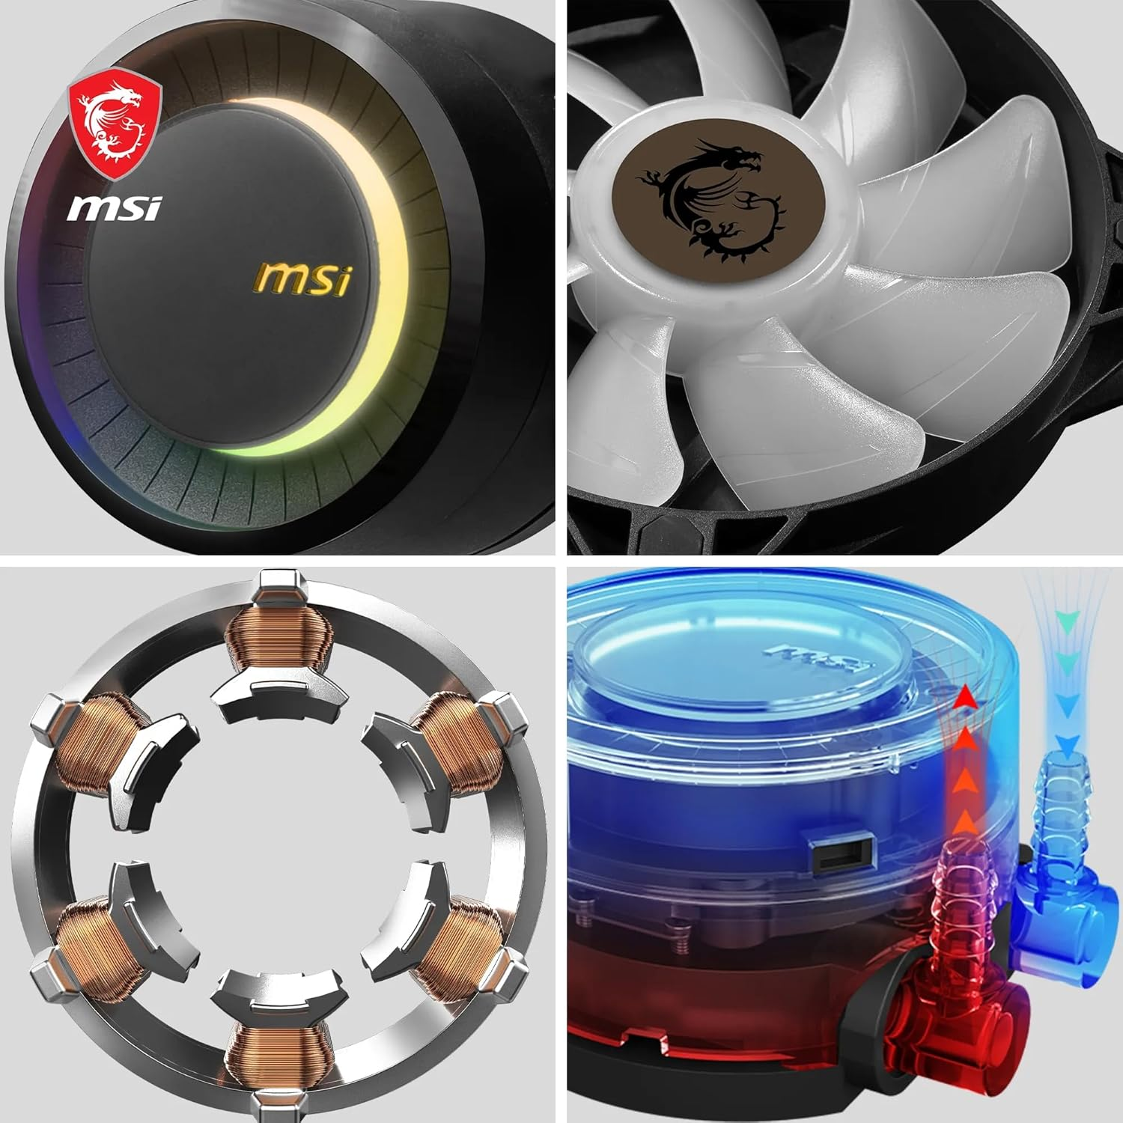
Liquid Cooling
Works like a car radiator.
A Radiator
Fan/s
A Pump
Notes:
So, lets take a look at liquid cooling.
Works like a car radiator.
It has a radiator, a fan or fans and a pump

Slide 49
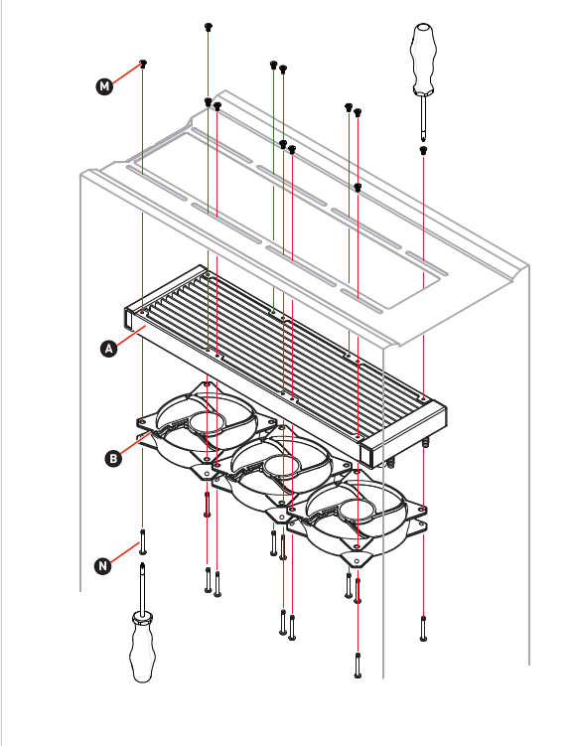
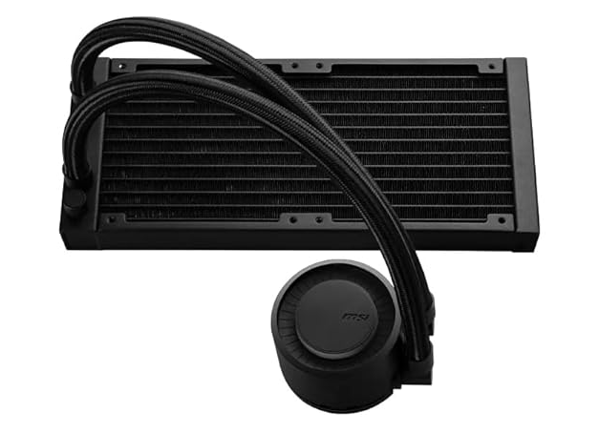
Notes:
A bit of a fiddle to install, but all went OK first time.
Part of this kit included some thermal paste for between the CPU and Cooler plate on the pump. So I could have saved myself £5.50 in buying my own that I didn’t use.

Slide 50
REVISED Shopping list
Item | Cost
Motherboard | £150
CPU i5 | £159
Resale of i5 on eBay | -£110
CPU i7 | £291
Liquid Cooler | £90
RAM | £160
Storage | £74
Power Supply | £113
Windows 11 Licence | £18
Thermal Paste | £5.50
Total | £950.50
Notes:
Here’s my revised shopping list
I spent an extra £461 on more RAM, a better Processor and a liquid cooler.
I sold the i5 processor on eBay for £110 so net increase was £351. Therefore total outlay £950.5.
Purchase price for these specs £1500 to £1700

Slide 51
Comparison: Old to new
Category | Original Dell Inspiron 3847 (2014) | Upgraded MAG Build (2025)
Processor | Intel Core i5-4460 (4 cores @ 3.2 GHz, Haswell) | Intel Core i7-14700K (20 threads, Raptor Lake)
Motherboard | Dell OEM H81 board, proprietary layout | MSI MAG Series, ATX – modern design, strong power delivery
RAM | 8GB DDR3 @1600MHz | 64GB DDR5 – high-speed, multitasking juggernaut
Graphics | NVIDIA GT 705 (1GB DDR3) | Discrete GPU optional or upgrade-ready
Storage | 1TB 7200RPM HDD | 1TB NVMe SSD – ultra-fast boot and file access
Cooling | Stock air cooler | MSI MAG CoreLiquid E240 AIO – quiet, efficient
Form Factor | BTX-like Mini Tower (limited airflow & expandability) | ATX Mid-Tower – spacious, modular, airflow-optimized
TPM / Security | No TPM 2.0, BIOS boot | TPM 2.0 & UEFI Secure Boot – fully Windows 11 ready
OS | Windows 7 | Windows 11
Aesthetics | Basic chassis | RGB lighting w/ Mystic Light, theme sync
Expandability | Limited by case & connectors | Fully modular, enthusiast-ready upgrade paths
Notes:
“Tara has transformed from a solid office-grade system into a sleek, high-performance workstation. From a slow spinning hard drive to lightning-speed NVMe, and a modest 8GB RAM to a towering 64GB DDR5—this build reflects a decade’s worth of innovation and thoughtful upgrades.”

Slide 52
Resources

Slide 53

Resources.
I used two resources
User Manuals & Bing Copilot
Transcript of the whole Copilot conversation available in our Downloads folder.
Notes:
***** User manuals & Copilot
My Copilot transcript is worth a look at. It was quite long over 150 pages. I don’t expect you to read the whole lot (unless you want to) but it is interesting. Use the navigation and pick out the bits that catch your eye.
We’ll have a little look at it in a minute.

Slide 54
And what of the original Computer?

Slide 55
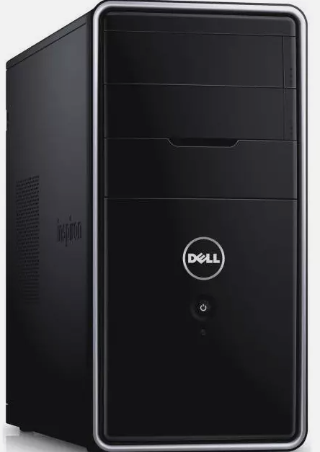
Dell 3847
Similar available pre-used on eBay £85
I DID upgrade it to Win 11 using a Microsoft
documented edit to the Registry.
To a good home, this is completely
Take it away today…… 😊
FREE
Notes:
Similar computers available on eBay for less than £100.
Specs on this one: i5 4460 processor, 1TB HDD, 16GB Memory
****** Upgrade.
Upgrade to Win 11. Using a documented edit to the registry. This skips over the checks that it would otherwise make. You add specific keys to the registry to:
Bypass the TPM check
Bypass the Secure Boot check
Bypass the RAM check
Bypass the CPU check
Whilst the RAM & CPU are hardware based and only mean that you are using older components or less than minimal memory.
Bypassing the TPM check and Secure Boot check mean that the PC will never be as secure as a “Regular” Windows 11 computer.
***** FREE
Now that I have my new computer, this one is FREE to one of you, you can take it away today……

Slide 56
Discuss
But first I want to show you the Copilot transcript.
Notes:
****** But first I want to show you the Copilot Transcript

