Slide 1

Wi-Fi Network: Memorial hall_guests
Password: 7F&3CB4P8C
Shrewsbury u3a Computer Club

Slide 2
Windows accessibility
What does that say? It’s too small for me to read. I can’t make out the colours, it’s blurred.
What does that say? It’s too small for me to read. I can’t make out the colours, it’s blurred.
Notes:
What do we mean by ”accessibility”?

Slide 3
Accessibility options:
What is available?
Vision options
Hearing options
& Interactions
Notes:
Accessibility options or “Ease of Use” are built in to Windows and Apple’s software. For many of us, we don’t even think of them and probably have never explored what is available – myself included. There is a surprising amount that you can change to make your computer sessions a more pleasing experience:
Windows first:
******
Vision Options
*****
Hearing Options
*****
& Interactions

Slide 4
Vision options
The Display
The Mouse Pointer
Text Cursor
Magnifier
Colour Filters
High Contrast
Narrator
Notes:
We can change a number of things that we can use to make us see better
*****
The Display
*****
The Mouse Pointer
*****
Text Cursor
*****
Magnifier
*****
Colour Filters
*****
High Contrast
*****
Narrator

Slide 5
Vision Options: The Display
With the Display you can:
Make text bigger
Make everything bigger
Make everything brighter or use Night Light
Notes:
All of these from the Settings Menu (Keyboard shortcut: Win+i) | Accessibility (Win 11) or Ease of Access (Win 10)
*****
With the Display you can
*****
Make text bigger
*****
Make everything bigger
*****
Make everything brighter or use night light

Slide 6
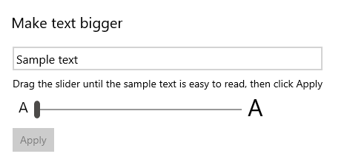
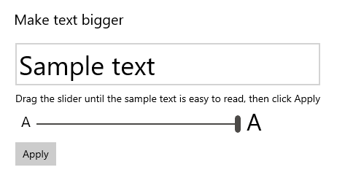
Notes:
Making the text bigger, drag the slider from the default of 100% (as is) to a maximum of 225%. You will see immediate results in the Text Preview (Win 11) or Sample Text (Win 10).
*****
When you are happy with your level of magnification click Apply to save the changes.

Slide 7

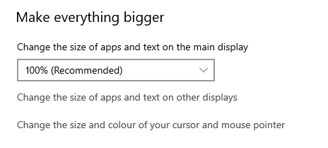
Notes:
Options from the drop down box give us the default of 100% +
125%, 150% & 175%
Note that you can change the size of apps and text on other displays
And change the size and colour of the cursor and mouse pointer.

Slide 8
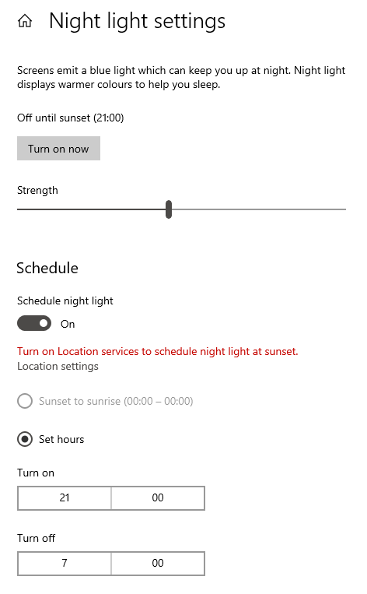

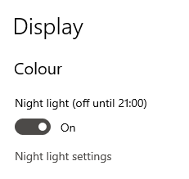
Menu settings on your monitor: Brightness and Contrast
Notes:
Night Light displays warmer orange-y colours than your regular display, it is supposedly help to make you sleep better.
***** The top part of the Night Light settings allows you to experiment with the colour scheme
***** You can schedule the change or, if you have location services turned on ie the computer knows where you are, then you could have it automatically change at sunrise and sunset. In my screenshot here, it’s greyed out as I have location services turned off.
You can also turn the Night Light on and off from the action centre – bottom right of your screen on the taskbar.
***** Or change the brightness and or contrast from the menu of your monitor

Slide 9

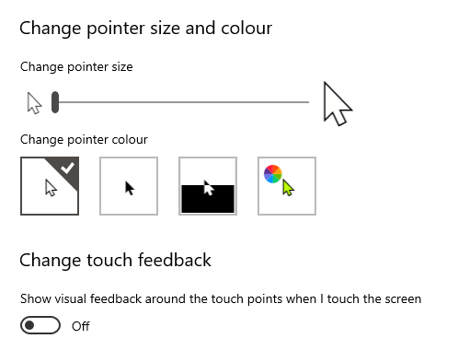



The Mouse Pointer
Notes:
The Pointer size makes a massive difference. Move the slider until you get to a size you are comfortable with. Works on a scale of 1 – 15. 15 is really big!!
Use of colour can help. Default White, options Black, inverted (black background but see through) and coloured.

Slide 10
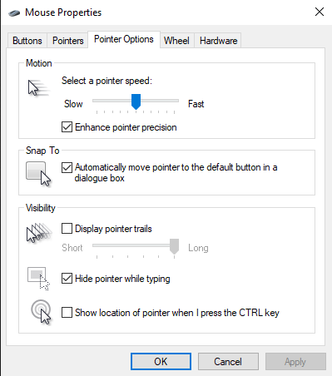
The Mouse Pointer
From Control Panel
Notes:
From the Control Panel (It’s still available in Windows 10 & 11) You have further options for the Mouse in particular the Pointer Options which allow you to select the pointer speed – how fast it will travel across the screen.
“Snap to” – automatically moves the mouse pointer to the default button in a dialog box and
“Display pointer trails”; this works very well and shows an “echo” as you move the mouse it makes it mush easier to see where the cursor is. You can adjust the length of the ‘echo’.

Slide 11
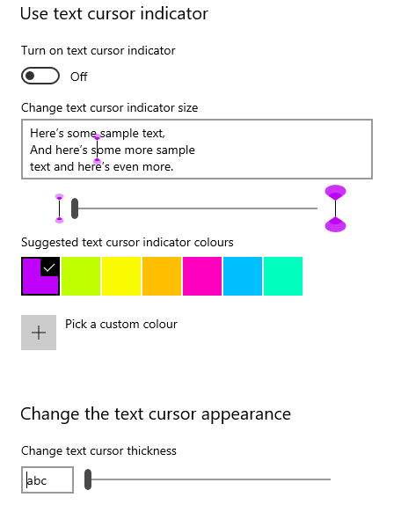
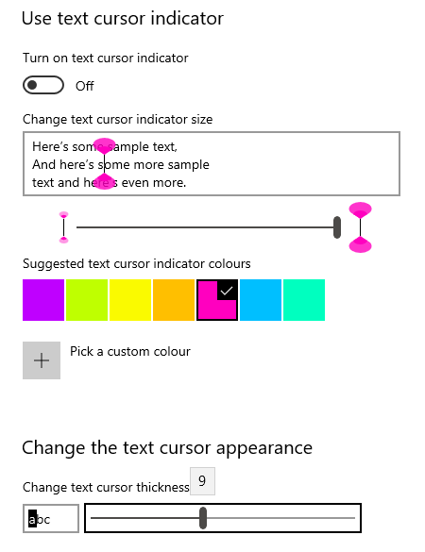
The
Text
Cursor
Notes:
With the text cursor, you can:
change the indicator to give it a blob at the top and bottom
change the size,
the colours of the indicator,
and the thickness of the text cursor.

Slide 12
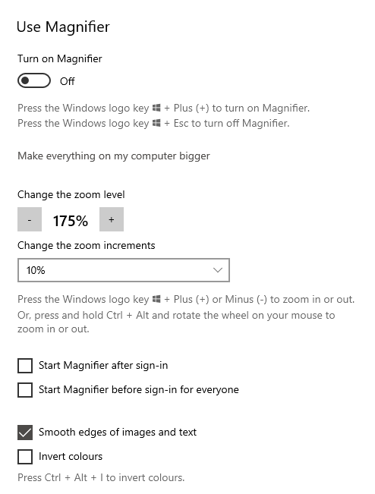
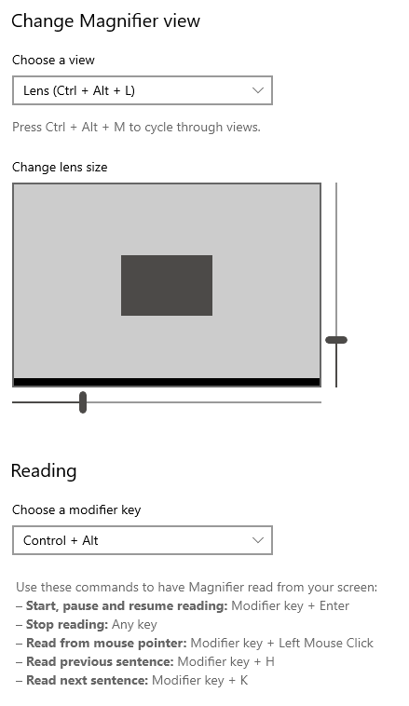
The
Magnifier
Notes:
Use the Magnifier to zoom in on parts of your display. The Magnifier can run in full screen, a separate window or as a lens that follows your mouse pointer around the screen.
***** The Lens option works quite well. You can see here that you can change the size of the lens too.

Slide 13
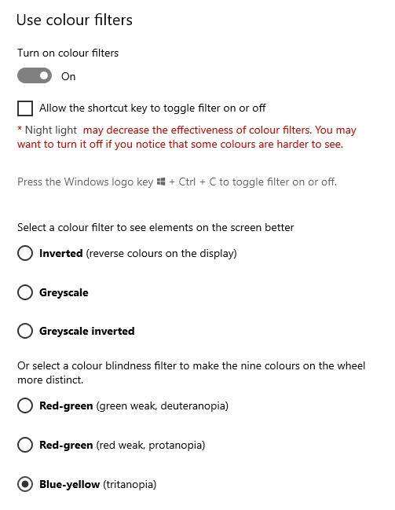

Colour
Filters
Notes:
Use a colour filter to make colours on your screen easier to see and differentiate.
The first selection either inverts the colours (white on black rather than black on white)
Greyscale: removes all colour to is presented as black and white
& Greyscale inverted – like a black and white photo negative.
And the second section is more attune to those with differing levels of colour blindness making some colours stand out more

Slide 14
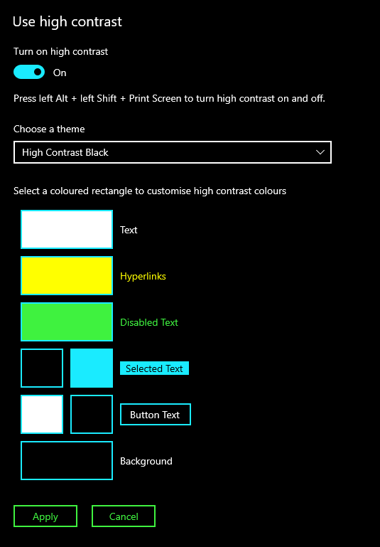
High
Contrast
Notes:
High Contrast reverses colours and lets you choose contrasting colours for text, hyperlinks, selected text and so on.
Windows 11 has a number of Themes with different high contrast colours set up for you already.

Slide 15
Narrator
Built in screen reader for both Win 10 & Win 11.
Choice of voices: Male, Female, English or American
Change: voice speed, pitch or volume
Choose what you hear: Text only, Some control details, All control details, Some text details, All text details.
Change what you hear when typing.
Show the Narrator cursor, sync your cursor with Narrator, read and interact with the screen using the mouse.
Quite intense, has it’s own Complete guide in windows support.
Notes:
Narrator is a screen reader that describes what’s on your screen so you can use that information to navigate your device.
It can be controlled by keyboard, touch and mouse.

Slide 16
Hearing options
Audio
Closed Captions

Slide 17
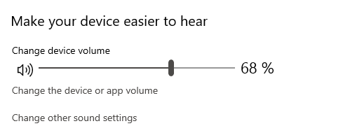
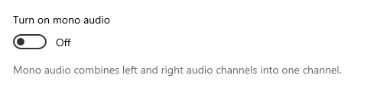
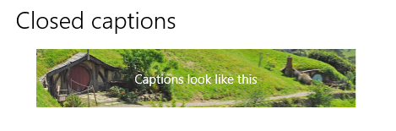
Audio &
Closed Captions
Notes:
Turn up the volume!
Turn on mono audio. Combines left and right channels into one – stereo to mono
Use Captions. Display audio as text. Many settings to change how the captions look. Font size, colour, background, transparency etc.

Slide 18
Interaction
Speech
Keyboard
Mouse
Eye Control
Notes:
With interaction we can use
***** speech,
***** the keyboard,
***** the mouse
***** and eye control to control how things work.
Speech, keyboard and Mouse are all inbuilt within Windows. To use the eye control, you would need to connect a supported eye tracking device – which then controls your mouse, you can type using the onscreen keyboard and communicate with people using text to speech software.

Slide 19
Speech
Talk to your computer to get it to fill in text fields.
Use auto punctuation or add it in as you go.
There are common dictation commands for both text and punctuation, so although there is a learning curve to start with – it does work well.
Notes:
Use dictation to convert spoken words into text anywhere on your PC with Windows 10. Dictation uses speech recognition, which is built into Windows 10, so there's nothing you need to download and install to use it.
*******
Talk to your computer
*****
Use auto punctuation
******
Common commands
To start dictating, select a text field and press the Windows logo key + H to open the dictation toolbar. Then say whatever’s on your mind. To stop dictating at any time while you're dictating, say “Stop dictation.”
There are common dictation commands to select words, paragraphs etc and to go forward or backwards through your document. You can elect to have auto punctuation or dictate the punctuation as you go.

Slide 20
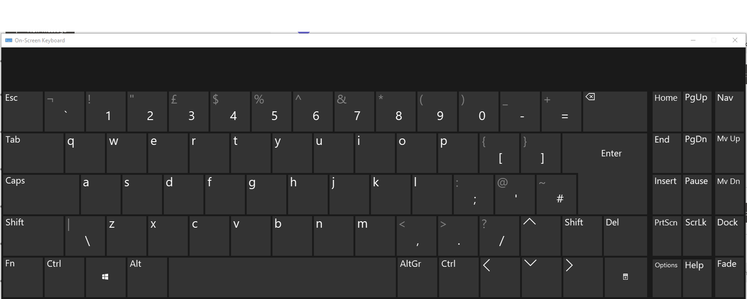
Keyboard
Try the onscreen keyboard. Touch screen or mouse.
Notes:
If you have trouble with a physical keyboard. Windows has a built in onscreen version. Use with a mouse and/or if you have a touchscreen, with that. Win + Ctrl + O

Slide 21
Keyboard
Sticky keys – press keys in sequence
Toggle Keys – plays a sound
Filter Keys – Ignore brief or repeated keystrokes
Print Screen Shortcut – rather than Win + Shift + S
Autocorrect misspelt words
Highlight misspelt words
Notes:
Sticky Keys
With Sticky keys turned on, rather than press a key combination, Win + Ctrl + O for example, you can now press them one at a time. To turn Sticky keys on, the keyboard shortcut is to press the shift key 5 times in a row, or from the Settings | Ease of Access | Keyboard menu. Or from Settings | Ease of Access | Keyboard.
***** Toggle Keys
Plays a sound whenever you press Caps Lock, Num Lock or Scroll Lock
***** Filter Keys
Ignore brief or repeated keystrokes and change keyboard repeat rates.
***** Print Screen Shortcut
Use the PrtScreen button to open screen snipping (rather than Win + Shift + S)
***** Autocorrect misspelt words
***** & Highlight misspelt words

Slide 22
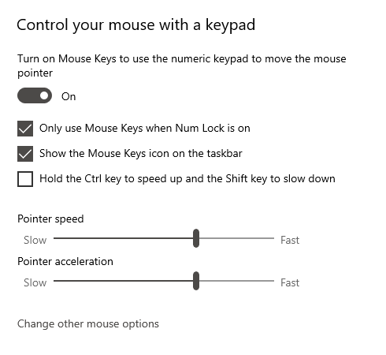
Mouse
Notes:
Control your Mouse with the numeric keyboard, keys 1 – 8 and the + key
You can move the mouse pointer with the numeric keys. 8 is up, 2 is down, 4 is left and 6 is right. Diagonals work with 7, 9, 1 & 3.
Adjust pointer speed and acceleration to suit. Modify with Ctrl & Shift to speed up and slow down.
Works well. When the mouse is over your selected text / button / link or whatever, press the + sign on the numeric keypad to ‘click’.

Slide 23
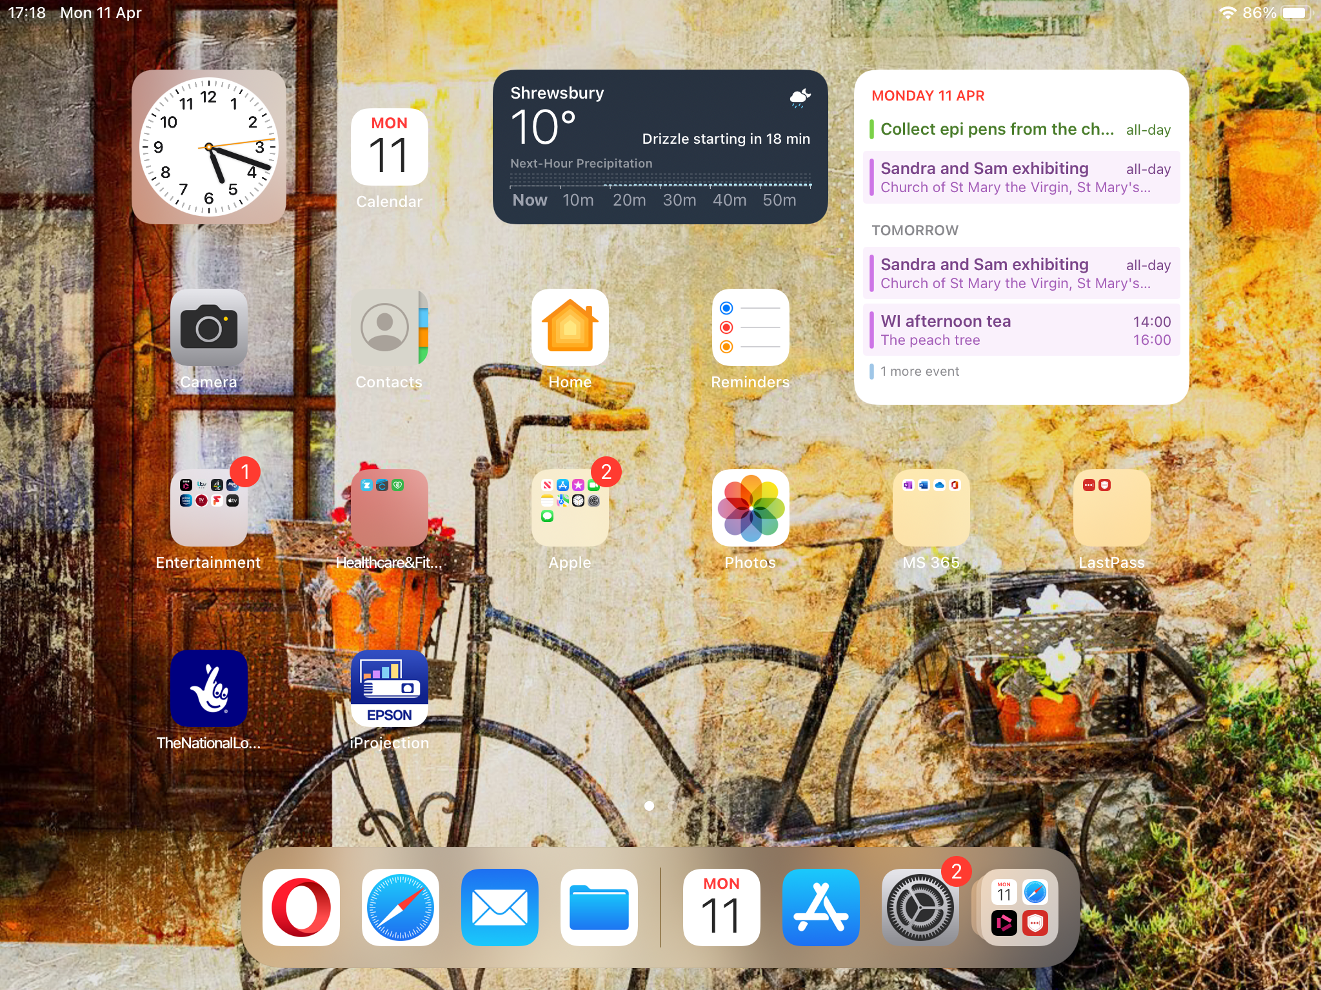
Apple iPad

Slide 24
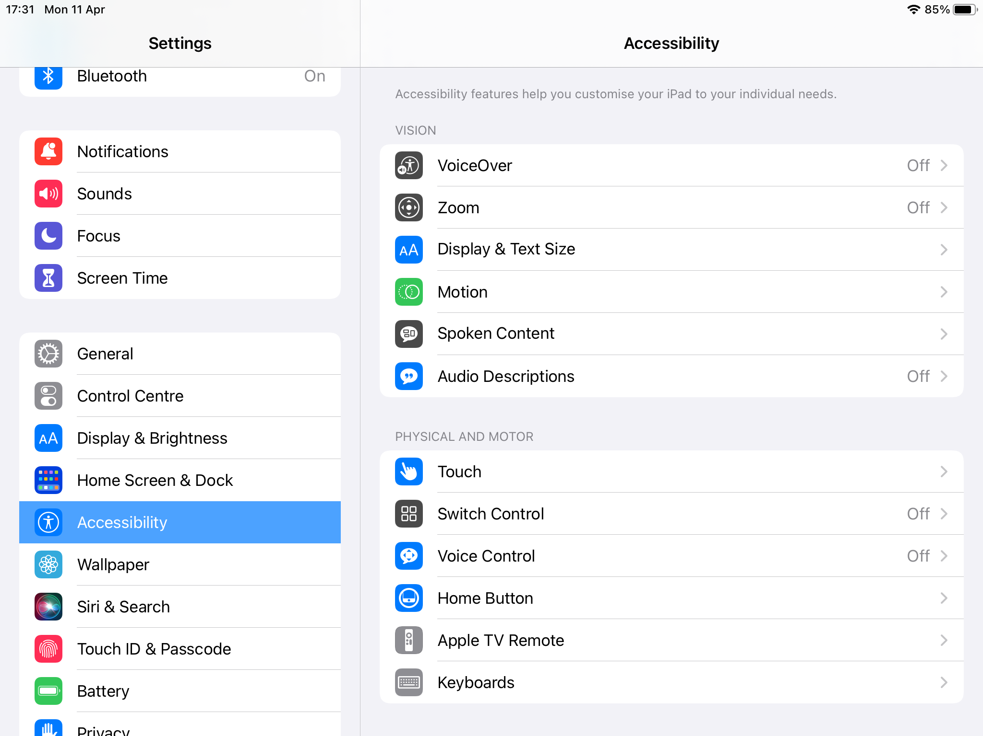
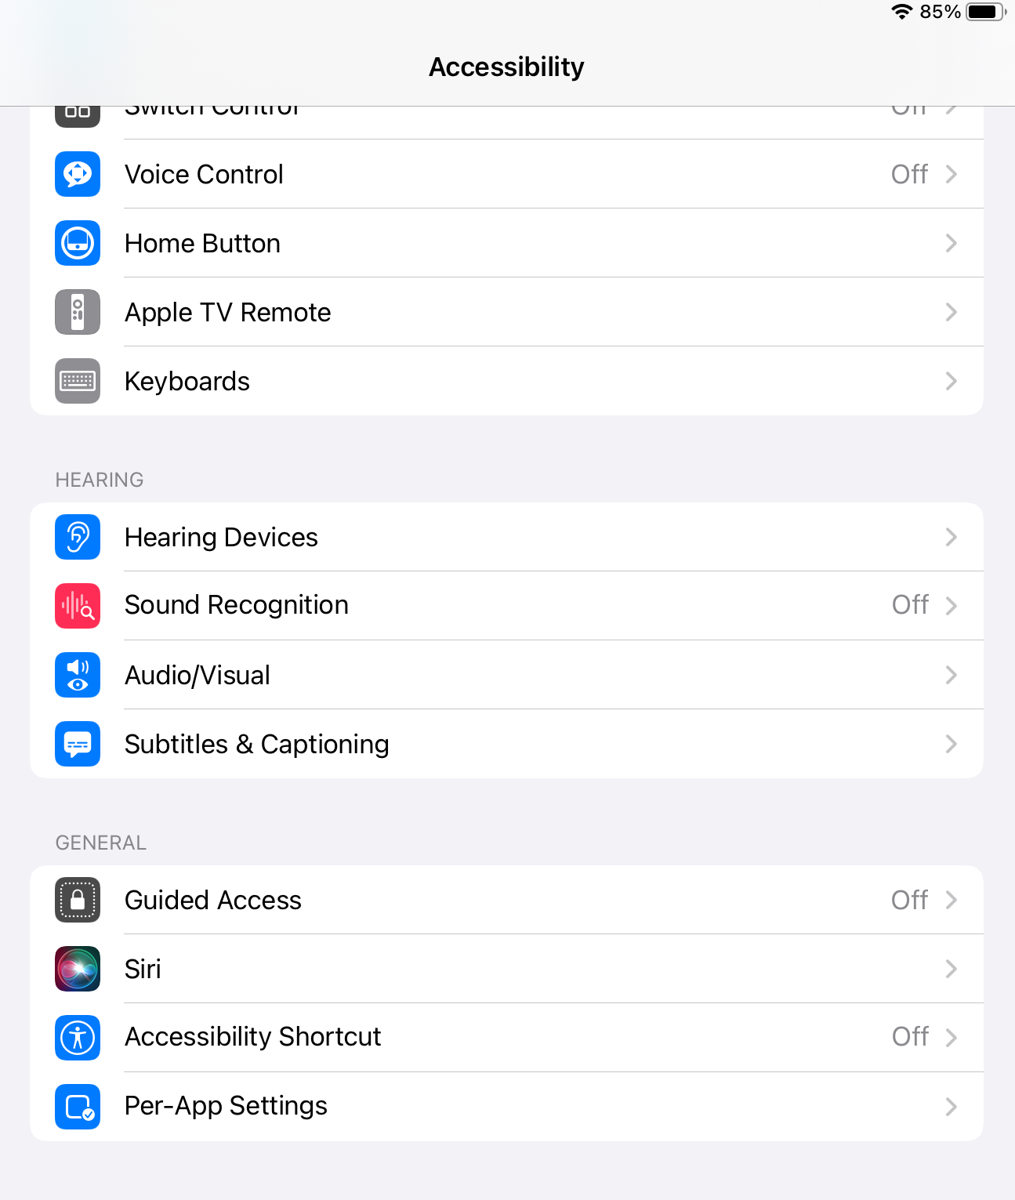
Settings | Accessibility
Notes:
iPads also have a range of accessibility options. Go Settings | Accessibility
Separate sections for
***** Vision,
***** Physical & Motor,
***** Hearing
***** General.

Slide 25
Questions & Action time!
Spend next 20 minutes or so exploring the options that might work for you.
Make a note of what you change, you might want to change it back again
Notes:
Fire up your laptops and tablets. Explore the options available.
Make a note of what you change (you might need to un-change it later!)

