Slide 1
Where should I save my data?
Shrewsbury u3a Computer Club

Slide 2

Introduction
Knowing where to save data is a really important part of understanding your computer and how best to use it.
Clicking File | Save is one option – but where has the computer put the file that you have so carefully created? Is it safe, can you get it back again?
We are going to explore some of the options and discuss some advantages and disadvantages from one system to the other.

Slide 3
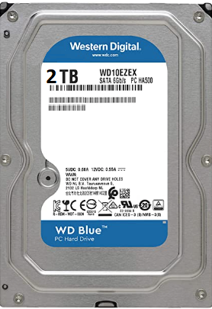
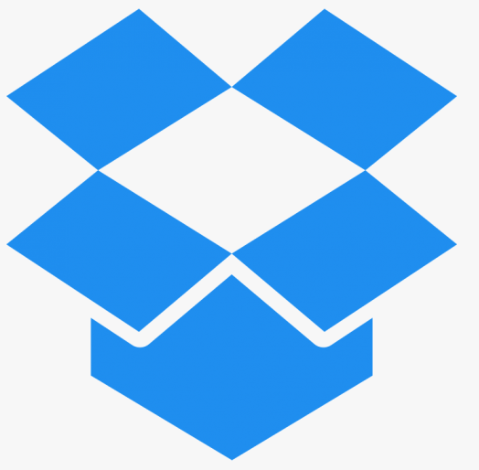
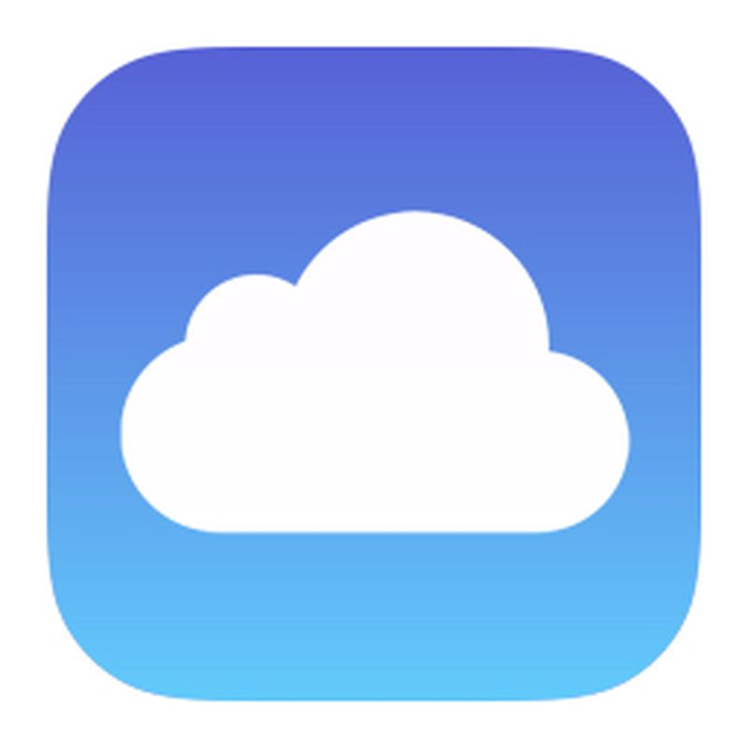
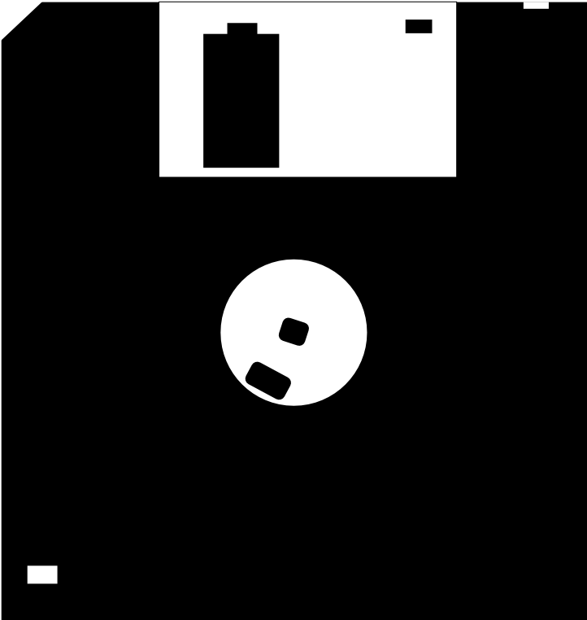
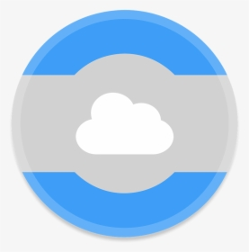
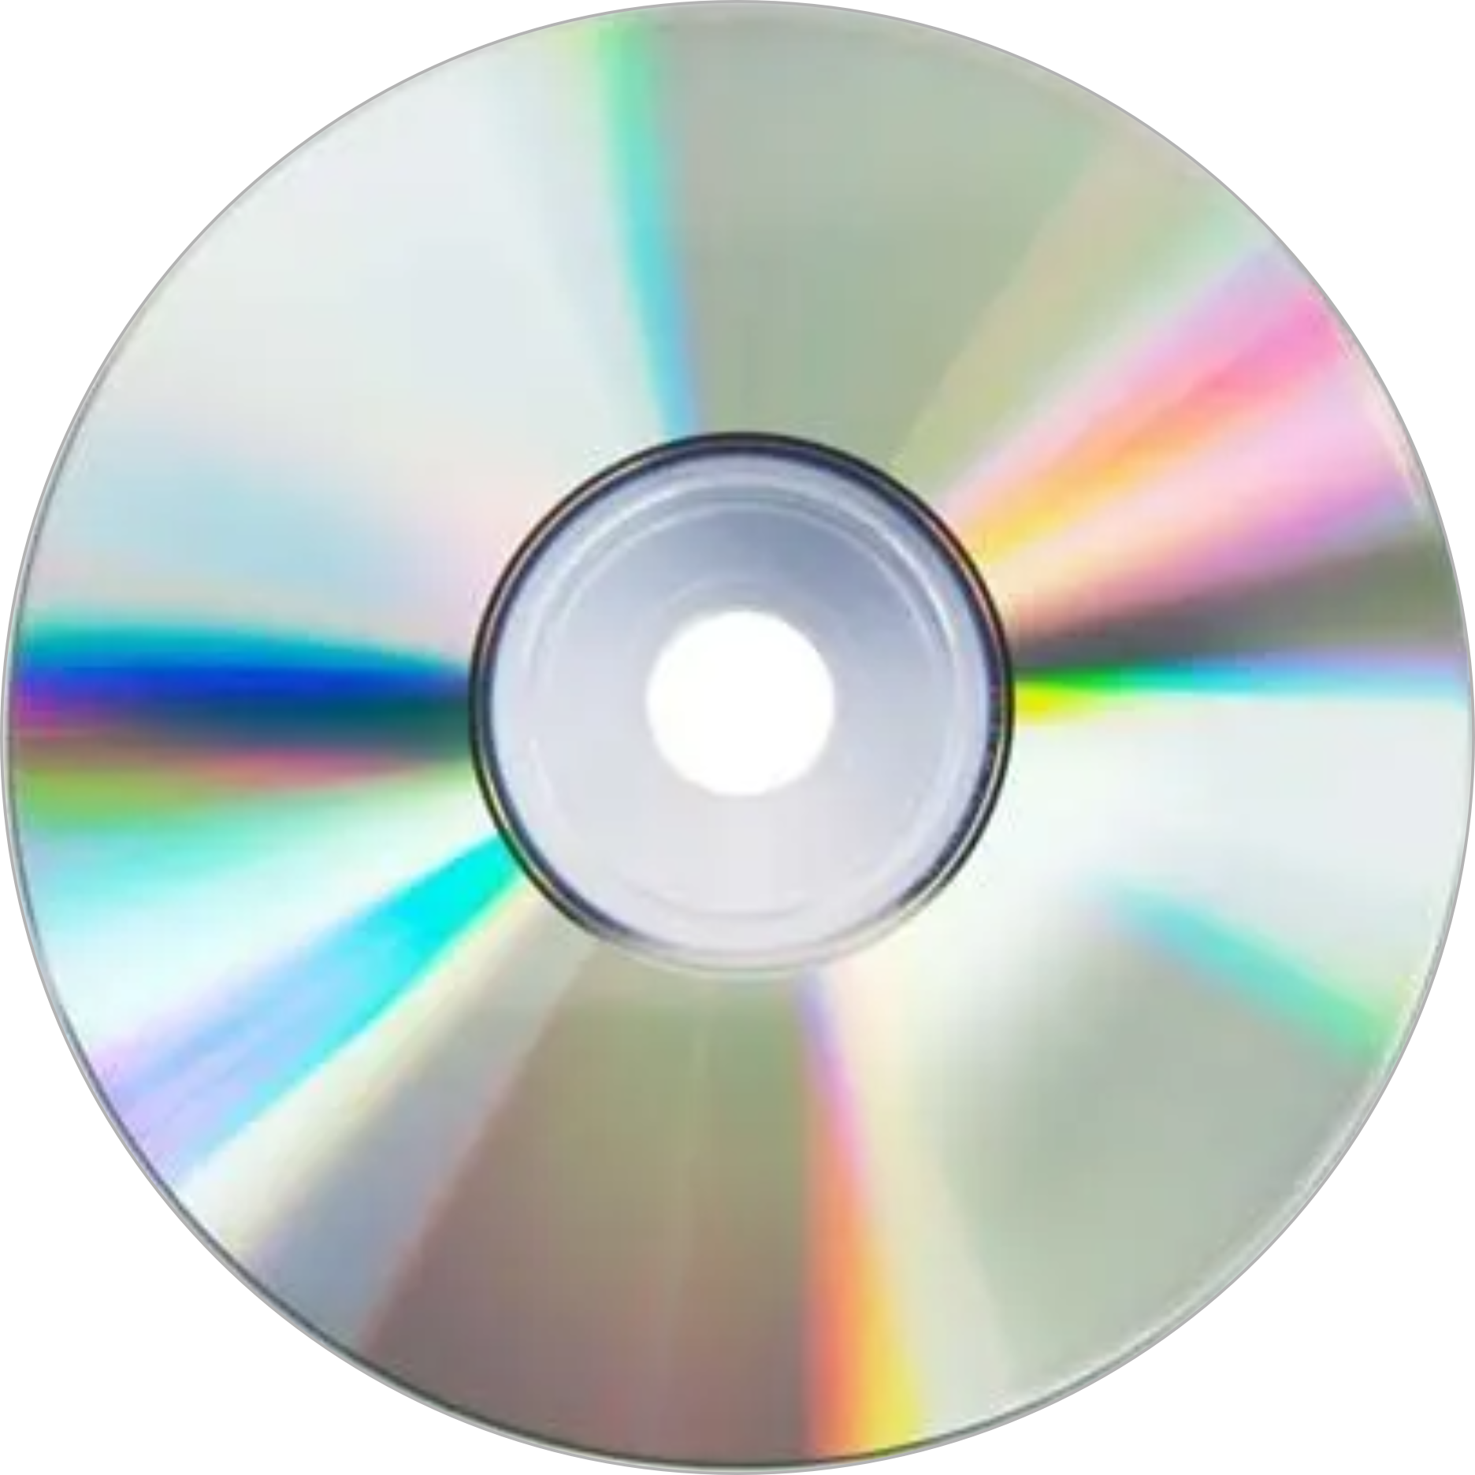


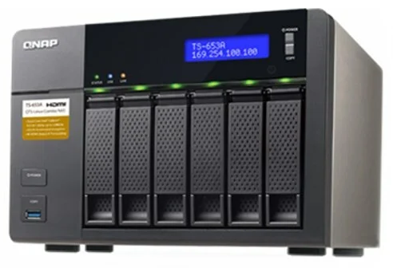
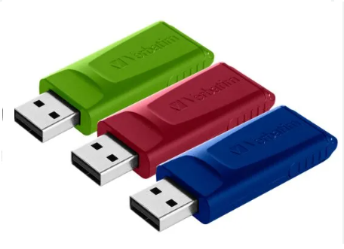

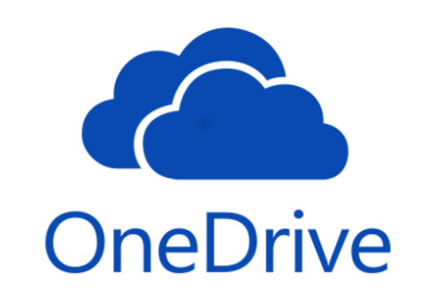
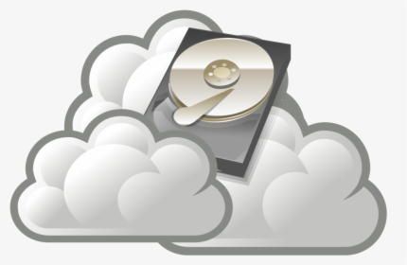
The Options
Floppy Disk Drives
CD / DVD Drives
Hard Disk Drives
External Drives – USB
Networked Drives (on another computer)
Networked attached Storage (NAS)
Cloud services:
OneDrive
Apple iCloud
Google Drive
Dropbox
Amazon Web Services
Idrive

Slide 4
The Floppy Drive
Notes:
The Floppy Drive. Floppy disk drives were first created in 1967 (by IBM). They measured 8” in diameter and were indeed ‘Floppy’ hence their name. Later 5½” Floppies were introduced and then in 1982 the 3½” floppy disk came into being introduced by Sony, these had better protection as they were manufactured with a hard plastic case around them (So no longer a real ‘floppy’ disk, but the name stuck.)
The 3½” floppy was able to store 1.44MB of data, tiny by today’s standards, but in the absence of anything else it was the default storage for many years.
The physical size was just right for portability. The sliding metal cover kept the dirt and dust out and the new shape (they were previously square) meant that you could no longer insert it sideways!
In the late 1990’s Floppy disk drives had reached the end of their lives are were replaced by CDs and DVDs.
You did need an awful lot of them!

Slide 5
Notes:
Due to their small capacity, Floppy drives were replaced with CDs and DVDs. You needed a lot of floppy disks to store a decent amount of data.
I remember installing Microsoft office onto a computer once with floppy disks – there were 33 of them and as I got to No 31……. The power went off and I had to start again once it was restored!

Slide 6
The CD Rom and DVD drive
Notes:
CD ROM. Comact Disc Read-Only Memory
First developed by Philips and Sony in 1982 from audio CDs. Later modified to be able to write to them. R/W (read & write) CDs use an entirely different procedure than the standard CD ROM. Able to contain much more data than a 3½” floppy disk – around 700 MB of data.
Initially they span at x speed, but with manufacturing improvements and better error detection on the software side, speeds up to 72 times the standard x 1 speed were possible. The faster the CD could spin, the faster it could read date into the computer. A CD Drive cannot read a DVD, you need a DVD Drive for that.
DVD Drives. Digital Versatile Disk or Digital Video Disk. From the mid 1990s
A single-sided single-layer disk is capable of holding 4.7 GB of Data. Nearly 7 Times that of a CD ROM and over 3,300 that of a Floppy disk.
As with rewriteable CD ROMS, you can get rewritable DVD drives. A DVD drive can read both DVDs and CDs but a CD Drive can only read CDs.
CDs and DVDs have also been overtaken in the technology stakes.

Slide 7
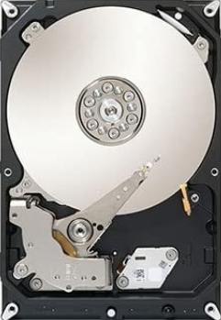
The Hard Disk Drive HDD
Notes:
The staple of any computer produced in the past 50 odd years.
As with the floppies and CD/DVDs the Hard Disk Drive is also non volatile – meaning it keeps it’s data when the power is switched off.
***** Contains 1 or more platters housed inside an air-sealed casing. Data is written to the platters (the circular disk) using a magnetic head which moves rapidly over them – the platters are spinning at about 7,200 rpm.
First introduced by IBM in 1956 with a storage of 5MB and cost about $50,000!
The first hard drive to have storage of 1GB in 1980 (IBM) and weighed 550 pounds and cost $40,000
The 3½” drives that we know today came in 1983 with a storage of 10MB.
Storage is now massive. I recommend any replacement Hard Disk Drive to be at least 1 Terabyte (1,000 Megabytes). You can buy a 1TB drive for around £40.00.
Western Digital (Hard Drive Manufacturer) now produce 20 TB drives for the home user. That’s 4,255 times the capacity of a DVD and over 14 million times that of a floppy disk.
Every computer has an internal fixed HDD, so saving data here means that it is only in one place and not portable like the Floppy disk, CD ROM and DVD. Being a mechanical device there is also potential for failure.

Slide 8
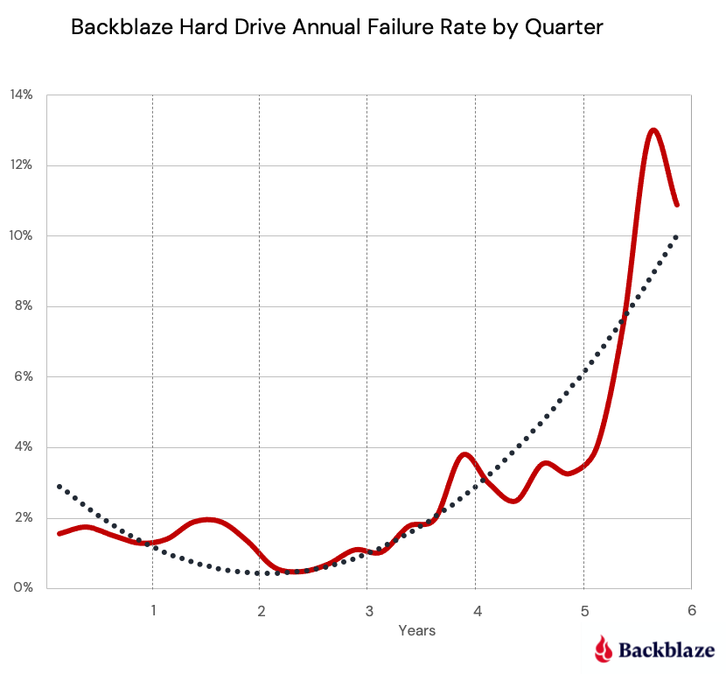
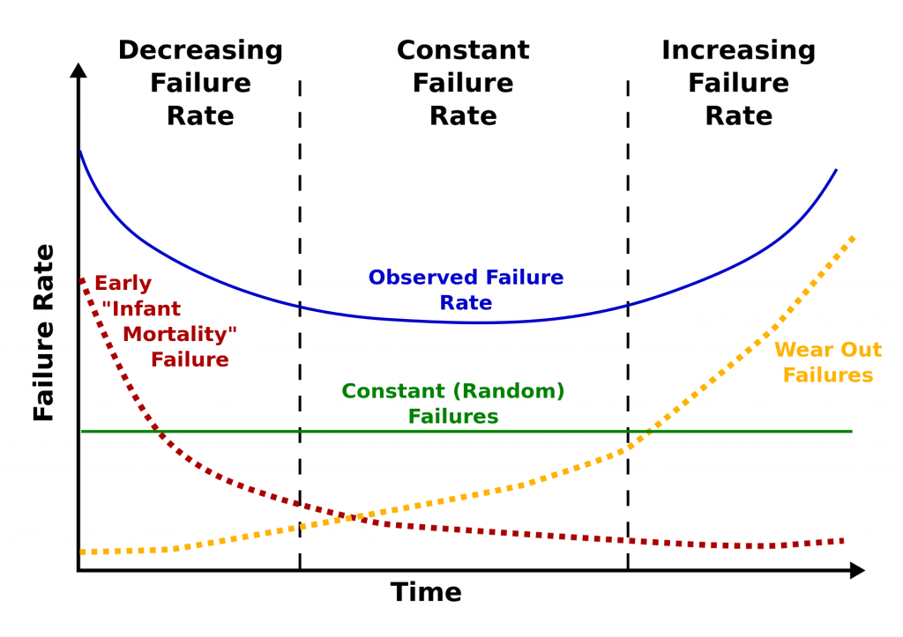
Notes:
Hard drives fail in one of 3 categories: (a) Factory defects that result in ‘infant mortality’, (b) random failures that can occur at any time and ©, ‘Wear out’ failures after a lot of use. If you add these together you observe the ‘bathtub effect’ shown in the graph here as the observed failure rate.
*****
If you google “How long should a hard drive last” you’ll get a lot of answers that say between 3 and 5 years. I think it’s longer than that. I’m still using hard drives that are 7 or even 8 years old (Although they are backed up and not mission critical). In all my time dabbling in computers, I think I’ve only every had a single hard drive failure.
The interesting study from Backblaze that recorded stats from 200,000 of their drives found that 6 years and 9 months was a good lifespan. I agree.
This might also be a good time to change your computer and get a new one!

Slide 9
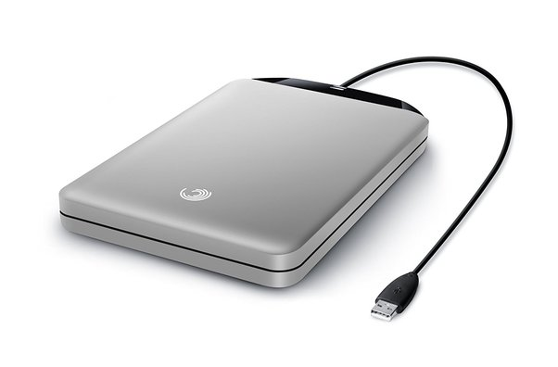
External Drives
Notes:
There are various types of external hard drives – they all connect via the USB interface.

Slide 10
The USB Flash Drive
Ultra portable.
Sizes from a few megabytes to a terabyte!
Cheap
Solid state – no moving parts
Notes:
The USB interface was a milestone in computing history. The ‘U’ stands for Universal and it really is. Printers, mice, keyboards, cameras and external storage in the case of a USB drive are all connected via USB.
A 32GB, 64GB or even 128GB are all good sized drives to have in your arsenal. Prices from about £5:00 to £15:00 – you can even get a ‘1TB’ stick on Amazon for £27:00 that’s even waterproof!

Slide 11
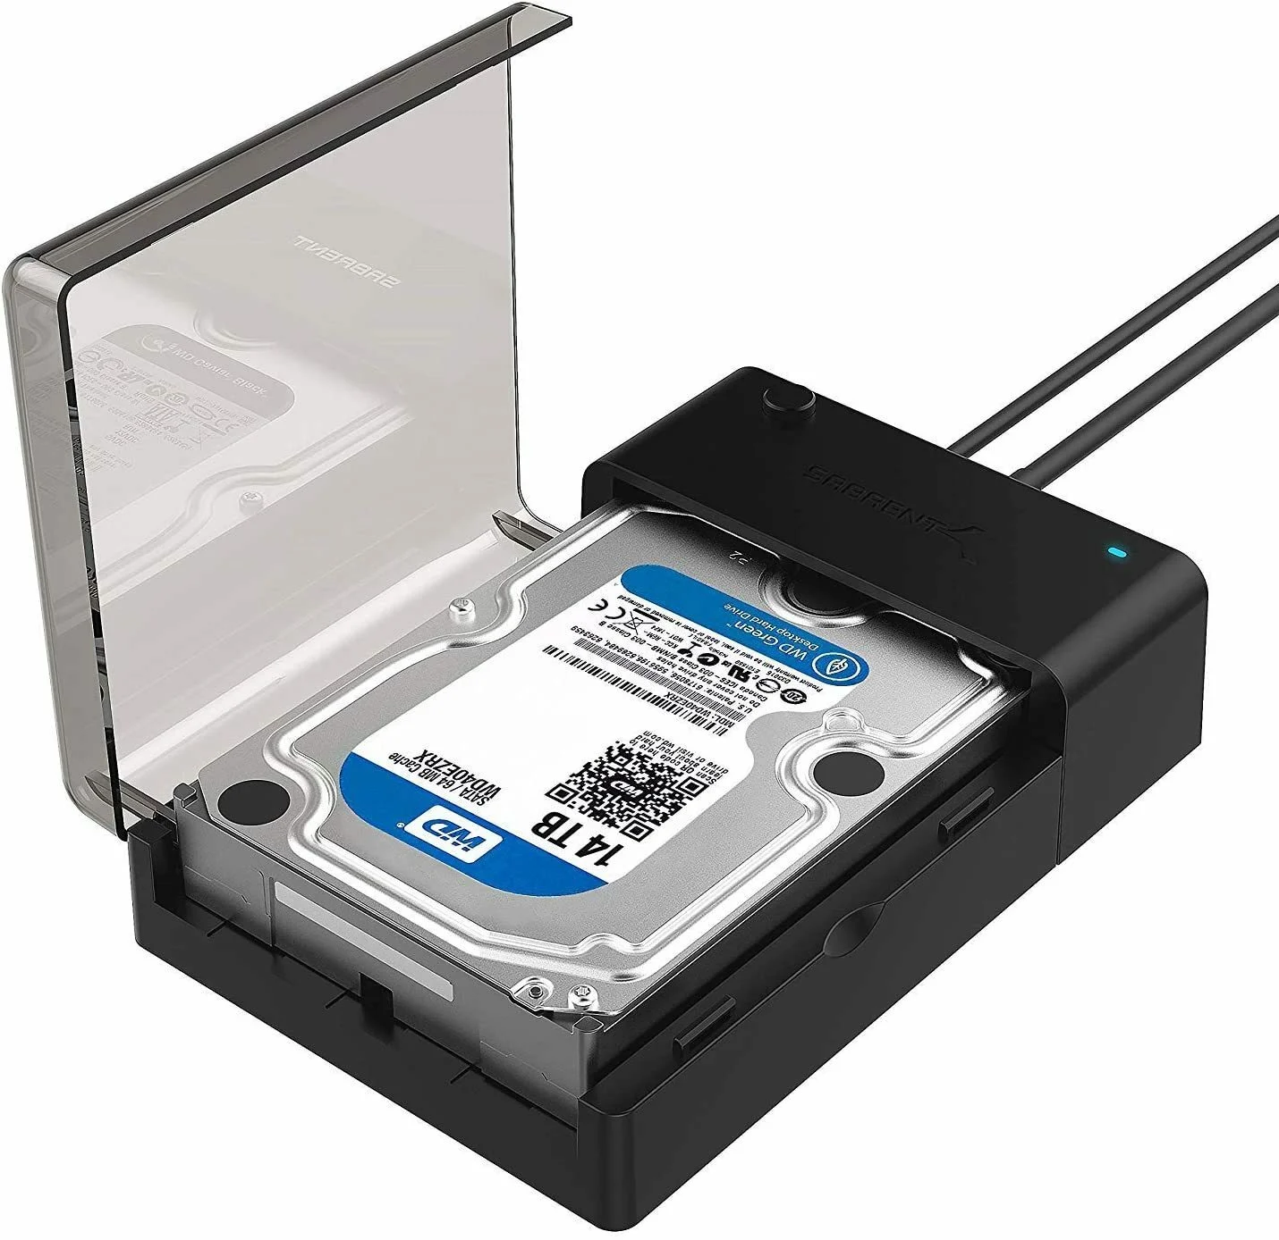
An external USB Drive
Similar to the Flash Drive
Sizes from megabytes to a terabytes
Cheap
Solid state – no moving parts
or old style mechanical
Notes:
In this case the mechanical HDD is an internal drive in a caddy for external use. You can see the size as 14TB.

Slide 12
Networked Drives

Slide 13
Networked Drives
One of the computers on the network act as a server.
Data is saved to this computer only.
Avoids duplication
Only one PC needs a large Hard Drive
Only useful for multiple PC households
Notes:
For those that know me, you’ll know I run a home network and am a strong believer of networked drives.
All data in our household is saved to the ‘Tara’ computer. A virtual drive has been created; the G drive for all our Documents. On every other computer on the network a similar virtual drive – the G drive has been created – they all point to the Documents folder on Tara. (You can set the default save location in Word, Excel etc to be the G:/ drive (or any other location you choose))
We have a similar thing for Downloads and Pictures. Downloads are the H drive and Pictures are on the I drive.
This also makes backups easier as I only have to backup from one location and not multiple computers.
Slight disadvantage in that it will be slightly slower than if you were using the internal Hard Drive of each computer. Data has to go from Computer B to the Router, then the Router to the Server (computer A) then back to the Router and then back to computer B.

Slide 14
Networked Attached Storage
Notes:
Rather than use a computer to save all the data on a network, lets just attach a Hard Drive direct to the router. It’s called Networked Attached Storage - NAS.

Slide 15
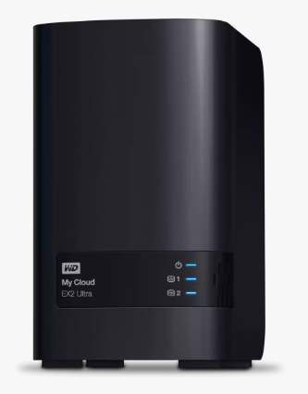
NAS
Quick – data effectively direct from the Router
Easy to set up
Can provide for failure with RAID
Reading data is quicker.
With RAID only half the effective storage.
Notes:
As the NAS is connected directly to the Router it is quicker than having to be written to and read from another computer on the network. In my tests, it took an average of 6-8ms to ping another computer yet only 1 or 2ms to ping the NAS.
It is quick and easy to set up.
Using RAID – Redundant Array of Independent Disks you can provide for redundancy should one of the disk drives fail. With RAID 1 (there are other levels doing technically more stuff each time) data is written to at least 2 Drives. They are an exact copy of each other and should one fail, the other will take over automatically.
Reading Data is quicker than a single drive as data can be read from both drives at the same time
Disadvantage is that you only get half of the total storage space ie an 8GB system will allow you to save 4GB (as the other 4GB is duplicated on the other drive)
I like this and have just transferred to such a system. So no longer am I saving all data to the Tara computer as I mentioned in the last slide!

Slide 16
Cloud Storage
Notes:
Cloud storage is really good – all the major players are developing it. Rather than save your data locally on your own computers, data is saved to the cloud – ie the internet.
There are many advantages:

Slide 17
Cloud Storage: The Pros and Cons
Easy to Share files with friends and family
Data is a lot more secure from failure
You can access your data from any internet connected device
Good for backups
Storage for a lifetime
There is a cost for extra storage
You have to be online
Security & privacy concerns with some providers
Notes:
You can share your files and pictures with friends and family – send them a link or add them as a user. Allow to edit or not as required.
A cloud provider will have a lot more safeguards in place to ensure your data is not lost – much more than you could do.
Access available from any intent connected device
Use the cloud as a backup for your physical data on your computer at home. Follows part of the 3-2-1 process for backups. 3 copies of data, 2 local copies on different devices and 1 off site – in the cloud perhaps.
Storage for a ‘lifetime’. Cloud data centres are secure, fireproof, air conditioned and maintained 24/7. This is much better than saving your data to a laptop that might get lost stolen or just fail.
There is a cost for extra storage – nothing comes free
You have to be online
Only go with a reputable system. There have been issues about security and privacy with some providers

Slide 18
Microsoft OneDrive
5GB free with a MS account
Best value Microsoft 365 family
£79.99 per year
1TB each for 6 family members
Includes MS 365 (Office)

Slide 19
Apple iCloud
5GB free with an Apple account
$0.99 50GB for single user
$2.99 200GB for family use
$9.99 2TB for family use
Notes:
Work out and pay for only what you need, you can always upgrade later.
Currently we have 133GB of just photographs, nearly 55,000 of them plus another 337GB of other data. That’s nearly half of a terabyte (470 GB)

Slide 20
Google Drive
15GB free with a Google Account
£1.59 per month for 100GB with Google One Basic
£2.49 per month for 200GB with Google One Standard
£7.99 per month for 2 TB with Google One Premium

Slide 21
Dropbox
2GB free with a Dropbox account
£7.99 per month for 2TB with Dropbox Plus
£13.99 per month for 6 users, share 2TB with Dropbox Family

Slide 22
Amazon Web Services
5GB free with an Amazon account
Due to be retired end of next year (2023)
Notes:
Shutting down with effect 31 Dec 2023. No uploads after 31 Jan 2023.

Slide 23
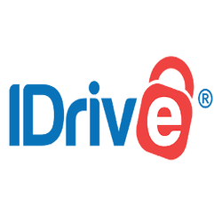
IDrive
10GB free with an IDrive account
$59.62 for year 1. 5TB storage
Notes:
PC Magazines Editors Choice. Other choices/services are available

Slide 24
Summary
There is no right or wrong solution – whatever works best for you.
Consider using more than one system, this could be part of your backup strategy.
Having a copy of your data off-site is a good thing.
Cloud services are much improved than a few years ago.
Link your phone, tablet, laptop & desktop so they are all in sync
Please, don’t just click File | Save and hope for the best!

Slide 25
thank you
Geoff Lane
Shrewsbury u3a Computer Club

