Slide 1
The role of the media in International Relations
Our media map and images 2024
Theoretical framework - media interaction and impacts on international relations
Facts, figures and trends in regional and global media
Brief case studies Northern Ireland and the Middle East &
a word about the US elections…
Conclusion, questions and discussion

Slide 2
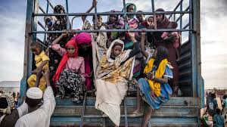
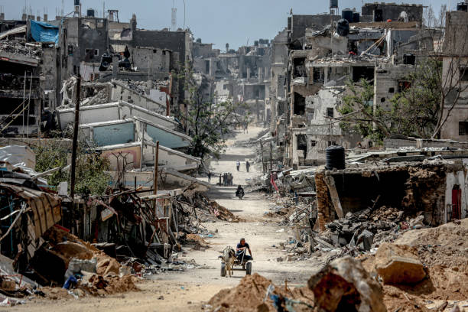
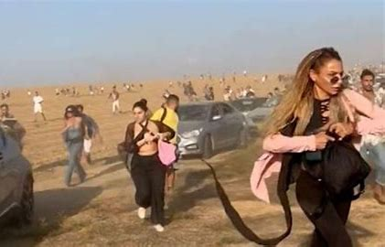
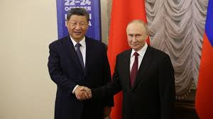
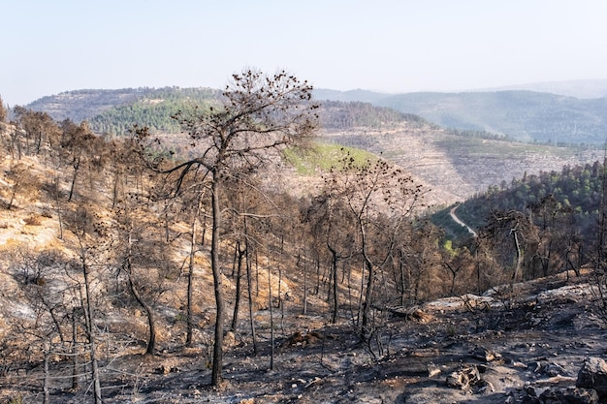
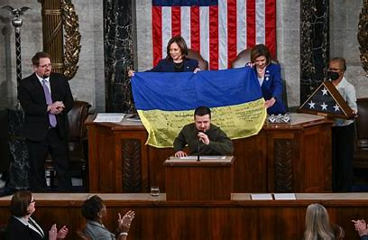
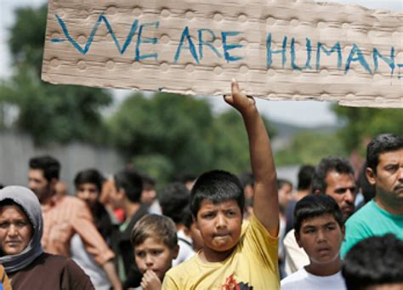
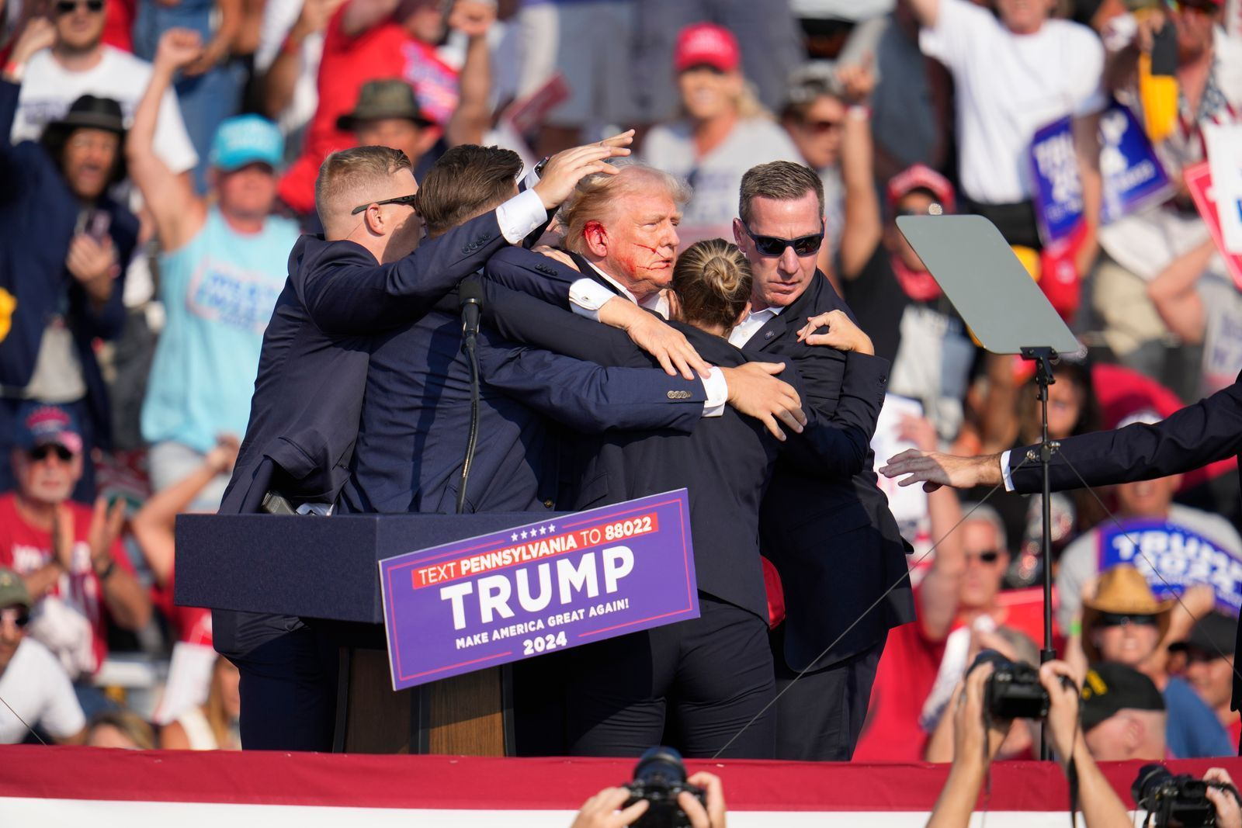
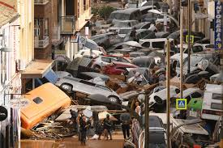
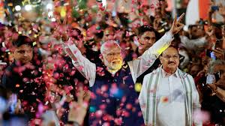
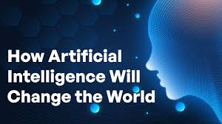
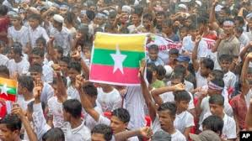

Slide 3
Multifaceted role of the media in International Relations – theoretical framework
Shaping opinion, policy and decision making
Agenda setting – prioritisation
Dissemination ( and distortion) of information
Contribution to diplomatic communication / soft power
Framing of crises and conflicts, shaping and controlling
Providing a feedback mechanism to governments – “X” ,live reporting. YouTube etc.
And more?

Slide 4
Facts, figures and media trends
Top news websites August 2024
bbc.co.uk, bbc.com. | 986m
msn.com | 601m
cnn.com | 571m
nytimes | 517m
news.google | 329m
theguardian | 303m
foxnews.com | 288m 169m
Indiatimes.com | 169m
Domination and ownership of the English speaking media
3 UK publishers control 90% of print and 40% of online reach
Social media – a primary news source feeding existing views
Media influences in India, China and Russia
Algorithms and AI –generated information / misinformation, “X”, TikTok and Gaza
Partisan celebrity. Links :Musk, Trump, Putin and Xi Jinping
Propaganda, bias, disinformation and misinformation…?

Slide 5
Global use of social media 5.22 billion monthly users
Gaming, music food but political content growing
Facebook YouTube What’s App Instagram TikTok WeChat ( Chinese app) Telegram ( Russian owned) | 3 billion 2.7b 2.4b 2.3b 1.4b 1.3b 950 million

Slide 6
Brief Case Studies :
Media portrayal of the Northern Ireland conflict – to what extent did the media fuel the conflict , then promote peace?
UK
Security lens : terrorist threat to the state, censorship, denying terrorists the oxygen of publicity …
BBC, Army Press Office
Irish media
N. Ireland : Irish News, Belfast Telegragh
South – RTE
US and European

Slide 7

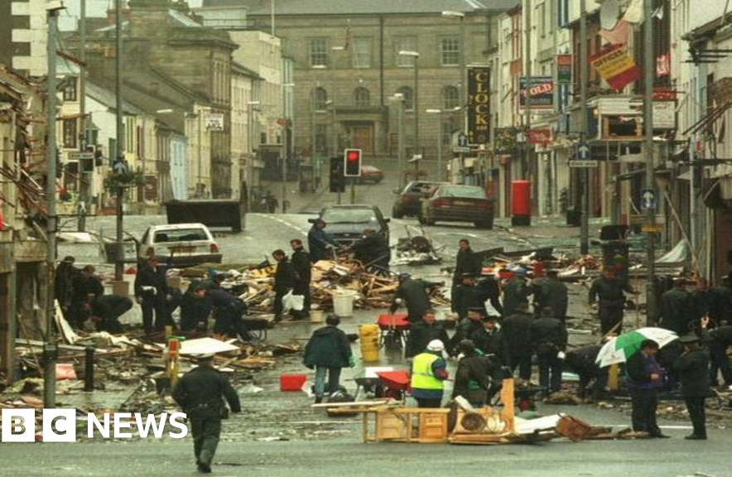
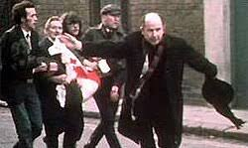
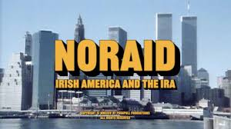

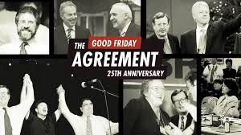
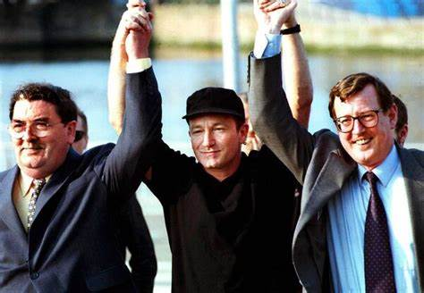

Slide 8
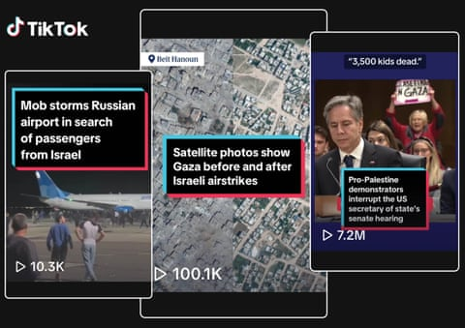
The Middle East : Gaza and TikTok
- TikTok ownership is Beijing based
- Online content curation systems – serving up what people want to see so that they view more?
- “Systematic analysis” indicates overwhelming bias towards Palestinian content
- In the 4 months after the October 7th attacks 20x more Pro Palestinian content
Recent content analysis 80% content is pro Palestinian, often generated locally from the street , by activists
Or is this a moral panic and the use and abuse of the media remains as it always has?

Slide 9
Thoughts on Trump and the US elections….
Conclusions about the impact of the media on International Relations
US election – politics international relations - did Trump win the election via celebrity politics? ( media advertising and podcasts )
Conclusions
The media is increasingly more partisan and polarised
Media impact is profound but complex : negative and positive
Think and read widely and critically. Click wisely!

