Slide 1
The Bosnian Wars in 1990s
Were they worth it?
What role did outside powers play in the dissolution of Yugoslavia and in the wars that wrecked that once-stable country?
Why did the victors in the Cold War and the 1991 Gulf War not act earlier to stop the slaughter?
What might be the implications for other situations of communal conflict given the international community's failure to take timely action when war enveloped Bosnia?
What might be the implications of Yugoslavia's wars for future peacekeeping and peacemaking by the United Nations and by NATO?
And what can outside powers do to heal the real and imagined wounds of war?
Excerpt: The World and Yugoslavia's Wars | Council on Foreign Relations (cfr.org) 1997

Slide 2
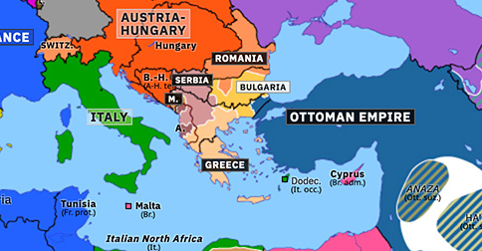
1913

Slide 3
Origins of Yugoslavia
Originally named the Kingdom of Serbs, Croats and Slovenes, the country was formed in 1918 after WWI and its population was mostly South Slavic Christians, but with a substantial Muslim minority.
It was renamed Yugoslavia in 1929. Yugoslavia survived as a kingdom until WW2 when it came under attack by Nazi Germans. In 1941, the then king fled to London and, eventually, the United States where he died in 1970.

Slide 4
Tito’s Yugoslavia 1945 – 1980
Yugoslavia was established in 1945 under Tito who maintained a strongly authoritarian leadership but comparatively relaxed socialist/communist regime
A federation of six republics, it brought together
  Eastern Orthodox Serbs,
  Catholic Croats,
  Bosnian Muslims,
  Albanians,
  Slovenes and others
Tensions between these groups were successfully suppressed under the leadership of President Tito.
https://www.bbc.co.uk/news/world-europe-17632399

Slide 5
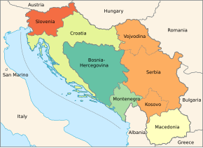
The former Yugoslavia - the communist years
https://en.wikipedia.org/wiki/Yugoslav_Wars

Slide 6
Tensions and conflict
After Tito's death in 1980, tensions re-emerged. Calls for more autonomy within Yugoslavia by nationalist groups led in 1991 to declarations of independence in Croatia and Slovenia. The Serb-dominated Yugoslav army lashed out, first in Slovenia and then in Croatia. Thousands were killed in the latter conflict which was paused in 1992 under a UN-monitored ceasefire.
Bosnia, a complex mix of Serbs, Muslims and Croats, was next to try for independence. Bosnia's Serbs, backed by Serbs elsewhere in Yugoslavia, resisted. Under leader Radovan Karadzic, they threatened bloodshed if Bosnia's Muslims and Croats - who outnumbered Serbs - broke away.
Despite European blessing for the move in a 1992 referendum, war came fast.

Slide 7
Origins of the Balkans War 1991
……. be warned: trying to unravel what happened, and why, is like trying to solve Rubik’s cube if you are monochromatically colour blind! Basically, there were two opposing forces at play – religion and ethnicity – both dominated by conflicting power politics and personal egos and some tensions are still unresolved.
https://www.kathmanduandbeyond.com/history-balkan-wars-1991-1999/

Slide 8
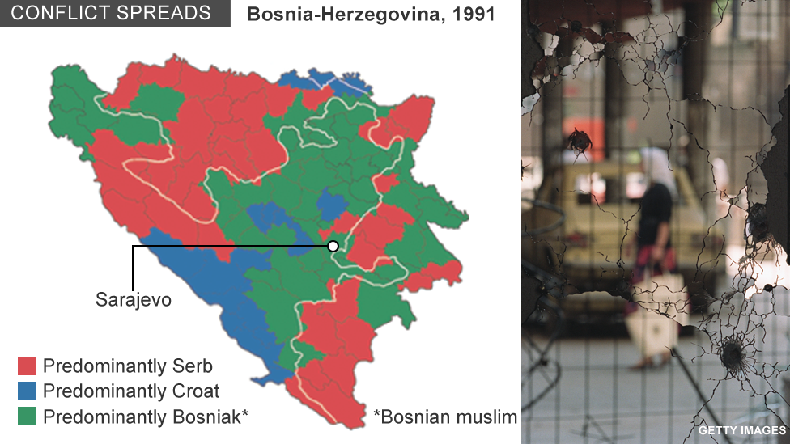
The Rubik’s cube

Slide 9
Serbs v Muslims and Croats
Yugoslav army units, withdrawn from Croatia and renamed the Bosnian Serb Army, carved out a huge swathe of Serb-dominated territory. Over a million Bosnian Muslims and Croats were driven from their homes in ethnic cleansing. Serbs suffered too. The capital [of B/H] Sarajevo was besieged and shelled. UN peacekeepers were brought in to quell the fighting
International peace efforts to stop the war failed, the UN was humiliated and over 100,000 died. The war ended in 1995 after Nato bombed the Bosnian Serbs, and Muslim and Croat armies made gains on the ground. A US-brokered peace divided Bosnia into two self-governing entities, a Bosnian Serb republic and a Muslim-Croat federation, lightly bound by a central government which was seen as ineffective.

Slide 10
Emergence of Independent States
However, in August 1995, the Croatian army stormed areas in Croatia under Serb control prompting thousands to flee. Soon Croatia and Bosnia were fully independent. Slovenia and Macedonia had already gone. Montenegro left later. In 1999, Kosovo's ethnic Albanians fought Serbs in another brutal war to gain independence. Serbia ended the conflict beaten, battered and alone.

Slide 11
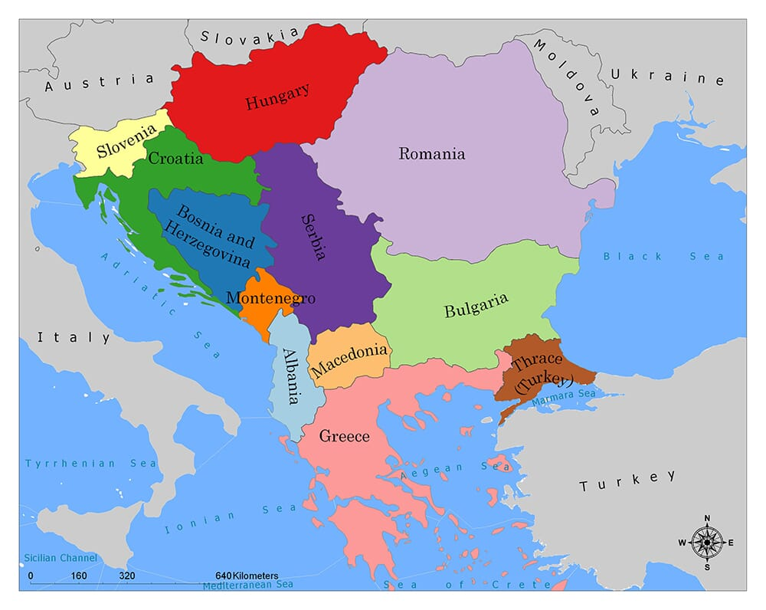
The Balkans now Kosovo?

Slide 12
UN Intervention- UNPROFOR
In September 1991 the United Nations became involved in Yugoslavia
In February 1992 United Nations Protection Force UNPROFOR was established
In September 1992, the UN authorised deployment in Bosnia to create conditions for peace and security, and to protect aid convoys run throughout the region by the United Nations High Commission for Refugees (UNHCR).
The UN troops were often referred to as ‘peacekeepers’, but this was not their role. There was no peace to keep in Bosnia, and UNPROFOR did not have the mandate to enforce a ceasefire.
UNPROFOR's mandate extended to five republics: Croatia, Bosnia and Herzegovina, Macedonia, Montenegro, and Serbia.
UNPROFOR established United Nations Protected Areas (UNPAs) to ensure these areas were demilitarized and protected from armed attack.
https://www.nam.ac.uk/explore/bosnia#:~:text=British%20soldiers%20first%20deployed%20to,on%20peacekeeping%20duties%20ever%20since.
https://aoav.org.uk/2022/civilian-casualties-from-british-military-the-bosnia-and-herzegovina-intervention/

Slide 13
Safe Zones
In 1993 the UN declaring various cities to be “safe zones” for persecuted Muslims. Serbs largely ignored these zones and committed terrible atrocities.
In July and August 1995, Bosnian Serbs massacred thousands of Muslims following their capture of the 'safe areas' of Srebrenica and Zepa. This was followed by a mortar attack on a crowded market place in Sarajevo.
UN then empowered NATO to act, and air strikes were authorised against Bosnian Serbs.
The first ethnic cleansing–akin to genocide–in Europe since the Holocaust during World War II.
In 1995, after three years of warfare, the Serbs decided to end the war forcefully by destroying the ethnic enclaves of Srebrenica and Zepa, Bosnia
https://www.aph.gov.au/~/media/wopapub/house/committee/jfadt/Bosnia/Bos_Ch2_pdf.ashx .
https://www.thecollector.com/1990s-yugoslav-wars-explained/

Slide 14
Air strikes
UN then empowered NATO to act, air strikes were authorised against the Bosnian Serbs.
In the end, Nato bombing, coupled with a major offensive by the Croatian Army, brought the Serbs to the conference table. A ceasefire was agreed in October 1995 and the three factions signed the Dayton Peace Agreement in November.
This brought an end to the fighting and, after some adjustments of the former front line, left Bosnia divided approximately in half: the north and east under Serb control and the south and west under the Muslim-Croat Federation.

Slide 15
UK military presence
Around 2,400 troops were deployed as part of UNPROFOR in November 1992.
Although several British Army observers, medics and liaison staff were already on the ground in Sarajevo and elsewhere, Britain’s main initial contribution to UNPROFOR was a battlegroup based around 1st Battalion The Cheshire Regiment and a Reconnaissance Squadron of the 9th/12th Lancers.

Slide 16
UK Presence as Violence spread 1992-95
The British presence in Bosnia was later reinforced, with units normally spending six months in Bosnia before being relieved. The British contingent’s area of responsibility was in Muslim-Croat territory in central Bosnia.
Within months of their arrival, the British found themselves in the middle of a vicious war-within-a-war as Croats and Muslims turned on each other, while also fighting the Serbs.
In June 1995, to deter air attacks against them, the Bosnian Serbs temporarily took 350 UN troops hostage, including 33 members of The Royal Welch Fusiliers who were serving in the ‘safe area' of Gorazde.

Slide 17
Implementation Force IFOR
At the end of 1995, a Nato peace implementation force known as IFOR replaced UNPROFOR. Its task was to ensure that the three factions adhered to the terms of the Dayton Peace Accord.
IFOR enforced restrictions on the size, movement, training and weaponry of the factions’ armies. It also supported the International Police Force and the UNHCR, as well as providing a secure environment in which elections could take place.
The British IFOR contingent formed part of Multi-National Division Southwest, which had its headquarters in Serb-held Banja Luka.

Slide 18
Stabilisation Force SFOR and EUFOR
In 1996 IFOR was replaced by a Stabilisation Force, SFOR, which had the mission of ‘peace-building’.
In the years that followed, the number of British troops committed to Bosnia was reduced.
Between 1992 and 2019, 59 British soldiers were killed in Bosnia and many more injured. Many of the deaths were caused by accidents on Bosnia’s poor roads, made treacherous during bad weather.
In September 2019 120 British troops arrived in the country.
In 2004, SFOR was replaced by the European Union Force Bosnia and Herzegovina (EUFOR).
At one time, EUFOR had around 600 soldiers from across Europe in Bosnia. Its duties included helping to monitor elections and mentoring local forces.
Civilian Casualties from British Military: The Bosnia and Herzegovina Intervention - AOAV

Slide 19
The Diplomatic Issues
The references below argued that none of the great powers concluded that any plausible outcome of the Balkan Wars would so jeopardize its interests as to impel its military intervention to defend them.
On the contrary, the major powers today perceive their interests in terms sharply different from those that made the Balkans the vortex of earlier great power conflicts. Europe's peace today is a divisible peace: violent conflicts will be sufficiently confined so that they will be very unlikely to escalate across the threshold of war among the major European powers.
https://www.cfr.org/excerpt-world-and-yugoslavias-wars (2024 I think)
The World and Yugoslavia's Wars | Council on Foreign Relations (cfr.org) (1997)

Slide 20
Kosovo
Enough to be the subject of another presentation
In 1999, British soldiers were deployed as a peacekeeping force to Kosovo in the western Balkans. Today, a small detachment still serves in the disputed country as part of a multi-national force helping to ensure security and stability.
..https://www.nam.ac.uk/explore/kosovo

Slide 21
Is it all over?
UK deploys military experts to counter Russian malign influence in Bosnia and Herzegovina
UK military specialists will be sent to Bosnia and Herzegovina to reinforce the NATO Mission and promote stability and security in the country.
UK Govt press release June 2022

Slide 22
Is it all over?
Romania's Nations League match against Kosovo was abandoned in stoppage time after home fans allegedly shouted "Serbia".
Kosovo players left the pitch after the alleged chants, with the score at 0-0 with only seconds to go, and did not return to finish the game.
The referee blew the whistle more than 30 minutes later.
The Romania players had stayed out on the pitch in Bucharest's National Arena.
The Uefa website said: "The Uefa Nations League match between Romania and Kosovo has been abandoned. Uefa will communicate further information in due course."
Kosovo declared independence from Serbia in February 2008.
After the break-up of Yugoslavia in the 1990s, Kosovo sought independence.
Serbia responded with a brutal crackdown against ethnic Albanians that ended in 1999 after a Nato bombing campaign against Serbia.
Serbia does not recognise Kosovan independence.
The nations are always kept apart in Uefa and Fifa competitions.
November 2024 BBC Sports report

Slide 23
EU Membership of Balkan countries
Existing members
Bulgaria
Croatia
Greece
Romania
Slovenia
Current candidates
Albania.
Bosnia and Herzegovina.
Georgia.
Kosovo (not recognised by Serbia)
Moldova.
Montenegro.
North Macedonia.
Serbia. (might prefer BRICS)
Turkey.

Slide 24
The Bosnian Wars in 1990s
Were they worth it?
What role did outside powers play in the dissolution of Yugoslavia and in the wars that wrecked that once-stable country?
Why did the UN and NATO not act earlier to stop the slaughter?
What might be the implications for other situations of communal conflict given the international community's failure to take timely action when war enveloped Bosnia?
What might be the implications of Yugoslavia's wars for future peacekeeping and peacemaking by the United Nations and by NATO?
And what can outside powers do to heal the real and imagined wounds of war?
Excerpt: The World and Yugoslavia's Wars | Council on Foreign Relations (cfr.org) 1997

