Slide 1
The Rise of China - the last 30 years
“Beware the sleeping dragon. For when she awakes, the Earth will shake.”
Attributed to Winston Churchill

Slide 2
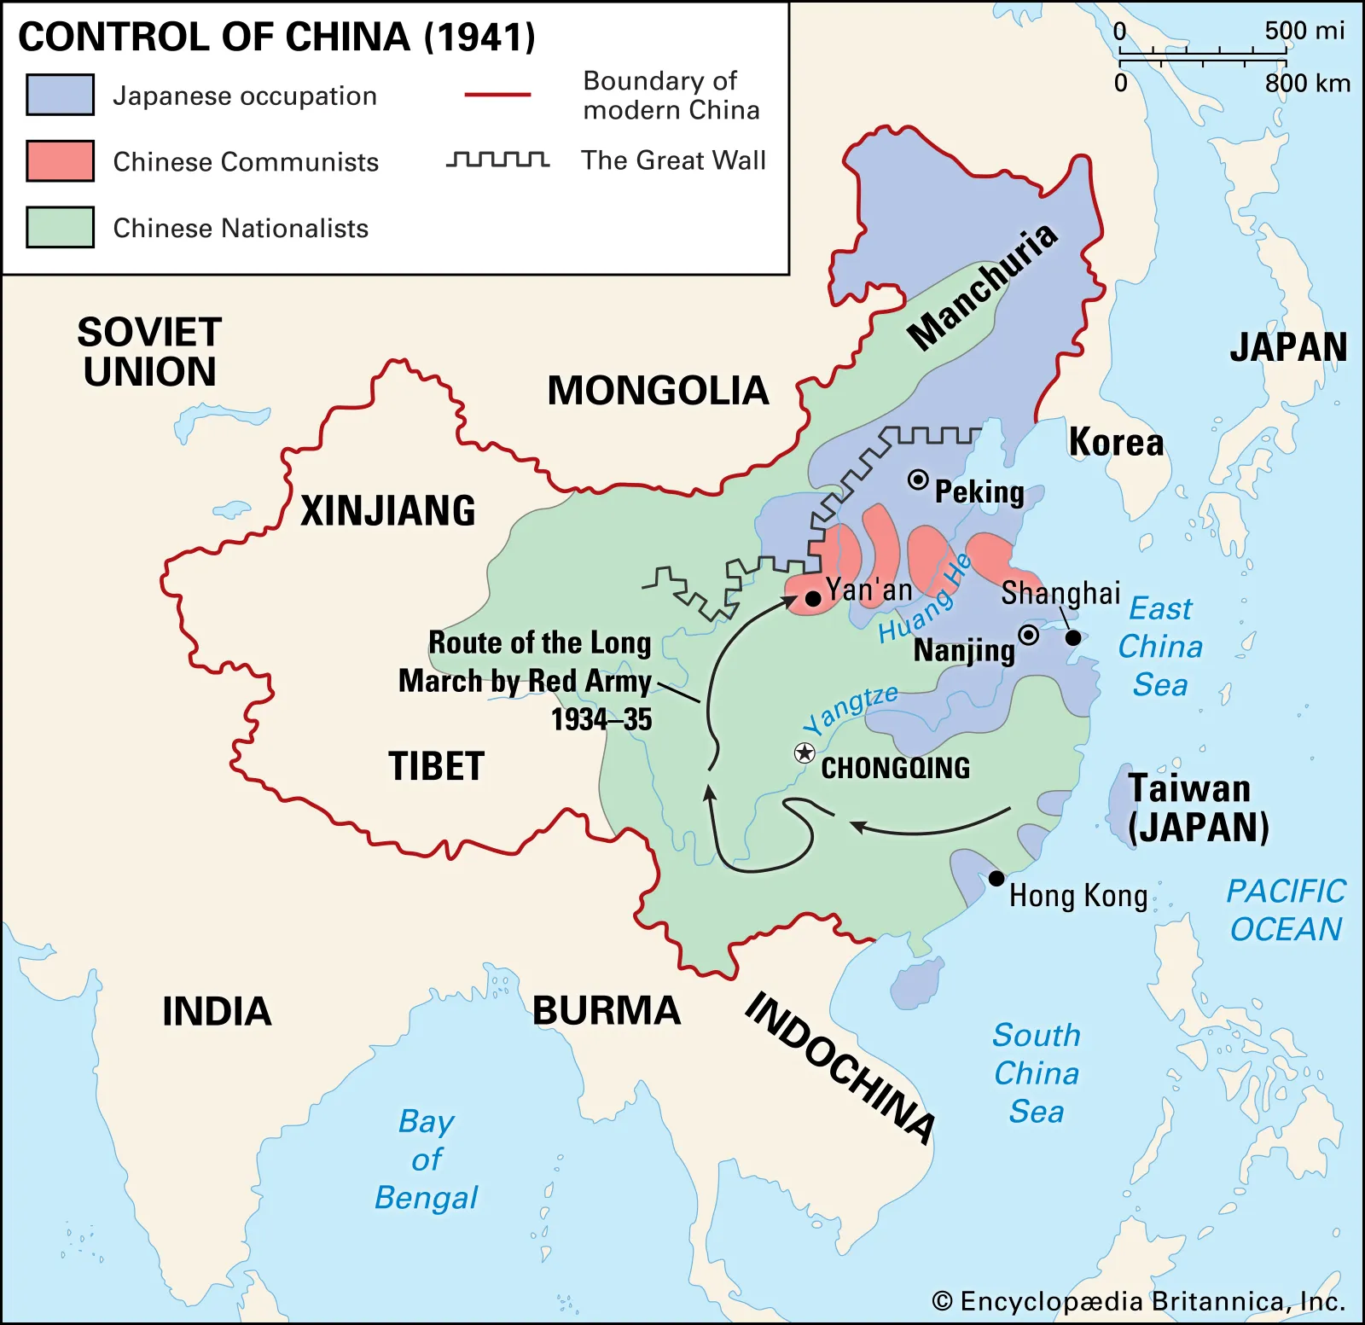
State of China at end of Pacific War - 1945

Slide 3
China after World War II map
1. Illustrates how much of China was occupied by Japan. They had been at war for centuries.
2. Illustrates how little land the Communists held at that time considering ultimately they would be taking over the whole country.
3. China would lay claim to Tibet (1951) and Xinpiang (1949-50), thereby increasing their land mass by a quarter to a third.
4. Finally shows the route of the Long March, (1934-35) basically a military retreat by the Communists of 6,000 men. They moved from the south east, further north to Shensi Province and set up headquarters there under this man …

Slide 4
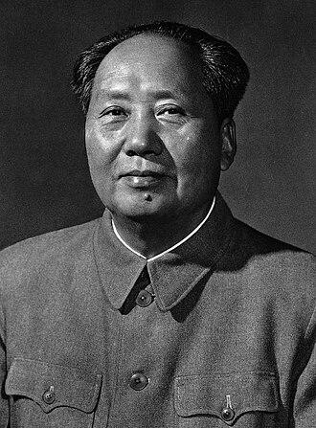
President of The People’s Republic of China, 1949 - Mao Zedong

Slide 5
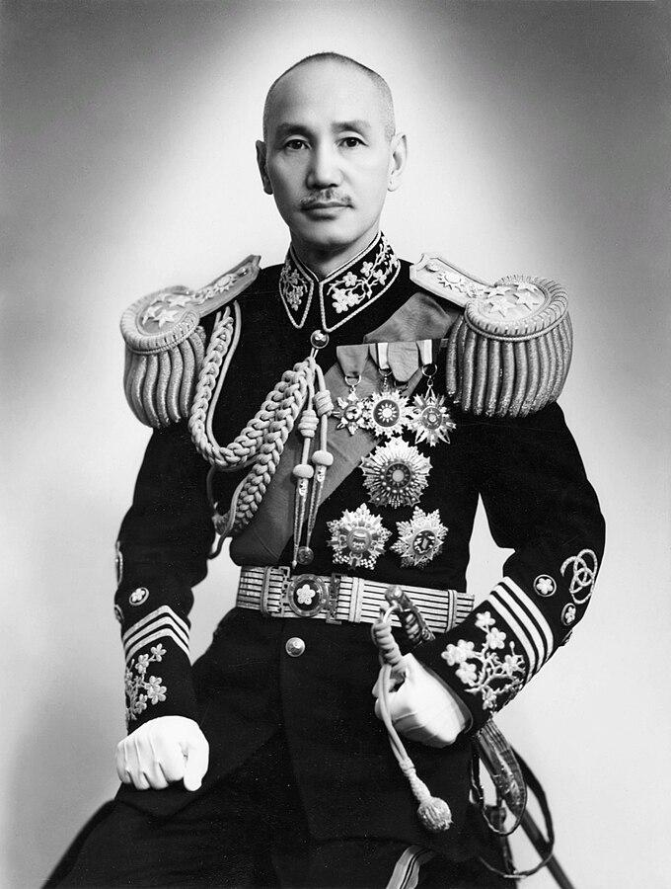
Chiang Kai-Shek - leader of the Republic of China 1928 - 1949

Slide 6
How did the dispute about Taiwan come about
There was Civil War in China from 1927 to 1937 between the Govt versus the Communists, which ground to a halt to fight the Japanese invasion of 1937. The Long March was 1934-5 when Red Army lost ground.
After the Japanese surrendered at the end of WW2, (1945) the plan was for China to be ruled by a coalition Govt - the Nationalists under Shek and the Communists under Zedong. It was never going to work out.
So civil war broke out again, (1945 - 1949) this time with and the Red Army having the upper hand and the Nationalists, under Chiang Kai -Shek, fleeing to Taiwan.
In 1949 Mao Zedong declared the People’s Republic of China followed by a period of isolationism until the 1970s with the Nixon/Kissinger era.
Kissinger visited China secretly in 1971 and came up with the ‘fudge’ that has remained in place ever since. US troops left Taiwan, there was a ‘One China’ policy (a diplomatic coup for Chairman Mao) and the US had ‘unofficial’ ties with Taiwan.

Slide 7
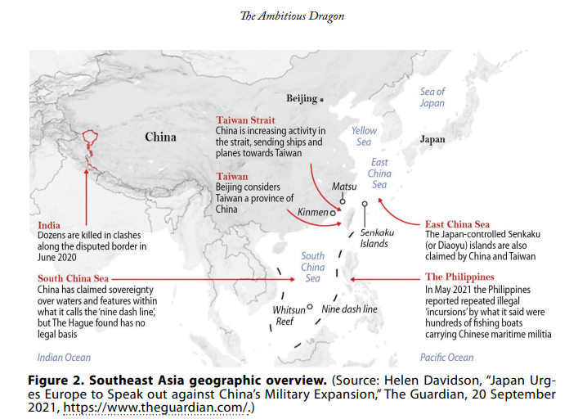
China’s military expansion ambitions - ‘The Guardian’ Sept. 2021

Slide 8
President Xi Jinping speech at China’s Party Congress
18th October 2022
“Taiwan is China’s Taiwan. Resolving the Taiwan question is a matter for the Chinese, a matter that must be resolved by the Chinese. We will continue to strive for peaceful reunification with the greatest sincerity and the utmost effort, but we will never promise to renounce the use of force, and we reserve the option of taking all measures necessary.” Xi Jinping

Slide 9
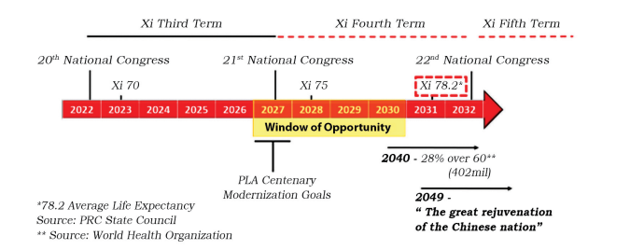
Timeline of when China is mostly likely to invade Taiwan
(from The Journal of Indo Pacific Affairs June 2023)

Slide 10
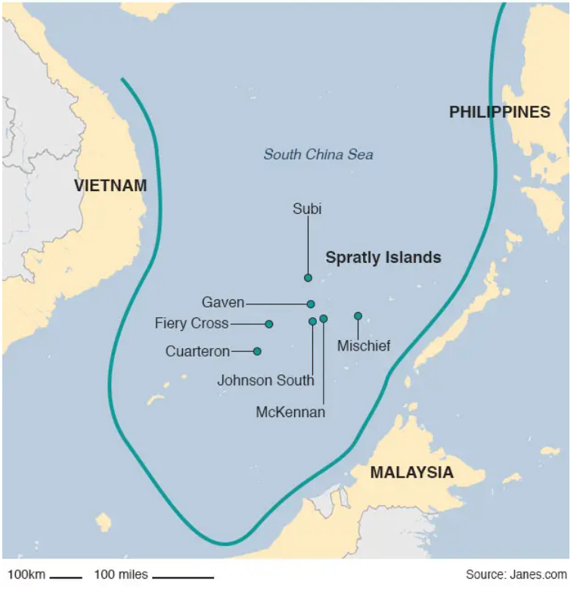
Where are the Spratly Islands?

Slide 11
Claims to the Spratly Islands
Claimants, apart from China and probably with a better claim geographically, are the Philippines, Malaysia and Vietnam, but also Taiwan and Brunei.
There are about 70 islands, reefs, atolls etc.
Apart from being important from a geographic/military point of view, they are also rich in oil and gas. And provide two thirds of the 10 million tons of fish caught annually in the South China Seas.
In 2015, President Xi assured President Obama that they would not be used for military purposes.
Also in dispute are the Paracel Islands and Scarborough Shoal to the north west.

Slide 12
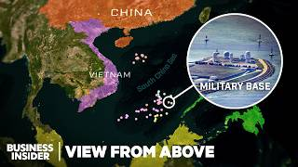
YouTube - what’s actually happening in the South China Seas

Slide 13
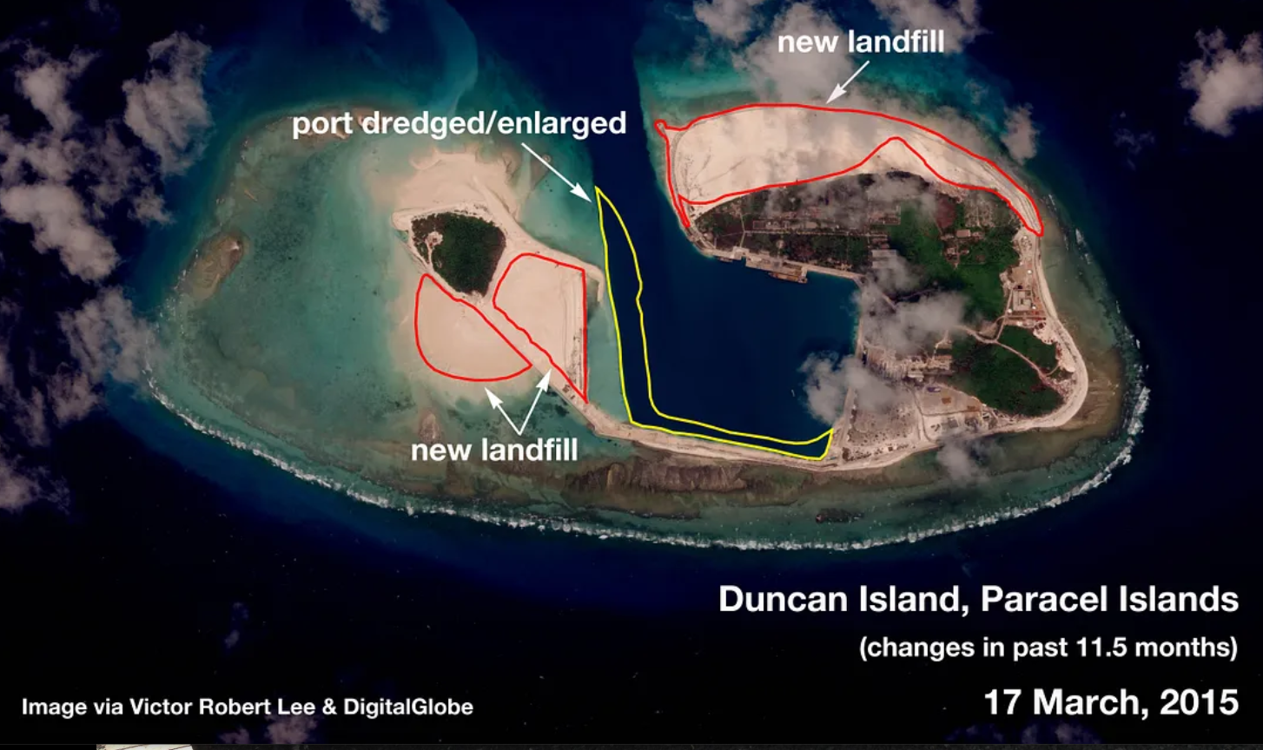

Slide 14
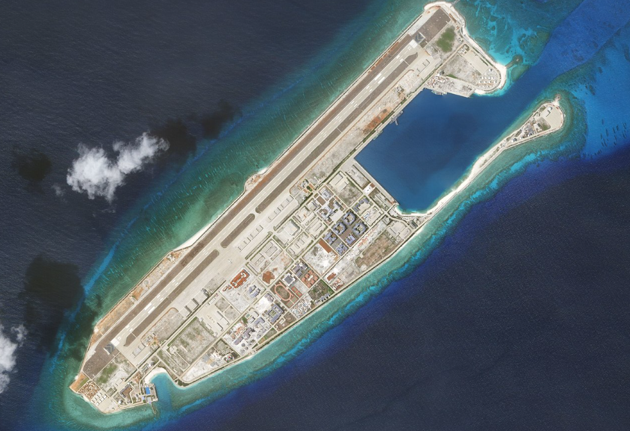
Fiery Cross Reef

Slide 15
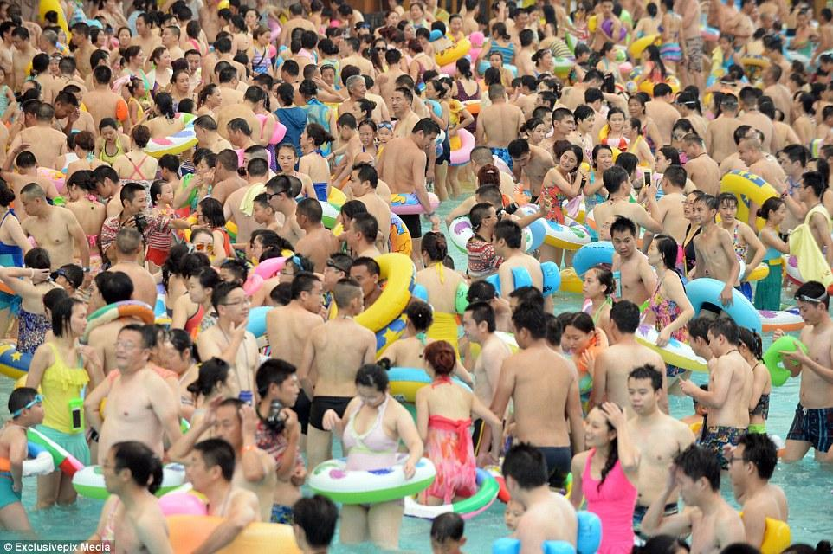
8,000 Chinese swimming in ‘Dead Sea’ water park - Sichuan 2015

Slide 16
China and its population
1. China was overtaken by India last year as the most populated country on earth.
2. But China’s present population is still 1,426 billion. This is more than the whole of Europe (744 million) and the Americas (1.4 billion) combined.
3. It used the one child policy (1980 - 2015) as a control measure, but this led to a) little emperors and b) an imbalance in male/female ratio as parents favoured boys.
4. Female infanticide was rampant and there are now 30 million excess males in China.
5. However, China’s birth rate fell to a record low in 2023 falling by nearly 6%.
6. The Chinese Govt is trying to rectify the birth rate fall by improving maternity leave, employment rights and giving tax breaks
7. But Mark Williams (chief Asia economist) at Capital Economics says ‘once people get used to smaller families, it takes a lot to shift that. An ideal family is close to the family size you grew up with’.

Slide 17
The meteoric rise of China’s economy
Economic growth since 1978 has been meteoric at about 9% of GDP. It had slowed to 5% by 2024.
It is the world’s second largest economy focused mainly on manufacturing. Used to be more heavy stuff like coal, steel etc., now more high tech - computers, chips etc.
But also second in the world as a consumer of goods.
It is called a mixed market socialist economy - mostly state owned, but 60% of GDP is from the privately owned sector. A sort of pragmatic communism.
Not all plain sailing for China - Western analysts are concerned over Chinese Govt debt, high youth unemployment (20% in 2023), the property bubble debacle with developer, Evergrande, defaulting and subsequent crash in house prices - the usual boom and bust cycle normally seen in the West.
China wants to overtake the dollar as global currency of choice (renminbi)

Slide 18
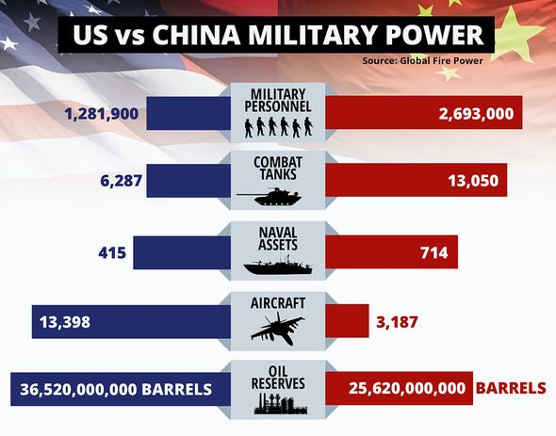
US v China armed forces - 2020

Slide 19
China’s military personnel
PLA - the People’s Liberation Army is the largest in the world with 2 million active duty soldiers.
Ditto for China’s navy - the largest, but not necessary the most effective - yet
Because the GFP (Global Fire Power), which ranks military strength, only puts the PLA as 3rd out of 145 countries. The UK perhaps surprisingly, given its size, is 6th.
Why is China only 3rd? Mainly because it is untested - unlike the US or UK, who experienced fighting in Iraq and Afghanistan (or not, according to JD Vance)
La Monde (the leading French newspaper) in February this year said “Xi’s ambitions are hampered by a shortage of qualified young people and his inexperienced forces”.
The PLA exists to protect the Govt and its interests before the country or people of China

Slide 20
China’s armed forces - budgets
1. Between 1997 and 2003, China’s military budget doubled and by 2024 was around 2% of its GDP at US$231 billion. US military budget for the same year was $842 billion.
2 However, in 2011 the International Institute for Strategic Studies stated that if spending trends continue, China will achieve military equality with the US in 15–20 years - that’s by 2031.
3. Chinese budget isn’t all hardware and troop spending, like every other army that includes salaries, training costs, maintenance of equipment and facilities etc.
4. But China puts a lot into asymmetrical warfare - hacking of state systems, interfering in elections, launching cyber attacks against infrastructure, misinformation etc. Also according to US Congressional Committee 2024, China has been fuelling the opioid crisis by flooding the US with fentanyl.
Also ‘elite capture’ i.e. recruiting former politicians or business leaders to promote Beijing’s interests. Prince Andrew was a victim of this with his friendship with Chinese spy, Yang Tengbo 2024. Also Christine Lee, lawyer gave donations to Labour MP, Barry Gardiner (£400,000) and Lib Dem leader, Sir Ed Davey.
And the latest is China’s new weapon to cut any underwater cables. These deep sea cables are layered with steel, rubber and polymer sheaths, but these can be severed by a diamond-coated grinding wheel working to a depth of 13,000 ft. 95% of global data transmission goes via such cables. The Chinese use third country flagged ships to maintain ‘a layer of deniability’.
British steel

Slide 21
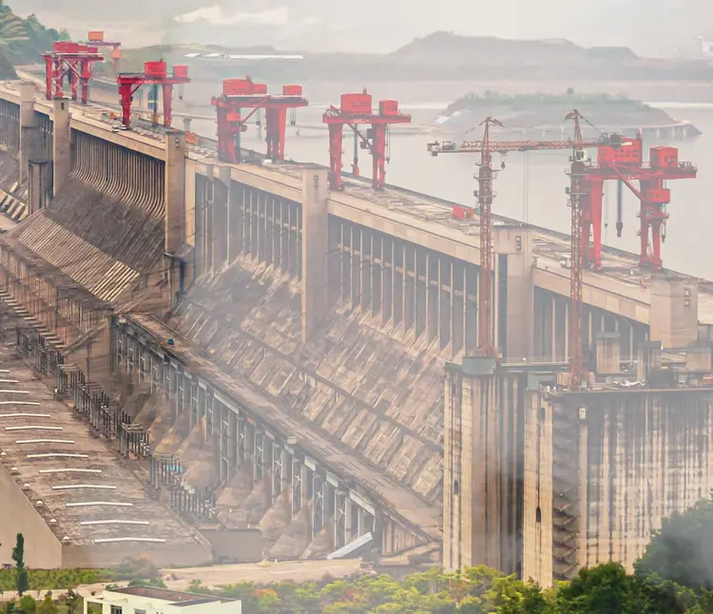
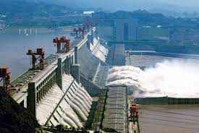
China and the investment in infrastructure
1.Three Gorges Dam

Slide 22
The Three Gorges Hydroelectric Dam
(The 3 Gorges Dam - it is a hydroelectric dam across the Yangtze River)
1. It is the world's largest concrete gravity dam
2. The reservoir created behind the dam is 370 miles long (that's the distance from Shannon in the Republic of Ireland to London)
3. In building it, the Govt displaced 1.3 million people, destroyed cities and saw the extinction of the Yangtze freshwater dolphin
4. These earthworks are blamed for an increase in seismic activity in the region
5. And most extraordinary of all, in building it, China has slowed the earth's rotation by 0.06 microseconds, (because it has redistributed the earth's mass and altered the moment of inertia)

Slide 23
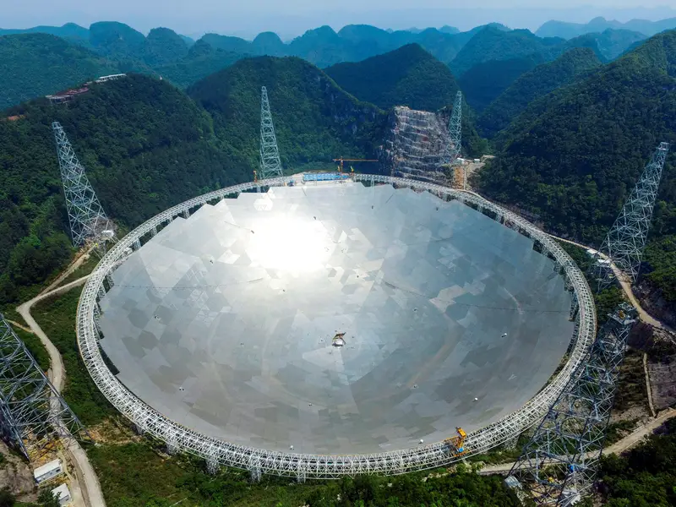
2. The Pingtang telescope was turned on in September 2016 and is now the world's largest radio telescope. Its dish measures 1,640 feet across.

Slide 24
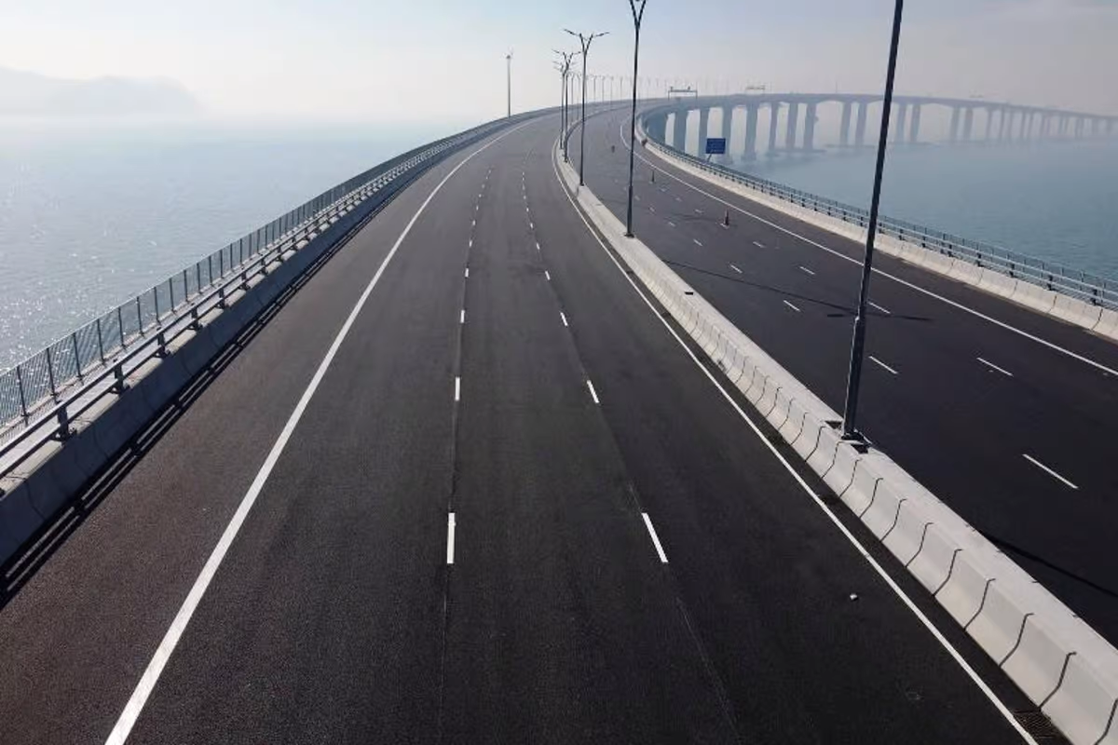
3. China/Hong Kong/Macau bridge - world’s longest sea crossing bridge
(34 miles in length)

Slide 25
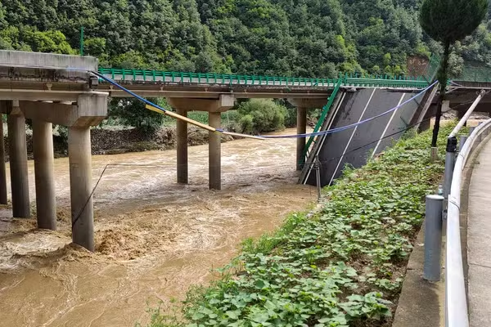
News headline - July 20th 2024
‘China highway collapses - 12 killed, 30 missing’

Slide 26
China’s Belt and Road Initiative - BRI
The BRI is basically new trade routes for China using the old Marco Polo silk road.
3 reasons why China is promoting this:
1. Rivalry with the US - but also most Chinese trade passes through the Malacca Strait near Singapore, which is a US ally. So it needs more secure routes.
2. It is seeking new markets for its huge state owned companies. During the 2008 financial crisis, China’s 4 trillion (yuan) stimulus package flooded the country with bridges, roads, airports etc. Now looking for new markets as the Chinese one is saturated.
3. Wants to build China’s political and economic power in the world.

Slide 27
Pros and cons of the BRI
In Africa: Chinese banks have funded many projects like major gas pipelines in NIgeria and railways. Also helped other countries such as Uganda, Egypt and Ethiopia. Kenya has Africa’s first high speed train between Mombasa and Nairobi
In Pakistan: Pakistan is the crucial for the BRI project with the China Pakistan Economic corridor running close to disputed Kashmir. India not happy with two nuclear countries co-operating on her borders
In Greece: After 2008 financial crisis, Greece was in serious debt and had poor relations with the EU. In stepped China with Cosco (Chinese shipping firm) buying a major stake in the port of Piraeus. This is Europe’s 7th largest harbour
In Sri Lanka: the Hanbantota port development is an example of ‘debt trap diplomacy’. The Sri Lankan Govt couldn’t service the loans that funded the port so in 2017, the port was handed over to the Chinese on a 99 year lease. This gives China a strategic foothold in the Indian Ocean

Slide 28
BRI on decline
Beijing has allocated no new capital to BRI since 2015 and Chinese investments abroad have declined since 2019.
If China is to reach peak CO2 emissions by 2030 and achieve carbon neutrality by 2060, it will have to draw in on infrastructure projects and that would include the BRI.
2021 G7 summit saw a united European response to BRI with ‘Build Back Better’ - an alternative infrastructure programme backed by Western democracies.

Slide 29
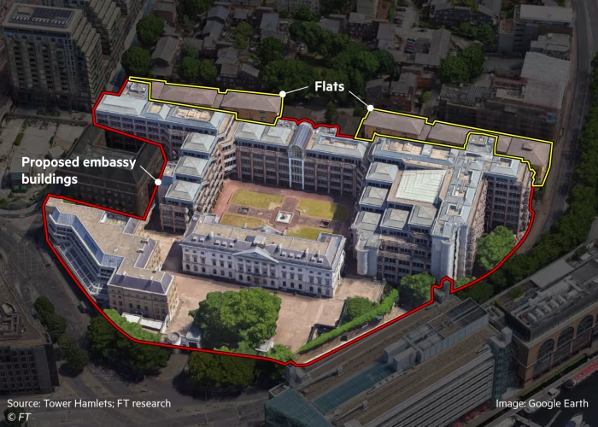
Plans for Chinese super Embassy in UK

Slide 30
Chinese super embassy on site of former Royal Mint
This is 5.5 acres of prime land on the site of the former Royal Mint.
Tower Hamlets council blocked the application in 2022 saying it would attract hundreds of protestors and take resources away from fighting crime.
The City of London is worried as there are financial data-sensitive cables running close to the proposed Embassy site, which could be cut or hacked.
Dr Calder Walton, a China expert at Harvard’s Kennedy School of Govt says ‘you can be sure that it’s going to be packed full of Chinese intelligence officers working under diplomatic cover’.

Slide 31
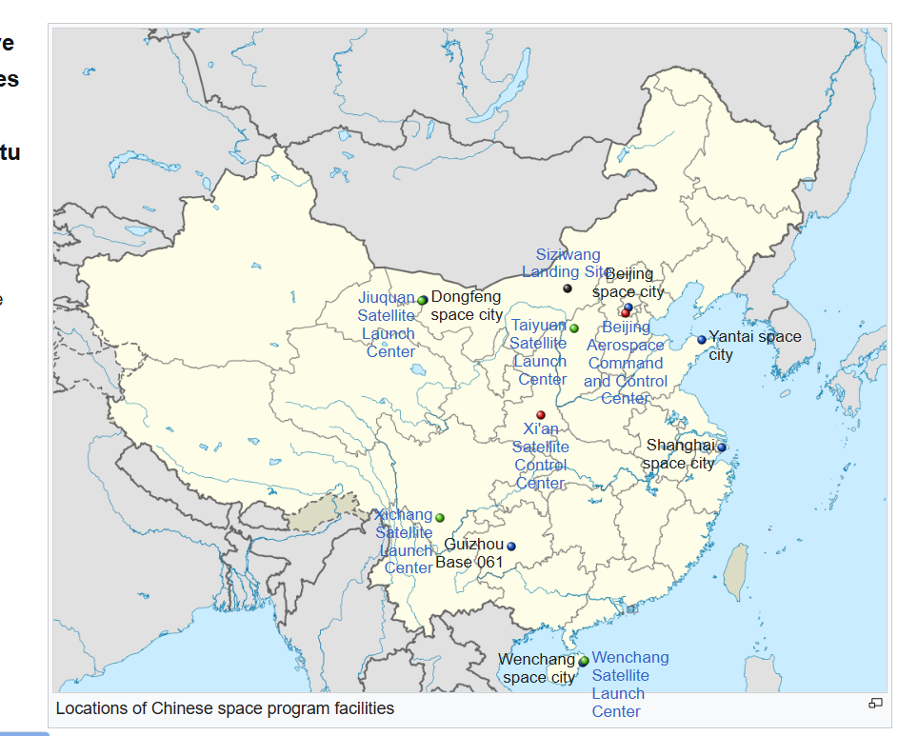
Sites for China’s space programme

Slide 32
China and the space race
In 2019, China became the first country to land a rover on the far side of the moon. In 2021, China landed a spacecraft on Mars. China plans to establish a research station on the moon by 2035.
But there are different motives between the US and China re the moon.
a)The US wants a Lunar Gateway orbiting the moon, using it as a gas station for Mars.
b) the Chinese want to mine for rare earths - cobalt, lithium and helium -3 used in nuclear fusion.
China has its own station which opened in 2022 because it was banned from the US/European/Canadian/Japanese one over fears of poaching technology.
The 2011 Wolf Amendment bans NASA from working with China in space. And Chinese engineers are also banned from NASA facilities.
But, ironically, Russia is part of the ISS and has been since its inception. The station is divided into Russian and American parts.
Rare earth elements: China has a vested interest in the moon because of rate earth elements like lithium, cobalt, and nickel.

Slide 33
China and satellites
1. China has many satellites and adding more to rival Elon Musk’s Starlink. They are for communications, navigation, remote sensing and scientific research. It launched 18 satellites in 2023 to provide broadband coverage.
2. But to put this in context, China has 650 satellites while the US has 7,000.
3. General Whiting of US Space Command says China has tripled the number of spy satellites in orbit over the last six years
4. Military significance: Some in the US are concerned that China's space programme could be used for military purposes. A 1967 UN treaty bans military activity on the moon, but not in space.
65 Also Chinese have counter-space weapons, some of which can pull satellites out of orbit. They have missiles to destroy satellites and their arsenal includes lasers, microwave weapons, plus electronic and cyber warfare.

Slide 34
China operating outside international rules
The rise of China as a superpower has resulted in a rise in confidence too.
Who is going to stop them?
Intellectual property theft: Oxford University molecular structure of water project.
Treatment of Uyghur people- about 1 million out of population of 11 million are ‘re-educated’ in camps. They also undergo intense surveillance, forced labour and sterilisation. They are a Muslim minority.
Suppression of Umbrella Protest Movement in Hong Kong 2014, which was passive resistance to China’s refusal to have transparent elections. So much for Chris Patten’s ‘one country, two systems’.
Harassment of Chinese dissidents in other countries, particularly true in universities via the Confucius Institute promoting Chinese education, language and culture in overseas universities. There are 30 of these on British campuses. In 2024 they were stripped of UK Govt funding. They are closely affiliated to the CCP - Chinese Communist Party and are run by their propaganda dept.

Slide 35
China and biological warfare
WUHAN

Slide 36
Additional notes
India v China border - skirmishes over the years fighting with sticks and rocks because a 1996 Agreement bans the use of guns and explosives. They are both nuclear powers.
2. The 12 nautical mile zone around a nation’s coast is sacrosanct and then a further 200 miles of EEC - exclusive economic zone under 1982 Law of the Sea.
3. The distance between China and Taiwan is 112 miles so you can see China’s anger at ships going along the Taiwan Strait. It is frequently used by US, France, Germany, Canada , Japan, Australia and NZ ships, because it is a navigational link between South and East China seas.
4.Today Programme Radio 4 last Saturday - Prof Peter Frankopan discussing hegemony and China. No Xi doesn’t want to take over world, but does want to be dominant power over the Far East as it was back in Imperial Days. We’re back to the tribute system and kowtowing and that is President Xi’s plan for the 2049 Great Rejuvenation.

