Slide 1


Slide 2
America’s Secret Cold War in the Ukraine

Slide 3
Overview of US Backed Regime Change Operations During the Cold War
64 Covert(Secret) Attempts; 6 Overt = Send in the Marines
Early Cold War centred on Eastern Europe
Eg: Albania, Ukraine SSR, East Germany, Latvian SSR, Czechoslovakia, Hungary, Poland, Romania.
(1949-1956).
As bi-polar competition spread world wide so did the scope of US Regime change ops
Eg, Iran(52-53), Indonesia(54-58), Lebanon(52-58), Laos(59-73) South Vietnam(63), Guatemala(52-54), Dominican Republic(60-65) Chile(62-73), Nicaragua(79-83), Grenada(83) Panama(87-89), Afghanistan(1979-)

Slide 4
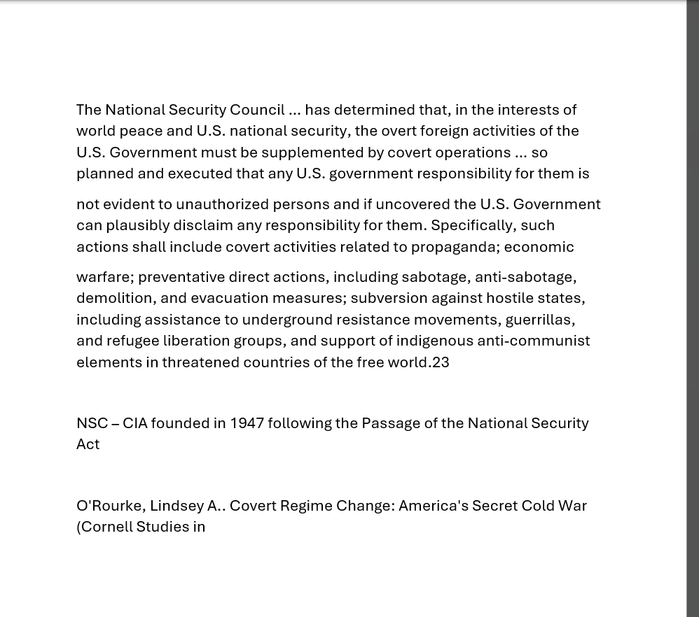

Slide 5
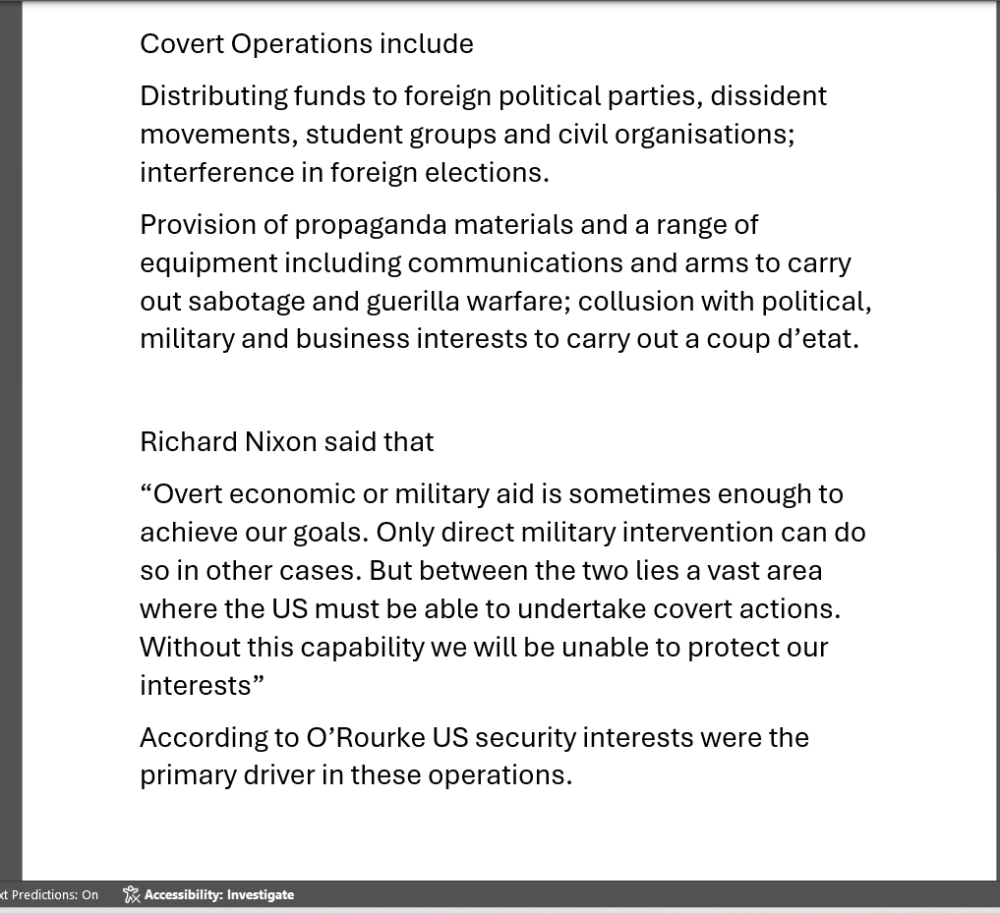

Slide 6
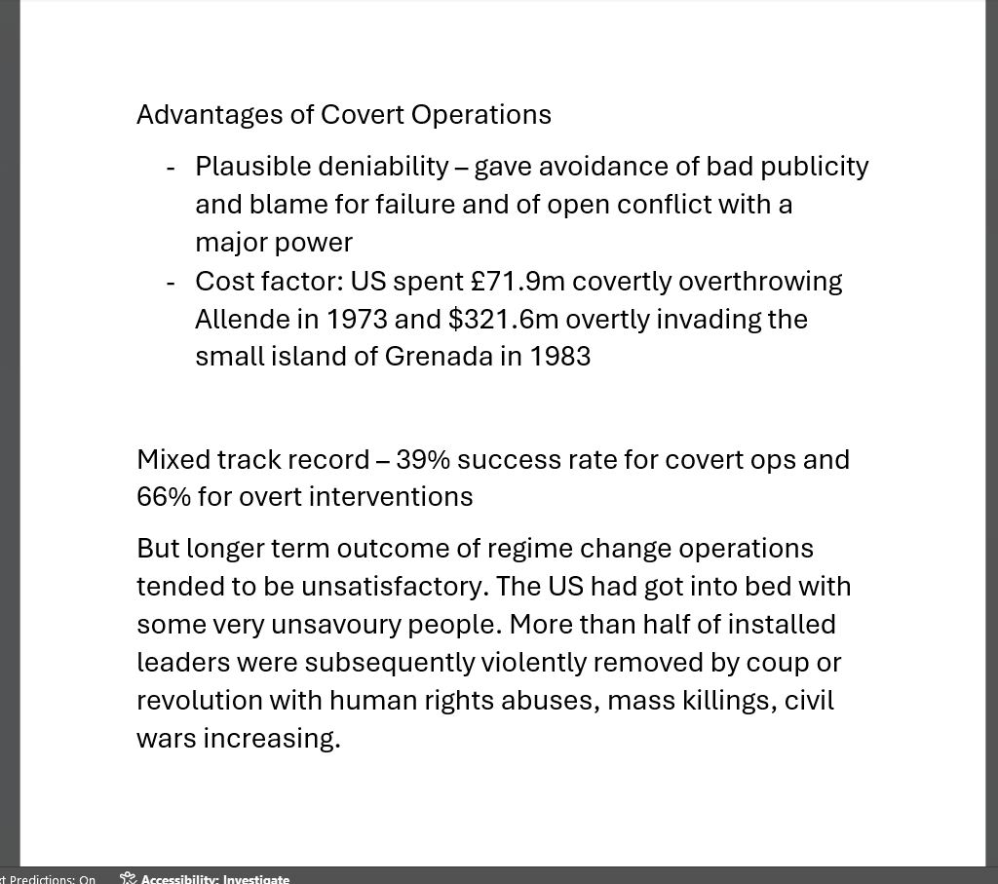

Slide 7
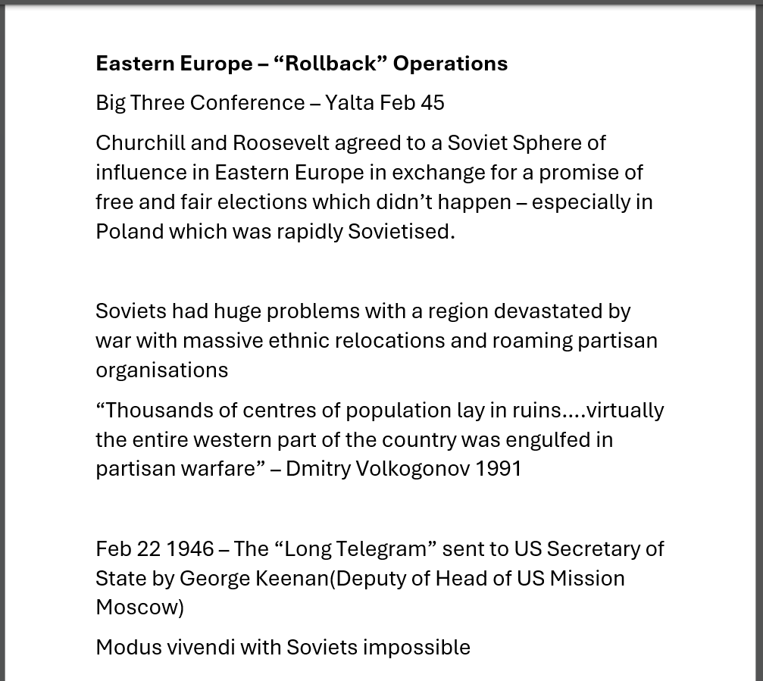

Slide 8
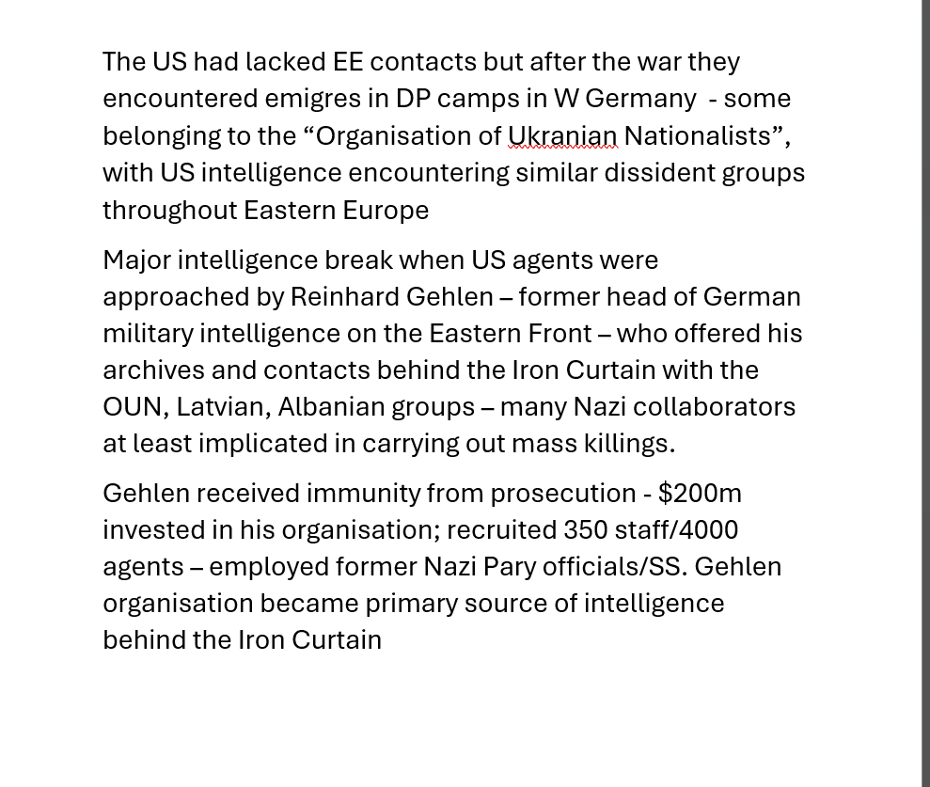

Slide 9
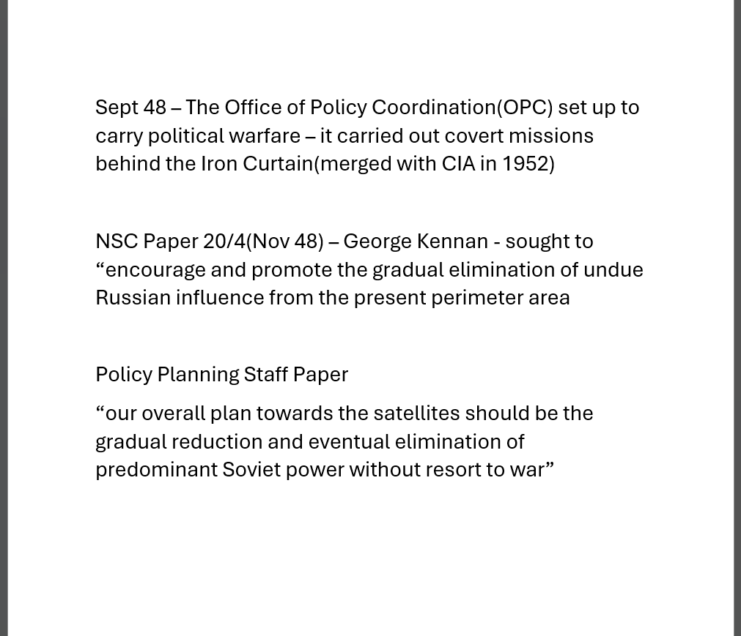

Slide 10
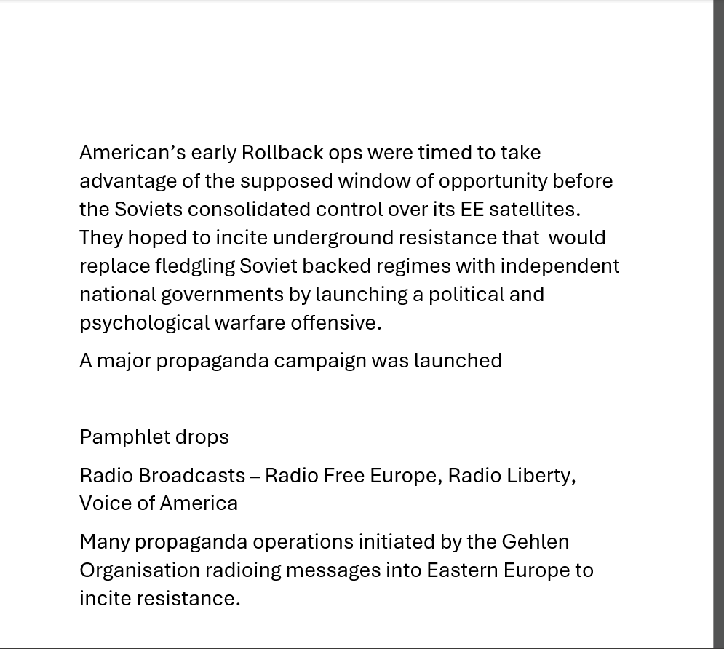

Slide 11
Origin of the Ukrainian Partisans
Ukrainian War of Independence(1917-21) – Ukrainian Nationalists fought the Soviet Bolsheviks and the Poles to establish a nation state. By 1921 the Soviets had captured most of Ukraine, Poland had annexed Galicia
1929 – Organisation of Ukrainian Nationalists founded – goal to reclaim the lost territories and overthrow the Soviet regime
1928- 1933 Stalin’s 5 year plan
Forced Industrialisation, Collectivisation; Deportation, famine
Sept 1939 – Poland divided between Soviet Union and Nazi Germany – Soviets took over Galicia and Volhynia
Hard-line Ukrainian Nationalists Stephan Bandera and Mikola Lebed become prominent in OUN

Slide 12
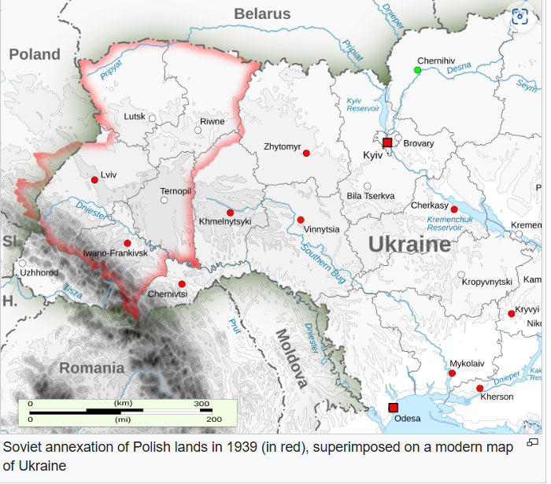

Slide 13
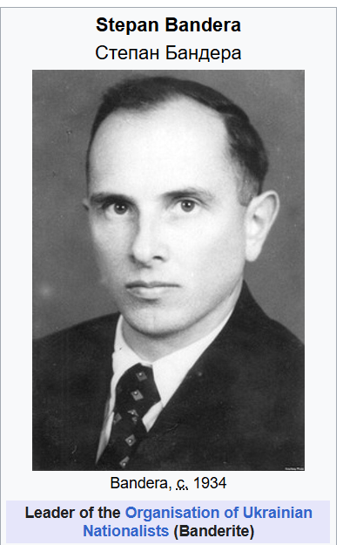
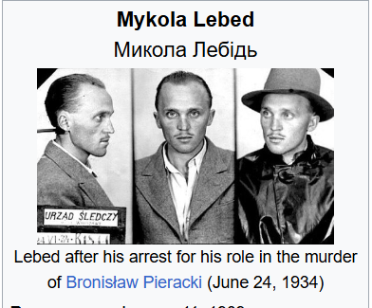

Slide 14
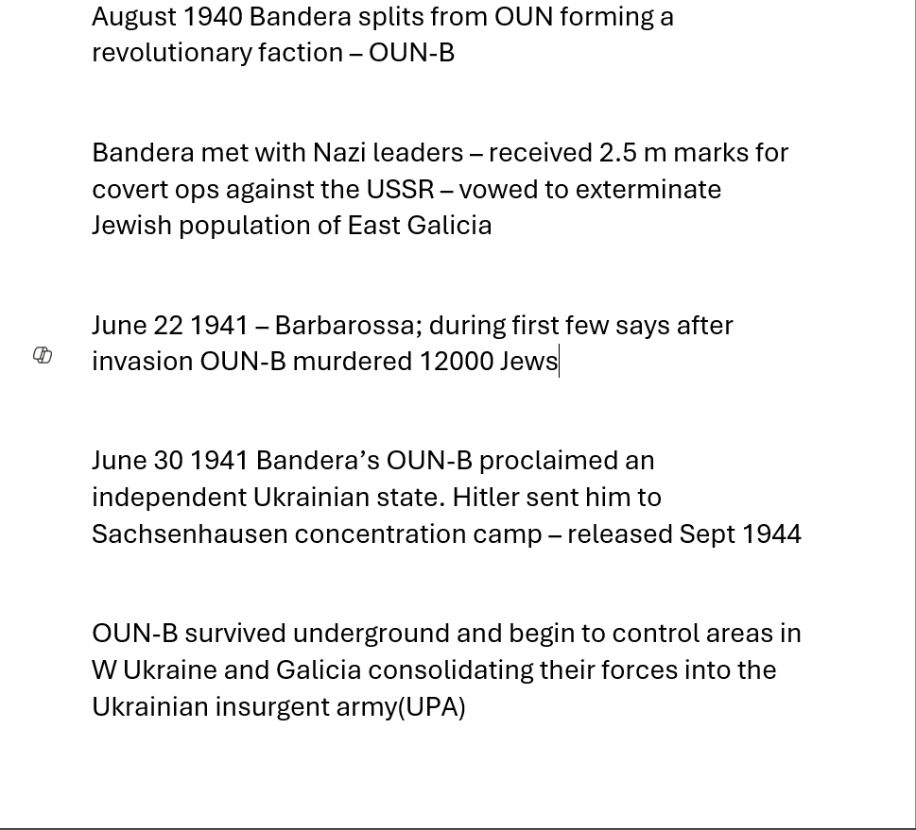

Slide 15
In the areas they control they ethnically cleansed the Polish, Soviet, German and Jewish populations
“Bandera’s men are not discriminating about who they kill. They are gunning down whole villages – Jews first, then Poles….” Diary of Molshe Matz
By July 1944 the Red Army had returned to the region – UPA attacked follow on NKVD troops, lines of communication troops, Soviet administrators and officials. Soviets responded with ferocious anti-partisan operations.
However…………
“The Soviets may be the rulers of the towns but the Bandera gangs reign supreme in the surrounding countryside – especially at night

Slide 16
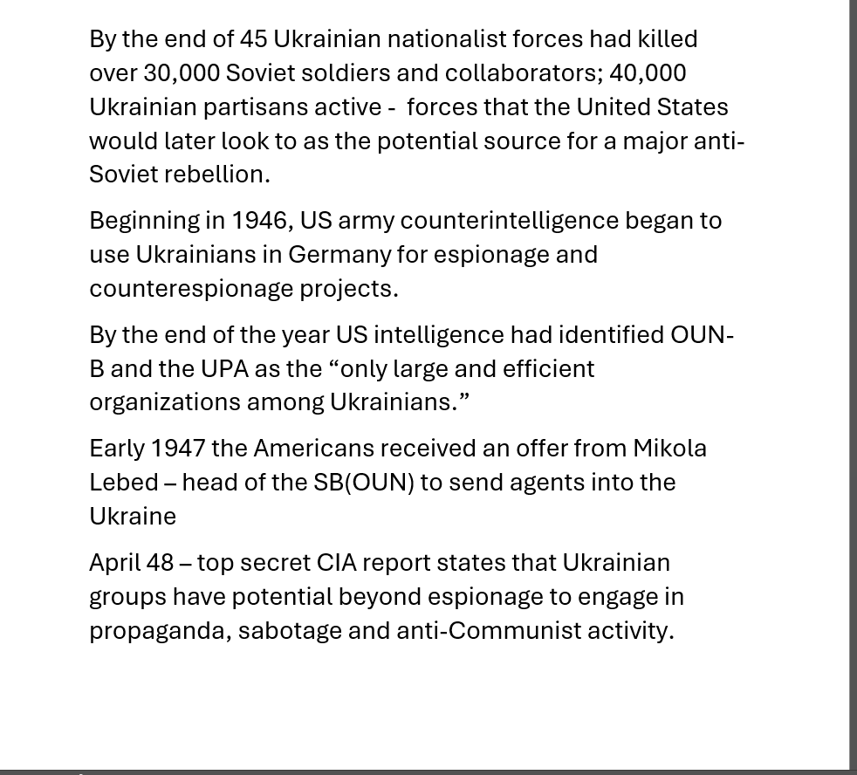

Slide 17
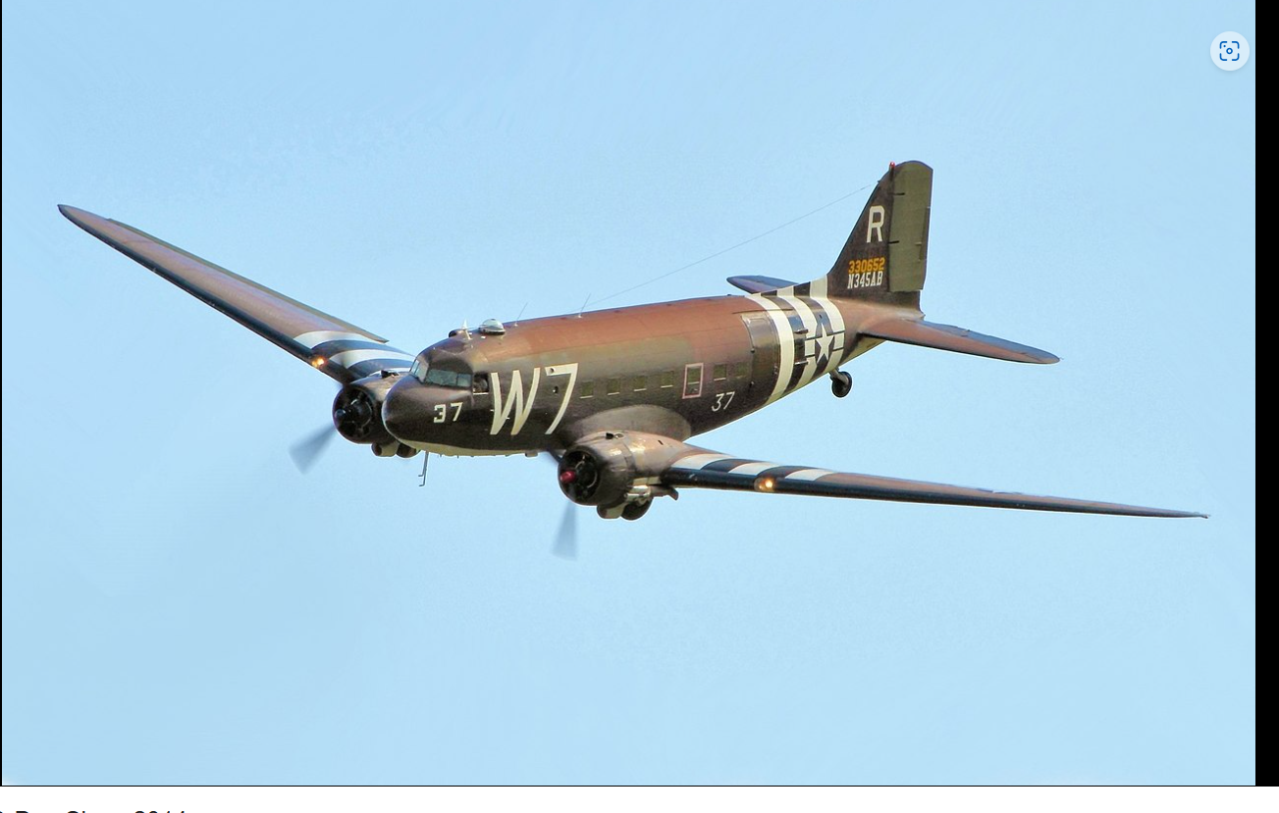

Slide 18
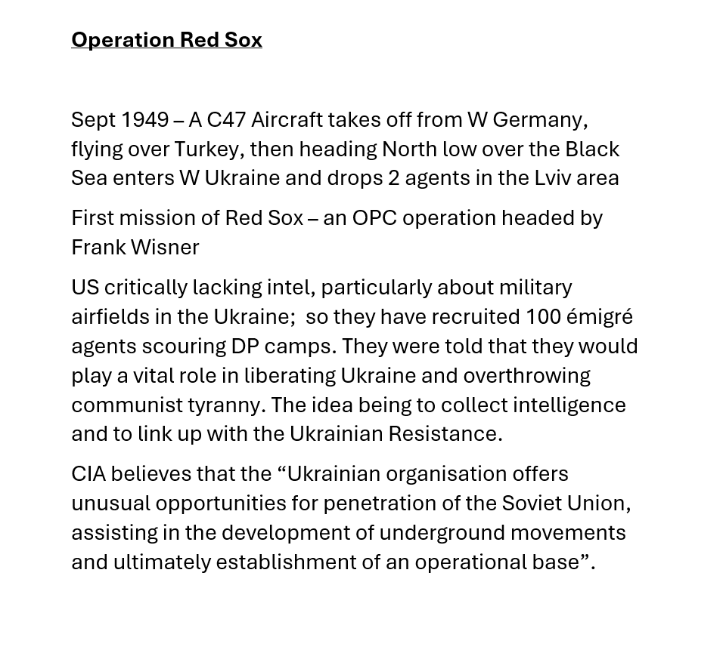

Slide 19
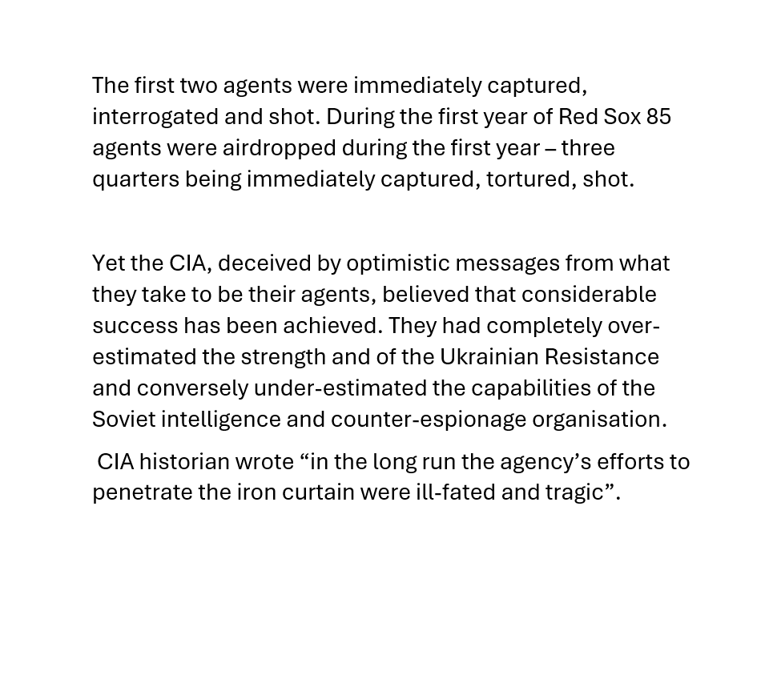

Slide 20
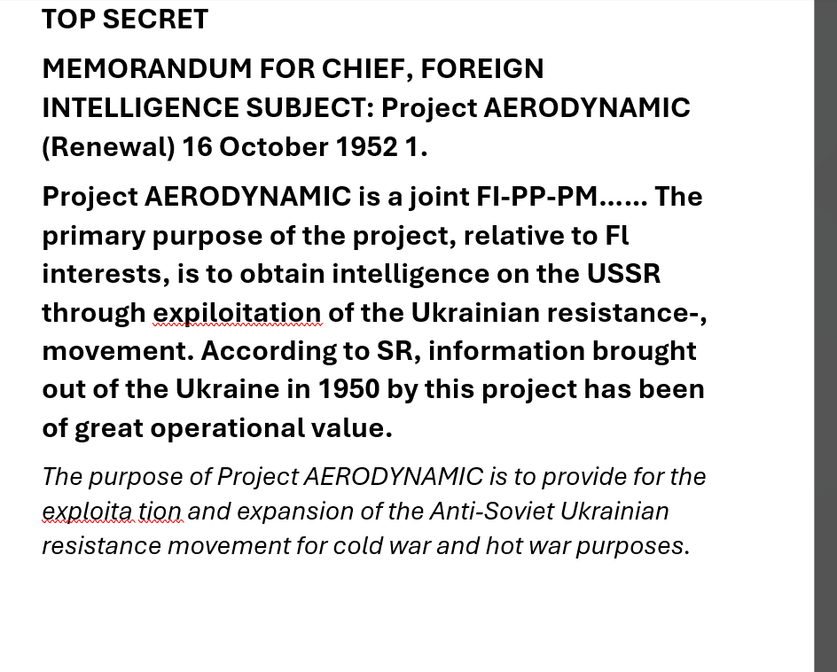

Slide 21
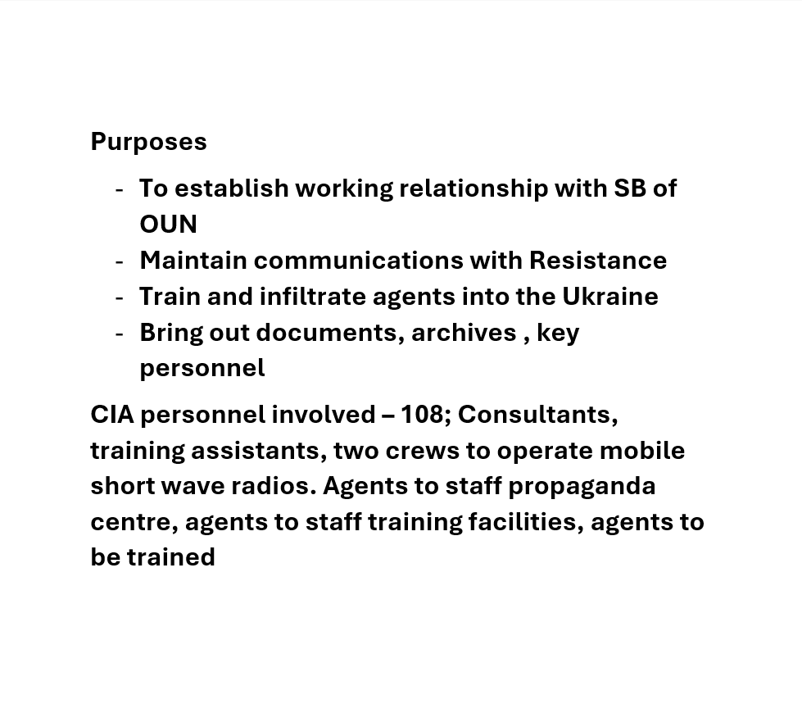

Slide 22
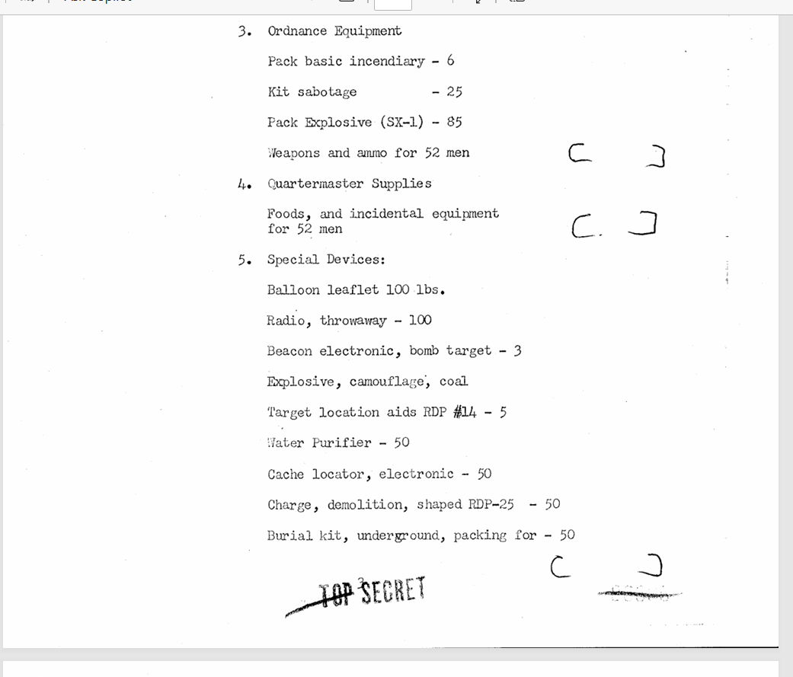

Slide 23
However Aerodynamic proved no more successful than previous operations.
The time had passed, whilst the Ukrainian nationalist movement was very strong in 1945-7, this was not the case in 1950. After WW2 was over the Soviets launched a savage anti-guerilla campaign against the UPA and its supporters. Terror and repression were the order of the day – approx. 600,000 people arrested in W Ukraine(1/3 executed 2/3 exiled imprisoned).
In response OUN-UPA stepped UP counter-terror against the Soviets – being particularly adept at assassinating Soviet officials.
During 1947 Soviet agents thoroughly penetrated OUN-UPA networks which considerably reduced effectiveness – so by 1950 Ukraine resistance was a remnant of what it had been

Slide 24
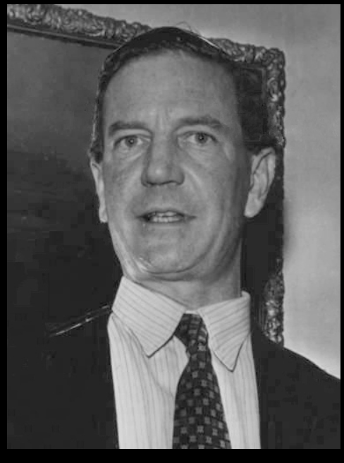
“Kim Philby also played a role in the collapse of this operation. In March 1951, In March 1951, he notified Soviet forces that the United States planned to airdrop three teams of six men into Ukraine.

Slide 25
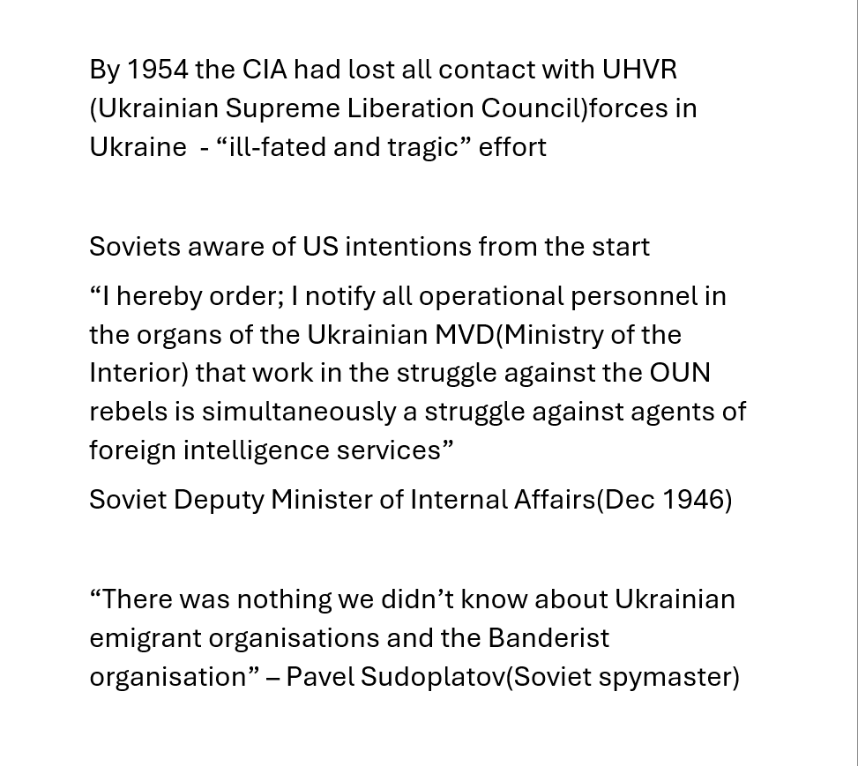

Slide 26
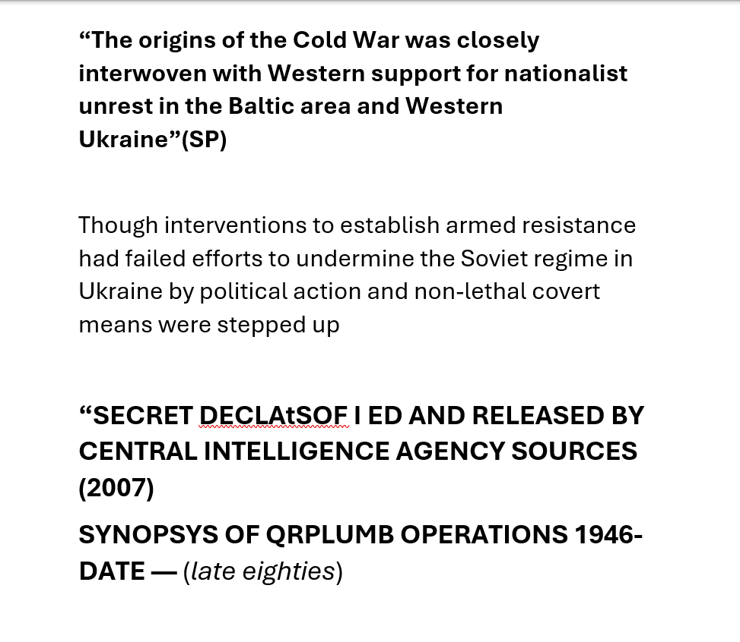

Slide 27
Aerodynamic was superseded by QRPLUMB – headquartered in New York and Munich(as Prolog Research)
Infiltrated a monthly journal into the Ukraine and copies of books they published
They published “books on topical Ukrainian themes, such as "Famine in Ukraine 1932-33", and dissident poetry
.Towards the end of their operations they infiltrated video duplicating equipment and video tapes into the Soviet Union and Poland.

Slide 28
