Slide 1
Databases
An introduction to

Slide 2
Why a database and not a Spreadsheet?
A spreadsheet is very good at crunching numbers, it is not so good at recording “records of records”!
A database can RELATE one record to another.
Membership fees 2017
Joe Bloggs
Club member
Membership fees 2018
Membership fees 2017
Membership fees 2019
Membership fees 2018
Membership fees 2019

Slide 3
Database Objects -
A database is made up a number of different types of objects, the four main types are:
Tables, Queries, Forms and Reports.
Tables hold the raw data.
Queries sort and select that data.
Forms present data (normally from a Query) in an easy to view format.
Reports are the output of the database. Show me a list of all paid up members.... Generate a Telephone list...

Slide 4
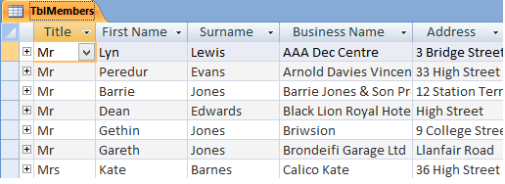
Database Objects
TABLES
The Raw data is
held in a TABLE.
Tables are the
underlying source
of all the data in a
database.
A single table can be compared to an Excel Worksheet.
Complex databases may have hundreds of tables that are all linked together.

Slide 5
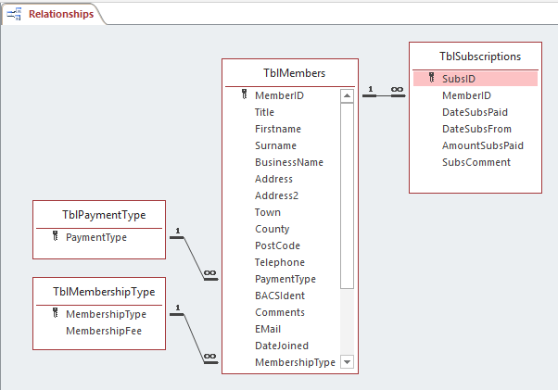
Database Objects
Relationships
The database is based
around the Members Table.
There is a “One to Many”
relationship with
Subscriptions
And from the Payment &
Membership Type,
a “Many to One”

Slide 6
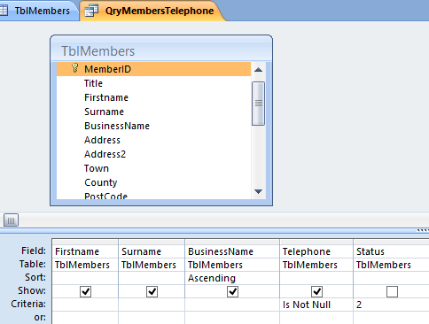
Database Objects
Queries
Queries sort and select data.
Here we are using the
“Members” table to select
all those who have a ‘phone
number ie the field is NOT
blank.
The list is sorted by the Business
Name and the Query
only selects those with a Status of “2” (ie current members).

Slide 7
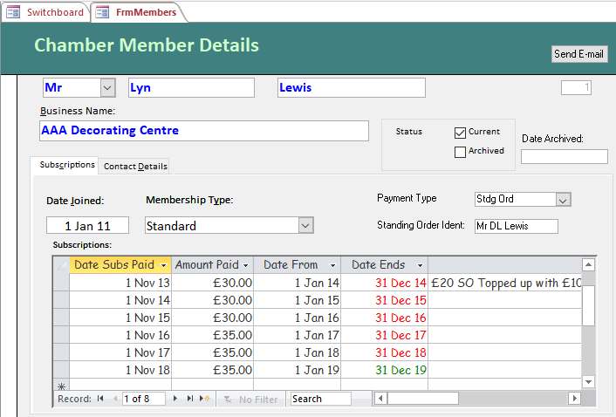
Database Objects
Forms
Forms present data in an easy
to view format.
This form is based on each
Chamber Member, there
are currently about 80 records.
Inside the main form is a sub-
form showing each year’s subscriptions. There may be
many (sub) records for each Chamber member.
This is the beauty and advantage of a relational DBase.

Slide 8
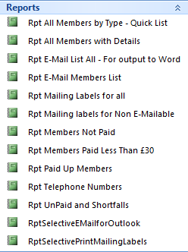
Database Objects
Reports
Reports are the ‘Output’ of a database.
Even a simple database like our may
have many reports.
Reports are normally based on a query.
Conditionally formatting enables us to
highlight for example, those who haven’t paid, or
those who haven’t paid the full amount.

Slide 9
Data flow
Forms
Input Output
Reports
Visible
Invisible
Tables
Queries

Slide 10
Let’s see how it works in practice

