Slide 1
Backing up your Data
How to create a Successful Backup strategy

Slide 2
What do I need to Backup?
Data from your User Account:
  Documents
  Music
  Pictures, Photographs
  Videos
  Desktop etc
  Includes the hidden folder “App Data”
Not required
  Installed Programmes
  System files
Notes:
What to Backup.
You only really need to backup your personal data, ie data in your “User” account folder, it’s your “User Account Profile”: My Documents, My Music, My Pictures, My Videos etc. Personal data can mount up. We have over 34,000 photographs since we started saving our digital images. Together with our Documents and other items our User account is in the order of 200GB.
There is no need to back up Installed programmes as you can reinstall then again from the original software or updated versions downloaded from the internet.
There is no need to backup System files or the Operating system as Windows provide a number of solutions to reinstall the Operating System software

Slide 3
Where should I save my Backups?
Same Computer, same drive (C: Drive)
Same Computer, different drive (D: Drive)
Same Computer USB Drive
Same Computer External Drive
Networked Drive
To the Cloud
Notes:
Things to consider. If you back up to the same Computer and the same drive (the C: Drive), this is the worst of all worlds – but at least it is a start. If your computer crashes or you have a hard drive failure then you are stumped. A regular Hard Disk Drive (HDD) is a mechanical device and will eventually fail… ☹
An additional drive in the computer is a step better. You can at least take this out and then put it into another computer.
An External drive can be plugged into any computer – as can a USB drive.
All the above suffer from the same problem of location. Fire, flood or other disaster could be the end of your data.
A network drive, particularly in a separate building is getting better.
Finally, Off Site – to the cloud might be better still, although you are now generally at the mercy of your chosen supplier. (What are their policies, what happens if they go out of business, what if someone hacks their data, is my data encrypted and safe etc)

Slide 4
3-2-1 Rule
Keep at least 3 copies of your Data
Keep it in 2 separate places
At least 1 must be off site
Notes:
3-2-1 Rule is useful to summarise the previous slide.

Slide 5
Cloud Options
Cloud Storage – Additional to local HDD.
Cloud Backup – Replication of local HDD.
Cloud Storage:
  One Drive, iCloud, Google Drive, Dropbox, Amazon Prime
Specific 3rd Party Cloud Backup Solutions:
  IDrive, Acronis True Image, Backblaze, Livedrive, Carbonite and others
Notes:
There is a subtle difference between Cloud Storage and Cloud Backup. Storage gives you ADDITIONAL storage space to your local storage on your own computer. You may choose to save documents to the cloud, your own computer or both. Cloud storage acts INDEPENDANTLY from your local, own computer, storage.
Cloud Backups on the other hand try and REPLICATE all, or more generally, parts of the data on your own computer ie your Documents and Picture folders. There is some crossover, as indeed you could copy your Documents folder to Cloud Storage and you have in effect a Backup. (Although it doesn’t really work the other way – Using a Backup provider to give you extra storage)
Cloud Storage:
Microsoft OneDrive. Free online storage that comes with your Microsoft account. 5GB Free. Subscribe to Office 365 for £80.00 pa then you get 1TB.
iCloud 5GB free. 200GB £30.00pa. 2TB £84.00pa
Basic user Google Drive 15GB Free. Upgrade to Google One 200GB for £25.00 pa. 2TB £80.00 pa
Amazon Prime £80.00 pa Unlimited space for Photos
Norton Security Premium 25GB £40.00 + Antivirus etc.
McAfee LiveSafe £90.00 1TB secure protection Face, voice and PIN

Slide 6

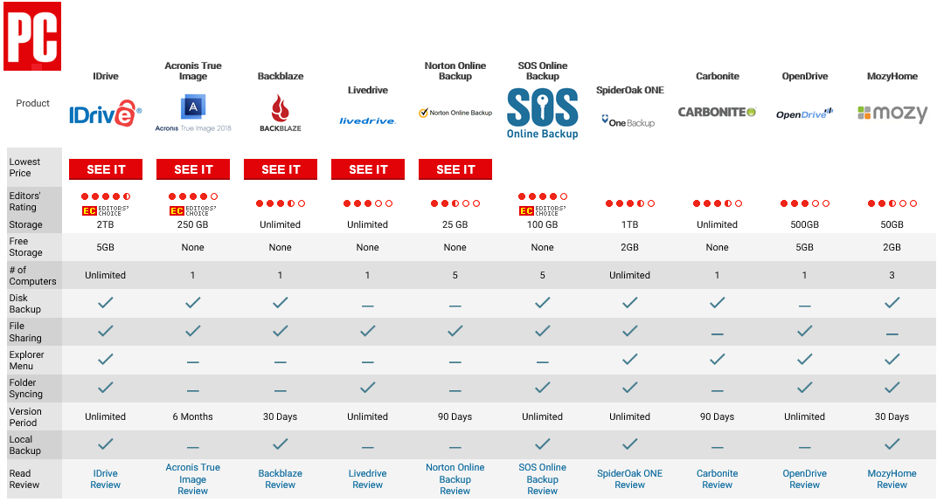
Notes:
Cloud Backups
I Drive: 2TB $104.25 for 2 years
Acronis True Image: Standard one time purchase £35.00. Advanced – One year Subscription 250GB £35.00. Premium – One year Subscription 1TB £70.00
Backblaze: $50 per year
Livedrive: Standard Backup £60 pa
Norton Security Premium 25GB £40 + Antivirus etc
Chart from PC Magazine Best Cloud Backup solutions for 2019. https://uk.pcmag.com/file-syncing-and-backup/8648/the-best-online-backup-services

Slide 7
Windows Back up and Restore
Start | Settings | Update & Security | Backup |
Backup using File History | Add a Drive …… will search for all networked drives, external drives or USB drives. Select as required.
More Options | See Advanced Settings …. Opens up the File History part of the old Control Panel.
From here, Advanced settings allows you to specify how often you want to save your documents and how long to keep them.
Exclude Folders: As you would expect.
Notes:
Windows has it’s own built in backup system. It’s called “File History”. This doesn’t backup to the same computer, so you need either a USB drive, and external Hard Drive or a networked drive.

Slide 8
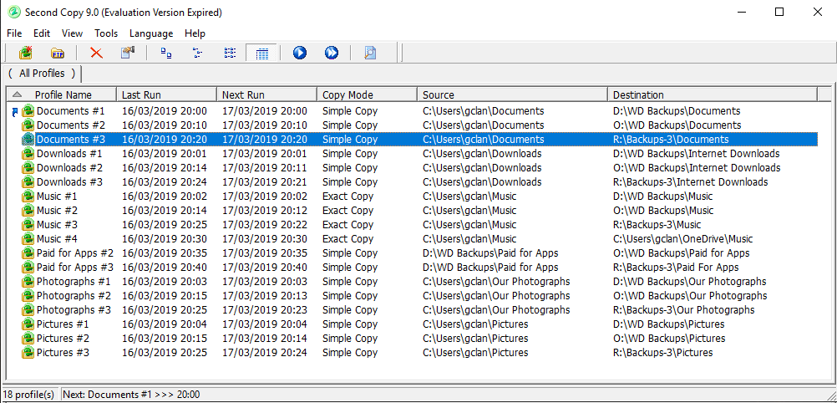
Notes:
Or you can use some 3rd party software
This one: Second Copy is Application on your local computer. One off cost $30.
You can use it for free for the first 30 days. After that it still works, but you can’t make any changes. Get it right in those 30 days and you have a free version!
This screenshot is from my own computer and you can see that I am generally saving 3 copies of data from my user account: C:\Users\gclan\ to 3 different locations: The D drive, the R drive and the O Drive (More on these drives later)
The profiles here run every day although you can change this to whatever you like from hourly to monthly or manually.
The copy mode is either a simple copy or exact copy. The Simple copy copies any changed or new files to the destination drive. The Exact copy does the same, but in addition it will look to see what I have deleted from the source directories and then delete them from the destination directories too so that they (The destination and source directories) are an exact match.

Slide 9
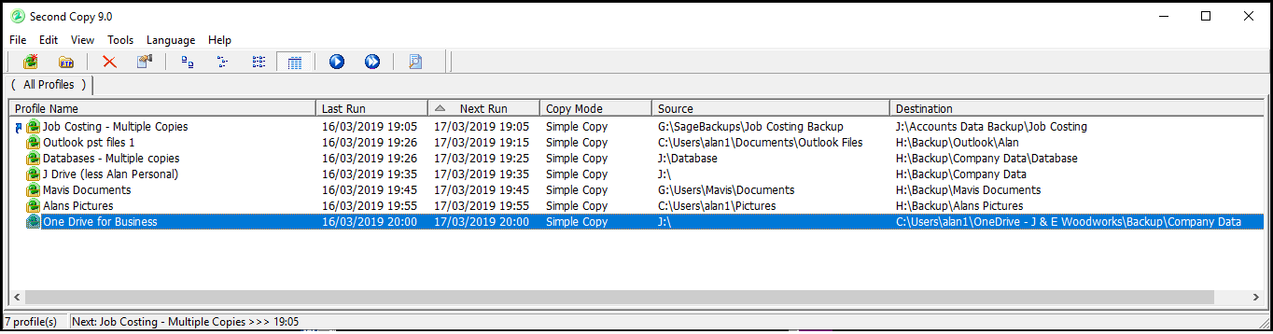
Notes:
And this screenshot is from a local business.
In addition to saving data to the H drive, a copy (The highlighted entry) is also saved to the One Drive in the cloud

Slide 10
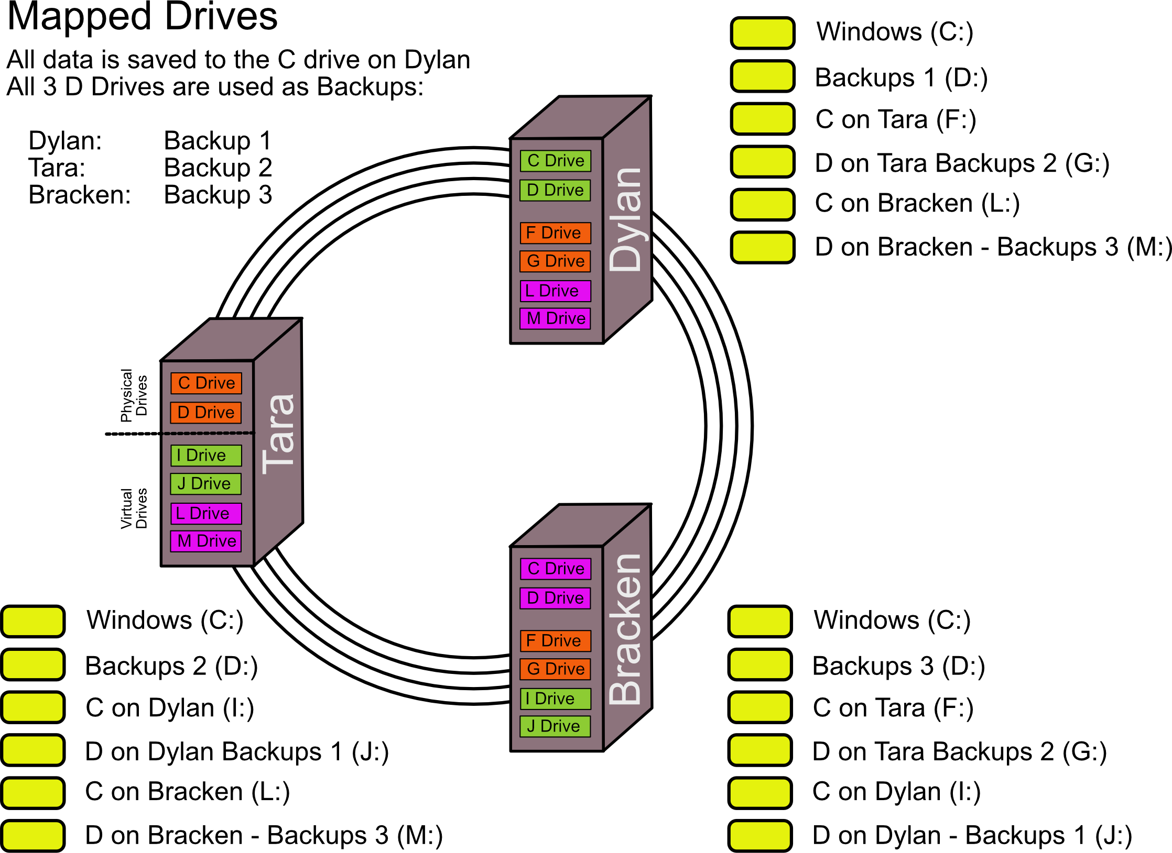
Notes:
Mapped Drives: Mapped drives are really useful in that they allow you to easily navigate across your network. You “Share” the drive on the computer you want to allow access to and give the ‘share’ a name “C on Tara” perhaps.
On a different computer, you map a spare Drive using unused letters from A to Z to the Share that you named earlier.
This now pops up in your File Explorer window for you to use as a regular drive.

Slide 11
Types of Backup
Full Backup:
  Backs up everything, even if it did it yesterday.
Incremental Backup
  Backs up changes since the last backup.
Differential Backup
  Cumulative backup of all changes since the last Full Backup
Continuous Backup
  Backs up changes continually as you work
Notes:
Types of Backup.
Full Backup.
Incremental Backup,
Differential Backup.
Continuous Backup
Full Backup: as the name implies it backs up everything – even if you did a full backup yesterday
Incremental Backup: Only Backs up data changed since the last back up. Say you did a full back up on Friday, then an Incremental backup on Monday. This would only takes changes made over the weekend. An incremental backup on Tuesday would take Monday’s changes. To fully restore all data, you need the last full backup and all successive incremental backups.
Differential backup: Cumulative backup of all changes since the last full backup. Full Backup on Friday, then a Differential Backup on Monday takes changes over the weekend. A Differential Backup on Tuesday takes changes over the weekend and Monday. Advantage, only need two Backups to restore all your files, the last Full Backup and the last Differential Backup. Although note that each successive Differential Backup will get bigger and bigger in size.
Continuous backup. Continually backs up your files in the background as you are working. Windows Backup and Restore works like this as do most 3rd part home backup solutions. It is generally only big IT sections that would be doing the former types of Bckup.

Slide 12
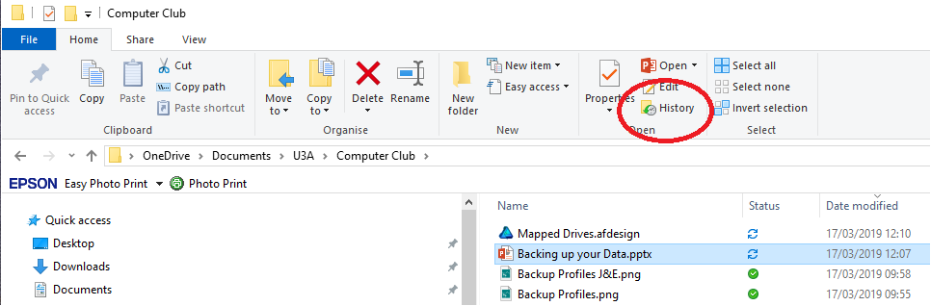
Versioning
Some Backup programmes will overwrite a file with the newer version.
Versioning keeps a history of previous versions so that you could go back to an earlier edit of a file if required.
Notes:
Versioning is good. Imagine that a datafile becomes corrupt and you don’t notice. The corrupt file is backed up and overwrites the previous older, but intact file. We now have two versions of the corrupt file. Versioning guards against this because we would have both versions (and more) backed up, you just need to go back in time to find the last good version.
In Windows 10 they call it File History. The default period is 1 hour although you can change this if you wish.
Apple’s Backup programme is called Time Machine. Hourly backups for the past 24 hours, Daily backups for the past month and Weekly backups for all previous months.
Windows’ File History works like this.
In this case you can see that I have highlighted the “Backing up your data” file. If I now press the “History” icon …… (Now see the next slide)

Slide 13
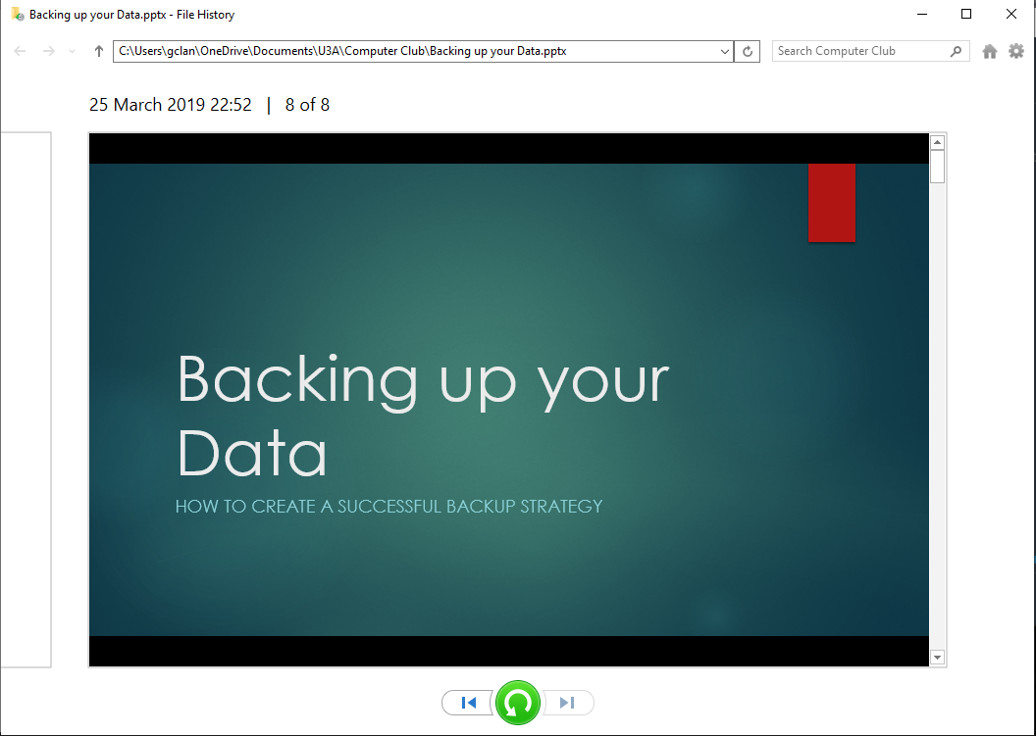
Notes:
…If you click the file History icon, you see how many previous versions of the file are available. In this case there are eight copies. The last saved copy is dated 25 Mar when I finished editing the file and there are 7 other versions going back to version 1 when I started the file.
Use the arrow buttons at the bottom to go forward and back through the versions, and the green arrowed circular button to restore a particular version.

Slide 14
Other things to Consider
Automatic or manual Backups
RAID: Redundant Array of Independent Drives
Crypto viral extortion
Full System Image
System Restore
Notes:
Automatic backups give peace of mind. Set it up and forget.
Manual backups require YOU to initiate the process – easy to forget.
RAID – Redundant Array of Independent Drives. Works against HDD failure in that if one drive of the array fails, the rest will still be able to carry on working.
Crypto Viral Extortion; Ransomware. A virus encrypts your files so that you can’t access them unless you pay a ransom. Once the ransom is paid you are (maybe) given a key to unlock the crypto and re-access your files. These viruses search any available files on your computer OR NETWORK. So although you may be backing up your files to a Network drive automatically, if your backup software can see the drive then so will the virus. Stumped. So there is a case for manual backups eg don’t plug the external drive in until you are ready to backup or don’t save the network credentials so that you have to enter a user account and password to access the rest of your network.
System Image takes a snapshot of your HDD so that you could use this on a new drive if the old one fails.
System Restore. Microsoft offer a number of ways to get you’re your computer up and running again if Windows fails. System Restore is the starting point.

Slide 15
Final things
Your backup strategy will be individual to you and might be totally different to mine.
Think how you can work with your data. Do you mind paying for peace of mind, Are you happy to pay an annual subscription or would you rather pay a one off? Does it matter if you lose everything?
Local backups or to the cloud?
A Backup is only good if you can easily recover your file/s.
Test Test Test!
Notes:
End

