Slide 1

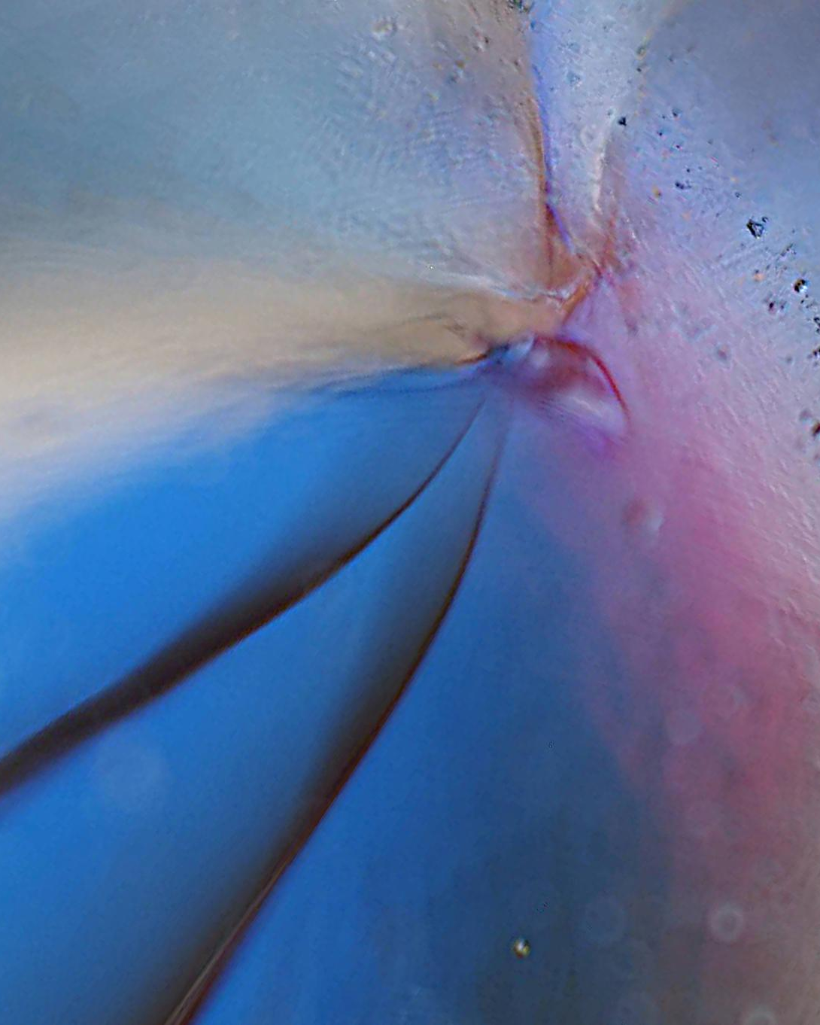
Macro Photography
Digital Photography Group
These are my thoughts and suggestions for photographing small things indoors.
Ultimately how you take or make your images will be a very personal choice, based on your own skill, taste and style. The best image will be the one that pleases you!
Notes:
These are my thoughts and suggestions for photographing small things that do not or cannot move about. Like most things in photography, it can be done on a “shoestring” budget or by spending bucket loads of money. This is also about learning by your mistakes, having fun and knowing that the best images are the ones that please YOU!
The focus today is mainly on doing this indoors in a very controlled environment, but the skills you’ll practice will be good grounding to take into the great outdoors where the environment and your chosen subject will almost certainly be less cooperative.

Slide 2
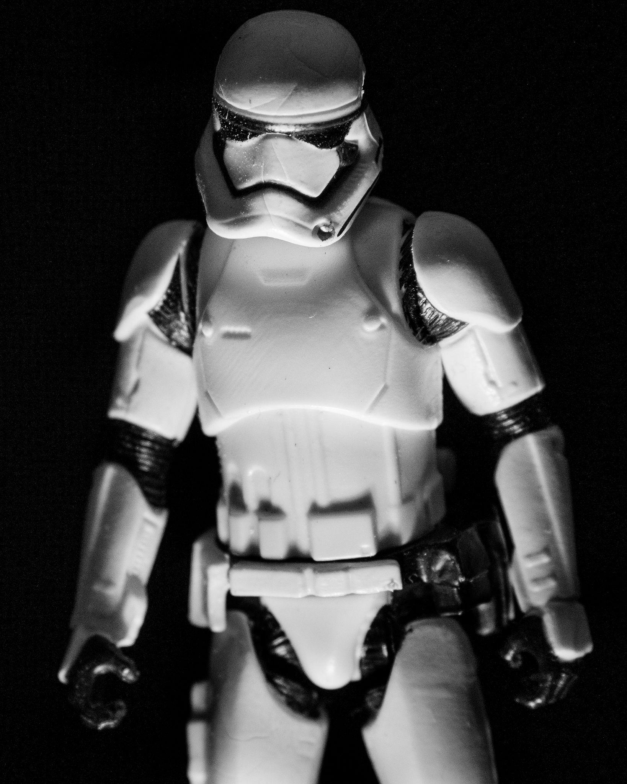
Macro Photography
Digital Photography Group
What do you need?
Camera or a Mobile ‘phone with a Macro feature?
A “Macro” lens?
A controllable light source
Notes:
Today we are not considering a career in product photography with speed lights, radio triggers, expensive background sets and high paying clients, all though…
For our purposes today we will be looking at macro, or close up photography for fun.
The basics…
1.Ideally, a camera that accepts interchangeable lenses, DSLR or Mirrorless, but bridge camera and phones can work too. Sensor size is not too important
2. Lens offering 1:4, 1:3 and 1:2 magnification are a good start, but better still 1:1 magnification (a true macro lens). What are these magic ratios I hear you ask. These ratios are, briefly, the relationship between the size of your subject's projection on the camera sensor and the subject's actual size.
e.g. if you are photographing something 1 metre high and the height on your sensor is 1cm. The magnification ratio is 1cm/100cm or 1/100.
A 10cm long subject, and its projection on the sensor is 2cm long, the magnification ratio is 2cm/10cm or 1:5. The subject is five times larger in real life than its projection on the sensor.
The subject of magnification ratios is a little technical and not something I want to stray into today, but worth reading up if you are interested in the science of lens design.
Cost wise, true macro lenses are expensive. Consider a “used” purchase first if you are becoming serious.
Lenses with lower magnification ratios are more affordable and you may already own one. They can still achieve great results, especially with the use of optional accessories which will allow even higher magnification. This is often a more affordable and usual way of entering the world of macro photography.
For all cameras
Magnifying Filters, these are another lens, but fixed to the front end of the camera lens using the filter screw thread.
For interchangeable lens cameras
Extension tubes fitted between an existing lens and the camera body with or without Magnifying Filters.
Magnifying filters and extension tubes are cheap to buy and ideal to experiment with.
Also worth noting that extension tubes do not include any optical elements, which means they cannot detract from image quality.
Reversing rings, or fitting your lens to the camera via the lens filter thread. It’s cheap, but in my opinion comes with too many challenges. Lens compatibility issues, some may not perform well when reversed. Very high levels of magnification, but loss of autofocus and aperture control. Also a risk of dust egress and damage to your lens.
If already owned, add a teleconverter and you can increase the focal length while keeping the same minimum focus distance, thus greatly increasing the magnification of the subject without having to move.
3. What is a controllable light source?
This can be as simple as natural light, used on its own or modified with a simple DIY “smoked salmon” reflector or piece of kitchen foil.
Often though, a “next purchase” is a small portable light source. These come in a variety of sizes, some need batteries, others are rechargeable but, to get you started, it can be as simple as a small pocket torch.

Slide 3
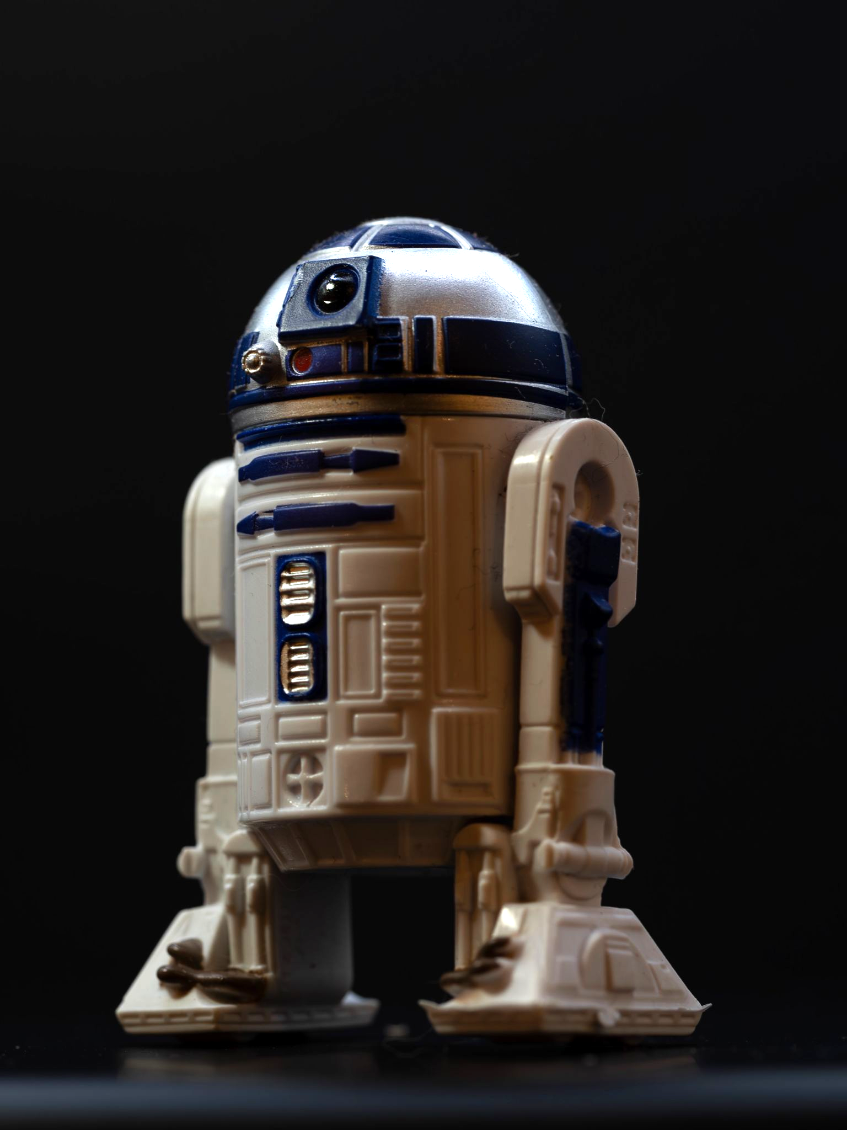
Macro Photography
Digital Photography Group
What else might you need?
Tripods and/or bean bags
Light Box
Small blocks/boxes
Notes:
Tripod Ideally you will need something to support your camera while you focus on your subject and work out the your best view point or angle.
A simple bean bag may also serve in the right situation.
If you are using a portable light source, that too may benefit from being attached to a mini tripod to allow small adjustments or fine tuning.
A light Box? This can be made simply by using a transparent storage box and a couple of inexpensive desk lamps. Diffusers can be made from white paper tissue or printer paper. A background can be made from printer paper, or a large cardboard sheet or an old white cotton pillow case or a combination of all. Blu tac will be your friend here. Consider also a textured surface, wood or stone perhaps.
Your DIY reflector can also play a part in this set-up.
Alternatively, buy a cheap “Amazon” light box for £20 to £30?
Phone Clamp: If you're using a phone to shoot, an inexpensive clamp or stand can help keep your phone steady.
Subject Clamp: A flexible arm that can hold small subjects or plants in the right place. Good ones tend to be expensive!
Boxes: Small plain boxes or blocks, usually painted black, can be used to stand your subject on allowing better viewing and lighting angles.

Slide 4
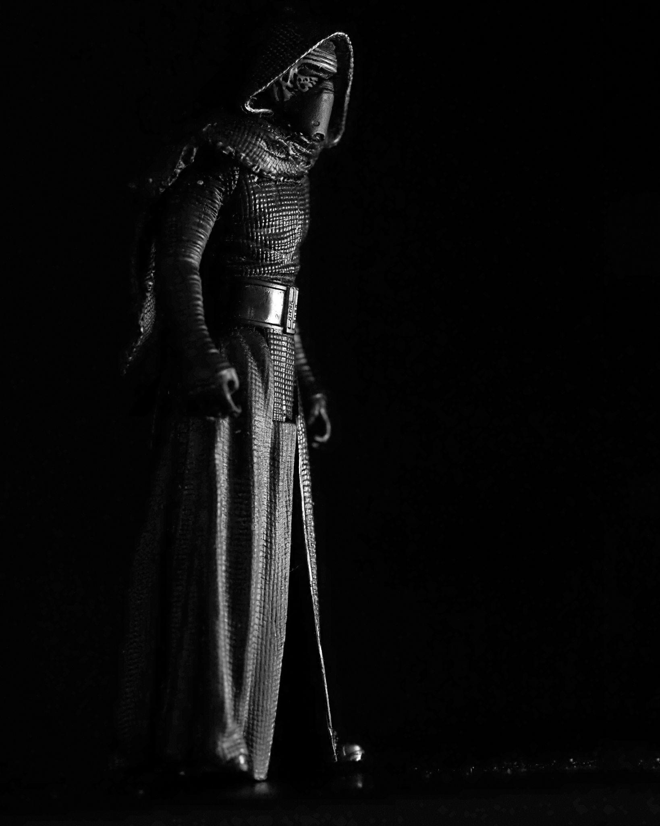
Macro Photography
Digital Photography Group
Camera settings
ISO
Shutter speed
Aperture
Composition
Notes:
ISO.
Keep to the camera's native ISO setting, generally (but not always) the lowest option available e.g. ISO 100 or 200. Consult your cameras manual if in doubt or use a search engine for speed!
Shutter speed.
As you should be using a Tripod or beanbags for stability and accuracy, short shutter speeds are not essential. Anything should do!
Aperture setting.
This will vary depending on your choice of composition.
Large apertures allow a narrow depth of field, blurring backgrounds, say f1.2 to f2.8
Any aperture with a small f-number is considered a large aperture, meaning it lets in more light and creates a shallow depth of field, keeping only selected parts of the image in focus within the frame.
This will allow many creative possibilities, including focus stacking.
Small apertures allow a wide or deep depth of field and might be better for ‘close up’ shots rather than ‘macro’ shots, say f8 to f22
Any aperture with a larger f-number is considered a small aperture, meaning it lets in less light and creates a deeper depth of field, keeping more of the image in focus across the frame. This might be useful when the subject needs to be seen as a whole or the background is to be part of the image.
In this scenario, stacked images can also be used to build up an evenly lit subject when you have only one light source. The light source can be moved around the object between shots from a static camera position, so that when “stacked” or blended with computer software you have an evenly lit subject. This is often used in Product photography.
Composition:
Pay Attention to Angles: Small objects can look very different depending on the angle you shoot from and also the angle the light is coming from. Experiment with high, low, or side angles for variety.
Avoid Overcrowding: Keep compositions clean and uncluttered, especially when photographing small items—negative space can make the subject stand out more.
Composition rules: These all apply here too, particularly the Rule of Thirds.

Slide 5
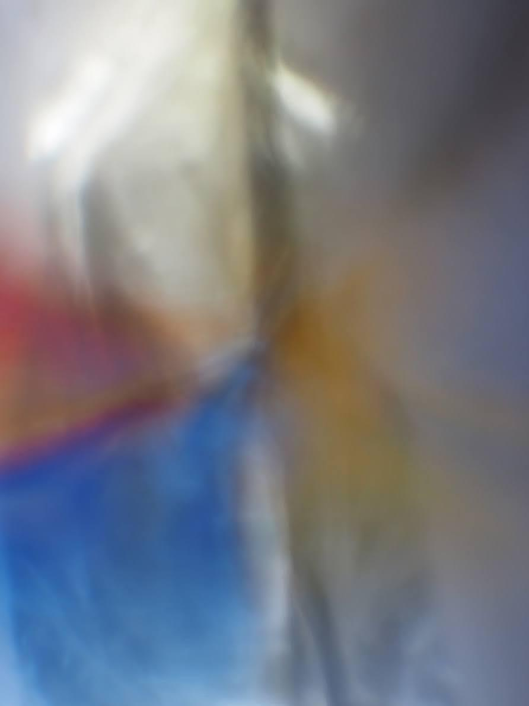
Macro Photography
Digital Photography Group
Next it’s up to you.
It’s your vision and your creation, so experiment.
It’s the best way of working out what looks right and what looks wrong and who knows, what magic powers you might possess?

Slide 6
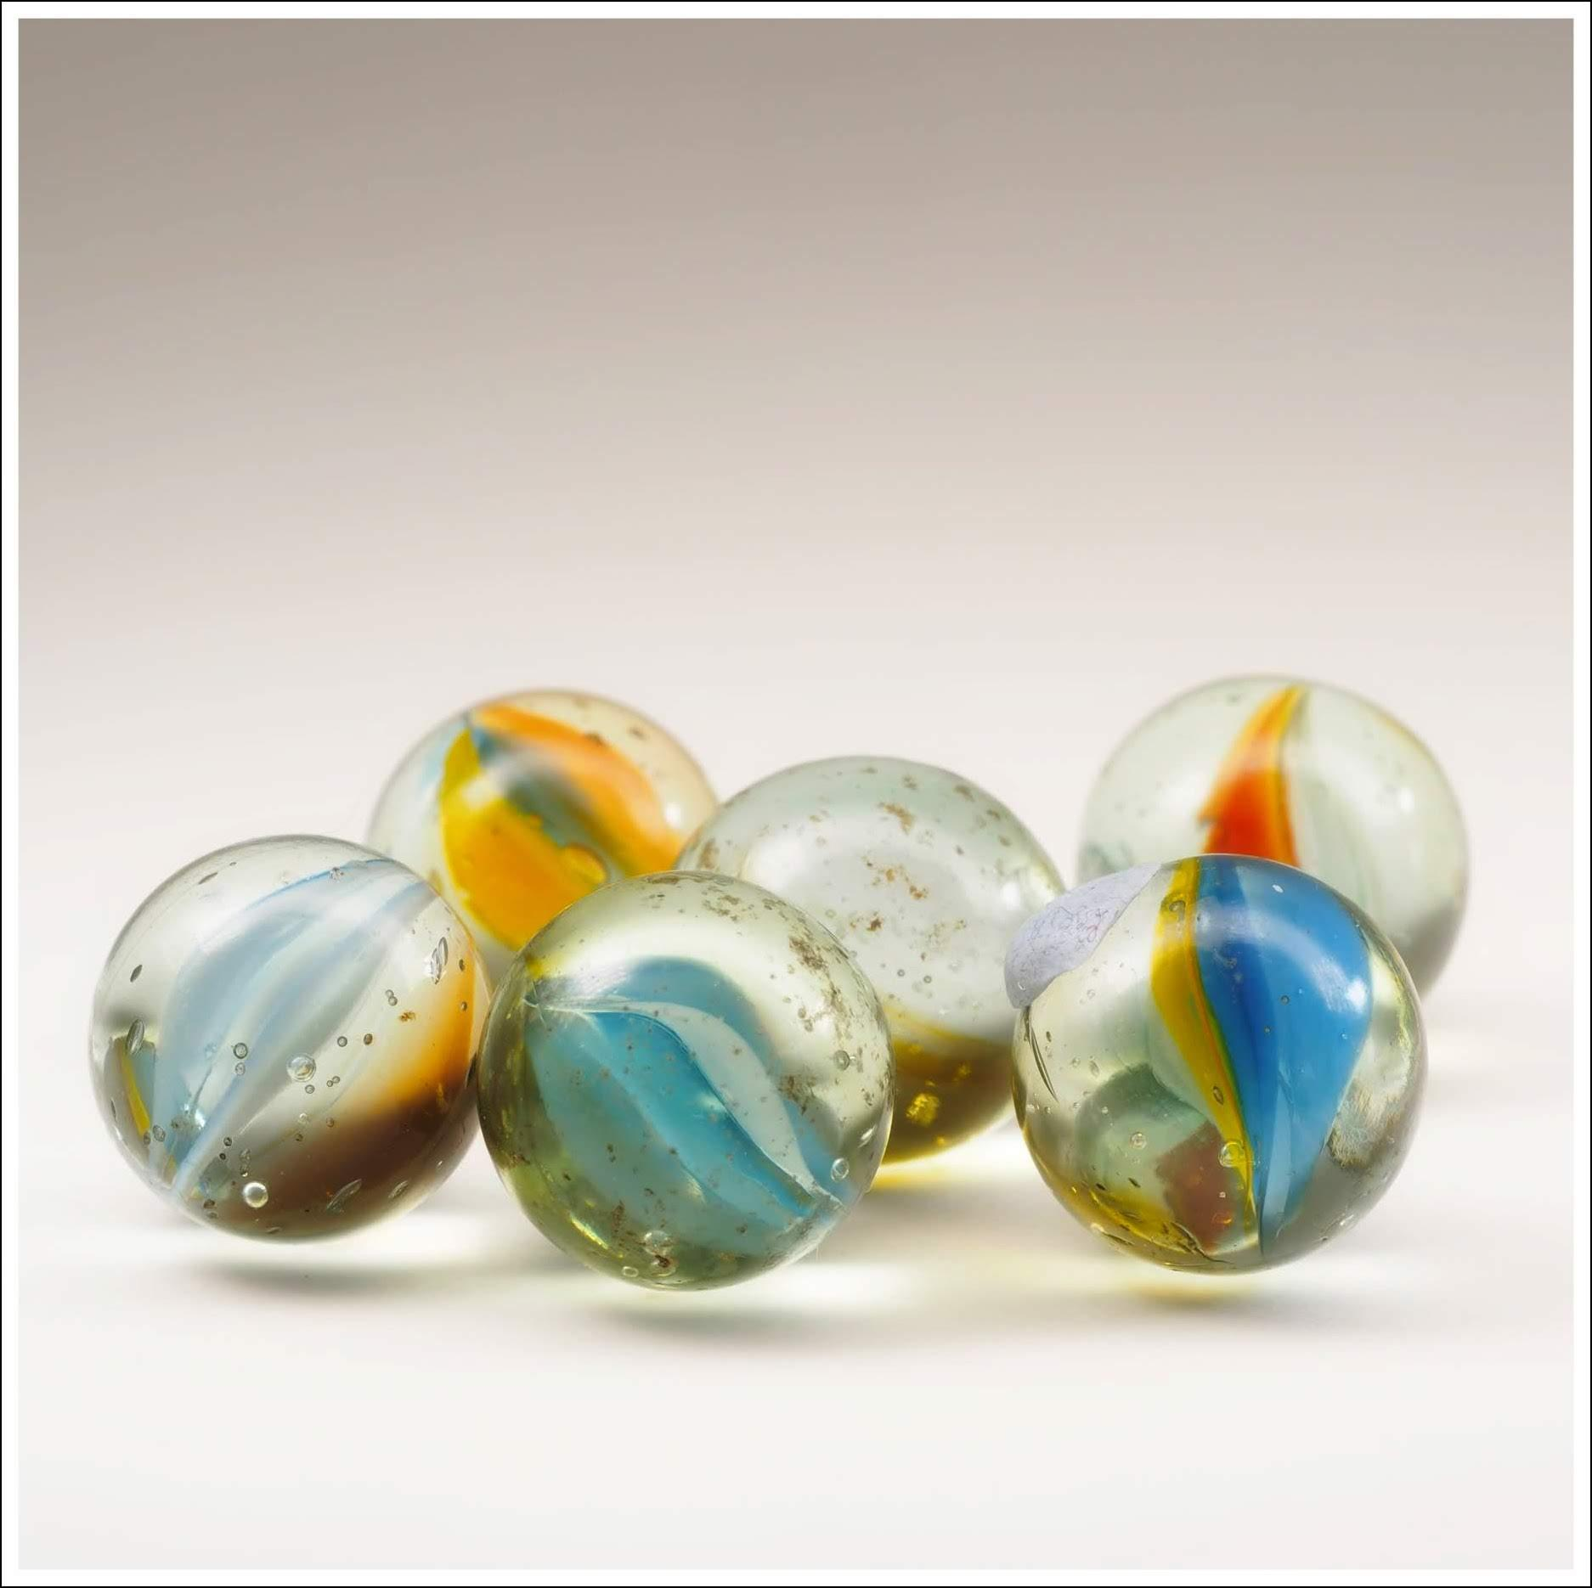
Macro Photography
Digital Photography Group
…levitating marbles for instance?

Slide 7
Macro Photography
Digital Photography Group
The End

