Slide 1
U3A IT Skills Group
21st May 2019

Slide 2
Microsoft Office
Timeline
1970’s: Mainframe-based “Office”/ ”Personal Organiser” applications available as ‘Office Productivity’ applications (corporate / business users only)
  IBM “Profs”
  ICL “Executive Action” aka “Exac”
  Data General “Common Electronic Office” (on ‘minicomputers’)
1970’s: Development of ‘microprocessor’ technologies
Late 1970’s: Early versions of “Personal Computers” launched
  Tandy TRS-80, Apple I, Commodore Pet…
  Sinclair ZX81 and Spectrum, Amstrad, BBC Microcomputer, etc…)
1983: IBM launches the IBM Personal Computer
1985: November: Microsoft launches Windows 1.0 for IBM & IBM-compatible pc’s
1991: World Wide Web launched
1996: Microsoft launches first version of MS Outlook

Slide 3
What is Outlook?
Outlook is most often used for Email
  Based on what was previously called ‘Hotmail’
Has other “personal information manager” functions:
  Tasks / Reminders
  Contact management / Address book
  Diary / Journal
  Calendar
  Note taking
  Integrated with Skype for Instant Messaging
  Integrated with other MS Office products and web services

Slide 4
Is Outlook free?
Office Online is a FREE version of Office (including Outlook) that you can use through a web browser
Outlook apps are NOT free
  Can be purchased as a standalone App or as part of MS Office 365
    Yearly or monthly subscription
  Latest release is Office 2019 (released Sept 2018)
    Can be purchased as a single up-front cost BUT there are no upgrade options
Outlook / Office apps are available across a range of platforms – PCs, MACs, tablets and phones (Windows, iOS and Android)
Outlook and Outlook Express are completely different products
  Outlook Express is not a “slimmed-down” version of Outlook

Slide 5
Size / Storage Restrictions
Every registered Microsoft user is allocated 50Gb of Cloud storage
  How / whether each user uses this is down to the individual user
Maximum size of each email is 25Mb
  Including any attachments (documents, photos, etc)
Recommend no more than 10 attachments to any 1 email
No restriction on the number of emails you can send / receive / store
  Subject to the overall 50Gb storage limit

Slide 6
Advantages / Disadvantages of Browser version
+ve:
Simpler user interface (not so complicated, easier to learn)
Access to other Microsoft apps is simpler
-ve:
User MUST be connected to the internet to use it
‘Customization’ is limited

Slide 7
Advantages / Disadvantages of Desktop App
+ve:
Can be used when NOT connected to the internet
  Will synchronise next time device is online
Functionally rich
Extensive ‘customization’ features
-ve:
Overly complex – many features most users are unlikely to need
Some inconsistencies between different versions / releases

Slide 8
Using Outlook with other email systems
Can use Outlook as a ‘single interface’ to other email systems
  Outlook/Hotmail; Yahoo mail; Gmail; etc..
Up to 20 POP3 and IMAP email systems can be connected to a single Outlook instance

Slide 9
Desktop App
demonstration

Slide 10
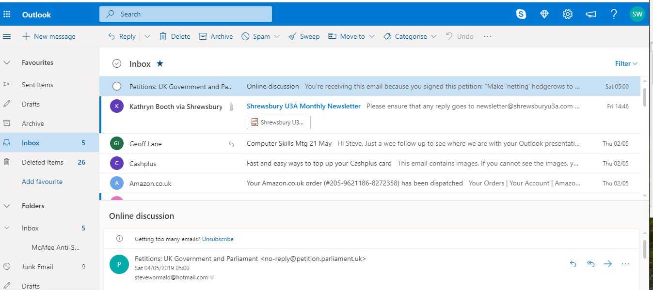
Outlook browser version

Slide 11
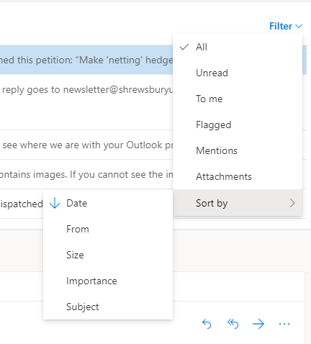
Changing how emails are displayed

Slide 12
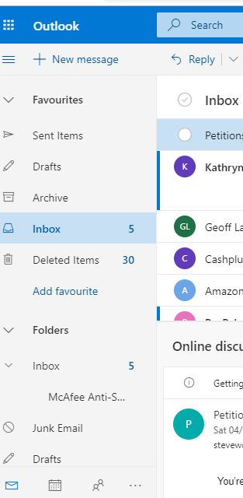
Outlook – Email Folders

Slide 13
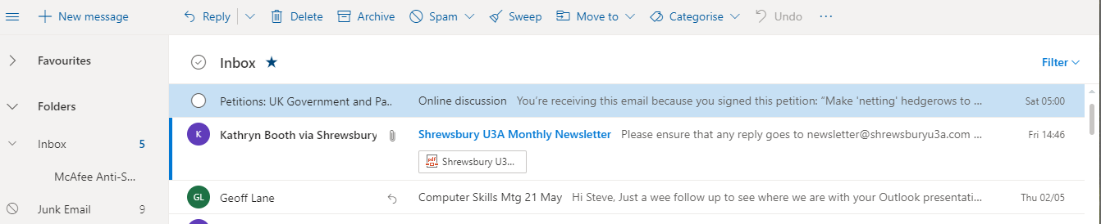
Outlook function bar (“Ribbon”)
– most commonly used functions

Slide 14
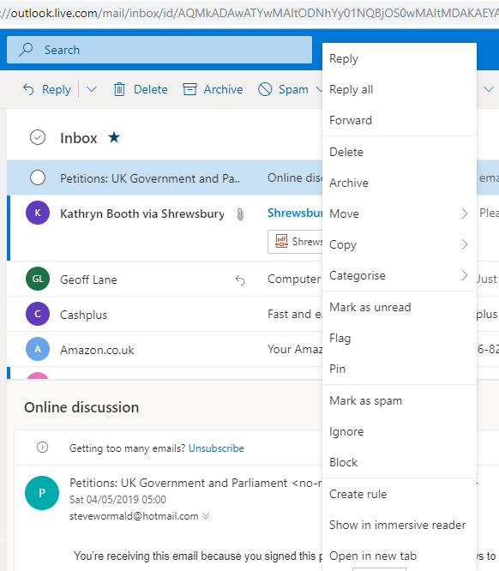
Alternative Shortcut - Display an email and ‘right click’ on it

Slide 15
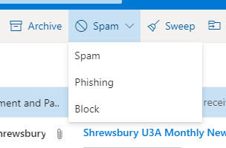
Outlook toolbar functions – Spam and Sweep
You can mark an individual email as ‘Spam’, ‘Phishing’, or ‘Block’
‘Sweep’ is a drastic tool for ‘housekeeping’, enabling deletion en masse

Slide 16
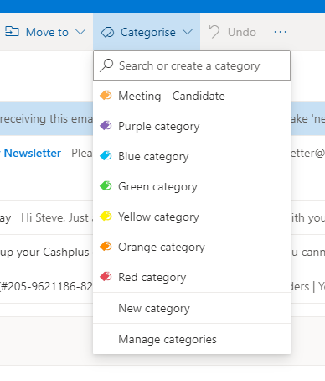
Outlook ‘Categorize’ function

Slide 17
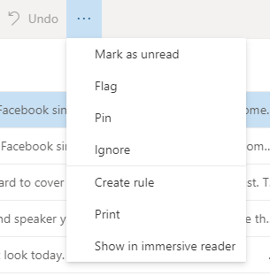
Outlook toolbar
– additional functions
Clicking the 3-dot symbol gives a number of additional functions:

Slide 18

Title Ribbon – more functions
Further ‘quick link’ functions:
Skype
Manage Premium (‘premium’ users only)
Settings
What’s New
Help
Logout / switch user

Slide 19
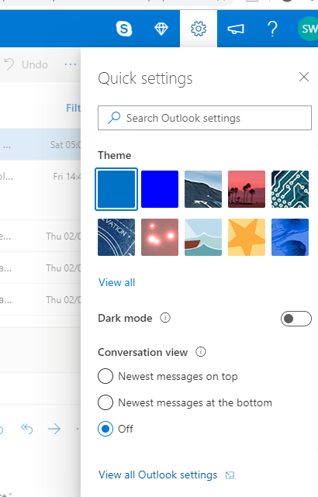
Outlook Settings

Slide 20
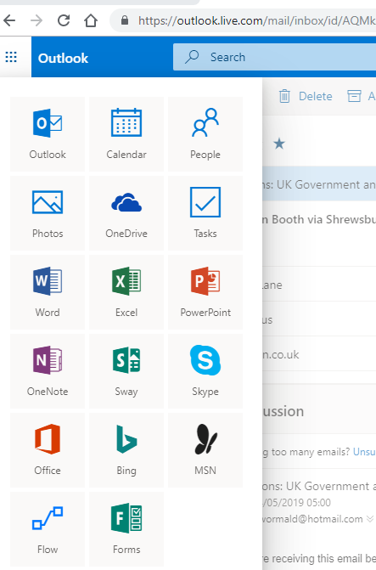
Accessing other Applications
& Outlook Functions

Slide 21
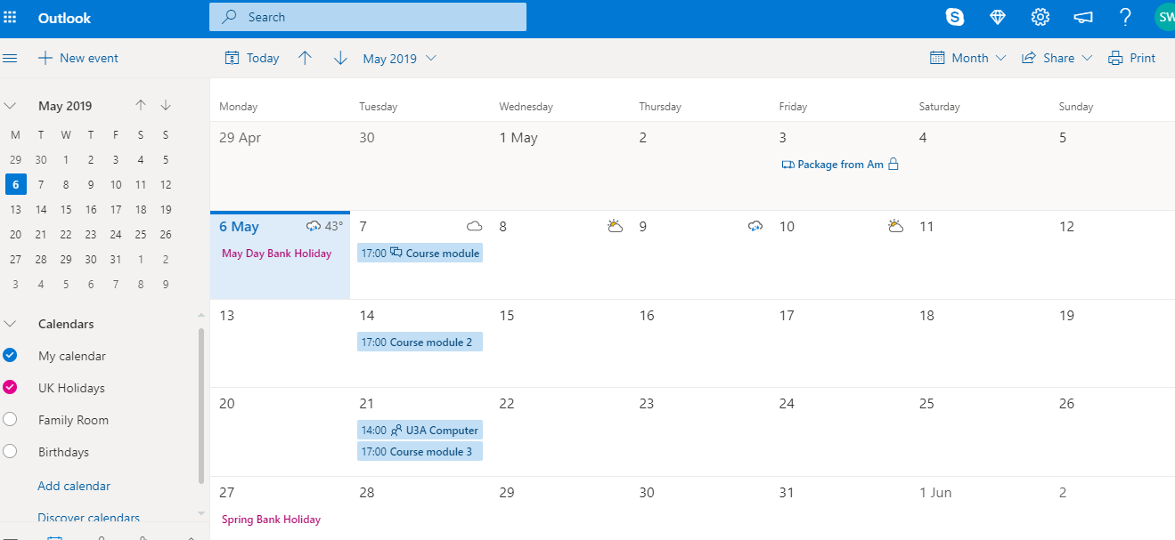
Outlook Calendar

Slide 22
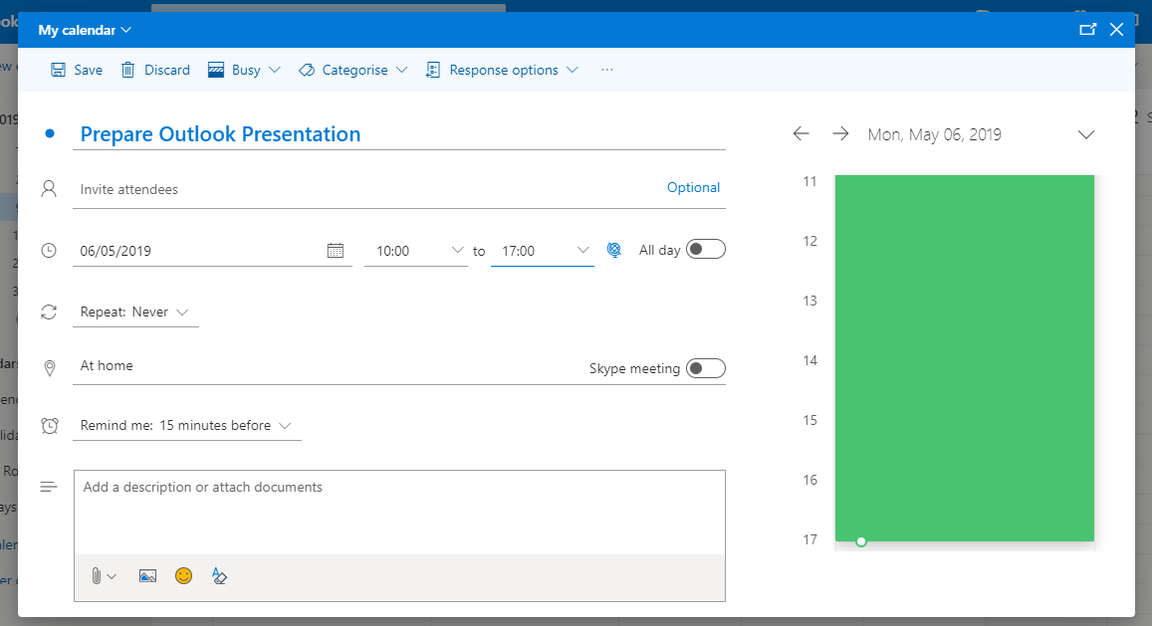
Appointments & Invitations

Slide 23
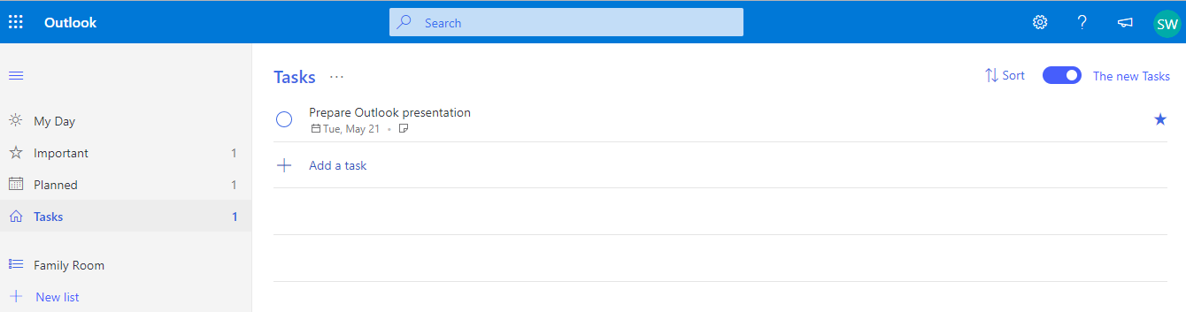
Tasks & Reminders

Slide 24
Q & A

