Slide 1
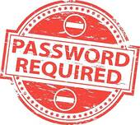
Using a Password Manager

Slide 2
Advantages
Passwords are kept in one safe place; an encrypted vault.
You only need to remember one really strong password.
Your passwords are synchronised across all your devices.
The Password Manager will remember your usernames and passcodes etc.
The Password Manager will generate really robust passwords – unique for each site.
You can also store other sensitive information such as credit card details, Passport number etc.
They do what they say they will.

Slide 3
Disadvantages
Forgetting the master password could be disastrous……
Forgetting to sign out could allow someone access to all your accounts.
It might not support all your devices and browsers.
Most only work with Web-based browser logons. Not desktop applications.

Slide 4
What about Browser-Based Password Managers?
Web browsers – Chrome, Firefox, Internet Explorer and others all have integrated Password Managers. But none of them can compete with a dedicated programme written specifically for the job.
Notes:
For example, Chrome and Internet Explorer store passwords in an unencrypted form.
Whilst Firefox does store then encrypted, you can’t generate random passwords and doesn’t sync across different platforms / Windows to Android for example.

Slide 5
The Main Players
Dashlane
LastPass
NordPass
Sticky Password
Avira
RoboForm
1Password
Kaspersky
IoloEverkey
Zoho Vault
Keeper PM & DV
Agile Bits

Slide 6
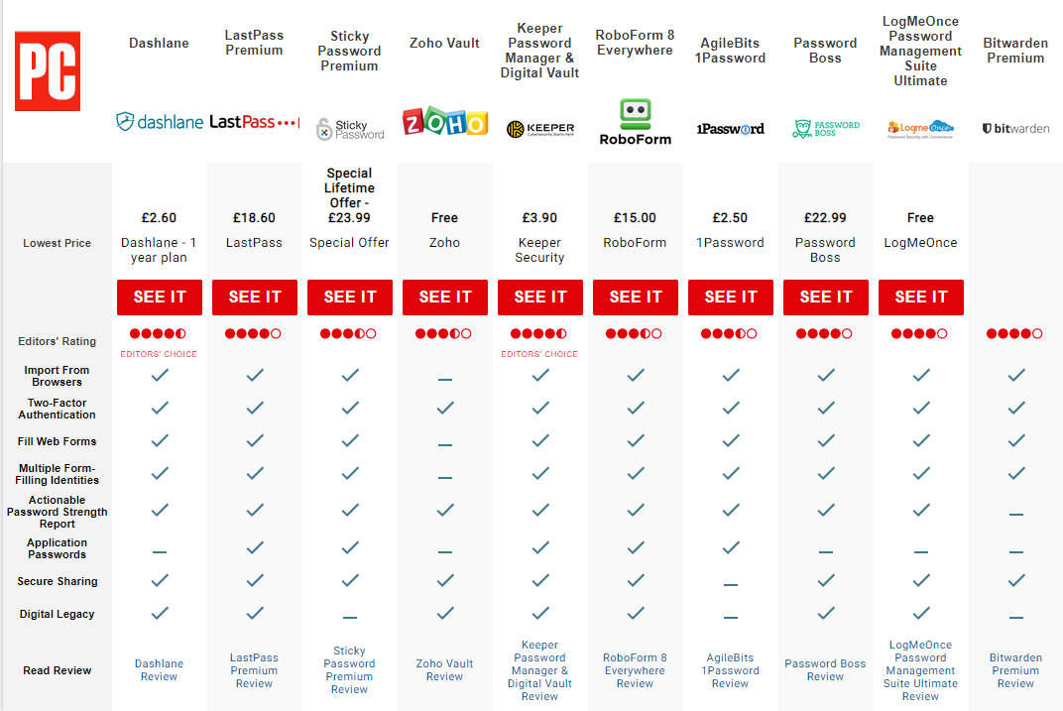

Slide 7
Principles of Operation
After installation, the application works with your Browser.
Create a Master really strong password to access your ‘Vault’.
Visit your regular websites that require login and password. Do so.
The PWM prompts you to save the site in the Vault. Say Yes.
Update the PW with one from the PWM. Update your Vault.
Explore Settings and adjust to suit.
Log out of the PWM when you have finished.

Slide 8
Lets see it in action……

