Slide 2
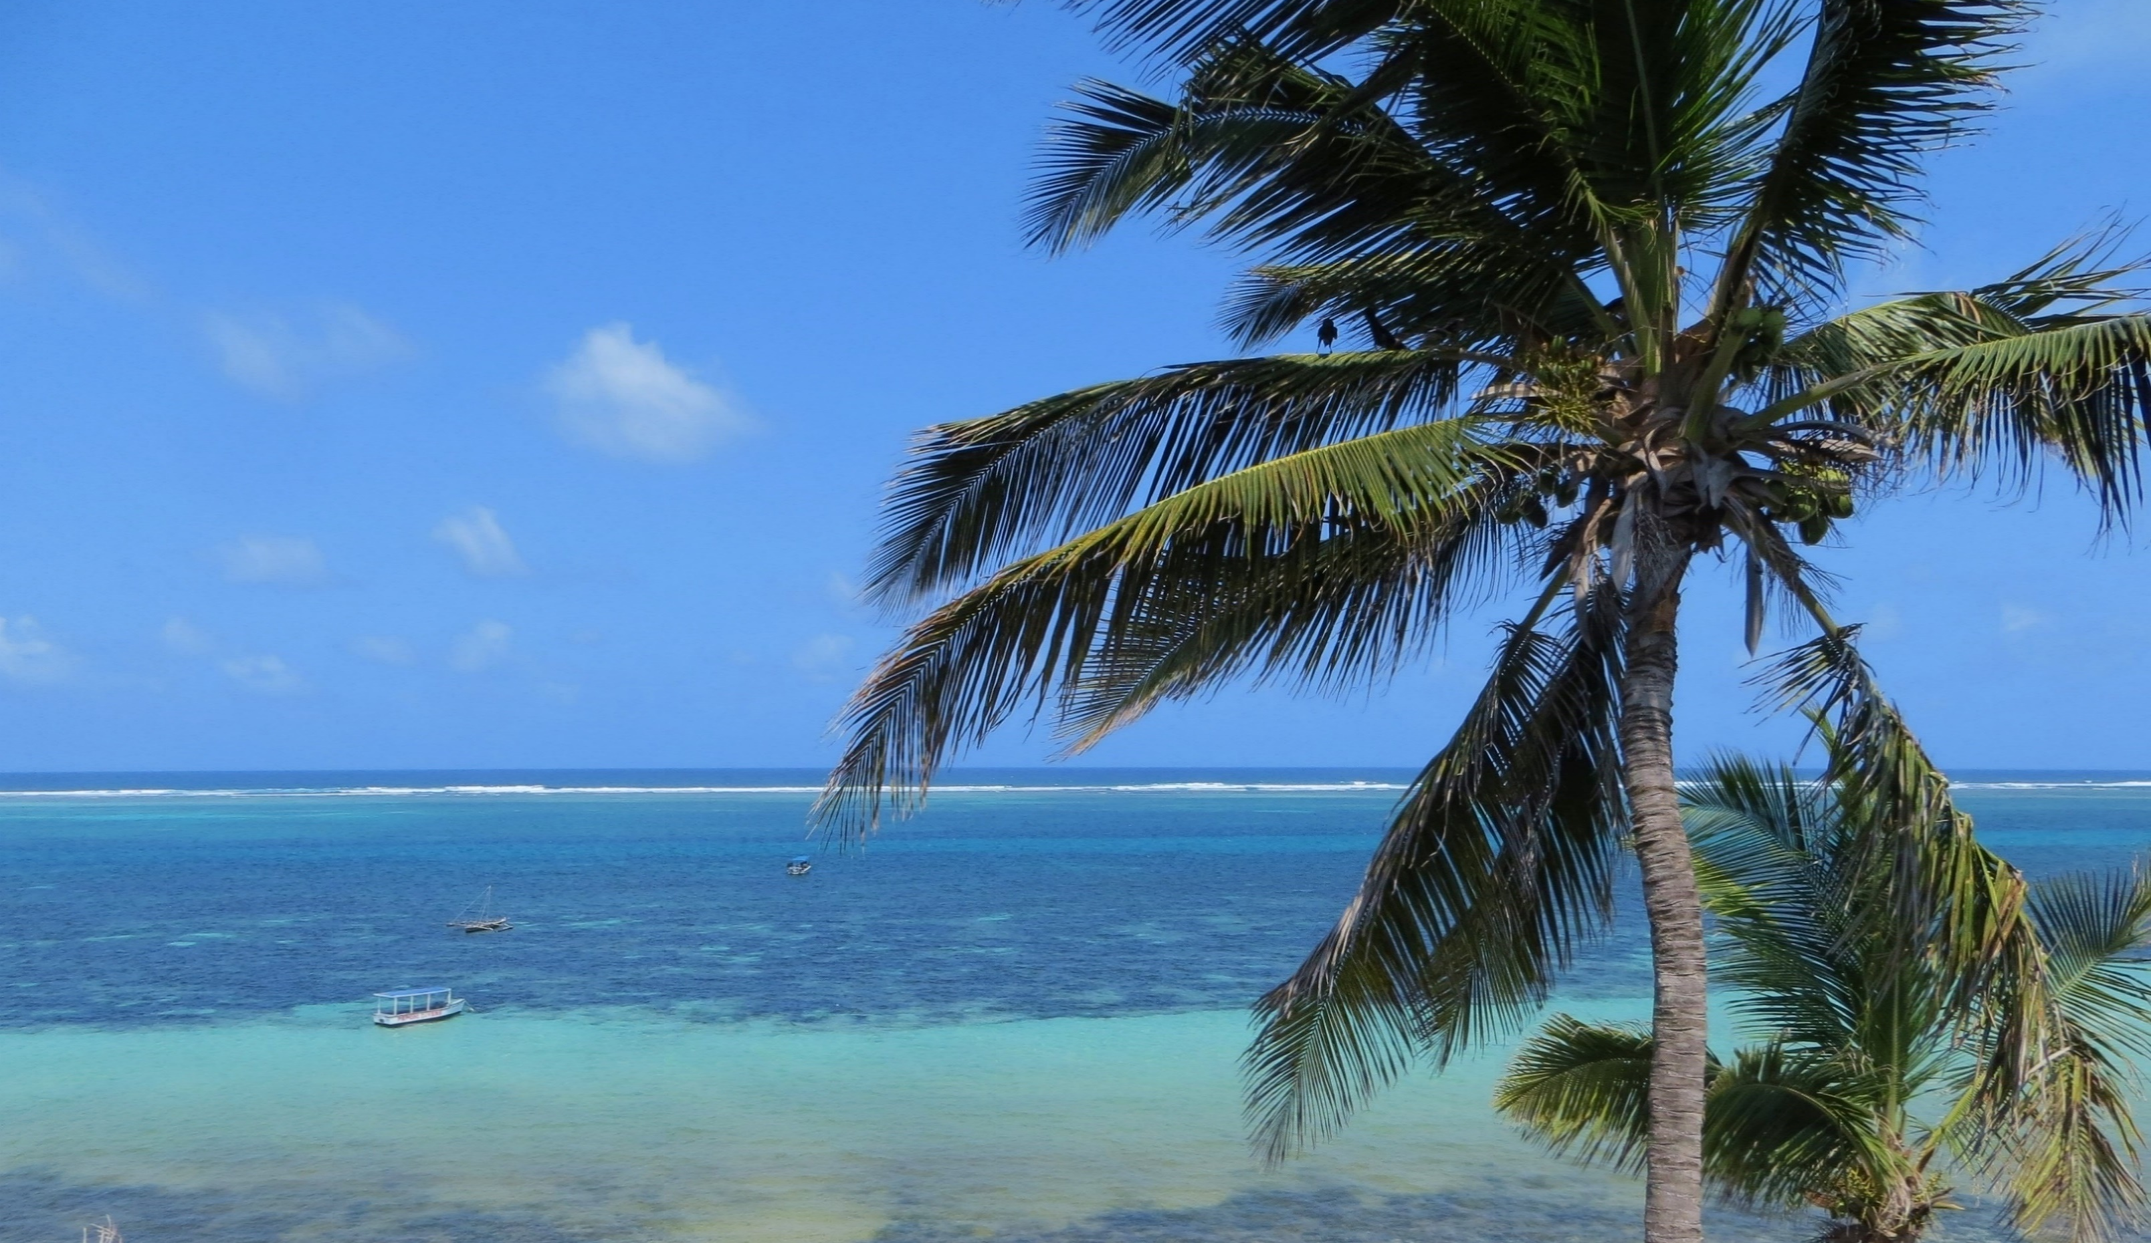

Password Security
and other related items
This Photo by Unknown Author is licensed under CC BY-SA
Notes:
Whilst I’ve called Password Security and other related items, I’d like to start with the related items…..
Introduce myself. RAF for 38 years in Telecommunications includes IT and IT networks. Not a professional in IT security but this is what I have learnt over the past 38 years. Keen Hobbyist.

Slide 3
Logins or usernames

Slide 4
A password is only half of the story, you also need a login or username.
A username might be your name or email address – both of these are easy to obtain….. and with that
A hacker will have half of your security information.
Notes:
A password is only half of the story, you also need a login or username.
A username might be your name or email address – both of these are easy to obtain and with that they have half of your security information.

Slide 5
Wherever possible, change your login name to something different, something that only you will know.
This way, you immediately, massively, enhance your security effectiveness.
Notes:
Where-ever possible, change your login name to something different, something that only you will know.
This way, you immediately and massively enhance your security effectiveness.

Slide 6
Security Questions
Please answer the following security questions
Notes:
Many Security Questions are of the Mother’s maiden name,
your 1st school, your first car, place of birth etc.
Before social media these type of questions were adequate.
Nowadays you might belong to a facebook group for “St Johns Primary School” or you might have made public, your family tree on Ancestry.com and so on. It is much easier to discover this kind of information than it was previously.
The answer? Make them up! As long as the characters match it doesn’t matter.
Your first school? Eton college.
Place of birth? Buckingham Palace.
No one will know if you don’t tell them.

Slide 7
Many Security Questions are of the
Mother’s maiden name,
your 1st school,
your first car,
place of birth etc.
Before social media these type of questions were adequate.
Notes:
Many Security Questions are of the Mother’s maiden name,
your 1st school, your first car, place of birth etc.
Before social media these type of questions were adequate.

Slide 8
Nowadays you might belong to a facebook group for “St Johns Primary School”
or you might have your family tree on Ancestry.com made public and so on.
It is much easier to discover this kind of information than it was previously.
Notes:
Nowadays you might belong to a facebook group for “St Johns Primary School” or you might have made public, your family tree on Ancestry.com and so on.
It is much easier to discover this kind of information than it was previously.

Slide 9
The answer? Make them up! As long as the string of characters match it doesn’t matter.
Your first school? Eton college.
Place of birth? Buckingham Palace.
Mount Everest!
No one will know if you don’t tell them.
Notes:
The answer? Make them up! As long as the string of characters match it doesn’t matter. No-one is going to check
Your first school? Eton college.
Place of birth? Buckingham Palace. Mount Everest!
No one will know if you don’t tell them.

Slide 10
How secure is my Password?

Slide 11
Types of HaCK or ATTACK
Local or Personal attack
Dictionary attack
Full blown Brute Force (FBI or MI5/MI6) attack
Notes:
There are 3 main types of attack:
Local or Personal attack: Loved by detective and whodunnit films. Someone sitting at your desk looks around and sees the picture of the dog Spotty, they put Spotty in the PW box and job done, they have hacked it!
Dictionary attack: Lists of dictionary words and login names, they check (loop) each login name for all the dictionary words and then go onto the next login name until a match is found.
Full blown attack: every character and every combination of characters on the keyboard is checked against each other. On my keyboard there are 10 digits, 26 lowercase letters, 26 uppercase letters and 33 special characters. Total 95. Do not use the ‘space’, therefore you have effective 94 characters to choose from.

Slide 12
How secure is my password
howsecureismypassword.net is a useful website that calculates how long it might take an average home computer to crack your password.
The longer the better.
Notes:
numbers 0-9 2 – 100. 3 - 1000. 4 - 10000 combinations.
26 letters of the alphabet 2 - 675. 3 – 17,500. 4 – 450,000.
94 Keyboard characters 2 – 9000, 3 – 830,000. 4 – 80,000,000

Slide 13
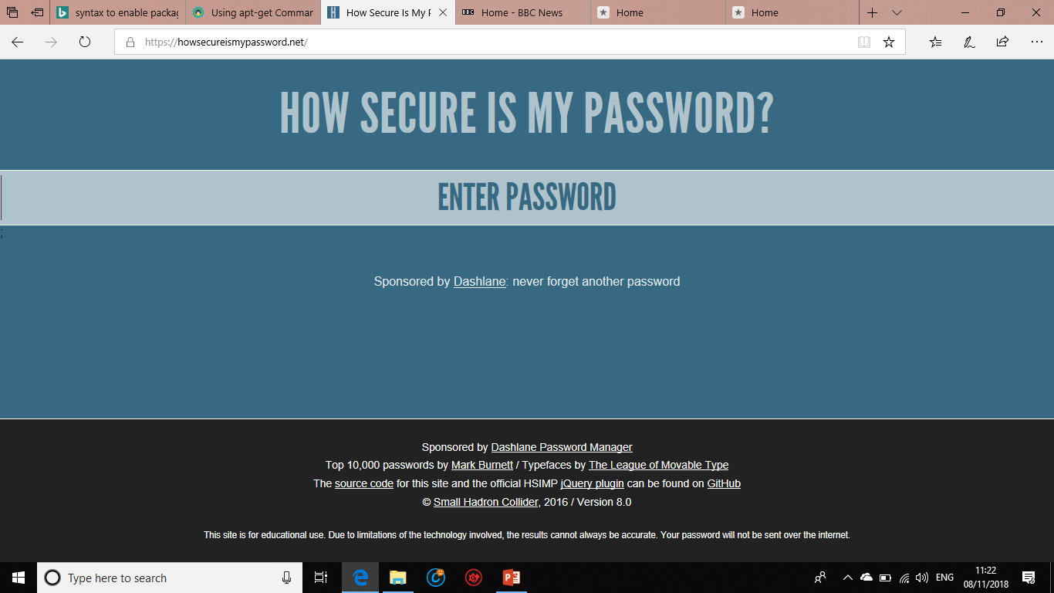
Notes:
The background changes colour as the security increases

Slide 14
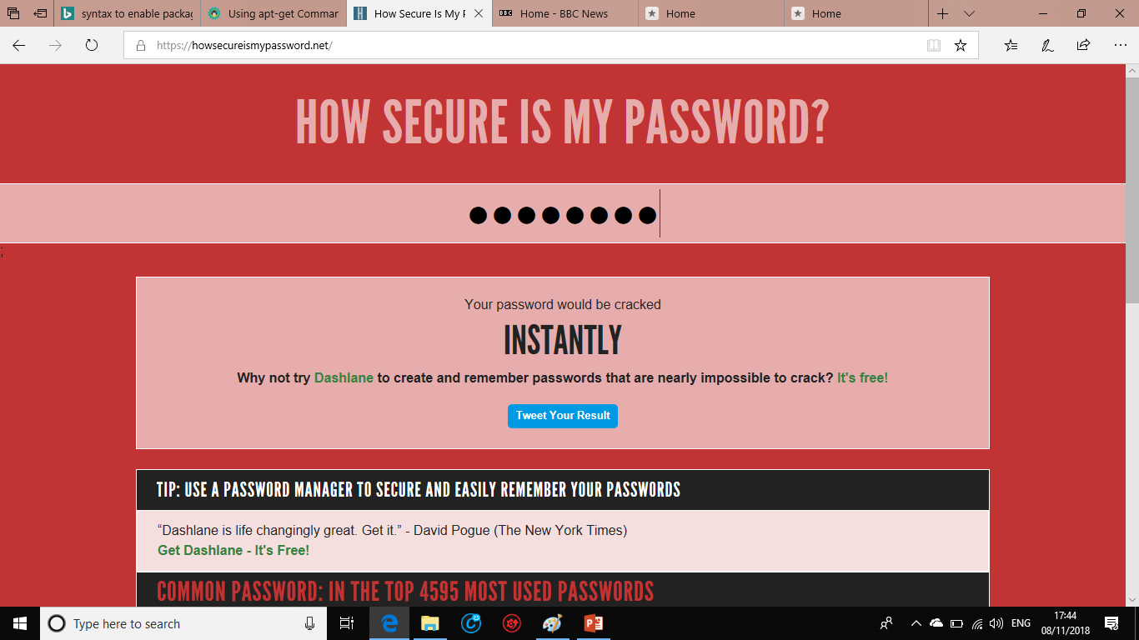
Notes:
8 charters – a name geoffrey

Slide 15
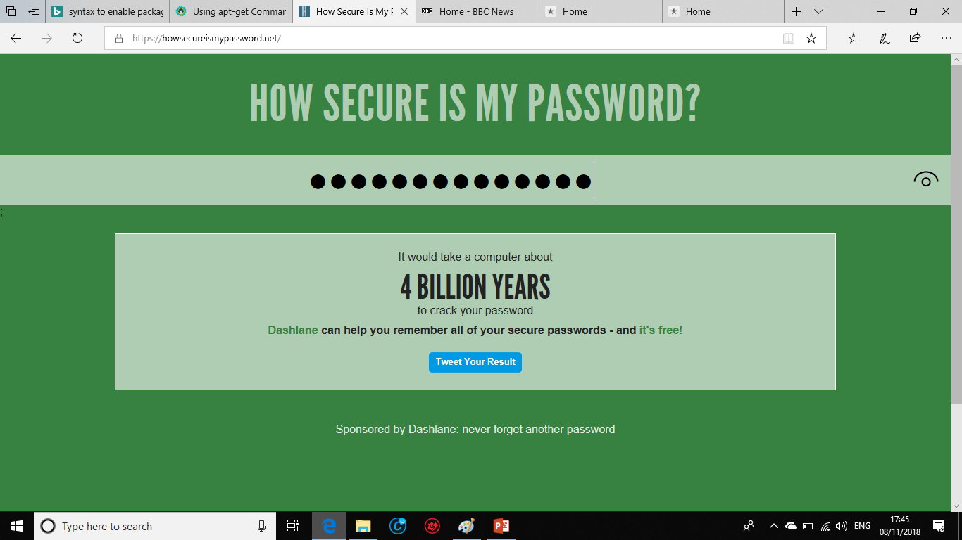
Notes:
14 characters

Slide 16
How secure is my password
During the tea break, we’ll have a little competition to see who has the most secure password.
A prize for the winner!
Notes:
Howsecureismypassword.net is a useful website that calculates how long it might take an average home computer to crack your password. Obviously, the longer the better.

Slide 17
How to create a secure Password

Slide 18
A couple of facts
Nearly 50% of all passwords currently being used today can be cracked in seconds due to them be very weak.
Another 45% can be cracked within a few hours.
Only around 5% of passwords offer any real challenge, and given that computers today can make millions of guesses per second, it would not take long to crack many of these also.
Notes:
In fact, around half of all passwords currently being used today can be cracked in seconds due to them be very weak, and another 45% can be cracked within a few hours.
Only around 5% of passwords offer any real challenge, and given that computers today can make millions of guesses per second, it would not take long to crack many of these also.

Slide 19
It is better to have a longer simple password than a shorter complex password.
Microsoft officially recommend 14 characters as its minimum.
Doesn’t Rely on Obvious Substitutions: For example, “H0use” isn’t strong just because you’ve replaced an o with a 0. That’s just obvious.
PassPhrases are generally better than passwords because they are much longer.
A PassPhrase is a combination of about five completely unrelated words.
Notes:
It is better to have a longer simple password than a shorter complex password.
Microsoft officially recommend 14 characters as its minimum and Wikipedia recommend 12 to 14 characters.
Doesn’t Rely on Obvious Substitutions: Don’t use common substitutions, either — for example, “H0use” isn’t strong just because you’ve replaced an o with a 0. That’s just obvious.
PassPhrases are generally better than passwords because they are longer.
A PassPhrase is a combination of about five unrelated words.

Slide 20
One way to create a password is to take the initial letters of a simple phrase
Jack and Jill went up the hill to fetch a pail of water
becomes JaJwuthtfapow
Take the a in ‘and’ and substitute it for an & (special character) and the ‘o’ for a 0 (number – this substitution doesn’t necessarily make it stronger, but does add required number/s)
You now have J&Jwuthtfap0w – adequate for most needs.
Notes:
One way to create a password is to take the initial letters of a simple phrase
Jack and Jill went down the hill to fetch a pail of water
JaJwdthtfapow take the a in ‘and’ and substitute it for an & (special character) and the ‘o’ for a 0 (number – this substitution doesn’t necessarily make it stronger, but does add required number/s)
You now have J&Jwsthtfap0w – adequate for most needs.
How about from a Hymn
I vow to thee my country all earthly things above. Ivttmcaeta.
Split it in the middle to add some numbers, say 4 perhaps – year of birth maybe YYYY or a DDMM or MMYY for something that you can easily remember.
Ivttm1954caeta
Add in some special characters .Ivttm1954caeta+ Eh voila

Slide 21
How about from a Hymn
I vow to thee my country all earthly things above. Ivttmcaeta.
Split it in the middle to add some numbers, say 4 perhaps – year of birth maybe YYYY or a DDMM or MMYY for something that you can easily remember.
Ivttm1954caeta
Add in some special characters .Ivttm1954caeta+ Eh voila
Notes:
How about from a Hymn
I vow to thee my country all earthly things above. Ivttmcaeta.
Split it in the middle to add some numbers, say 4 perhaps – year of birth maybe YYYY or a DDMM or MMYY for something that you can easily remember.
Ivttm1954caeta
Add in some special characters .Ivttm1954caeta+ Eh voila

Slide 22
Pass Phrases
A PassPhrase – a combination of about 5 completely unrelated words - is not necessarily more complicated than a regular strong password, but it is easier to remember and stronger by virtue of it’s length >than 20-25 characters.
There are PassPhrase lists to help you generate a suitable PassPhrase, easier is to open a dictionary and stab your finger somewhere on the page!
You might end up with clink, photo, sweep, group & chain.
Notes:
A PassPhrase is not necessarily more complicated than a regular strong password, but it is easier to remember and stronger by virtue of it’s length >than 20-25 characters.
There are PassPhrase lists to help you generate a suitable PassPhrase, but the easiest way is to open the dictionary at a random page and stab your finger somewhere on the page!
You might end up with clink, photo, sweep, group & chain.

Slide 23
Pass Phrases
Your passphrase becomes clinkphotosweepgroupchain
Add in some capitals, say the 2nd letter of each word cLinkpHotosWeepgRoupcHain
Separate the words with a special character or set of characters
cLink-pHoto-sWeep-gRoup-cHain
Add in some numbers cLink-1pHoto-9sWeep-5gRoup-4cHain and you have a really secure password!
Notes:
Your passphrase becomes clinkphotosweepgroupchain
Add in some capitals, say the 2nd letter of each word cLinkpHotosWeepgRoupcHain
Separate the words with a special character cLink-pHoto-sWeep-gRoup-cHain
Add in some numbers cLink-1pHoto-9sWeep-5gRoup-4cHain and you have a really secure password!

Slide 24
Changing Passwords
Take “Adequate Precautions”.
For online Banking passwords, I recommend you change it every six months.
You might keep your ‘regular’ password but add some sort of date code to it. I added 3 digits to mine in the format MMY. “xxxxxxxxxxMMY”
Notes:
I have learnt that some Banks have refused to compensate some customers when hacked because there weren’t taking ‘adequate’ precautions for their online banking security. The reason? They created a password when they setup their online banking and have never changed it since.
For online Banking passwords, I recommend you change it every six months. You might keep your ‘regular’ password but add some sort of date code to it. I added 3 digits to mine in the format MMY. xxxxxxxxxxMMY

Slide 25
Changing Passwords
If you make the MMY the 6 month point in the future, then you will know when to change it when the time arrives. So, if we changed it today, the 6 month point would be xxxxxxxxxx059
(May – the 05th month and 9 for 2019).
If you change it in Apr May or Jun & Oct, Nov or Dec then you will always get at least two numbers to change.
Notes:
If you make the MMY the 6 month point in the future, then you will know when to change it when the time arrives. So, if we changed it today, the 6 month point would be xxxxxxxxxx059 (May – the 5th month and 9 for 2019).
If you change it in Apr May or Jun & Oct, Nov or Dec then you will always get at least two numbers to change.

Slide 26
What is your e-mail address?

Slide 27
What’s your e-mail?
Many people use the same e-mail address for everything, it is the only one they have. I think this is a mistake. I have a number of e-mail accounts and None of them do I give out willy nilly.
Once your email address has been spammed, it is pretty much impossible to get it removed from a spammers list. Therefore give your email addresses some sort of priority and distribute them accordingly. Working from a low level to the highest, we might have email address as follows:
Notes:
Relate Geoff@geofflane

Slide 28
What’s your e-mail?
An email for websites you have to register with to view their content.
An email for websites you log into for online shopping or other services.
An email for friends and family.
And top priority an email for internet banking and other financial institutions; HMRC, Premium bonds, PayPal, ISA’s etc.
Guard this top priority address carefully, and change it should you ever get any spam email into the account. There are lots of websites to get a free e-mail address or you could create a new account (and use it for nothing else) with Microsoft, Google, Apple etc.
Notes:
If you run a website for your local club or business, please don’t advertise the email address in ‘plain view’ it is very easy for webbots to search for *@* and add your email address to their spamming lists.

Slide 29
Two Factor Authentication

Slide 30
Two Factor Authentication
Two Factor Authentication is a great security boost. It’s a method of confirming your identity by using a combination of two different factors. Something you know or something you have.
It might be your regular login and password PLUS a 6 digit PIN that your host might send you by text or other means. For example, only you would have your phone to receive the text.
Notes:
Two Factor Authentication is a great security boost. It’s a method of confirming your identity by using a combination of two different factors. Something you know or something you have.
It might be your regular login and password PLUS a 6 digit PIN that your host might send you by text or other means. Only you would have your phone to receive the text.

Slide 31
Two Factor Authentication
There are apps available that generate PINs that synchronise with the host authentication system and change every 30 seconds or so.
Wherever two factor Authentication is offered, I recommend you use it. Some systems have it, but it is not the default setting, you have to go and find it. Google works like this.
Notes:
Show the app
There are apps available that generate PINs that synchronise with the host authentication system and change every 30 seconds.
Wherever two factor Authentication is offered, I recommend you use it. Some systems have it, but it is not the default setting, you have to go and find it. Google works like this.

Slide 32
Make everything unique

Slide 33
Make them different, make them unique
Finally, many people use the same password for every occasion, this is a mistake. Ideally, everyone should be different.
One way is a take your “regular” password and add a few extra characters – 3 is a good number, to make it unique. Make the extra characters specific to the website or service you are using so that you can easily remember it.
This works for logins and usernames too.
Never use/tick ‘Remember me’.
Notes:
Finally, many people use the same password for every occasion, this is a mistake. Ideally, everyone should be different.
One way is a take your “regular” password and add a couple of characters – 3 is a good number to make it unique. Make the extra characters specific to the website or service you are using so that you can easily remember it.
This works for logins and usernames too.
Never use the “Remember Me” option.

Slide 34
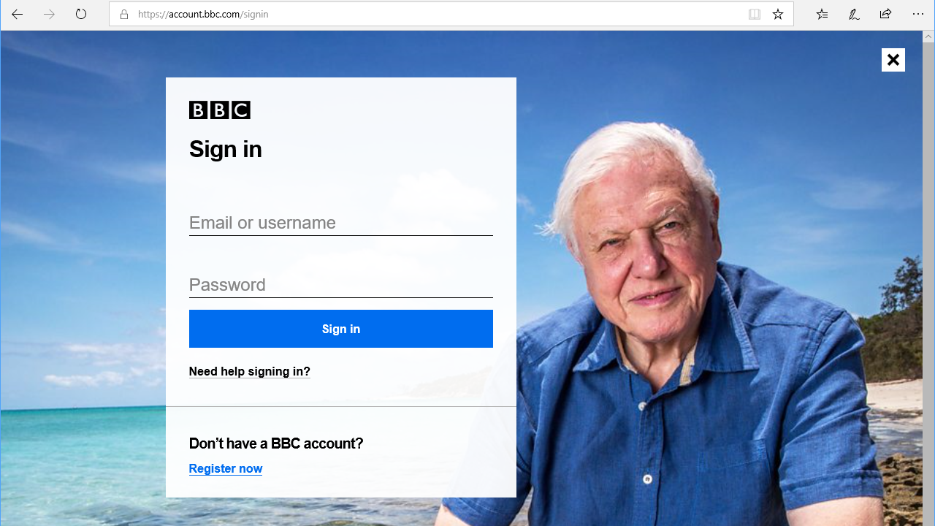

Slide 35
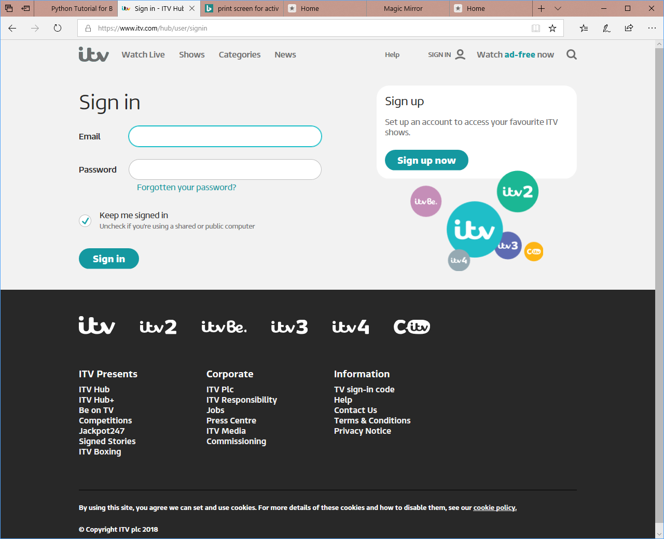

Slide 36
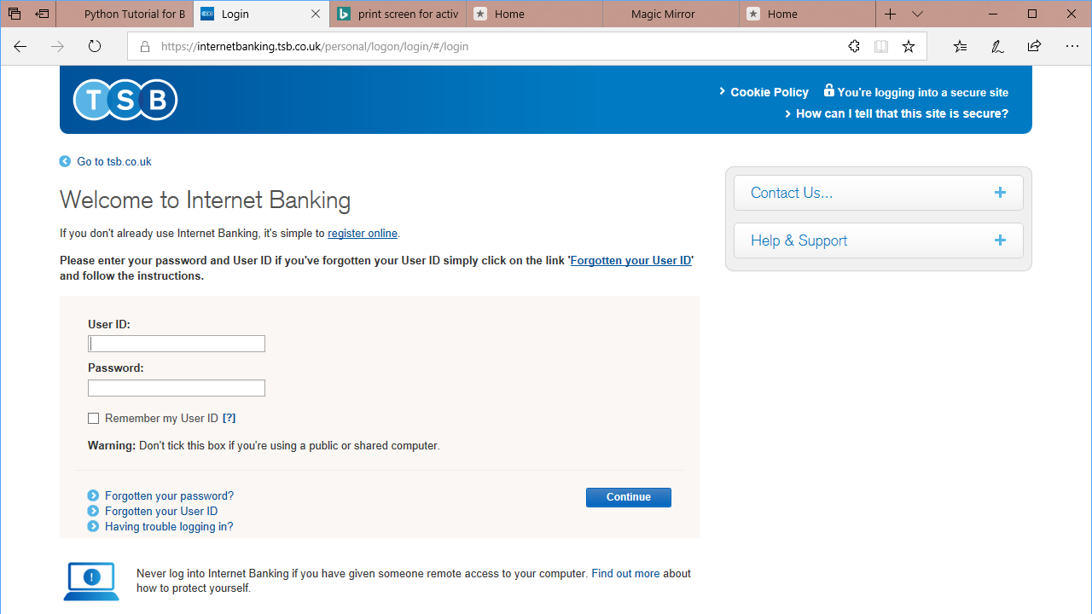

Slide 37
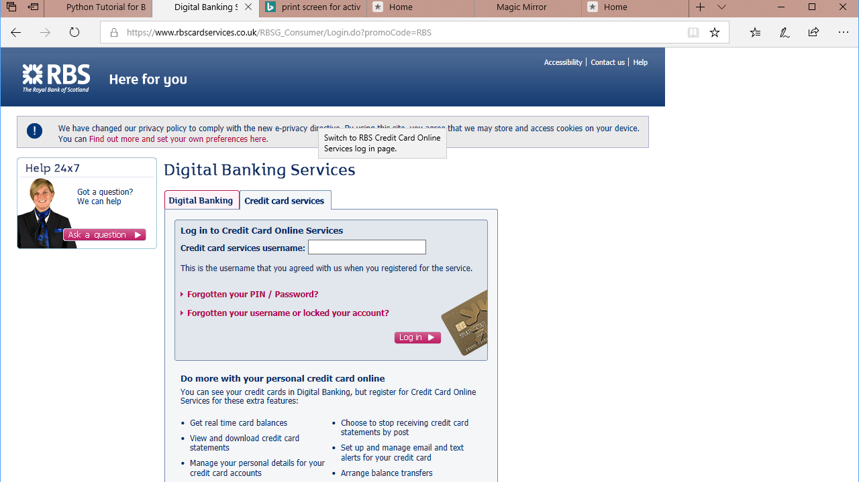

Slide 38
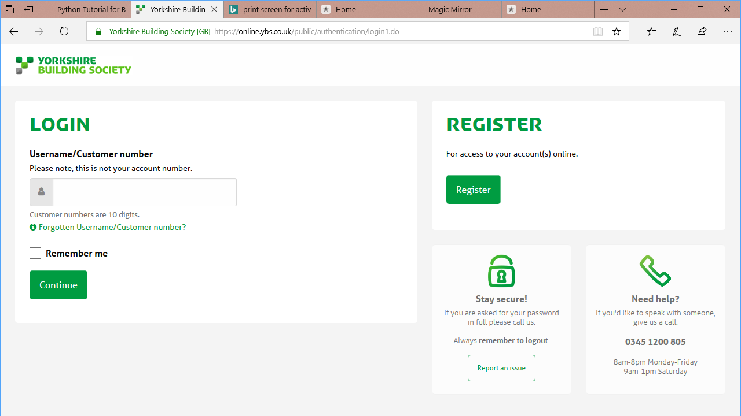

Slide 39
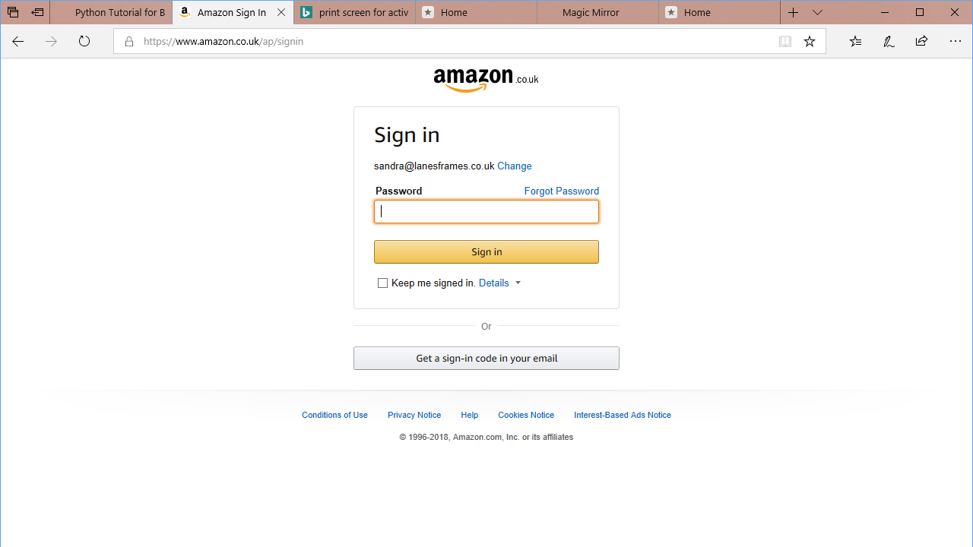

Slide 40
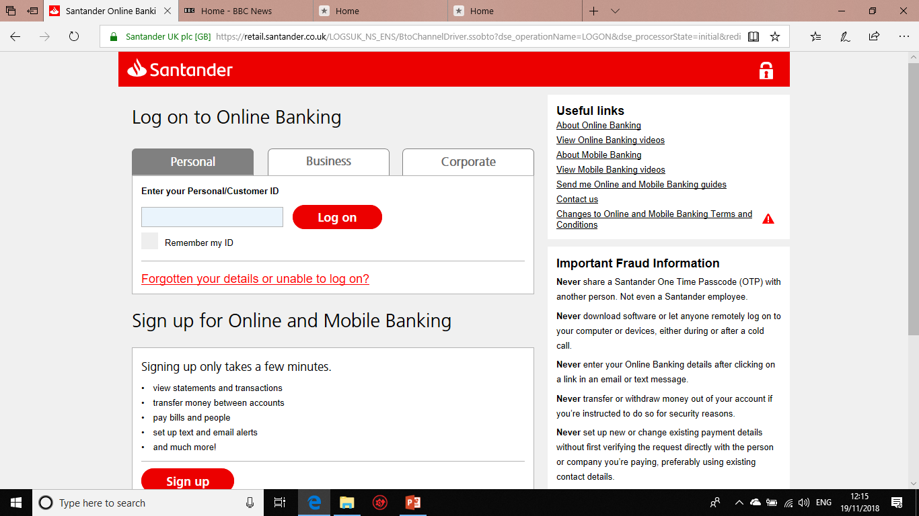

Slide 41
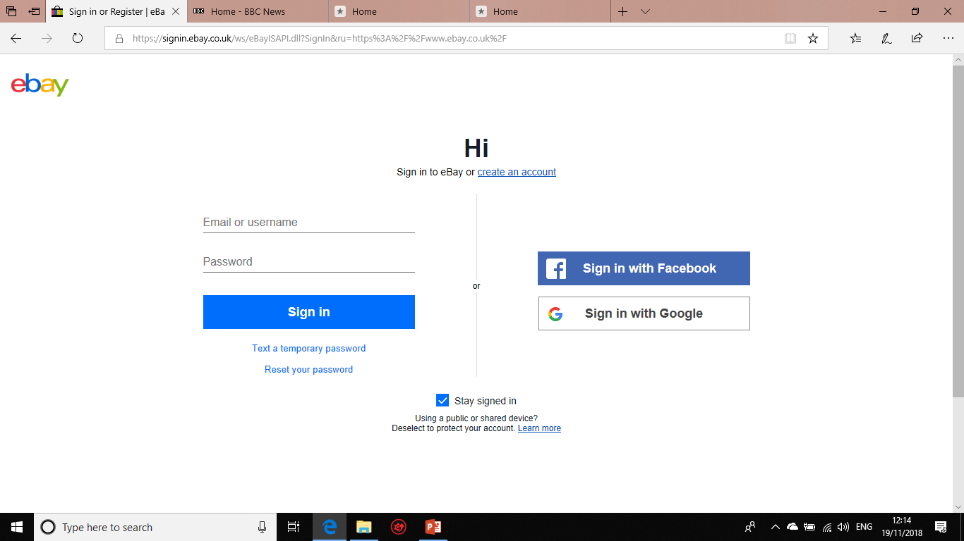

Slide 42
COnclusion

Slide 43
Create your own username or logon if possible
Make up answers to common security questions
Pass Phrases are more secure than Pass Words
The longer, the better
Change regularly for high security applications
Use more than one e-mail address
Use Two-Factor Authentication
Make logins and passwords unique
Don’t use ‘Remember Me’
Notes:
Conclusion
Create your own username or logon if possible
Make up answers to common security questions
Pass Phrases are more secure than Pass Words
The longer, the better
Change regularly for high security applications
Use more than one e-mail address
Use Two-Factor Authentication
Make logins and passwords unique

