Slide 1
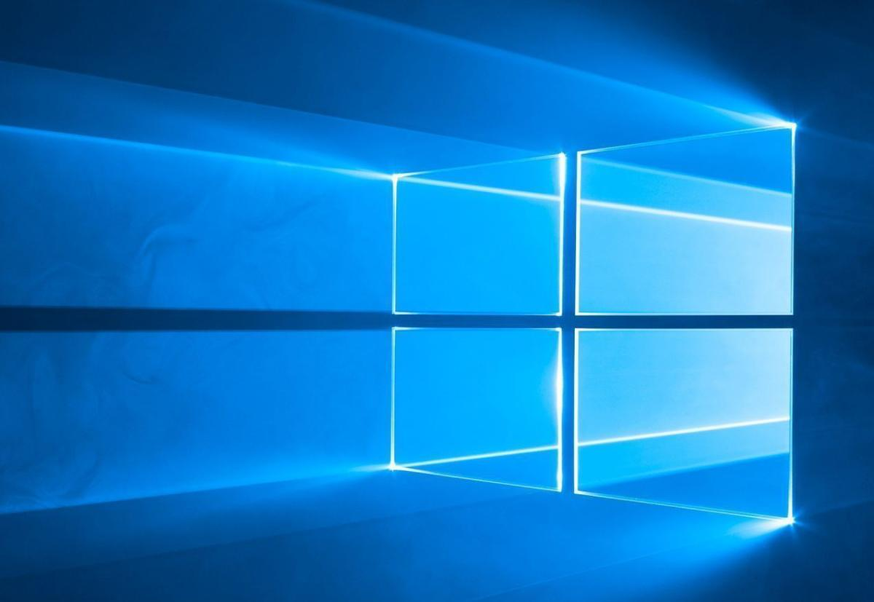
Reinstalling Windows 10
Notes:
There are good reasons to reinstall Windows: Over time your computer slows down, moving from the swish when you bought it to the I wish (it was faster) a few years later. The main reasons are:
Malware: too much malware and advertising popups?
Performance issues
Changed settings
Corrupted Registry
Startup programmes. Extra programmes installed that run at start up consume CPU, memory and other system resources in the background. There are generally an unnecessary amount of start up items installed by the manufacturer known as bloatware.
File Explorer plugins, Services and More. Applications that add shortcuts to Windows File Explorer context menus can take much longer if they are poorly programmed. Other programmes install themselves as a system service – running in the background even though you can’t see them. Many of these programmes think they should be available to you at all times – and thus run all the time in the background, yet in reality, you may only probably use once or twice. You could start it when you need it.
Heavy Security Suites. Security suites like Norton consume a lot of resources to perform all their functions. Do you need everything they offer?
PC Cleaning tools. Paradoxically they can make your computer slower as they add themselves as a startup item and try to get you to install other products of a similar nature.
Other junk. Poorly written programmes may clutter your system with useless DLL files and fill your registry with unnecessary entries.
Browser toolbars and extensions. Even well written extensions will have am impact on your computers performance, poorly written ones, certainly will.
Essentially, it all comes down to junk software. Reinstalling windows and starting from scratch, will give your computer that new, right out of the box experience.

Slide 2
Why Should we Reinstall Windows?
Performance Issues
Malware & advertising popups
Corrupted Registry
Unnecessary Start up Programmes
Heavy Security Suites
PC Cleaning Tools
Browser Toolbars and Extensions
Junk Software
Updates to the latest version – Better than doing a factory reset

Slide 3
There are a number of ways to install or re-install Windows to a computer.
Installing Windows directly from the internet.
Installing Windows from within Windows, called “Fresh Start”.
Using installation media; a USB drive or DVD.
Notes:
There are normally 3 ways to install/reinstall Windows 10 to your computer.
From the Microsoft website (search download Windows 10) and then Download Tool Now. Need to be working on the computer you want to update.
From within your computer use windows Fresh Start
From a USB Drive or DVD Drive – created by creating Installation Media from the same page as above. Providing you have a licence, you can use this on any number of PC’s. This is my preferred option.
Options 1 & 3 give you the option of how much to save prior to the reinstall. Account, settings, data etc or nothing at all – My preference.

Slide 4
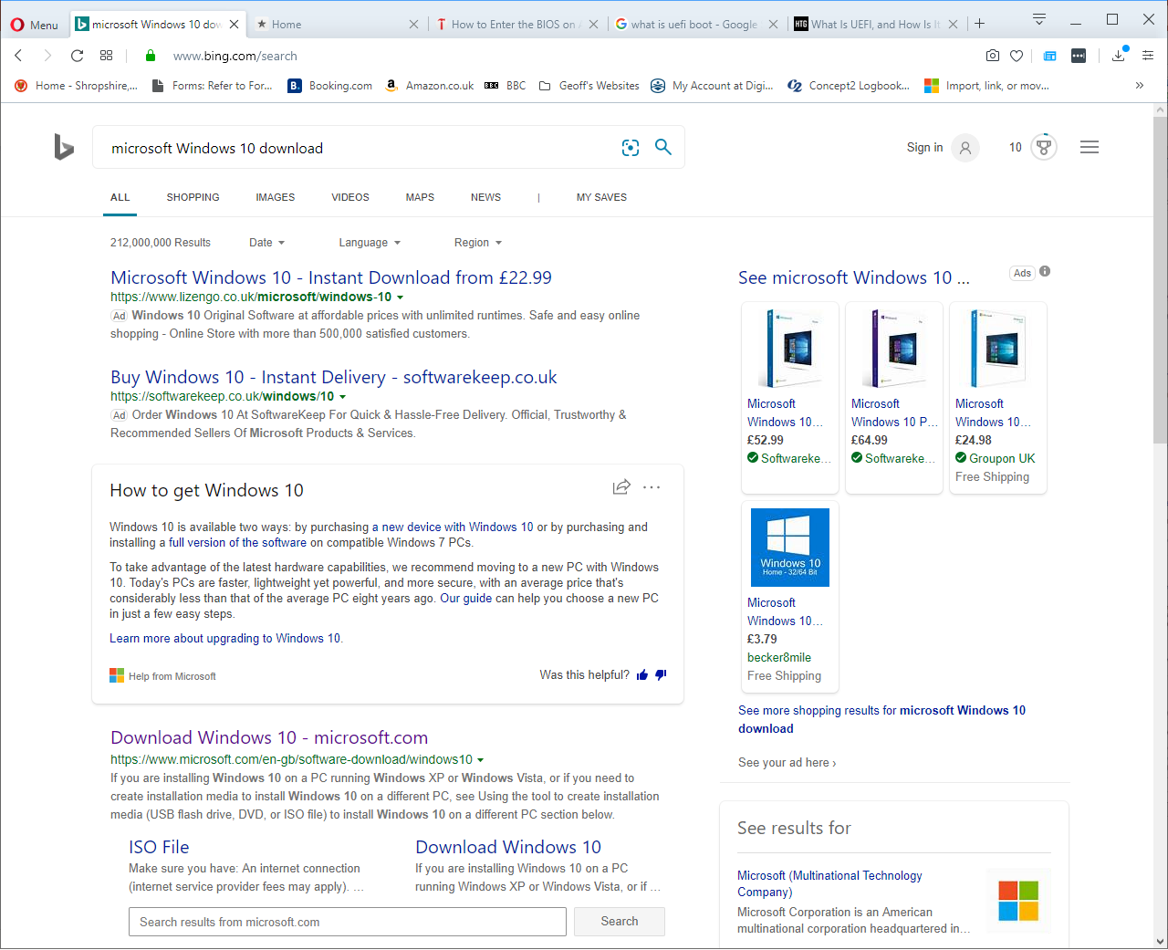
Notes:
Make sure you download Windows from the official Microsoft Download pages
https://www.microsoft.com/en-gb/software-download/windows10

Slide 5
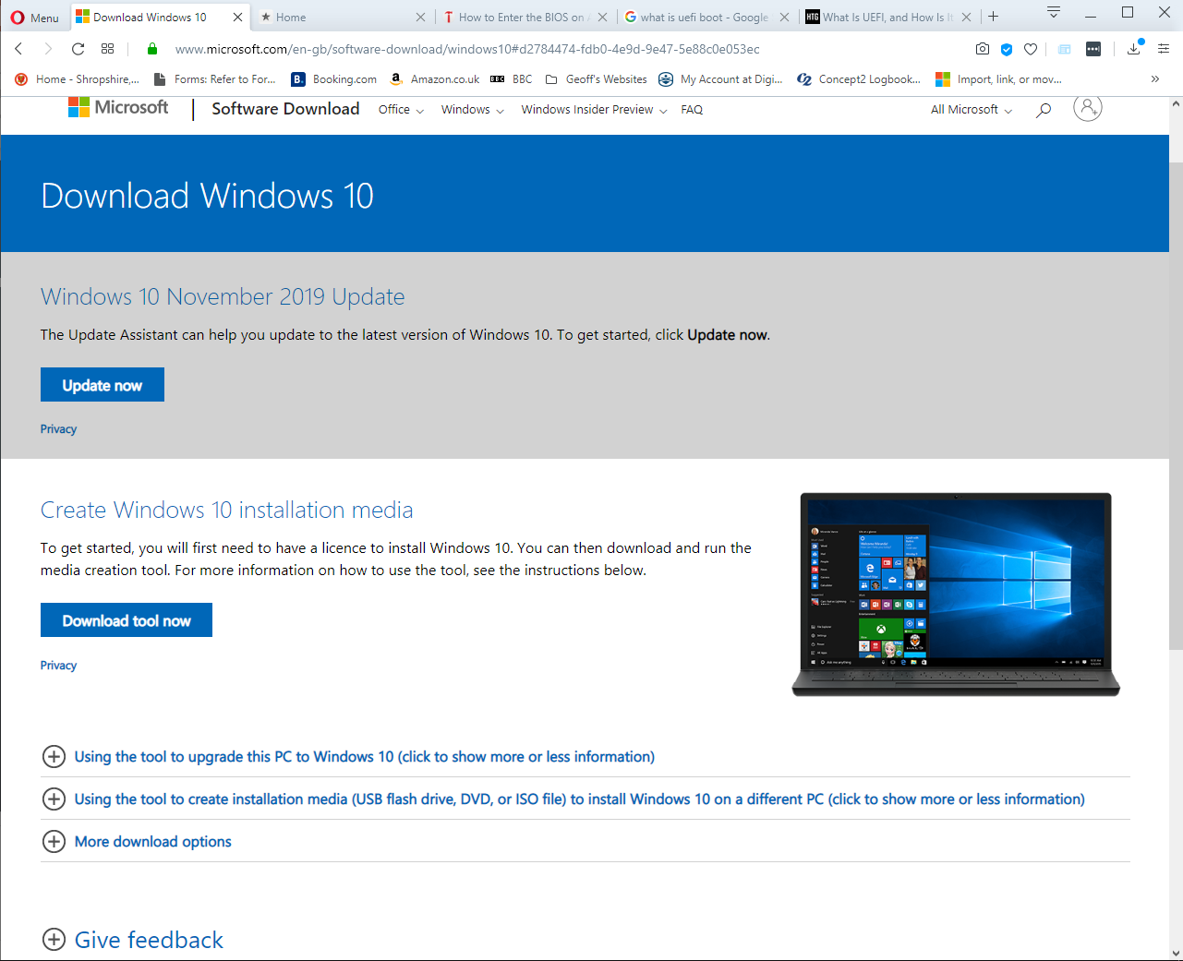
Notes:
The top half; “Update Now” will update – not reinstall, Windows to the latest version
The “Download tool now” will allow you to re-install windows to your current computer or, if you create the installation media to another computer or computers. Note of course that you will need a licence for each installation.

Slide 6
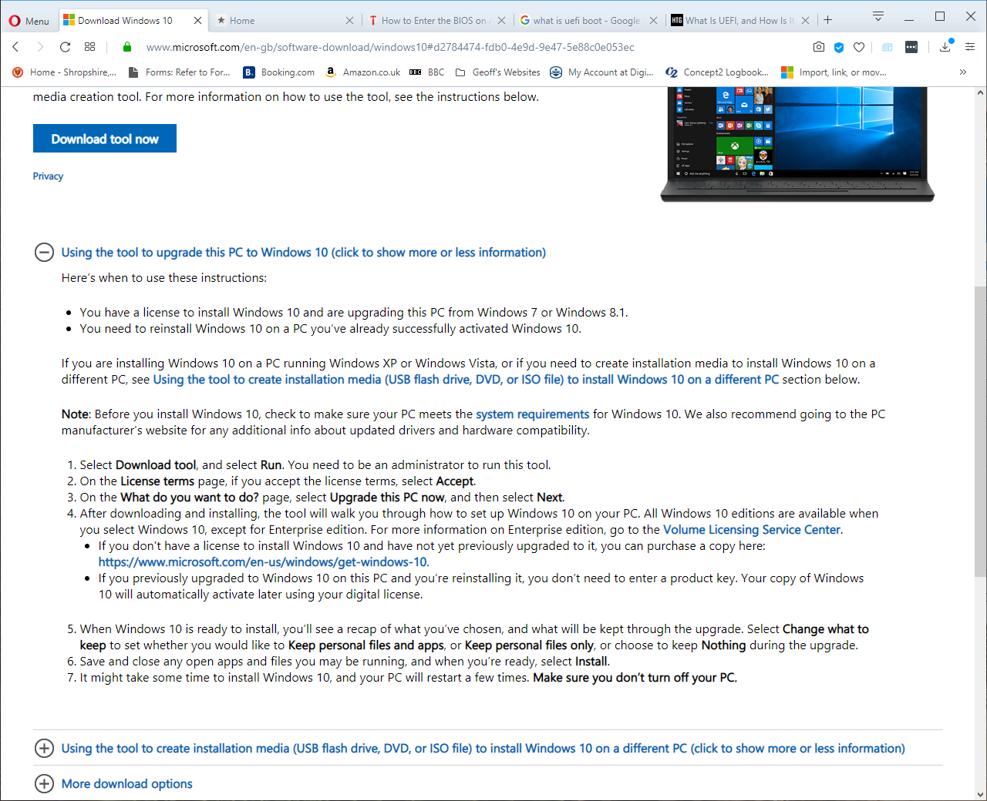

Slide 7
Using Windows “Fresh Start”
Fresh start will reinstall and update Windows 10.
Fresh Start REMOVES 3rd party software and apps that doesn’t come standard with Windows. It only keeps Microsoft Store Apps that the manufacturer installed.
You will have to reinstall a lot of your software, although Microsoft have handily provided a list of apps that were removed during the process. There will be an icon on your desktop for this list.
There is a lot of preparation to do beforehand.
Notes:
Fresh Start; added in the Nov 2019 version makes this much easier than previous. It keeps your account settings, wifi settings, printers etc and of course data (if you so wish). It does remove 3rd party software that you have installed since purchase.
A list of apps that have been removed (and thus those that you may wish to re-install) are detailed on a report as part of the re-installation process. The report will be available on your desktop when the process has completed.

Slide 8
Preparation

Slide 9
List of all your software you have installed so you know what you need to re-install.
Ensure you have installation media or can download it from the internet.
Check for any license numbers required. (Use a product key finder if required)
Drivers for Printer/s
List any settings that you might have to reapply ie:
Mail accounts
Mail settings rules and folders
Windows Settings. Start | Settings
Screensaver settings
Desktop Picture/s
Lock settings
Power and Sleep settings
Wi-Fi network & password
Are you bothered about app’ preferences? Margins, Page setup, default fonts, default save locations etc. What about your Word custom dictionary?
Notes:
There is a lot to think about before you wipe your computer clean. Whilst Fresh Start retains many settings, I like to go the whole hog and start from scratch. Time spent here on the preparation beforehand is always well worth it.
I use a check sheet to help me and even after a number of years of doing this, I still add to the check list almost every single time
Custom Dictionary: Users | App Data | Roaming | Microsoft | Uproof | Custom.dic

Slide 10
Ensure your Documents are safe – in the Cloud, backed up, copied etc
Ditto for Photos, videos and music.
Check for data in unusual locations ie other than “My Docs, My Photos” etc
How about your Custom Dictionary from Word? C:\Users\%username%\AppData\Roaming\Microsoft\Uproof\Custom.Dic
Do you have any software running in the background? Backups for example. What are these settings?
Remove your device from any software apps where you are 1 of nnn installations ie Office 365 and Norton subscriptions.

Slide 11
List of all your software you have installed so you know what you need to re-install.
Windows Start button and view the programmes
File Explorer
File Explorer
Start | Settings | Apps
Notes:
Custom Dictionary: Users | App Data | Roaming | Microsoft | Uproof | Custom.dic

Slide 12
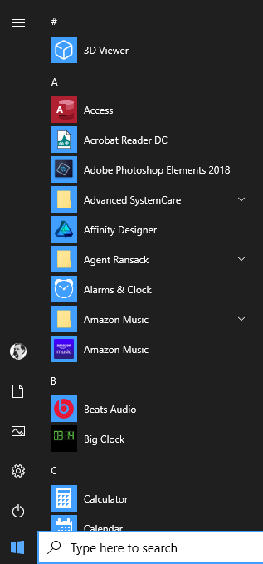
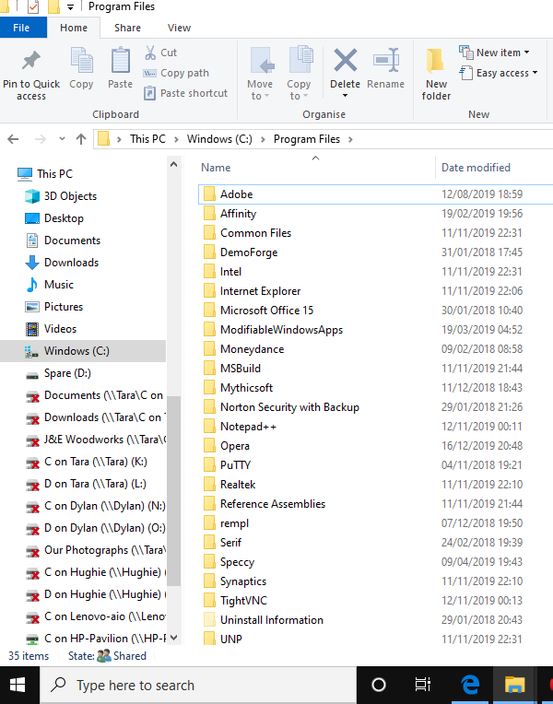
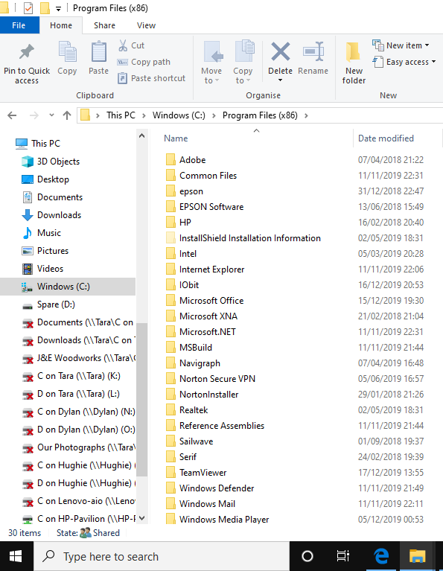

Slide 13
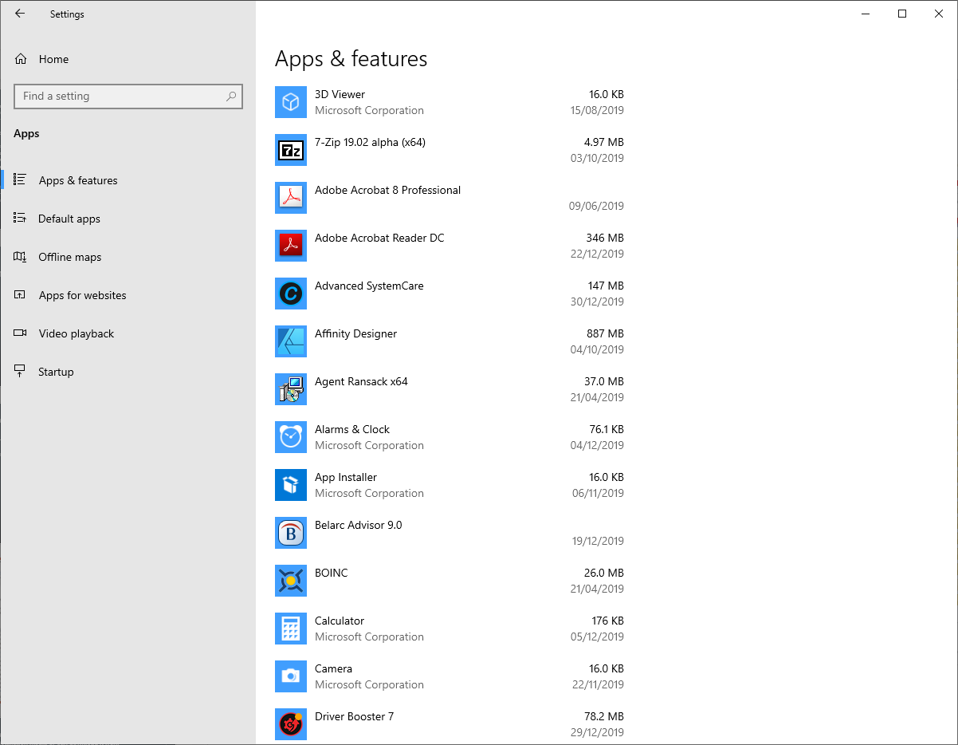

Slide 14
List of all your software you have installed so you know what you need to re-install.
Ensure you have installation media or can download it from the internet.
Check for any license numbers required. (Use a product key finder if required)
Drivers for Printer/s
List and make a note of any settings that you might have to reapply ie:
Mail accounts
Mail settings, rules and folders
Notes:
Custom Dictionary: Users | App Data | Roaming | Microsoft | Uproof | Custom.dic

Slide 15
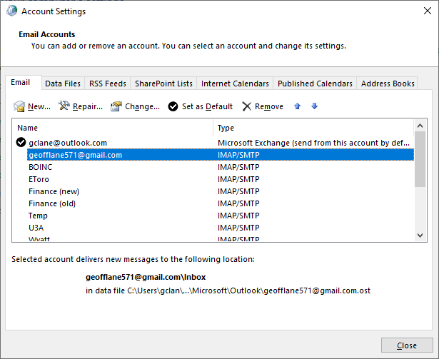
Notes:
To get to this e-mail accounts screen. Go to: Control Panel | Mail | E-mail accounts

Slide 16
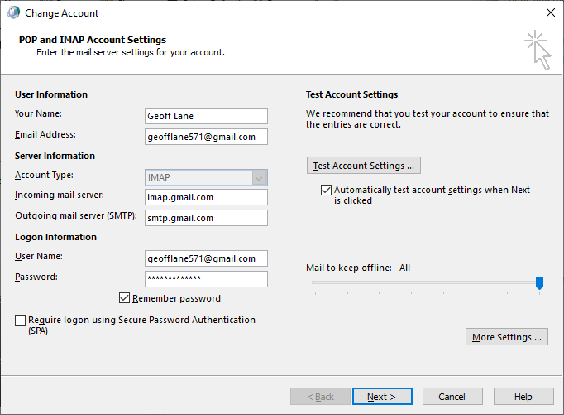

Slide 17
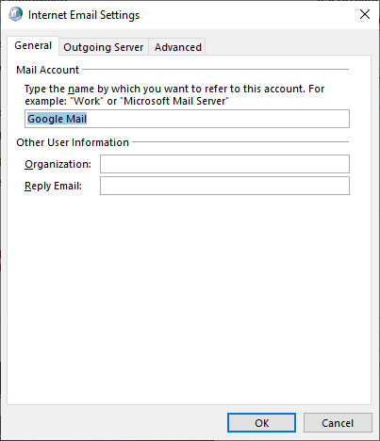
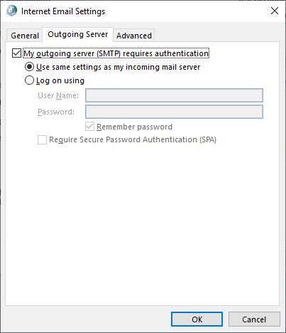
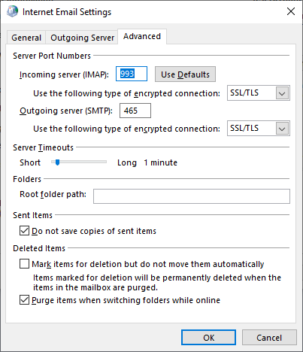

Slide 18
List of all your software you have installed so you know what you need to re-install.
Ensure you have installation media or can download it from the internet.
Check for any license numbers required. (Use a product key finder if required)
Drivers for Printer/s
List any settings that you might have to reapply ie:
Mail accounts
Mail settings rules and folders
Windows Settings. Start | Settings
Screensaver settings
Desktop Picture/s
Lock settings
Power and Sleep settings
Wi-Fi network & password
Are you bothered about app’ preferences? Margins, Page setup, default fonts, default save locations etc.
Notes:
Custom Dictionary: Users | App Data | Roaming | Microsoft | Uproof | Custom.dic

Slide 19
Ensure your Documents are safe – in the Cloud, backed up, copied etc
Ditto for Photos, videos and music.
Check for data in unusual locations ie other than “My Docs, My Photos” etc
How about your Custom Dictionary from Word? C:\Users\%username%\AppData\Roaming\Microsoft\Uproof\Custom.Dic
Do you have any software running in the background? Backups for example. What are these settings?
Remove your device from any software apps where you are 1 of nnn installations ie Office 365 and Norton subscriptions.

Slide 20
Using Fresh Start
Notes:
The following slides record the progress of using Frest Start on my laptop, Dec 2019

Slide 21
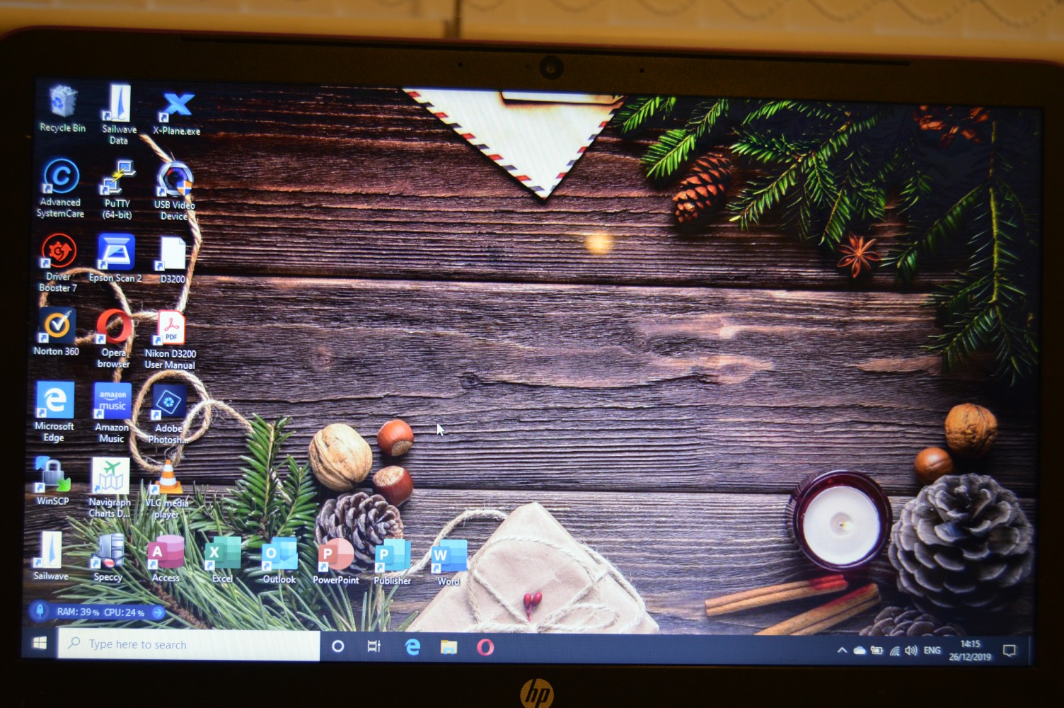

Slide 22
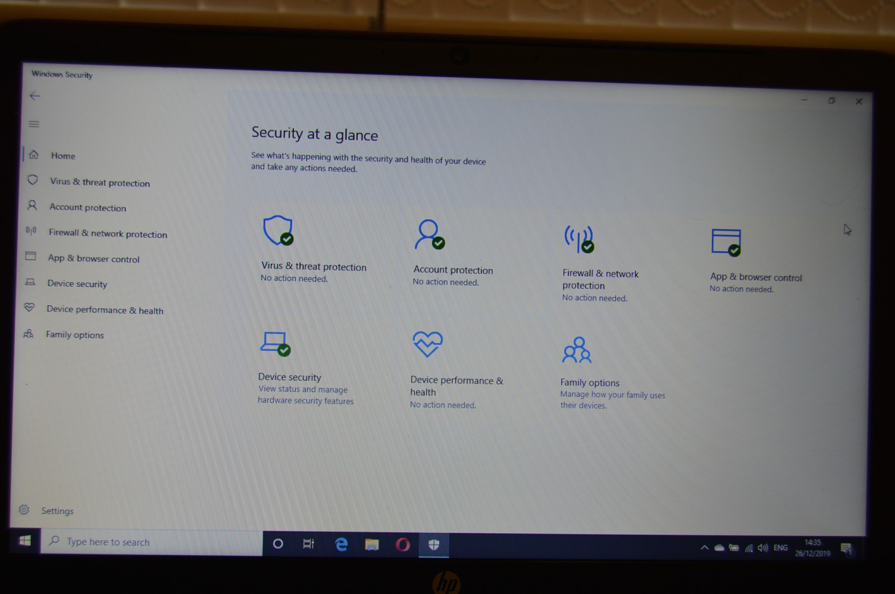

Slide 23
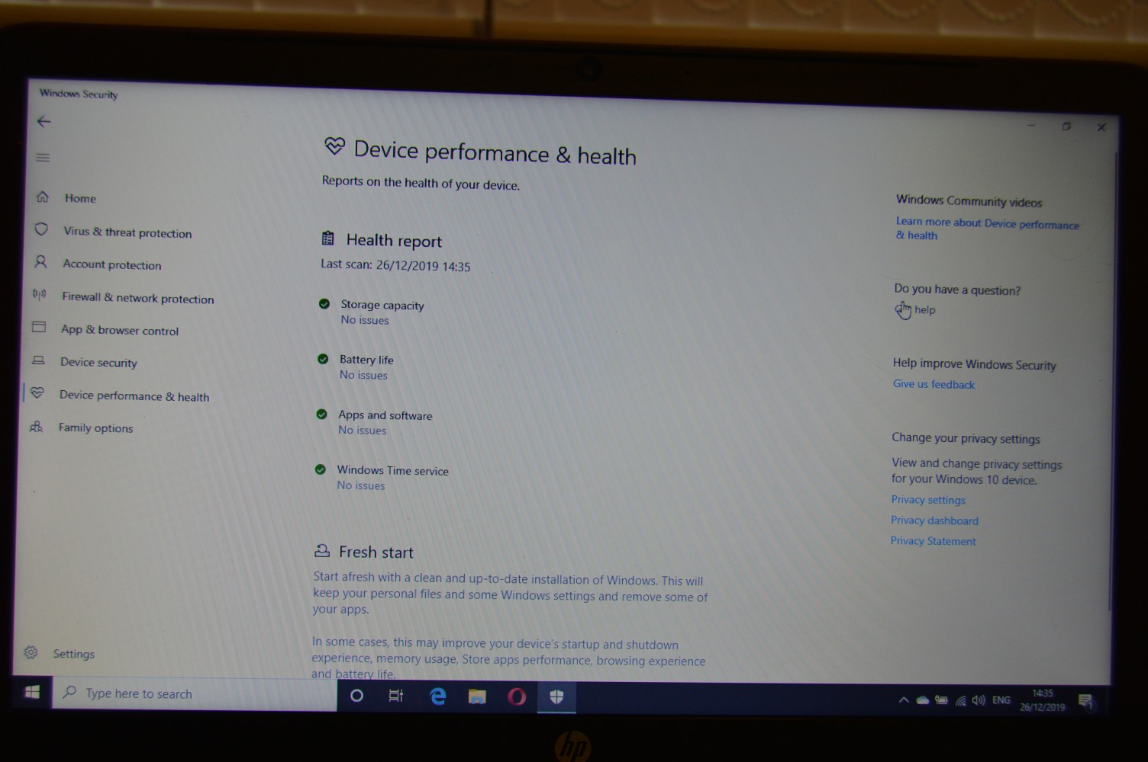

Slide 24
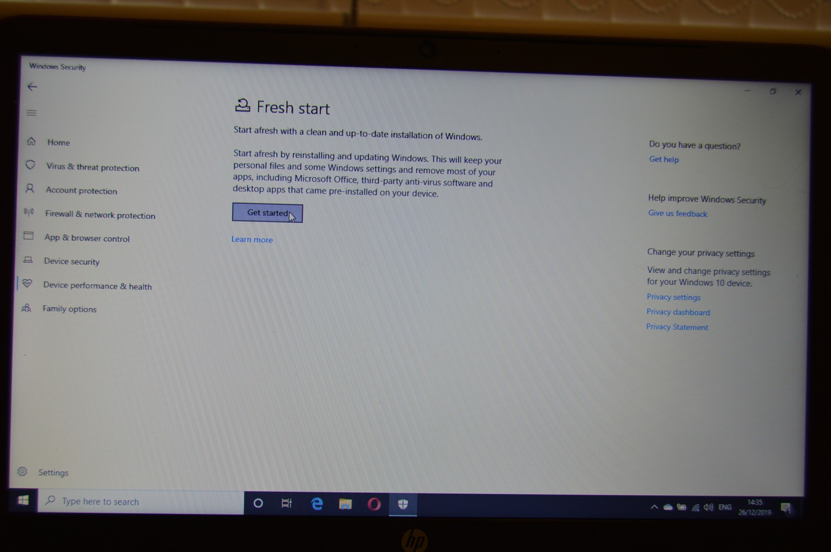

Slide 25
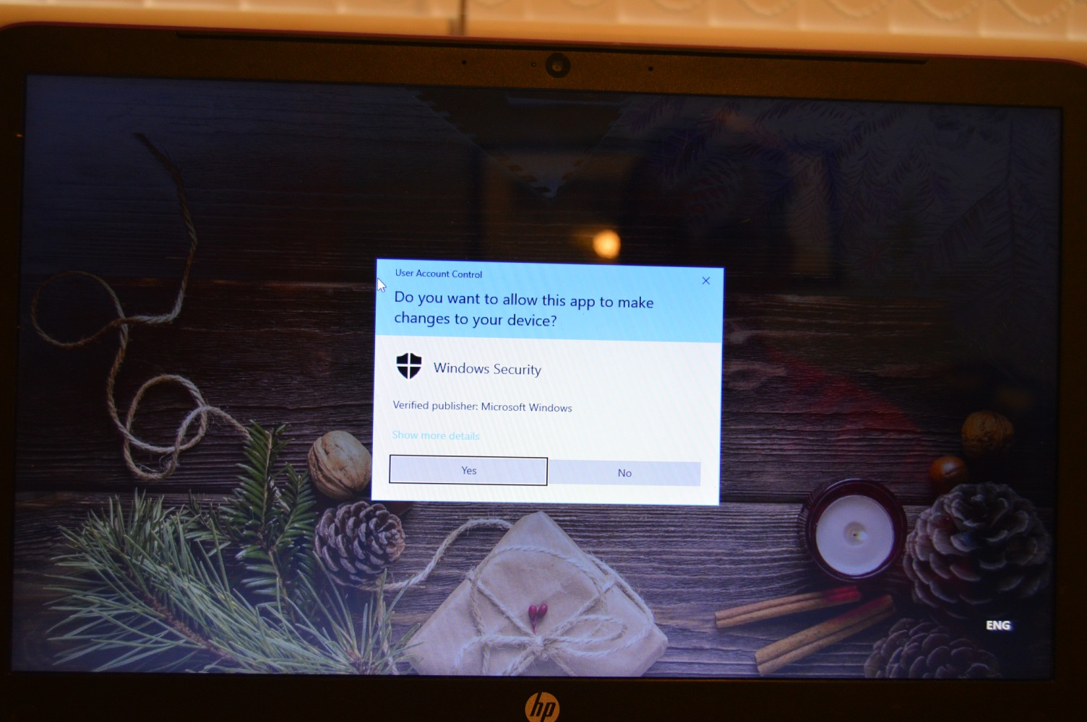

Slide 26
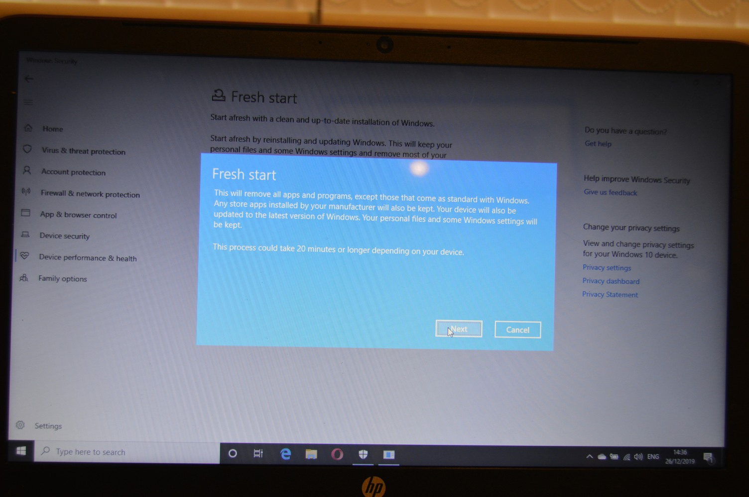

Slide 27
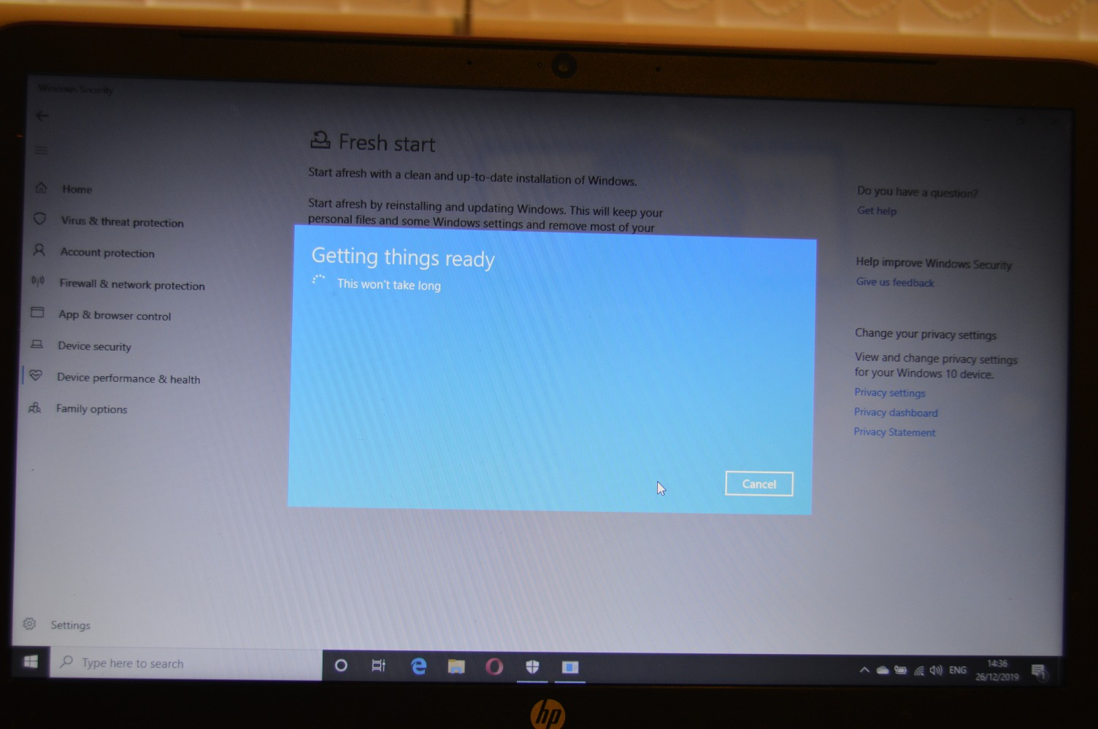

Slide 28
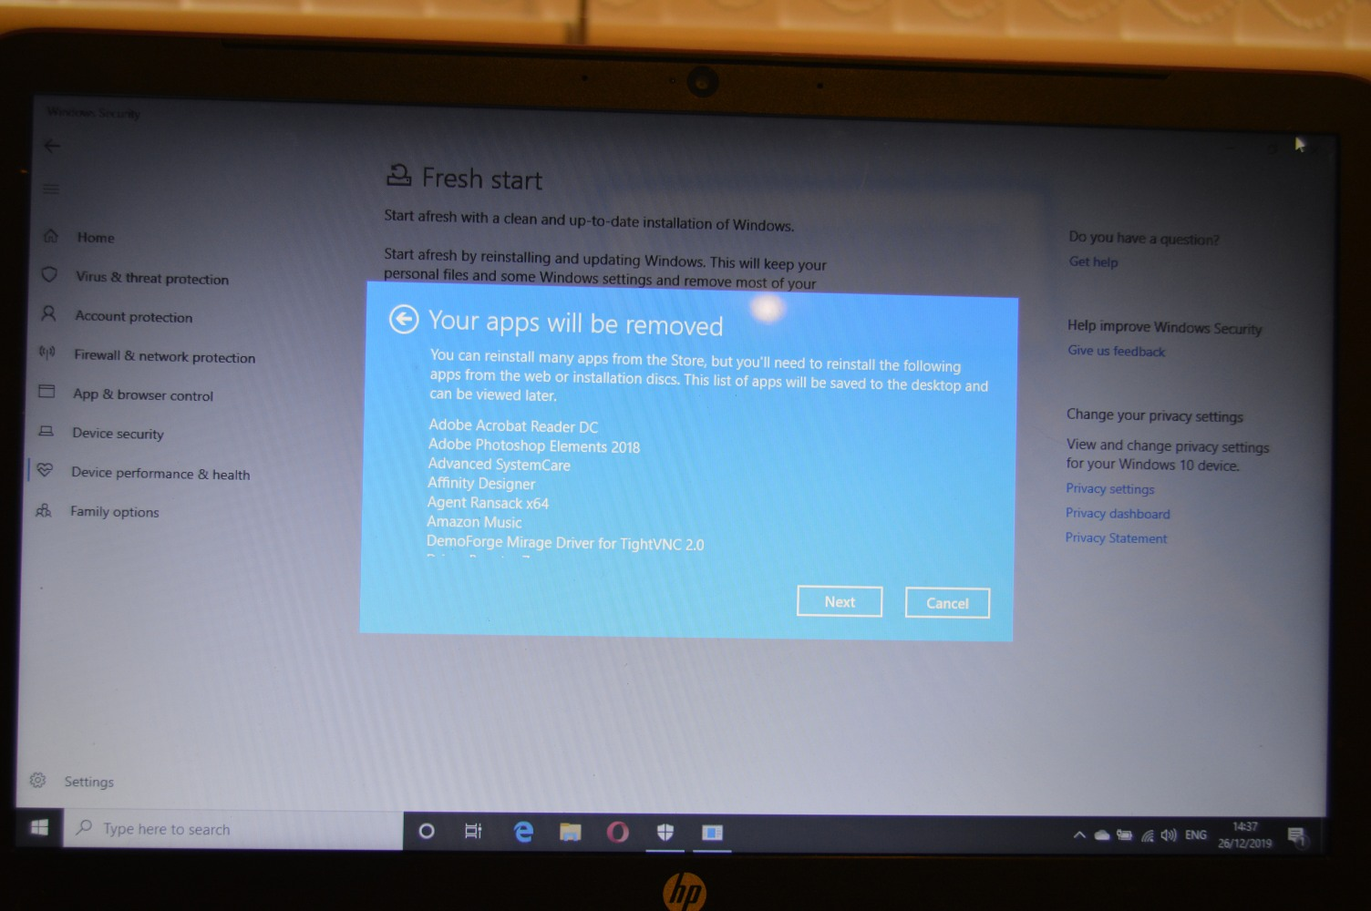

Slide 29
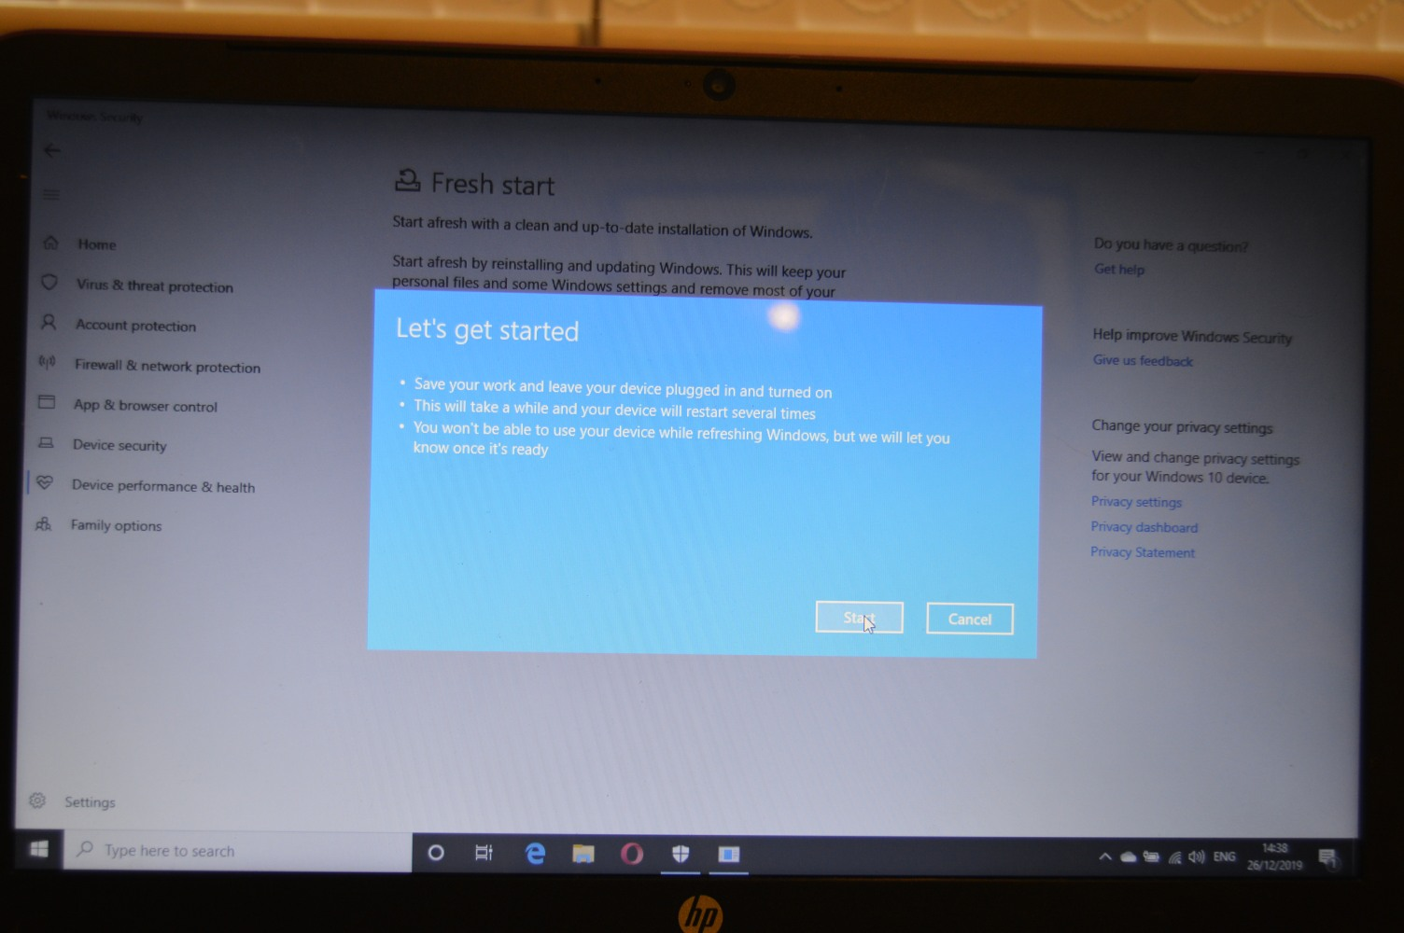

Slide 30


Slide 31


20 mins

Slide 33
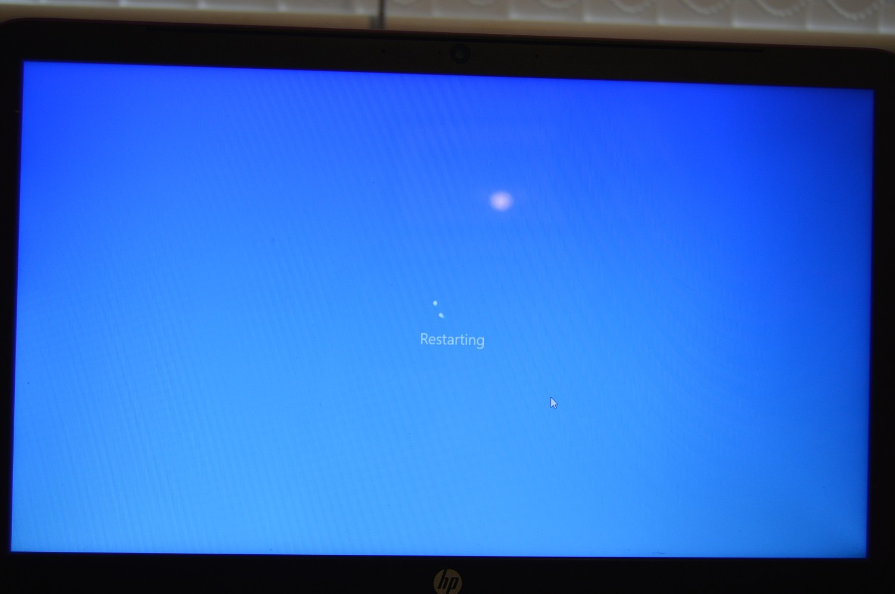

Slide 34
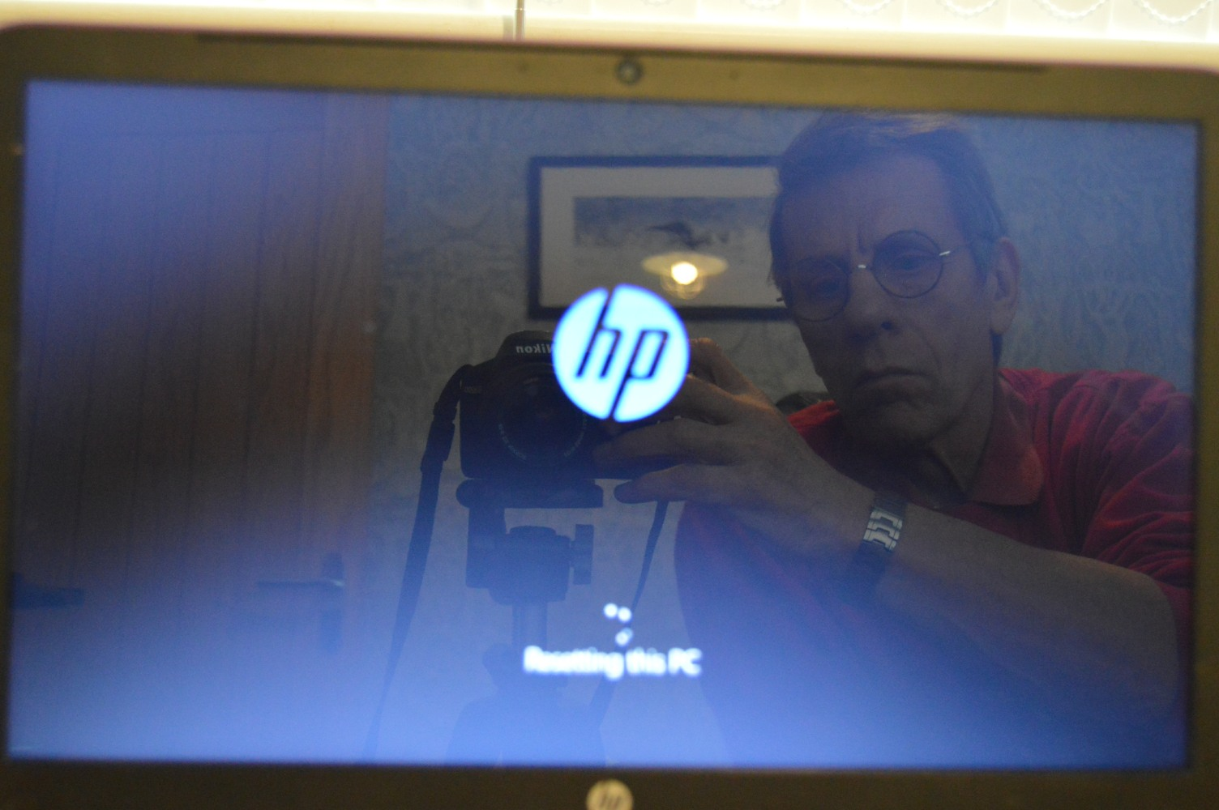

Slide 35
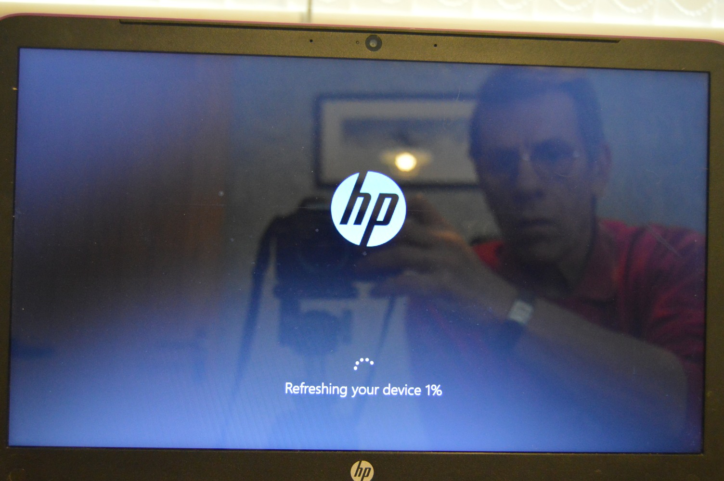
40 mins

Slide 36
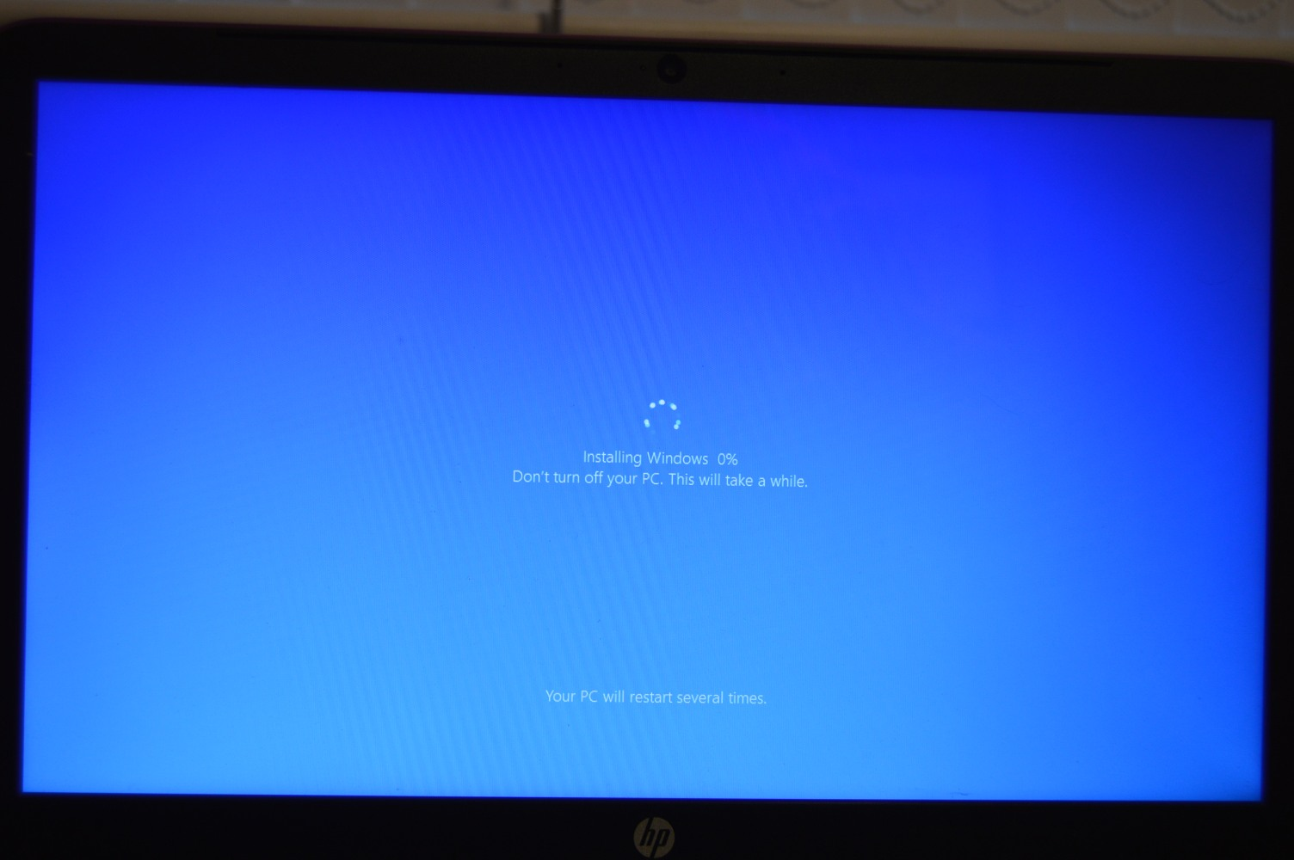

Slide 37
50 mins

Slide 38
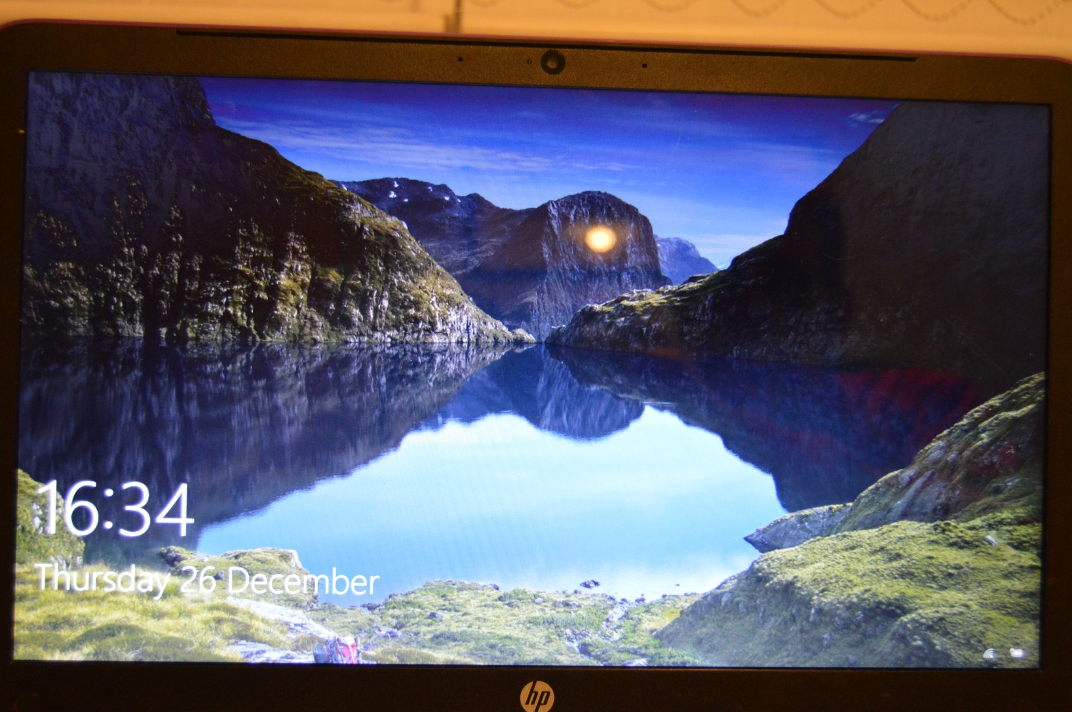

Slide 39
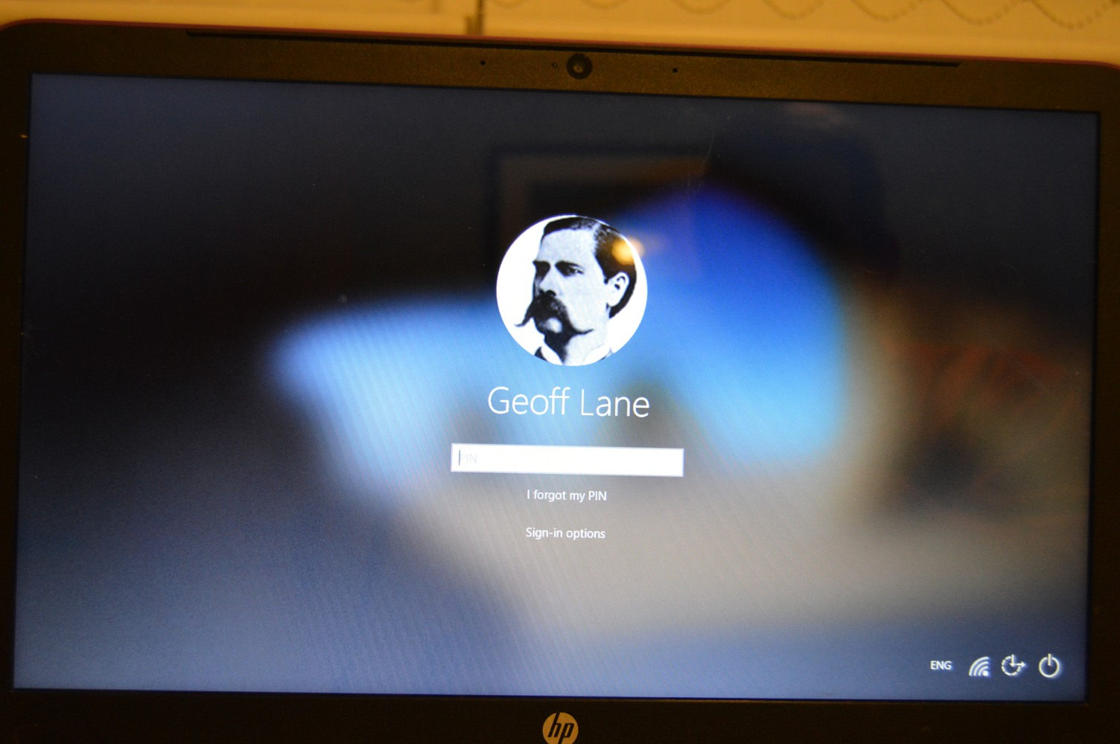

Slide 40
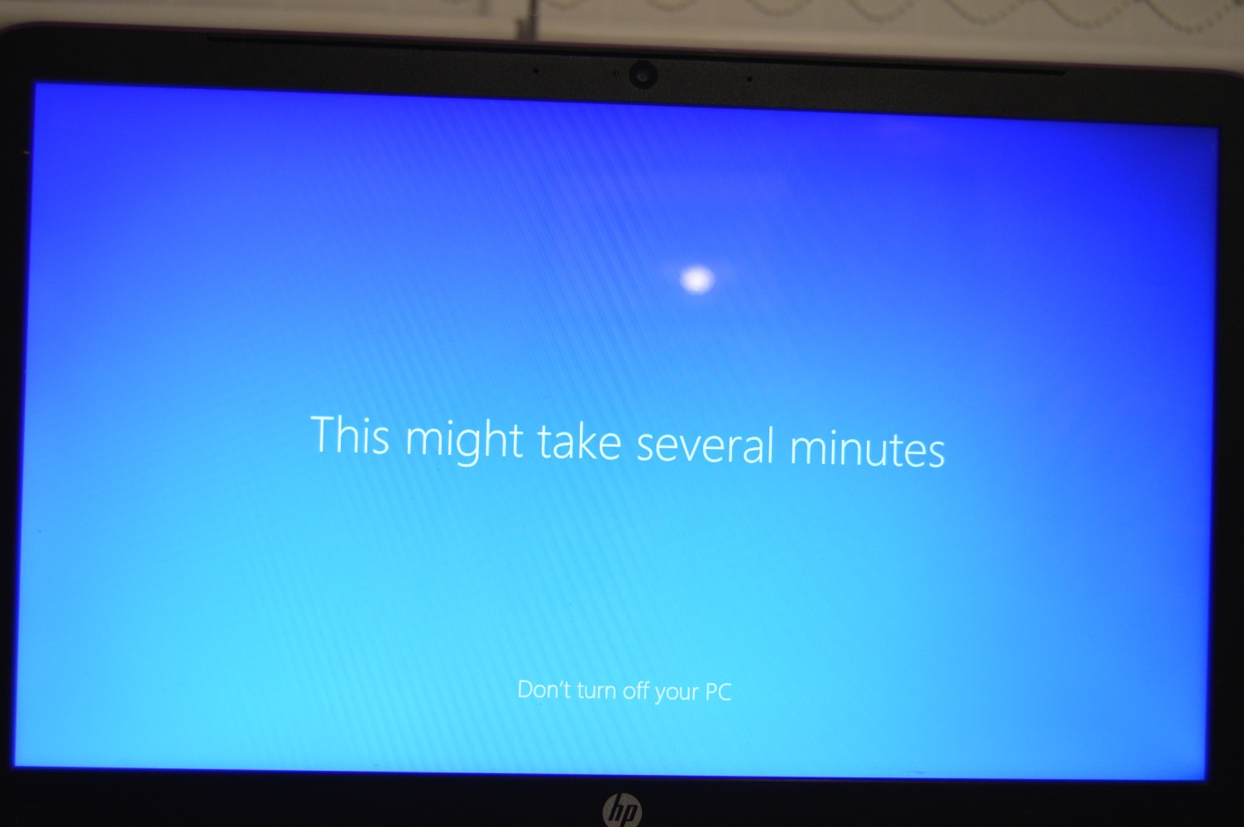

Slide 41
5 mins

Slide 42
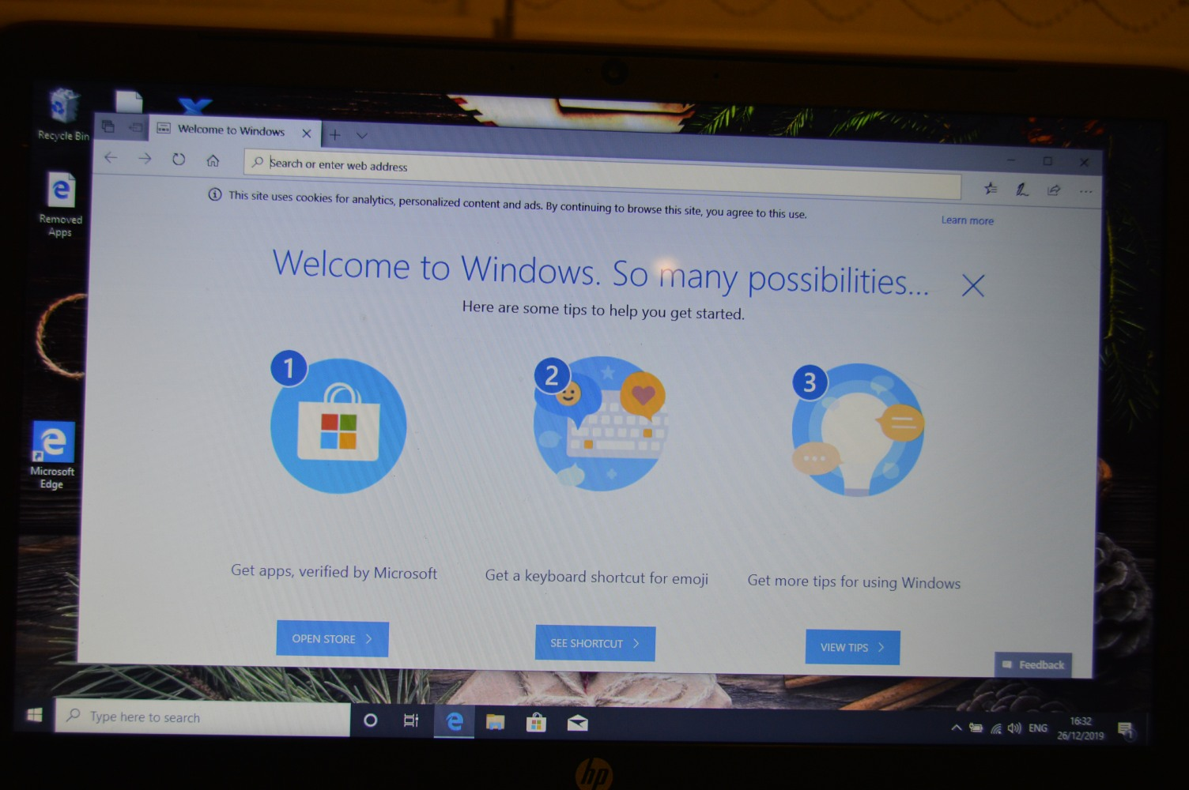

Slide 43
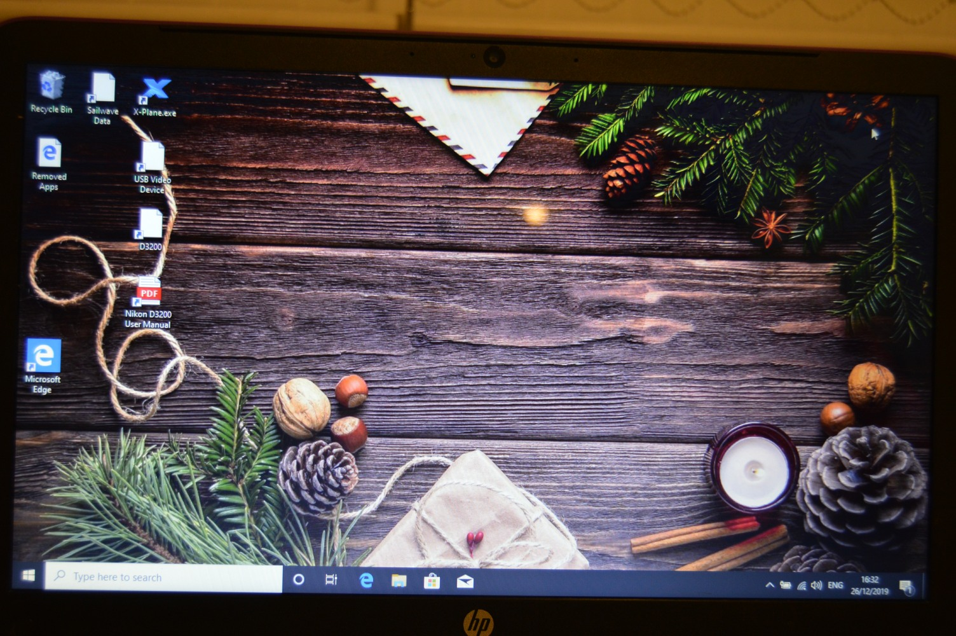
Notes:
Sorted, back to normal with a new installation of Windows 10

Slide 44
There are a number of ways to install or re-install Windows to a computer.
Installing Windows directly from the internet to the computer you are working on.
Installing Windows from within Windows of the computer you are working on.
They call this “Fresh Start”.
Using installation media; a USB drive or DVD. You can create these yourself by downloading Windows 10 from the Microsoft Website. This has the advantage that you could use your media in more than one PC (providing you have a licence of course).
Notes:
There are normally 3 ways to install/reinstall Windows 10 to your computer.
From the Microsoft website (search download Windows 10) and then Download Tool Now
From within your computer use windows refresh
From a USB Drive – created by creating Installation Media from the same page as above.

Slide 45
Using a USB Drive or DVD you need to make the computer use that drive first rather than the C Drive
Do this by entering the BIOS as the computer boots up
Different computer manufacturers have different key combinations
Notes:
To enter the BOIS, you have to interrupt the regular boot up sequence. You do this by pressing a key on the keyboard before Windows starts to get loaded. Once the computer is powered on, the usual method is to continually press the appropriate key at a frequency of about once per second (or very slightly faster) until the boot screen appears. If you get to the Windows screens or circular dots then you have missed it and will have to restart the computer and try again.
Different computer manufacturers have different keys assigned to the interrupt. Common keys are Del (Delete), F2, F10, F12 & Escape.

Slide 46
ASRock: F2 or DEL
ASUS: F2 for all PCs
Acer: F2 or DEL
Dell: F2 or F12
ECS: DEL
Gigabyte / Aorus: F2 or DEL
HP: F10
Lenovo (Consumer Laptops): F2 or Fn + F2
Lenovo (Desktops): F1
Lenovo (ThinkPads): Enter then F1.
Microsoft Surface Tablets: Press and hold volume up button.
Origin PC: F2
Samsung: F2
Toshiba: F2
Zotac: DEL
BIOS INTERRUPT KEYS

Slide 47
Using a USB Drive or DVD you need to make the computer use that drive first rather than the C Drive
Do this by entering the BIOS as the computer boots up
Different computer manufacturers have different key combinations
The BIOS has now been replaced by the UEFI specification (Unified Extensible Firmware Interface)
The BIOS has limitations:
Only supports hard drives of 2.1TB or less
Must run in 16 bit mode
Has only 1MB of memory to run in.
Does not support a mouse.
UEFI is a great improvement
Notes:
Even though the UEFI has been around for a number of years, people still call the process BIOS – and indeed I will for this presentation

Slide 48
Enter the BIOS and change the boot order (if required) so that the USB or DVD drive boots before the C drive.
With your USB stick or DVD in place. Restart the computer.
The computer will start up with the Windows 10 download that you downloaded.
Follow the prompts…….
When the computer restarts for the first time, take the USB or DVD drive out, otherwise you will be at point 1 again!
Notes:
When the computer restarts for the first time, you need to remove the USB stick or DVD drive from the computer, otherwise as it starts it’s 1st reboot, it will boot from the USB stick or DVD drive again and you will be back at point 1! (It took me a couple of times to realise this and to understand what was happening)

Slide 49
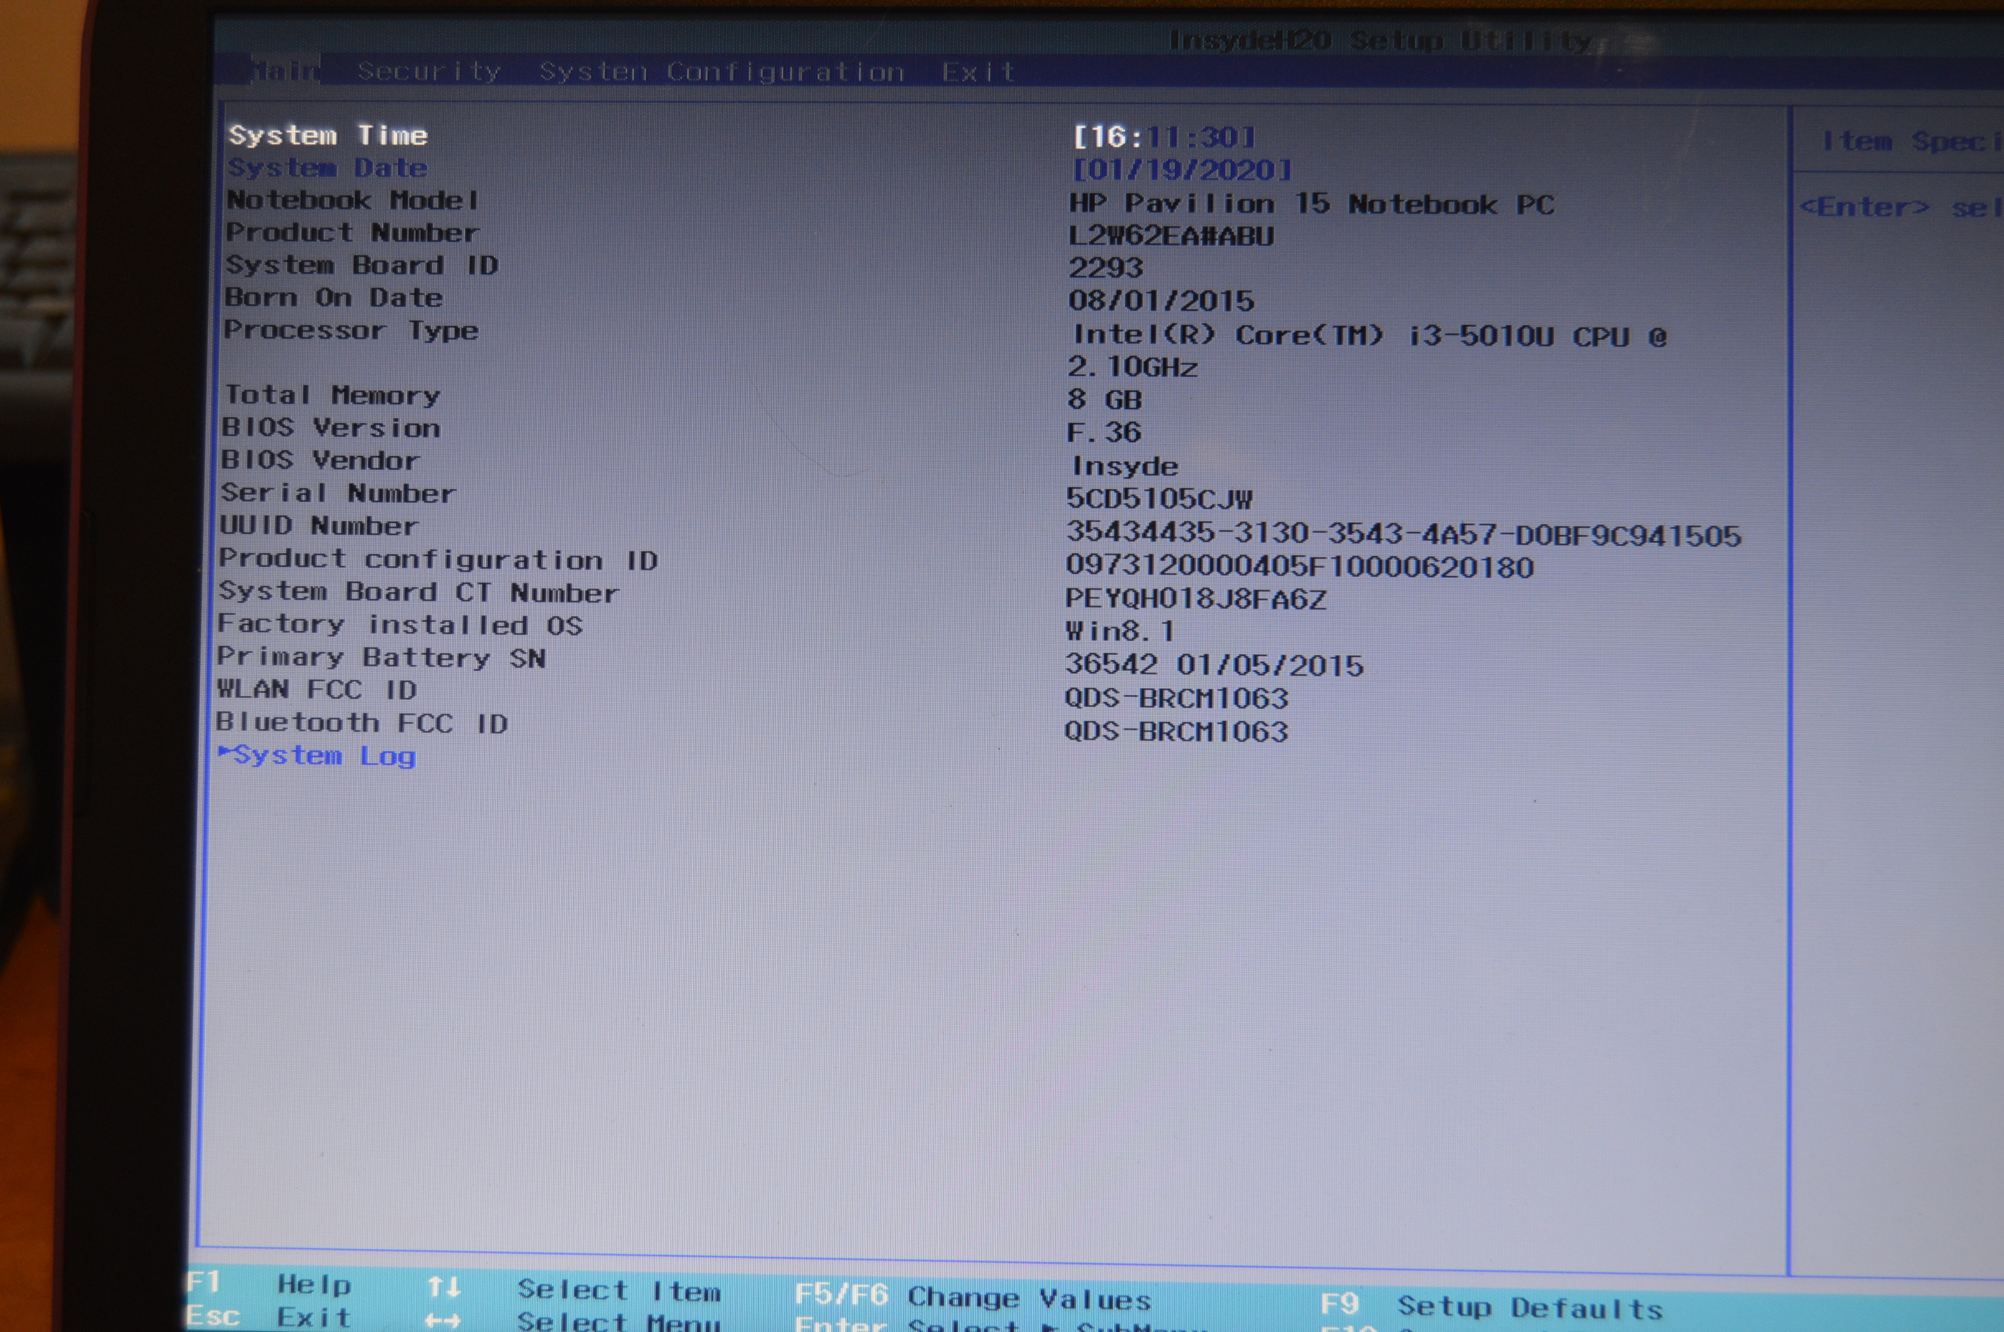
Notes:
Enter the BOIS, it opens to the ‘Main’ Tab. Use the cursor keys to cursor right twice to the ‘System Configuration’ menu. Press Enter.

Slide 50
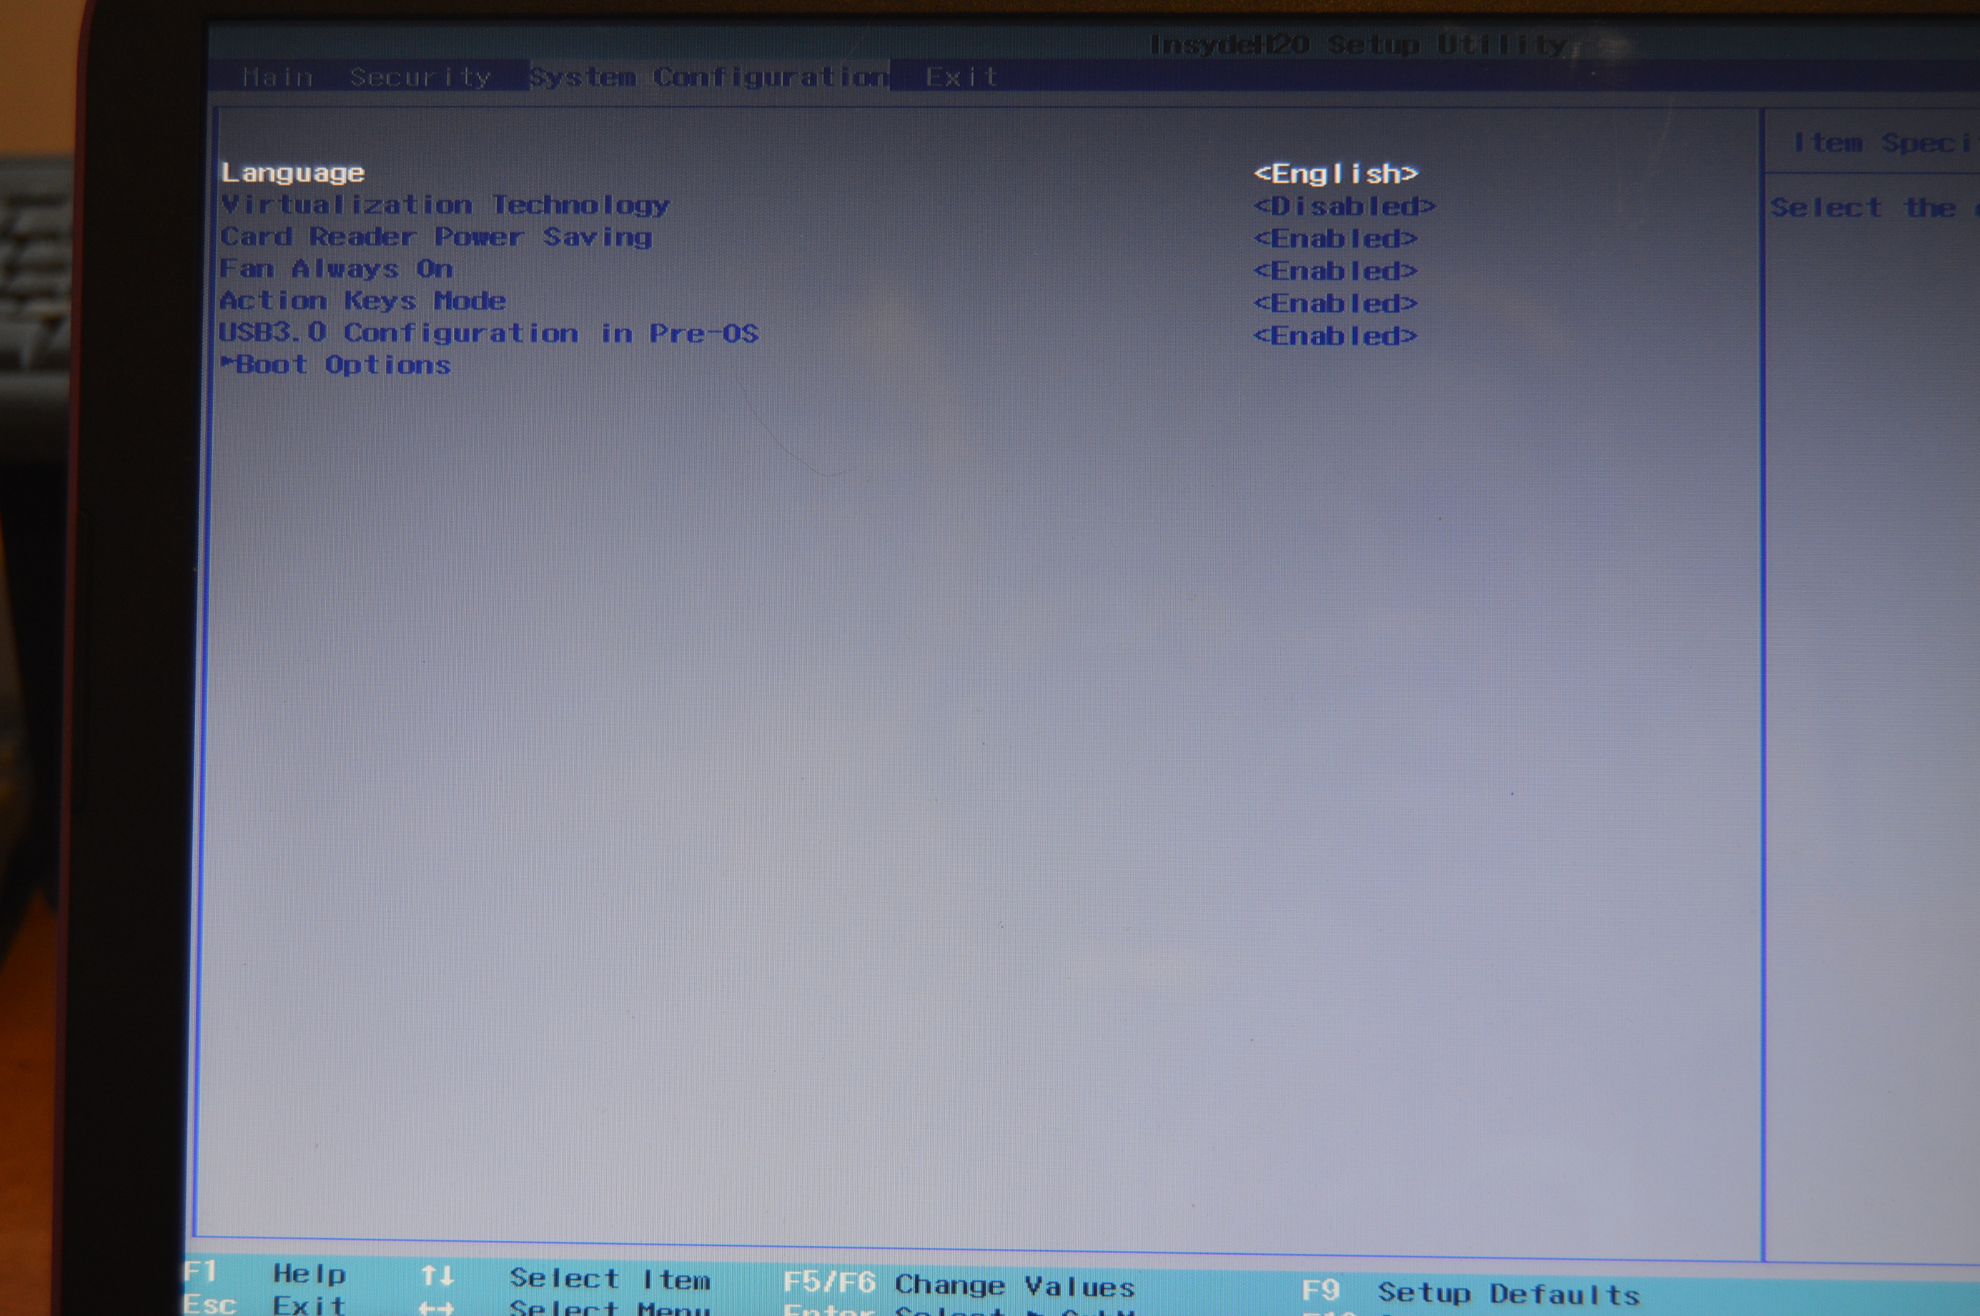

Slide 51
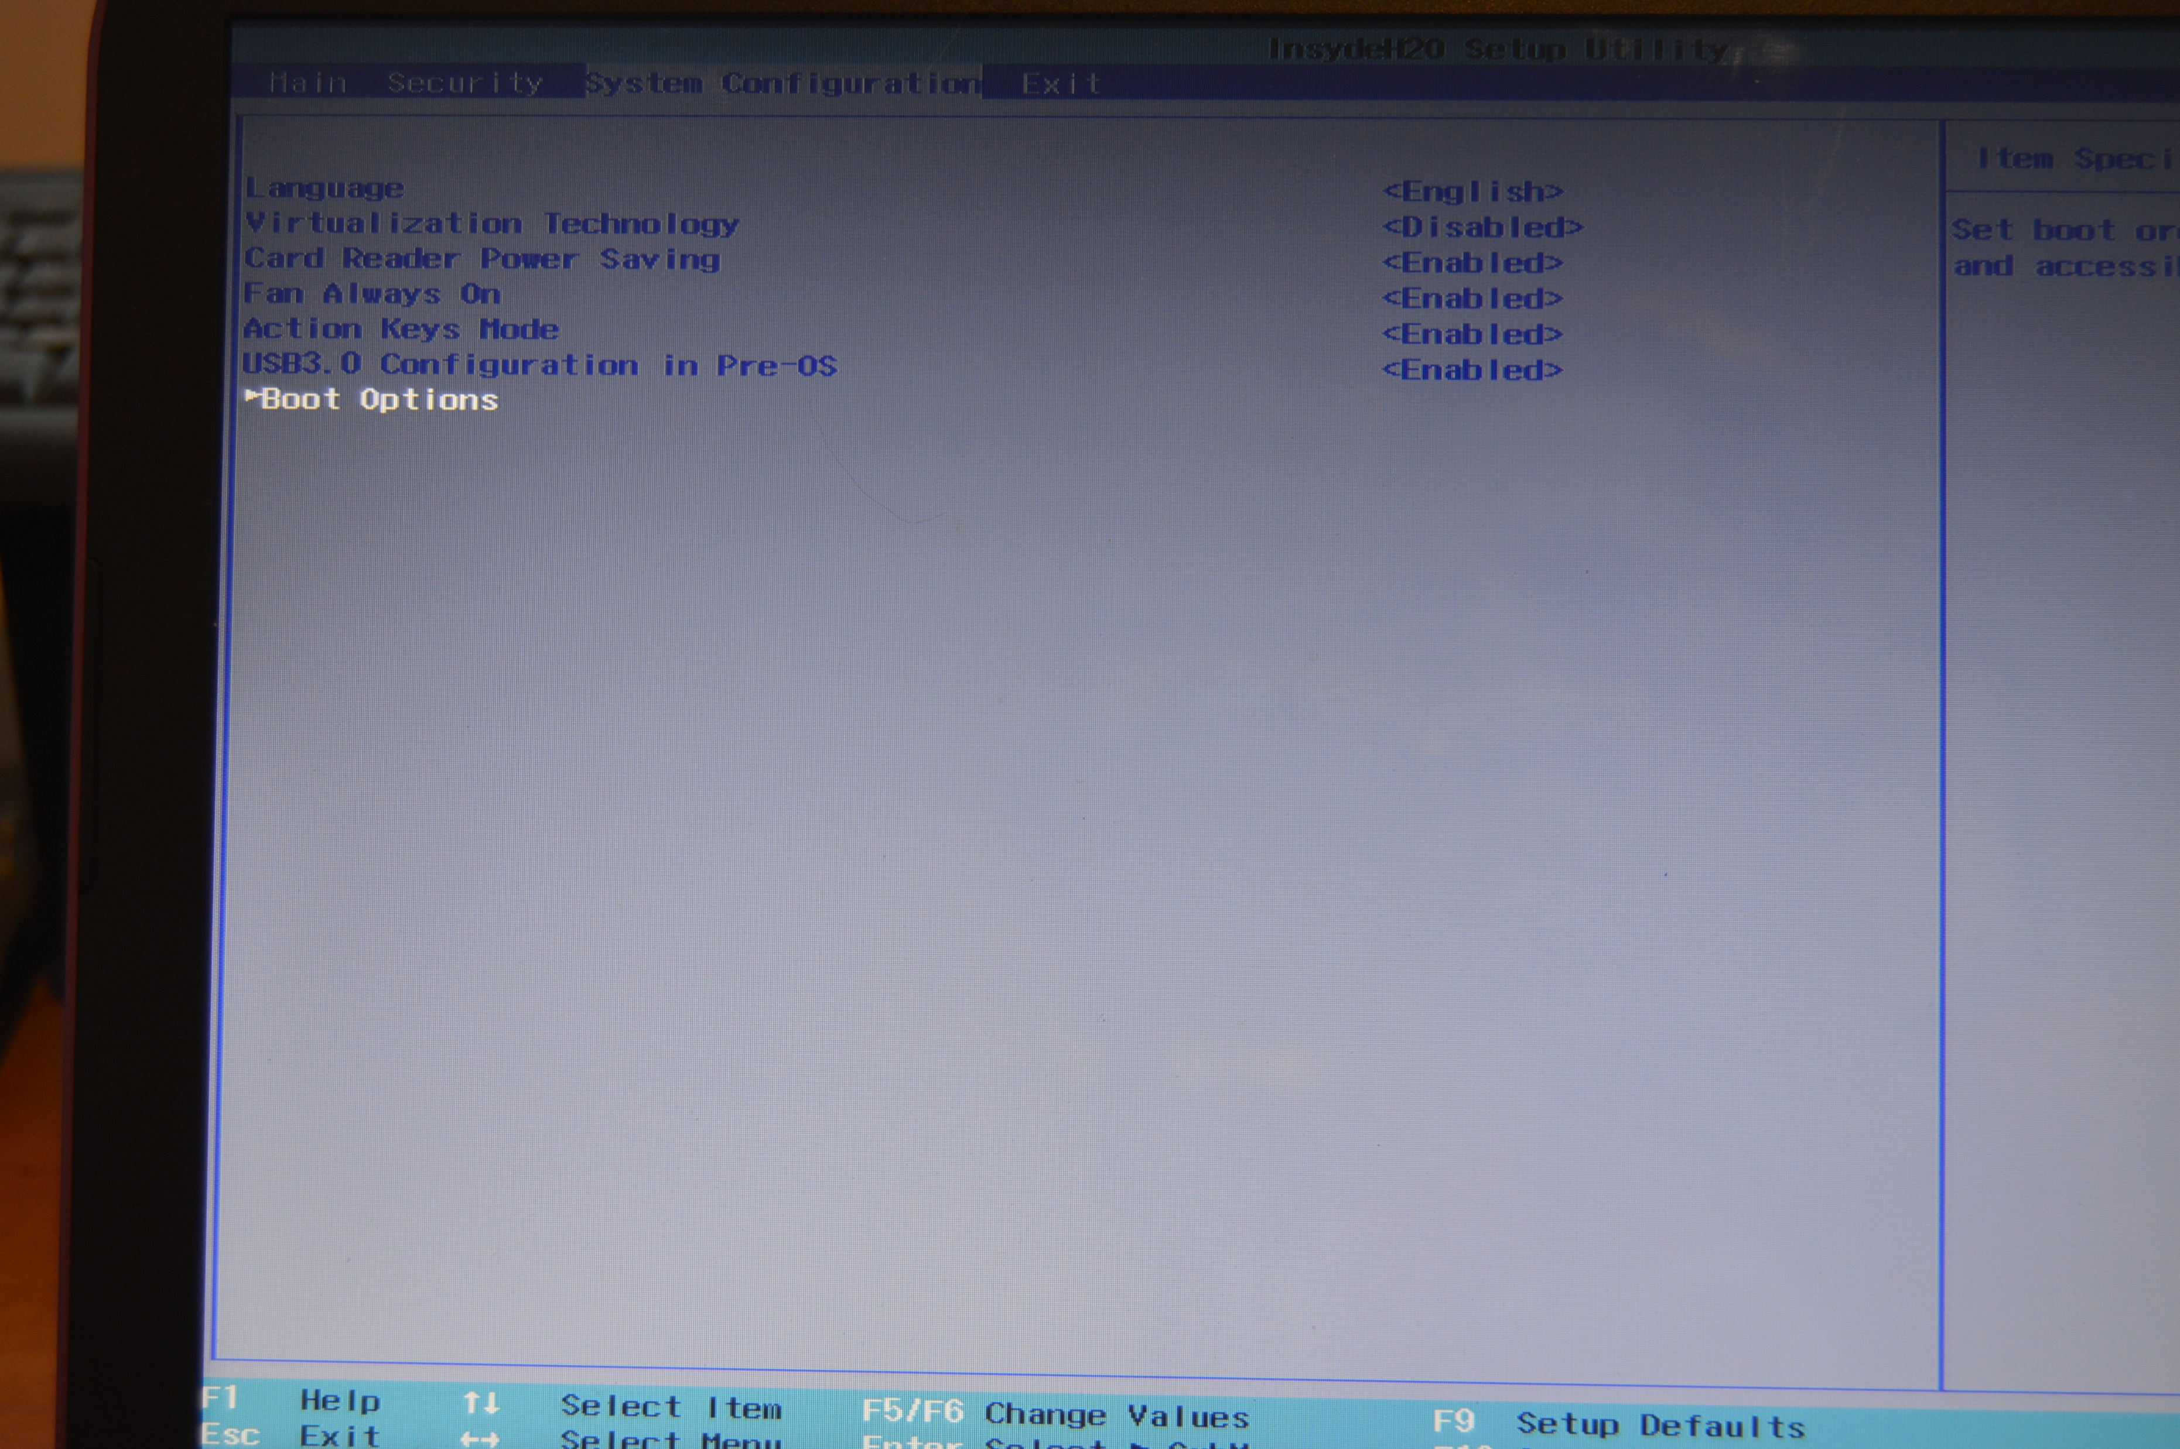
Notes:
Use the Cursor keys to cursor down to the ‘Boot Options’ Press Enter

Slide 52
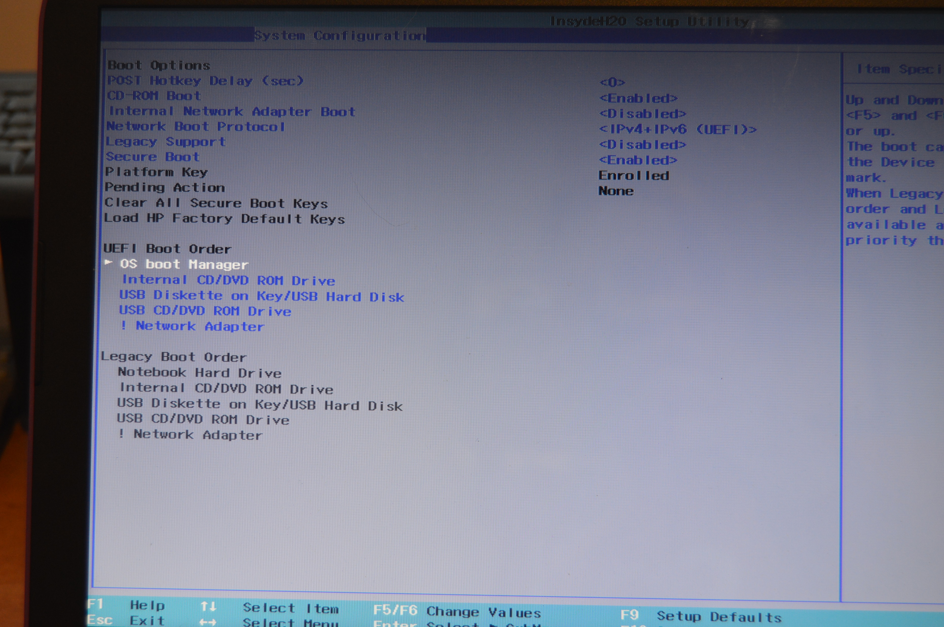
Notes:
You can see here that the 1st item in the Boot order is the OS (Operating System) Boot Manager. This is the normal Windows installation on the C Drive

Slide 53
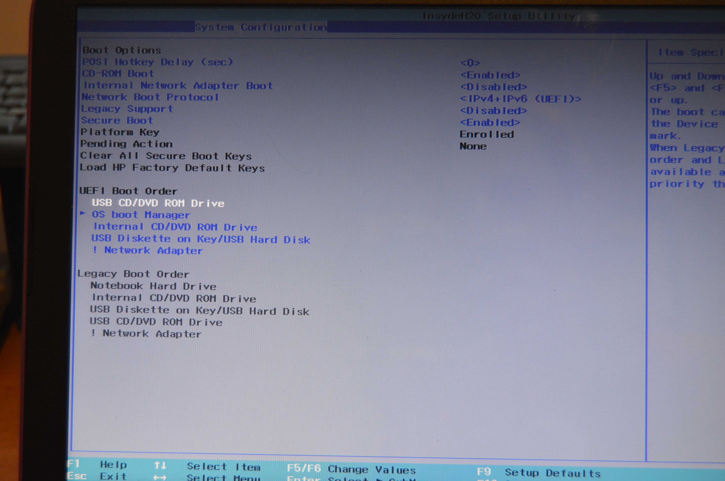
Notes:
Use the cursor keys to cursor down to the entry that you want to move to the top. Then use the F5 or F6 key to move it up or down the list.
(Teccy admission: You can see here that I have selected the “USB CD/DVD ROM Drive”. I selected this and tried it for the rest of the photographs, but it didn’t work. I then realised that it wasn’t as I had read, a USB OR CD/DVD Drive, but a CD/DVD drive that is powered by USB – in other words, an external CD/DVD drive connected by a USB Cable. The Option I should have chosen was the ‘USB Diskette on Key/USB Hard Disk”. I changed it to this and it then worked as expected although I didn’t take a new photograph, so I’ve left this picture in the slideshow.)

Slide 54
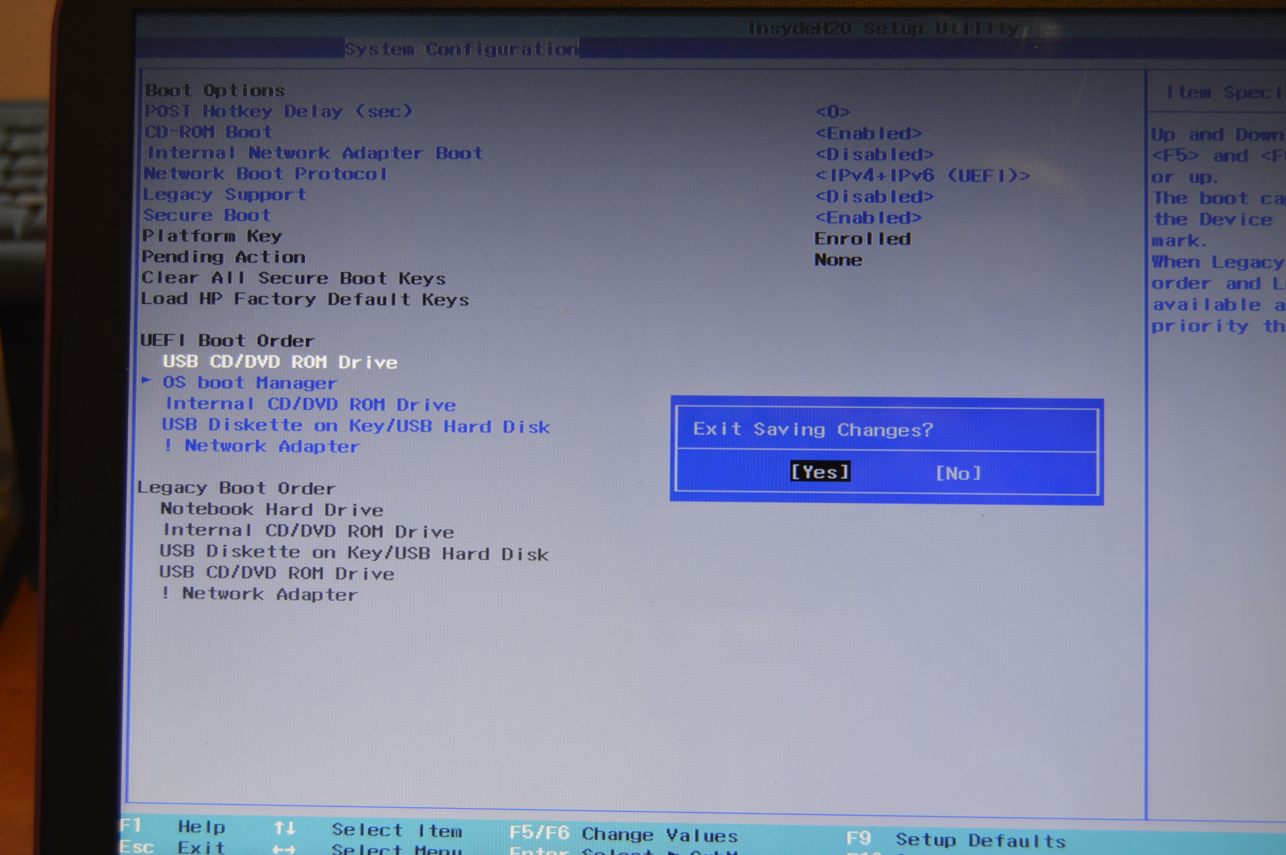
Notes:
Press F10 to exit, you get the option to save your changes or not. You obviously do want to save your changes.
The BIOS will exit and restart your computer with your new settings.

Slide 55
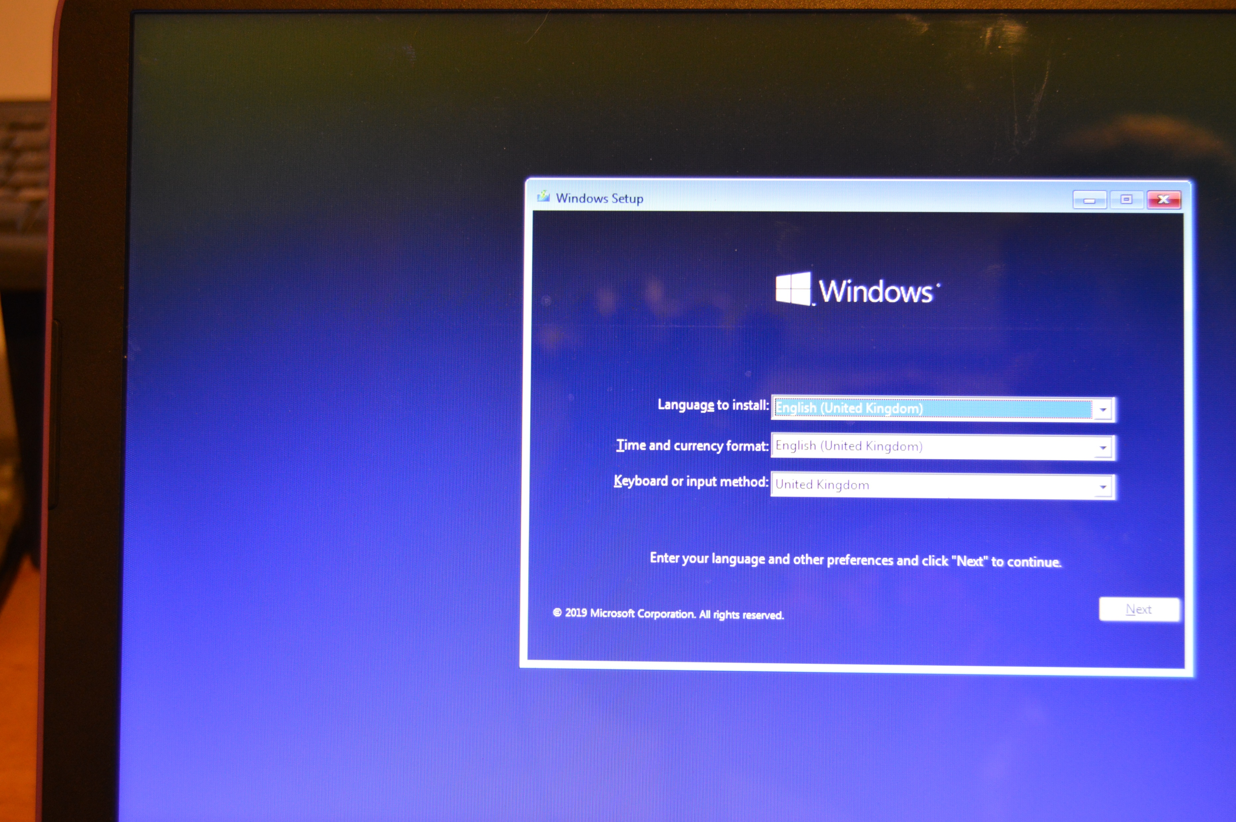
Notes:
The start of the Windows 10 installation process.

Slide 56
Good luck
Any Questions?

